Slide 1

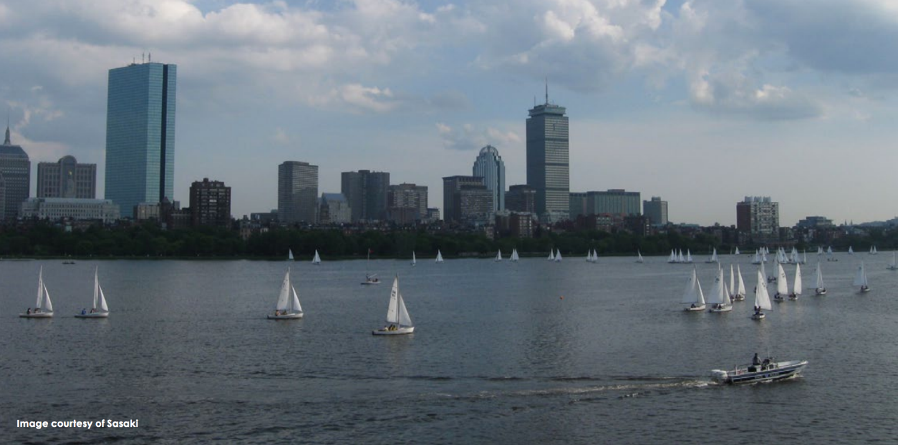
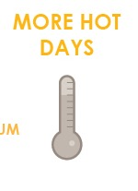
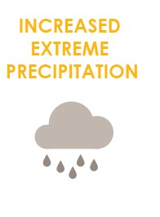
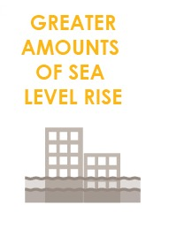
FOCUS AREA: CHARLES RIVER
142,000+ people, 237,000 jobs, +$46 billion to city economy.

Slide 2
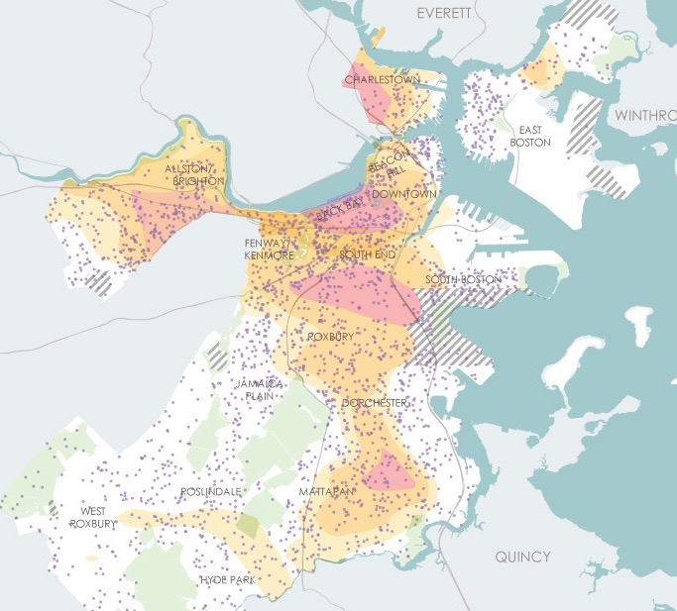
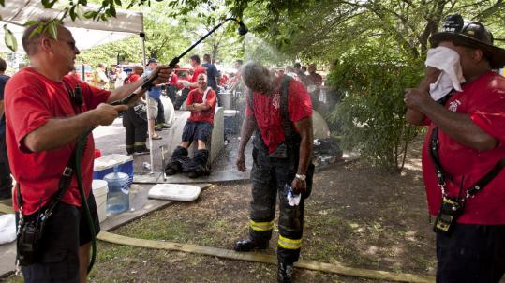
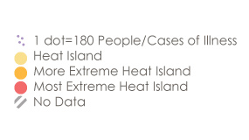
WHAT CLIMATE CHANGE MEANS FOR CHARLES RIVER
More Hot Days
Medical Illness and Heat Island Exposure
Urban “heat islands” where there is less tree canopy are hotter and most at risk.
Some people are more vulnerable to heat than other such as those with illnesses or the elderly.
Notes:
The Back Bay and Beacon Hill have among the highest percentage of people with medical illness and who are elderly.

Slide 3
WHAT CLIMATE CHANGE MEANS FOR CHARLES RIVER
More Flooding
Of the Charles River neighborhoods, Allston has the greatest exposure in the near term due to low-lying open space. By the end of the century, the Charles River neighborhoods will begin to experience some flooding with 1 percent annual chance events and may have hundreds of acres exposed to very low-probability events (0.1 percent chance).
Notes:
In the near term and through the middle of the century, buildings and infrastructure in Charles River has limited exposure to coastal flooding.
7% of the Charles River neighborhood is at risk in the near term from Stormwater flooding.

Slide 4
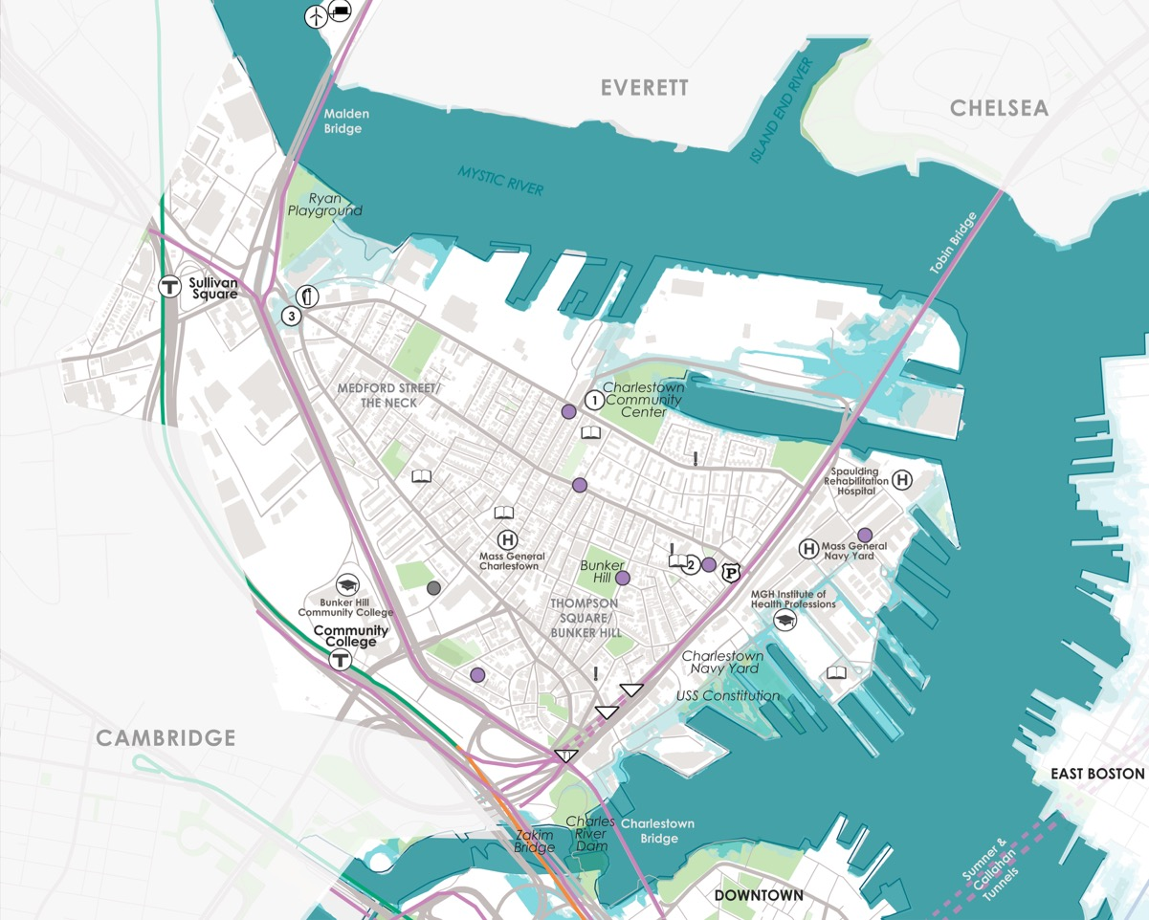
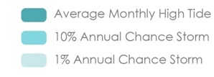
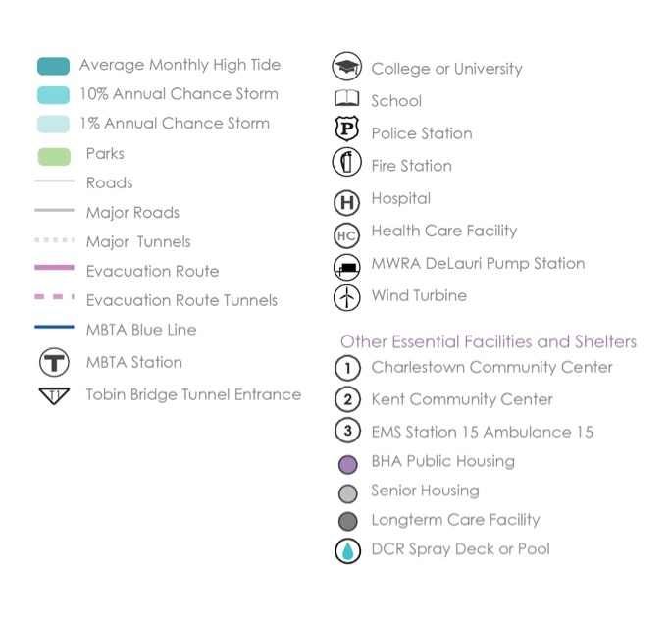
WHAT’S AT STAKE?
Community Assets and Flooding
9’’ sea level rise
2030s-2050s
Charles River
The Charles River neighborhoods have limited exposure to flooding until mid-century due to the New Charles River Dam.
Notes:
*The primary flood pathway is around and over the New Charles River dam. In the near term, flooding exposure is low as the dam’s pumps can be activated to address surge.

Slide 5
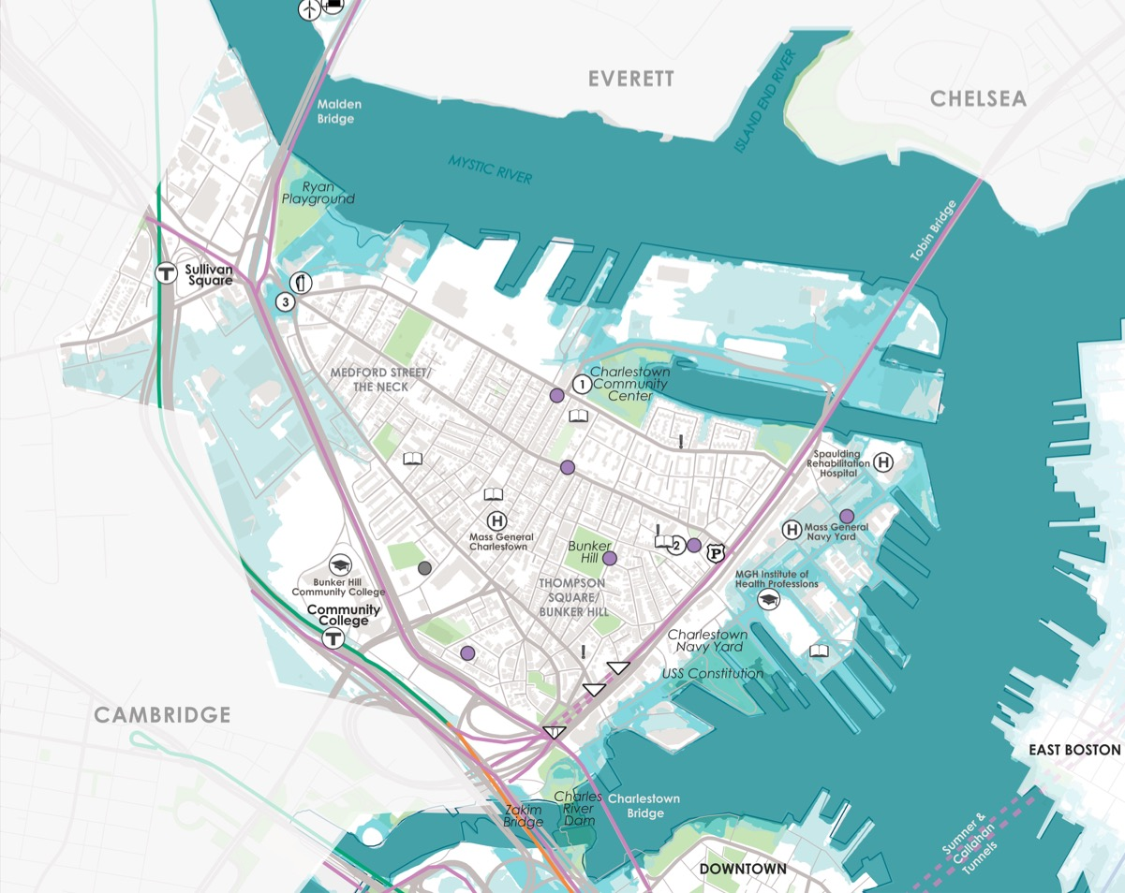
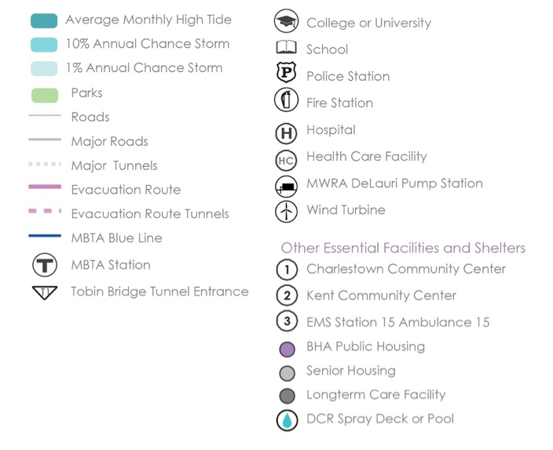
WHAT’S AT STAKE?
Community Assets and Flooding
21’’ sea level rise
2050s-2070s
Charles River
Transportation systems within the Charles River neighborhoods will have limited exposure to coastal flooding and sea level rise until later in the century. Major impacts are only expected for low-probability events.
Notes:
Parts of Storrow Drive will be exposed to flooding by the 2050s.

Slide 6
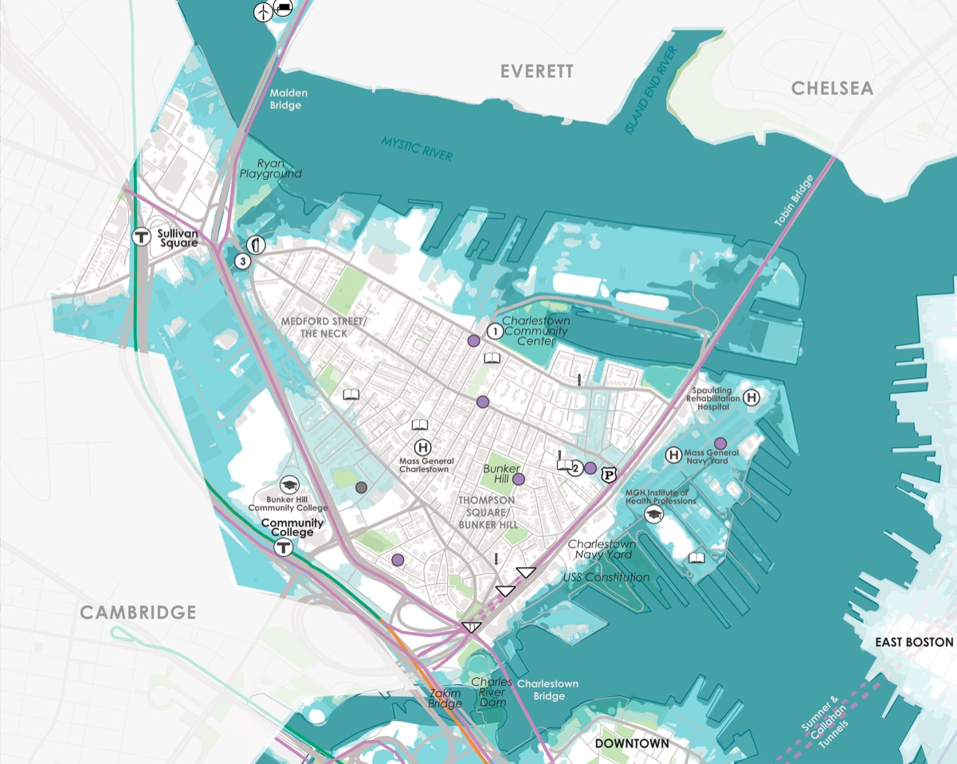
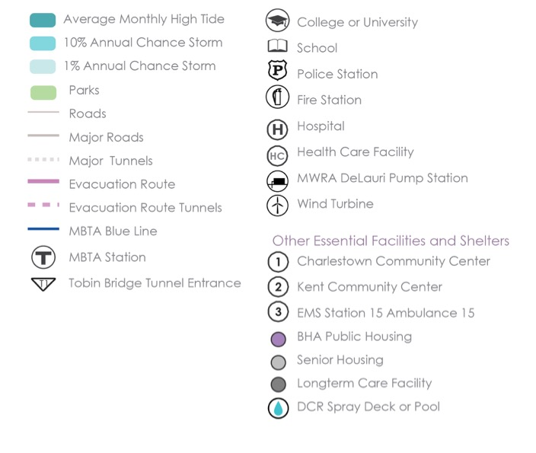
WHAT’S AT STAKE?
Community Assets and Flooding
36’’ sea level rise
2070s or Later
Charles River
By the end of the century, Beacon Hill, Back Bay, Fenway / Kenmore, and Allston/Brighton, Charlestown, and Cambridge are expected to be exposed to flooding by flanking and overtopping of the dam for low-probability events.

Slide 7
WHAT’S AT STAKE?
People and Buildings Impacted by 1% Annual Flood Events
4,800
PEOPLE
700 BUILDINGS
(Worth 6B)
0 PEOPLE
0 BUILDINGS
(Worth $0B)
2030+
2070+
Notes:
Residential buildings located along Chandler Street are mostly split-level,
three-story row houses and could experience significant flooding once waters are high enough to reach above grade.
The South End is in the top three exposed focus areas in Boston toward the end of
the century, with close to $200 million in annualized structure damage and related losses possible.

Slide 8
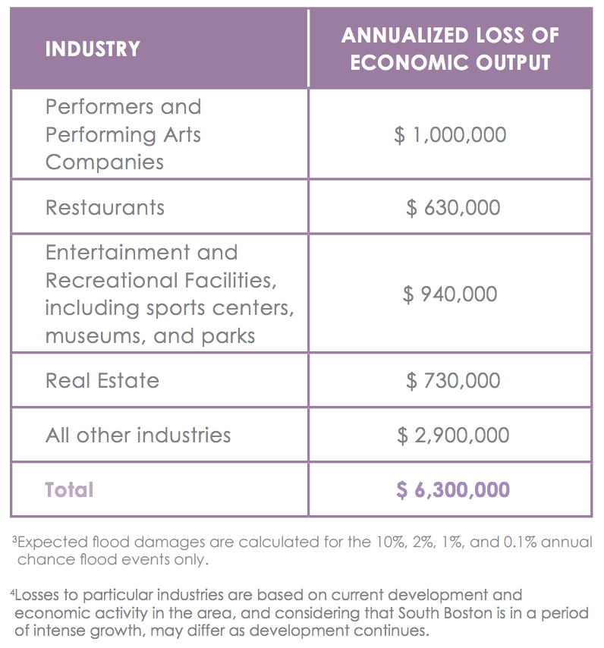
WHAT’S AT STAKE?
Economic Output and Jobs
$6.3M loss of economic output + 40 jobs per year towards the end of the century.

Slide 9


CHARLES RIVER IN ACTION
Prepared and Connected Communities
PROPOSED STRATEGIES:
Engage Bostonians as partners
Co-create neighborhood plans
Provide training for jobs in resilience
Notes:
The City can reach out small businesses in the Charles River neighborhoods currently exposed to stormwater flooding to help them develop response plans, evaluate insurance coverage needs, and identify low-cost physical adaptations. Roughly 160 commercial structures are at risk and the Brighton and the Allston Village Main Street Districts are expected to have areas exposed in the near term as well and throughout the century.

Slide 10

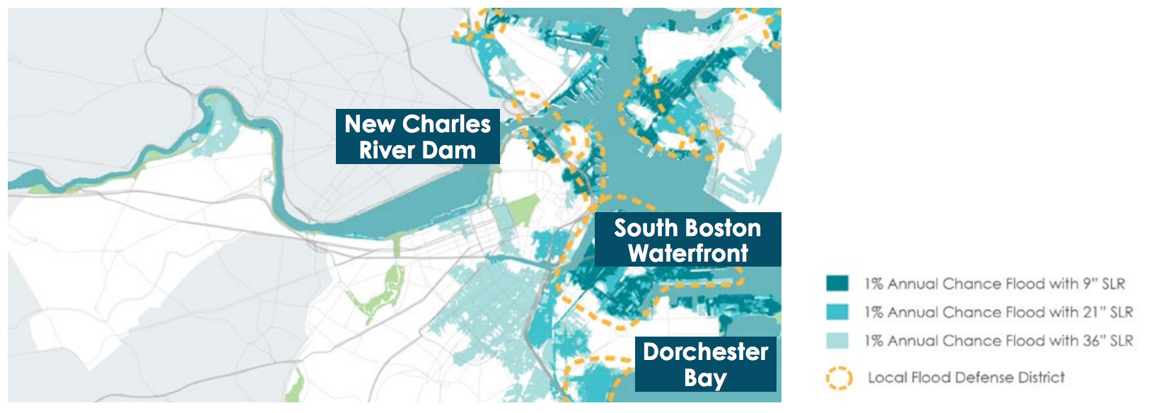
CHARLES RIVER IN ACTION
Protected Shores
PROPOSED STRATEGIES:
Engage Bostonians as partners
Co-create neighborhood plans
Provide training for jobs in resilience
Increase flood protection in North Charlestown and at the New Charles River Dam.
Notes:
Near term protections are not critical yet later in the century will be so at multiple locations including the New Charles River Dam, at the South Boston Waterfront to address inland flooding coming from, Fort Point Channel,
Boston Harbor, and the Reserve Channel; and at Dorchester Bay from Old Harbor and Savin Hill Cove.

Slide 11
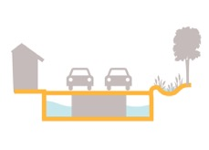

CHARLES RIVER IN ACTION
Resilient Infrastructure
PROPOSED STRATEGIES:
Develop coordinated risk response plans for extreme weather events.
Support MTBA’s assessment of flooding to the Orange Line.
Explore options for a neighborhood energy grid in the Main Street corridor.
Notes:
While the Charles River neighborhoods are not impacted by coastal
and riverine fl ooding in the near term, flooding Downtown could reduce mobility for residents who depend on the Red, Green, and Orange Lines. In addition, in the later century under the 1 percent annual flood event, the Green Line will be exposed to coastal flooding, via the Arlington and Prudential Stations.

Slide 12

CHARLES RIVER IN ACTION
Adaptive Buildings
PROPOSED STRATEGIES:
Update zoning and building codes and notify developers with projects in the pipeline to update plans.
Help building owners assess potential impacts and increase resilience.
Promote access to insurance.
Prepare municipal buildings to withstand change.
Notes:
http://www.subchat.com/read.asp?Id=1175613

