Slide 1
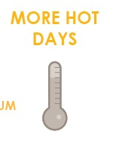
FOCUS AREA: CHARLESTOWN
16,000+ people, 12,200 jobs, +$2.5 billion to city economy.

Slide 2
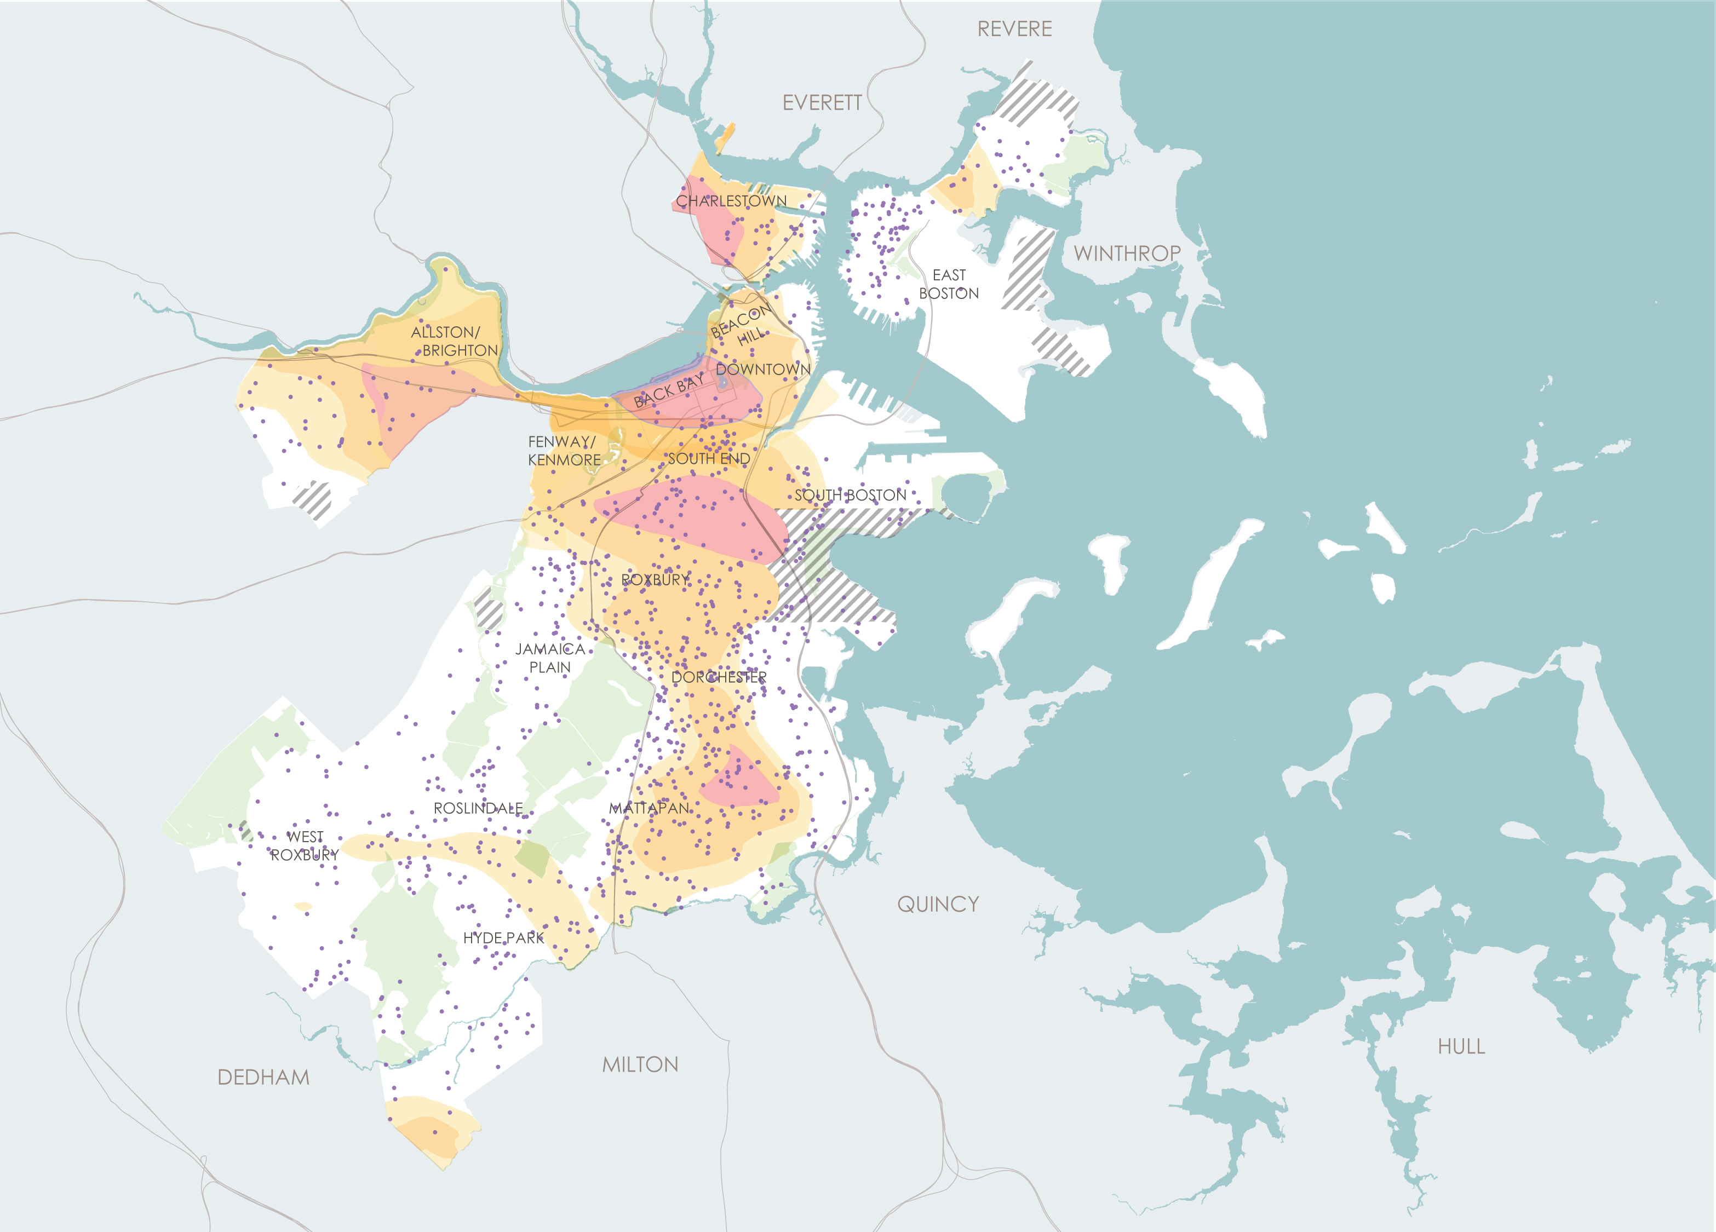
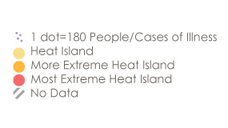
WHAT CLIMATE CHANGE MEANS FOR CHARLESTOWN
More Hot Days
Children and Heat Island Exposure
Charlestown does have “heat islands” or areas with less tree canopy that are most impacted by increasing temperatures.
Some people are more vulnerable to heat than other such as children.

Slide 3
WHAT CLIMATE CHANGE MEANS FOR CHARLESTOWN
More Flooding
Land area in Charlestown exposed to flooding is in the top three for all coastal neighborhoods throughout the century.
Notes:
While near term flooding risks will be limited to the waterfront edge, they will expand as time goes on given most of Charlestown waterfront is built on fill.
Charlestown will be impacted by storm water flooding however exposure is not expected to be as high as in other neighborhoods such as West Roxbury and East Boston.

Slide 4
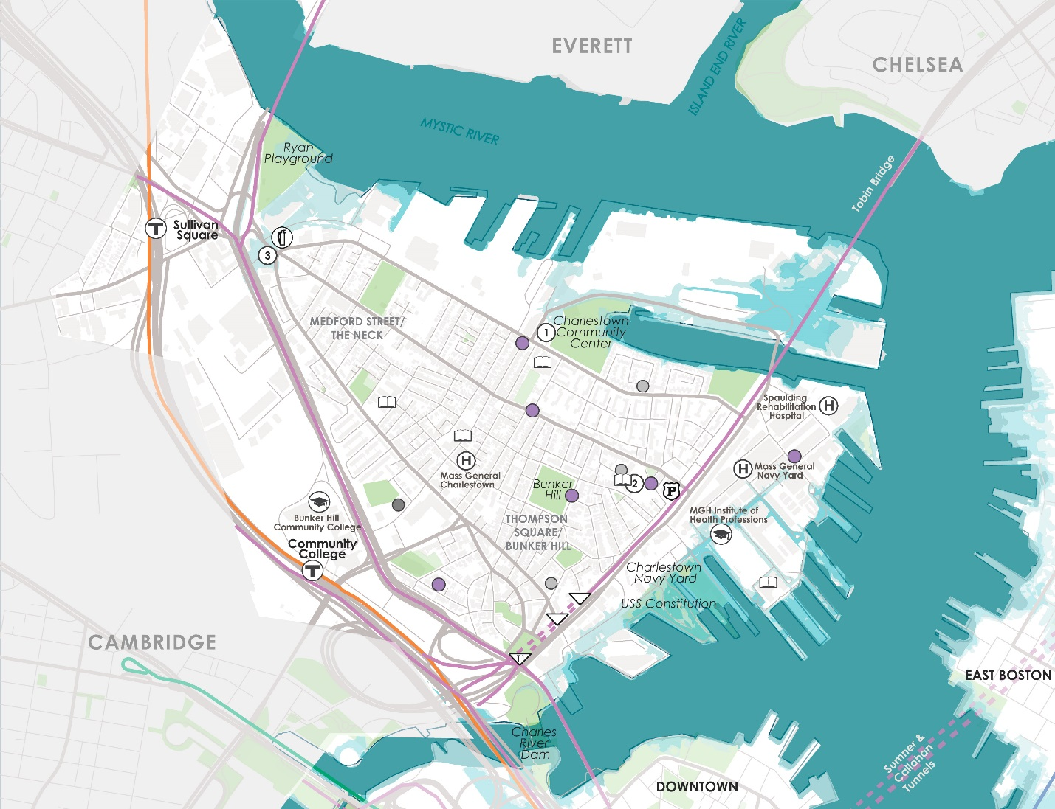
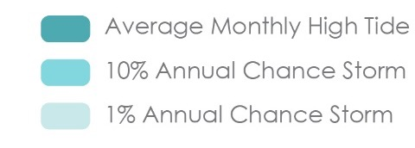
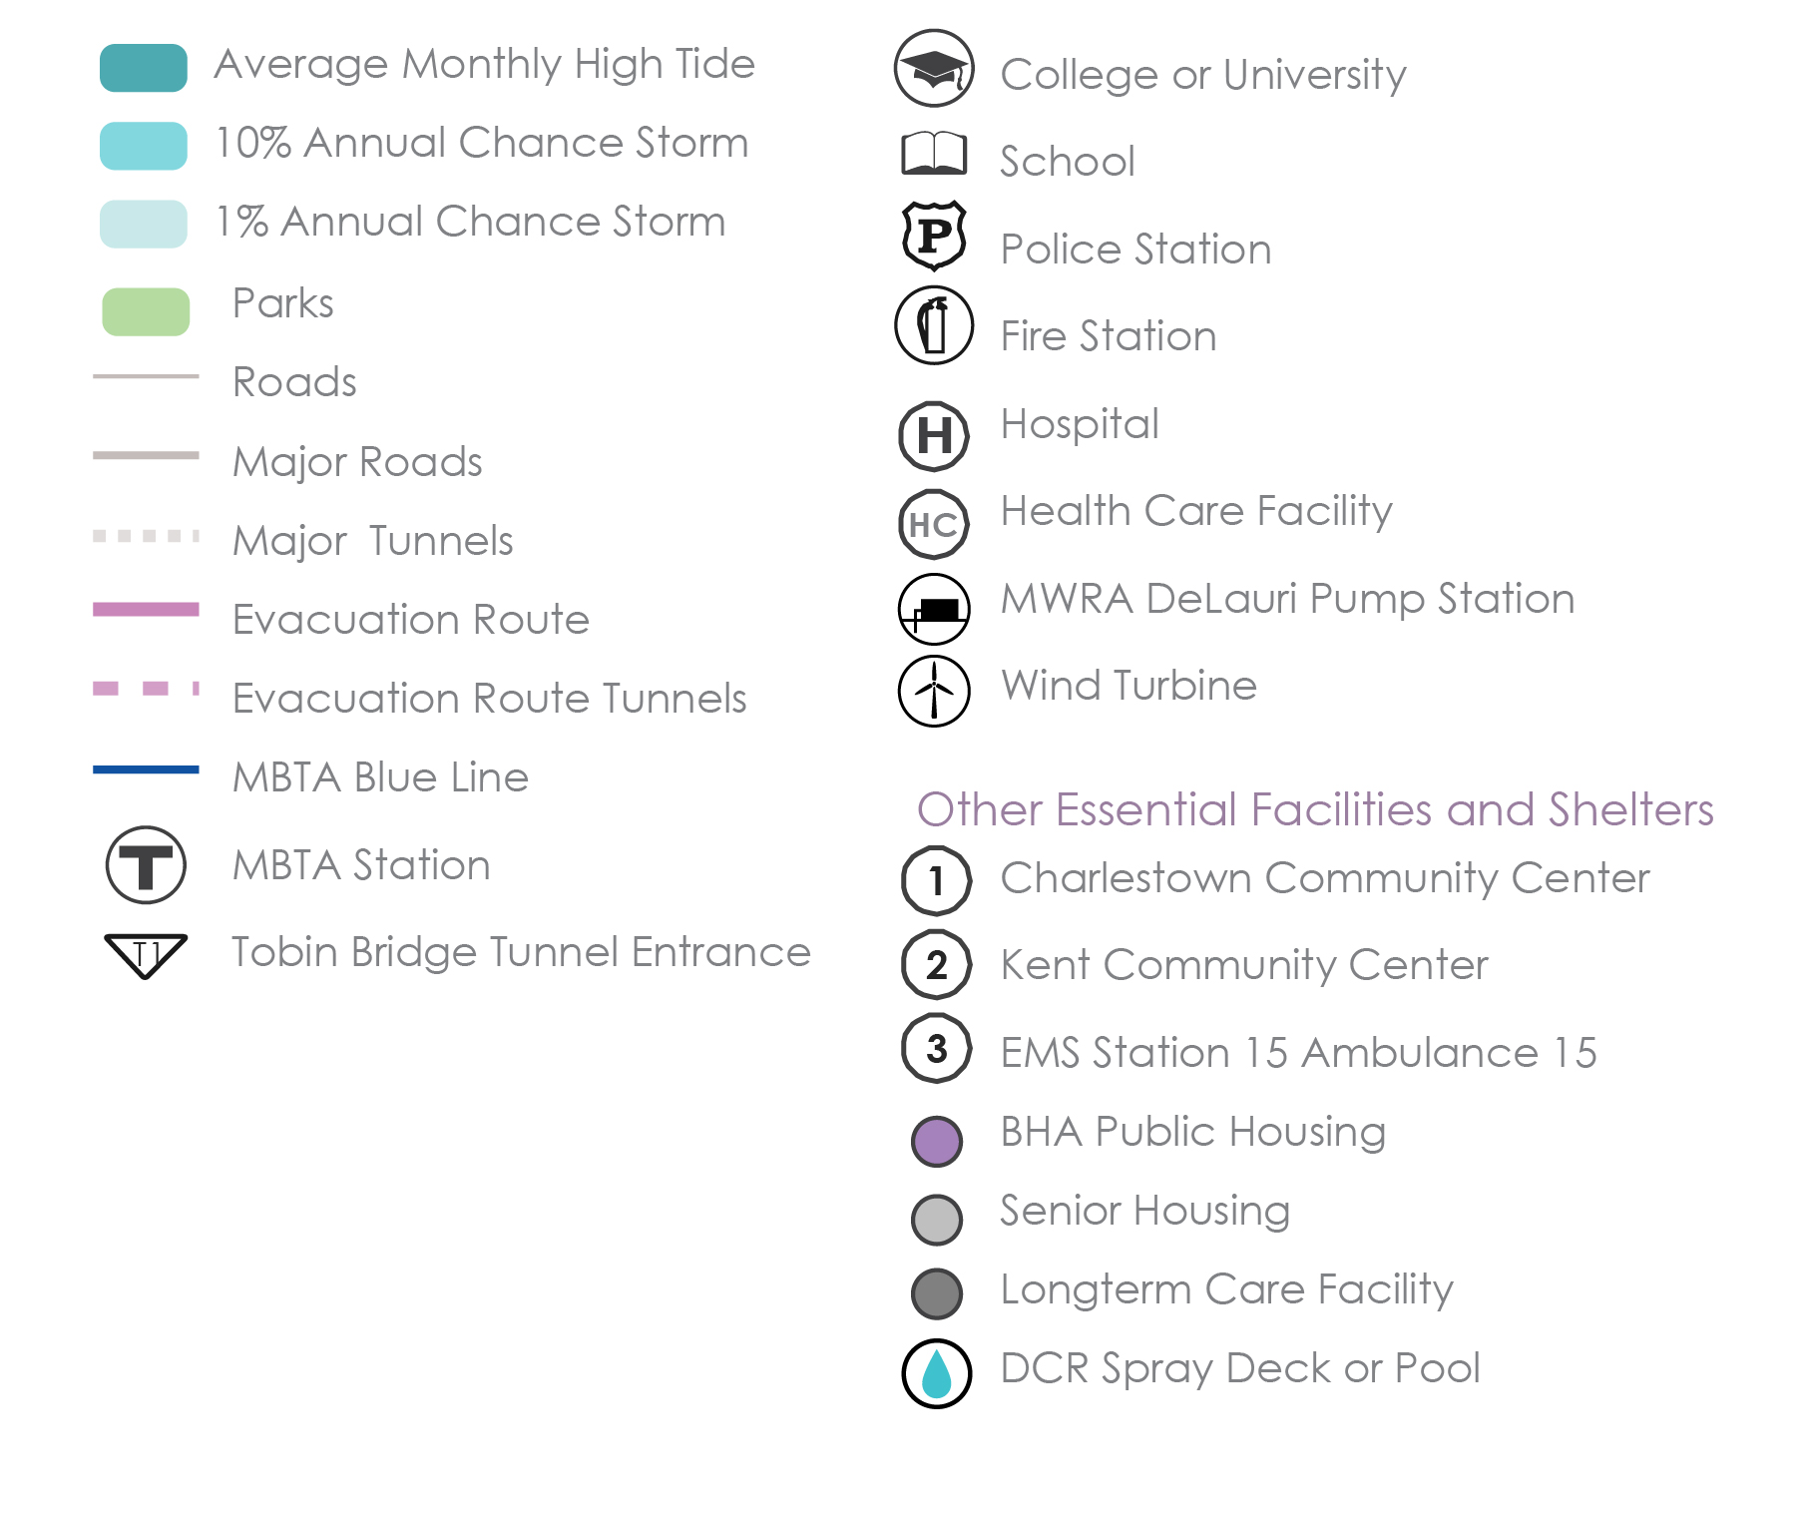
WHAT’S AT STAKE?
Community Assets and Flooding
9’’ sea level rise
2030s-2050s
Charlestown
In the near term, exposure will be concentrated near the Charlestown Navy Yard, and near the Schrafft building site.
Notes:
Near term flooding will primarily be in Charlestown’s Navy Yard, and near the Schrafft building site.
Important community assets could also be exposed including the Seaport Academy, Charlestown’s police station and one of its two fire stations.

Slide 5
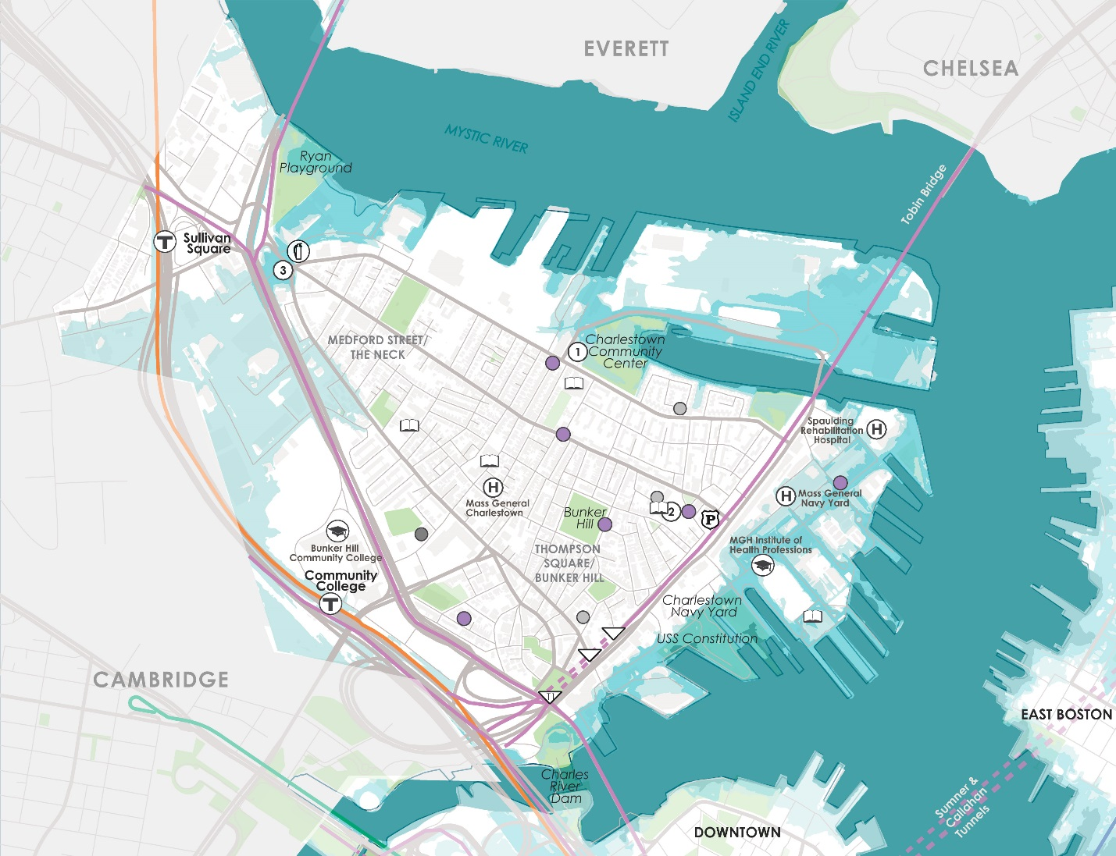
WHAT’S AT STAKE?
Community Assets and Flooding
9’’ sea level rise
2050s-2070s
Charlestown
In the middle of the century, exposure will extend along the Boston Auto Port near the Tobin Bridge and south of Sullivan Square.
Notes:
As soon as the early 2050s, areas flooded by low probability storms will increase 150% with the flood plain expanding in the low-lying areas near Sullivan Square. Once water from the Mystic River crosses Rutherford Ave, flooding will expand to the south.
Charlestown is separated from the rest of Boston by the Charles River and the Boston Harbor and flooding at both Orange Line stations would restrict access to Downtown and Bunker Hill Community College.

Slide 6
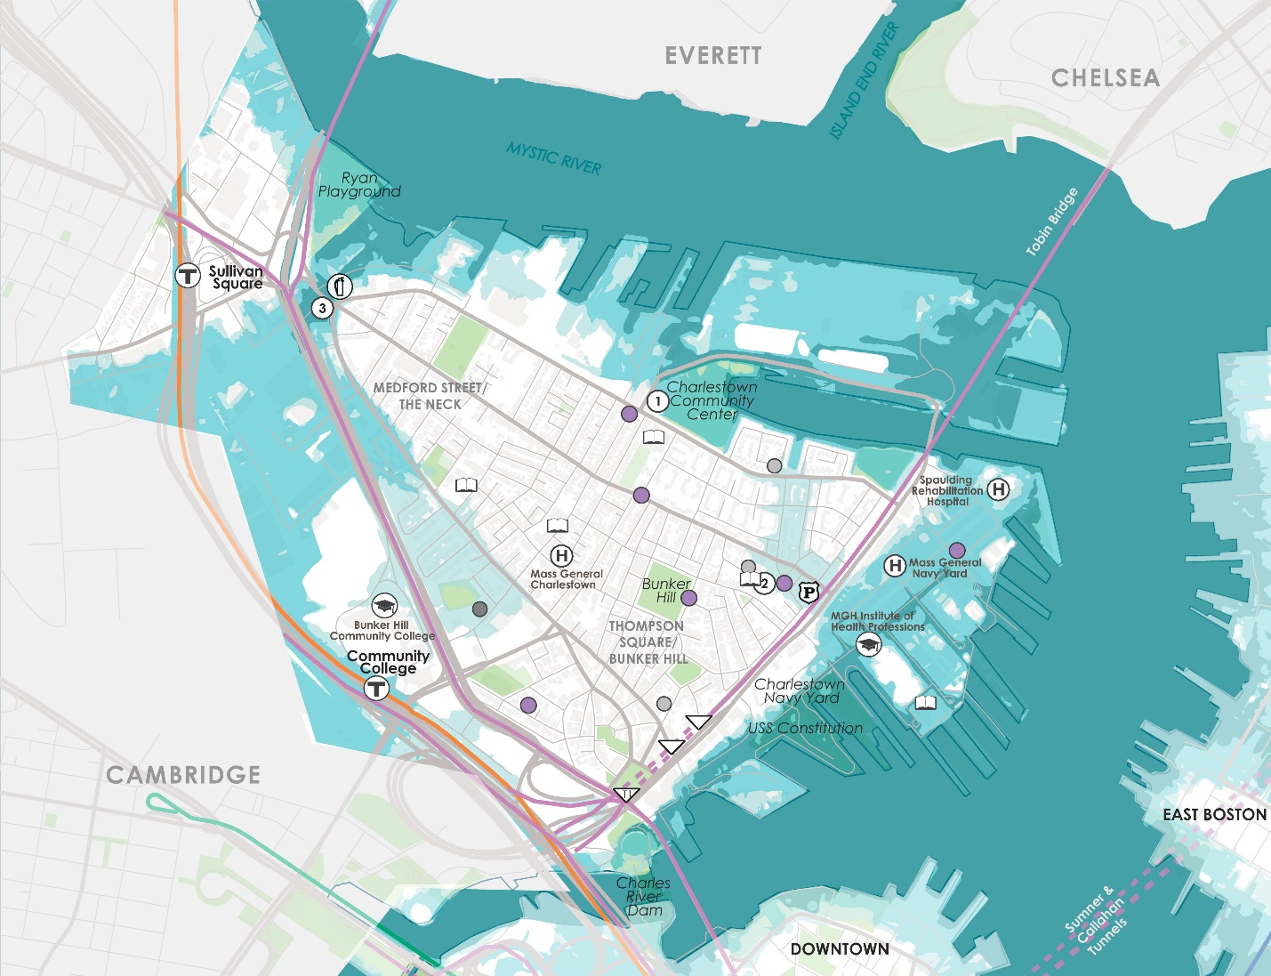
WHAT’S AT STAKE?
Community Assets and Flooding
9’’ sea level rise
2070s or Later
Charlestown
By late century, 10% annual chance flooding events will impacts the Ted Williams Tunnel entrance, Airport Silver Line stops, multiple MassDOT stormwater pump stations and other community assets.
Notes:
In the late century, much of the Charlestown waterfront is exposed to the average monthly high tide impacting four hospitals and medical research facilities including Beacon Hospice, Spaulding Rehabilitation Hospital, MGH Institute of Health Professionals, and the Martinos Center for Biomedical Imaging.

Slide 7
WHAT’S AT STAKE?
People and Buildings Impacted by 1% Annual Flood Events
680 BUILDINGS
(Worth $4.3B)
5,100
PEOPLE
1,300
PEOPLE
140 BUILDINGS
(Worth $2.2B)
2030+
2070+
Notes:
While Charlestown is a smaller-scale neighborhood than some of the other focus areas considered, it is still in the top four focus areas for expected annualized structure and content losses in the near term.

Slide 8
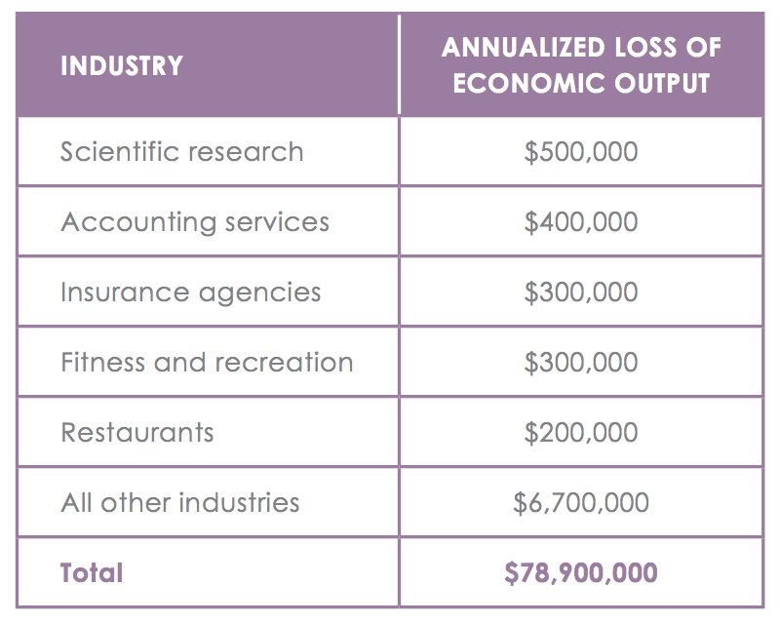
WHAT’S AT STAKE?
Economic Output and Jobs
$8M loss of economic output + 50 jobs per year towards the end of the century.

Slide 9
CHARLESTOWN IN ACTION
Prepared and Connected Communities
PROPOSED STRATEGIES:
Engage Bostonians as partners
Co-create neighborhood plans
Provide training for jobs in resilience

Slide 10
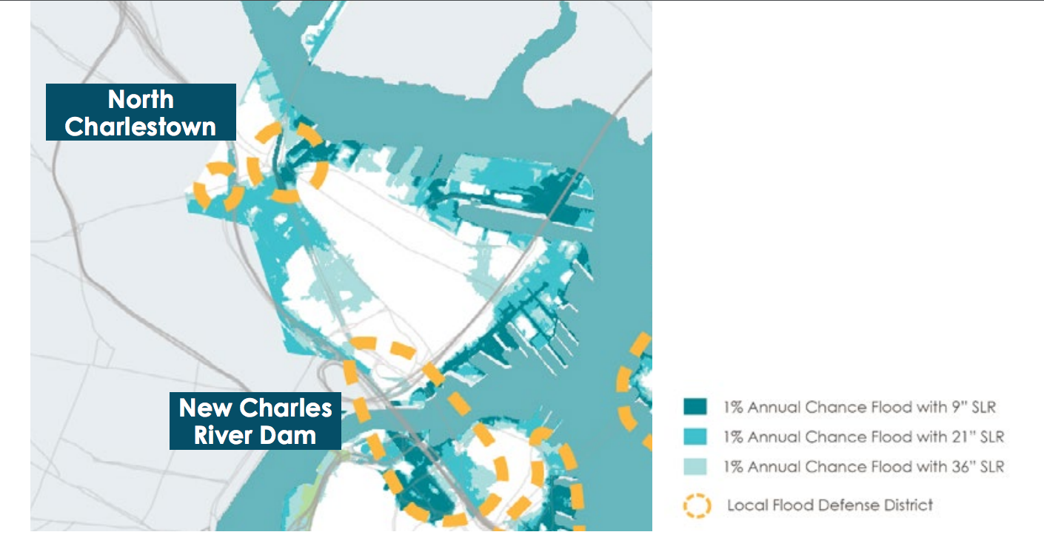
CHARLESTOWN IN ACTION
Protected Shores
PROPOSED STRATEGIES:
Engage Bostonians as partners
Co-create neighborhood plans
Provide training for jobs in resilience
Increase flood protection in North Charlestown and at the New Charles River Dam.

Slide 11
CHARLESTOWN IN ACTION
Resilient Infrastructure
PROPOSED STRATEGIES:
Develop coordinated risk response plans for extreme weather events.
Support MTBA’s assessment of flooding to the Orange Line.
Explore options for a neighborhood energy grid in the Main Street corridor.

Slide 12
CHARLESTOWN IN ACTION
Adaptive Buildings
PROPOSED STRATEGIES:
Update zoning and building codes and notify developers with projects in the pipeline to update plans.
Help building owners assess potential impacts and increase resilience.
Promote access to insurance.
Prepare municipal buildings to withstand change.
Notes:
Spaulding Rehabilitation Hospital is a 132-bed rehabilitation teaching hospital owned by Partners HealthCare that opened in 2013. It was designed to be resilient and is expected to be protected in a low-probability event in the near future. Existing flood mitigation measures at the site are expected to cut late- century annualized storm impacts in half.

