Slide 1

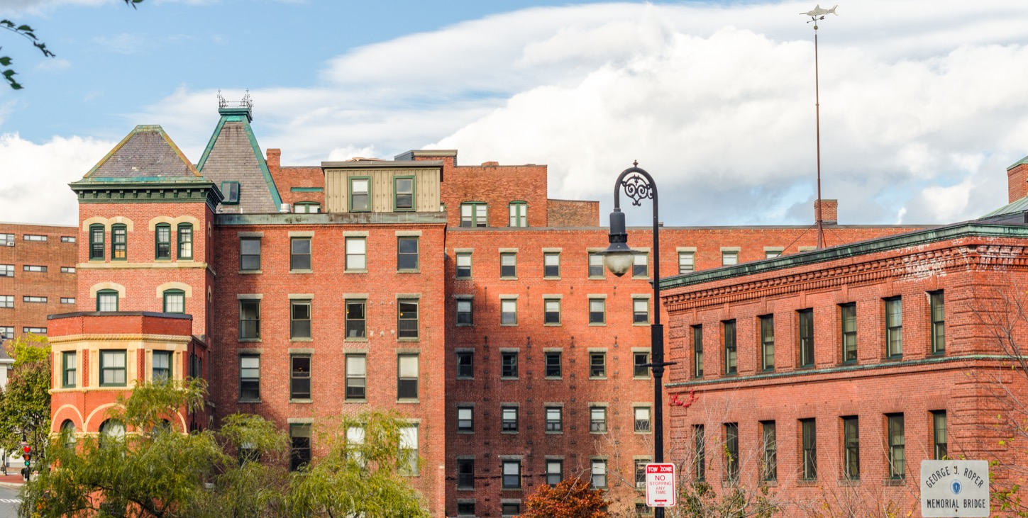
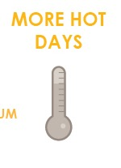
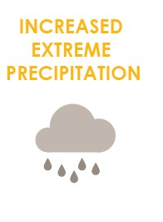
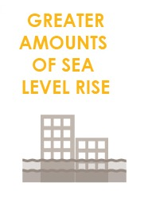
FOCUS AREA: DORCHESTER
87,000+ people, 35,000 jobs, +$7 billion to city economy.

Slide 2
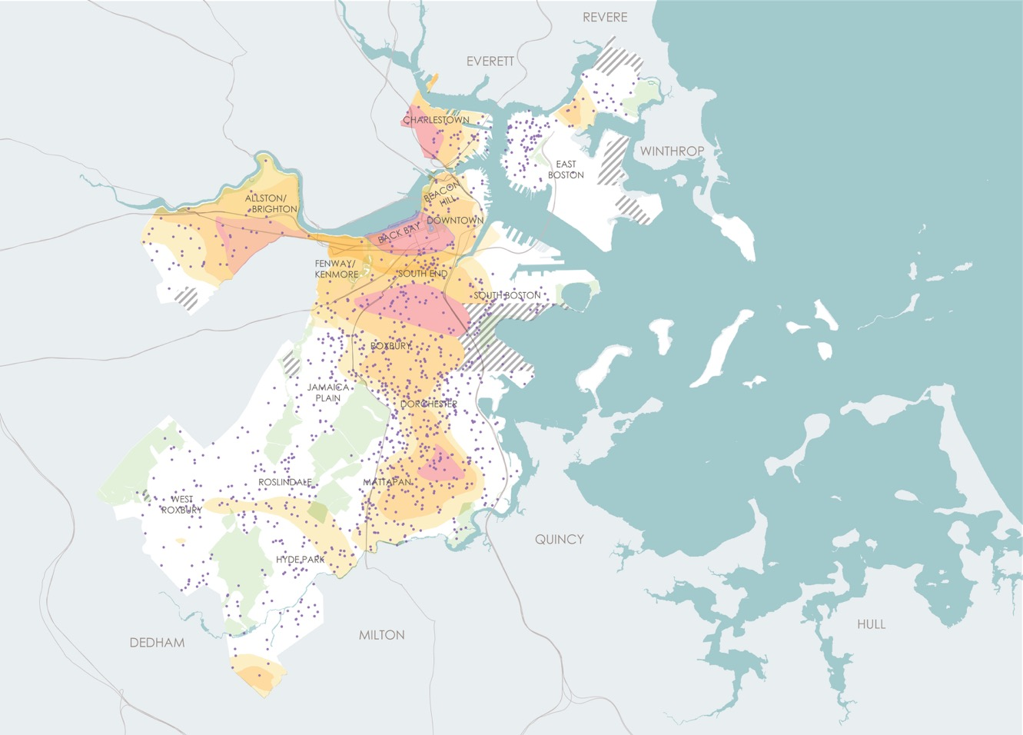
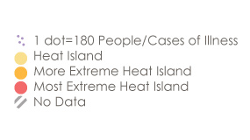
WHAT CLIMATE CHANGE MEANS FOR DORCHESTER
More Hot Days
Children and Heat Island Exposure
Urban “heat islands” where there is less tree canopy are hotter and most at risk.
Some people are more vulnerable to heat than other such as those with illnesses or who are low income.
Notes:
: In total, 24 percent of Dorchester households have children, compared to 17 percent citywide who can be particularly vulnerable to extreme heat events.

Slide 3
WHAT CLIMATE CHANGE MEANS FOR DORCHESTER
More Flooding
In the future, water could enter low-lying areas of Dorchester and flood inland areas. Protecting areas in Dorchester could benefit South Boston, the South End, and Roxbury as well.
Notes:
South Dorchester has one of the largest areas of land expected to be affected by stormwater flooding by mid-century.

Slide 4
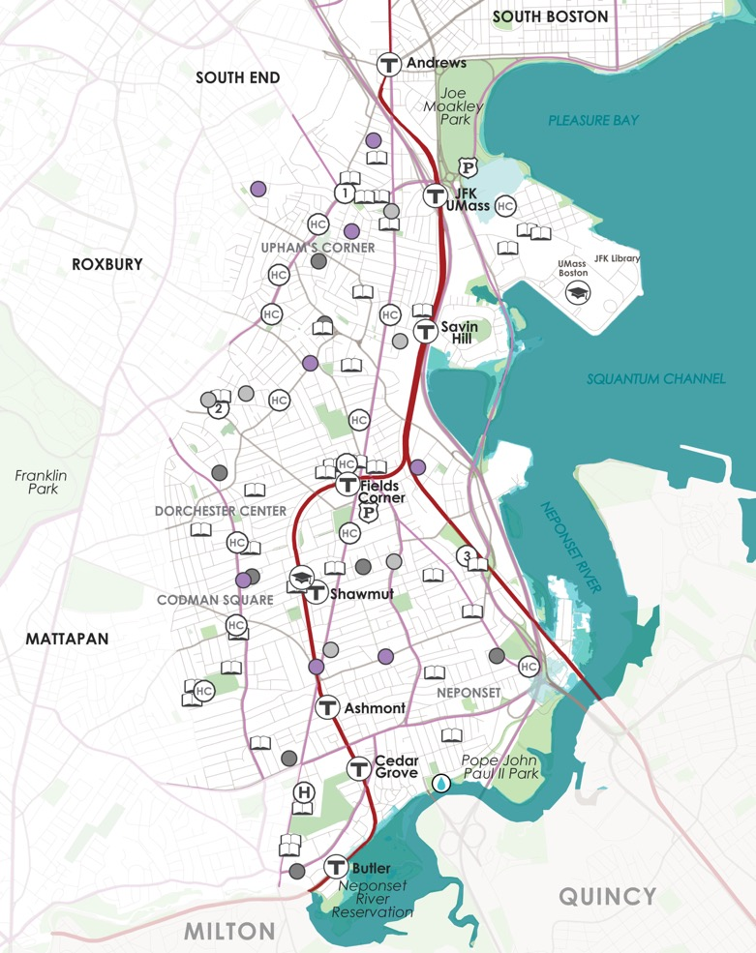
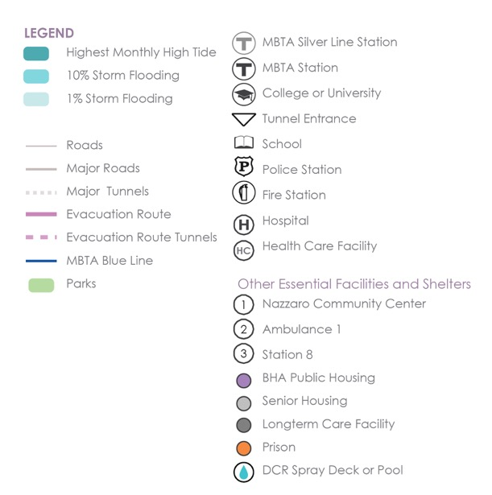
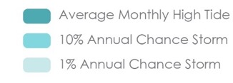
WHAT’S AT STAKE?
Community Assets and Flooding
2030s-2050s
9’’ sea level rise
Dorchester
In the near term, areas near the JFK/UMass Station will be exposed to 1% annual chance coastal flooding.
Notes:
Damage to exposed roads and the MBTA Red Line from this type of storm could isolate Columbia Point from the rest of Dorchester and impact transportation connections to North Quincy.
*One of the two ambulance stations in Dorchester is at risk from high probability storms (10% annual chance flood).
*Commercial Point is exposed to low probability storms in the near term and is home to a liquid natural gas (LNG) storage tank, solar panels, and a commercial marina. National Grid’s LNG storage tank on Commercial Point is elevated to provide protection against storm surge and is not expected to be exposed to flood impacts this century.

Slide 5
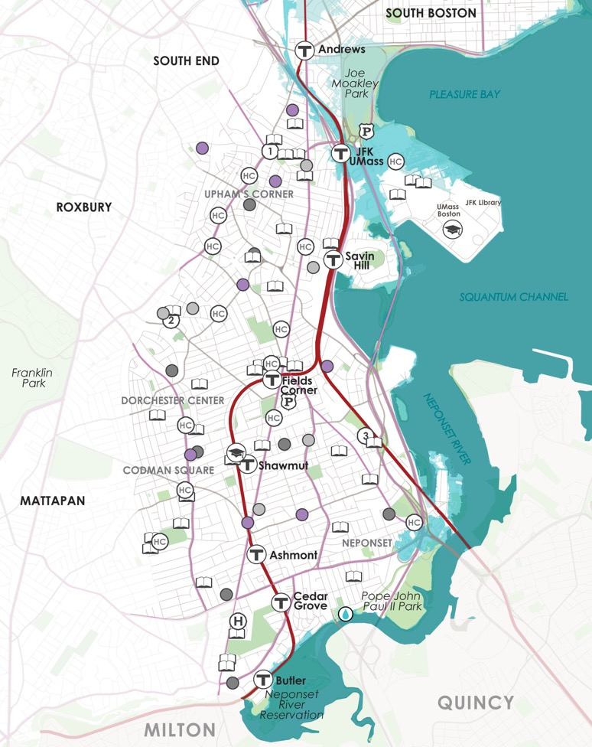
WHAT’S AT STAKE?
Community Assets and Flooding
2050s-2070s
21’’ sea level rise
Dorchester
Flooding will extend by mid-century along the Neponset River and Columbia Point.

Slide 6
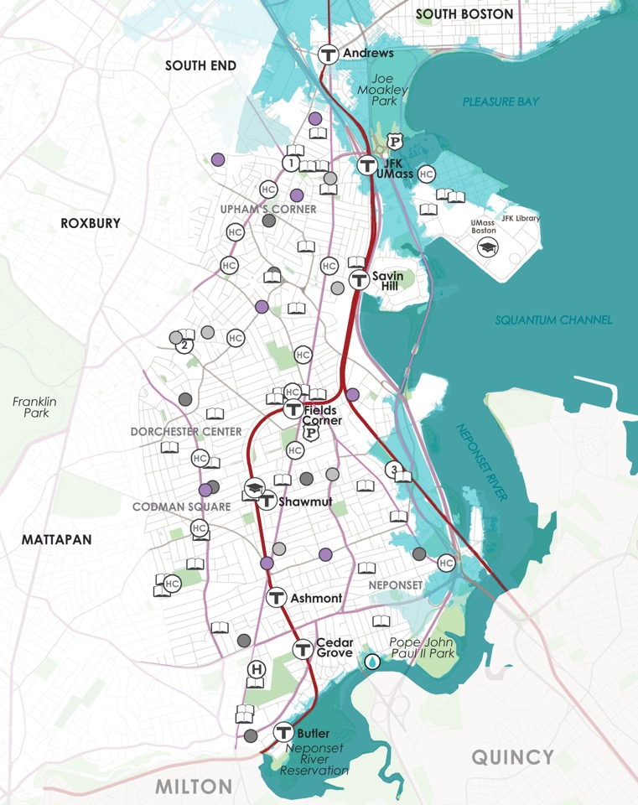
WHAT’S AT STAKE?
Community Assets and Flooding
36’’ sea level rise
2070s or LATER
Dorchester
Late century, Joe Moakley Park becomes a flood entrance to the South End, South Boston and parts of Roxbury.
Notes:
By 2070, Dorchester’s Engine 20 Fire Station would be exposed to flooding along with the Fairmont Line and Newmarket Station.

Slide 7
WHAT’S AT STAKE?
People and Buildings Impacted by 1% Annual Flood Events
1200 BUILDINGS
(Worth $15B)
400 BUILDINGS
(Worth $4.5B)
6800
PEOPLE
300
PEOPLE
2030+
2070+
Notes:
Close to 4,500 structures can expect some level of flooding from a low-probability event in the late century.
Over $200 million in current real estate market value is expected to be exposed to high tides in the late century.

Slide 8

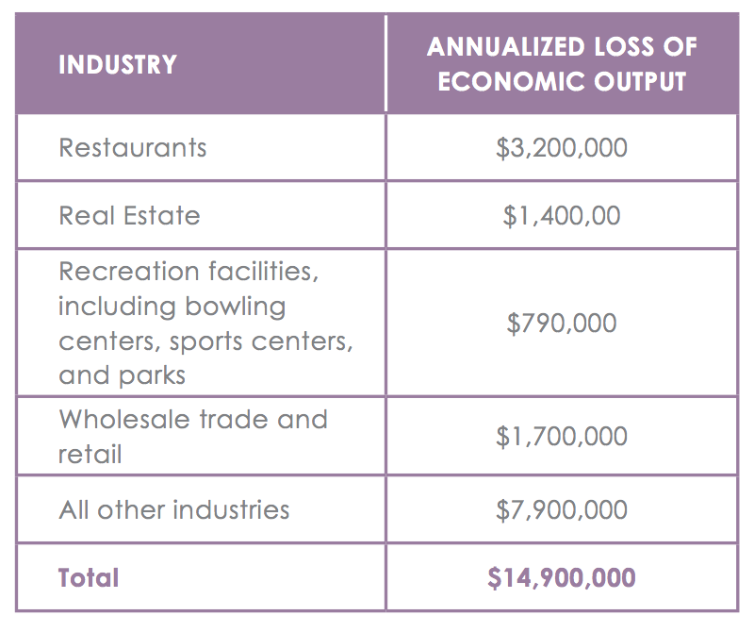
WHATS AT STAKE?
Economic Output and Jobs
$15M loss of economic output and 110 jobs per year as soon as 2070.

Slide 9

DORCHESTER IN ACTION
Prepared and Connected Communities
PROPOSED STRATEGIES:
Engage Bostonians as partners
Co-create neighborhood plans
Provide training for jobs in resilience

Slide 10
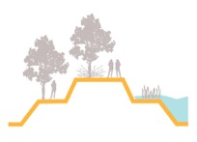
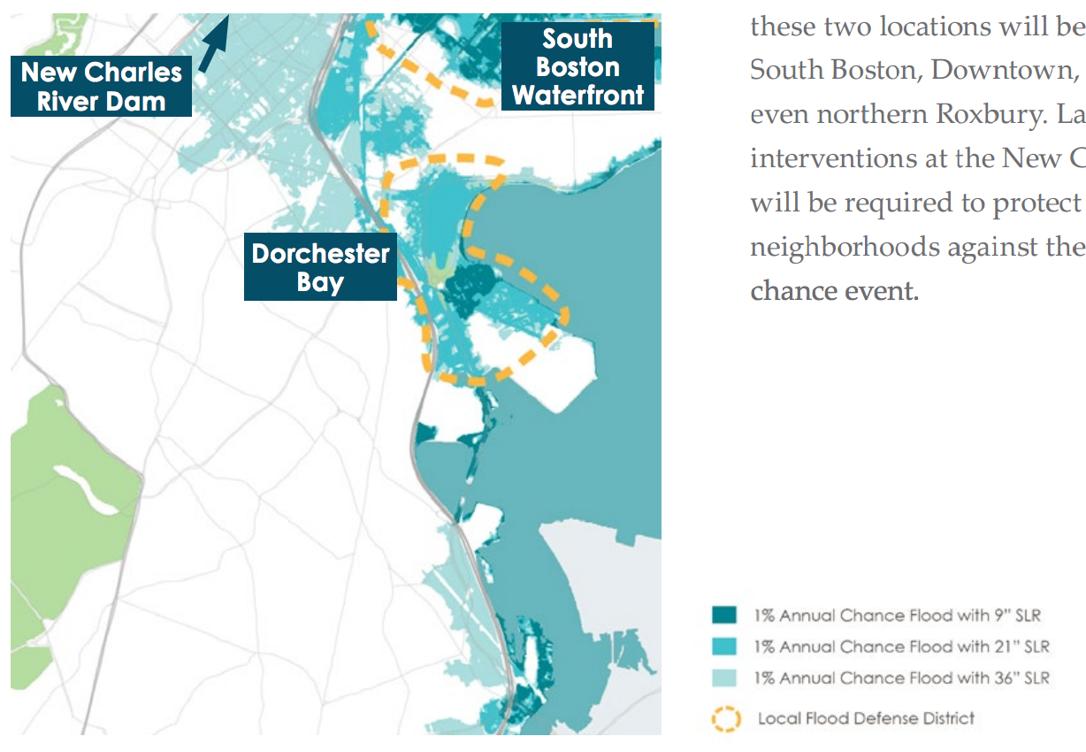
DORCHESTER IN ACTION
Protected Shores
PROPOSED STRATEGIES:
Engage Bostonians as partners
Co-create neighborhood plans
Provide training for jobs in resilience
Near term protection is needed at Dorchester Bay to address flooding coming from Old Harbor and Savin Hill Cove, at the South Boston Waterfront due to flooding form Fort Point Channel, Boston Harbor, and the Reserve Channel and at the New Charles River Dam.

Slide 11
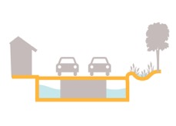

DORCHESTER IN ACTION
Resilient Infrastructure
PROPOSED STRATEGIES:
Develop coordinated risk response plans for extreme weather events.
Support MTBA’s assessment of flooding of the Red Line.
Explore options for a neighborhood energy grid at Gallivan Blvd and Neponset Ave, and/or at Fields Corner, Codman Square, Four Corners/Geneva and along Blue Hill Ave.

Slide 12

DORCHESTER IN ACTION
Adaptive Buildings
PROPOSED STRATEGIES:
Update zoning and building codes and notify developers with projects in the pipeline to update plans.
Help building owners assess potential impacts and increase resilience.
Promote access to insurance.
Prepare municipal buildings to withstand change.
Notes:
Notes: Municipal buildings at risk include McCormack Middle School, Paul A. Dever School, Boston Collegiate Middle School, and Engine 20 Fire Station.

