Slide 1

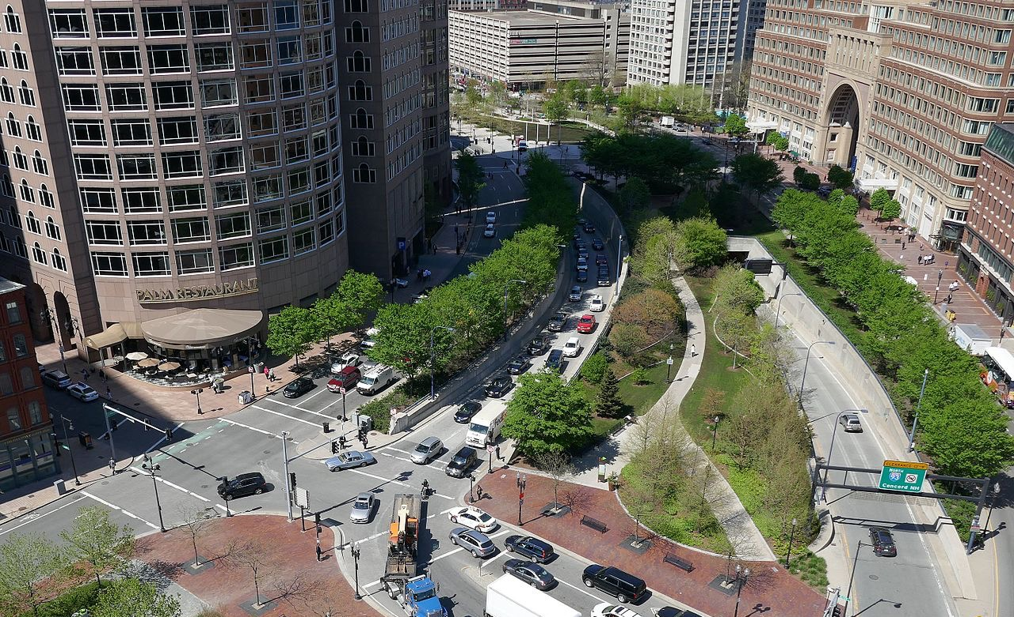
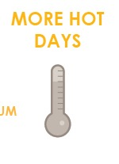
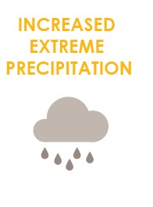
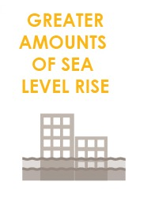
FOCUS AREA: DOWNTOWN
30,000+ people, 200,000 jobs, +$50 billion to city economy.

Slide 2
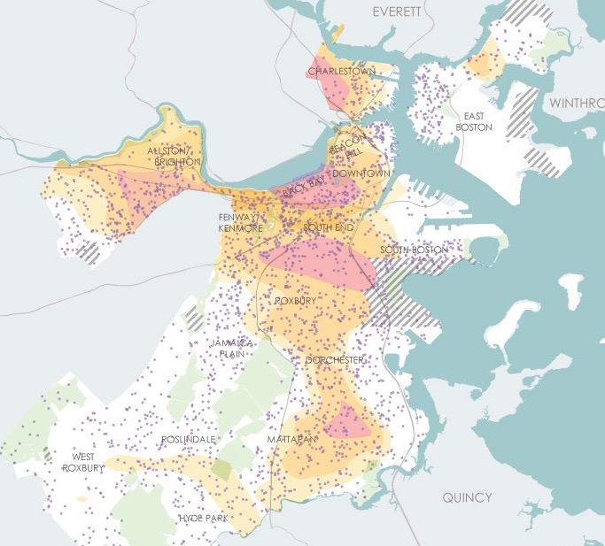
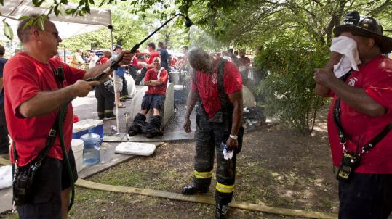
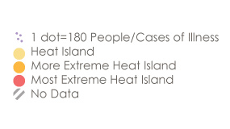
WHAT CLIMATE CHANGE MEANS FOR DOWNTOWN
More Hot Days
Medical Illness and Heat Island Exposure
Urban “heat islands” where there is less tree canopy are hotter and most at risk.
Some people are more vulnerable to heat than other such as those with illnesses or the elderly.
Notes:
Downtown has a larger number of older community members, people of color and renters who can be more vulnerable to heat waves and resulting power outages.

Slide 3
WHAT CLIMATE CHANGE MEANS FOR DOWNTOWN
More Flooding
Downtown’s total land area is less at risk from coastal and riverine flooding than some areas yet its density means flooding can lead to significant structural damage and economic losses.
Notes:
Like other neighborhoods, direct exposure to stormwater flooding will increase steadily over time with climate disruption.

Slide 4
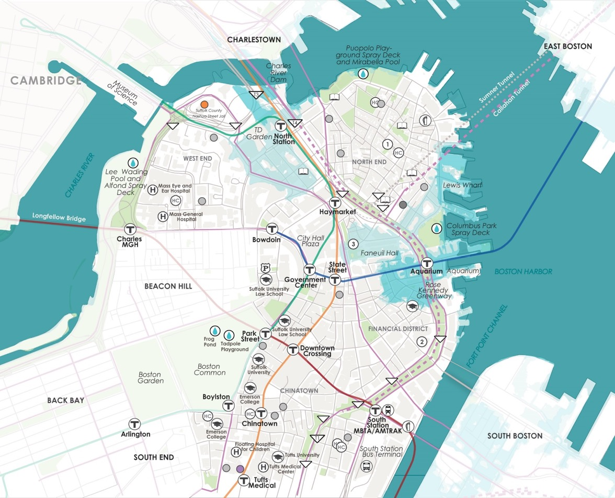
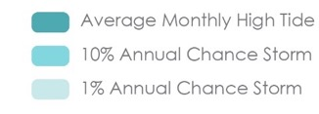
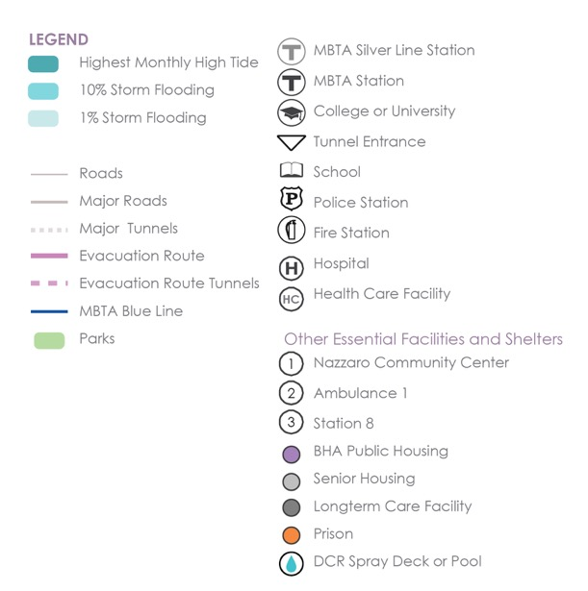
WHAT’S AT STAKE?
Community Assets and Flooding
9’’ sea level rise
2030s-2050s
Downtown
The waterfront from Union Wharf to the Aquarium and inland areas near Faneuil Hall and North Station will be exposed to coastal flooding.
Notes:
The most frequent exposure (10% annual chance) to flooding will be concentrated around the Aquarium.
*This type of storm will also impact the Aquarium Blue Line Station; and the Leverett Circle 1-93 and Central Artery north tunnel entrances.
*The State Police station at Leverett Circle will be impacted by monthly high tides.
*The EMS Ambulance station 8 in the North End will be at risk in
low-probability flooding (1 percent annual chance event)

Slide 5
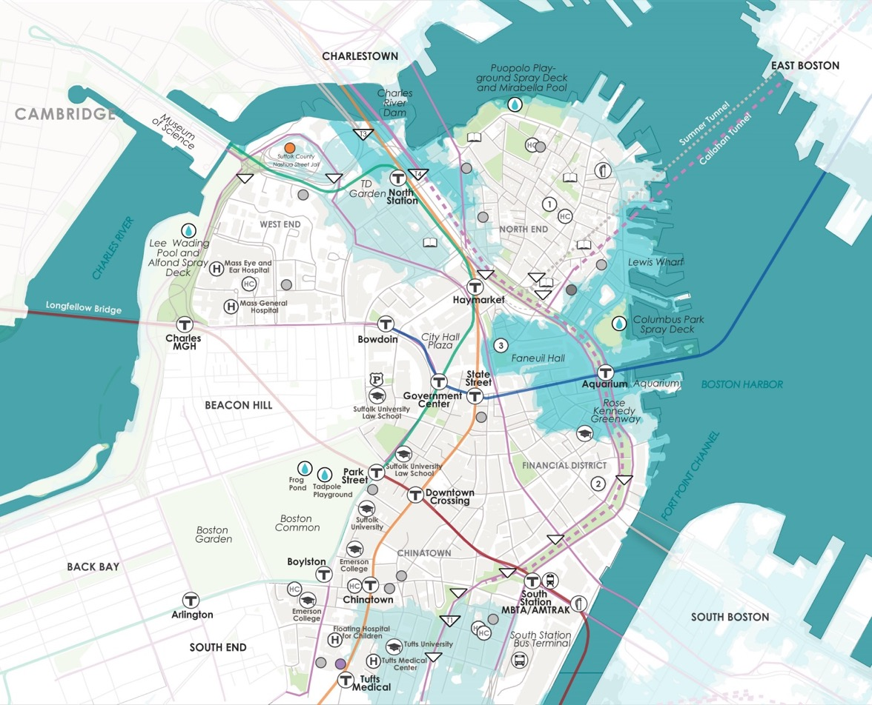
WHAT’S AT STAKE?
Community Assets and Flooding
21’’ sea level rise
2050s-2070s
Downtown
Flooding will expand mid-century in the North End, Leather District and Chinatown and be more likely from Faneuil Hall to the Financial District.
Notes:
In the second half of century, 1% annual chance flooding events will impact additional 1-93 and 1-90 tunnels; Tufts Medical Center, a number of MassDot stormwater pump stations and other critical community assets.

Slide 6
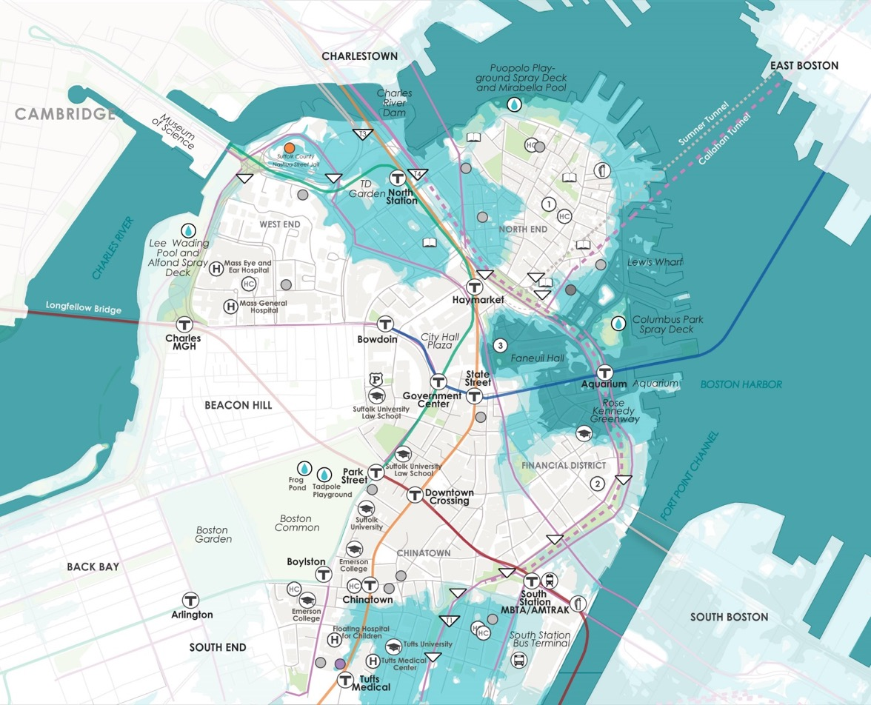
WHAT’S AT STAKE?
Community Assets and Flooding
36’’ sea level rise
2070s or LATER
Downtown
The most frequent exposure (10% annual chance) to flooding will be concentrated around the Aquarium.
Notes:
North Station is at risk from 10% annual chance flooding and South Station by lower probability 1% annual chance events.

Slide 7
WHAT’S AT STAKE?
People and Buildings Impacted by 1% Annual Flood Events
13,900
PEOPLE
4,600
PEOPLE
1200 BUILDINGS
(Worth $15B)
400 BUILDINGS
(Worth $4.5B)
2030+
2070+
Notes:
In the near term, Downtown is expected to have approximately 60 structures exposed to flooding during monthly high tides—more than any other part of the city and has more than double the current real estate market value exposed to monthly high-tide flooding.
Expected annualized losses for Downtown make up about one-third of all those expected citywide in the near term and over 20 percent of all expected citywide losses toward the end of the century.

Slide 8

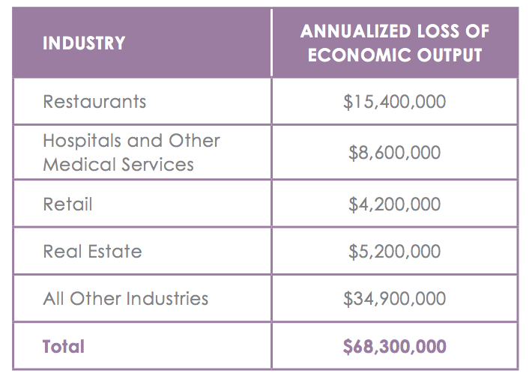
WHATS AT STAKE?
Economic Output and Jobs
$68M loss of economic output and 500 jobs per year by the end of the century.

Slide 9
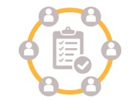
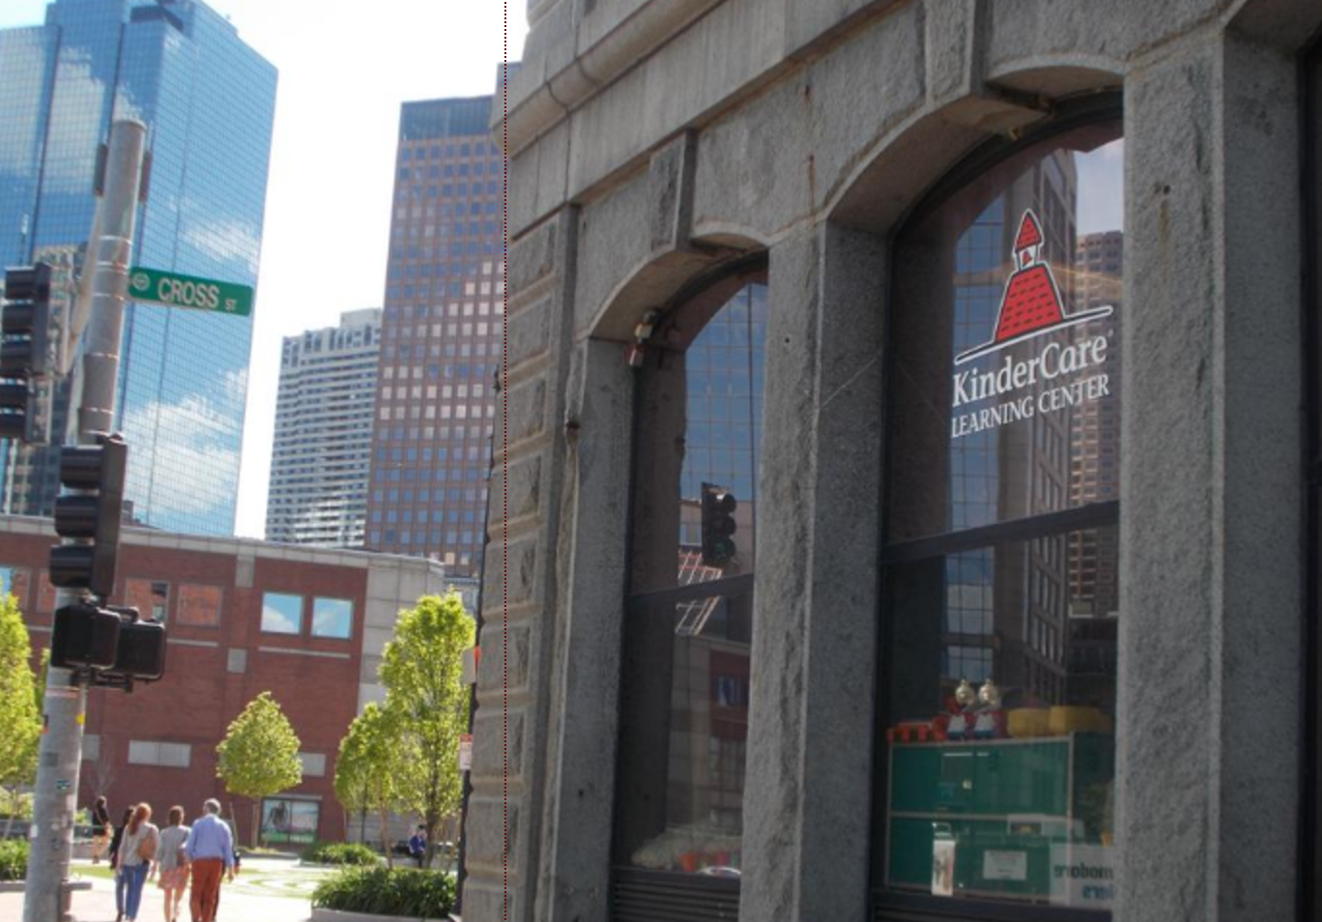
DOWNTOWN IN ACTION
Prepared and Connected Communities
PROPOSED STRATEGIES:
Engage Bostonians as partners
Co-create neighborhood plans
Provide training for jobs in resilience

Slide 10
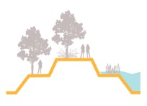
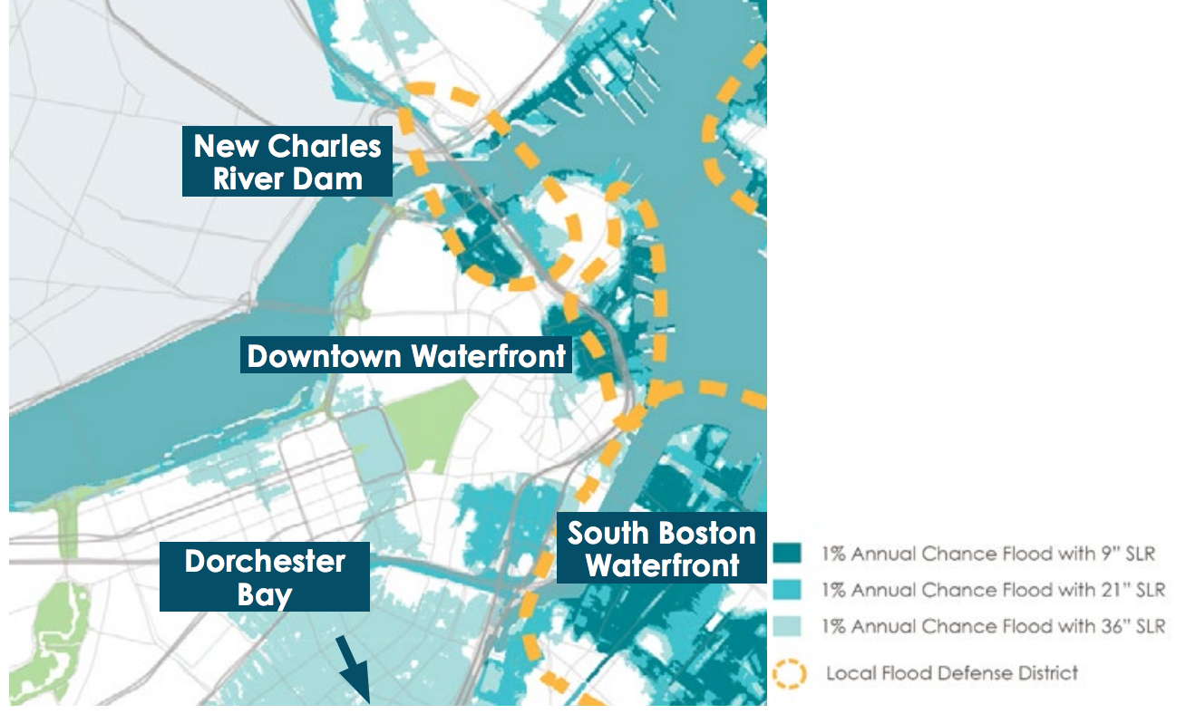
DOWNTOWN IN ACTION
Protected Shores
PROPOSED STRATEGIES:
Engage Bostonians as partners
Co-create neighborhood plans
Provide training for jobs in resilience
Near term protection is needed along the low-lying areas of the Downtown Waterfront and at the New Charles River Dam.

Slide 11
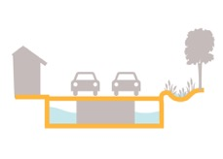

DOWNTOWN IN ACTION
Resilient Infrastructure
PROPOSED STRATEGIES:
Develop coordinated risk response plans for extreme weather events.
Support MTBA’s assessment of flooding to the Blue Line.
Explore options for a neighborhood energy grid in the North End.
Notes:
http://www.subchat.com/read.asp?Id=1175613

Slide 12

DOWNTOWN IN ACTION
Adaptive Buildings
PROPOSED STRATEGIES:
Update zoning and building codes and notify developers with projects in the pipeline to update plans.
Help building owners assess potential impacts and increase resilience.
Promote access to insurance.
Prepare municipal buildings to withstand change.

