Slide 1

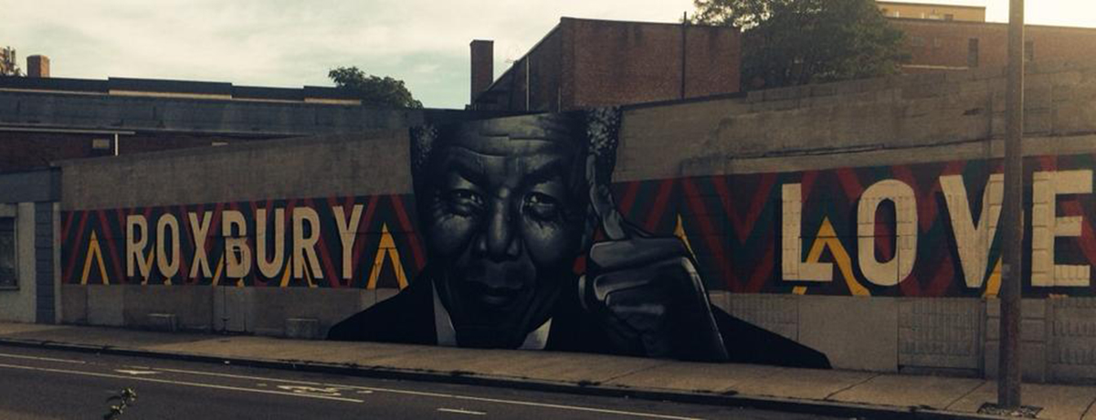
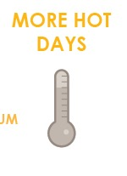
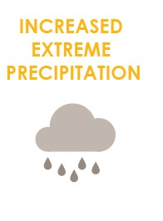

FOCUS AREA: ROXBURY
71,000+ people, 24,000 jobs, +$4.2 billion to city economy.

Slide 2
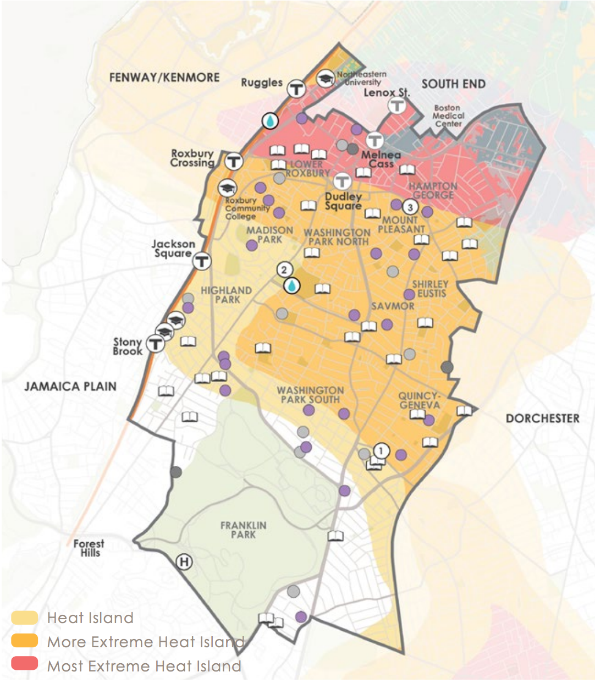
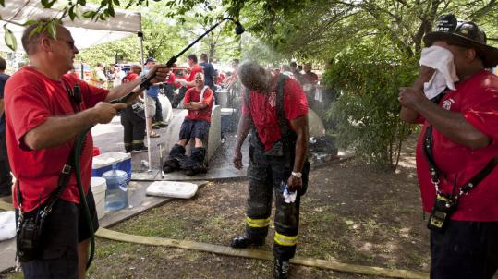
WHAT CLIMATE CHANGE MEANS FOR ROXBURY
More Hot Days
Urban Heat Island Exposure
Urban “heat islands” where there is less tree canopy are hotter and most at risk.
Some people are more vulnerable to heat than other such as those with illnesses or who are low income.
Notes:
Roxbury has some of the hottest summer temperatures and has a high percentage of community members who may be more at risk including low income, older Bostonians and children, and those dealing with medical illnesses.

Slide 3
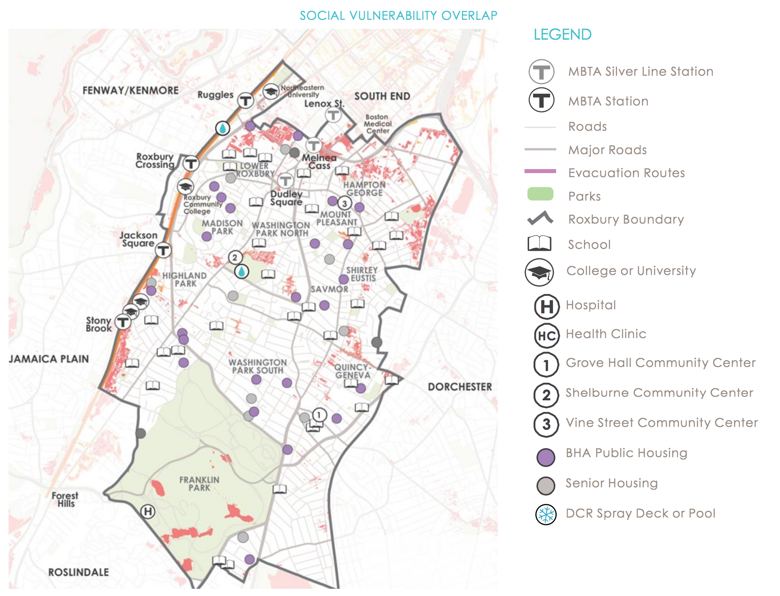
WHAT CLIMATE CHANGE MEANS FOR ROXBURY
More Flooding
Stormwater flooding already occurs in Roxbury with Melnea Cass Blvd often impacted. Even a few inches of road flooding can block access to essential services.
Notes:
Stormwater flooding is already an issue for Roxbury with Melnea Cass Blvd often impacted during heavy rains. More frequent intense storms will extend the exposure into the Lower Roxbury and Hampton George including the northern edge of Malcolm X Park and the area north of King Towers.

Slide 4
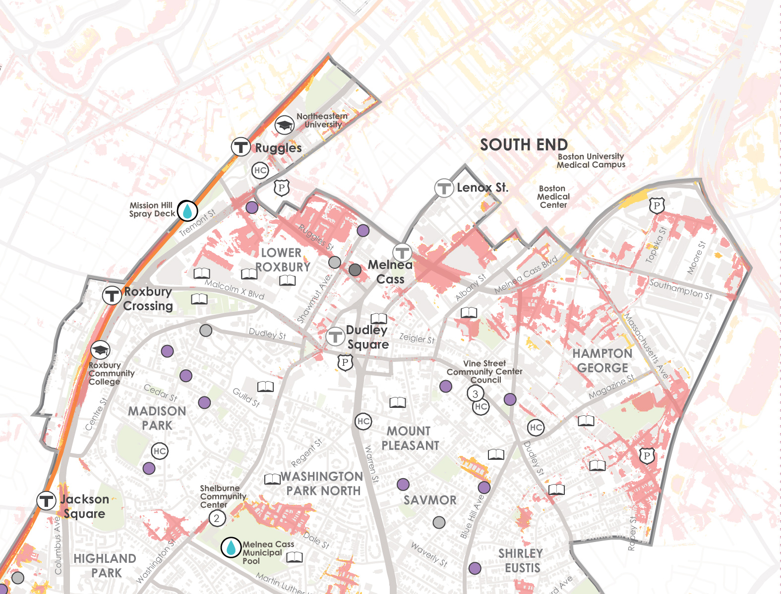
WHAT’S AT STAKE?
Stormwater Flooding
10-Year 24-Hour Flood
Roxbury
West Roxbury has one of the largest areas of land expected to be affected by stormwater flooding in the city.
Notes:
Flood progression into Roxbury takes place through the South End. In addition to impacting the roads, the Amtrack/MBTA lines between Tremont and Columbus are exposed to stormwater flooding.

Slide 5
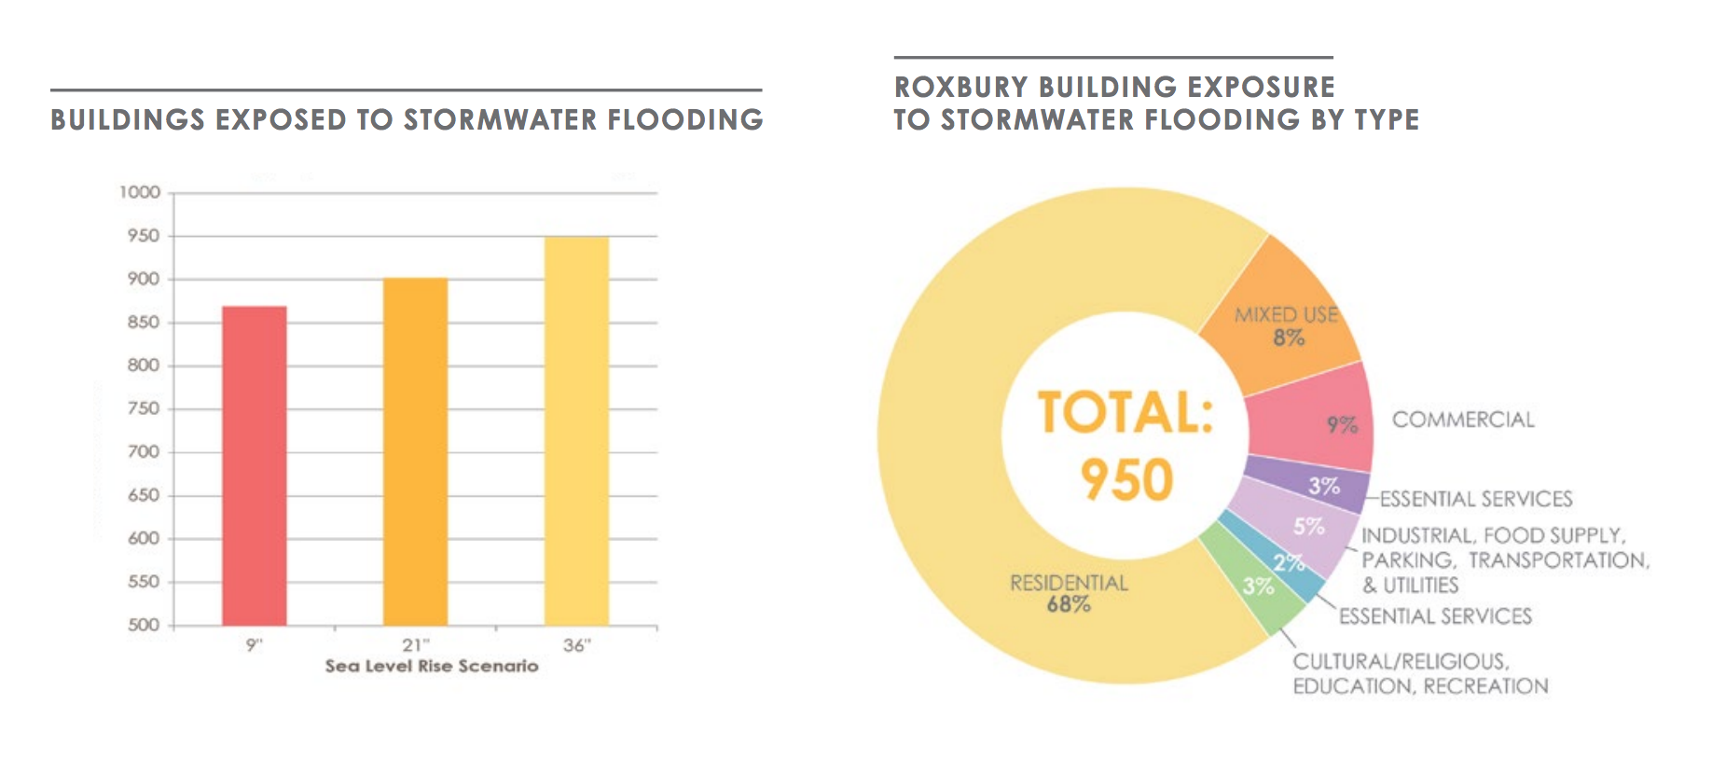
WHAT’S AT STAKE?
People and Buildings Impacted by Stormwater

Slide 6
WHAT’S AT STAKE?
People and Buildings Impacted by 1% Annual Flood Events
1,800
PEOPLE
230 BUILDINGS
(Worth $700M)
Roxbury’s population remains largely unexposed to coastal flood impacts until later in the century.
2070+
Notes:
Roxbury is among the least exposed in terms of land area, population, and buildings when compared to other neighborhoods. Later in the century the population and buildings exposed greatly increase including to the Boston Water and Sewer Commission headquarters.

Slide 7

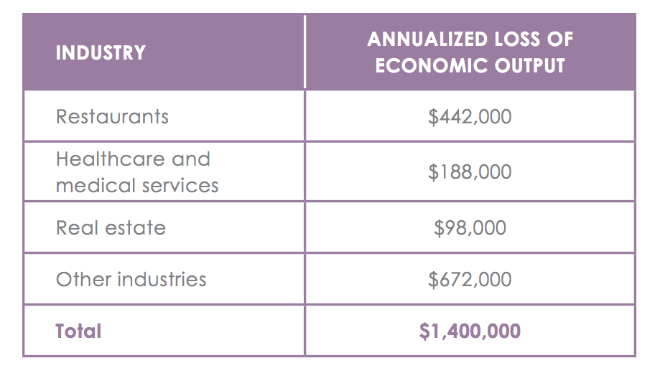
WHATS AT STAKE?
Economic Output and Jobs
$1.4M loss of economic output per year by 2070

Slide 8
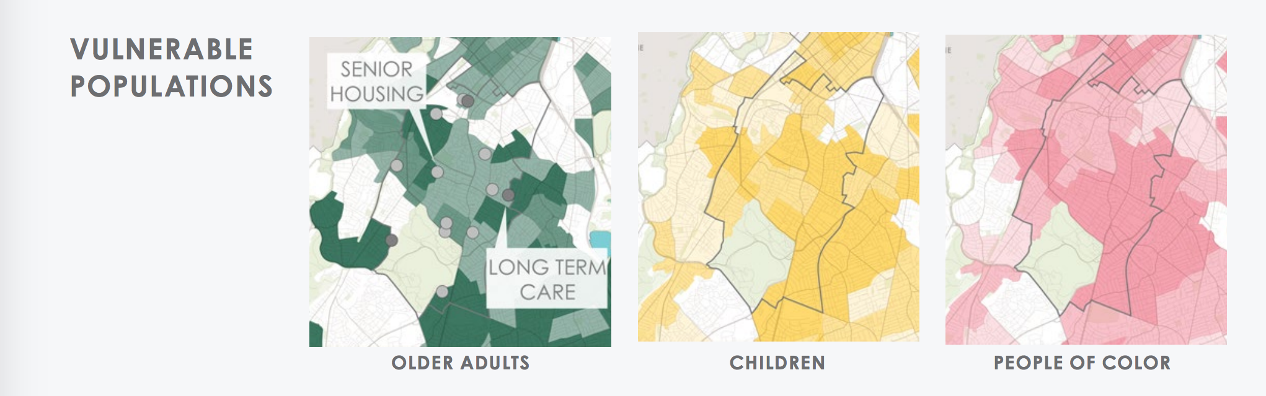
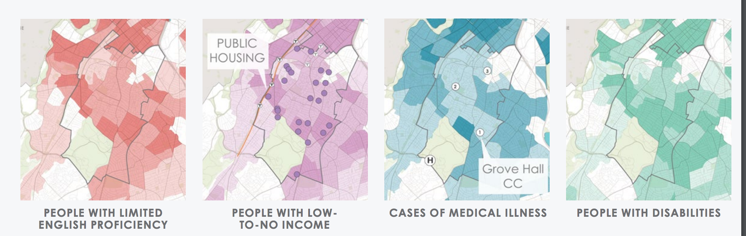
IMPACTS DON’T AFFECT EVERYONE EQUALLY
Roxbury has a richly diverse population. The vast majority of community members fall into at least one vulnerable category and most fall into several categories.
Notes:
Roxbury has high concentrations of vulnerable populations, but also many community organizations and non-profits that serve residents. Several Boston Centers for Youth and Families (BCYF) connect residents to resources and information and act as cooling centers. Community development corporations advocate for the neighborhood and develop affordable housing. These organizations help supplement the resource network for residents who have special needs and vulnerabilities and enhance resilience in the community in hazard events
83% of residents are people of color, the second highest concentration of people of color in the entire city and much higher than Boston as a whole.

Slide 9

ROXBURY IN ACTION
Prepared and Connected Communities
PROPOSED STRATEGIES:
Engage Bostonians as partners
Co-create neighborhood plans
Provide training for jobs in resilience

Slide 10
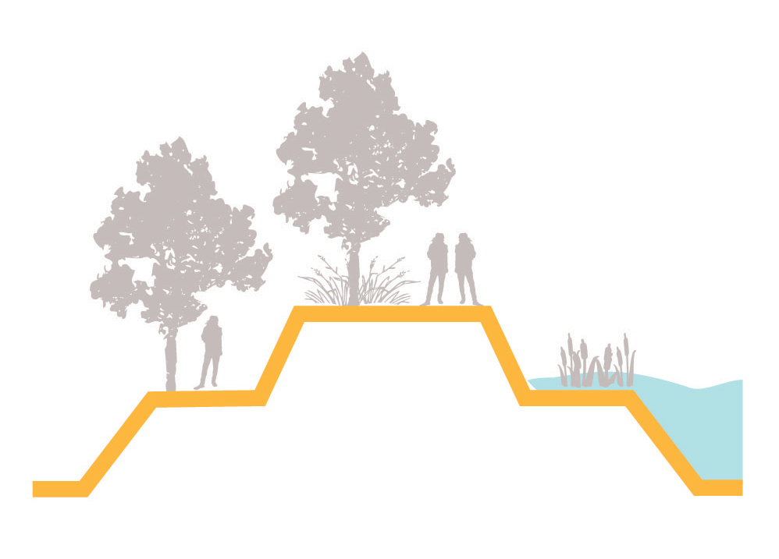
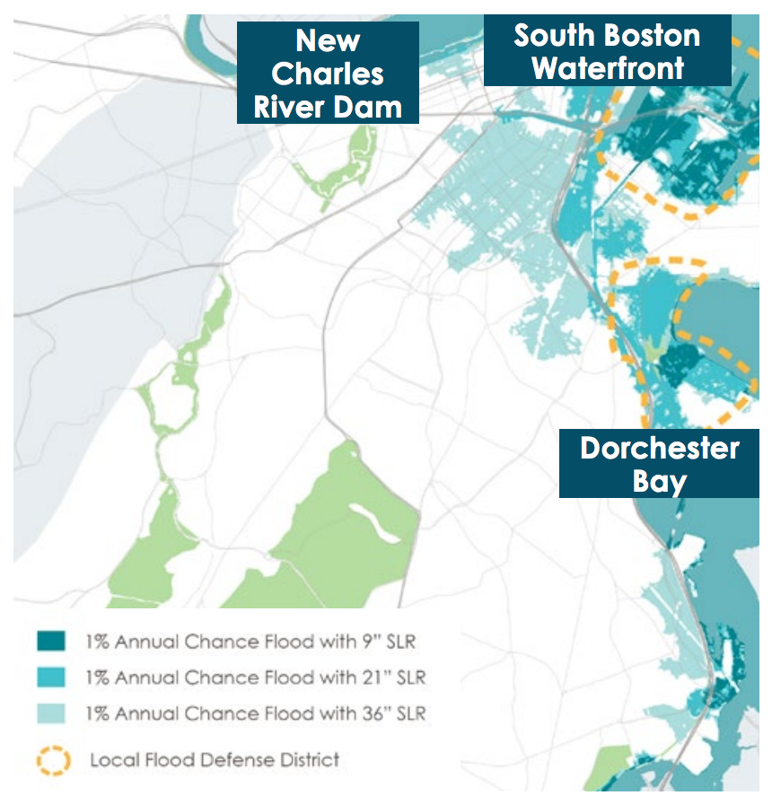
ROXBURY IN ACTION
Protected Shores
PROPOSED STRATEGIES:
Engage Bostonians as partners
Co-create neighborhood plans
Provide training for jobs in resilience
As soon as the 2050s, the northern edge of Roxbury will be exposed to flooding requiring protection at the South Boston Waterfront, Dorchester Bay, and the New Charles River Dam.
Notes:
Roxbury is not facing near term threats but will see flooding as soon as the 2050s requiring protections:
• At the South Boston Waterfront, addressing inland flood pathways originating from Fort Point Channel, Boston Harbor, and the Reserve Channel
• At Dorchester Bay, addressing inland flood pathways originating from the Old Harbor and Savin Hill Cove
• At the New Charles River Dam, addressing potential overtopping or flanking of the dam

Slide 11
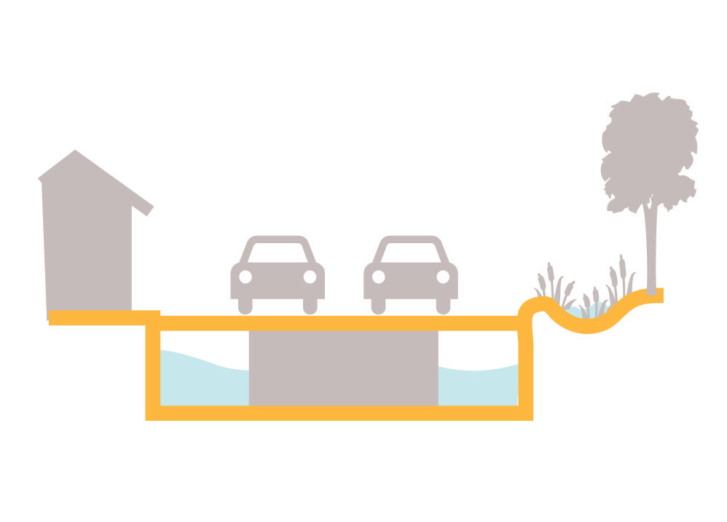

ROXBURY IN ACTION
Resilient Infrastructure
PROPOSED STRATEGIES:
Develop coordinated risk response plans for extreme weather events.
Support MTBA’s assessment of flooding of the Orange Line.
Explore options for energy justice microgrids in Roxbury which has the greatest potential for solar in the city.

Slide 12

ROXBURY IN ACTION
Adaptive Buildings
PROPOSED STRATEGIES:
Update zoning and building codes and notify developers with projects in the pipeline to update plans.
Help building owners assess potential impacts and increase resilience.
Promote access to insurance.

