Slide 1

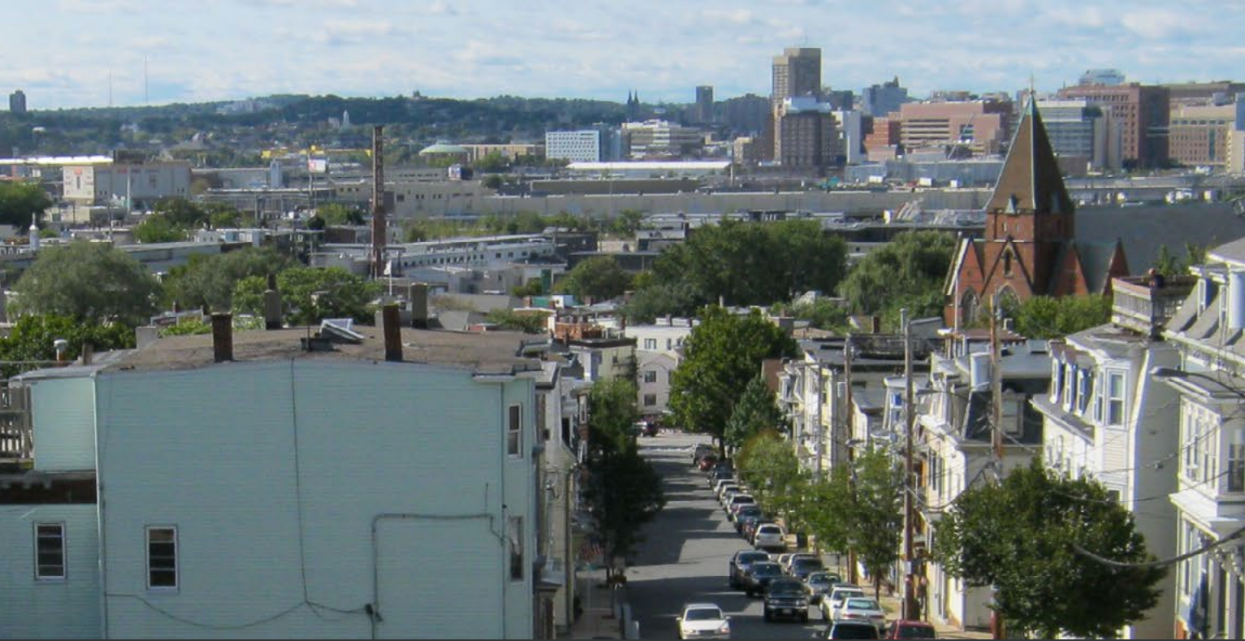
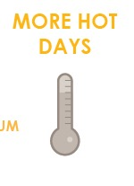
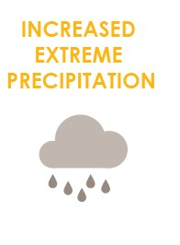
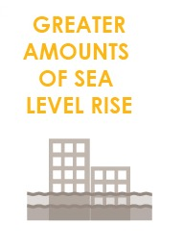
FOCUS AREA: SOUTH BOSTON
31,000+ people, 78,000 jobs, +$20 billion to city economy.

Slide 2
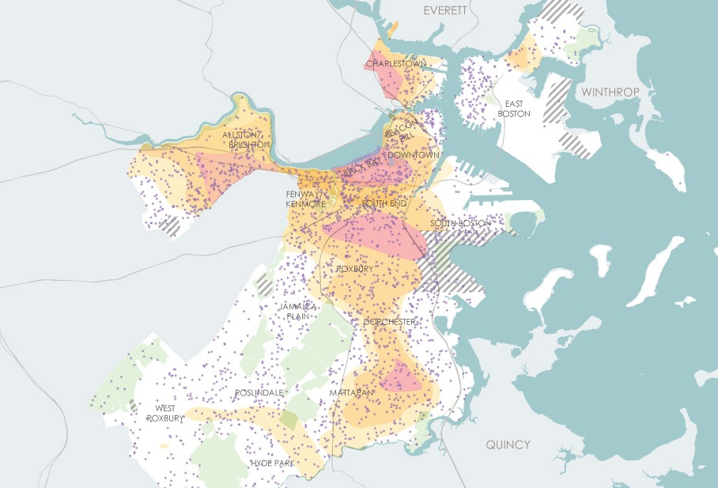
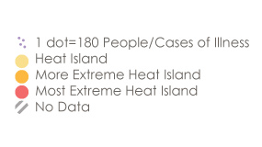
WHAT CLIMATE CHANGE MEANS FOR SOUTH BOSTON
More Hot Days
Medical Illness and Heat Island Exposure
Urban “heat islands” where there is less tree canopy are hotter and most at risk.
Some people are more vulnerable to heat than other such as those with illnesses or who are low income.

Slide 3
WHAT CLIMATE CHANGE MEANS FOR SOUTH BOSTON
More Flooding
South Boston is the most-exposed neighborhood in Boston, with nearly 25 percent of its land area exposed under 9 inches of sea level rise, 50 percent under 21 inches, and 60 percent under 36 inches at the 1 percent annual chance event. Nearly 20 percent of the neighborhood’s land area will be exposed to high tides with 36 inches of sea level rise.
Notes:
South Boston and the South End can also expect to see the greatest increase in land exposed to stormwater flooding as sea levels rise and precipitation events become more extreme.

Slide 4
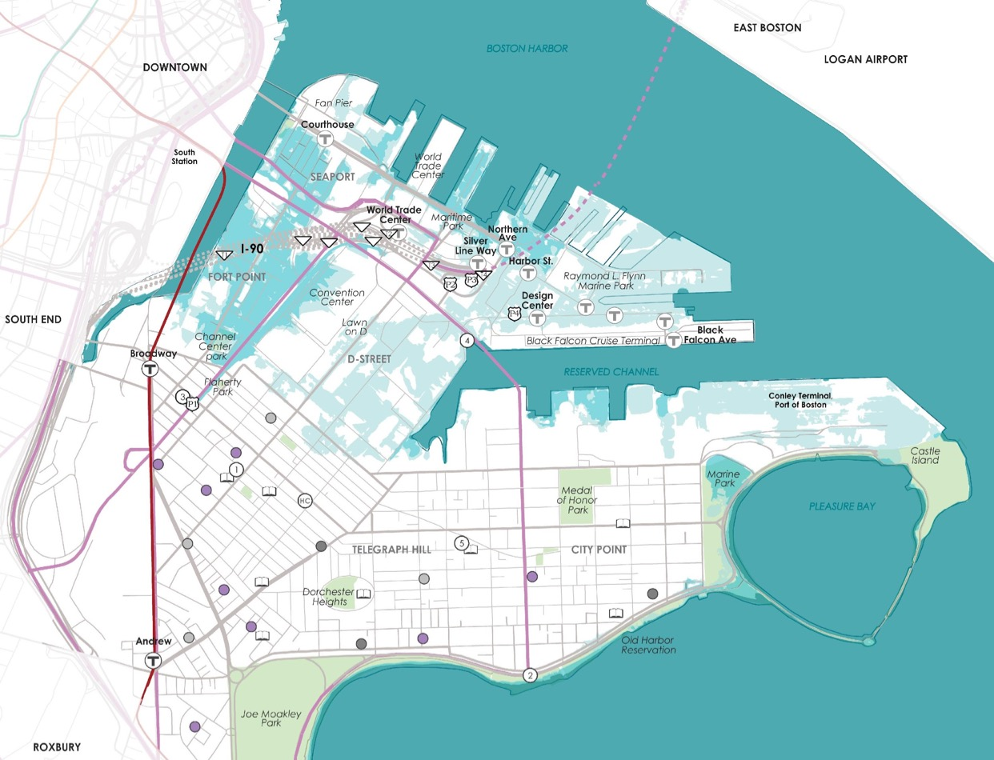
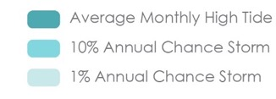
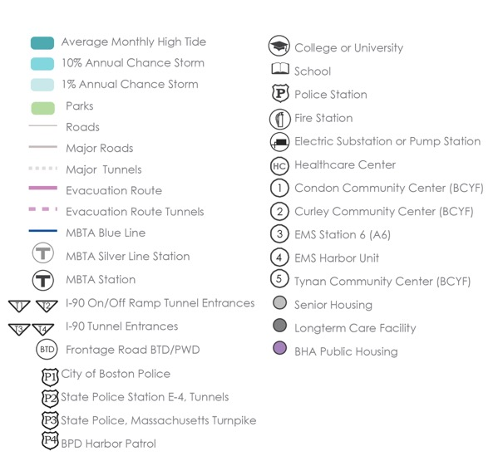
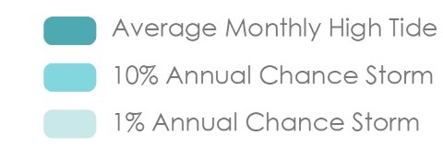
WHAT’S AT STAKE?
Community Assets and Flooding
9’’ sea level rise
2030s-2050s
South Boston
In the near term, the South Boston Waterfront is exposed to high-probability coastal storms (10 percent annual chance events) near Fort Point Channel and to the north along Boston Harbor.
Notes:
South Boston is a peninsula that houses many important transportation hubs; and growing and changing waterfront communities.
*In the short term, entrances and exits to the Ted Williams Tunnels are at risk from low probability storms (1% annual flooding event), potentially cutting South Boston off from East Boston.
*This level of flooding would also place important community assets at risk including the Curley Center, the EMS Harbor Unit, and one of South Boston’s pump stations.
*Though Substation 99 power station is expected to be exposed to low-probability flooding in the near term (1 percent annual chance event), it sits on a 15-foot-high elevated steel platform with reinforced cast-in-place concrete at its base. Sitting almost 26 feet above current mean sea level, this substation is expected to withstand storm surge and flood scenarios throughout this century.

Slide 5
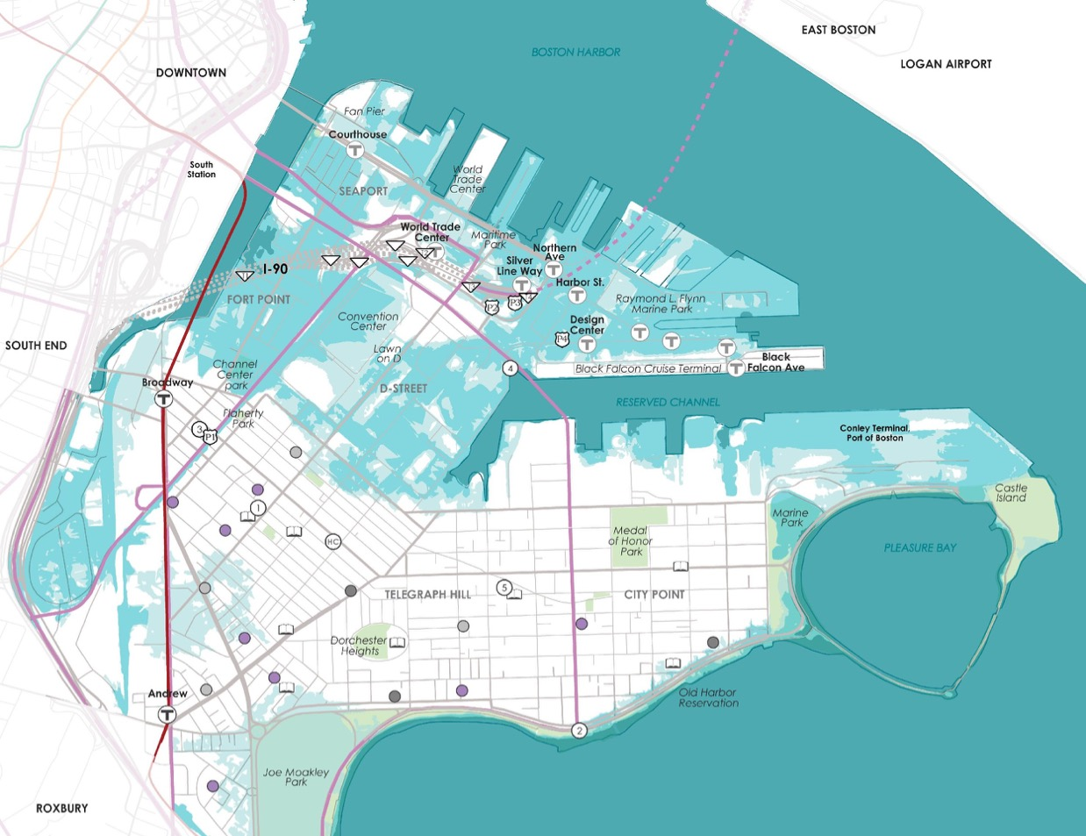
WHAT’S AT STAKE?
Community Assets and Flooding
21’’ sea level rise
2050s-2070s
South Boston
Much of the land area north of West First Street and East First Street will be exposed to 10 percent annual chance floods.
Notes:
In the second half of century, 1% annual chance flooding events could cut South Boston off from other parts of the city due to flooding on the South Boston Bypass, Dorchester, and William J. Day Boulevard; and essential locations such as the McCormack Development will be exposed.

Slide 6
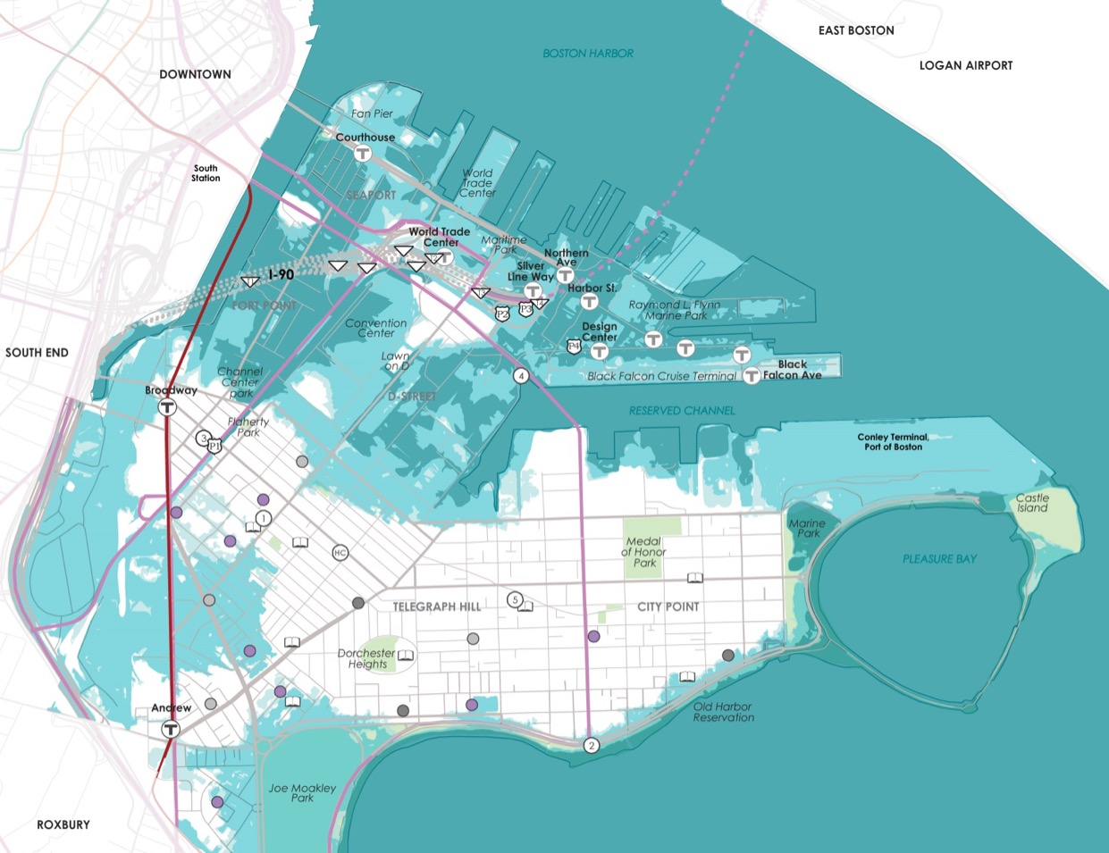
WHAT’S AT STAKE?
Community Assets and Flooding
36’’ sea level rise
2070s or Later
South Boston
Toward the end of the century, much of the South Boston Waterfront will be exposed to flooding from high tide, and many neighbourhoods exposed to 10 percent annual chance flood.
Notes:
Resilience planning requires consideration of the South Boston Waterfront’s long, low-lying waterfront edges and flood pathways through Fort Point Channel and Joseph Moakley Park, which create challenges for local flood defenses.

Slide 7
WHAT’S AT STAKE?
People and Buildings Impacted by 1% Annual Flood Events
10,960
PEOPLE
1,750 BUILDINGS
(Worth $19.5B)
2,330
PEOPLE
350 BUILDINGS
(Worth $1.9B)
2030+
2070+
Notes:
South Boston is second only to Downtown with total real estate market value expected to be exposed to flooding during high tides in the near term. In the late century, the community will continue to have the largest share (25 percent) of Boston’s total real estate market value exposed.

Slide 8
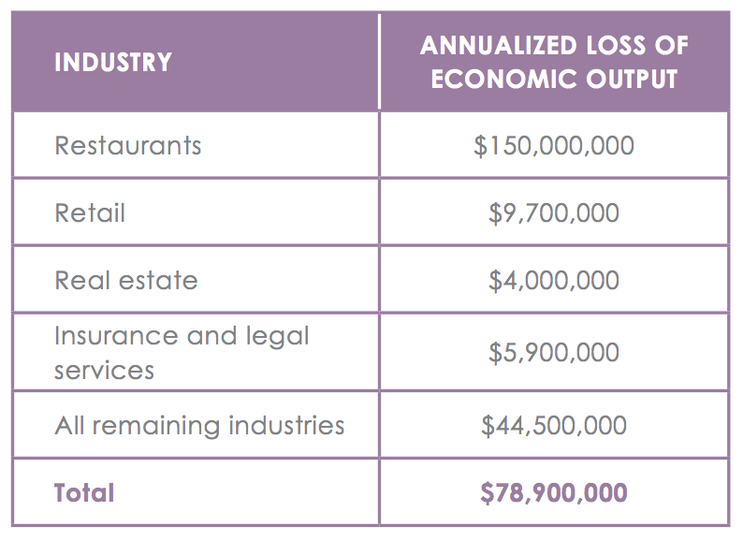
WHAT’S AT STAKE?
Economic Output and Jobs
$80M loss of economic output + 600 jobs per year as soon as 2070.

Slide 9


SOUTH BOSTON IN ACTION
Prepared and Connected Communities
PROPOSED STRATEGIES:
Engage Bostonians as partners
Co-create neighborhood plans
Provide training for jobs in resilience

Slide 10
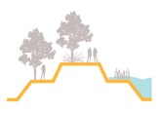
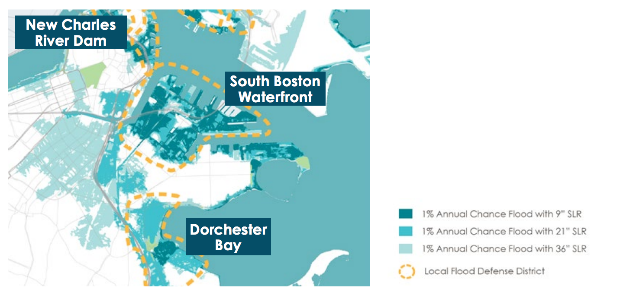
SOUTH BOSTON IN ACTION
Protected Shores
PROPOSED STRATEGIES:
Engage Bostonians as partners
Co-create neighborhood plans
Provide training for jobs in resilience
Near term protection is needed along the South Boston Waterfront from Fort Point Channel to Boston Harbor and the Reserve Channel.
Protections from flooding from Dorchester Bay is also critical along with enhancing the New Charles River Dam

Slide 11
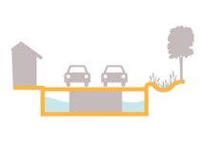
SOUTH BOSTON IN ACTION
Resilient Infrastructure
PROPOSED STRATEGIES:
Develop coordinated risk response plans for extreme weather events.
Support MTBA’s assessment of flooding to the Silver and Red lines.
Explore options for a neighborhood energy grid in Ray Flynn Marine Park.
Notes:
http://www.subchat.com/read.asp?Id=1175613

Slide 12

SOUTH BOSTON IN ACTION
Adaptive Buildings
PROPOSED STRATEGIES:
Update zoning and building codes and notify developers with projects in the pipeline to update plans.
Help building owners assess potential impacts and increase resilience.
Promote access to insurance.
Prepare municipal buildings to withstand change.
Notes:
http://tdworld.com/site-files/tdworld.com/files/gallery_images/boston4.jpg?1468416021

