Slide 1

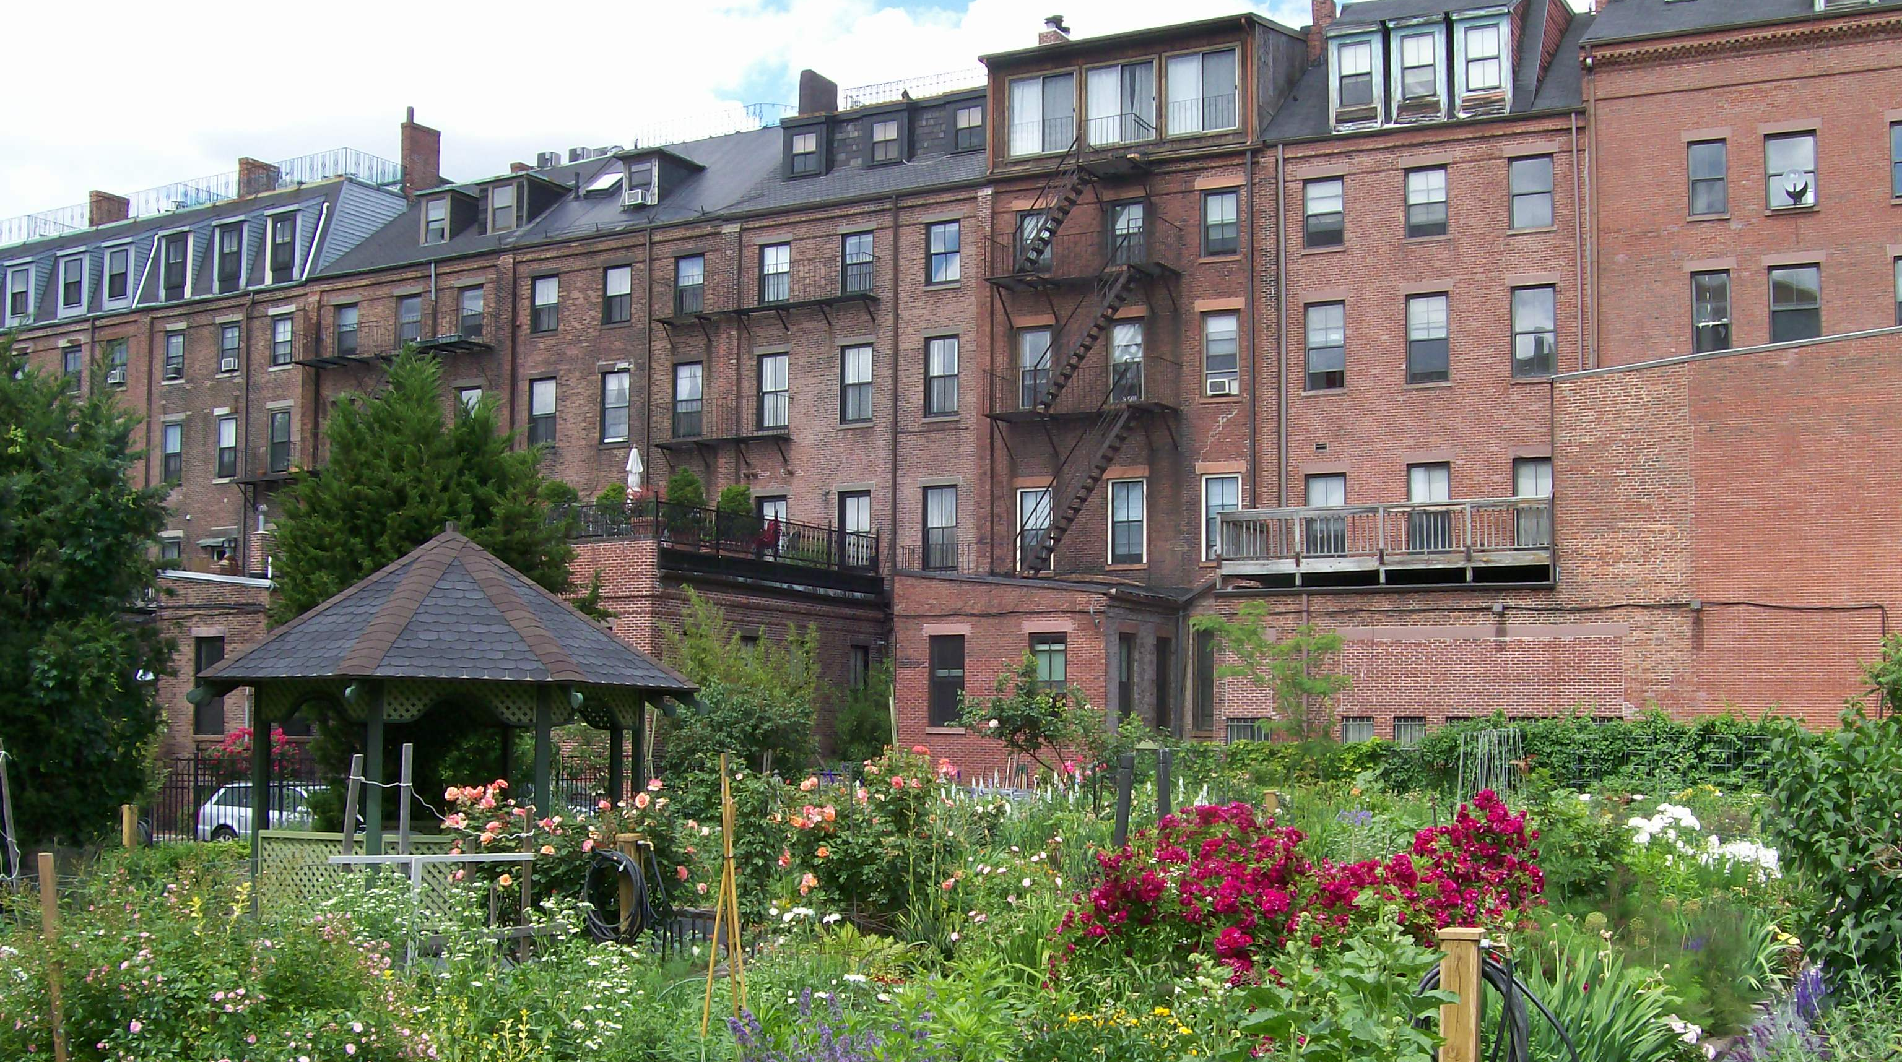
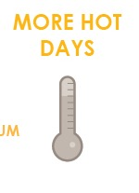
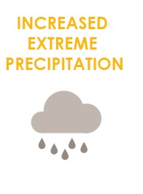
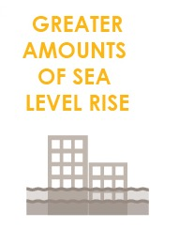
FOCUS AREA: SOUTH END
38,600+ people, 20,000 jobs, +$3.6 billion to city economy.

Slide 2
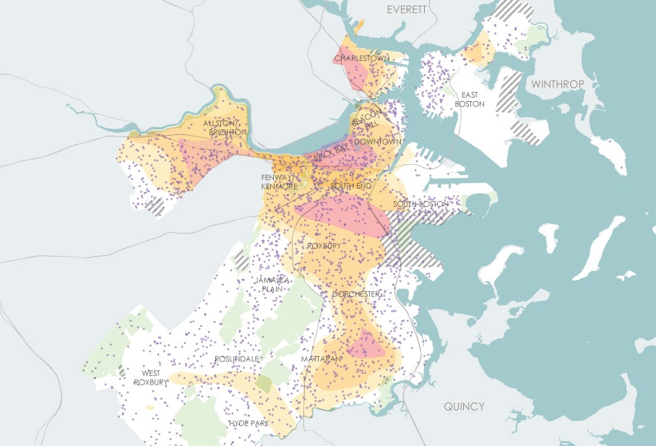
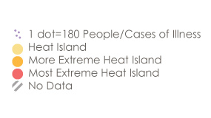
WHAT CLIMATE CHANGE MEANS FOR SOUTH END
More Hot Days
Medical Illness and Heat Island Exposure
Urban “heat islands” where there is less tree canopy are hotter and most at risk.
Some people are more vulnerable to heat than other such as those with illnesses or who are low income.
Notes:
Low income community members make up 30% of the population in the South End and could be impacted more than others by heat waves due to lack of access to air conditioning, adequate housing or green space.

Slide 3
WHAT CLIMATE CHANGE MEANS FOR SOUTH END
More Flooding
Of all Boston focus areas, the South End has the greatest percentage of land area per neighborhood exposed to low-probability storms expected by the end of the century.
Notes:
Coastal flooding in the South End is expected to be limited until the second half of the century.
The South End and East Boston can expect to see the greatest increase in land exposed to stormwater flooding as sea levels rise and precipitation events become more extreme.
(Sea level rise make stormwater flooding worse by preventing outflow or even causing backflow.)

Slide 4
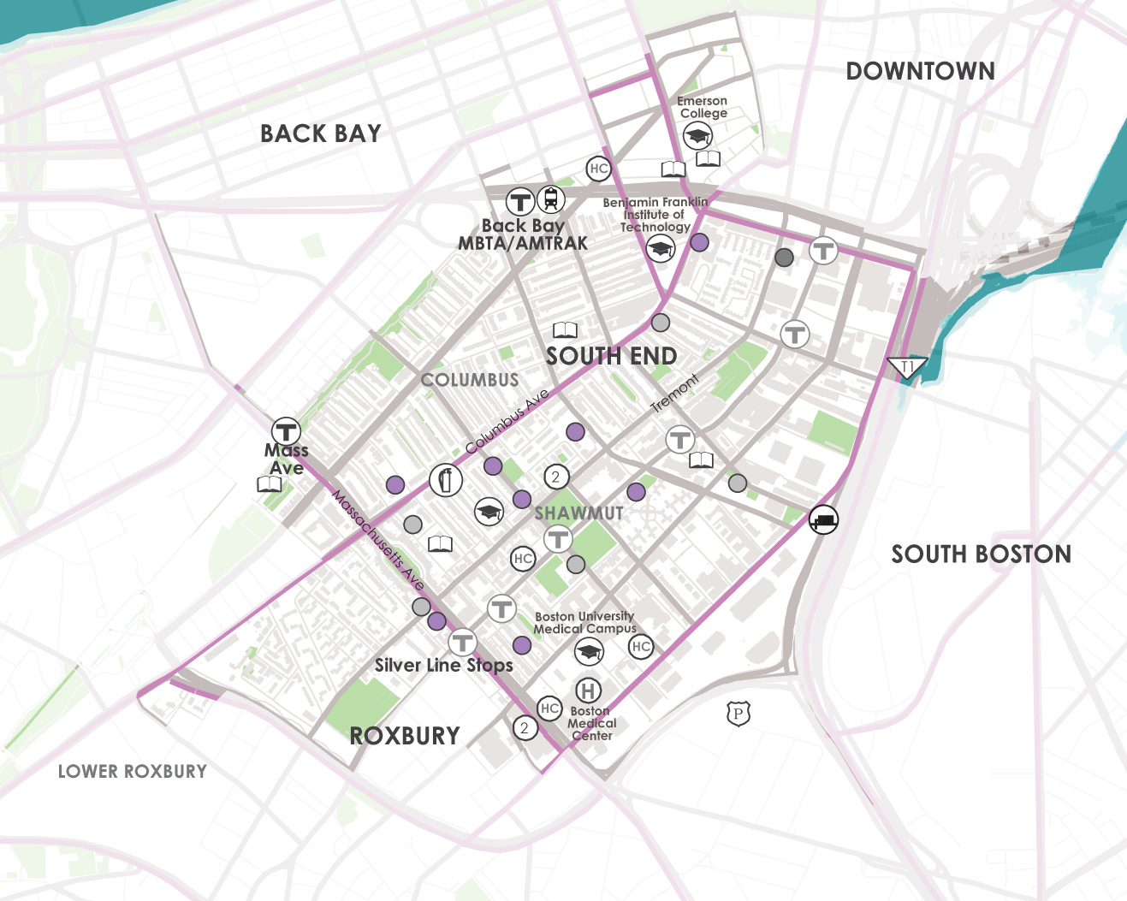
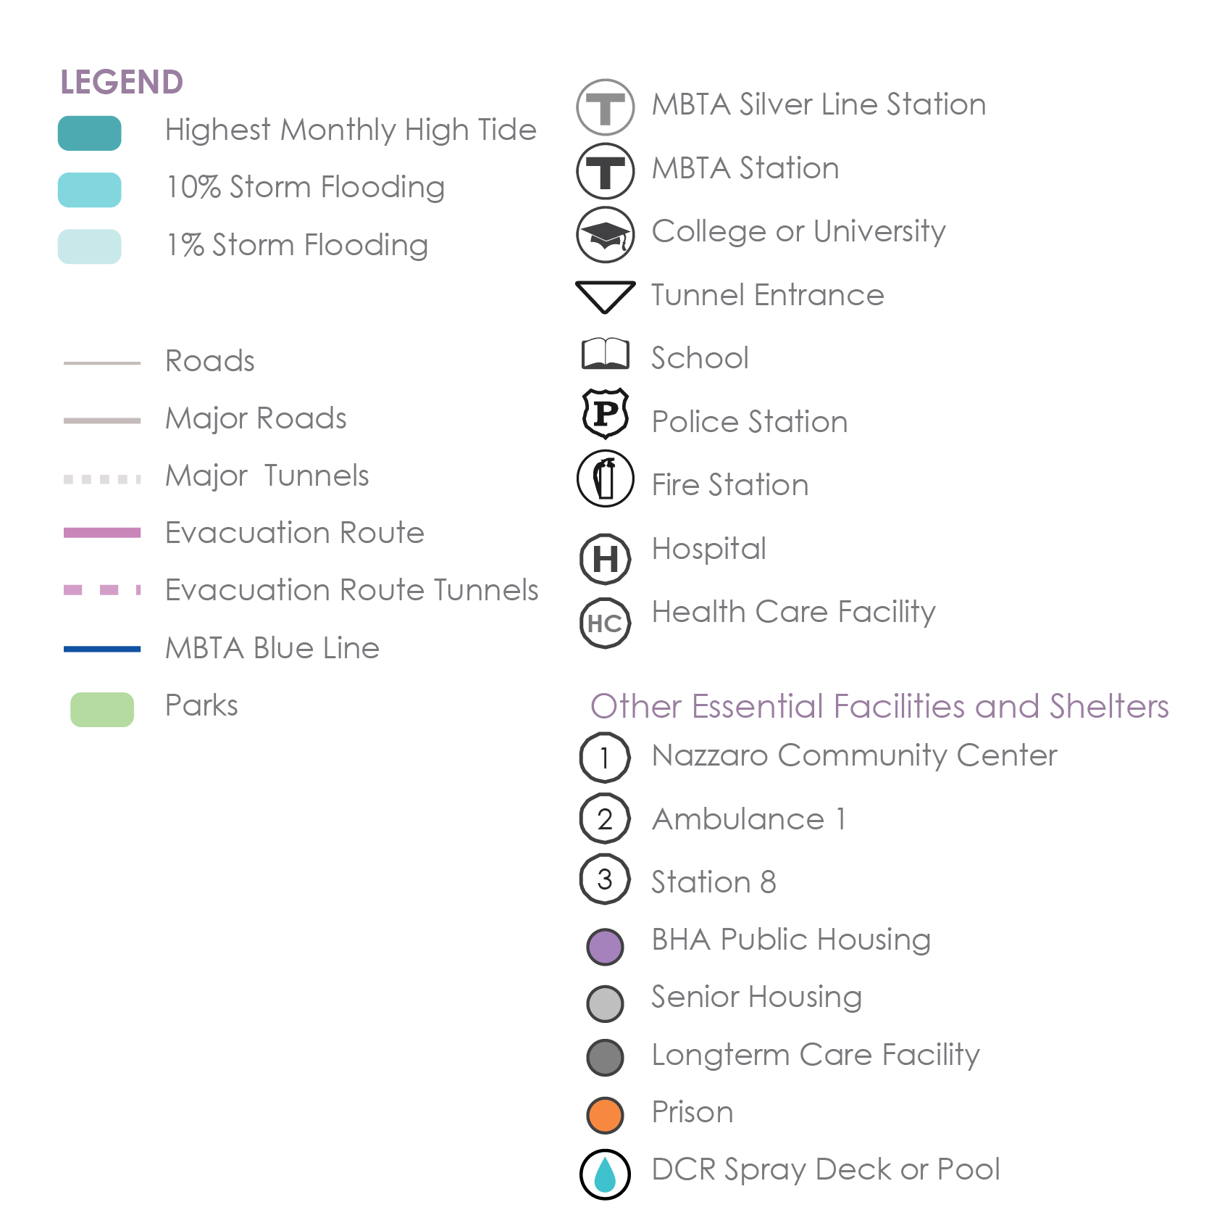
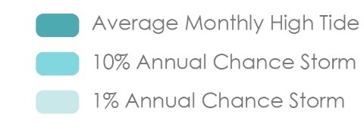
WHAT’S AT STAKE?
Community Assets and Flooding
9’’ sea level rise
2030s-2050s
South End
In the near term, areas near the Courthouse and adjacent to Fort Point Channel will be exposed most frequently (10% annual chance to coastal flooding) to coastal flooding.
Notes:
Flooding originates from the coast through relatively narrow and few penetration points.
Nevertheless, a topographic threshold is expected to be breached as a result of coastal storms later in the century.
*By 2050, portions of the Orange Line will be impacted by low probability (1% annual chance) flooding.

Slide 5
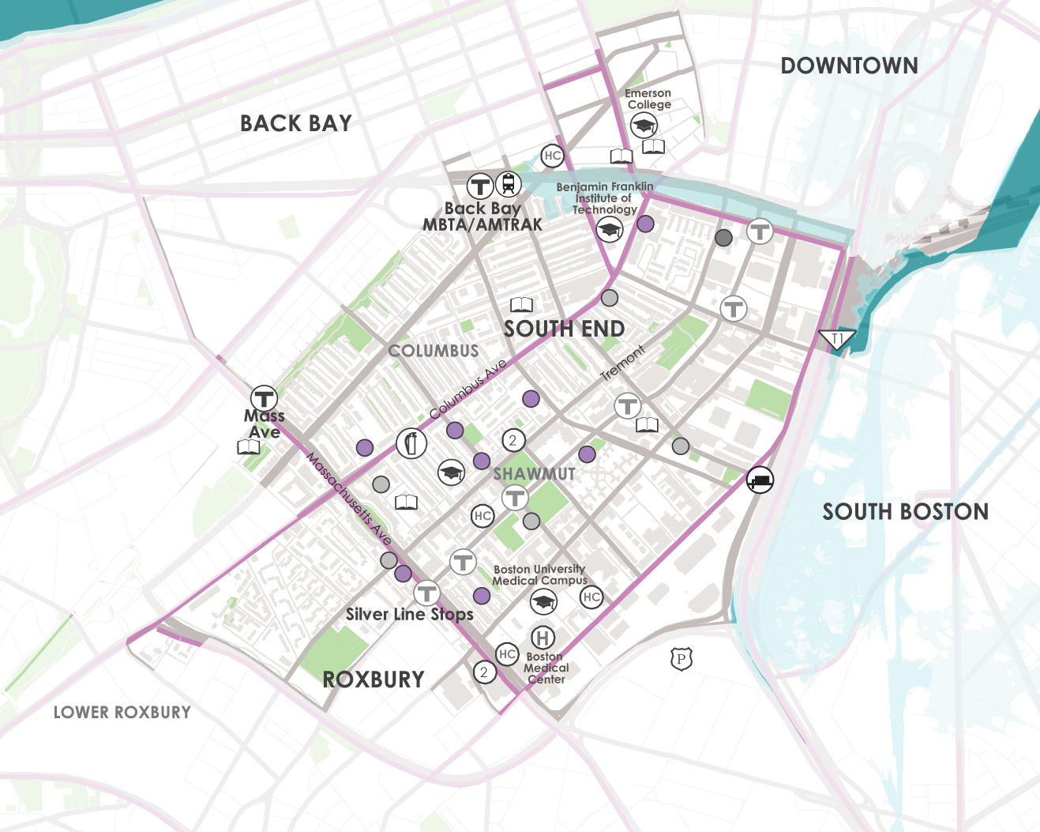
WHAT’S AT STAKE?
Community Assets and Flooding
21’’ sea level rise
2050s-2070s
South End
Mid century, exposure will extend to the Conley Terminal, Raymond Flynn Marine Park, Fan Pier, and Joe Moakley Park
Notes:
Though not as significant of a flood pathway as Fort Point Channel, there is some potential for flooding from Dorchester Bay through Joseph Moakley Park as soon as the 2070s.

Slide 6
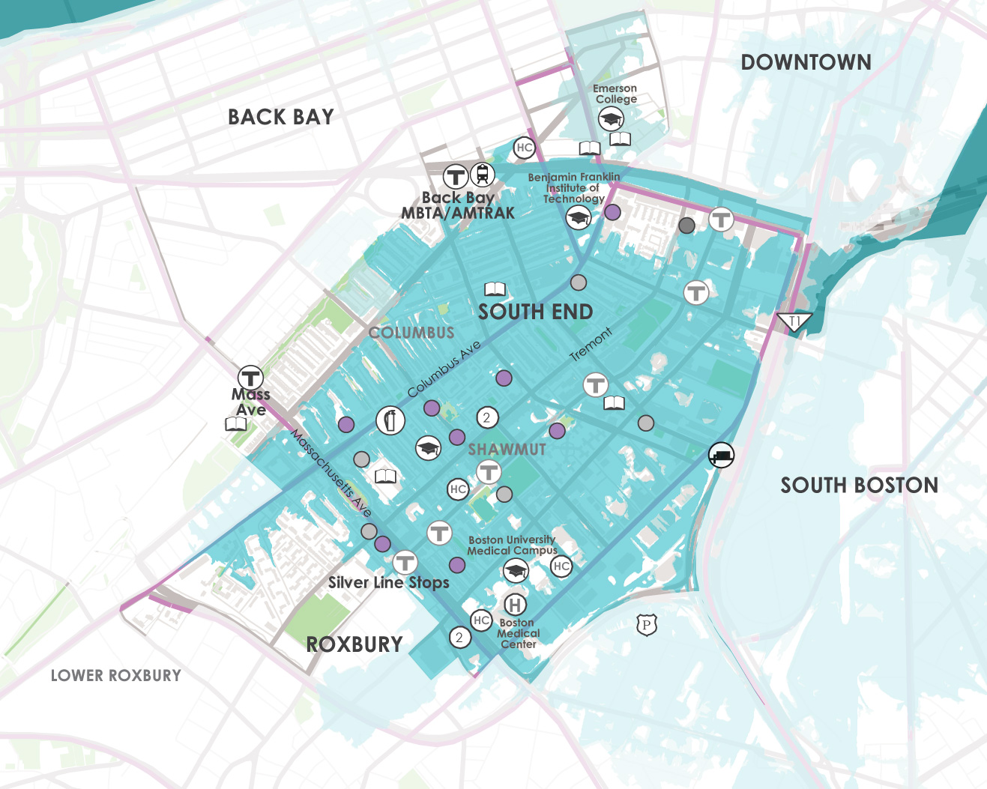
WHAT’S AT STAKE?
Community Assets and Flooding
36’’ sea level rise
2070s or LATER
South End
Late century, much of the Seaport is exposed to flooding at the average monthly high tide.
Notes:
The South End will have limited exposure to coastal flooding until the second half of the century, when very low-probability coastal storms occur (0.1 percent annual chance event). Exposure to these storms and the 1 percent annual chance event later in the century is significant due to a flood pathway through Fort Point Channel. Flooding is expected to be severe enough to flood portions of Roxbury.
Late in the century, the South End’s major roads and evacuation routes, in addition to the Orange and Silver Line routes in the neighborhood, will be exposed
to flooding, potentially compromising connectivity between Downtown and inland neighborhoods
In the South End, the Union Park pump station also may be exposed to high probability flood impacts later in the century (10 percent annual chance event).
Some of the area’s top economic industries, the Boston Medical Center and Boston University Medical Campus, will be exposed to late-century flooding.

Slide 7
WHAT’S AT STAKE?
People and Buildings Impacted by 1% Annual Flood Events
27,400
PEOPLE
3400 BUILDINGS
(Worth $15B)
0 PEOPLE
0 BUILDINGS
(Worth $0B)
2030+
2070+
Notes:
Residential buildings located along Chandler Street are mostly split-level,
three-story row houses and could experience significant flooding once waters are high enough to reach above grade.
The South End is in the top three exposed focus areas in Boston toward the end of
the century, with close to $200 million in annualized structure damage and related losses possible.

Slide 8

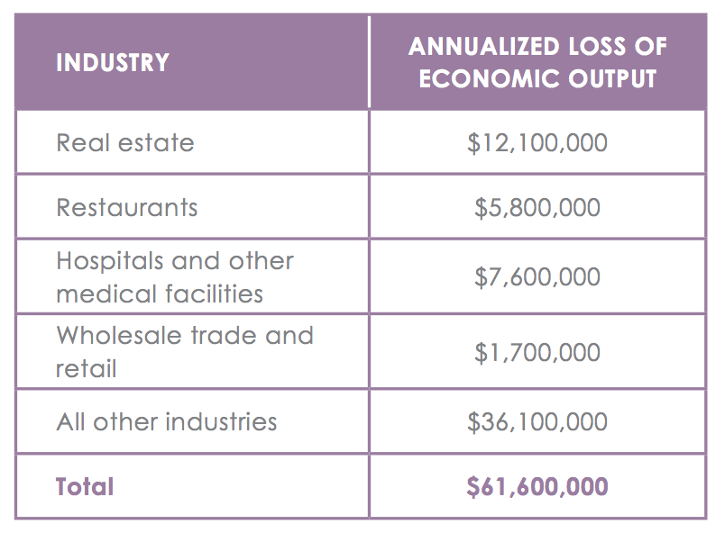
WHATS AT STAKE?
Economic Output and Jobs
$60M loss of economic output and 330 jobs per year form flooding by end of century.

Slide 9

SOUTH END IN ACTION
Prepared and Connected Communities
PROPOSED STRATEGIES:
Engage Bostonians as partners
Co-create neighborhood plans
Provide training for jobs in resilience

Slide 10
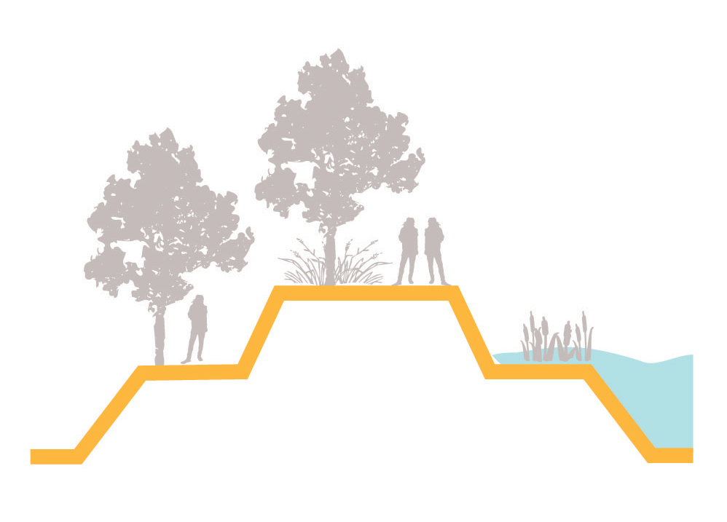
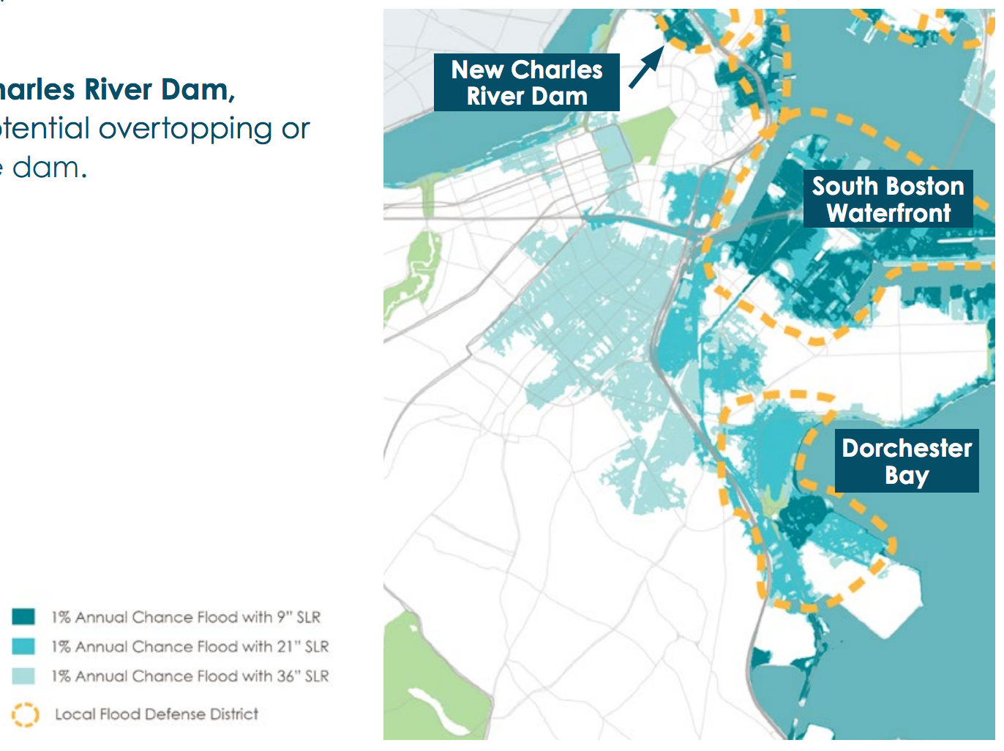
SOUTH END IN ACTION
Protected Shores
PROPOSED STRATEGIES:
Engage Bostonians as partners
Co-create neighborhood plans
Provide training for jobs in resilience
Near term protection is needed at Dorchester Bay, at the South Boston Waterfront, and the New Charles River Dam.

Slide 11
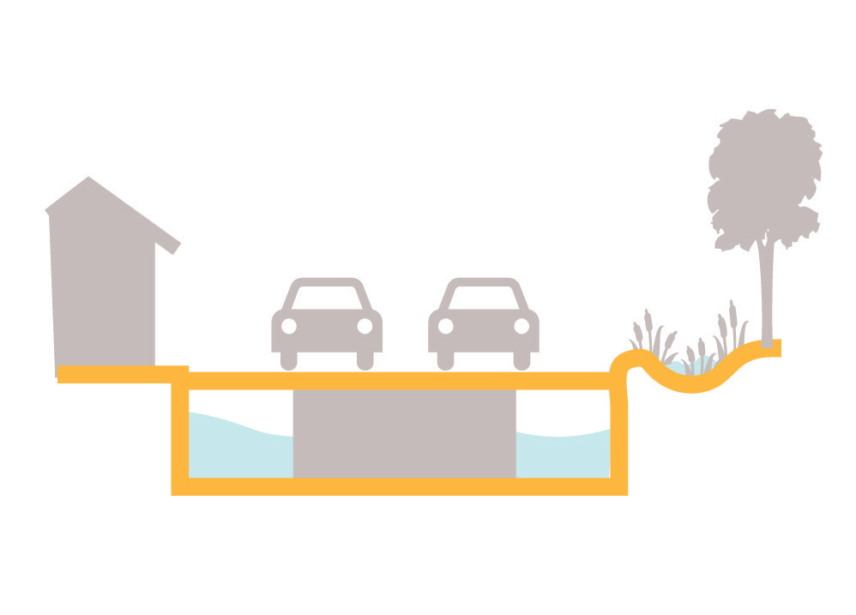

SOUTH END IN ACTION
Resilient Infrastructure
PROPOSED STRATEGIES:
Develop coordinated risk response plans for extreme weather events.
Support MTBA’s assessment of flooding impacts.
Explore options for a neighborhood energy grid along Massachusetts Avenue, Tremont Street and at Public Alley 706.

Slide 12

SOUTH END IN ACTION
Adaptive Buildings
PROPOSED STRATEGIES:
Update zoning and building codes and notify developers with projects in the pipeline to update plans.
Help building owners assess potential impacts and increase resilience.
Promote access to insurance.
Prepare municipal buildings to withstand change.
Notes:
Later in the century, there are a number of Boston Housing Authority developments that are expected to be exposed to coastal flooding, as well as access issues related to storm water flooding. These sites include Camden, Cathedral, Frederick Douglas, Hampton House, Lenox, Rutland/West Newton, Torre Unidad, and Washington Manor. The City will also prioritize adding backup power to emergency shelters that do not yet have power system redundancies. By later in the century, there will be a strong need for shelter capacity in the South End unless flood risk is mitigated, which will require all existing shelters to be prepared

