Slide 1
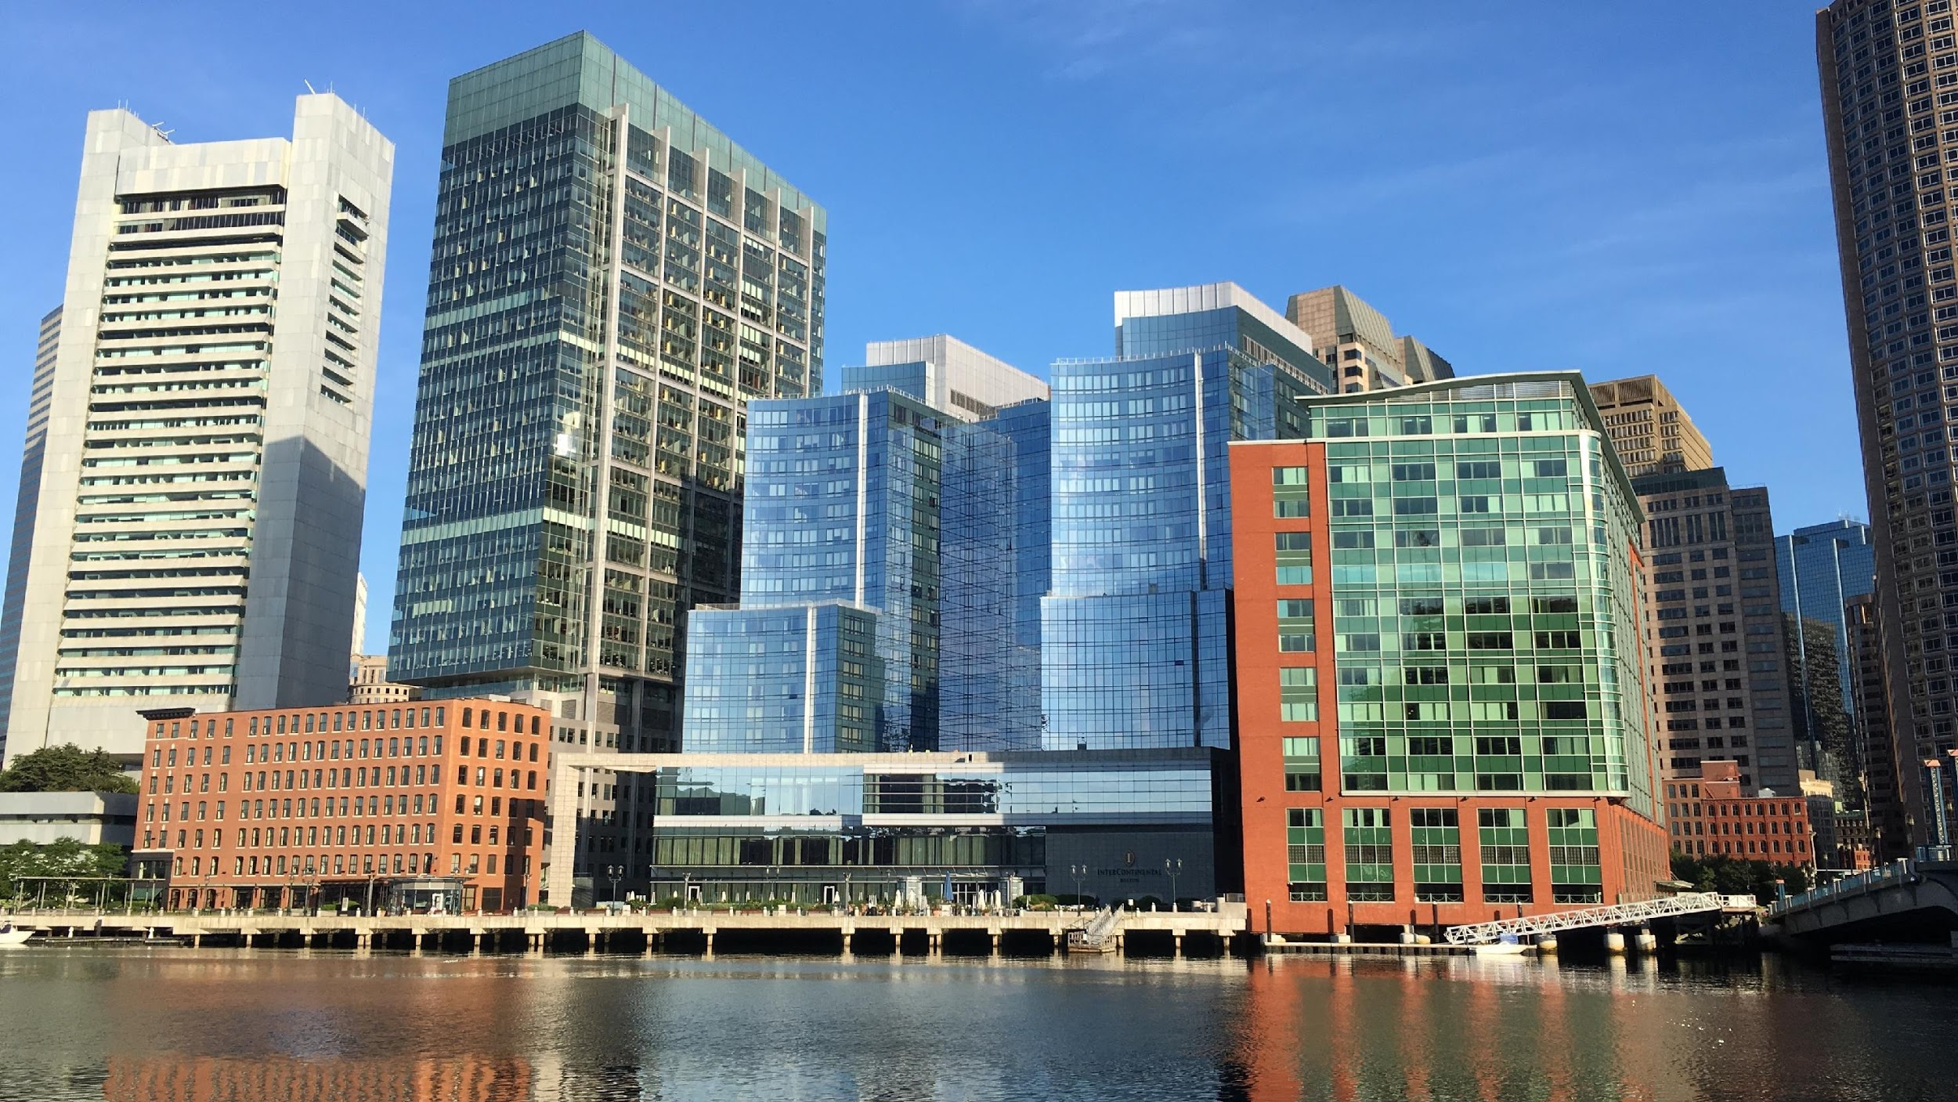

BYENVINI NAN
BOSTON PARE POU CHANJMAN
NAN KLIMA YO (CLIMATE READY BOSTON)
Notes:
Thanks! Great working with the City & GRC.
Thanks to those who attended the first design workshop but also who took the time to speak with me/send ideas post design workshop
*Some partners already giving climate talks & looking for the latest data/best way to present it. For others, presenting CRB findings not enough. Ready to engage with the city re: sector or neighborhood specific challenges and approaches.
Today – share basic climate leaders peer based outreach presentation & approach in am. In pm – enter a dialogue with the City re: ways to collaborate with CBOs re: resilience initiatives. Presentation & materials STILL IN DRAFT FORM – will be finalized post workshop.
This am – City re: update on CRB, how input from design session is being used, plans for Climate Leaders program moving forward.
Walk through materials
Hands on – time to adapt/revise
LUNCH
PM – Here from City re: efforts underway in E Boston. Walk through E Boston supplemental materials. Discuss collaboration opportunities. End at 3.
DIALOGUE DOC – presentation points, detailed messaging + tips – things you don’t need to lead with but may want in your back pocket.

Slide 2
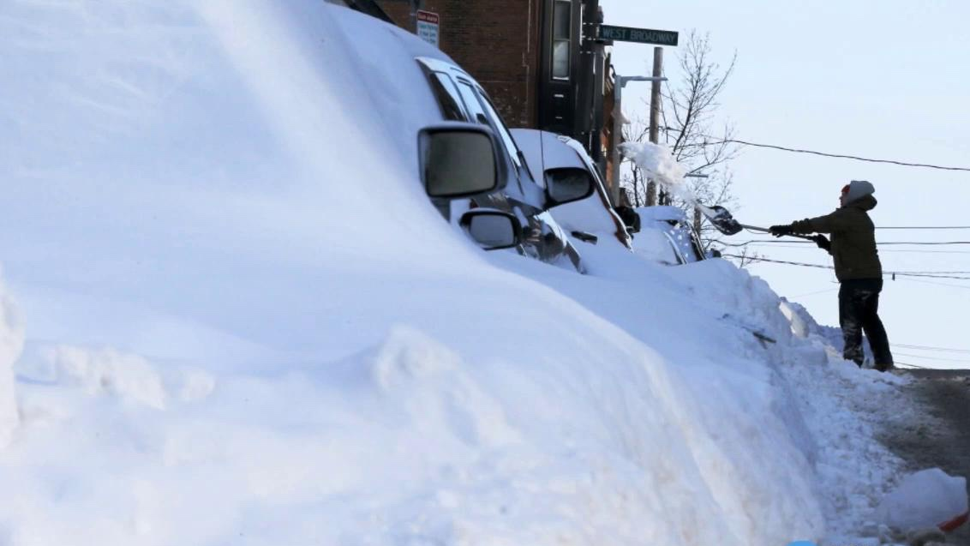
DEFI PREPARASYON POU CHANJMAN NAN KLIMA
OBJEKTIF PWOGRAM LIDÈ KLIMATIK CRB
Konprann enpak yo pi byen
Ankouraje manm kominote yo pou pwogrese nan estrateji rezistans yo
ENPAK YO LA A. LI LÈ POU N PREPARE NOU.
Notes:
GOAL – increase awareness & understanding. Involve community members, business etc. in developing response strategies. INPUT critical re: detailed understanding of how climate risks are playing out/impacting people’s lives + develop sensitive solutions.
Overall approach:
Concise & accessible
relevance of data versus science lesson
Position issue in the near term re: impacts people noticed & solutions underway to build on
Balance seriousness of what the data says with a can do attitude
People and equity – this is about Boston
START: Quick mention that in the last three years, worst heat wave/snow storms – places it in the present
Shift to purpose for the dialogue – understanding risks, relevance, solutions and how to help forward.

Slide 3
POUKI REZON NOU LA A?
VIZYON
BOSTON
PARE POU CHANJMAN NAN KLIMA YO
(CLIMATE READY BOSTON)
MEN SA K AP
TANN NOU
KISA KI KA
FÈT
Notes:
Outline plan for the dialogue.
Sequence – lead with the vision of what a CRB would be like
Then impacts re: the imperative followed by resilience strategies. Putting impacts into the middle of the vision and specific action steps makes climate impacts less overwhelming/fatalistic.
Some stakeholders you engage with might be interested in the detailed data however most want to know what does this mean for me and what can I do. Therefore, your job is not to perfectly convey all the details of the science, economics etc. but create a sense of relevance and possibility.

Slide 4
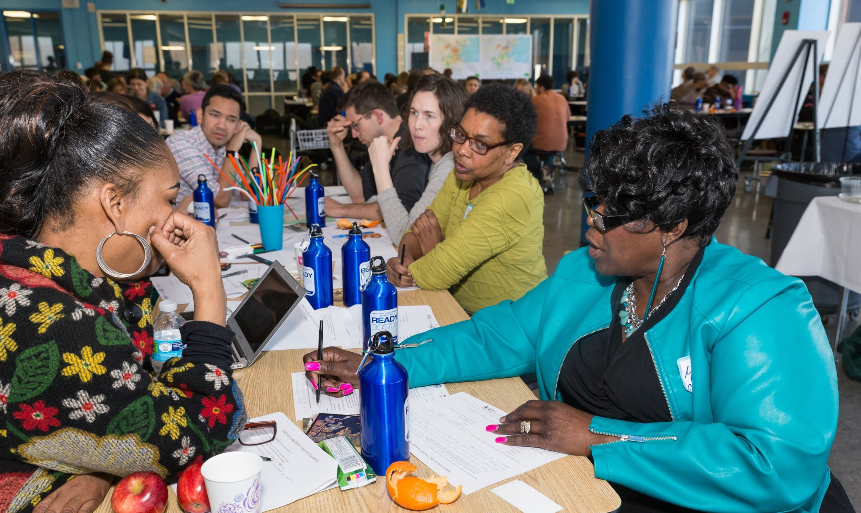



TRAVAY ANSANM
GWOUP KONSÈY K AP
FÈ RECHÈCH NAN BOSTON
Boston Pare pou Chanjman nan Klima yo (Climate Ready Boston), gen kòm objektif pou li prepare Vil la pou enpak chanjman klimatik yo.
https://www.boston.gov/environment-and-energy/climate-ready-boston
Notes:
Details on what the CRB project is all about. The people you are engaging may not need much detail however others might need the context, information on the partners & how the report was done. MAIN POINT – City’s leadership critical however many players coming together to ready Boston.

Slide 5
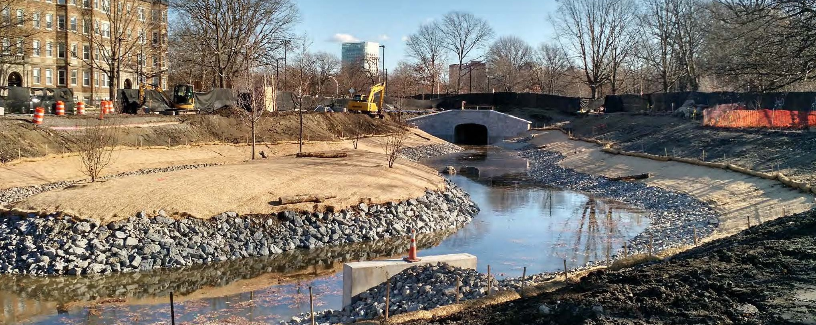
YON BOSTON KI PARE POU CHANJMAN NAN KLIMA YO
MEN KISA
N AP
DEFANN
Restorasyon RIVYÈ PLAT KI GEN LABOU pwoteje kont inondasyon epi an menm tan yo bay plis aksè a espas ki louvri (espas an plennè) epi yo pi bèl tou.
Yo ankouraje devlopman entelijan ak konstriksyon adapte, yo ogmante kalite lavi a, epi yo prepare Boston pou lavni.
BOSTON PARE POU CHANJMAN NAN KLIMA YO (CLIMATE READY BOSTON)
Notes:
https://media.defense.gov/2015/Dec/23/2001328586/-1/-1/0/151223-A-KF207-002.JPG
The VISION:
Giving a sense of the benefits/what’s possible with a CRB. Orienting to local examples (i.e. Muddy Flats) which is about quality of life (improved access to open space, beauty and flood protection at the same time).
CAN REPLACE WITH A NEIGHBORHOOD OR SECTOR SPECIFIC EXAMPLE.

Slide 6
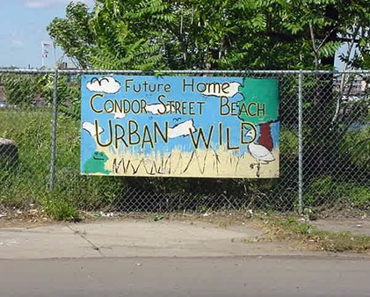
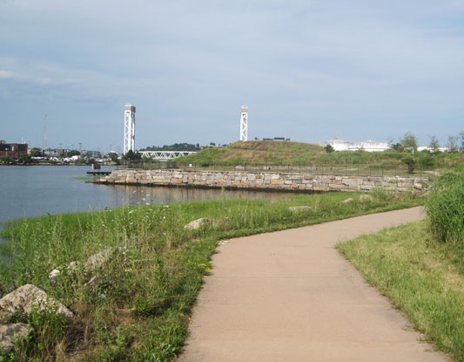
YON BOSTON KI PARE POU CHANJMAN NAN KLIMA YO
Te gen yon epòk, Condor Urban Wild Park se te yon kote toksik, men kounyeya moun ka ale sou litoral la epi l pwoteje kont inondasyon.
Alèkile katye yo amelyore, gen plis espas ki louvri (an plennè) epi litoral la amelyore tou.
BOSTON PARE POU CHANJMAN NAN KLIMA YO (CLIMATE READY BOSTON)
Notes:
Improving areas of the city is a core benefit (avoid “co-benefits) and addressing equity.
E Boston example re: Condor Urban Wild restoration (cleaning up toxic, unused area + access to shore + flood protection/protected shoreline)

Slide 7
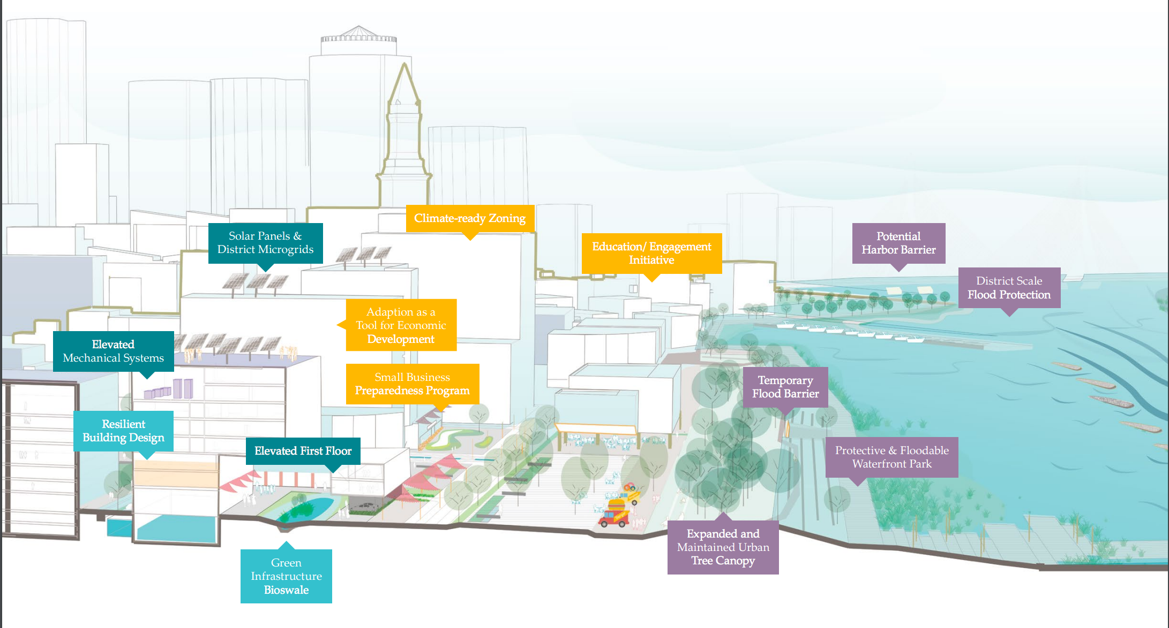
YON BOSTON KI PARE POU CHANJMAN NAN KLIMA YO
Zòn ki pare pou chanjman klimatik
Pano Solè ak Sistèm Mikwo-Rezo nan Distri a
Zòn Potansyèl pou Mete Baraj nan Pò a
Inisyativ Edikasyon/ Angajman
Pwoteksyon kont inondasyon onivo Distri a
Adaptasyon kòm Mwayen Devlopman Ekonomik
Sistèm Mekanize yo Elve
Pwogram Preparasyon pou Ti Biznis
Baraj Tanporè Kont Inondasyon
Konsèp Bilding Rezistan
Premye Etaj yo Elve
Pak sou Bòdmè ki Pwoteje e ki Inondab
Ekran Vejetal Iben yo Agrandi ak Antretni
Enfrastrikti Ekolojik ki gen Basen Byolojik
Sistèm transpò, enèji ak lòt sistèm kritik ki solid. Bilding ki sekirize e ki konfòtab.
BOSTON PARE POU CHANJMAN NAN KLIMA YO (CLIMATE READY BOSTON)
Notes:
Quality of life & equity key benefits but CRB also means – strong, reliable infrastructure + buildings.

Slide 8

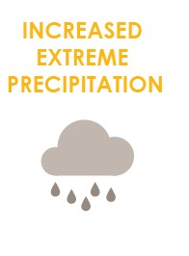
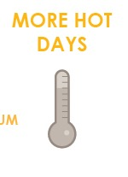
GEN ENPAK KI RIVE
PLIS GWO PRESIPITASYON LAPLI AK LANÈJ
NIVO KANTITE DLO LANMÈ A MONTE PI WO
PLIS JOU KI FÈ CHO
Gwoup Konsèy k ap Fè Rechèch nan Boston
Notes:
Once you have painted a vision of a desirable CRB future, shift to the imperative – not just good to do but must do given what is being faced.
Good to emphasize “SCIENTISTS AGREE” as we know this can be a point where we lose people.
Notes include re: reduction of cold days but a bit harder to get across why fewer cold days are a bad thing to most people.

Slide 9

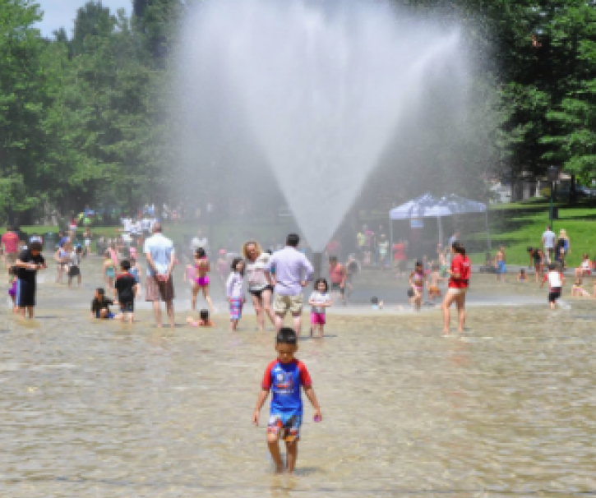
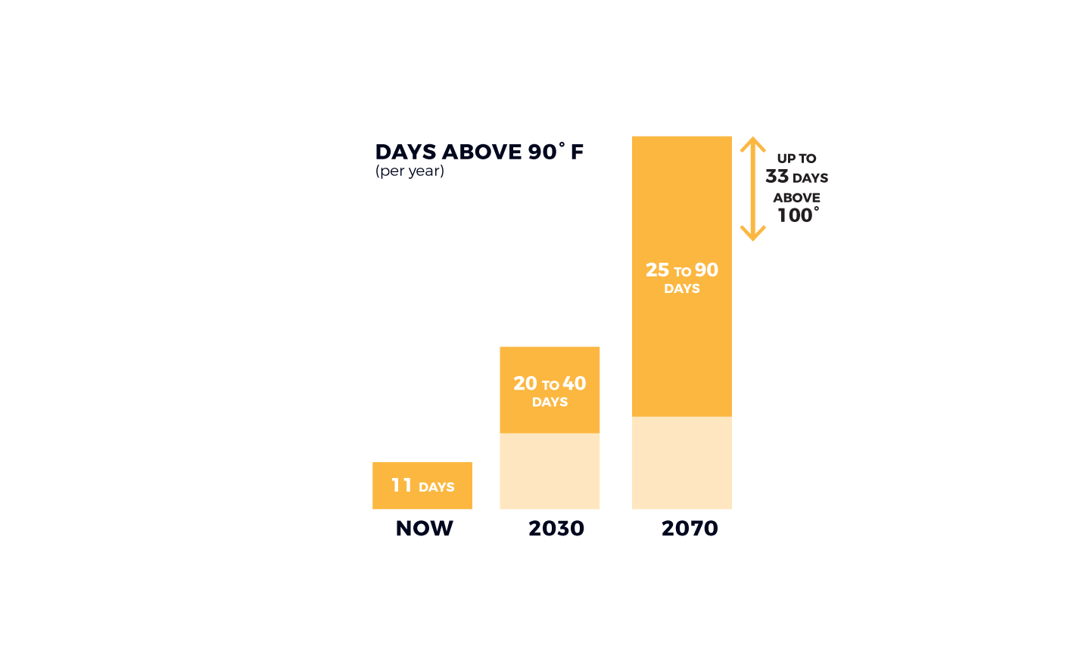
PLIS JOU KI FÈ CHO
Chalè nan sezon ete nan Boston ka menm jan ak Washington, D.C nan 50 lane, epi l ka tankou Birmingham Alabaman 80 lane.
KANTITE JOU TANPERATI A PI WO PASE 90˚ F
(pa ane)
JISKA 33 JOU KI PI WO KE 100˚
25 a 90
JOU
20 a 40
JOU
11 JOU
現在
Kounyeya
Notes:
Heat – looking again for the relevant examples I.e. talking about how many days above 90 now versus what’s in store for the future. Personalize it.
CAN ALWAYS SWAP OUT PHOTOS – BUT MAKE SURE YOU HAVE PEOPLE IN THEM – AVOID scary images.

Slide 10

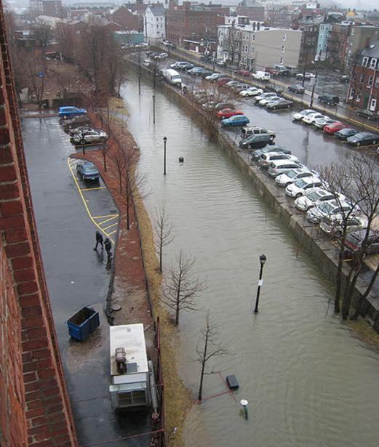
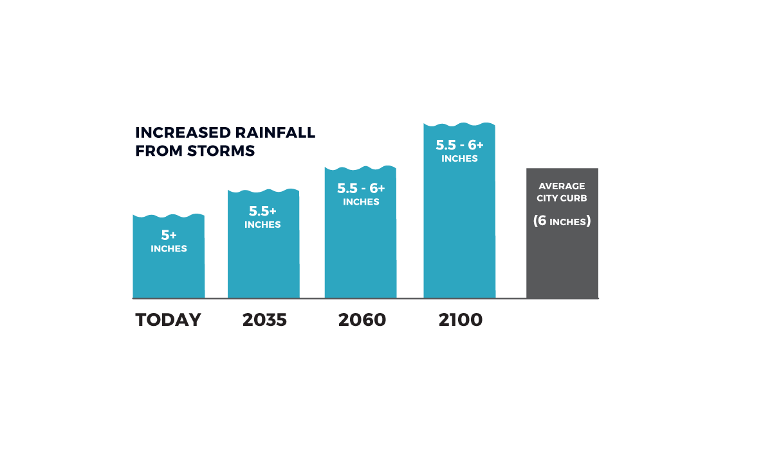
PLIS GWO PRESIPITASYON LAPLI AK LANÈJ
Disi lan 2060, gwo presipasyon yo ka bese a plis ke 6 pous dlo nan 24è, ki reprezante yon wòs nan koub mwayèn yon vil, epi 20% plis pase sa nou resevwa kounyeya.
Plis Lapli ki Tonbe Akòz Move Tan
Pous
Average City Curb: Bòdi Mwayèn Vil la
(8Pous)
Pous
Pous
Pous
Jodiya
Notes:
Providing comparisons that people can relate to – as high as the average city sidewalk/ 20% more than what we are used to.

Slide 11

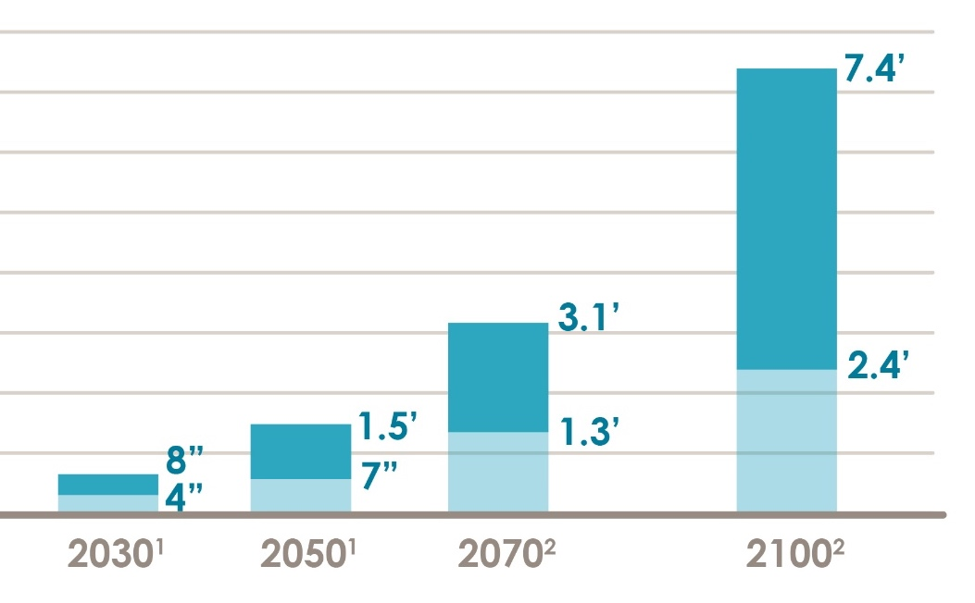

NIVO KANTITE DLO LANMÈ A MONTE PI WO
PWOJESKYON RELATIF POU BOSTON SOU NIVO LANMÈ A K AP MONTE
San yo pa diminye emisyon gaz yo, ap gen omwen 3 pye nan nivo lanmè a kap monte petèt pandan dezyèm mwatye syèk la.
6.11’
KEVIN GARNETT
Notes:
Don’t worry about explaining all the scenarios, possible flooding ranges & potential timelines. Easy to get lost in it and again, most don’t need to know.
Do need to know – SLR happening already + will make flooding worse as time goes on which means preparing now.
CRB uses inches of SLR in maps – important for technical but showing where flooding would come on your body provides an easy to understand reference. i.e. I’m only 5’3” so 3ft of flooding would be higher than my waist.

Slide 12
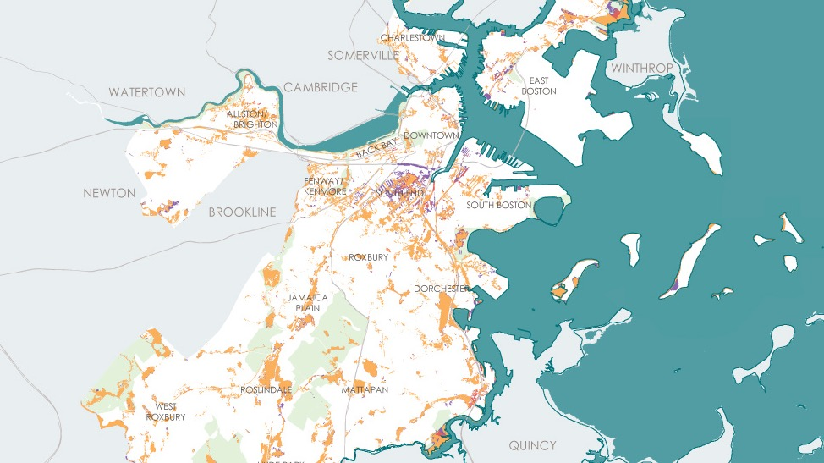
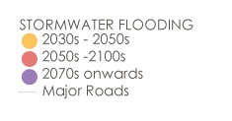
INONDASYON DLO GWO LAPLI
Inondasyon Gwo Lapli
Wout Prensipal
Notes:
ALREADY AN ISSUE.
Increase prec + SLR make worse
Like heat, impacts are city wide as all parts of the city have some locations at risk from increased exposure
Terminology for flooding events is confusing. Don’t worry about it. All you need to know is:
High probability flooding events (10% annual chance)
Low probability (1%)
Rare but major (0.1%)

Slide 13
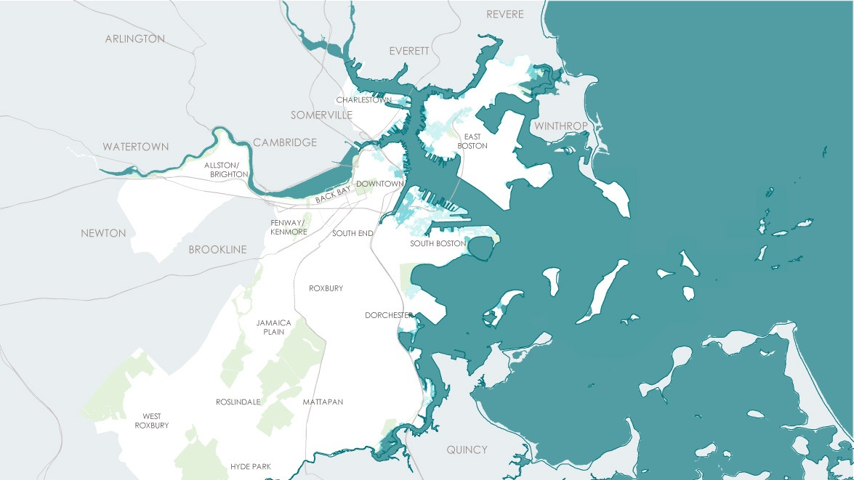
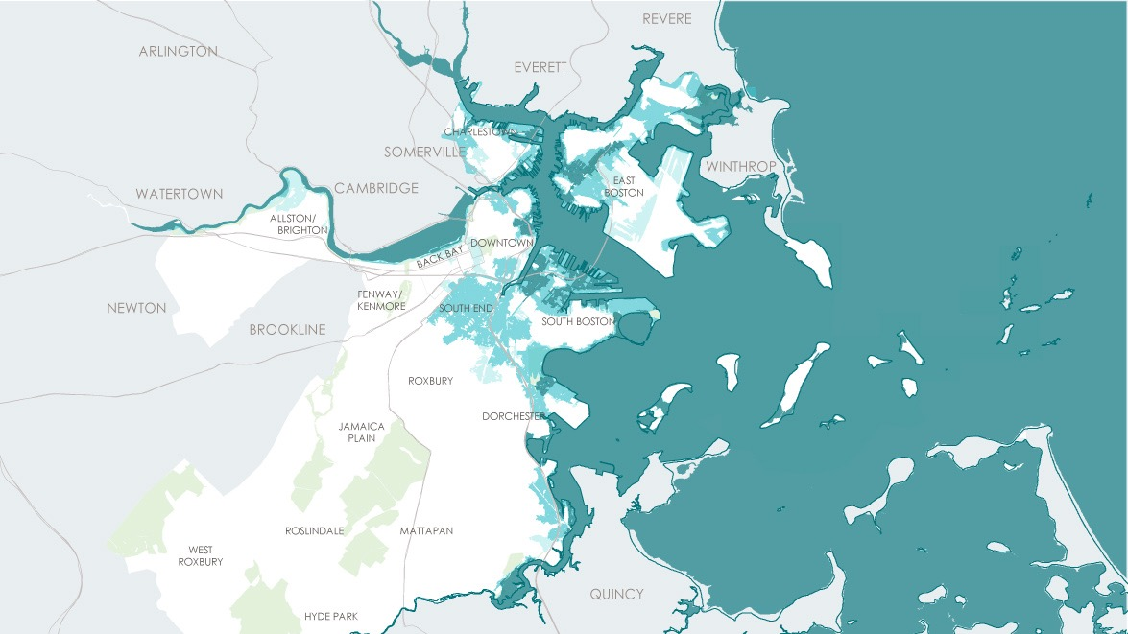
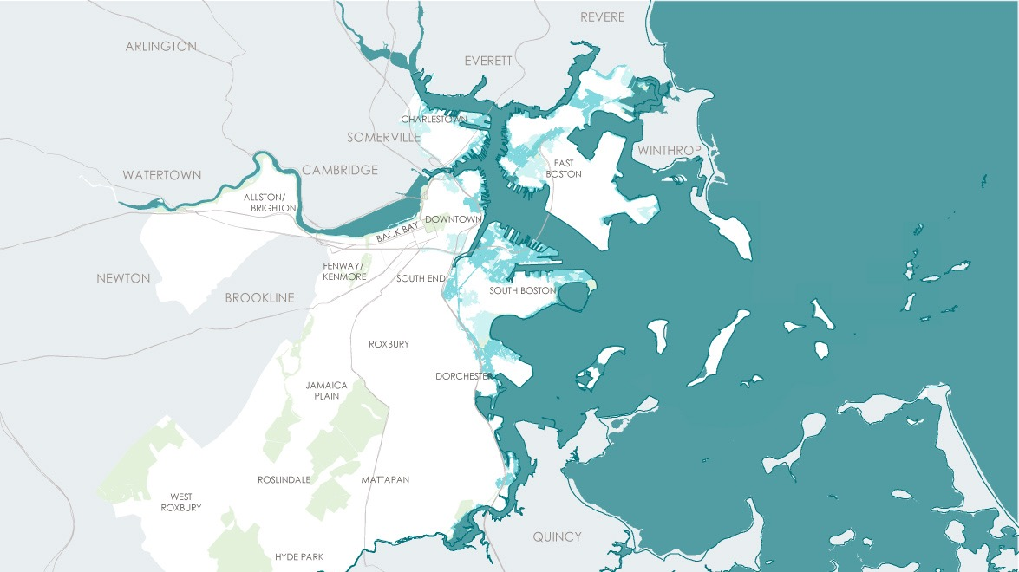
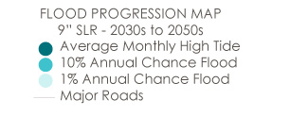
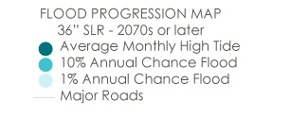
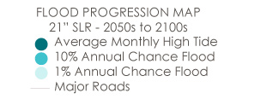
INONDASYON SOU LITORAL LA AK NAN RIVYÈ YO
9” SLR – 2030s oswa apre
36” SLR – 2070s oswa apre
21” SLR – 2050s oswa apre
KAT JEWOGRAFIK KI MONTRE PWOGRESYON INONDASYON AN
NIVO LANMÈ A AP MONTE 36” – NAN LANE 2070 YO OSWA APRE
Mwayèn Pi Wo Nivo Lamare Monte Chak Mwa
10% Chans Inondasyon Chak Ane
1% Chans pou Wout Prensipal yo Inonde Chak Ane
Wout Prensipal
Notes:
SLR – Don’t get bogged down by inches or years. NEAR TERM – MID Term (or mid-century) – later in the century.
Near term – South Boston, East Boston, Charlestown and Downtown
Mid Century – most waterfront neighborhoods + into Dorchester
Late Century – vast parts of the city + South End & along Charles River
Points to need to act now because range not locked in – dependent on carbon reductions. Act now while there is more flexibility and costs can be managed.

Slide 14






KI DANJE KI GENYEN?
Moun ak Bilding Ekspoze a 1% Risk Inondasyon
12,000 BUILDING
(Vo $85B)
18 000
MOUN
85 000
MOUN
2,000 BILDING
(VO $20B)
2030+
2070+
Notes:
Lots of details re: impacts to people, building and value, and economy.
Can’t cover it all therefore 1% storms chosen as they are the mid scenario
Lead with this but customize per who you are engaging with - i.e. pull out social vulnerabilities & economics.

Slide 15
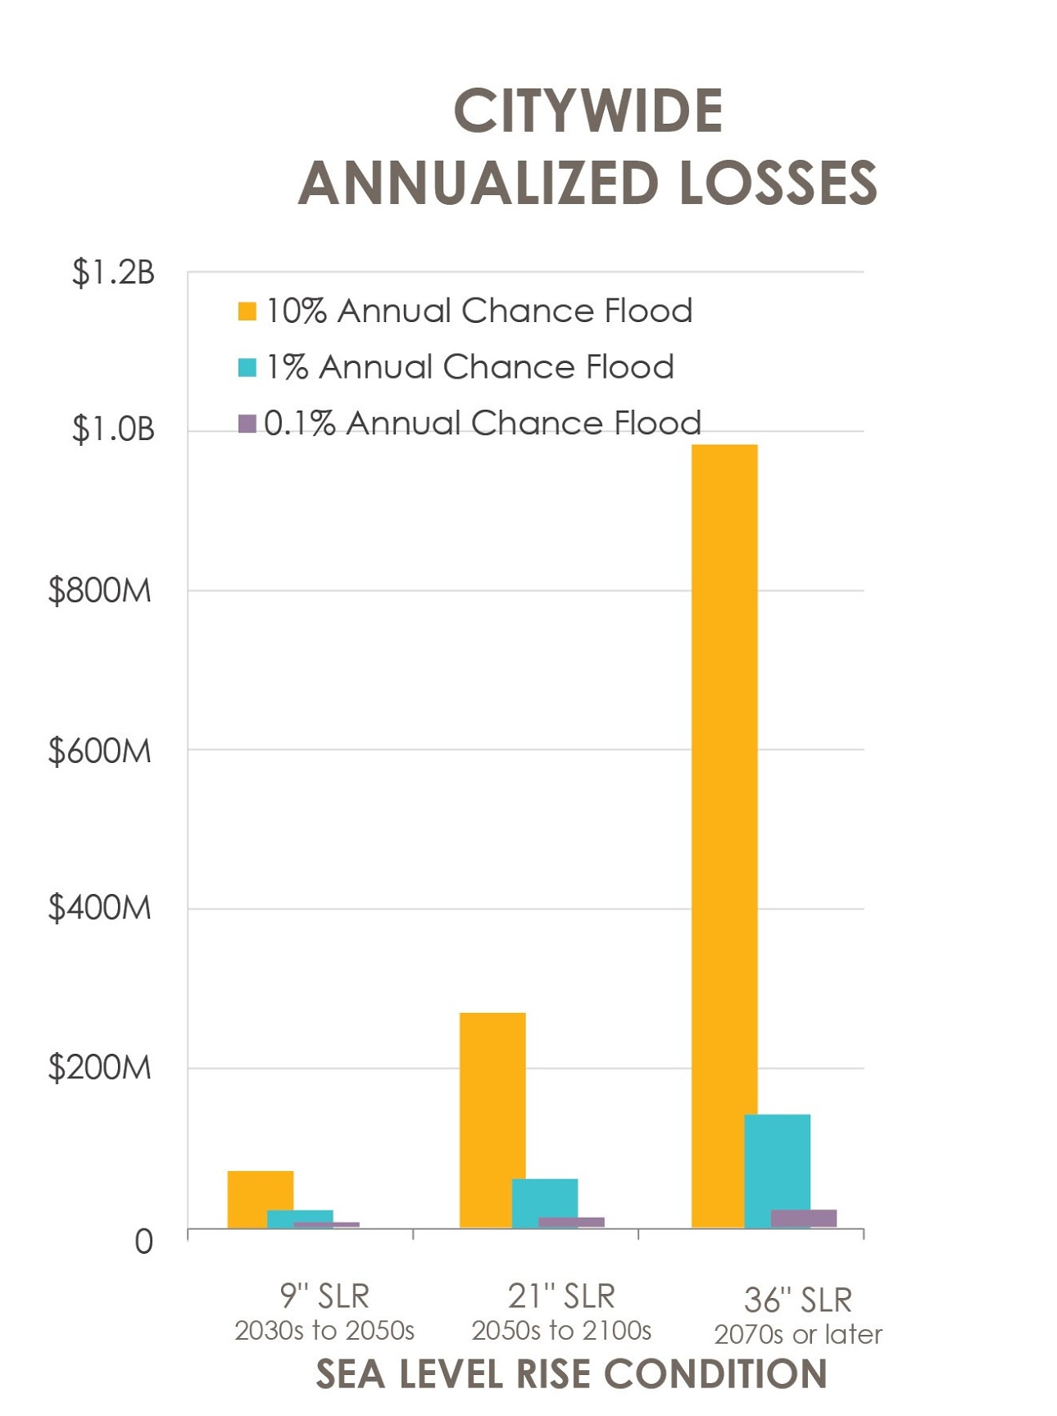
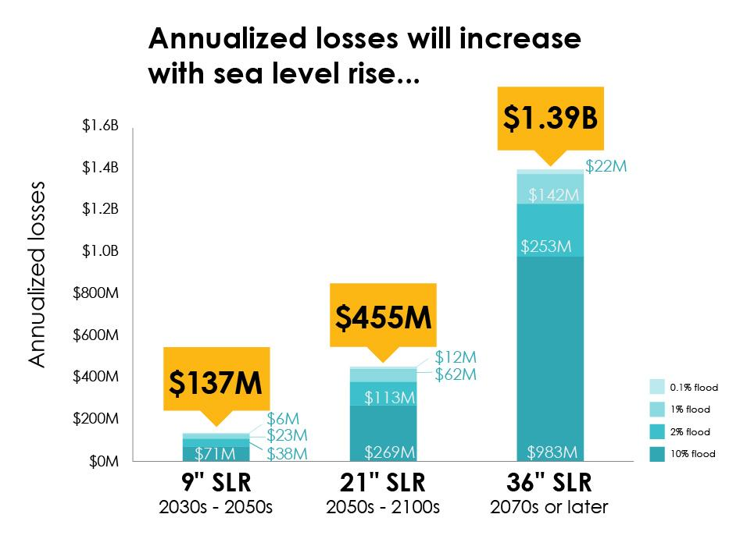
EKONOMI
PÈT ANYÈL TOUPATOU NAN VI LA
Pèt Anyèl yo pral ogmante
ak nivo lanmè a ki monte
10% Chans Inondasyon Annyèl
1% Chans Inondasyon Annyèl
0,1% Chans Inondasyon Annyèl
Pèt Anyèl
0.1 % inondasyon
1% inondasyon
2% inondasyon
10% inondasyon
NLM 9”
Lane 2030 –
2050 yo
NLM 21”
Lane 2050 –
2100 yo
NLM 36”
Lane 2070 yo oswa pare
NLM 9”
Lane 2030 –
2050 yo
NLM 21”
Lane 2050 –
2100 yo
NLM 36”
Lane 2070 yo oswa pare
Majorite depans yo pase nan domaj estriktirèl ak sa yo pèdi poutèt domaj.
SITYASYON NIVO LANMÈ MONTE
Notes:
Lots of details re: impacts to people, building and value, and economy.
Can’t cover it all therefore 1% storms chosen as they are the mid scenario
Lead with this but customize per who you are engaging with - i.e. pull out social vulnerabilities & economics.

Slide 16

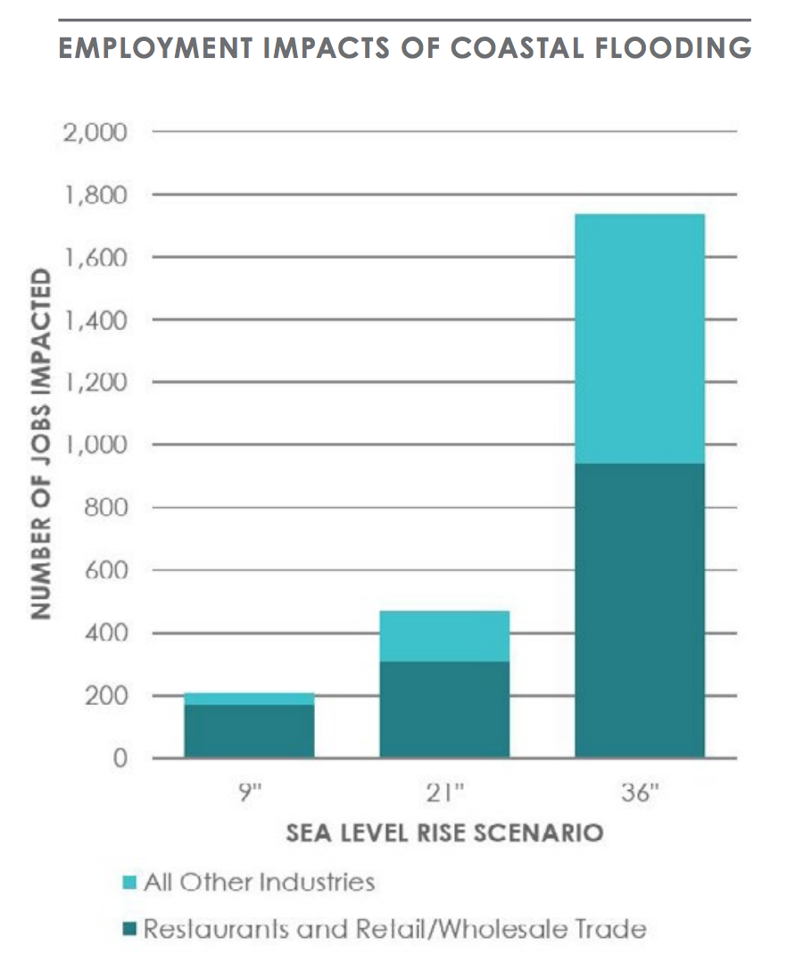
EKONOMI
ENPAK SOU TRAVAY INONDASYON LITORAL GENYEN
KANTITE TRAVAY KI AFEKTE
Restoran, imobilye, lavant an gwo e an detay, ak endistri transpò, se yo ki pi an danje, ansanm ak moun ki touche ant salè ba ak salè mwayen nan biznis ki bloke yo.
SENARYO KOTE NIVO LANMÈ MONTE
Tout Lòt Endistri yo
Restoran ak Biznis ki Vann an Gwo e an Detay
Notes:
Lots of details re: impacts to people, building and value, and economy.
Can’t cover it all therefore 1% storms chosen as they are the mid scenario
Lead with this but customize per who you are engaging with - i.e. pull out social vulnerabilities & economics.

Slide 17
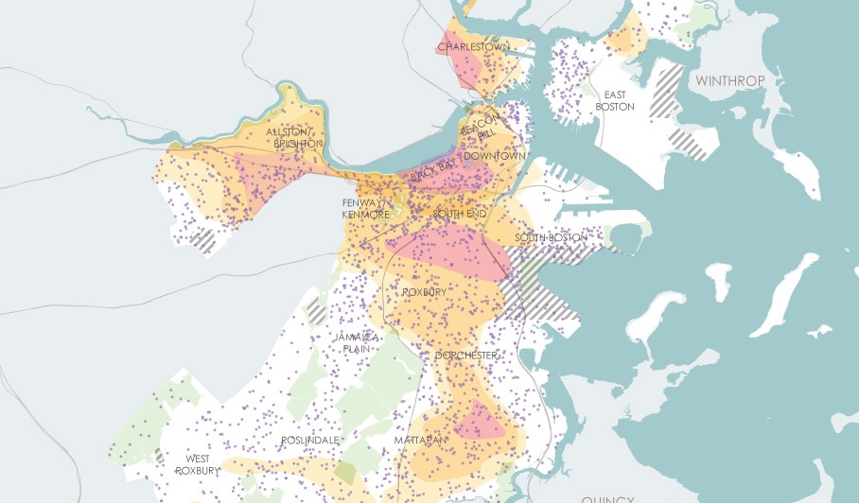
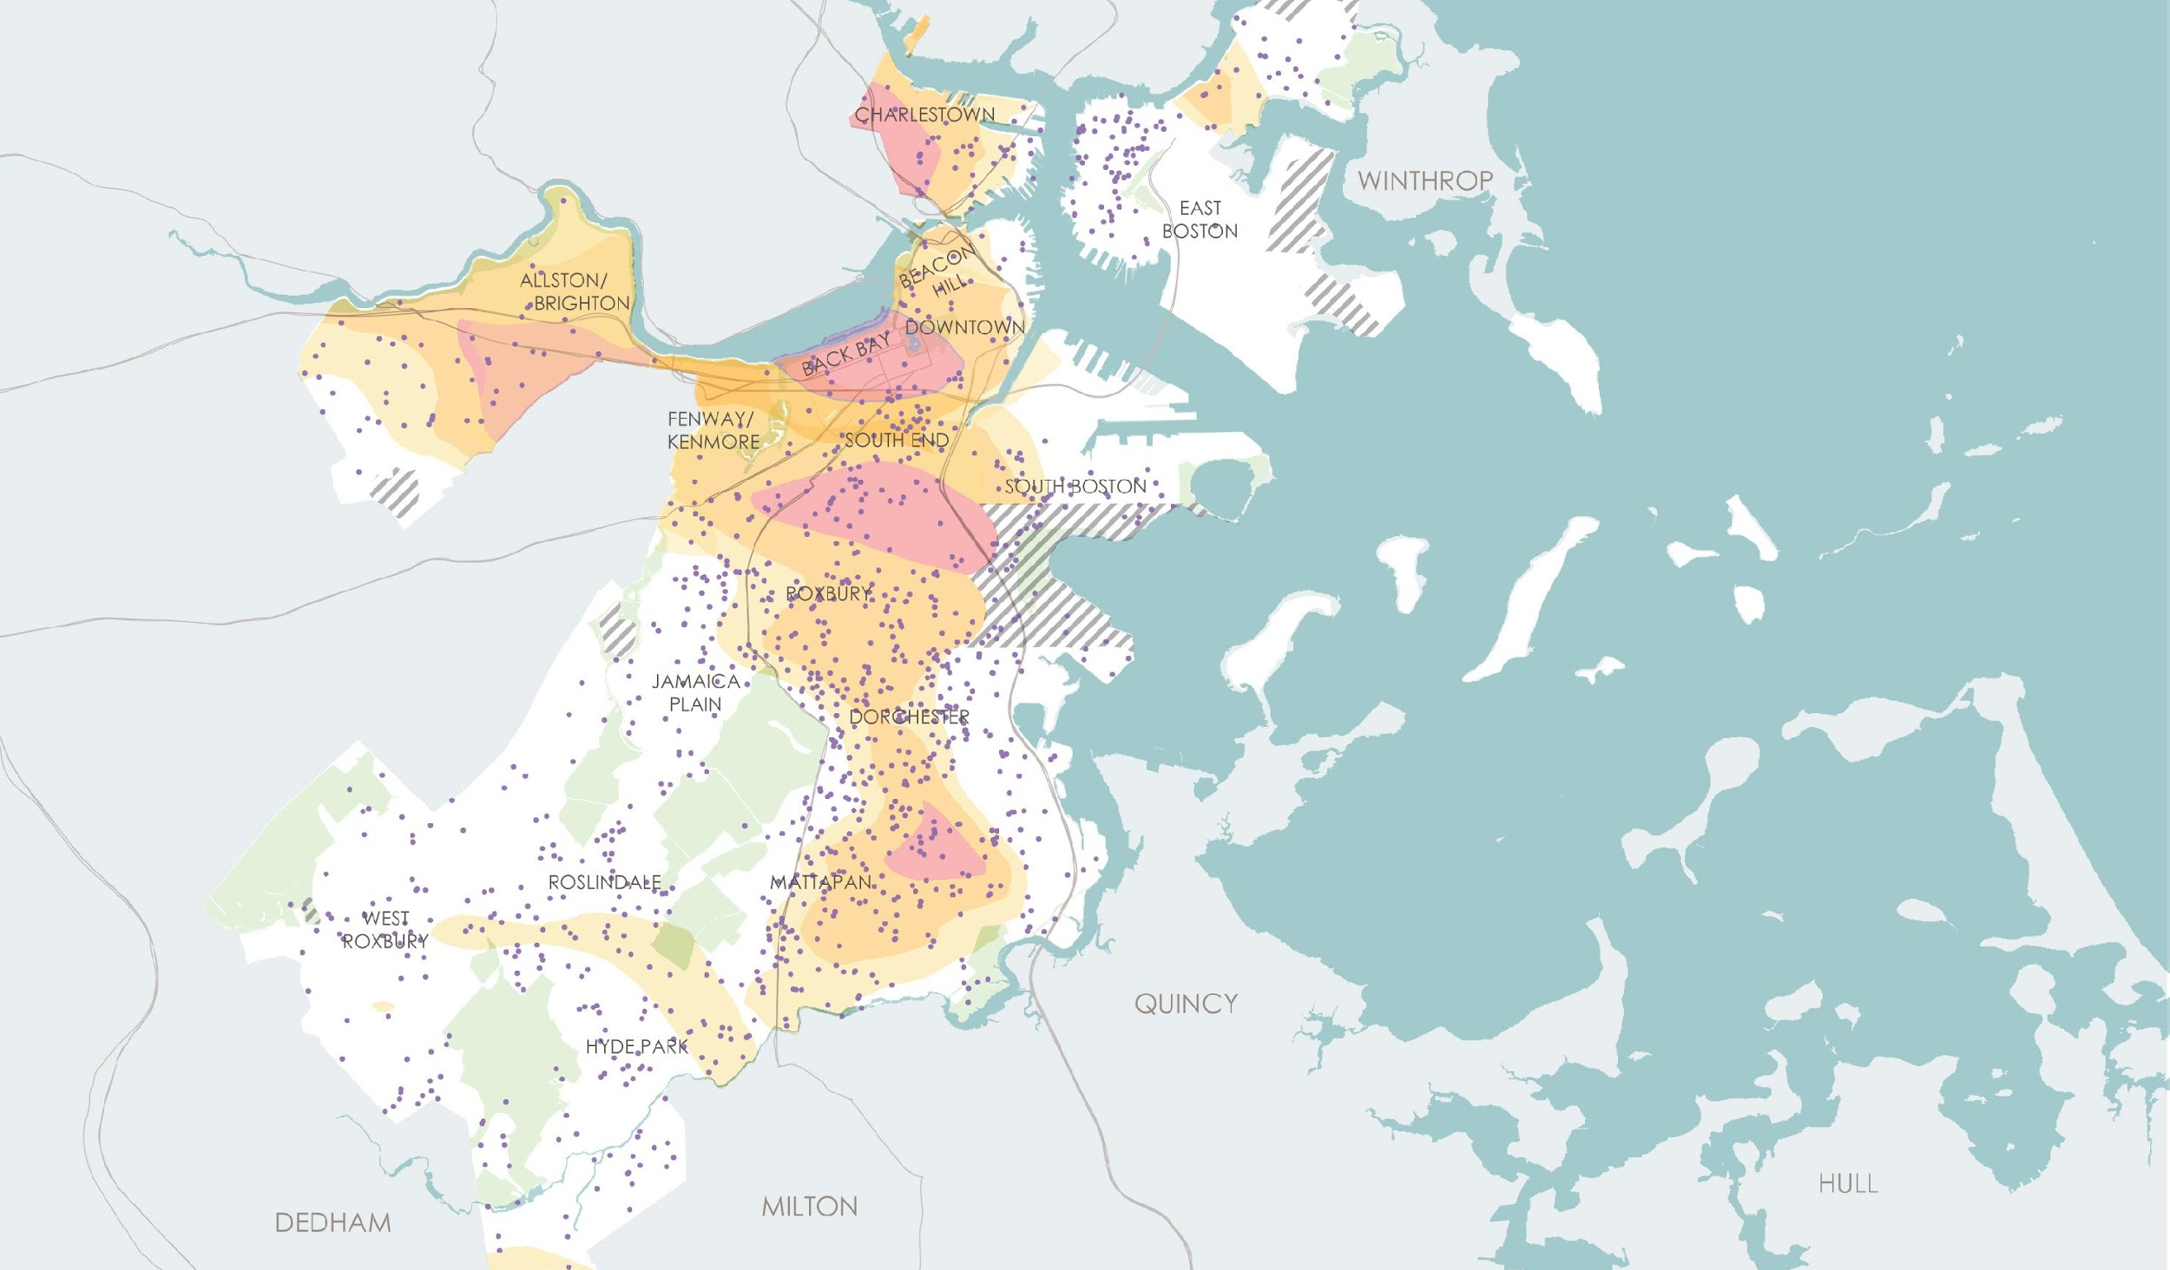
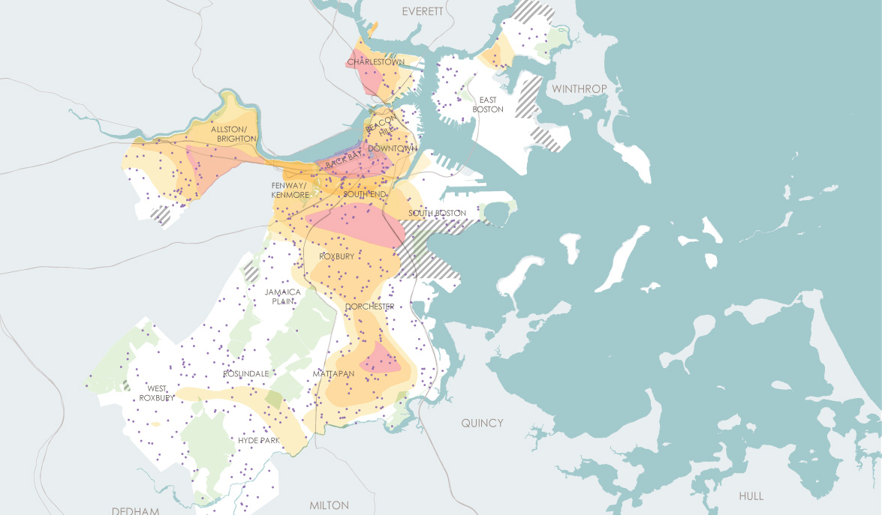
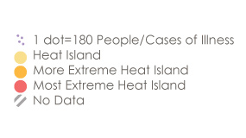
ZILE ANBA CHALÈ
Children and Heat Island Exposure
Medical Illness and Heat Island Exposure
Granmoun Aje ki Ekspoze a Ilo Chalè
Granmoun ki Pi Aje ak
Zile Anba Chalè
1 pwen = 180 Moun/Ka maladi
Zile Chalè
Zile Chalè ki Pi Ekstrèm
Zile Chalè ki Pi Ekstrèm Lontan
Pagen Done

Slide 18
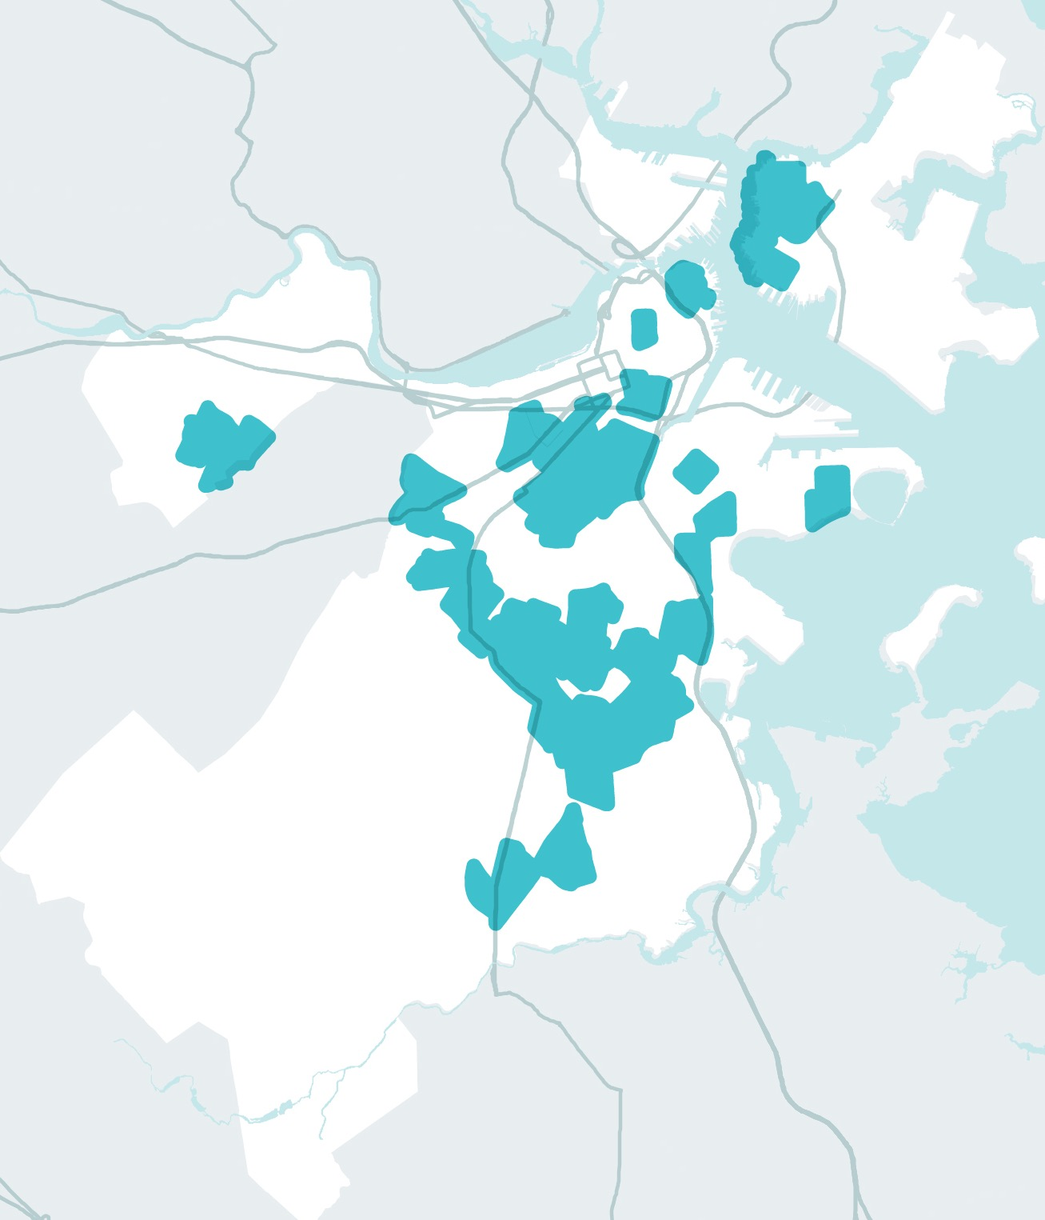
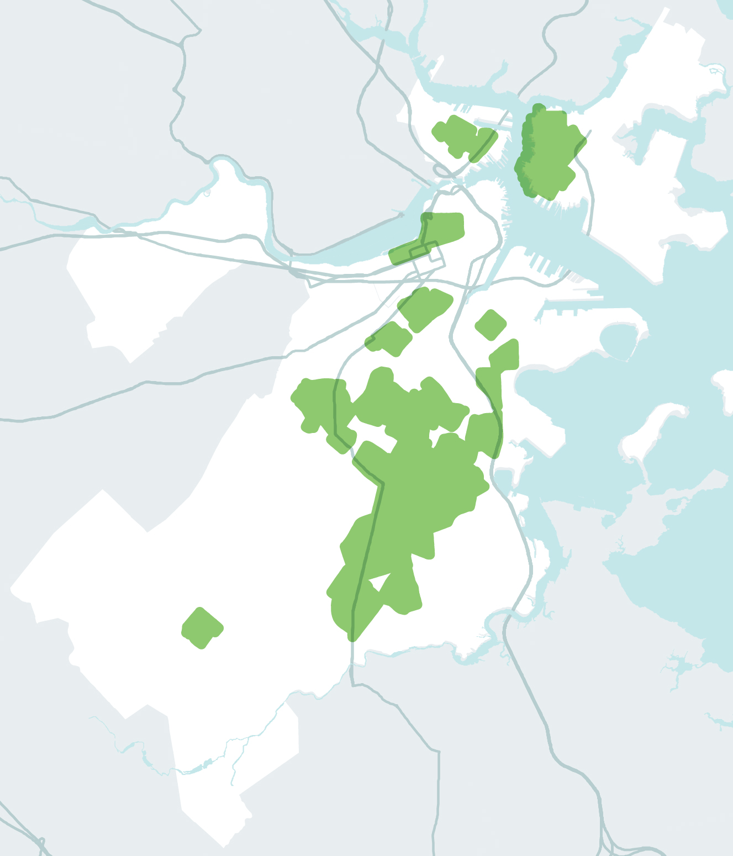
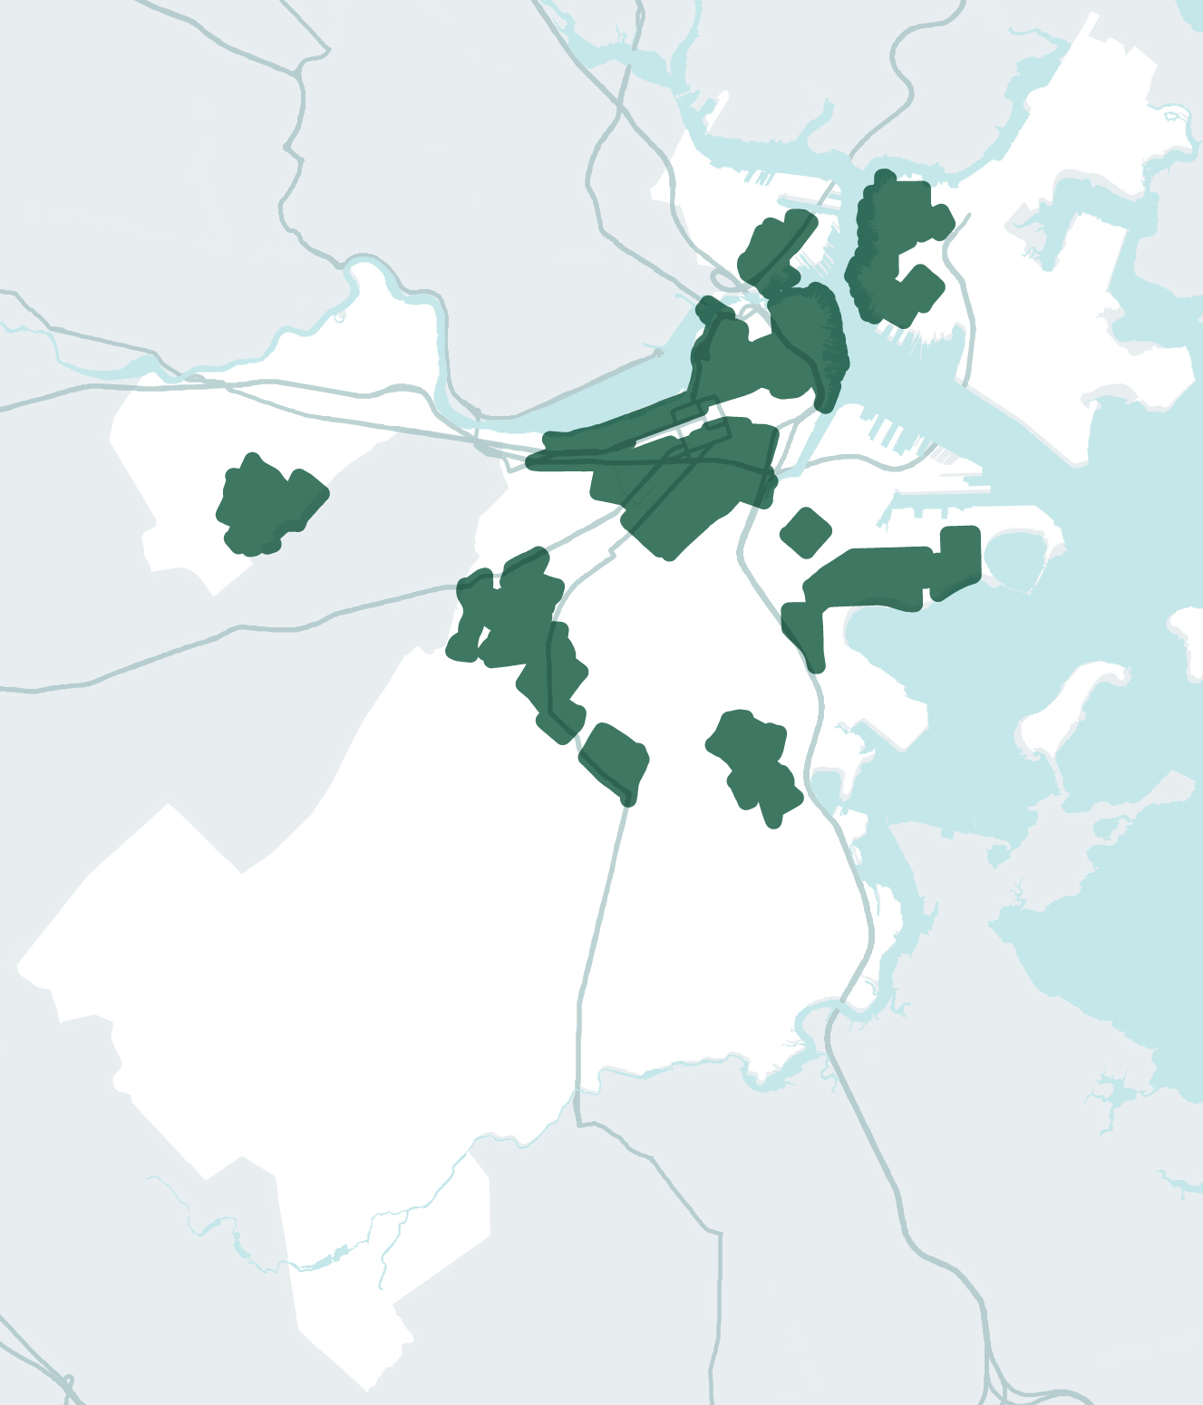
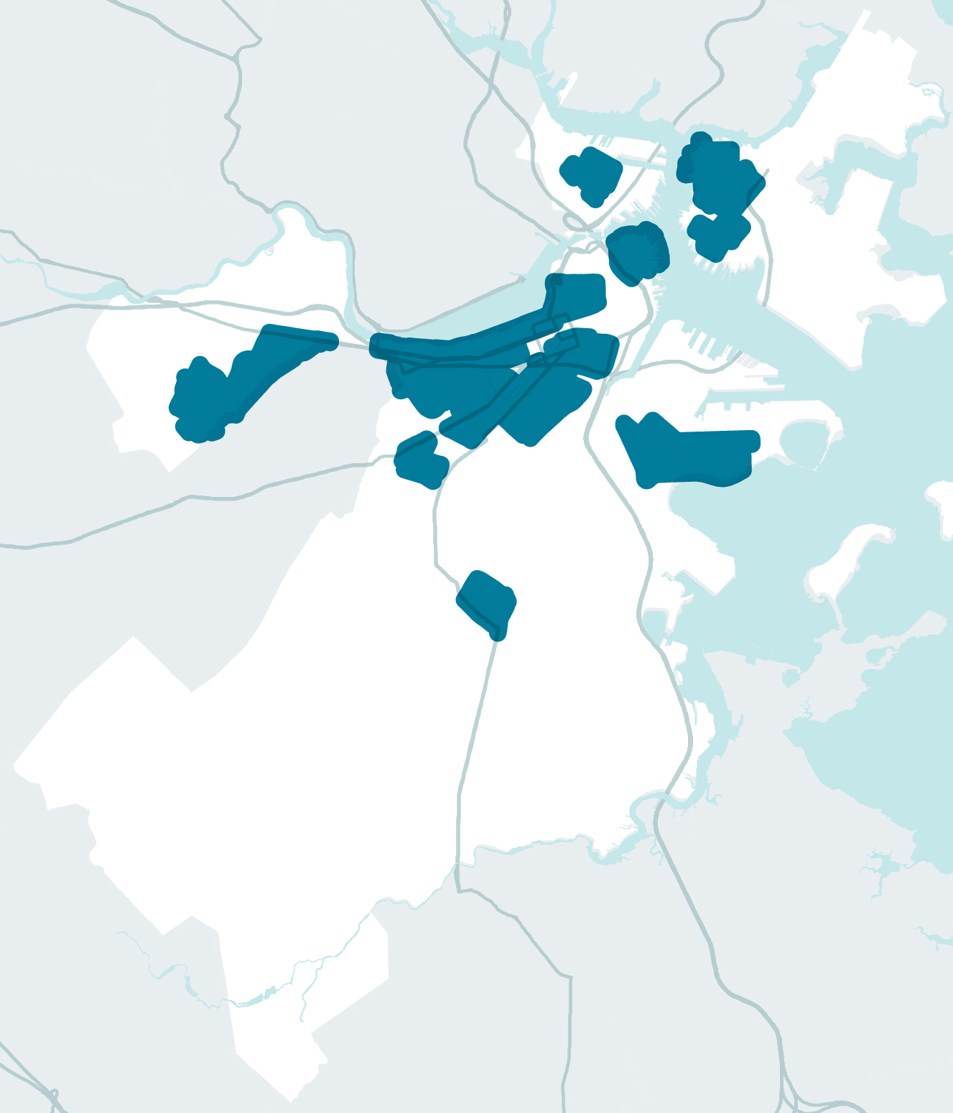
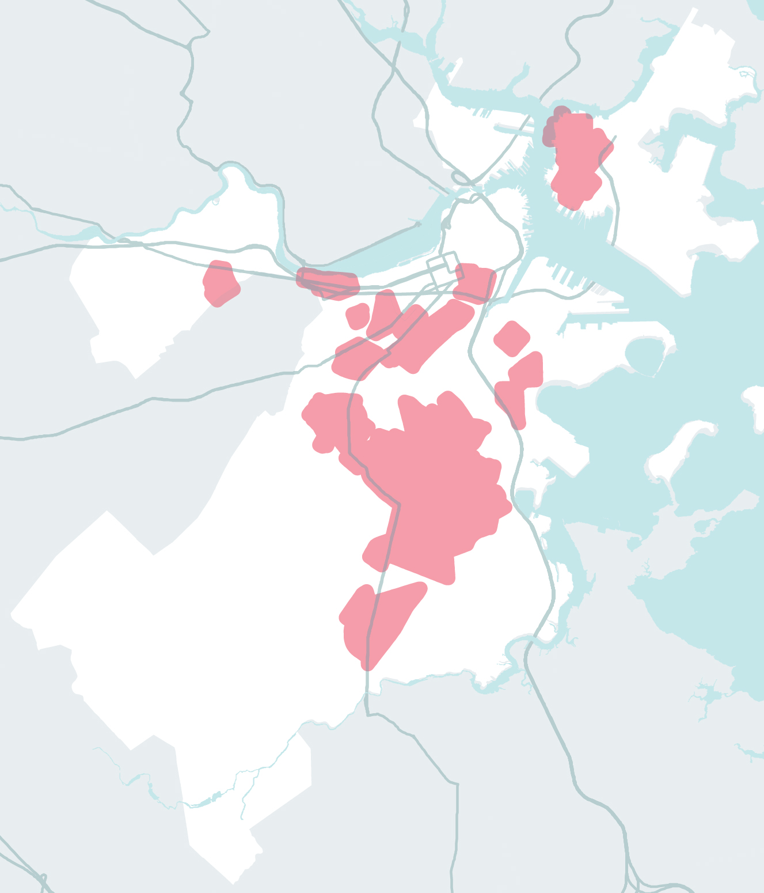
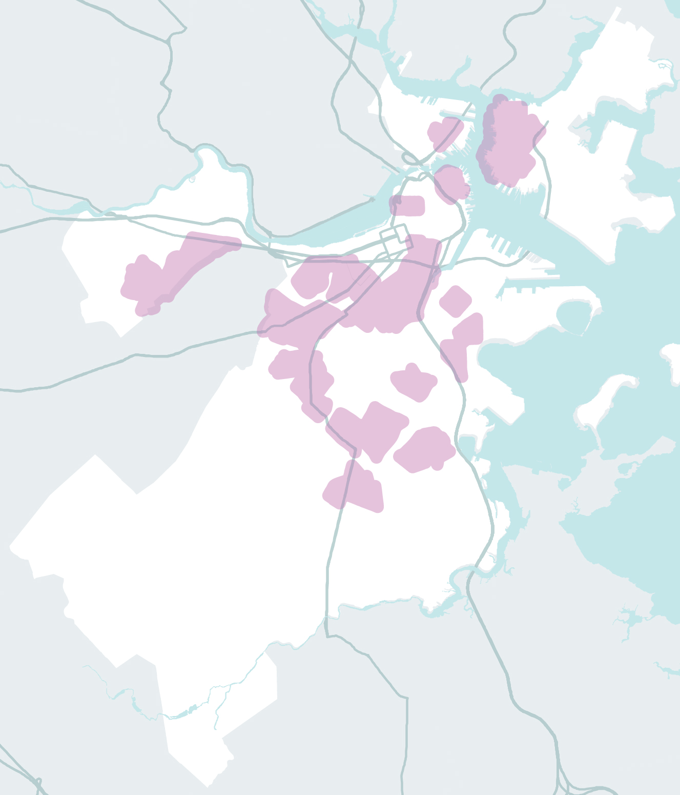
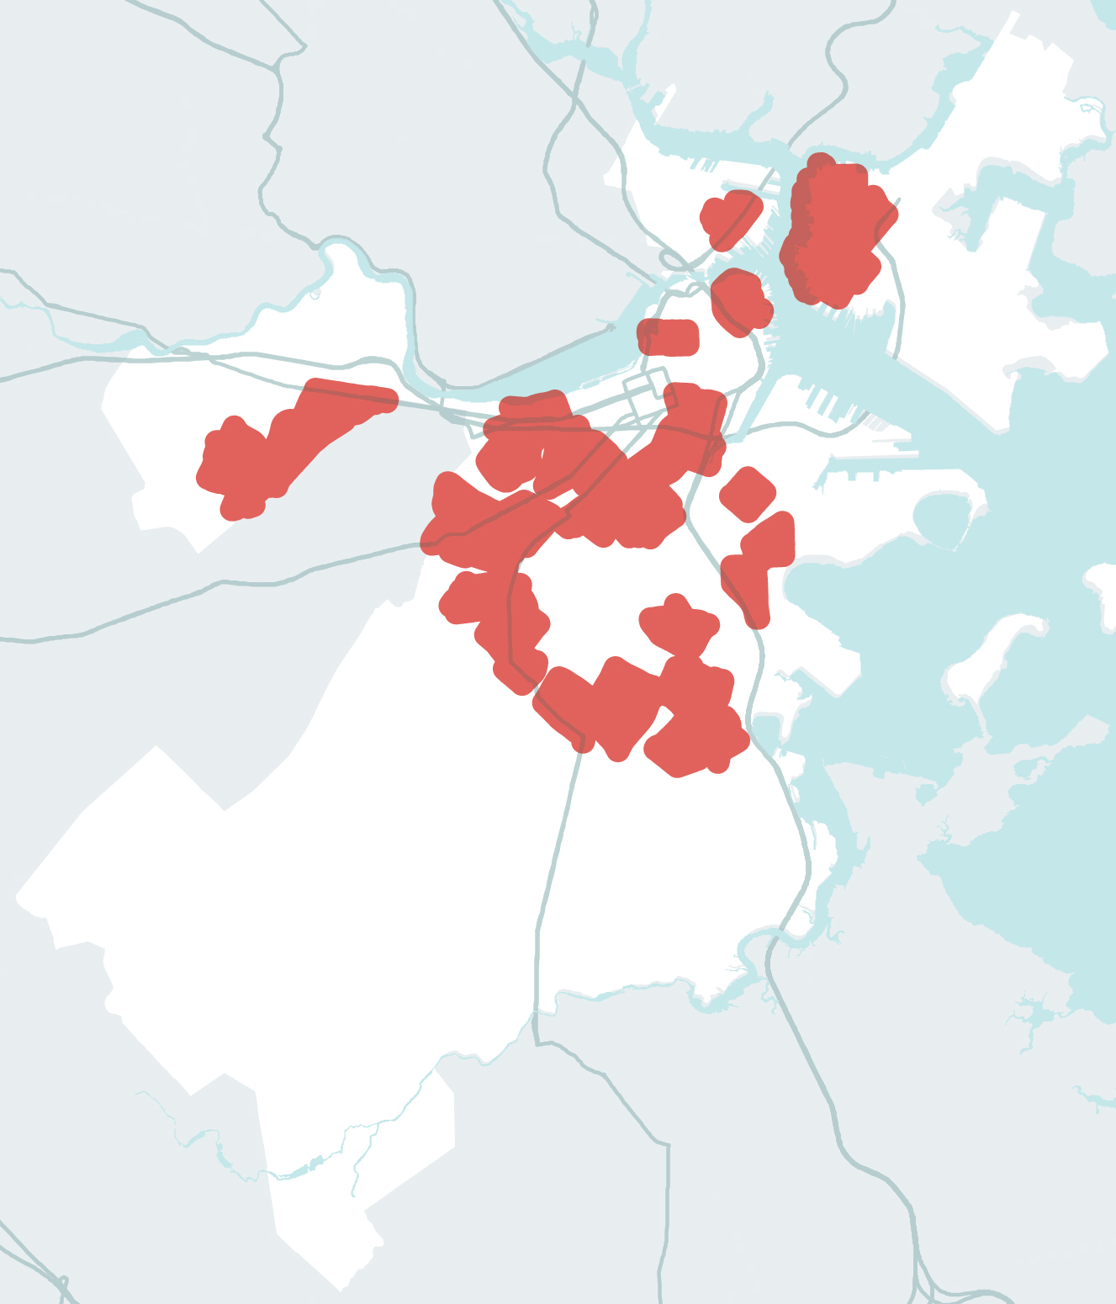
KONSANTRASYON POPILASYON KI VILNERAB SOSYALMAN
KONSANTRASYON POPILASYON KI VILNERAB SOSYALMAN
KONSANTRASYON POPILASYON KI VILNERAB SOSYALMAN
KONSANTRASYON POPILASYON KI VILNERAB SOSYALMAN
KONSANTRASYON POPILASYON KI VILNERAB SOSYALMAN
KONSANTRASYON POPILASYON KI VILNERAB SOSYALMAN
KONSANTRASYON POPILASYON KI VILNERAB SOSYALMAN
“MOUN PA AFEKTE EGAL-EGO.”
63,187
236,938
70,701
104,659
327,284
176,059
239,246
PEOPLE WITH LIMITED
ENGLISH PROFICIENCY
KA MALADI MEDIKAL
PEOPLE WITH DISABILITIES
OLDER ADULTS
CHILDREN
MOUN KI GEN PO NWA
PEOPLE WITH LOW-TO-NO INCOME
Notes:
Important to call out that social vulnerabilities and inequity affect how people will be impacted by climate disruptions. Quite a lot in the CRB report on this you can pull from.
Topline – age, health, physical disabilities, income, race play a role and must be recognized as a foundational factor in how Boston responds.
Depending on who you are engaging, it may make sense to focus more on this information. More in the neighborhood slides but important to note the extent to which this was a leading part of CRB.

Slide 19
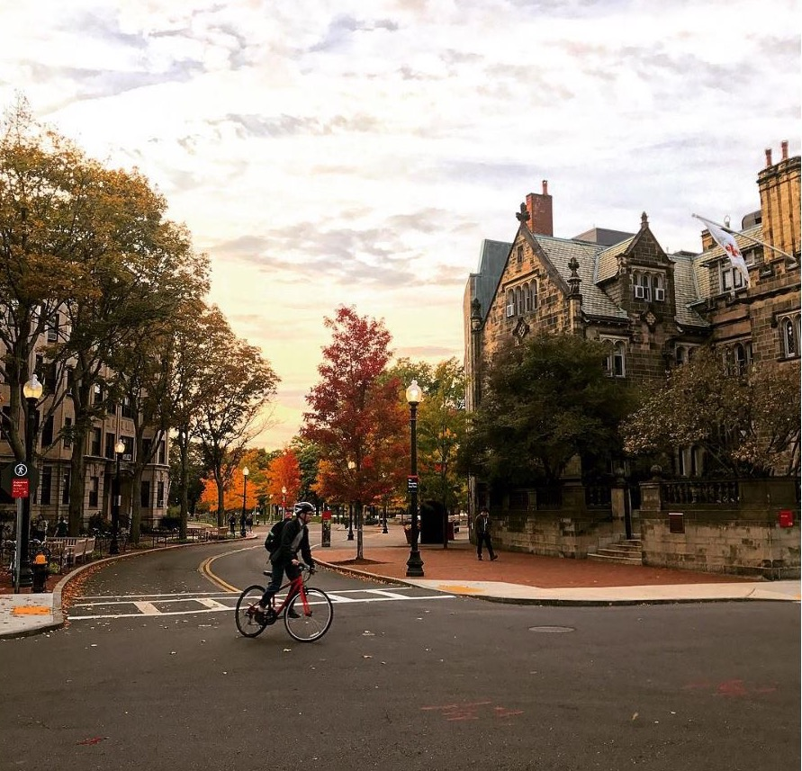
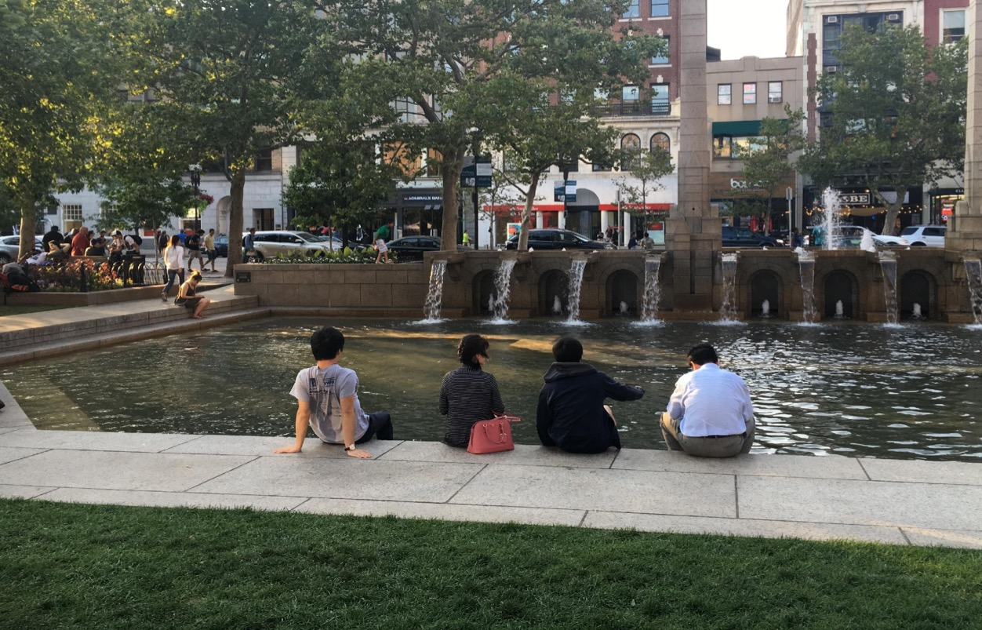
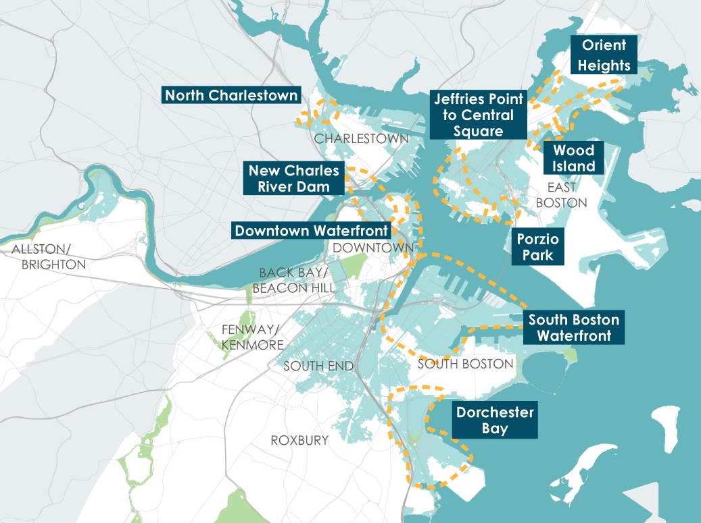
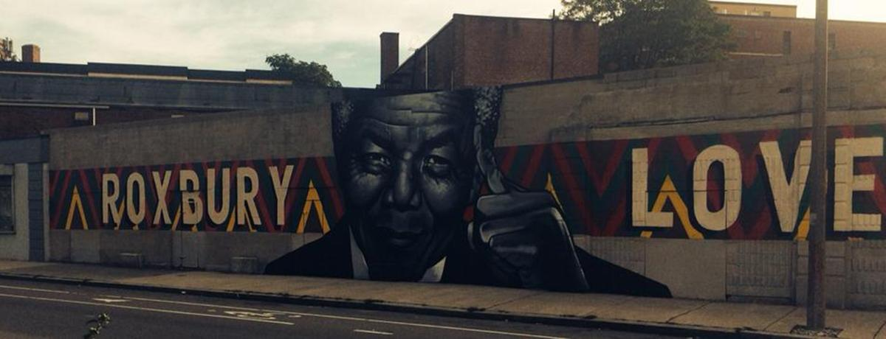
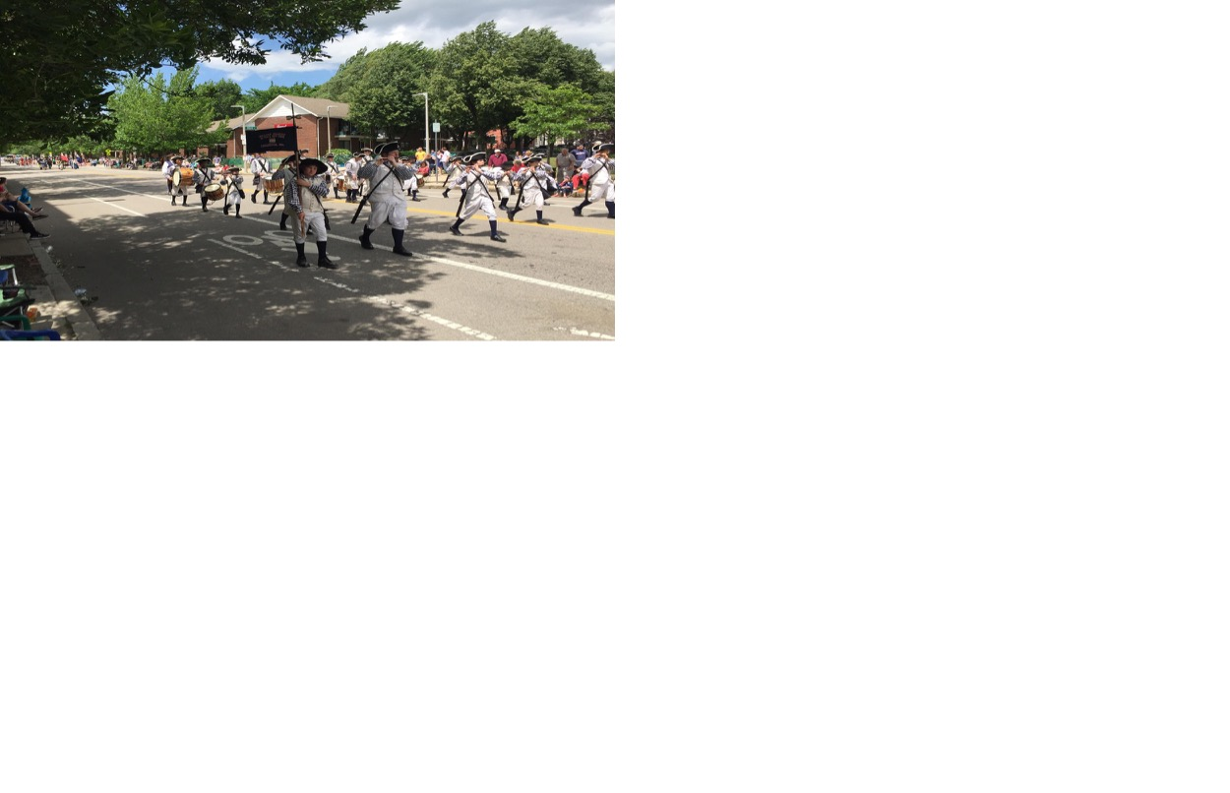
KONSANTRE SOU KATYE YO
Notes:
Starting to shift to what’s possible. Point out that CRB takes risks and potential responses down to the neighborhood level. Part of what makes the effort unique as most communities have not brought climate impacts projections down to this level of detail.
Have neighborhood slides in development. Could choose to start with this presentation or lead right into neighborhood specifics depending on audience. Even within the neighborhoods slides, call outs to how impacts care in one area versus another.

Slide 20
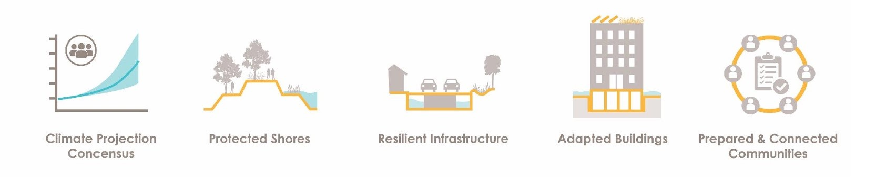
RELVE DEFI A
Konsansis sou Pwojeksyon Klima a
Litoral Pwoteje
Enfrastrikti ki Rezistan
Bilding Reyabilite
Kominote ki Prepare e ki Konekte
Notes:
Don’t need to detail out there are 11 resilience strategies as they fall into 5 key action areas which is easier to wrap your head around.
Climate Projection – for all Boston versus other solutions get specific in the focus areas.

Slide 21
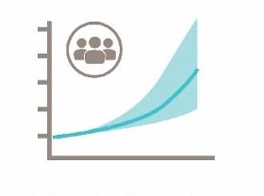
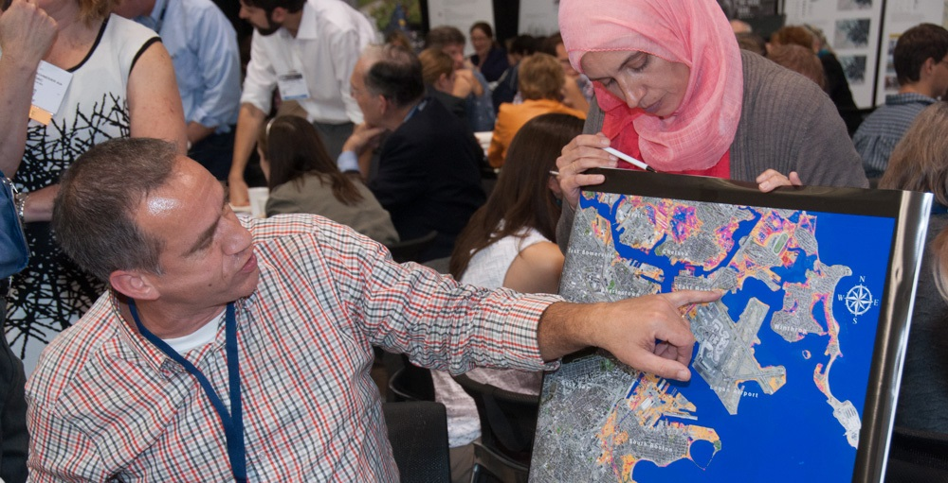
MIZAJOU SOU PWOJEKSYON KLIMATIK YO
ESTRATEJI YO PWOPOZE:
Fè mizajou nan done yo chak 5 an epi mete yo sou fòm zouti
Notes:
Data evolving rapidly. Need to continue to build on the scientific consensus by updating projections every 5 years.
Best available data to support smart decision making.

Slide 22
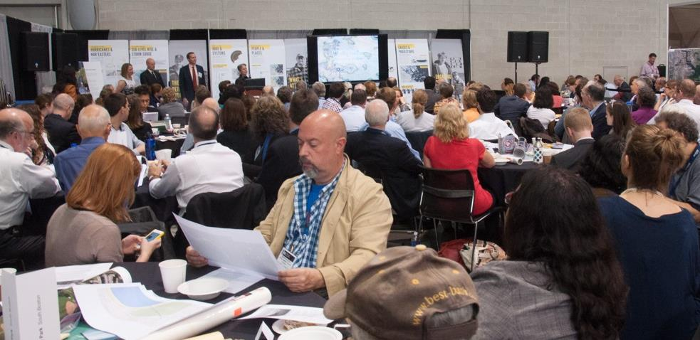

KOMINOTE KI PREPARE E KI KONEKTE
ESTRATEJI YO PWOPOZE:
Ankouraje Moun Boston antan ke patnè
Kreye plan katye ansanm
Fè fòmasyon pou travay ki mande rezistans.
Notes:
*People need to understand risks to respond
*Impacts are better understood with local knowledge
*Community sensitive solutions
*co-creating plans for the focus areas

Slide 23

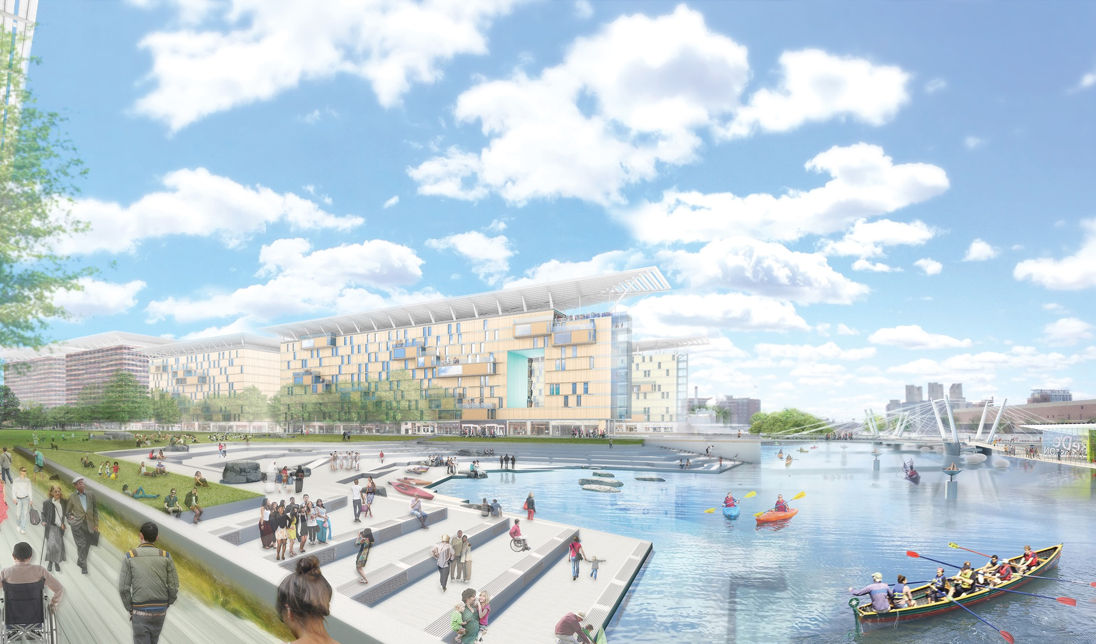
LITORAL PWOTEJE
ESTRATEJI YO PWOPOZE:
Envestige chwa pou pwoteksyon kont inondasyon ak devlopman entelijan
Notes:
District level flood protections i.e. shoring up New Charles Dam.
Zoning/building requirements that promote development adding to current and not limiting future flood responses

Slide 24

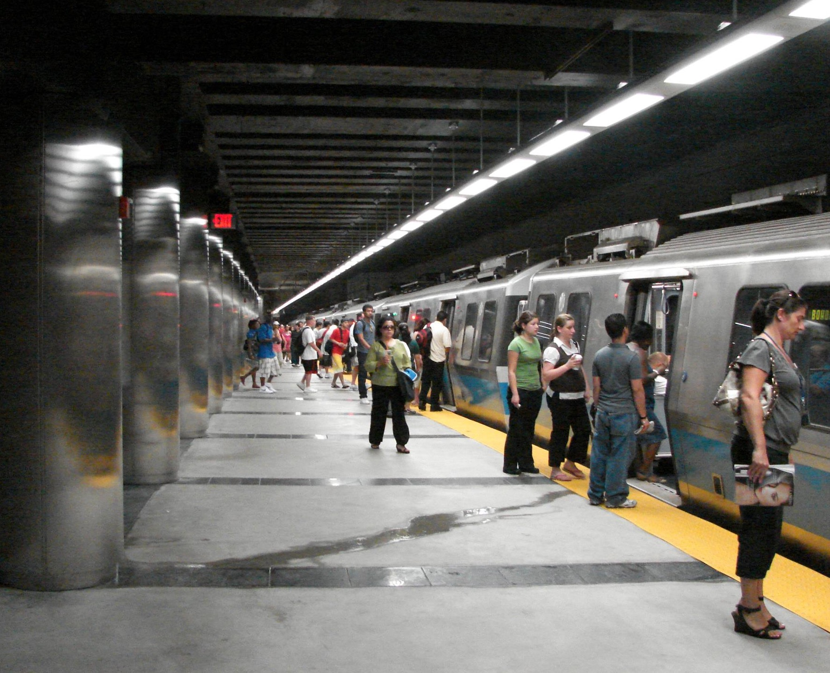
ENFRASTRIKTI KI REZISTAN
ESTRATEJI YO PWOPOZE:
Devlope estanda tou pare pou klima pou planifikasyon ak konsèp achitekti
Etabli rezo enèji nan katye
Travay ak lanati pou diminye enpak yo
Notes:
Coordinating plans across infrastructure providers including CRB strategies
Decentralize energy supply per micro grids

Slide 25

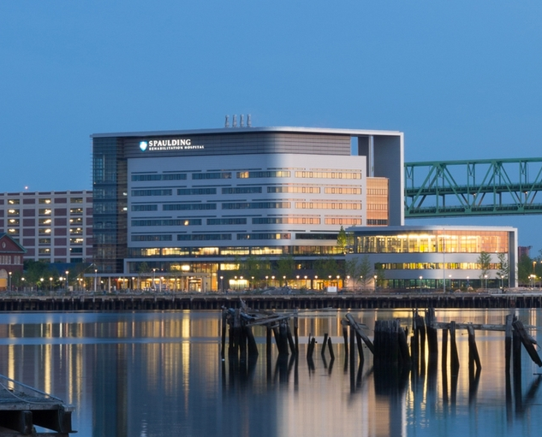
BILDING REYABILITE
ESTRATEJI YO PWOPOZE:
Fè mizajou nan kòd zonaj ak konstriksyon; eksplore modènizasyon.
Prepare bilding ki pi an danje.
Ankouraje moun pran asirans.
Notes:
Spaulding Medical Clinic already provides living example of what’s possible.
In addition to CRB friendly zoning and building codes.....
Retrofitting critical given most of Boston’s buildings exist already

Slide 26
PWEN PRIYORITÈ POU AVANSE INISYATIV BOSTON PARE POU CHANJMAN NAN KLIMA YO
DISKISYON
Zouti Avanse pou
Pran-Desizyon
Kominote ki
Prepare e ki Konekte
Litoral Pwoteje
Enfrastrikti ki Rezistan
Bilding Reyabilite
KI OPÒTINITE KI EGZISTE POU ADOPTE SOLISYON POU CHANJMAN KLIMATIK?
KI KALITE KOLABORASYON KI NESESÈ AK VIL LA E AK LÒT PATNÈ YO?
Notes:
Shift to dialogue/input mode
What existing efforts can be leveraged? Collaborations needed.

Slide 27
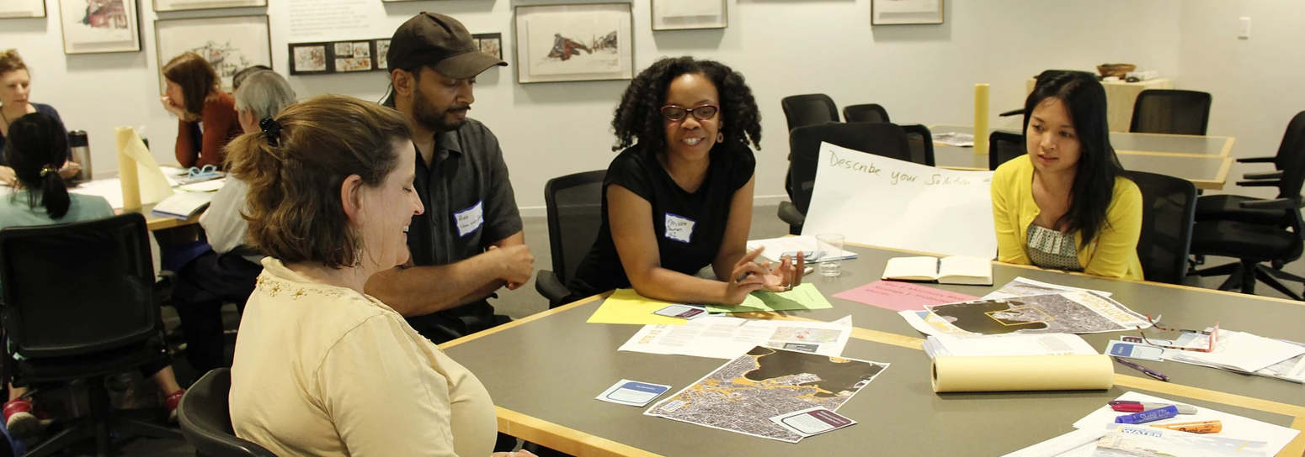
Patisipe nan yon Ekip Katye www.greenovateboston.org
Kontribye nan vizyon pou lavni Boston www.imagine.boston.gov
KISA W KA FÈ?
POTEKOLE AK PLAN AN
BOSTON PARE POU CHANJMAN NAN KLIMA YO (CLIMATE READY BOSTON)
Notes:
Resilience strategies are part of Imagine 2030 Boston still accepting public comment.
*Greenovate following up re: neighborhood resilience strategies.
CAN GET MORE SPECIFIC re: issues relevant per sector/issue i.e. Renew Boston
Refer to process doc re: dialogue steps

