Slide 1
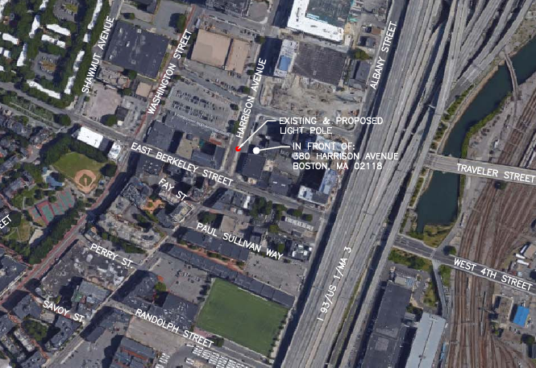
18.023 SE City ROW at 380 Harrison Avenue

Slide 2
18.023 SE City ROW at 380 Harrison Avenue
Replace double standard cast concrete light post with similar metal double standard light post.
Top of existing post is 29’ above grade level.
Top of proposed post is 36.8’ above grade level.
Decorative pole base and lamp post all to be painted to match the color of concrete.

Slide 3
