Slide 1
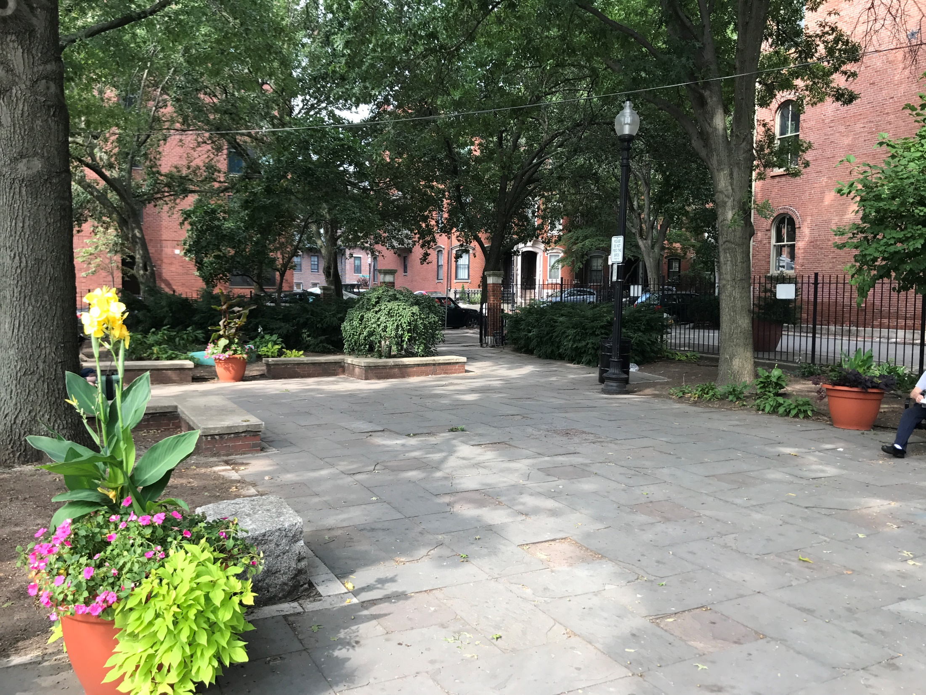



SOUTH END LIBRARY PARK
Improvements to
January 2, 2018
Boston Parks and Recreation

Slide 2
AGENDA
1
PROJECT TEAM INTRODUCTION
2
PROJECT SCHEDULE & FUNDING
3
EXISTING SITE CONDITIONS AND ANALYSIS
4
COMMUNITY INPUT
5
PROPOSED PLAN AND MATERIALS
Notes:
Agenda slide

Slide 3

PROJECT TEAM
Lauren Bryant
Project Manager
lauren.bryant@boston.gov or 617-961-3019
Marchelle Jacques-Yarde
Outreach Coordinator, External Affairs
marchelle.jacques-yarde@boston.gov or 617-961-3006
Weston & Sampson
Brandon Kunkel, RLA
Cassie Bethoney, RLA

Slide 4
PROJECT SCHEDULE & FUNDING
NOV 2017
Community Meeting
LATE SUMMER 2018
Anticipated Park Opening
FEB 2018
Design Development +
Construction Documents
JAN 2018
Landmarks Hearing
MARCH 2017
Construction Commences
Estimated cost of construction:
$115,000

Slide 5
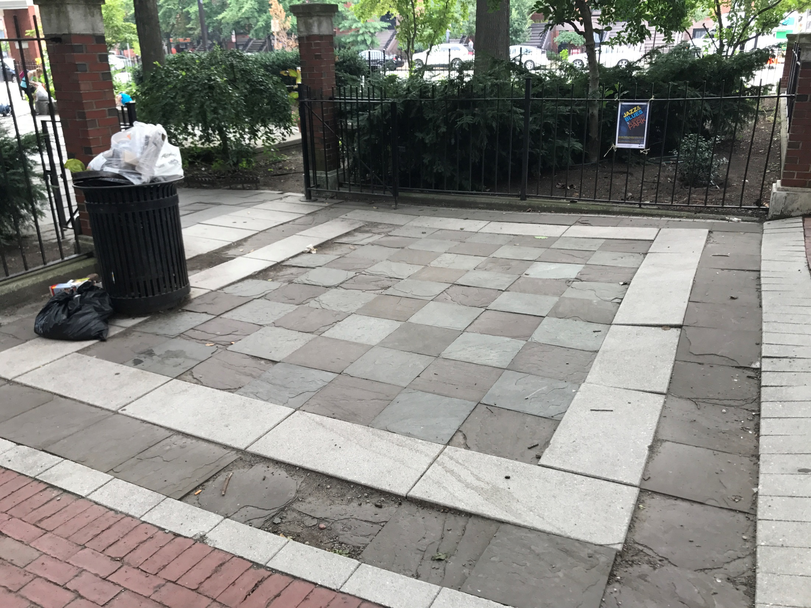
RUTLAND SQUARE ENTRANCE

Slide 6
MAIN PLAZA, LOOKING TOWARD THE RUTLAND SQUARE ENTRANCE

Slide 7
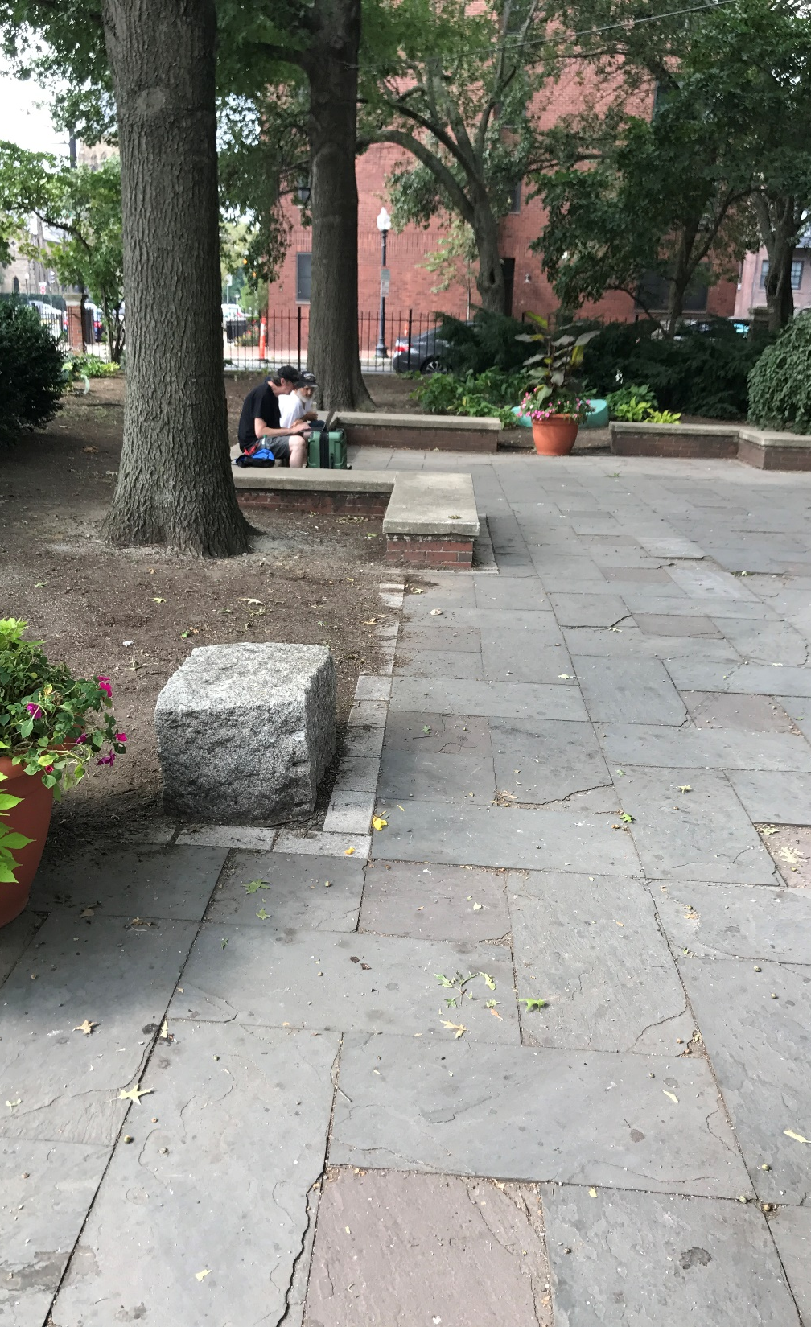
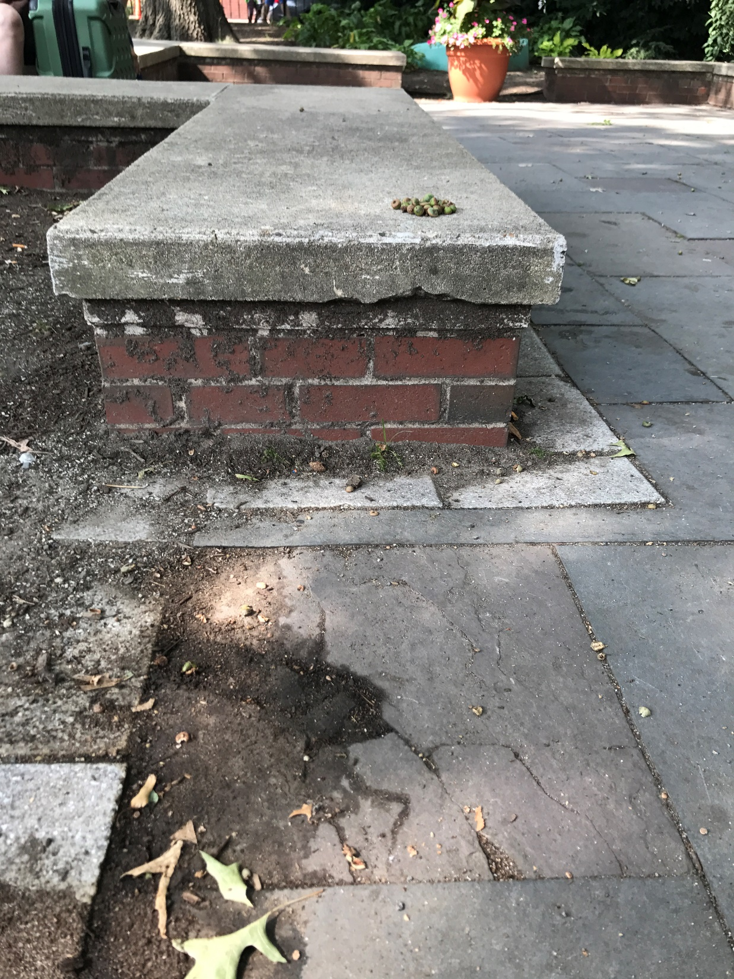
BLUESTONE PAVING
& BRICK SEATING

Slide 8
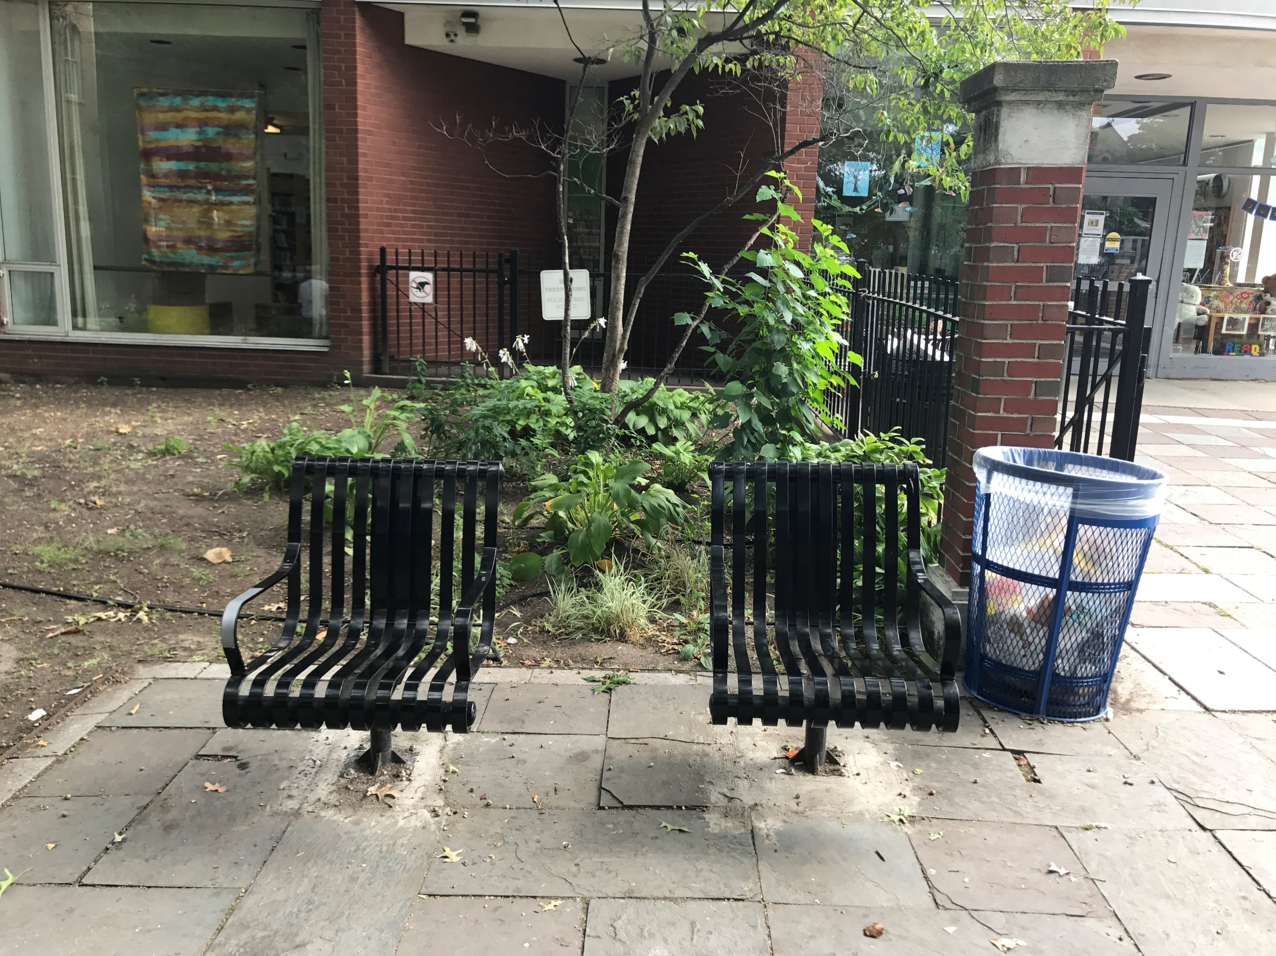
INDIVIDUAL SEAING

Slide 9
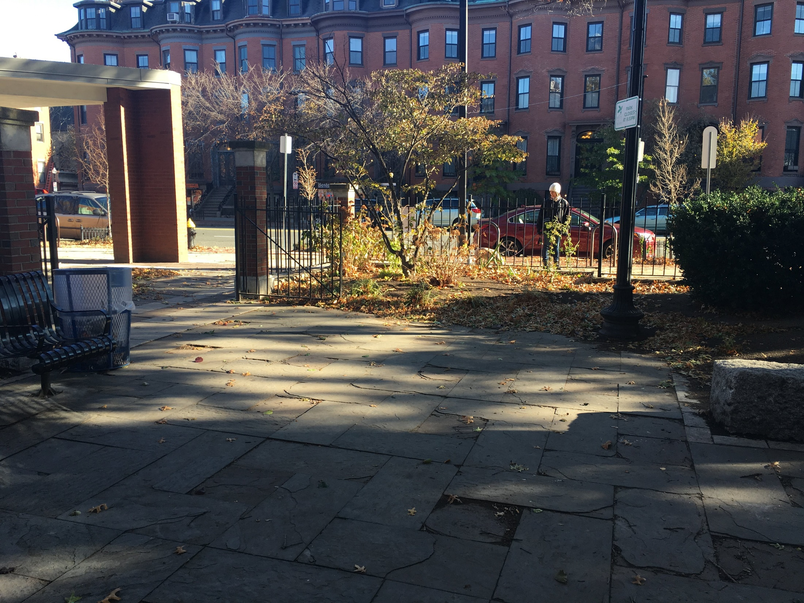
LOOKING TOWARD LIBRARY ENTRANCE

Slide 10
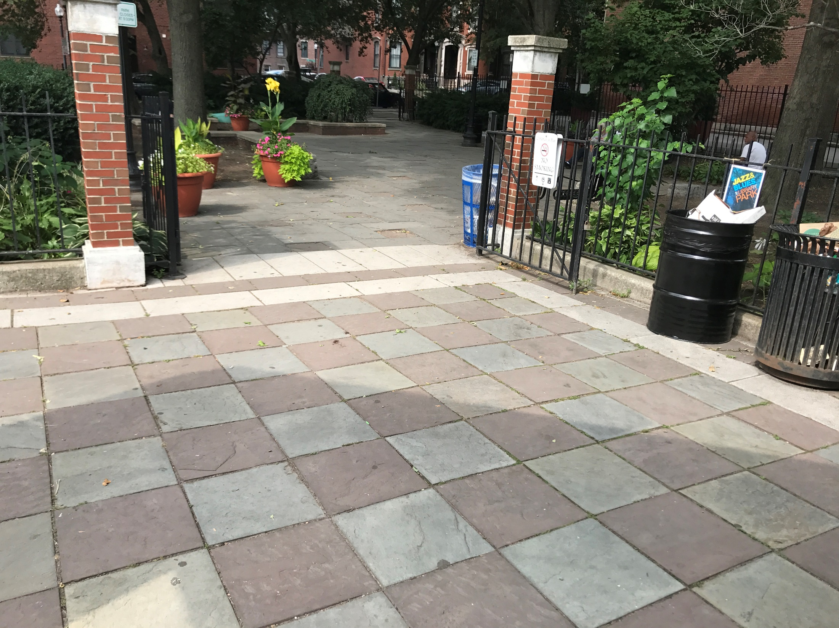
TREMONT STREET ENTRANCE

Slide 11
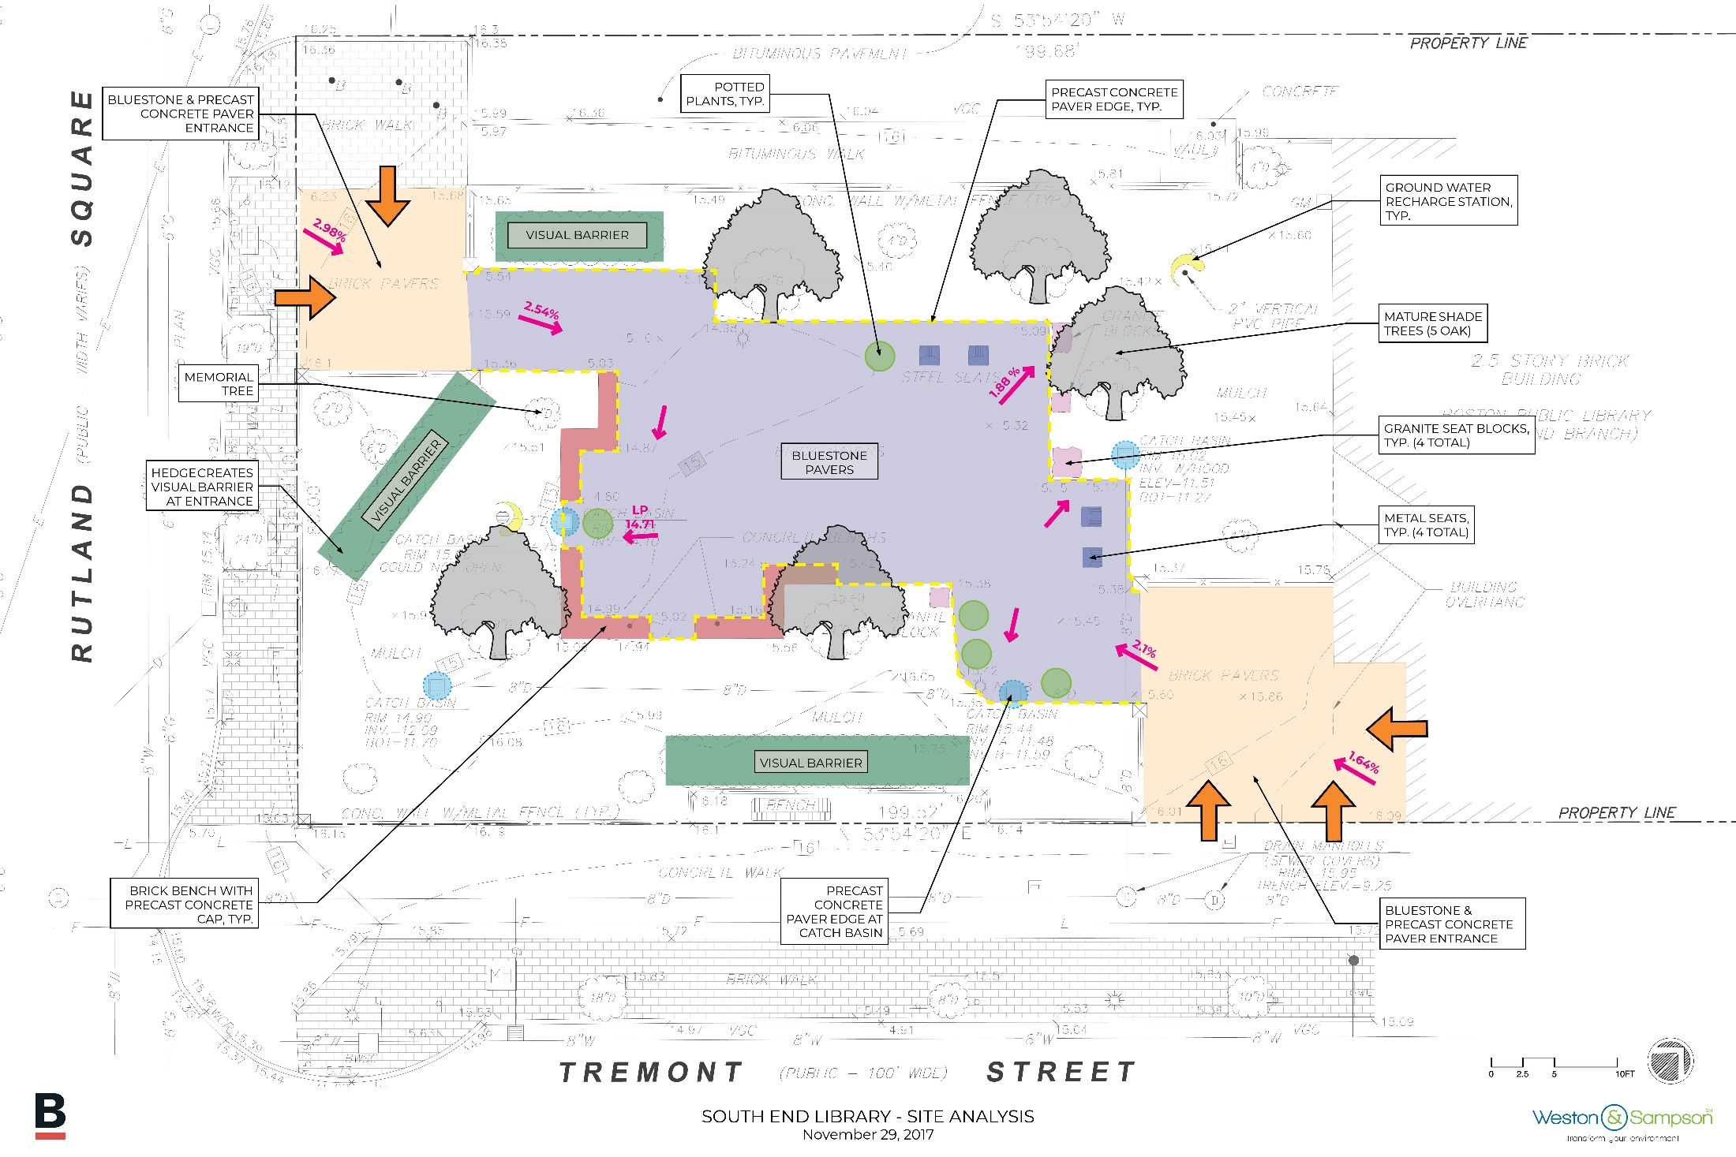
SITE ANALYSIS

Slide 12
COMMUNITY INPUT
The park needs to be refreshed; a new look will bring excitement and offer fundraising opportunities.
Bluestone replacement is not desired; preference between concrete unit pavers and concrete pavement is split.
Electricity located next to a large open area would be useful for concerts and other programming.
Watering the planting beds is important to the community and so correcting any deficiencies with the existing hose bib will be important.
Café tables and chairs would be a welcome addition. They should be located in places where there is no interference with large open spaces for programming.
Soil amendment would restore the nutrient-depleted soil and allow for future planting.

Slide 13
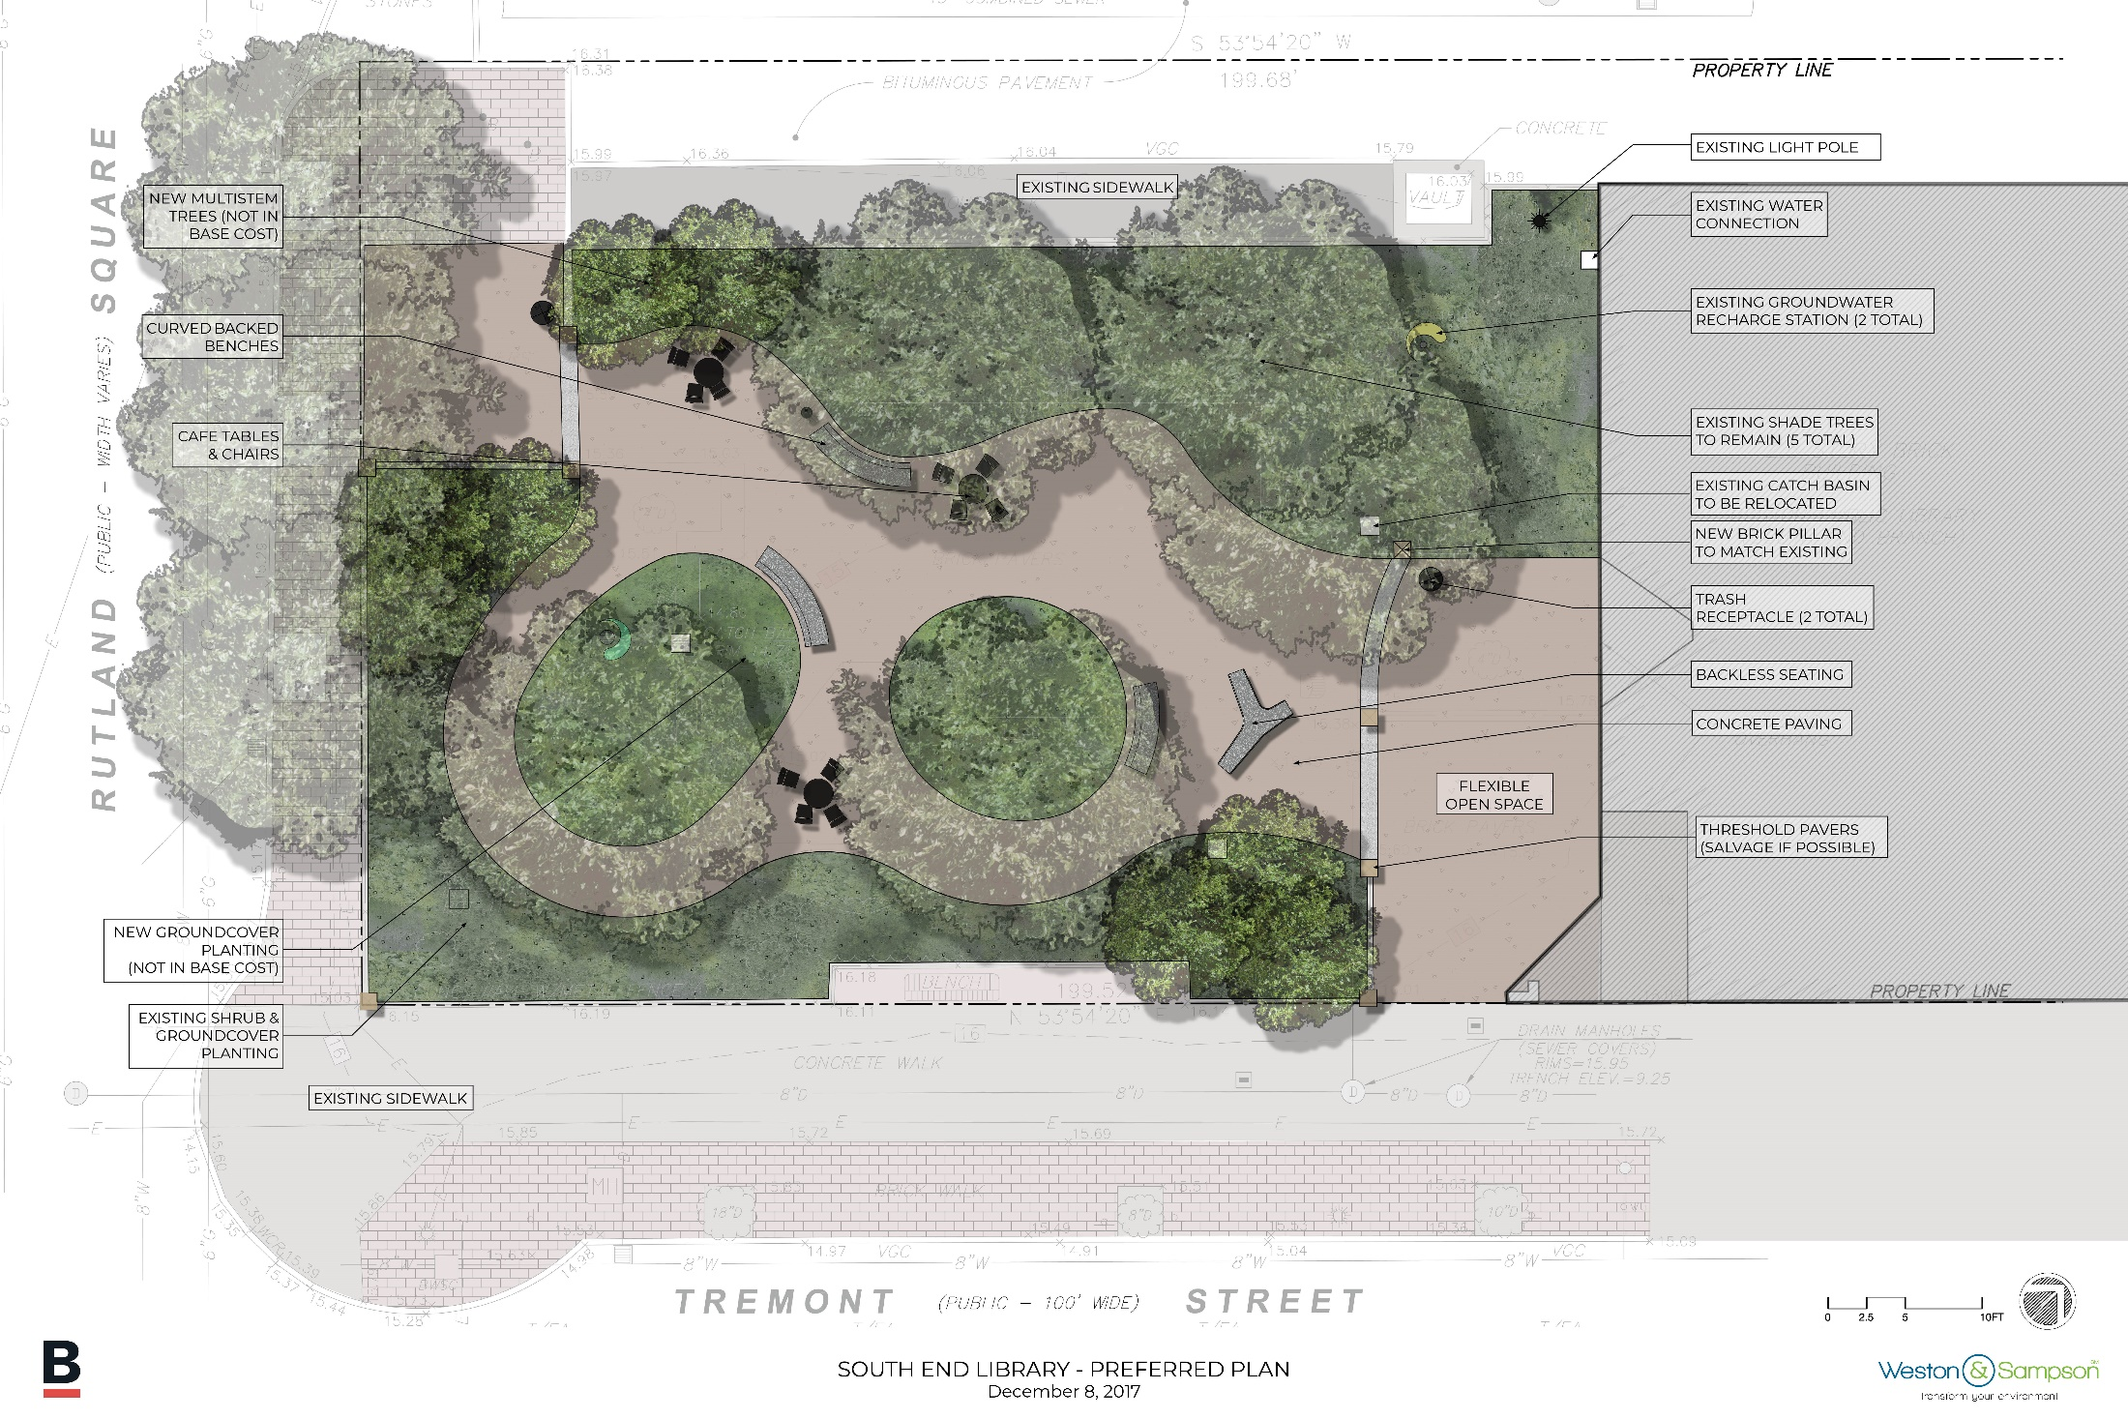
PROPOSED PLAN

Slide 14
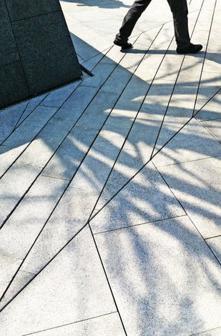
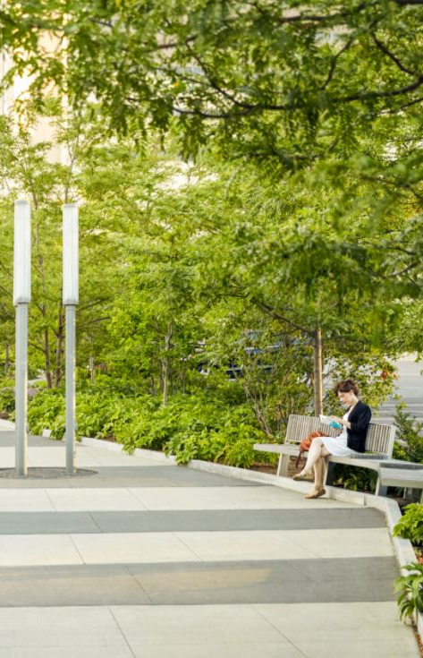
HARDSCAPE IMPROVEMENTS

Slide 15
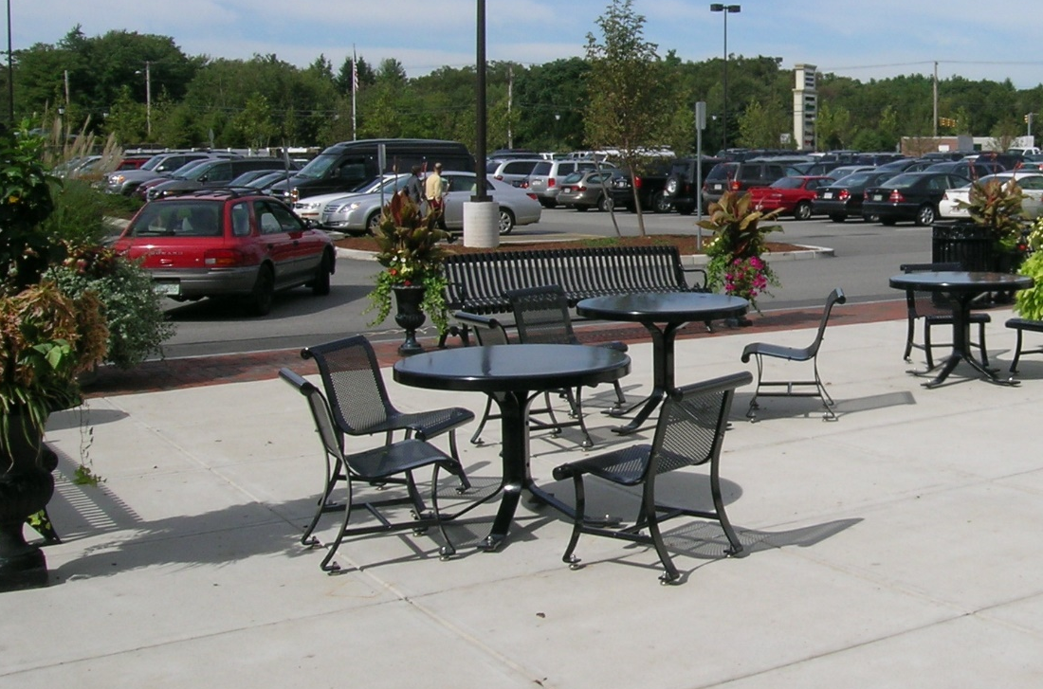
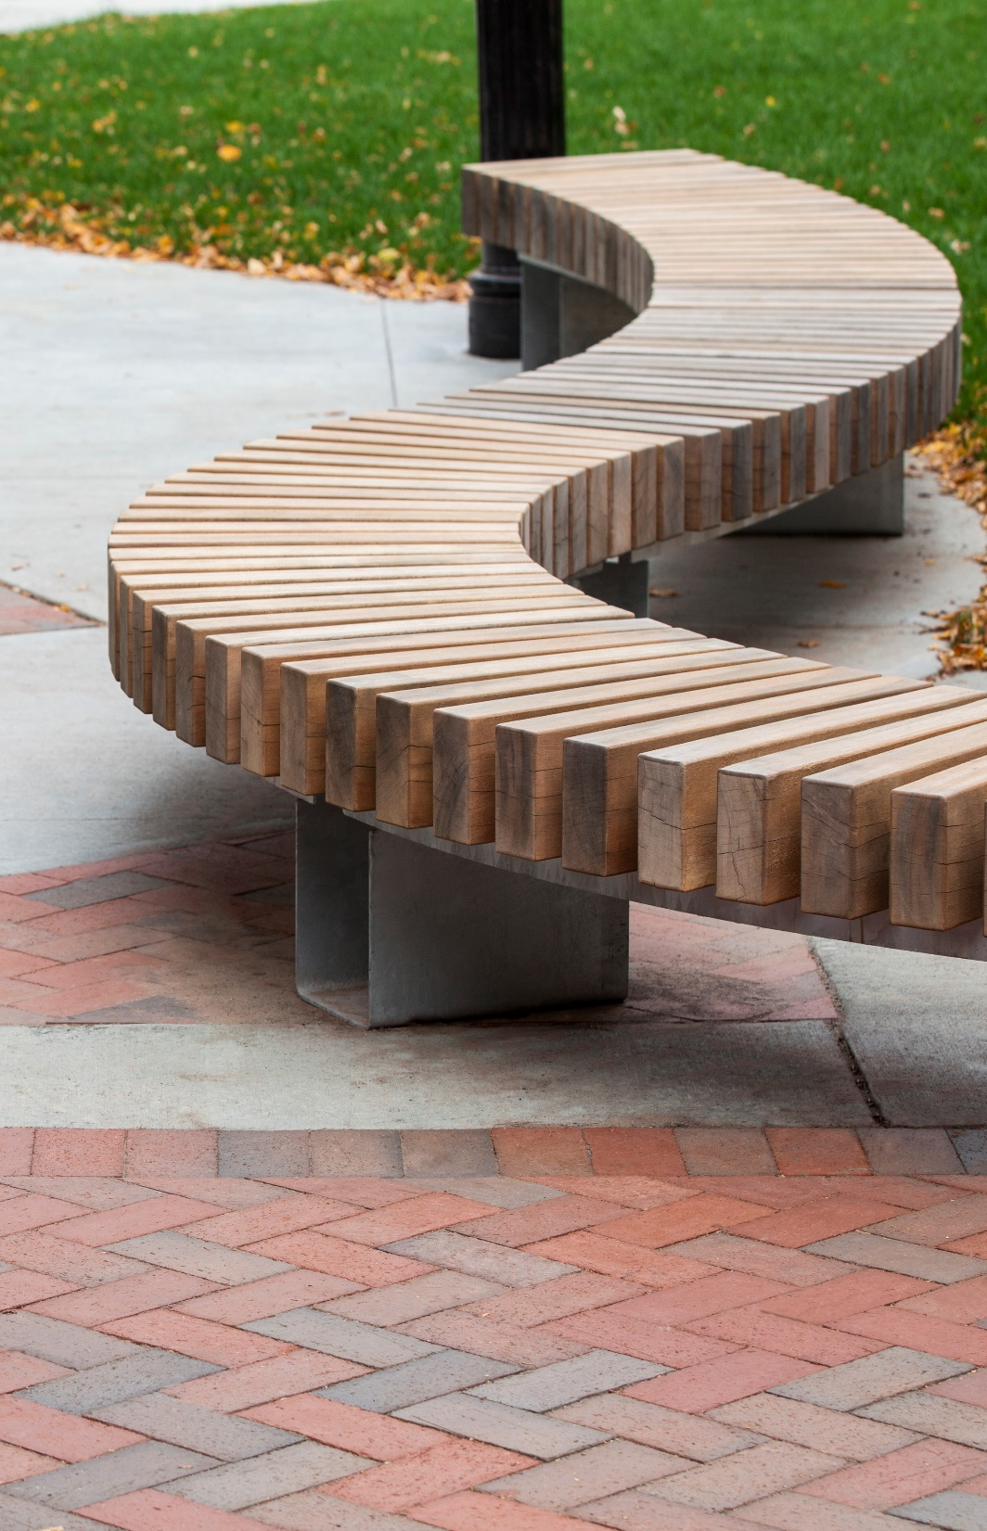
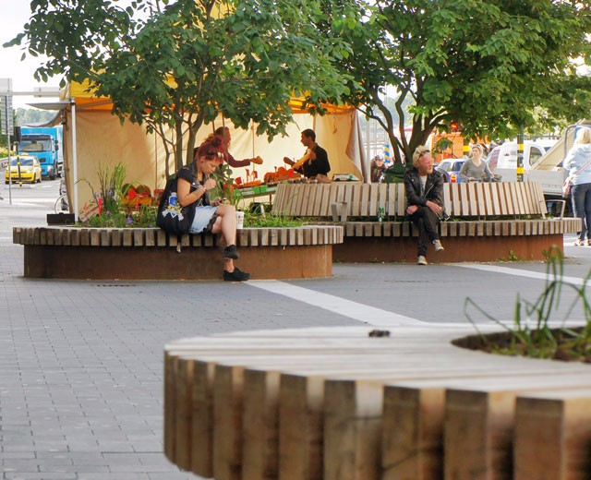
SEATING
OPTIONS

Slide 16
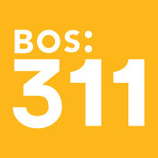
THANK YOU!
For questions, maintenance requests or
concerns regarding any of our
parks contact 311
January 2, 2017
Boston Parks and Recreation

