Slide 1
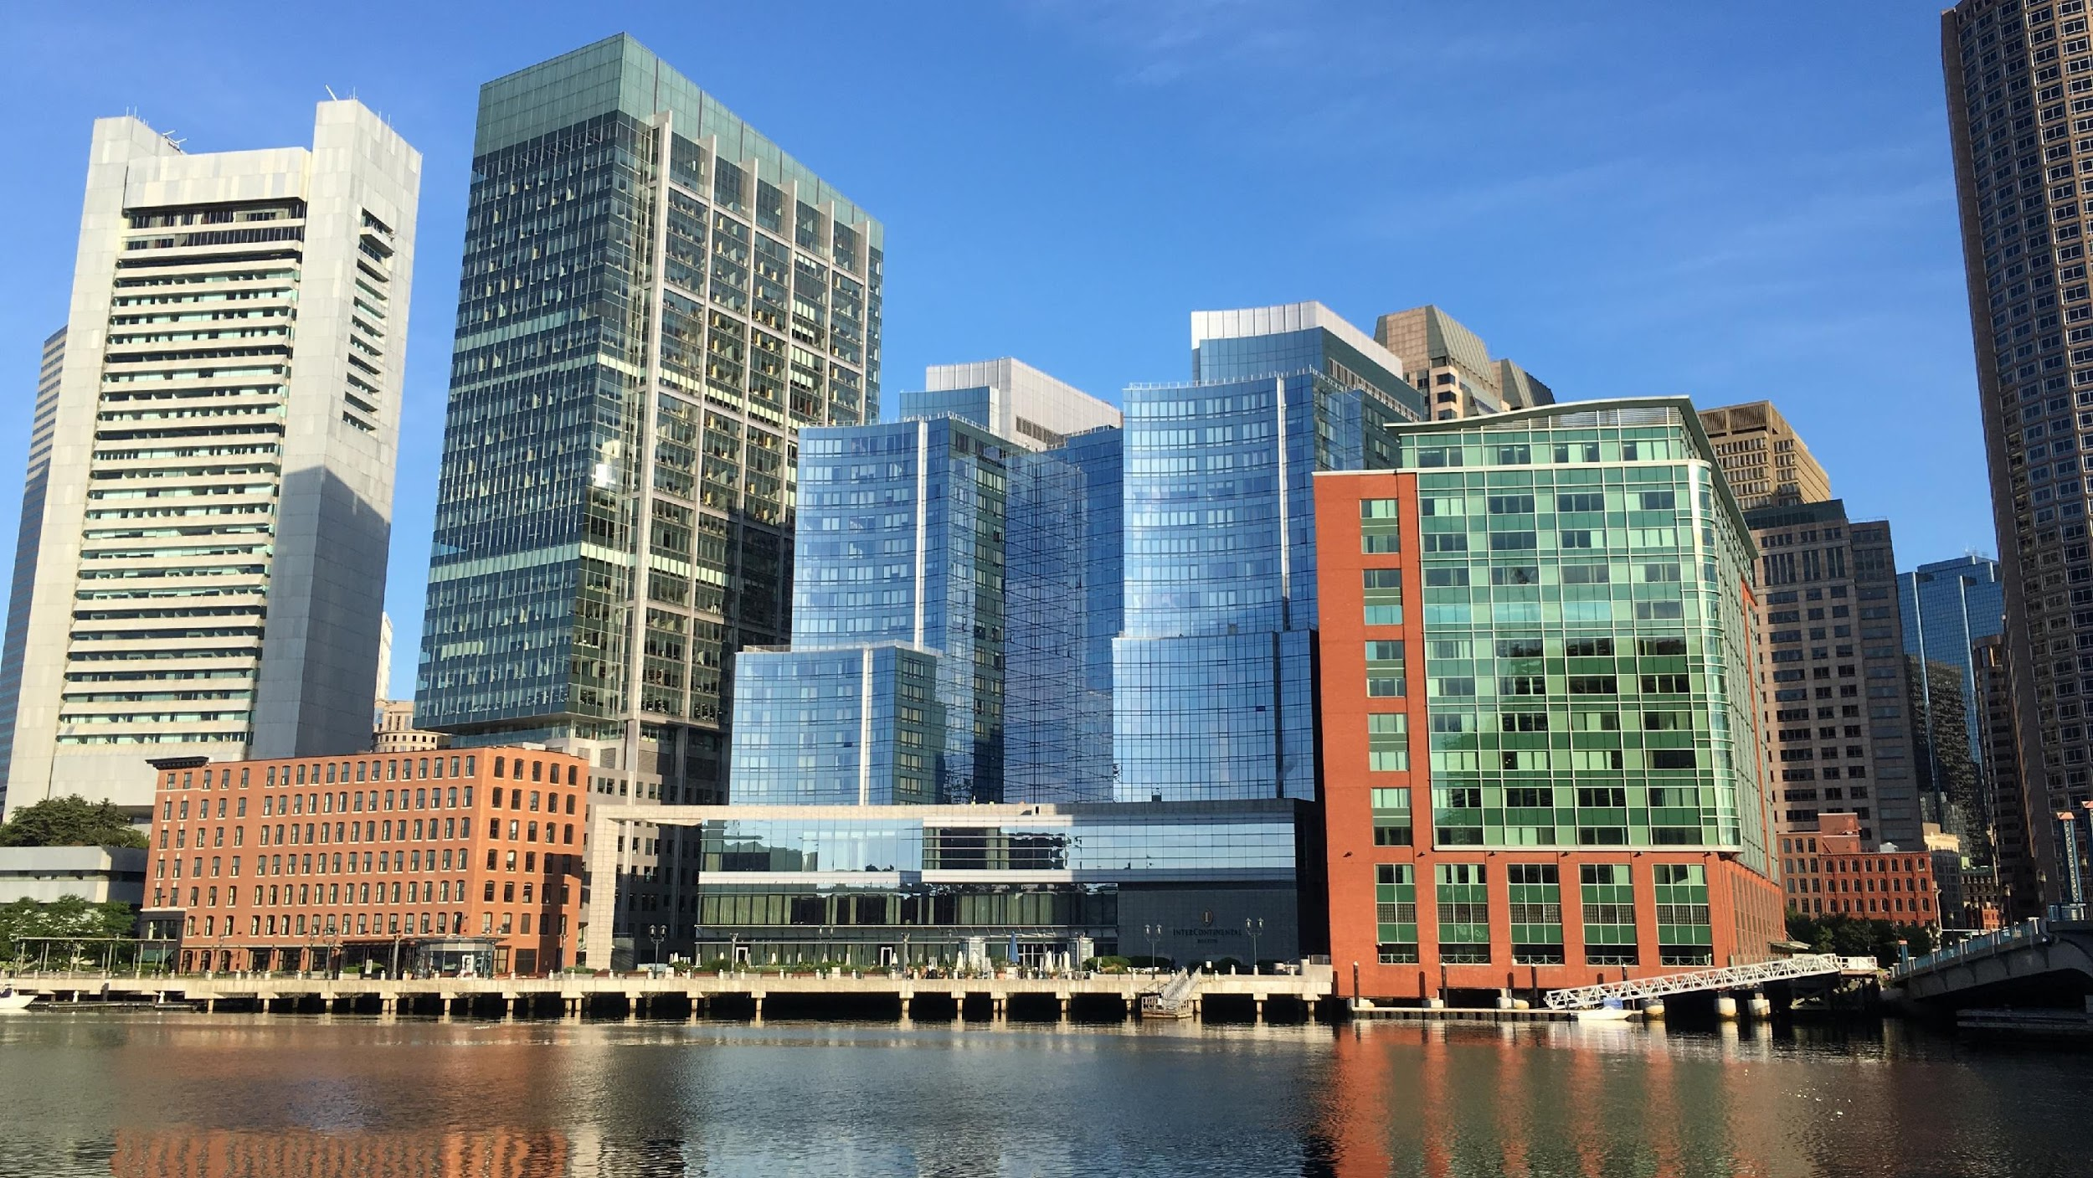
WELCOME TO THE
CLIMATE READY
BOSTON LEADERS PRESENTATION

Slide 2
WHY AM I HERE TODAY?
Insert 2:
I want to do my part
Insert 3:
I want to share this information to create action
Insert 1:
I care about my community
GOALS OF CRB CLIMATE LEADERS PROGRAM
Increase understanding of climate impacts
Involve community members in resilience strategies
Notes:
Introduce yourself and your affiliation and role
Give three reasons as to why you are here, which you will insert before presenting
Give a brief intro to the Leaders program

Slide 3
WHY ARE WE HERE TODAY?
WHAT WE’RE
FACING
CLIMATE
READY
BOSTON
VISION
WHAT CAN
BE DONE + WHAT IS OUR ROLE?
Notes:
Why are we here?
Outline the session
To talk about:
The City of Boston’s Climate Ready Boston vision, which addresses climate change head on
What climate change means for the City and what it is facing
And, what we as a community and as individuals can do to be a part of making Boston and our communities more resilient, equitable, and prepared.

Slide 4
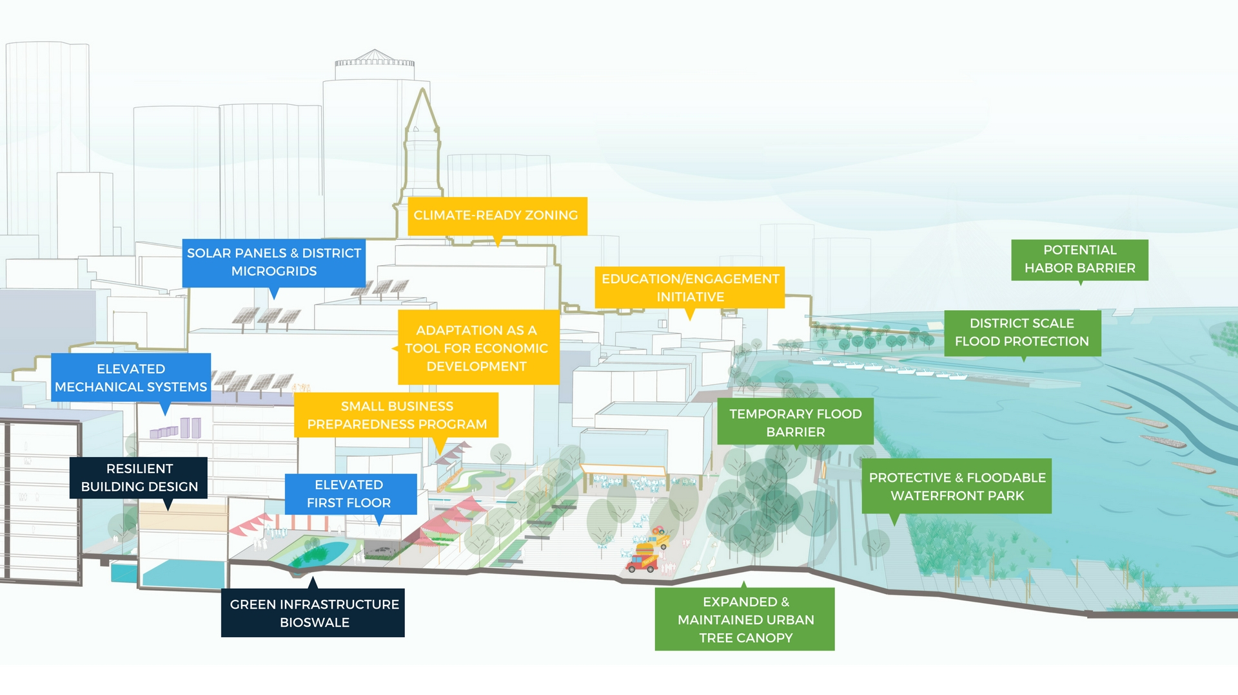
WHAT DOES A CLIMATE READY BOSTON LOOK LIKE?
Adapted Buildings; Resilient Infrastructure; Prepared Communities; Protected Shorelines
CLIMATE READY BOSTON
Notes:
Climate change is creating an opportunity to make Boston more resilient, equitable, and prepared.
Climate Ready Boston incorporates a many-leveled approach. It addresses infrastructure, energy systems, sustainable development, multi-purpose green spaces, stormwater infrastructure, protected shorelines, and prepared and connected communities because climate change affects all these things.

Slide 5
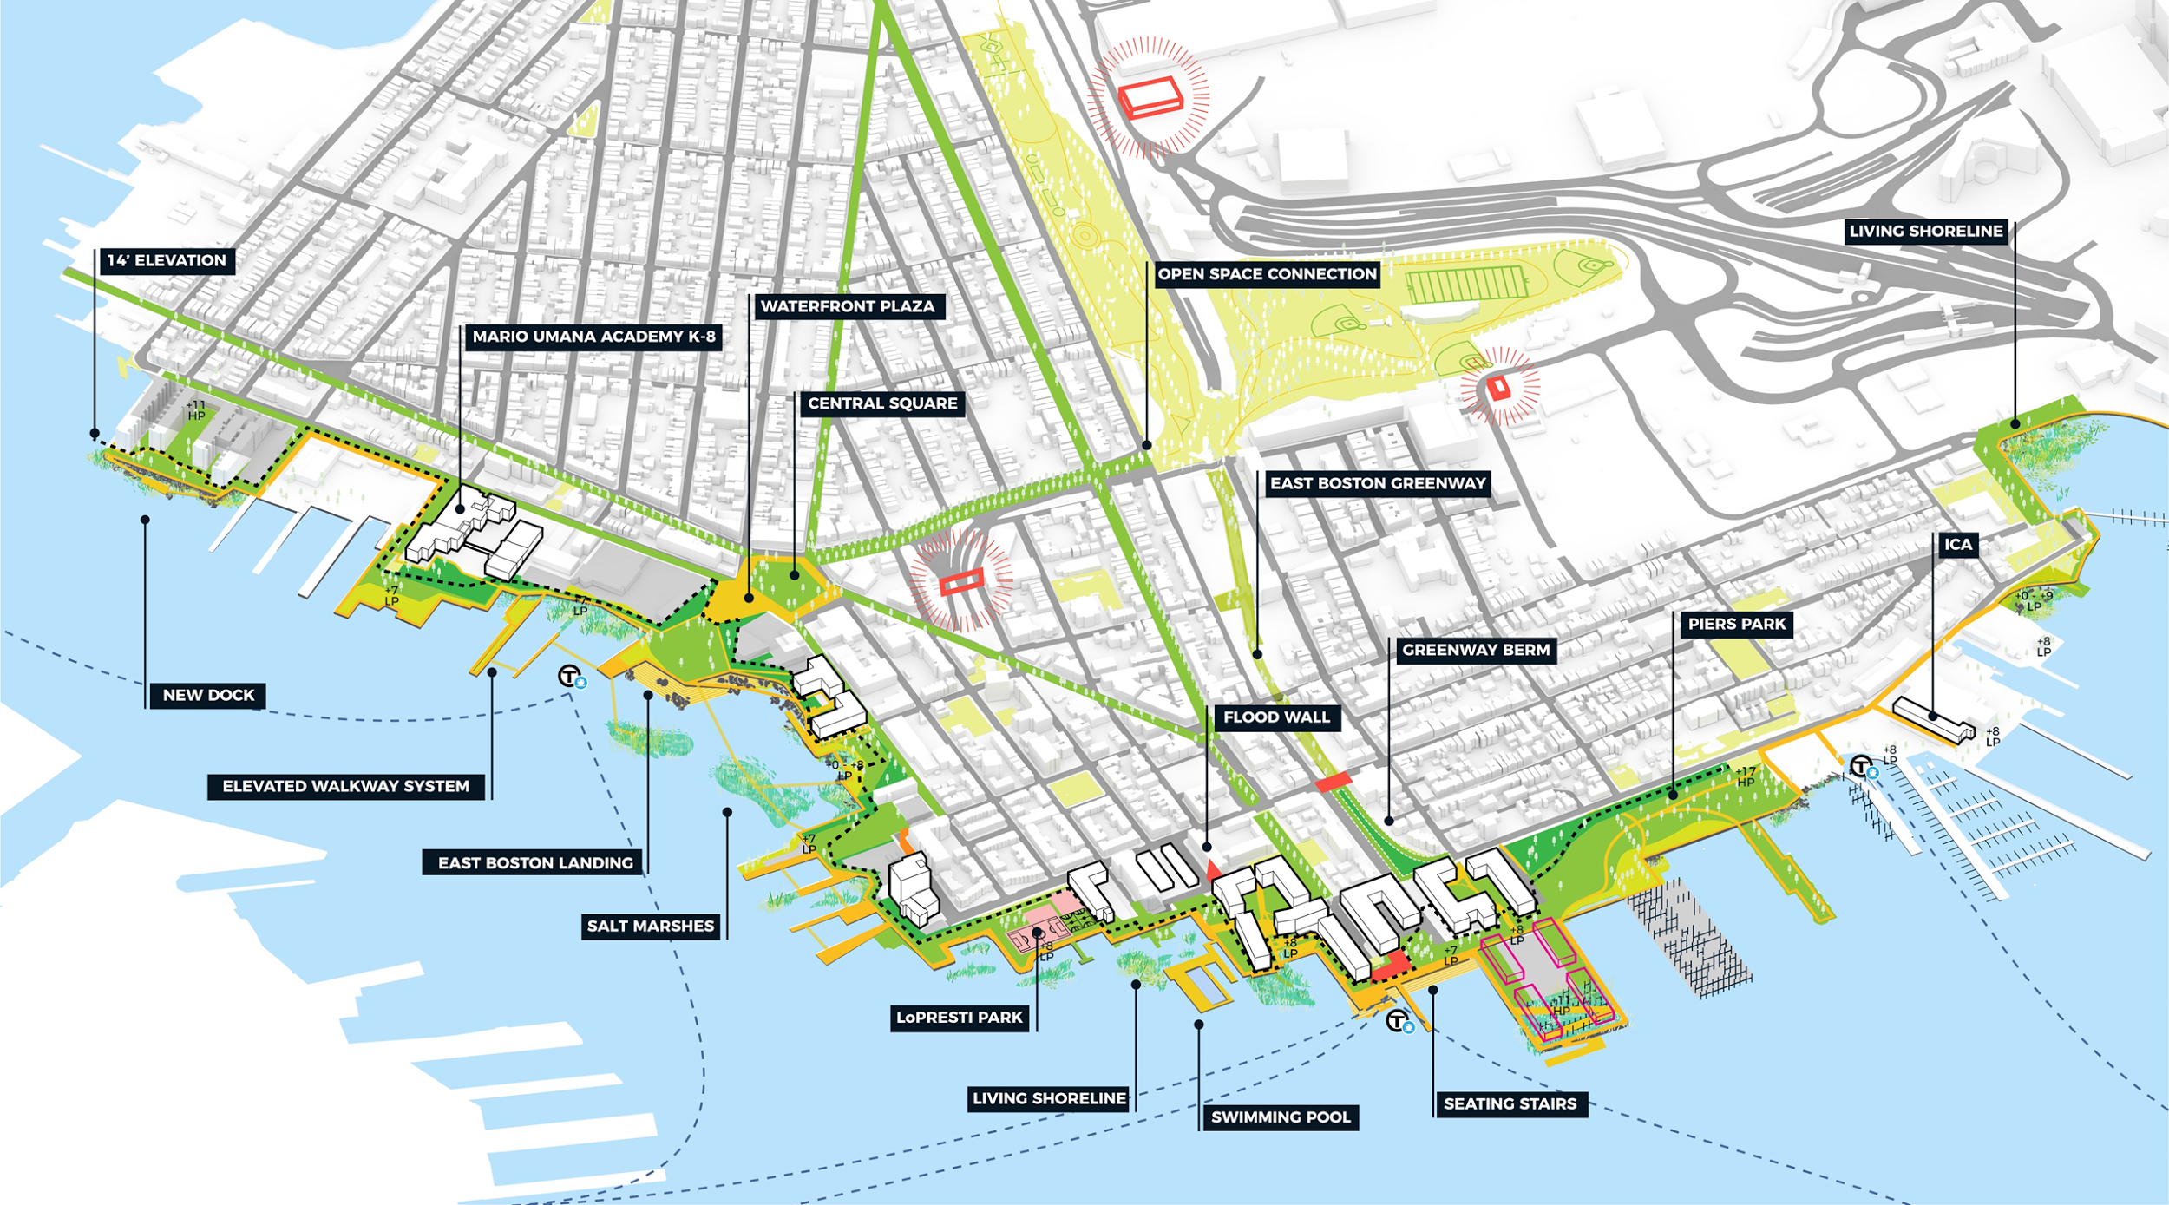
WHAT DOES A CLIMATE READY BOSTON LOOK LIKE?
Long term coastal resilience vision for East Boston
Full report at boston.gov/climate-ready
CLIMATE READY BOSTON
Notes:
Climate change is complex therefore solutions must also be.
In East Boston, pictured here, the City has published a new report called Coastal Resilience Solutions for East Boston and Charlestown, which develops long- and short-term designs and recommendations that address coastal flooding, stormwater management, and provide more and accessible green spaces for the community.

Slide 6
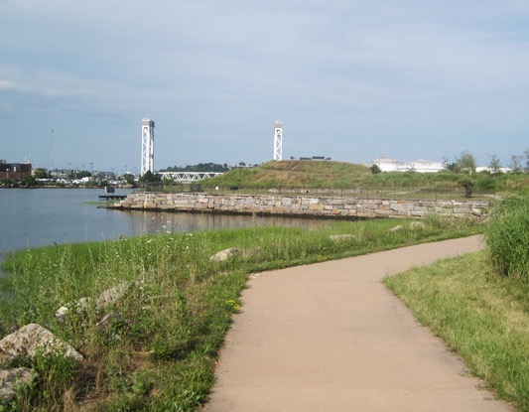
WHAT DOES A CLIMATE READY LOOK LIKE?
Solutions are not always grand in scale. They can be site specific.
Once a toxic industrial site, the Condor Urban Wild Park now offers access to the shore and flood protection.
CLIMATE READY BOSTON
Notes:
Solutions are not always grand or large-scale. The Condor Urban Wild is a site-specific example of how we can prepare for climate change. The site was once a toxic industrial site and has now become an accessible waterfront space for residents of East Boston

Slide 7
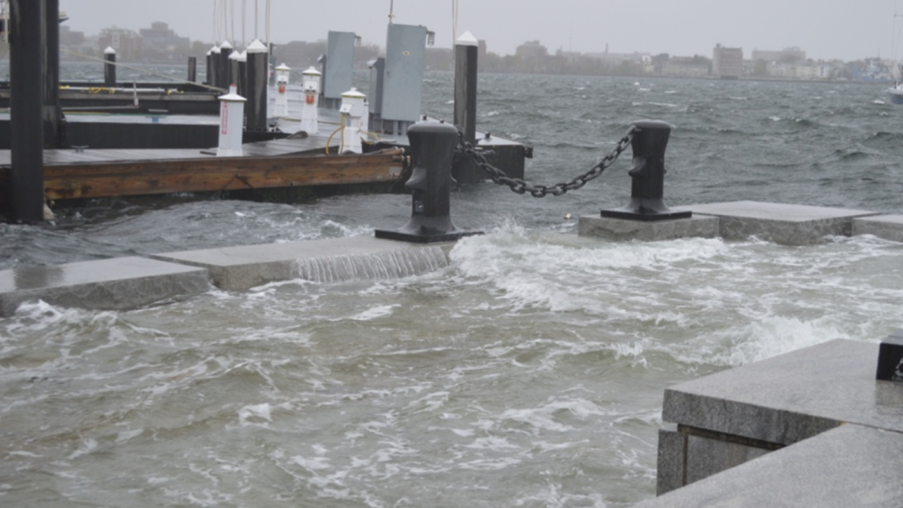
IMPACTS ARE HERE. TIME TO PREPARE.
Boston has experienced harsher snow storms, longer heat waves, and greater amounts of precipitation
Notes:
The impacts are here and it is time to prepare as a city, community, and as individuals.
The last three years we have experienced the largest snowfall in the city’s history and the warmest summer on record.
Climate Ready Boston is about better understanding the risks we are facing and developing strategies that result in a better city for everyone.

Slide 8
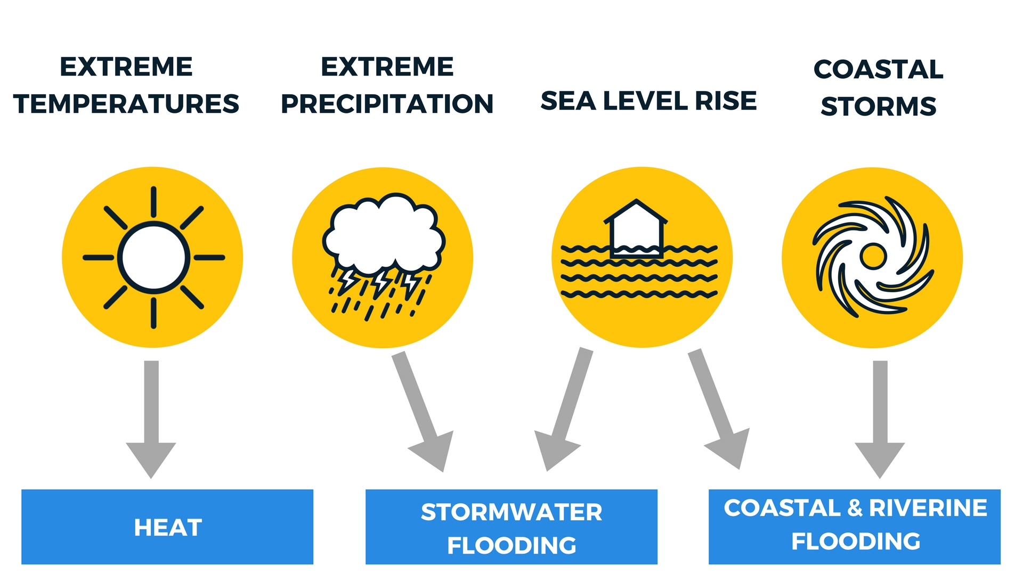
WHAT WE’RE STUDYING
Notes:
Scientists agree upon the impact of climate change on the Boston region.
These include extreme temperatures, extreme precipitation, and sea level rise.
We will be discussing these topics and their impacts as we move through the presentation

Slide 9
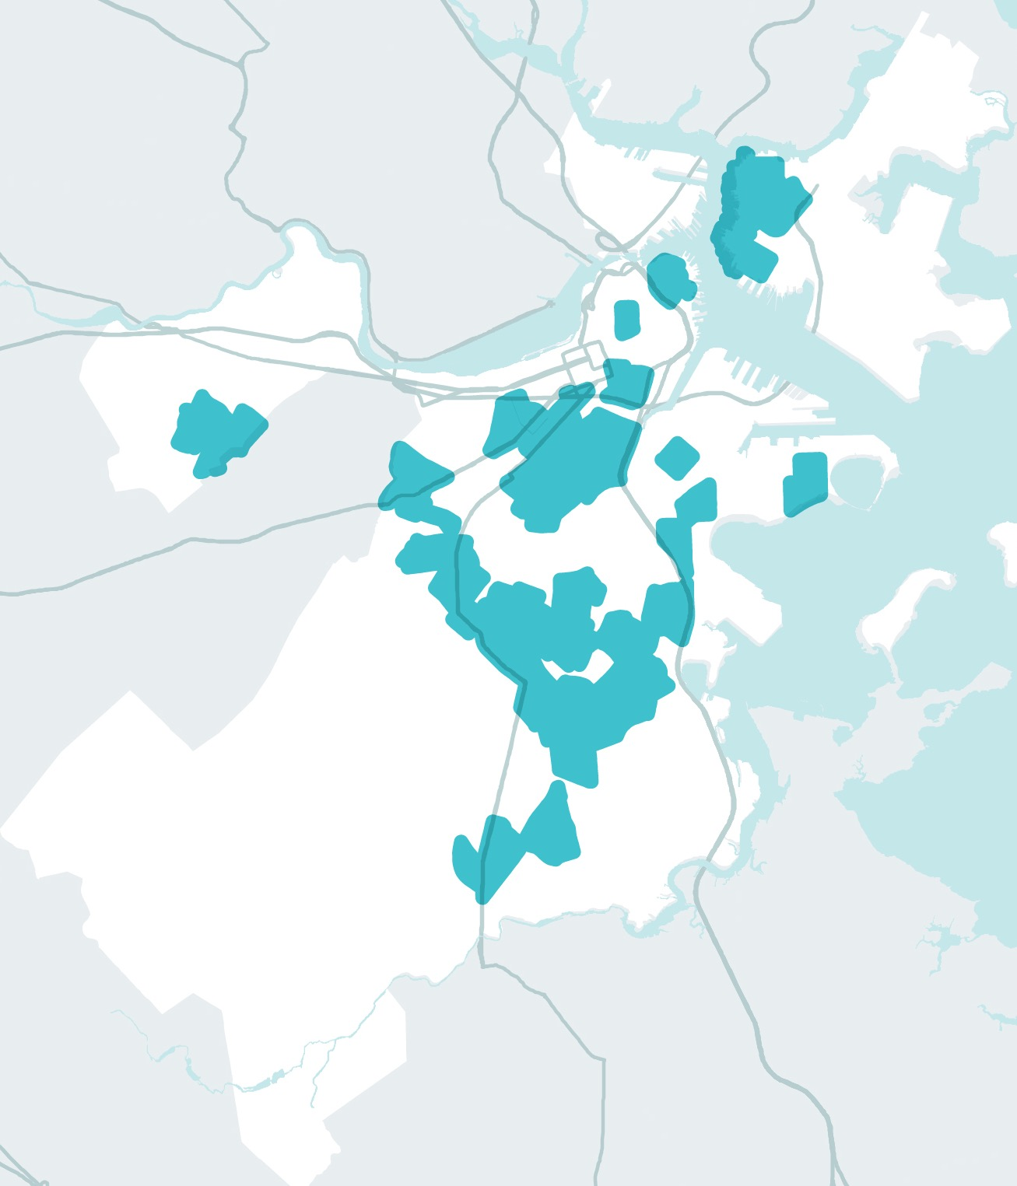
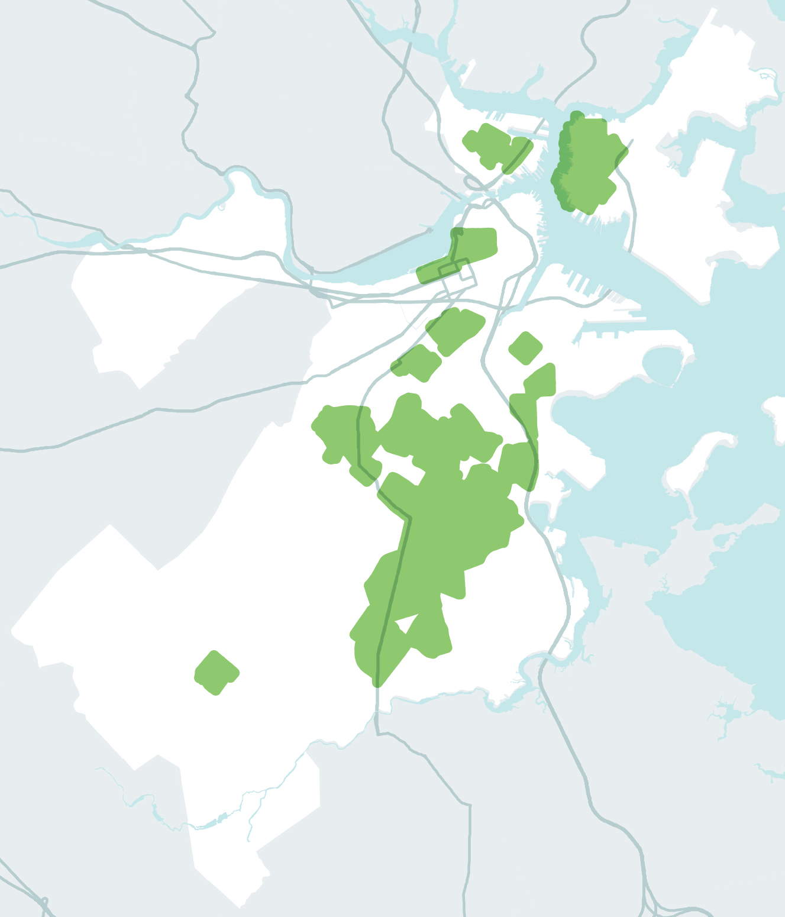
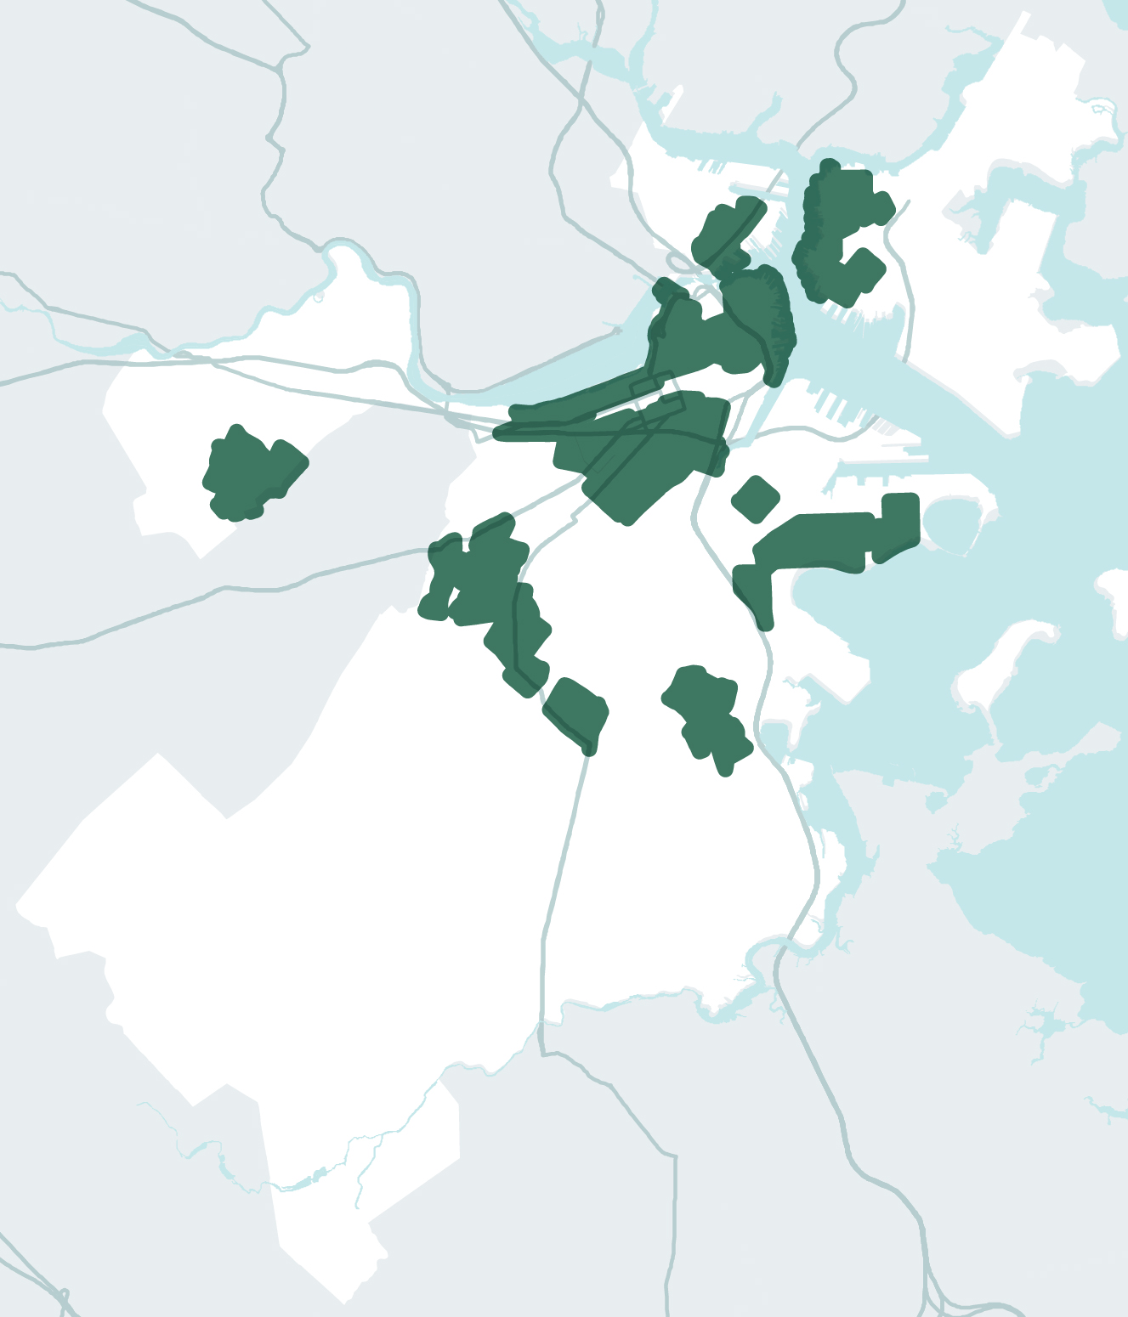
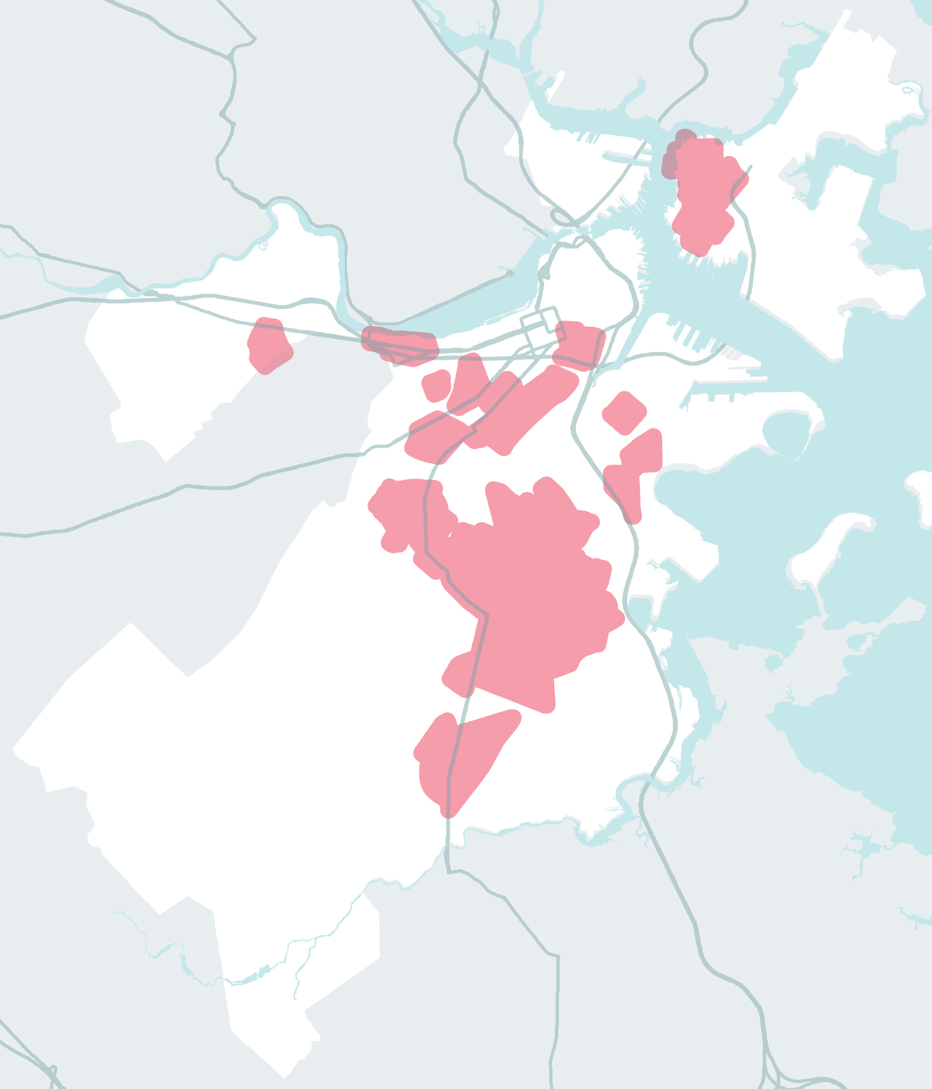
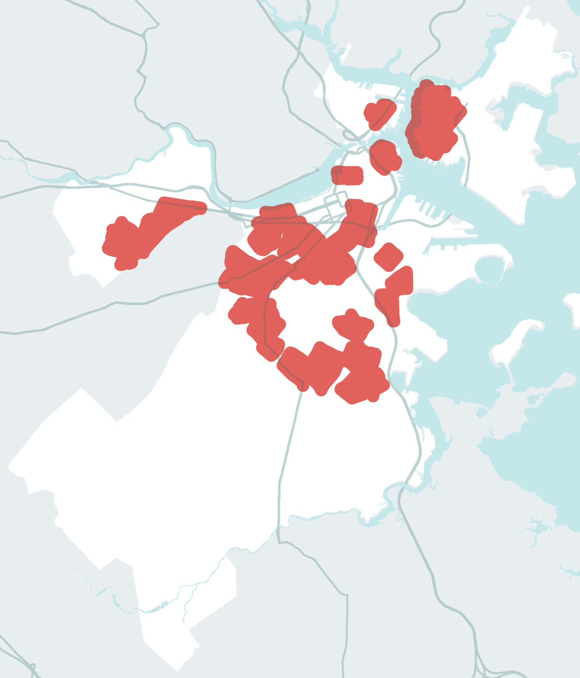
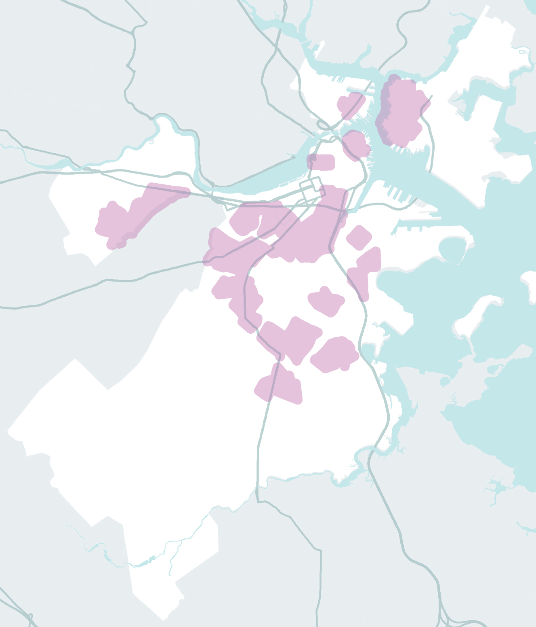
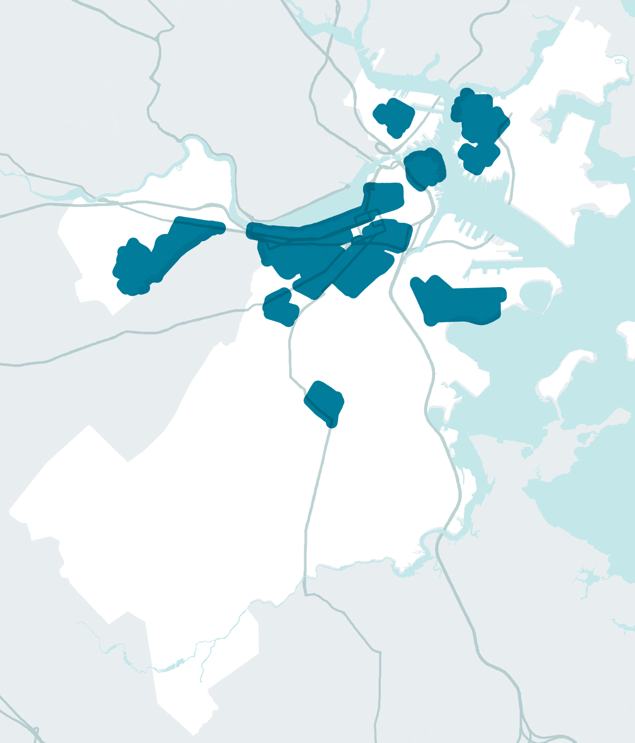
CONCENTRATIONS OF SOCIALLY VULNERABLE POPULATIONS
CONCENTRATIONS OF SOCIALLY VULNERABLE POPULATIONS
CONCENTRATIONS OF SOCIALLY VULNERABLE POPULATIONS
CONCENTRATIONS OF SOCIALLY VULNERABLE POPULATIONS
CONCENTRATIONS OF SOCIALLY VULNERABLE POPULATIONS
CONCENTRATIONS OF SOCIALLY VULNERABLE POPULATIONS
CONCENTRATIONS OF SOCIALLY VULNERABLE POPULATIONS
“PEOPLE AREN’T
AFFECTED EQUALLY.”
176,059
70,701
236,938
176,059
63,187
104,659
327,284
239,246
PEOPLE WITH LOW-TO-NO INCOME
PEOPLE WITH LOW-TO-NO INCOME
PEOPLE WITH DISABILITIES
CASES OF MEDICAL ILLNESS
PEOPLE WITH LIMITED ENGLISH PROFICIENCY
CHILDREN
OLDER ADULTS
PEOPLE OF COLOR
Notes:
These impacts do not affect everyone equally.
Age, health, income, race, and gender all play a role and are therefore important to address

Slide 10
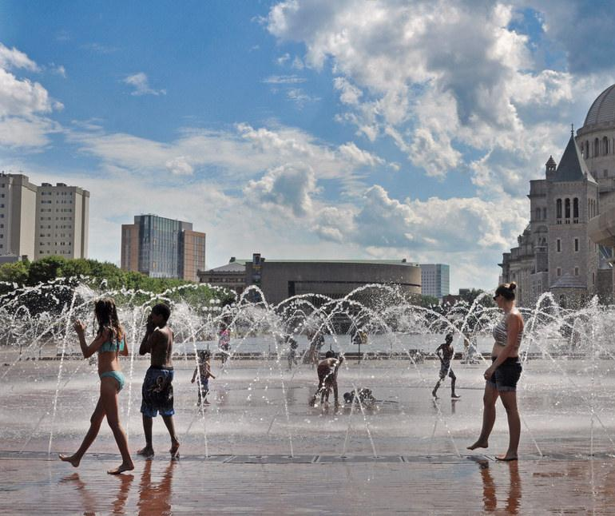
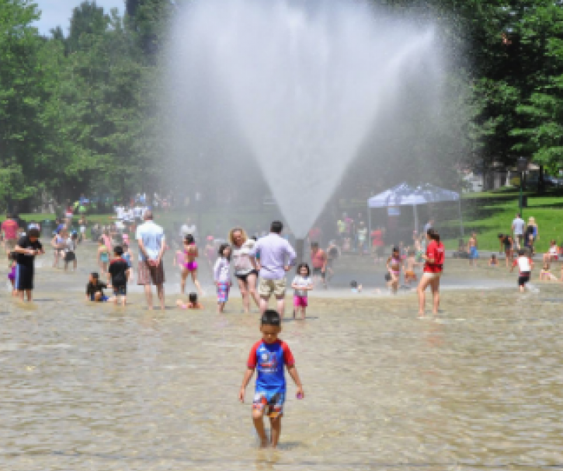
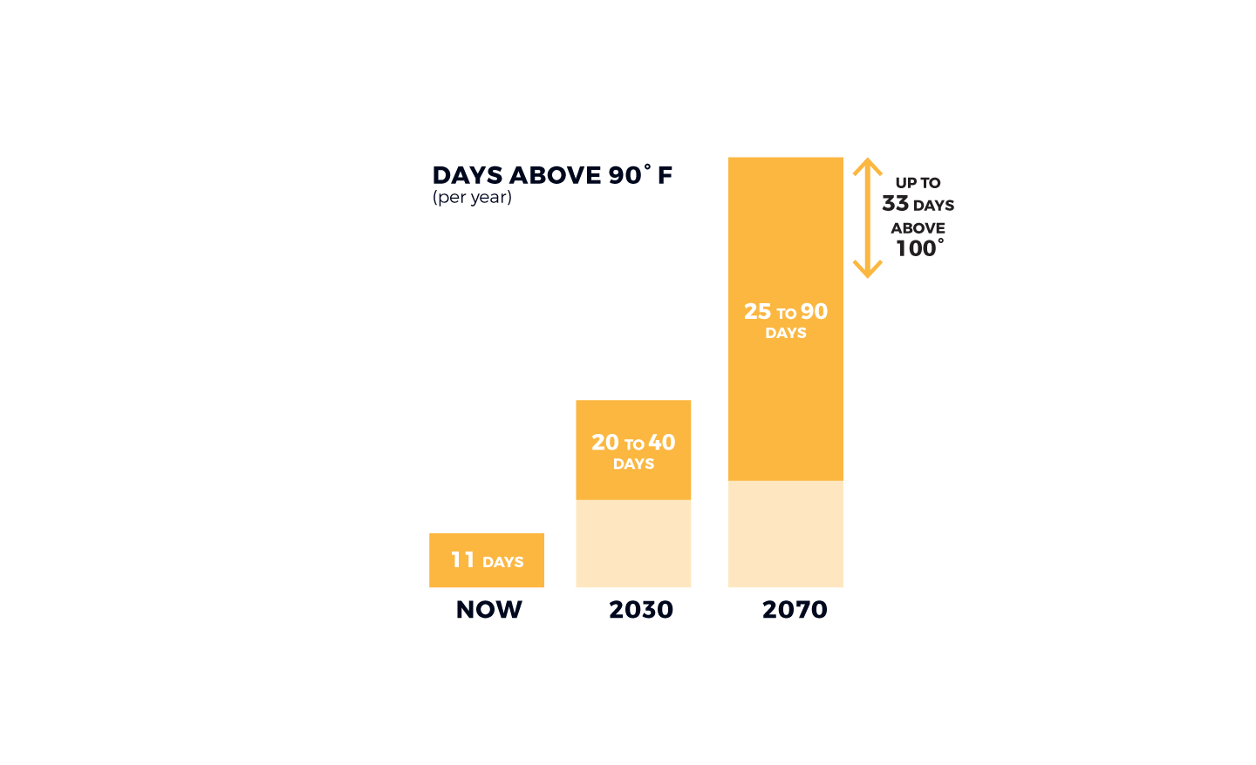
MORE HOT DAYS
Boston’s summers may be as hot as Washington, D.C’s in 50 years, and like Birmingham Alabama’s in 80.
Photo credit: Sarah Nichols, Kids with Fountain
Notes:
There were 22 days over 90 degrees in 2015 and by 2030 we could be seeing up to 40 days over 90 degrees.
Summers are getting hotter with more heat waves

Slide 11
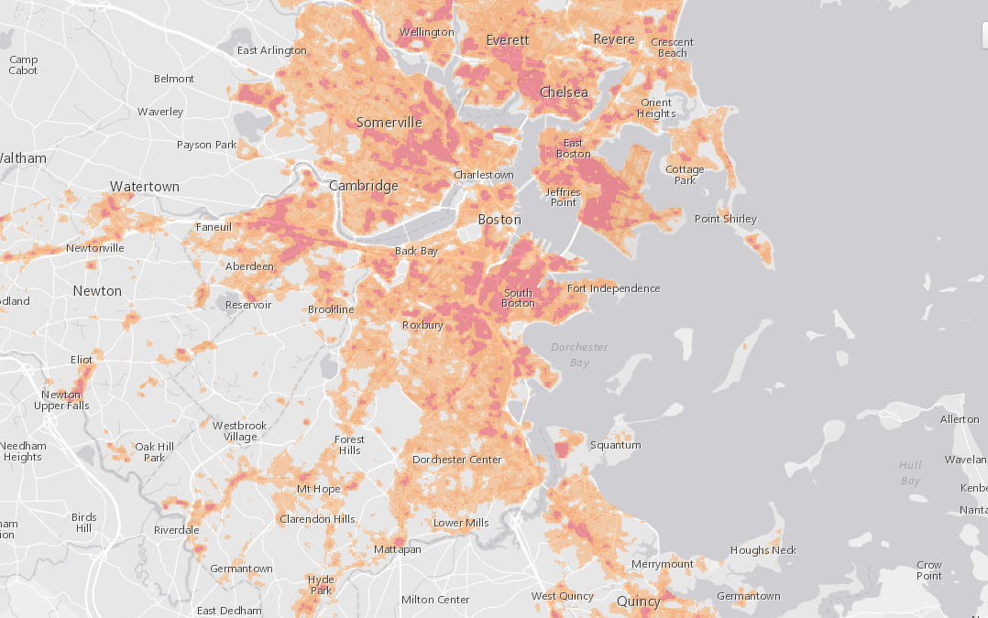
HEAT ISLAND EXPOSURE
Heat waves affect children and older adults at higher rates
Heat island exposure is also greater in neighborhoods with limited green space.
Notes:
More hot days means increased heat island exposure.
Heat waves and heat island exposure affect people unequally.
It affects children and older adults at higher rates, those who do not have access to cool spaces in the summer, and individuals with conditions that are exacerbated by heat exposure, like asthma.
Heat island exposure is also greater in neighborhoods with limited green space.

Slide 12
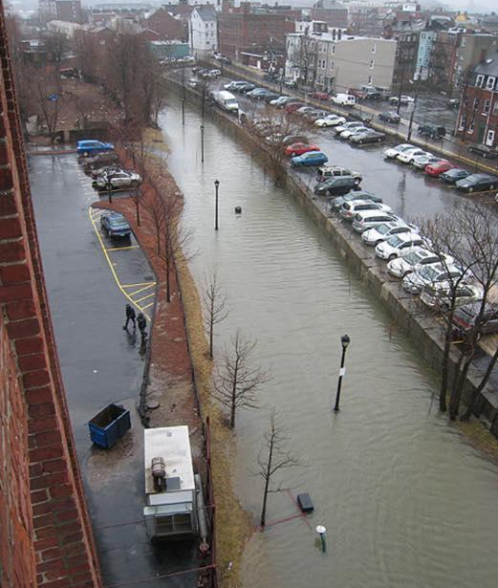
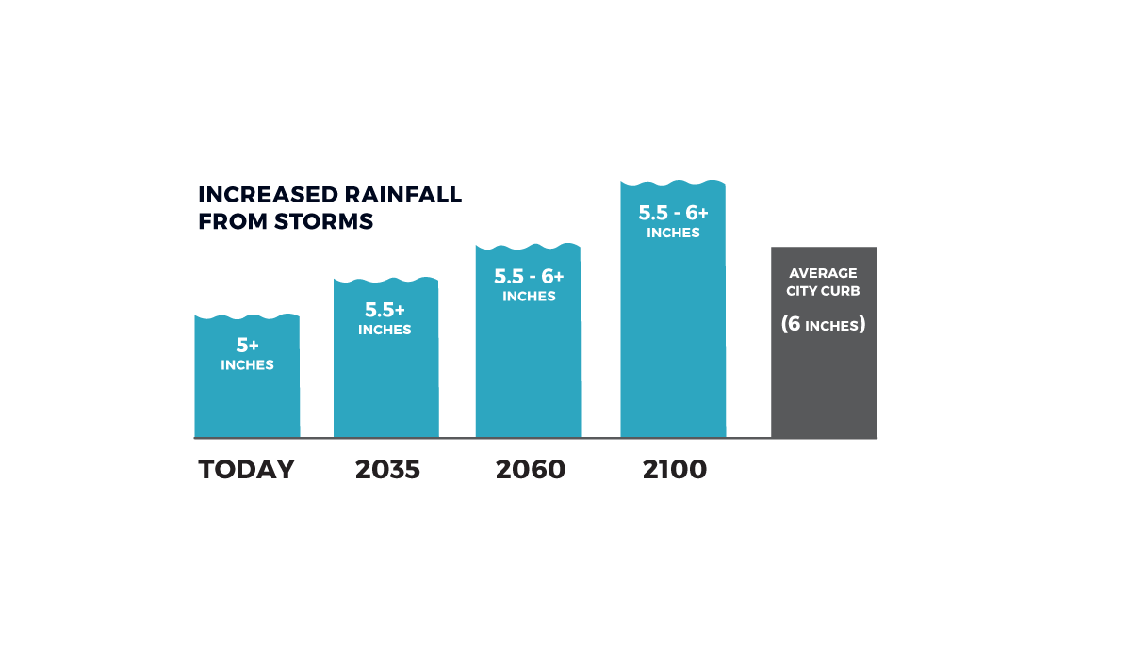
INCREASED PRECIPITATION
By 2060, heavy precipitation events could drop more than 6 inches of water within 24 hours, which is the height of an average city curb, and 20% more than what we get now.
Notes:
By 2060, heavy precipitation events will increase by 20%, at a rate of more than 6 inches per 24 hour period
This is the height of an average city curb.
This impacts stormwater systems, transit, etc.

Slide 13
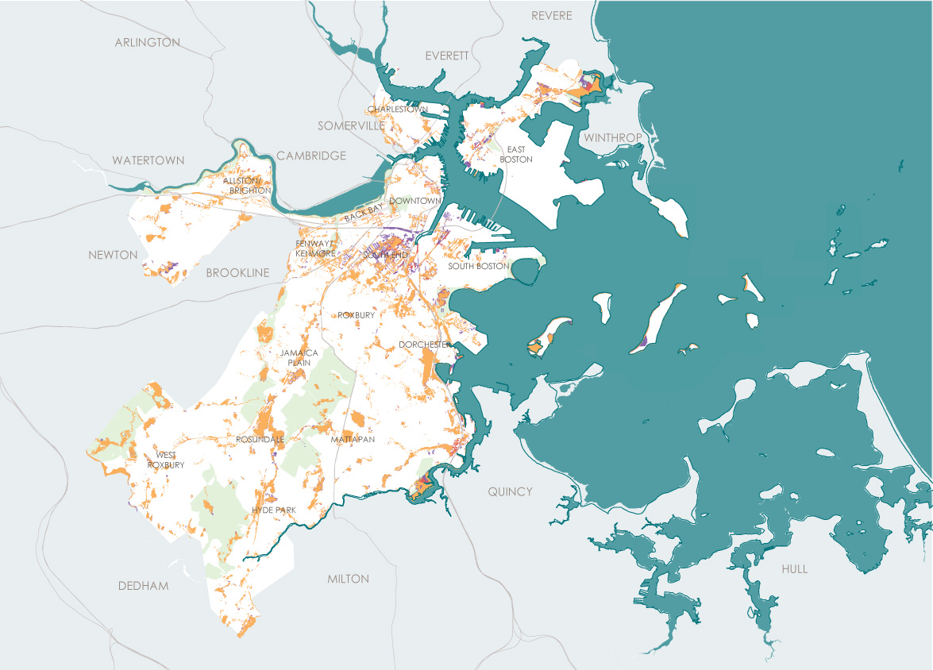
STORMWATER FLOODING
STORMWATER FLOODING FROM INCREASED PRECIPITATION
Notes:
This is data from Boston’s Water and Sewer Commission showing parts of the city that would see nuisance flooding as a result of increase in precipitation.

Slide 14
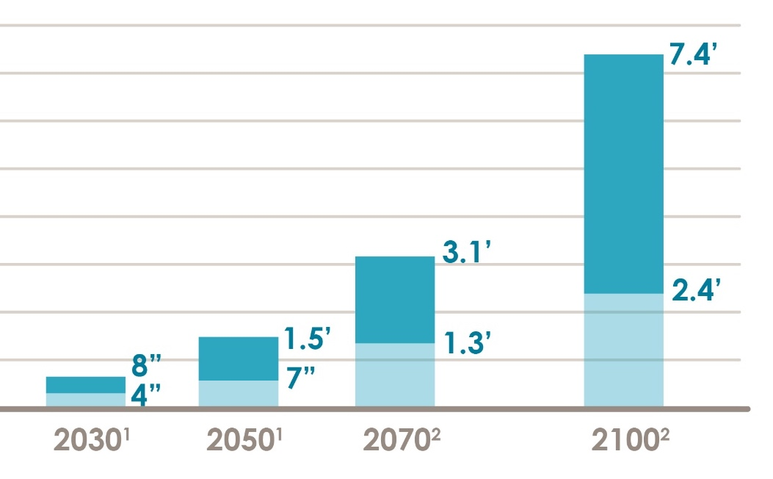
SEA LEVEL RISE
BOSTON RELATIVE SEA-LEVEL RISE PROJECTIONS
Without reducing emissions, at least 3 feet of sea level rise is likely during the second half of the century.
6.11’
KEVIN GARNETT
Notes:
SLR is occurring and will accelerate over time, bringing flood risks along coasts and rivers.
The darker blue bars shows projected sea level rise over time with a “business as usual” carbon scenario-- meaning we don’t reduce our use of fossil fuels.
The lighter blue bars shows us sea level rise if we do cut carbon in line with the levels required in the Paris Agreement.
This chart shows us that cutting carbon emissions is critical to seeing lower sea levels in Boston in the future.
And also that some sea level rise will happen no matter what so we need to start planning for it.

Slide 15
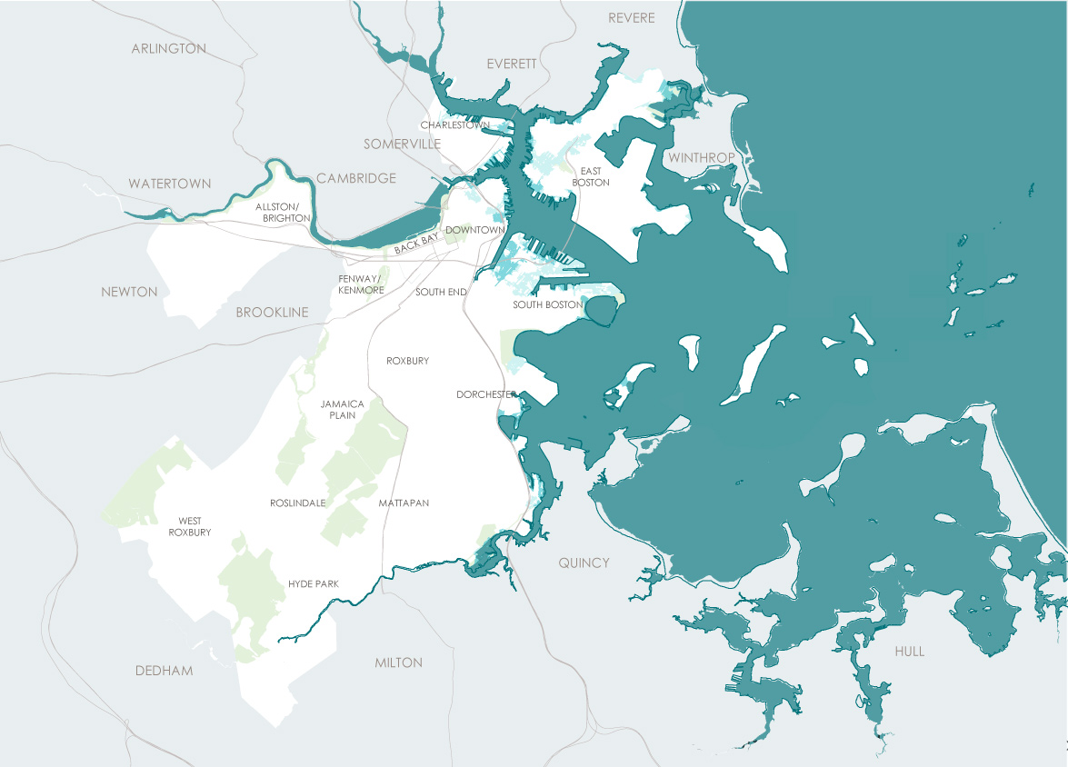
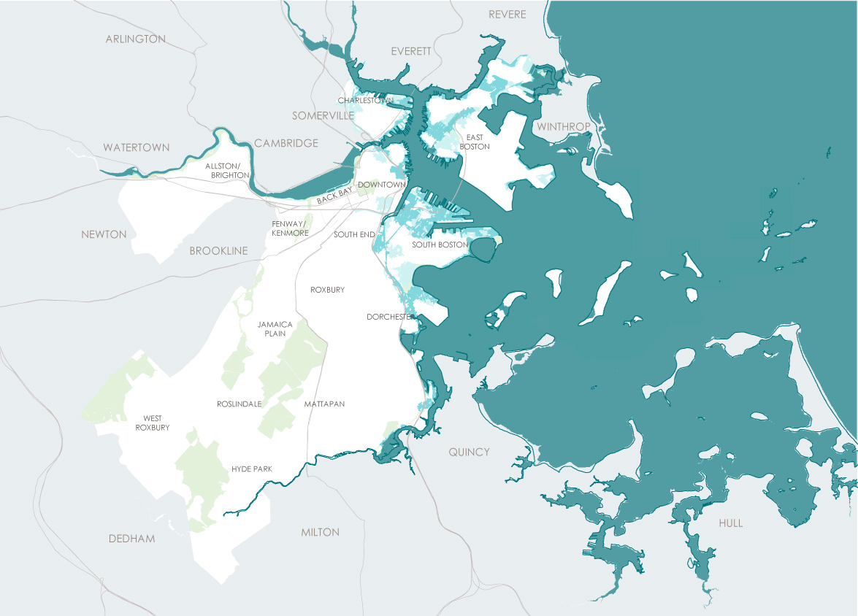
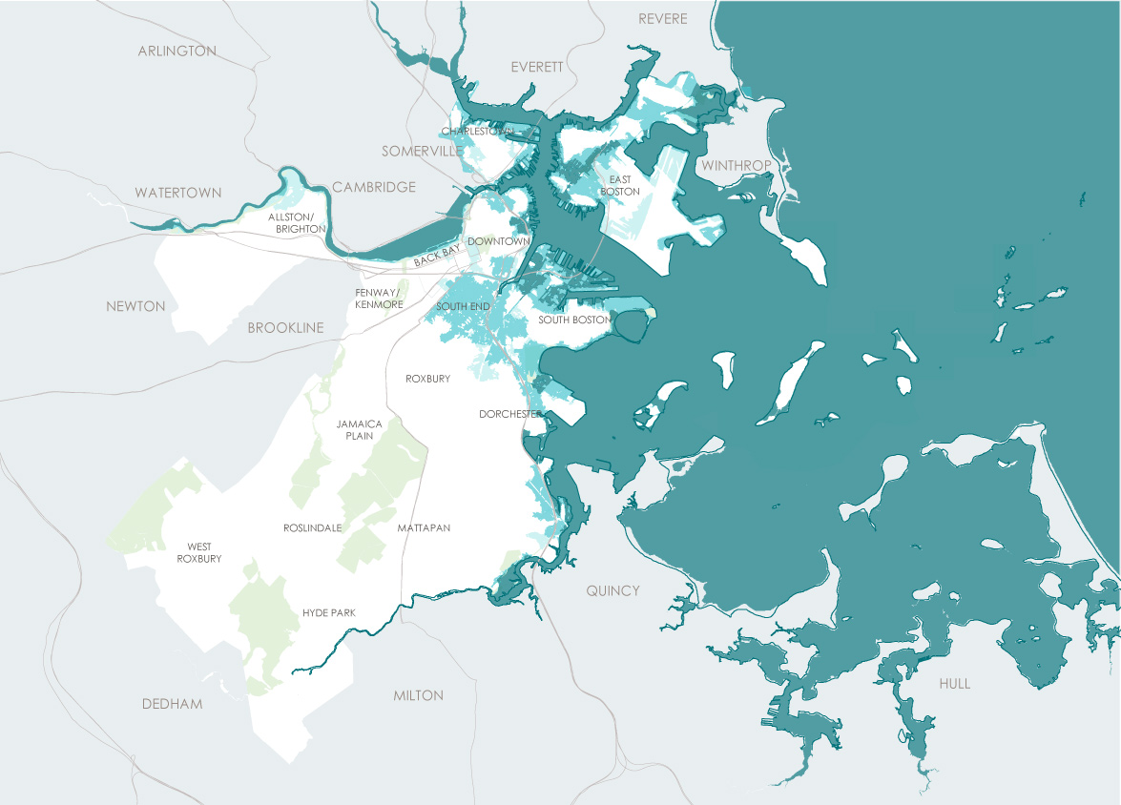
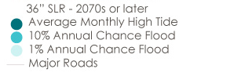
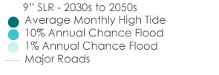
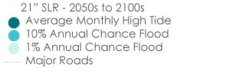
FLOODING ALONG COASTS AND RIVERS
NEAR TERM:
9” SLR –
2030s to 2050s
MID CENTURY:
21” SLR –
2050s to 2100s
LATE CENTURY:
36” SLR –
2070s or later
FLOOD PROGRESSION DUE TO SEA LEVEL RISE
FLOOD PROGRESSION DUE TO SEA LEVEL RISE
FLOOD PROGRESSION DUE TO SEA LEVEL RISE
Notes:
Greater amounts of Sea Level rise means flooding along coasts and rivers will increase
The lighter blue areas are parts of the city that--with 3 feet of sea level rise-- could see flooding during an extreme storm event, like a hurricane or Nor’easter.
The darkest blue are areas at risk for flooding at the monthly high tides-- with 3 feet of sea level rise.

Slide 16
WHAT’S AT STAKE?
People and Buildings Exposed to a 1% Flood Risk
2030+
2070+
18,000 PEOPLE
85,000 PEOPLE
2,000 BUILDINGS
12,000 BUILDINGS
$20B
$85B
Notes:
In the near term, major flooding events combined with sea level rise place 18,000 people and 2,000 buildings, valued at $20 billion, at risk
By 2070, the risk increases to 85,000 people, which is about 15% of Boston’s population, and 12,000 buildings, valued at $85 billion

Slide 17
WE ARE TAKING ACTION:
FIVE KEY CATEGORIES
CLIMATE PROJECTIONS
SHORELINES
INFRASTRUCTURE
BUILDINGS
PREPARED AND CONNECTED COMMUNITIES
Notes:
Boston is taking action across these five areas: Climate Projections, shorelines, infrastructure, buildings, and communities.
Climate resilience strategies need to be comprehensive-- we can’t depend on just on type of solution to work.
The next slides will address one project or component of each of these areas.

Slide 18
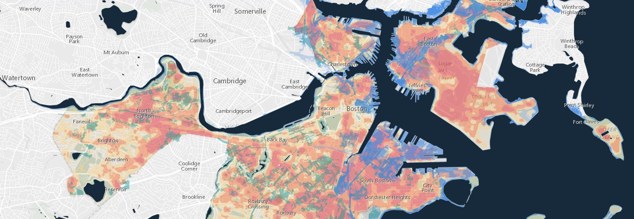
UPDATE CLIMATE PROJECTIONS
Climate Ready Boston Map Explorer Tool brings updated climate projections to you
www.boston.gov/climate-ready
Notes:
Climate Ready Boston Map Explorer tool brings updated climate projections to you
It helps people understand the risks they need to respond to
It brings data to you and allows you to focus in on specific neighborhoods and visualize different projections
You can visit the link at home and download the data on the City’s “Analyze Boston” platform.

Slide 19
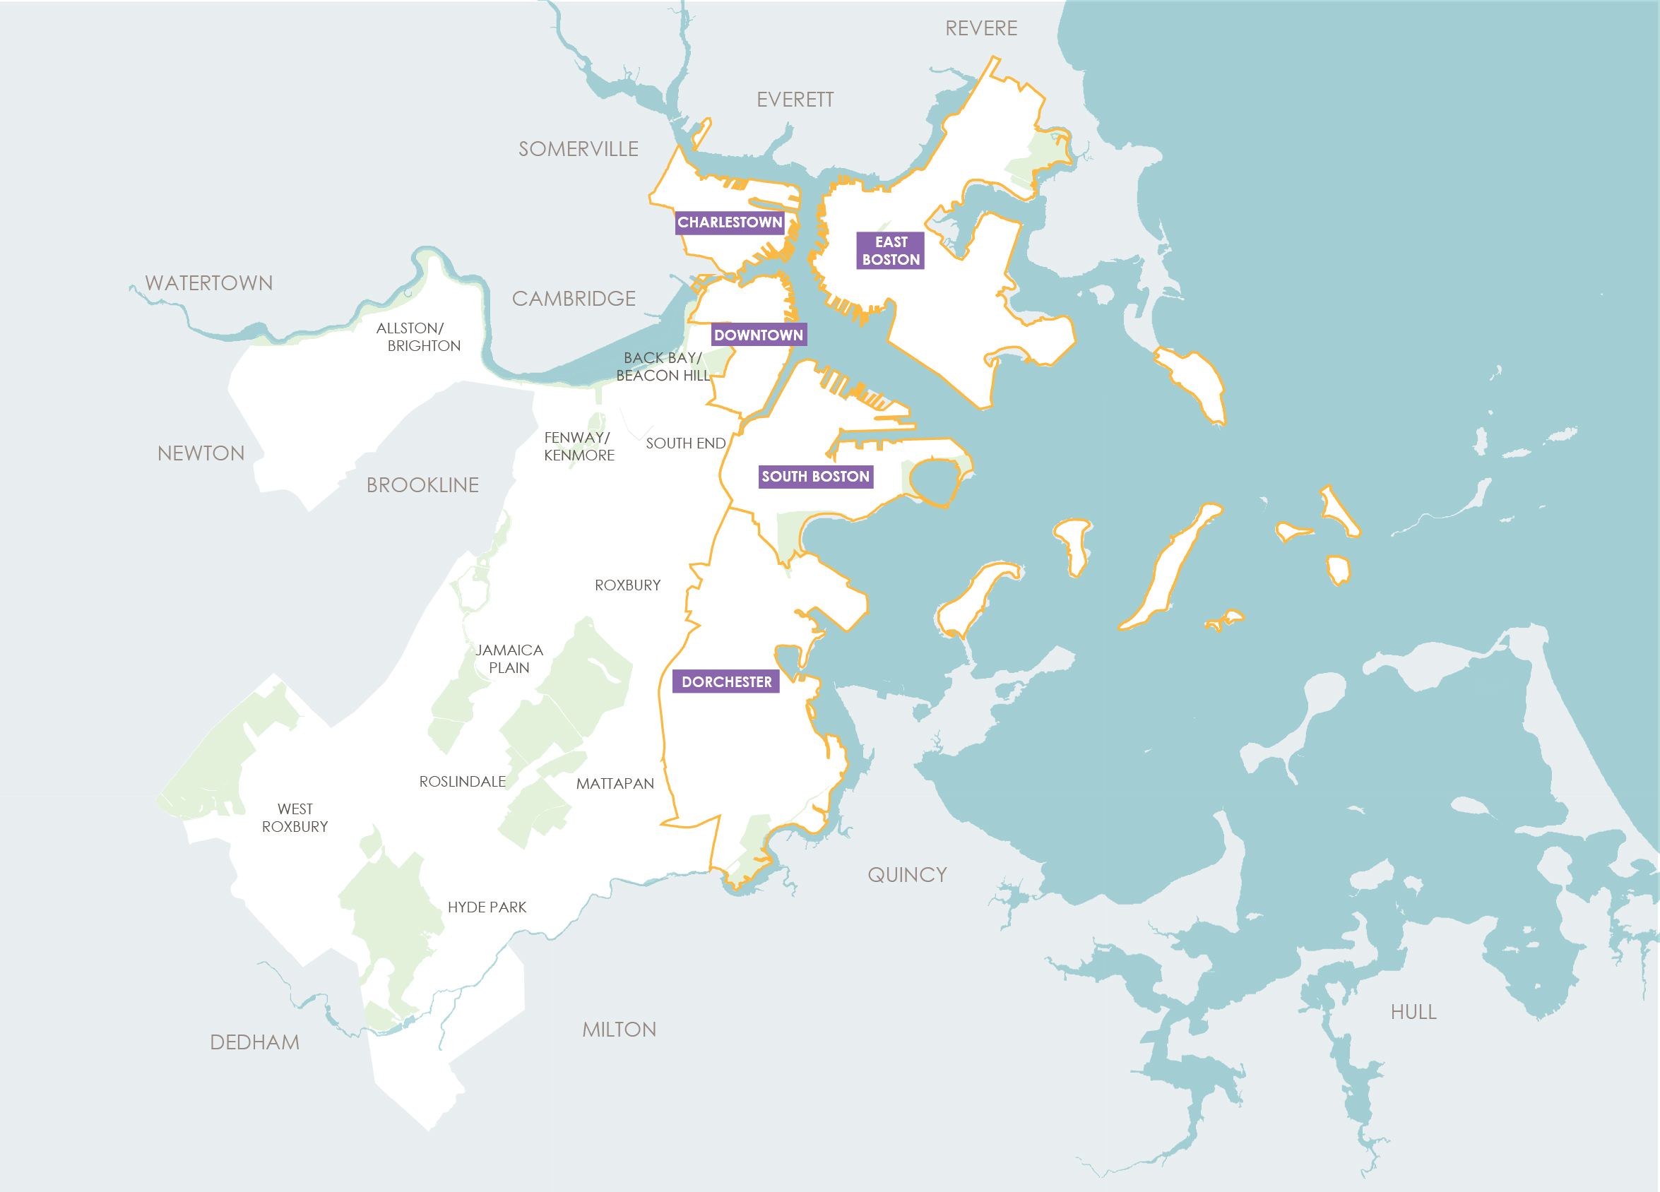
PROTECTED SHORELINES
DISTRICT-SCALE FLOOD PROTECTION
PROJECT SITES
Notes:
The City is in the process of developing neighborhood coastal resilience plans for all neighborhoods that could be impacted by sea level rise.
The red dots represent project sites that are currently being addressed.
These projects can be further explored through the Map Explorer tool.

Slide 20
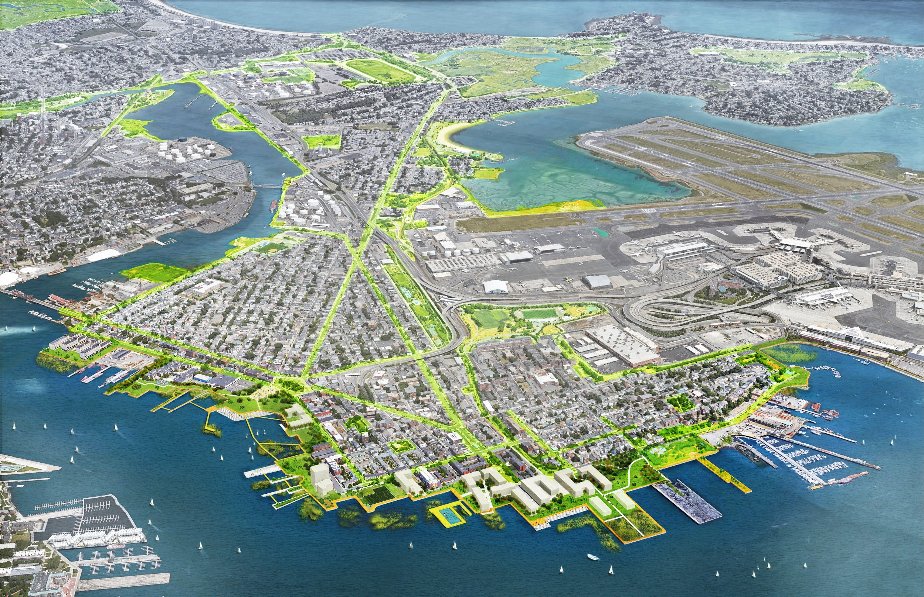
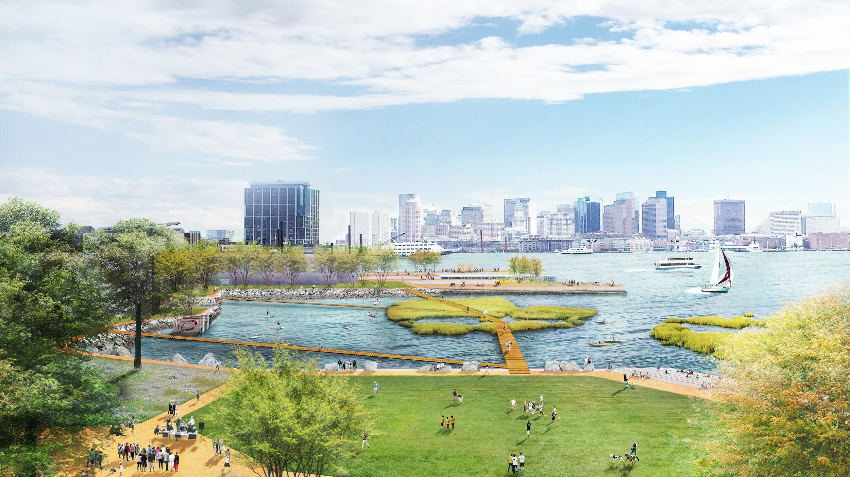
PROTECTED SHORELINES
Coastal Resilience Solutions for East Boston (Full report at boston.gov/climate-ready)
Developing short term actions and a long term vision for coastal resilience
Residents of East Boston came together with the City to create the report
Notes:
These are images from the “Coastal Resilience Solutions for East Boston and Charlestown” report-- the first neighborhood coastal resilience plan released in October.
It outlines long and short term designs and recommendations that address coastal flooding, stormwater management, and provide more accessible green spaces for the community
Addressing flooding in this way opens up possibilities for other community benefits.

Slide 21
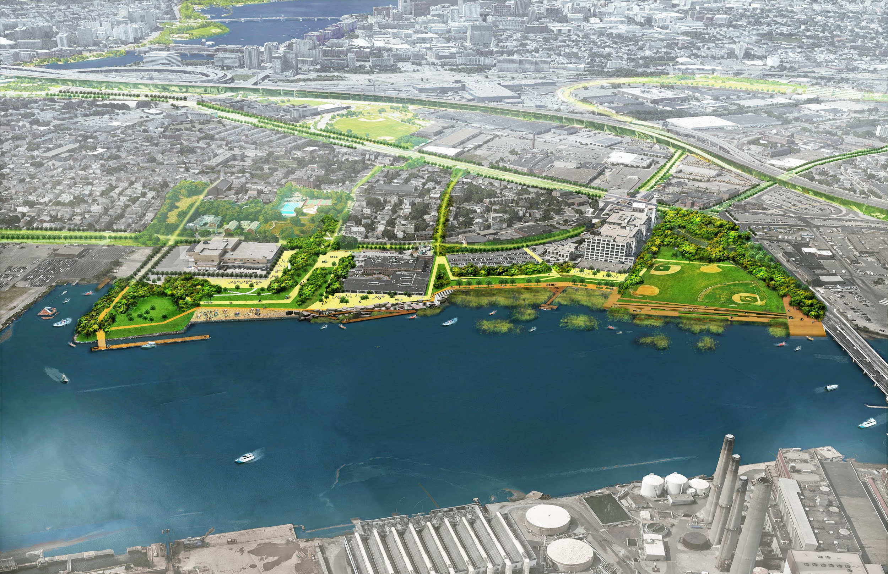
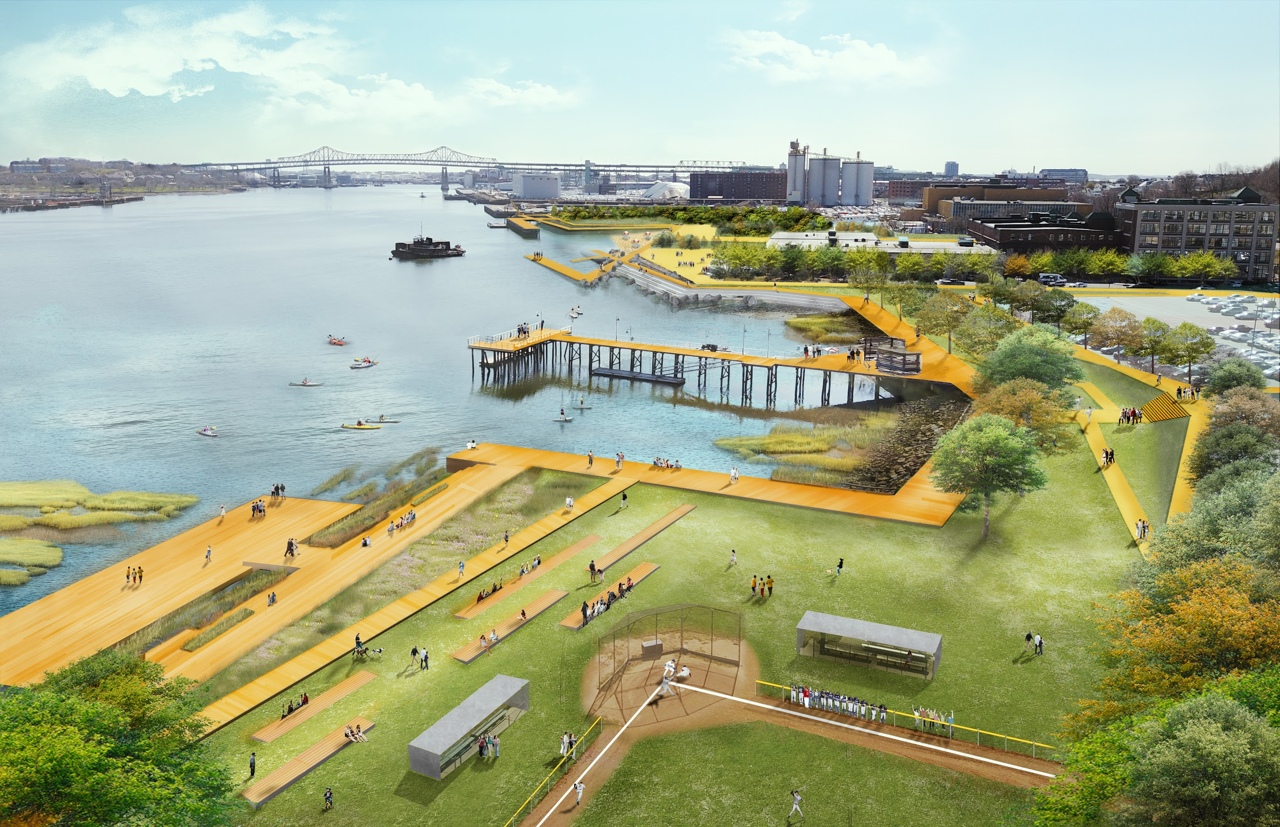
PROTECTED SHORELINES
Coastal Resilience Solutions for Charlestown (Full report at boston.gov/climate-ready)
Developing short term actions and a long term vision for coastal resilience
Residents of Charlestown came together, with the City, to complete the report
Notes:
Pictured here is Charlestown-- from the “Coastal Resilience Solutions for East Boston and Charlestown” report.
Another example of looking at green space and waterfront strategies to protect neighborhoods from sea level rise.

Slide 22
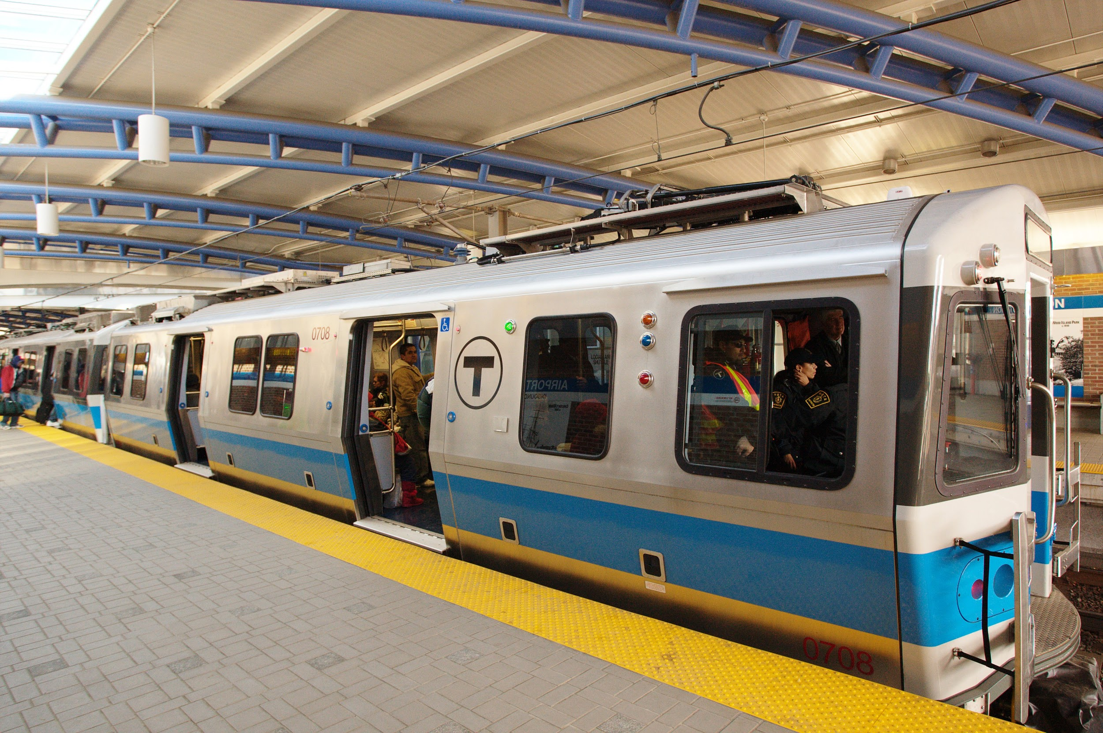
RESILIENT INFRASTRUCTURE
Developing an Infrastructure Coordinating Committee;
Improving coordination among utilities through the Smart Utilities Project (bostonplans.org)
Notes:
The City is establishing an Infrastructure Coordinating Committee in order to:
Develop climate ready planning and design standards
Coordinate actions across power, water, transportation, communication and other systems
Another example is Eversource Energy’s South Boston substation, which is built 15ft above ground to withstand the worst storms or tidal surges
Boston Smart utilities is also setting the stage for city-wide policies that will improve coordination among utilities and drive smart city solutions.

Slide 23
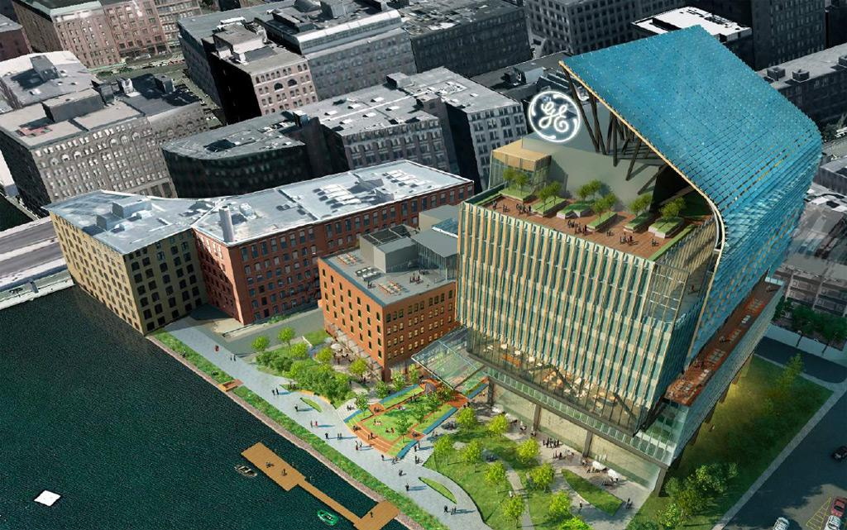
ADAPTED BUILDINGS
Updated zoning and resiliency checklist; exploring retrofitting buildings
Notes:
The City is currently working on:
Updated resilience checklist for new development
Exploring retrofitting buildings
Preparing buildings most at risk
Pictured here is the future GE Headquarters Building, that elevated its site 4.5 feet out of the floodplain. There are starting to be great examples of creative, resilience buildings in Boston.

Slide 24
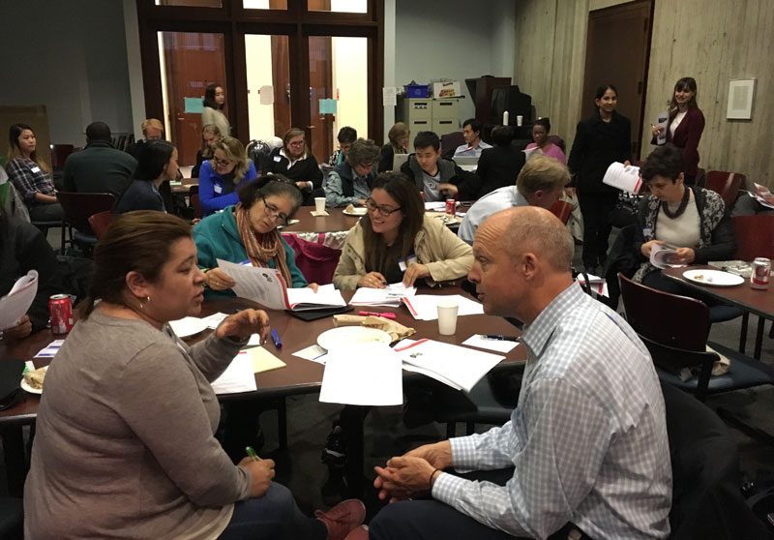
PREPARED AND CONNECTED COMMUNITIES
Climate Ready Boston Leaders:
Get trained to engage and inform your own communities on climate action
Notes:
Prepared and connected communities are:
Engaged with the planning process
Co-creating plans with the City of Boston
Staying informed on risks and how communities can be part of the solutions in both preparedness and mitigation.
Climate Ready Boston Leaders is a program (this program!) that trains leaders to engage and inform their own communities about climate action
Impacts are better understood with local knowledge

Slide 25
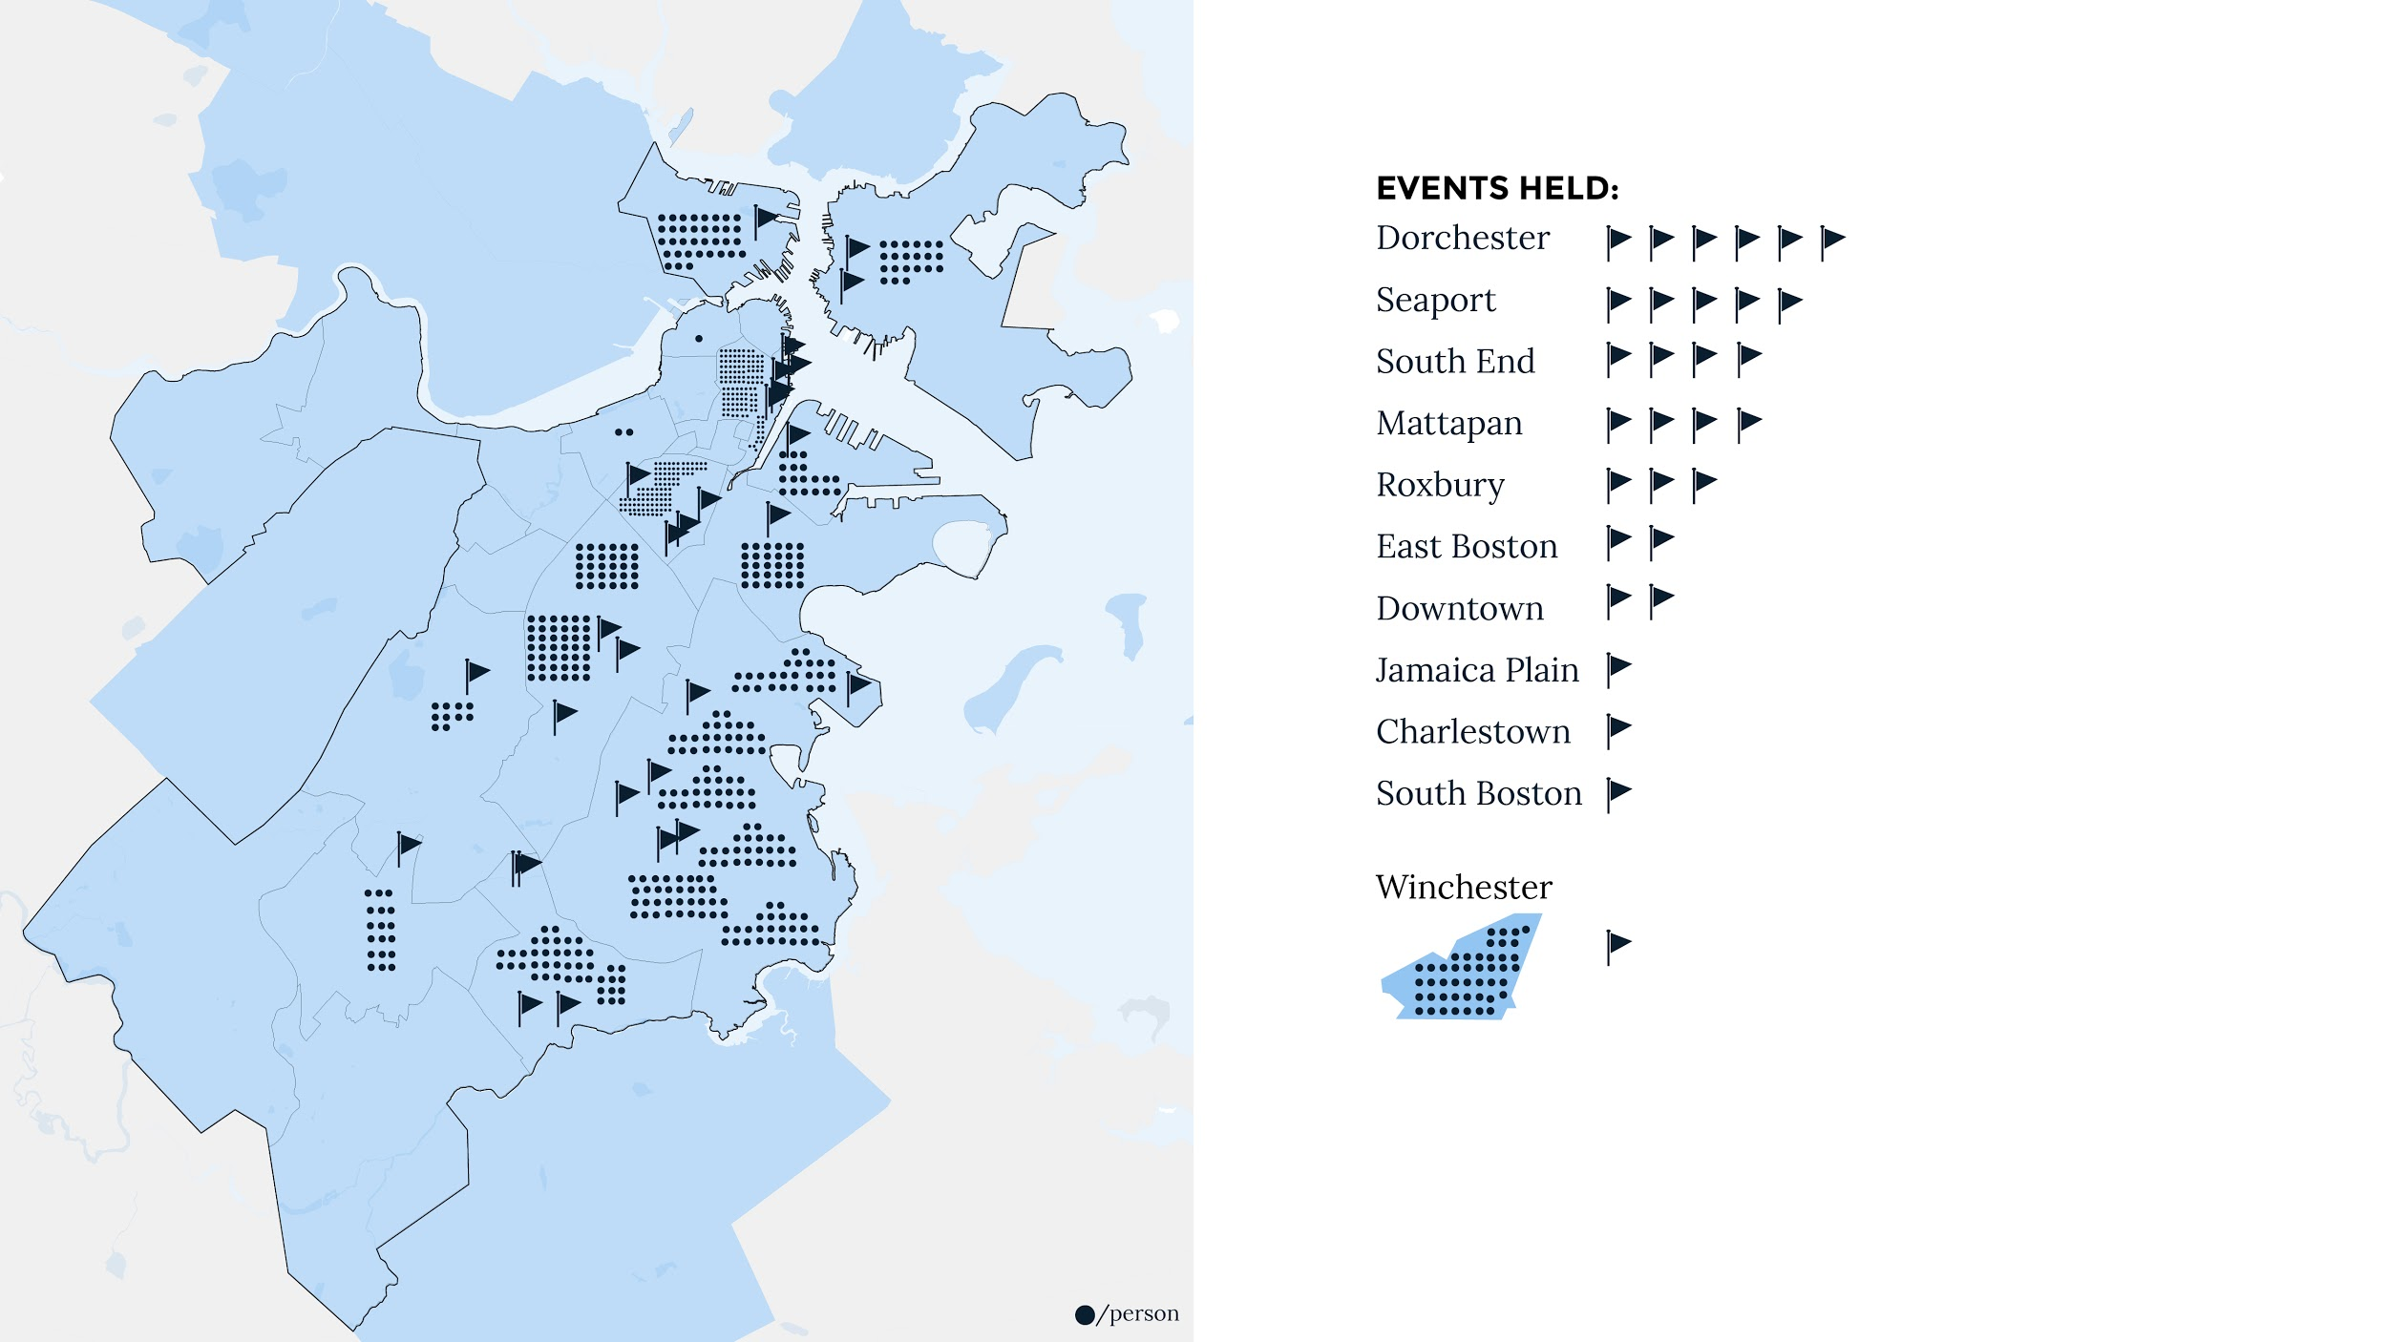
35 EVENTS AND 500+ PEOPLE ENGAGED IN SUMMER 2017
BECOME A CLIMATE READY BOSTON LEADER!
WWW.GREENOVATEBOSTON.ORG/CRB-LEADERS
Notes:
The Climate Ready Boston Leaders program has reached over 500 people in Boston’s neighborhoods
There were 35 events spread throughout the city and each event was held by people from different industries, with different passion, and varied goals.
If you are interested in becoming a leader, please sign up at Greenovateboston.org/crb-leaders.

Slide 26
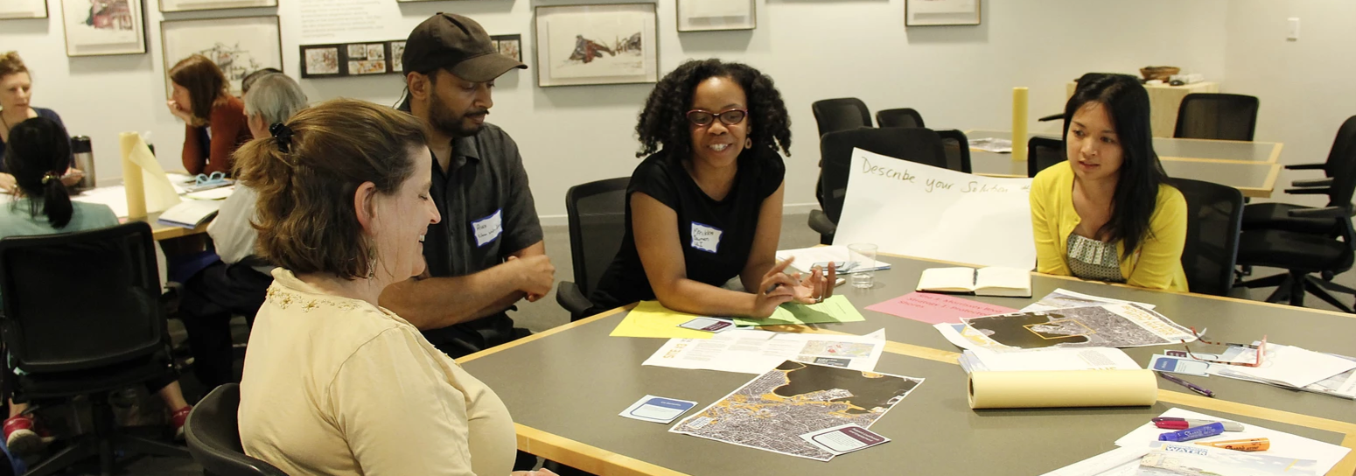
BE A PART OF THE PLAN. TAKE ACTION!
BECOME A LEADER
www.greenovateboston.org/crb-leaders
Lead a CRB event and send us your feedback
GET INVOLVED IN CITY OF BOSTON INITIATIVES THROUGH GREENOVATE:
Zero Waste Boston
Carbon Free Boston
Renew Boston: http://bit.ly/energy-visit
Climate Ready neighborhood plans
STAY UP TO DATE ON OUR PROGRESS
www.boston.gov/climate-ready-progress
SIGN UP TO HEAR ABOUT ENGAGEMENT OPPORTUNITIES
www.greenovateboston.org/signup_survey
Notes:
We all have a role to play in becoming a Climate Ready Boston
There are many ways to get involved, from being prepared to helping mitigate further damage
Here are a few ways to be engaged, get involved, and stay informed

Slide 27
WHAT CAN WE DO?
DISCUSSION
WHAT ARE OUR CHALLENGES AS A COMMUNITY?
WHAT CAN WE DO AS A COMMUNITY TO ADDRESS THESE CHALLENGES?
Notes:
What is our role, why are we all here?
What are our challenges as a community (list them)
What can we do as a community (to address these challenges)
What do we have the power to do, as a community, as individuals, as practitioners, as business owners?
The City cannot act alone to become climate ready. It will take all of us working together to create the path forward.
How can we take action as a community and what can we pledge to do?
Ask your participants to fill out the survey form! Fill out the presenter survey after your presentation and send all of these back to us.

