Slide 1
1937-1939 Beacon St (Mary Ann’s)
Install 6' by 22’ wood PVC-backed sign on blank front facade.
Sign have same color scheme and design language as old "Mary Ann's" sign, which was removed in November of 2015
No lights will be installed as part of this proposal

Slide 2
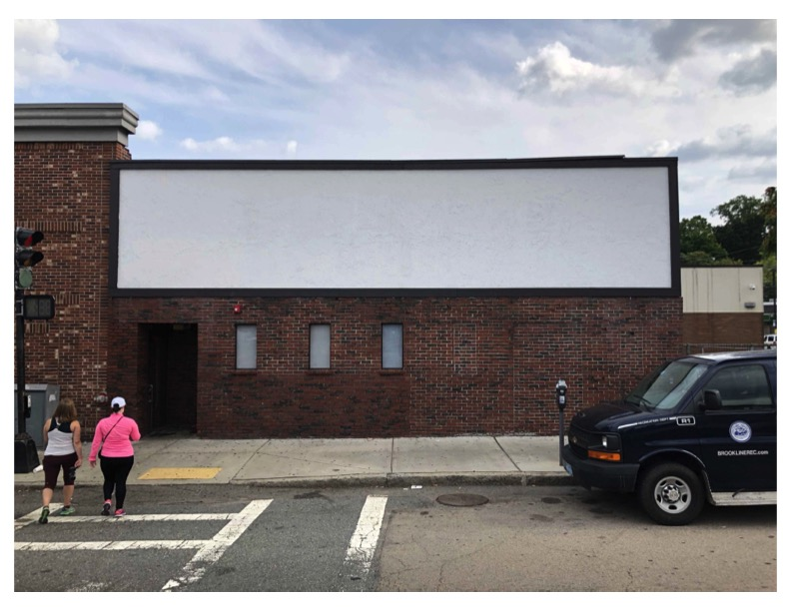

New Proposed Sign

Slide 3
New Proposed Sign - Details
PVC Backing mounted with screws, holes to be plugged
22ft
6ft
SW6748 ‘Greens’ or equivalent
SW6909 ‘Lemon Twist’ or equivalent

Slide 4
Previous Sign

