Slide 1
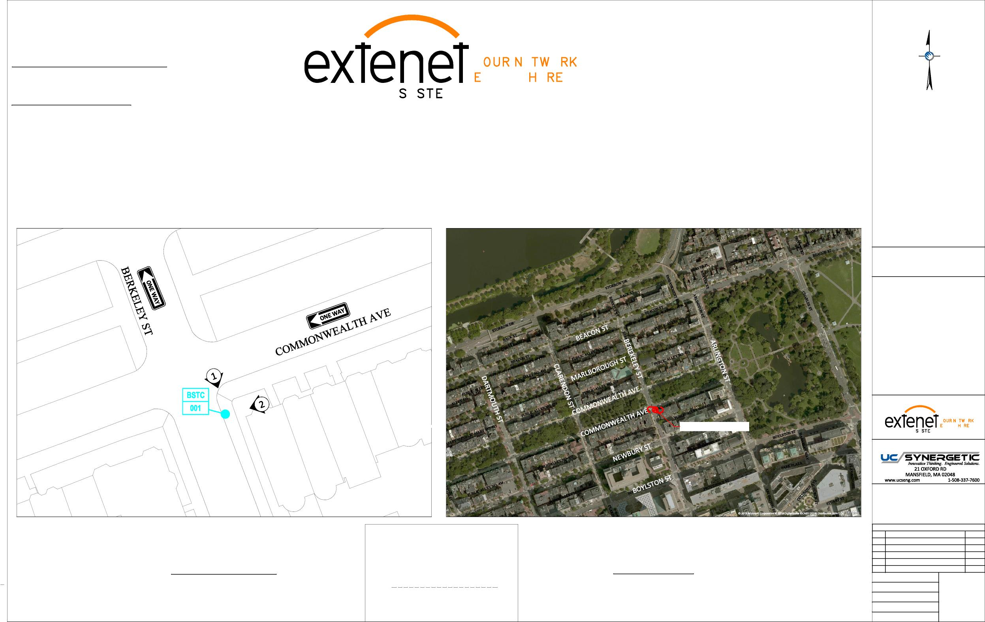
Extenet Systems
3030 Warrenville Rd., Suite 340 Lisle, IL 60532
24/7 Network Operations Center
YEO.
(866) 892-5327
Network Implementation
VERYWE.
YMS
Arthur Pino
Sr. Manager - Network Engineering & Implementation apino@extenetsystems.com Mobile: (978)-804-0652
BOSTON, MA
BACK BAY DISTRIBUTED ANTENNA SYSTEM
PROPOSED 4G/LTE NODE SITES
PROPOSED COMMONWEALTH AVE EXPANSION NODE NE-MA-BSTC8C01-001
COMMONWEALTH AVE AT BERKELEY ST
LOCATION:
BOSTON, MA SUFFOLK COUNTY
NOTES:
N:\Engineering\Extenet Systems\NE-MA-BSTC8C01-ATT\AA - AUTOCAD\NE-MA-BSTC8C01-001.dwg
PREPARED FOR:
YEO.
PROPOSED NODE POLE
YMS
VERYWE.
PREPARED BY:
REVISIONS
REV
DESCRIPTION
DATE
Location and Design Approved Boston Public Works
Street Lighting Department
1
ADDED ADA SITEPLAN
2/28/19
LOCATION MAP
LOCUS MAP
LATITUDE: 42.352782° LONGITUDE:-71.073718°
42° 21' 10.02" N, 71° 4' 25.38" W
SCALE: 1" = 50'
By:
ELEVATION: 11' AMSL
DRAFTER: CEM
SCALE: 1" = 500'
SCALE: AS SHOWN
1
10/9/18
Date:
ISSUE DATE: 10/05/18
INDEX NAME: NE-MA-BSTC8C01-001
SHEET #: 1 OF 9

Slide 2
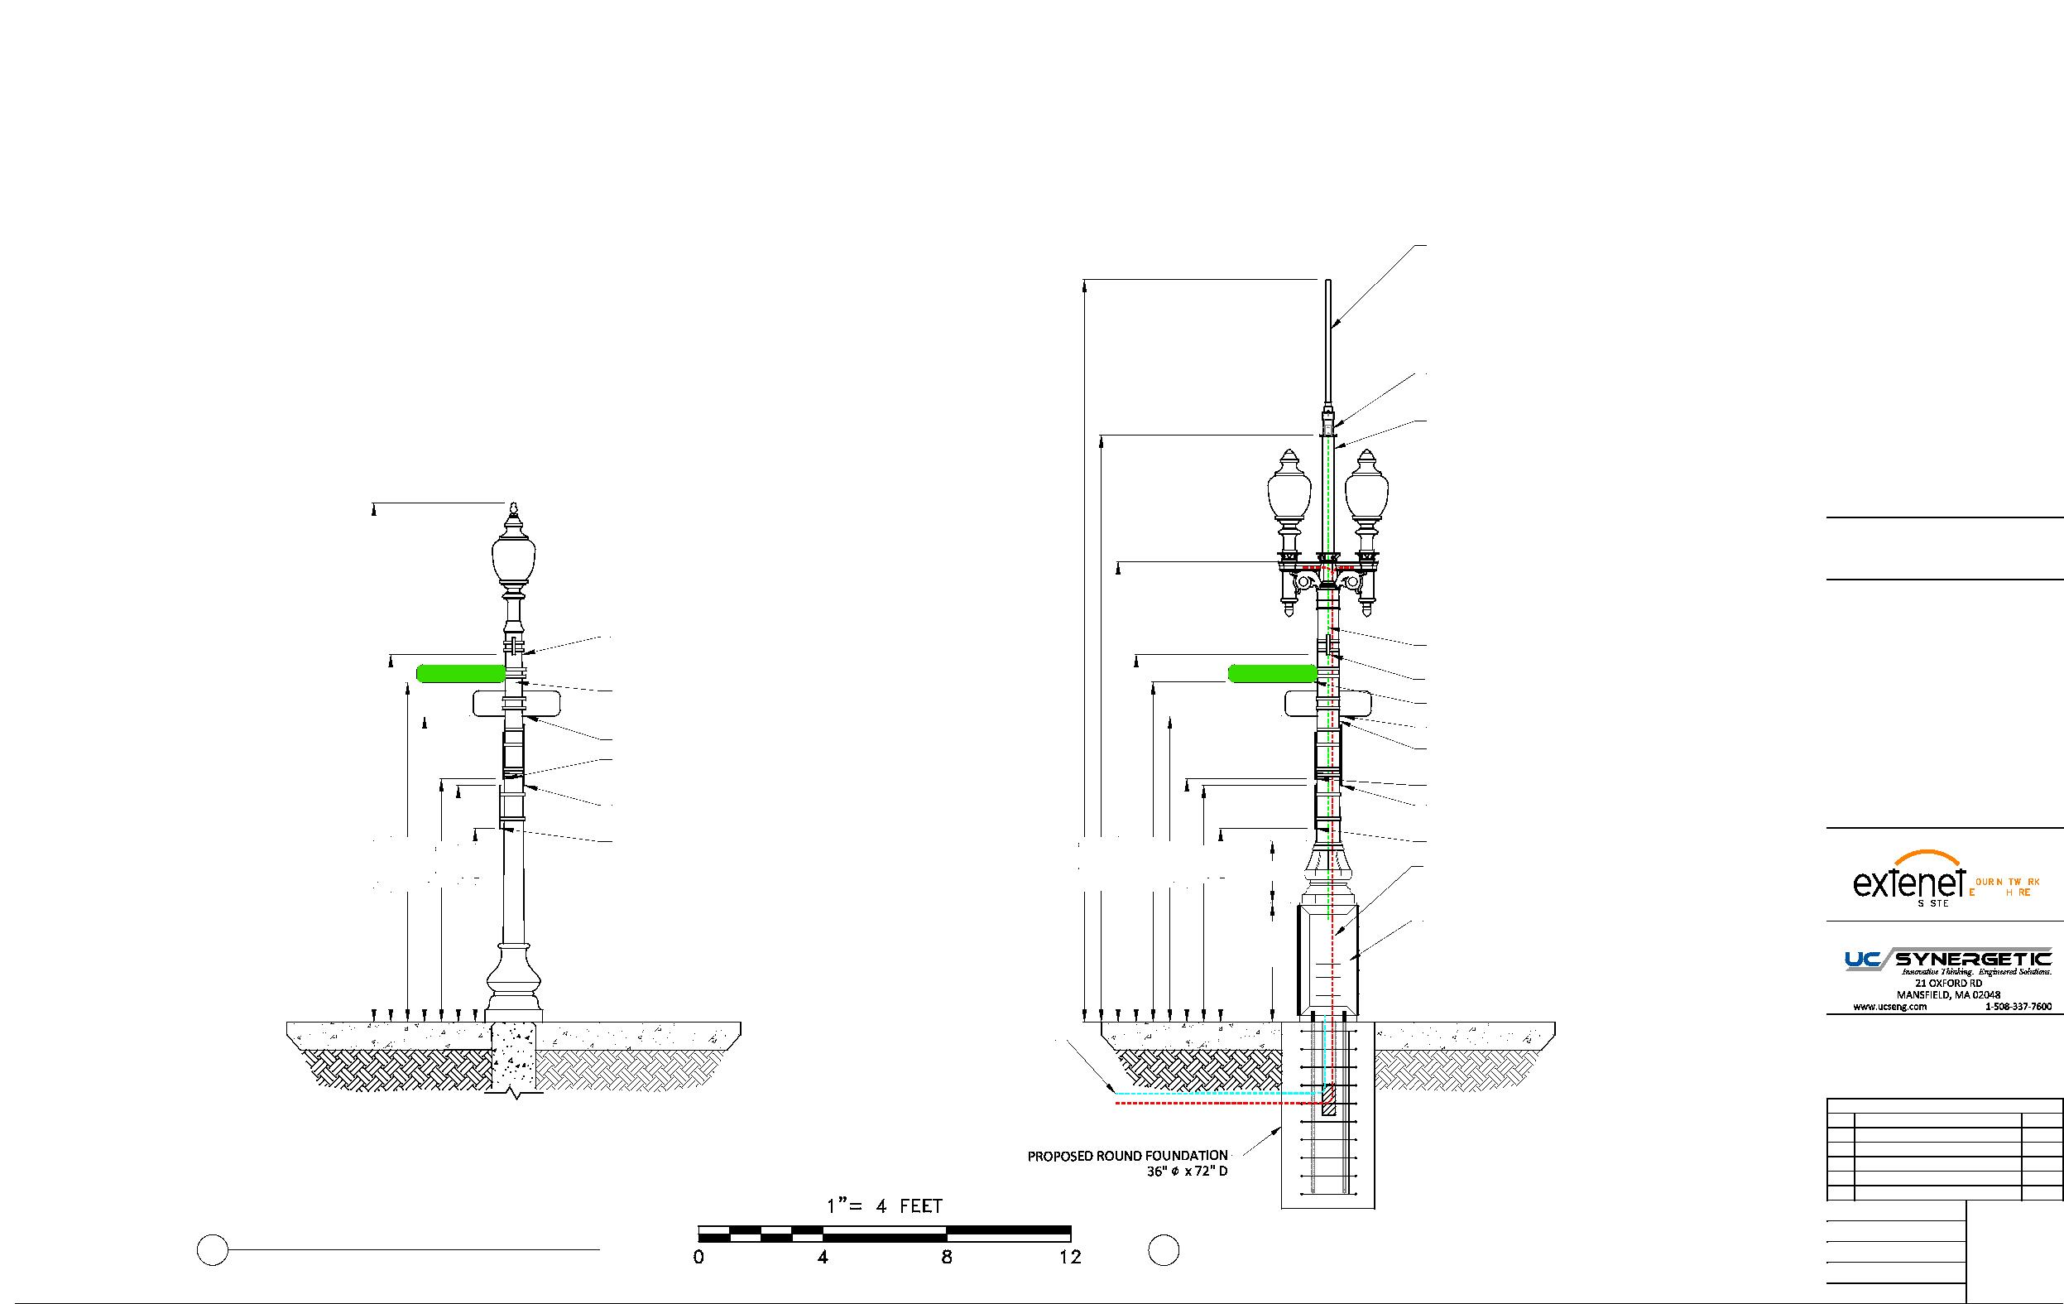
EXTENET BACK BAY BOSTON NODE NE-MA-BSTC8C01-001
PROPOSED EQUIPMENT MOUNTED ON REPLACEMENT STEEL POLE
PROPOSED OMNI ANTENNA
PHAZAR/BRSAWS360Q-698-1710-2-TOM-MD ANTENNA
(SEE DETAIL)
PROPOSED WHIP ANTENNA
CUSTOM ADAPTER (SEE DETAILS)
PROPOSED 3'-9" EXTENSION 4.5" DIAMETER
LOCATION:
BOSTON, MA SUFFOLK COUNTY
NOTES:
EXISTING STREET SIGN 11'-10"
COAX FEED
BERKELEY ST
BERKELEY ST
COMMSCOPE LDF4-50A(1/2")
EXISTING STREET SIGN 10'-11"
EXISTING STREET SIGN 11'-10"
EXISTING STREET SIGN 10'-11"
EXISTING ONE WAY SIGN 9'-10"
EXISTING ONE WAY SIGN 9'-10"
N:\Engineering\Extenet Systems\NE-MA-BSTC8C01-ATT\AA - AUTOCAD\NE-MA-BSTC8C01-001.dwg
EXISTING STREET CLEANING SIGN 7'-10"
PROPOSED 11' STEEL FLUTED POLE
TAPERED DIAMETER (9" BASE 8.1" TOP)
EXISTING DO NOT ENTER SIGN 7'-8"
EXISTING STREET CLEANING SIGN 7'-10"
EXISTING DO NOT ENTER SIGN 7'-8"
16'-9"
11'-10"
10'-11"
9'-10"
7'-10"
7'-8"
6'-3"
EXISTING PARKING SIGN 6'-3"
23'-11"
18'-11"
14'-10"
11'-10"
10'-11"
9'-10"
7'-10"
7'-8"
6'-3"
EXISTING PARKING SIGN 6'-3"
PREPARED FOR:
3'-10" 2'
SEPARATE POWER TO CONTINUE TO STREETLIGHT
YEO.
YMS
VERYWE.
(2) COMMSCOPE ION-M 7P-85P-17P-19P
PREPARED BY:
OPTICAL REMOTE UNITS
CONCRETE SIDEWALK
CONCRETE SIDEWALK
PROPOSED FIBER FEED
PROPOSED POWER FEED
REVISIONS
REV
DESCRIPTION
DATE
1
ADDED ADA SITEPLAN
2/28/19
DRAFTER: CEM
4
2 EXISTING PROFILE - REAR VIEW 2 LOOKING SOUTHWEST TOWARDS BERKELEY ST
PROPOSED PROFILE - REAR VIEW
LOOKING SOUTHWEST TOWARDS BERKELEY ST
SCALE: 1" = 5'
ISSUE DATE: 10/05/18
10/9/18
INDEX NAME: NE-MA-BSTC8C01-001
SHEET #: 4 OF 9

Slide 3
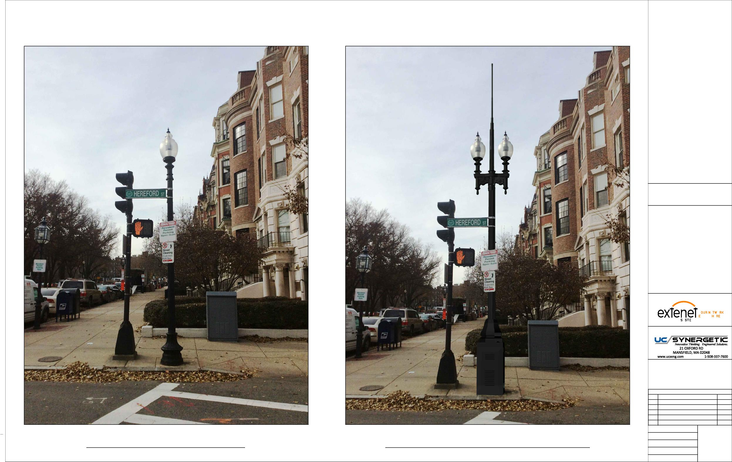
LOCATION:
BOSTON, MA SUFFOLK COUNTY
NOTES:
N:\Engineering\Extenet Systems\NE-MA-BSTC8C01-ATT\AA - AUTOCAD\NE-MA-BSTC8C01-001.dwg
PREPARED FOR:
YEO.
YMS
VERYWE.
PREPARED BY:
REVISIONS
REV
DESCRIPTION
DATE
1
ADDED ADA SITEPLAN
2/28/19
DRAFTER: CEM
EXISTING PHOTOGRAPHIC VIEW PROPOSED PHOTOGRAPHIC SIMULATION
SCALE: NTS
5
10/9/18
ISSUE DATE: 10/05/18
INDEX NAME: NE-MA-BSTC8C01-001
SHEET #: 5 OF 9

Slide 4
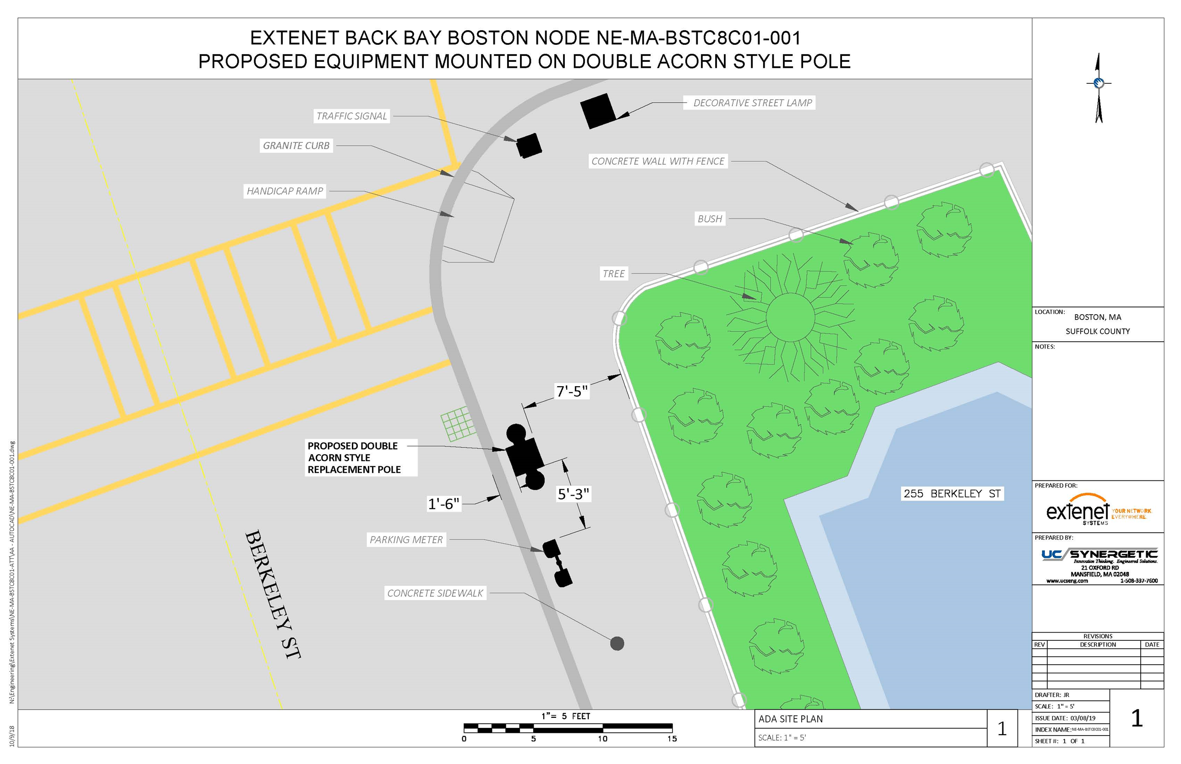

Slide 5
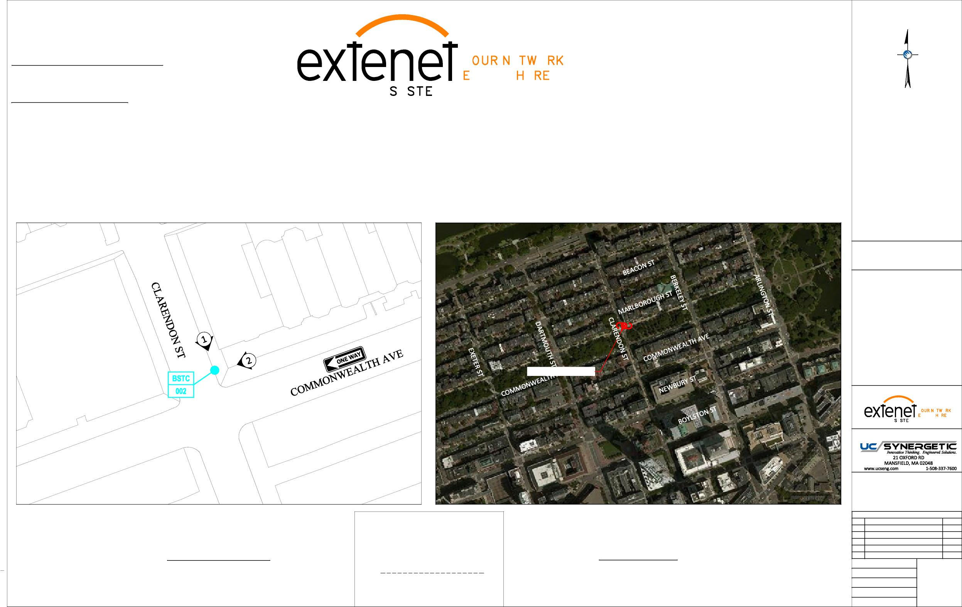
Extenet Systems
3030 Warrenville Rd., Suite 340 Lisle, IL 60532
24/7 Network Operations Center
YEO.
(866) 892-5327
Network Implementation
VERYWE.
YMS
Arthur Pino
Sr. Manager - Network Engineering & Implementation apino@extenetsystems.com Mobile: (978)-804-0652
BOSTON, MA
BACK BAY DISTRIBUTED ANTENNA SYSTEM
PROPOSED 4G/LTE NODE SITES
PROPOSED COMMONWEALTH AVE EXPANSION NODE NE-MA-BSTC8C01-002
COMMONWEALTH AVE AT CLARENDON ST
LOCATION:
BOSTON, MA SUFFOLK COUNTY
NOTES:
N:\Engineering\Extenet Systems\NE-MA-BSTC8C01-ATT\AA - AUTOCAD\NE-MA-BSTC8C01-002.dwg
PROPOSED NODE POLE
PREPARED FOR:
YEO.
YMS
VERYWE.
PREPARED BY:
REVISIONS
REV
DESCRIPTION
DATE
Location and Design Approved Boston Public Works
Street Lighting Department
1
ADDED ADA SITEPLAN
2/28/19
LOCATION MAP
LOCUS MAP
LATITUDE: 42.352748° LONGITUDE:-71.076145°
42° 21' 9.89" N, 71° 4' 34.12" W
SCALE: 1" = 50'
By:
ELEVATION: 10' AMSL
DRAFTER: CEM
SCALE: 1" = 500'
SCALE: AS SHOWN
1
10/9/18
Date:
ISSUE DATE: 10/05/18
INDEX NAME: NE-MA-BSTC8C01-002
SHEET #: 1 OF 9

Slide 6
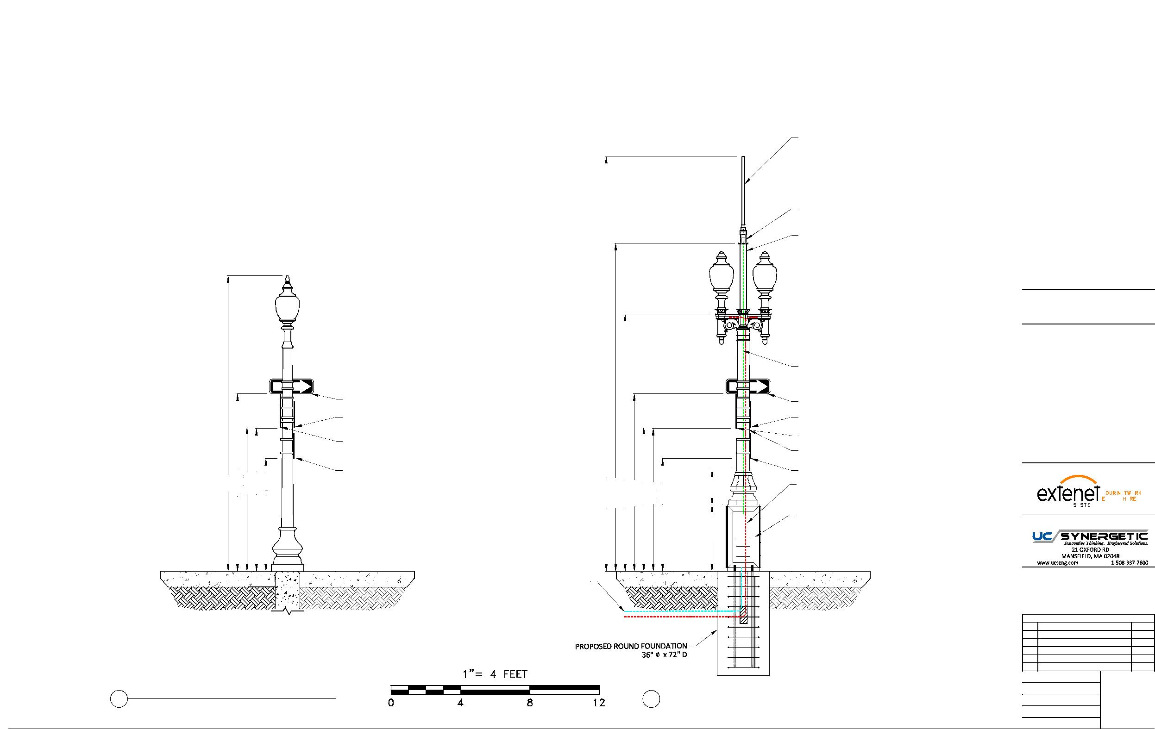
EXTENET BACK BAY BOSTON NODE NE-MA-BSTC8C01-002
PROPOSED EQUIPMENT MOUNTED ON REPLACEMENT STEEL POLE
PROPOSED OMNI ANTENNA
PHAZAR/BRSAWS360Q-698-1710-2-TOM-MD ANTENNA
(SEE DETAIL)
PROPOSED WHIP ANTENNA
CUSTOM ADAPTER (SEE DETAILS)
PROPOSED 3'-9" EXTENSION 4.5" DIAMETER
LOCATION:
BOSTON, MA SUFFOLK COUNTY
NOTES:
COAX FEED
ON WAY
ON WAY
COMMSCOPE LDF4-50A(1/2")
EXISTING ONE WAY SIGN 10'-3"
EXISTING ONE WAY SIGN 10'-3"
N:\Engineering\Extenet Systems\NE-MA-BSTC8C01-ATT\AA - AUTOCAD\NE-MA-BSTC8C01-002.dwg
EXISTING TOW ZONE SIGN 8'-4"
EXISTING TOW ZONE SIGN 8'-4"
EXISTING DO NOT ENTER SIGN 8'-3"
EXISTING DO NOT ENTER SIGN 8'-3"
PROPOSED 11' STEEL FLUTED POLE
EXISTING STREET CLEANING SIGN 6'-6"
TAPERED DIAMETER (9" BASE 8.1" TOP)
PREPARED FOR:
17'
10'-3"
8'-4"
8'-3"
6'-6"
23'-11" 18'-11" 14'-10" 10'-3"
EXISTING STREET CLEANING SIGN 6'-6"
8'-4"
8'-3"
6'-6"
3'-10" 2'
SEPARATE POWER TO CONTINUE TO STREETLIGHT
YEO.
YMS
VERYWE.
(2) COMMSCOPE ION-M 7P-85P-17P-19P
PREPARED BY:
OPTICAL REMOTE UNITS
CONCRETE SIDEWALK
CONCRETE SIDEWALK
PROPOSED FIBER FEED
PROPOSED POWER FEED
REVISIONS
REV
DESCRIPTION
DATE
1
ADDED ADA SITEPLAN
2/28/19
DRAFTER: CEM
4
2 EXISTING PROFILE - REAR VIEW 2 LOOKING SOUTHWEST TOWARDS CLARENDON ST
PROPOSED PROFILE - REAR VIEW
LOOKING SOUTHWEST TOWARDS CLARENDON ST
SCALE: 1" = 5'
ISSUE DATE: 10/05/18
10/9/18
INDEX NAME: NE-MA-BSTC8C01-002
SHEET #: 4 OF 9

Slide 7
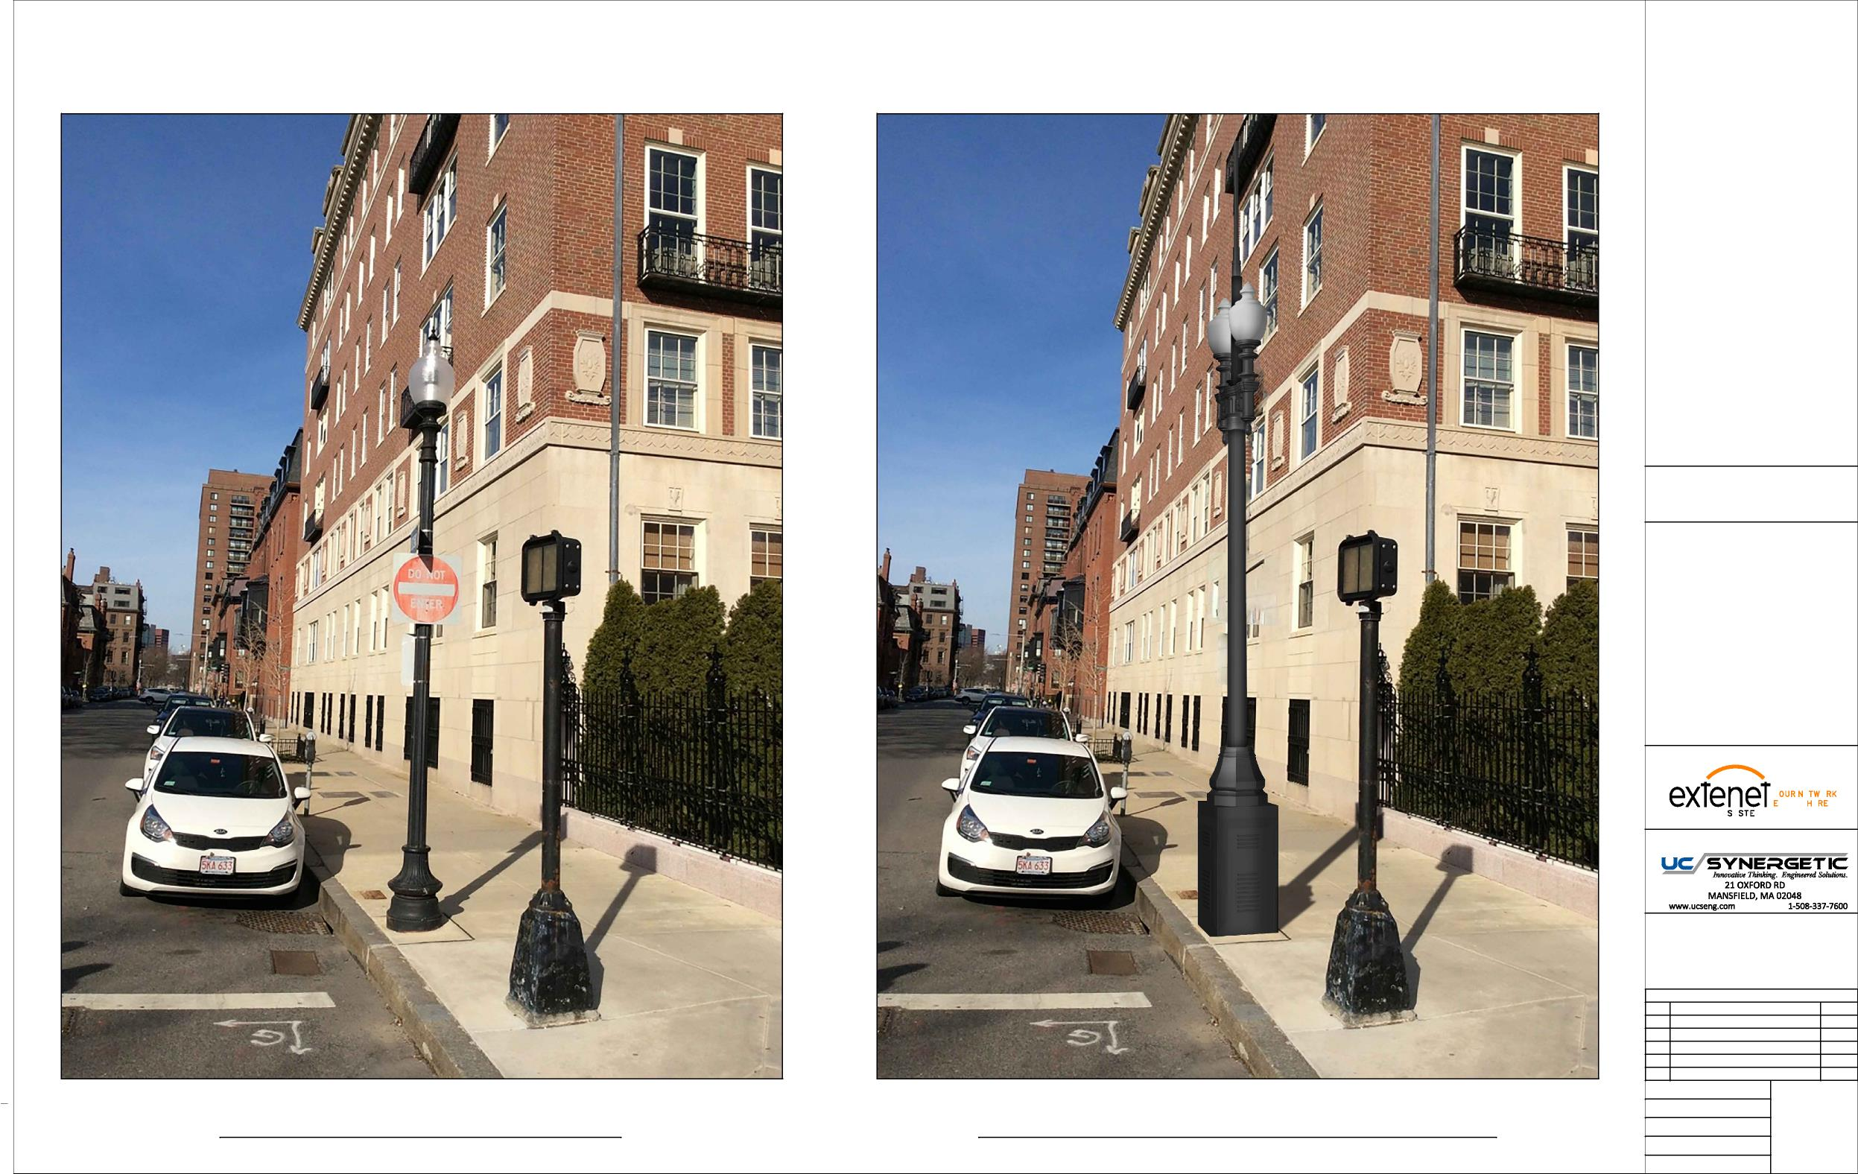
LOCATION:
BOSTON, MA SUFFOLK COUNTY
NOTES:
N:\Engineering\Extenet Systems\NE-MA-BSTC8C01-ATT\AA - AUTOCAD\NE-MA-BSTC8C01-002.dwg
PREPARED FOR:
YEO.
YMS
VERYWE.
PREPARED BY:
REVISIONS
REV
DESCRIPTION
DATE
1
ADDED ADA SITEPLAN
2/28/19
DRAFTER: CEM
EXISTING PHOTOGRAPHIC VIEW PROPOSED PHOTOGRAPHIC SIMULATION
SCALE: NTS
5
10/9/18
ISSUE DATE: 10/05/18
INDEX NAME: NE-MA-BSTC8C01-002
SHEET #: 5 OF 9

Slide 8
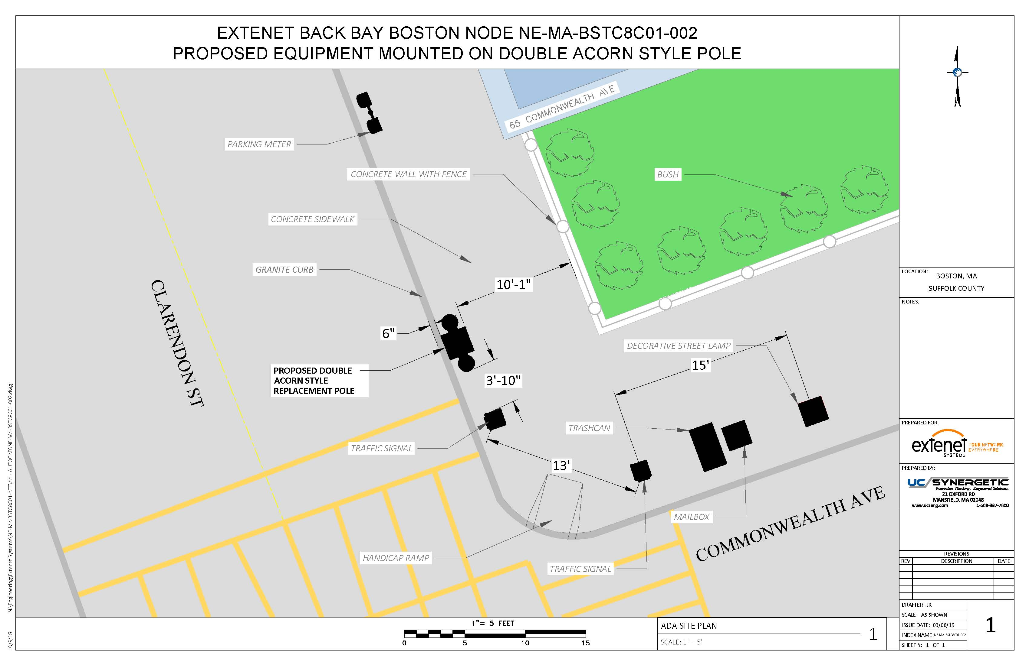

Slide 9
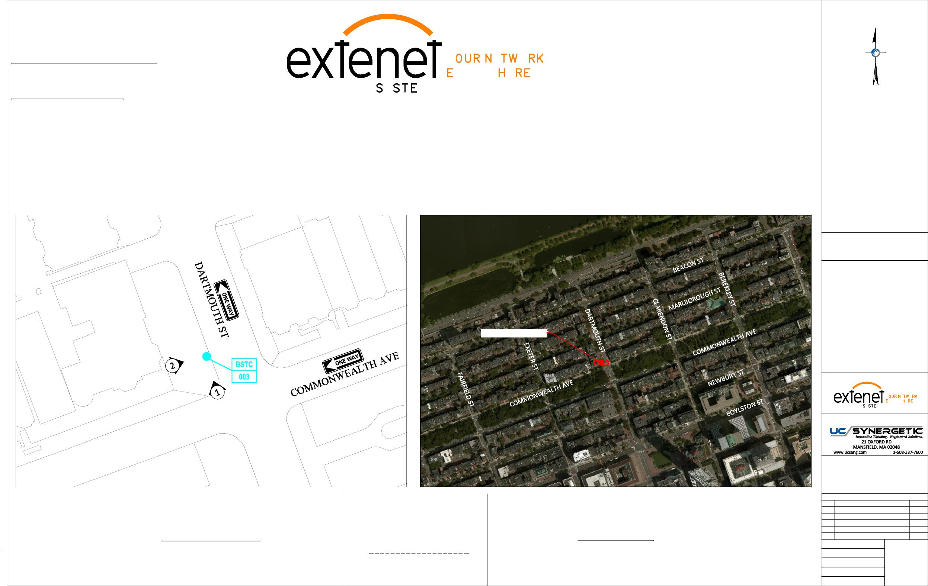
Extenet Systems
3030 Warrenville Rd., Suite 340 Lisle, IL 60532
24/7 Network Operations Center
YEO.
(866) 892-5327
Network Implementation
VERYWE.
YMS
Arthur Pino
Sr. Manager - Network Engineering & Implementation apino@extenetsystems.com Mobile: (978)-804-0652
BOSTON, MA
BACK BAY DISTRIBUTED ANTENNA SYSTEM
PROPOSED 4G/LTE NODE SITES
PROPOSED COMMONWEALTH AVE EXPANSION NODE NE-MA-BSTC8C01-003
COMMONWEALTH AVE AT DARTMOUTH ST
LOCATION:
BOSTON, MA SUFFOLK COUNTY
NOTES:
N:\Engineering\Extenet Systems\NE-MA-BSTC8C01-ATT\AA - AUTOCAD\NE-MA-BSTC8C01-003.dwg
PROPOSED NODE POLE
PREPARED FOR:
YEO.
YMS
VERYWE.
PREPARED BY:
REVISIONS
REV
DESCRIPTION
DATE
Location and Design Approved Boston Public Works
Street Lighting Department
1
ADDED ADA SITEPLAN
2/28/19
LOCATION MAP
LOCUS MAP
LATITUDE: 42.352168° LONGITUDE:-71.078455°
42° 21' 7.8" N, 71° 4' 42.4" W
SCALE: 1" = 50'
By:
ELEVATION: 8' AMSL
DRAFTER: CEM
SCALE: 1" = 500'
SCALE: AS SHOWN
1
10/9/18
Date:
ISSUE DATE: 10/05/18
INDEX NAME: NE-MA-BSTC8C01-003
SHEET #: 1 OF 9

Slide 10
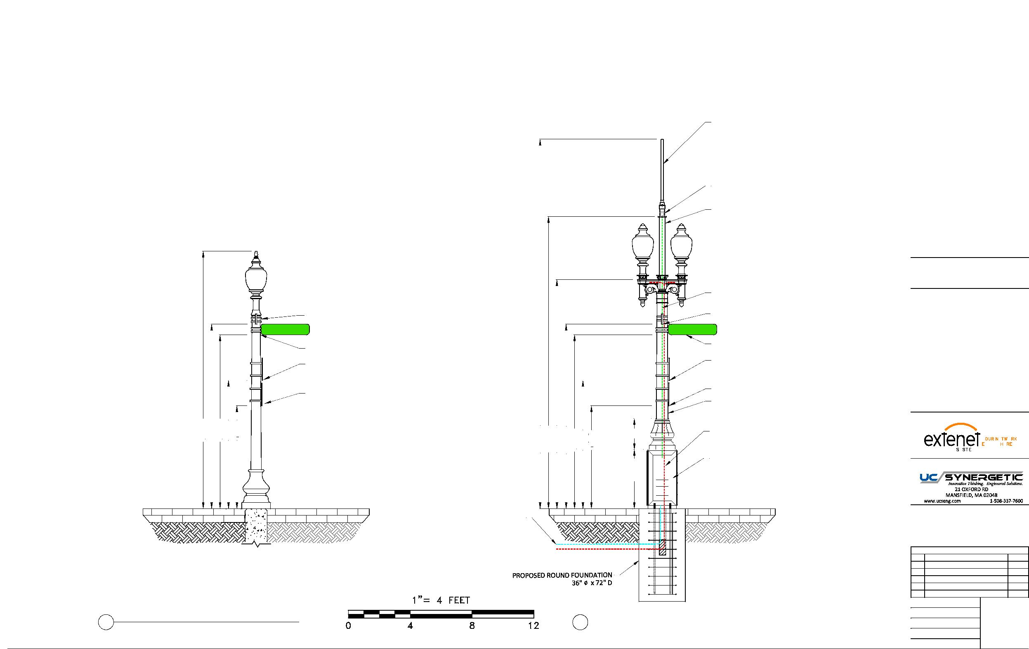
EXTENET BACK BAY BOSTON NODE NE-MA-BSTC8C01-003
PROPOSED EQUIPMENT MOUNTED ON REPLACEMENT STEEL POLE
PROPOSED OMNI ANTENNA
PHAZAR/BRSAWS360Q-698-1710-2-TOM-MD ANTENNA
(SEE DETAIL)
PROPOSED WHIP ANTENNA
CUSTOM ADAPTER (SEE DETAILS)
PROPOSED 3'-9" EXTENSION 4.5" DIAMETER
LOCATION:
BOSTON, MA SUFFOLK COUNTY
COAX FEED
NOTES:
COMMSCOPE LDF4-50A(1/2")
DARTMOUTH ST
EXISTING STREET SIGN 11'-11"
DARTMOUTH ST
EXISTING STREET SIGN 11'-11"
EXISTING STREET SIGN 11'-3"
EXISTING STREET SIGN 11'-3"
EXISTING PARKING SIGN 8'-4"
EXISTING PARKING SIGN 8'-4"
N:\Engineering\Extenet Systems\NE-MA-BSTC8C01-ATT\AA - AUTOCAD\NE-MA-BSTC8C01-003.dwg
EXISTING PARKING SIGN 6'-8"
EXISTING PARKING SIGN 6'-8"
PROPOSED 11' STEEL FLUTED POLE
11'-11"
TAPERED DIAMETER (9" BASE 8.1" TOP)
PREPARED FOR:
16'-8"
11'-3"
8'-4"
6'-8"
23'-11" 18'-11" 14'-10" 11'-11"
11'-3"
8'-4"
6'-8"
3'-10" 2'
SEPARATE POWER TO CONTINUE TO STREETLIGHT
YEO.
YMS
VERYWE.
(2) COMMSCOPE ION-M 7P-85P-17P-19P
PREPARED BY:
OPTICAL REMOTE UNITS
BRICK SIDEWALK
BRICK SIDEWALK
PROPOSED FIBER FEED
PROPOSED POWER FEED
REVISIONS
REV
DESCRIPTION
DATE
1
ADDED ADA SITEPLAN
2/28/19
DRAFTER: CEM
4
2 EXISTING PROFILE - REAR VIEW 2 LOOKING NORTHEAST TOWARDS DARTMOUTH ST
PROPOSED PROFILE - REAR VIEW
LOOKING NORTHEAST TOWARDS DARTMOUTH ST
SCALE: 1" = 5'
ISSUE DATE: 10/05/18
10/9/18
INDEX NAME: NE-MA-BSTC8C01-003
SHEET #: 4 OF 9

Slide 11
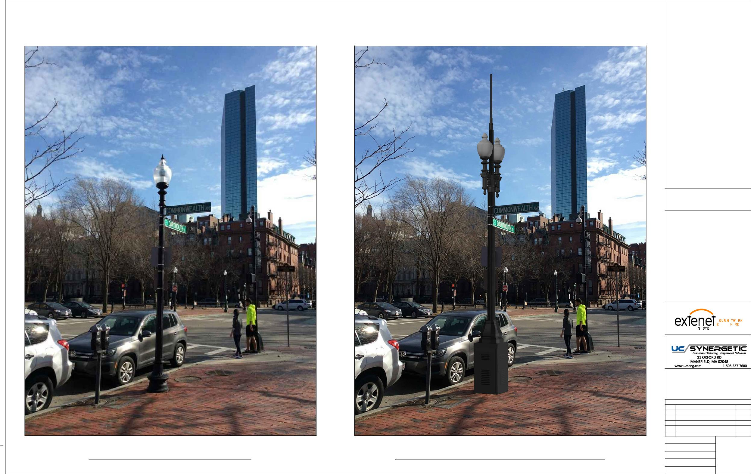
LOCATION:
BOSTON, MA SUFFOLK COUNTY
NOTES:
N:\Engineering\Extenet Systems\NE-MA-BSTC8C01-ATT\AA - AUTOCAD\NE-MA-BSTC8C01-003.dwg
PREPARED FOR:
YEO.
YMS
VERYWE.
PREPARED BY:
REVISIONS
REV
DESCRIPTION
DATE
1
ADDED ADA SITEPLAN
2/28/19
DRAFTER: CEM
EXISTING PHOTOGRAPHIC VIEW PROPOSED PHOTOGRAPHIC SIMULATION
SCALE: NTS
5
10/9/18
ISSUE DATE: 10/05/18
INDEX NAME: NE-MA-BSTC8C01-003
SHEET #: 5 OF 9

Slide 12
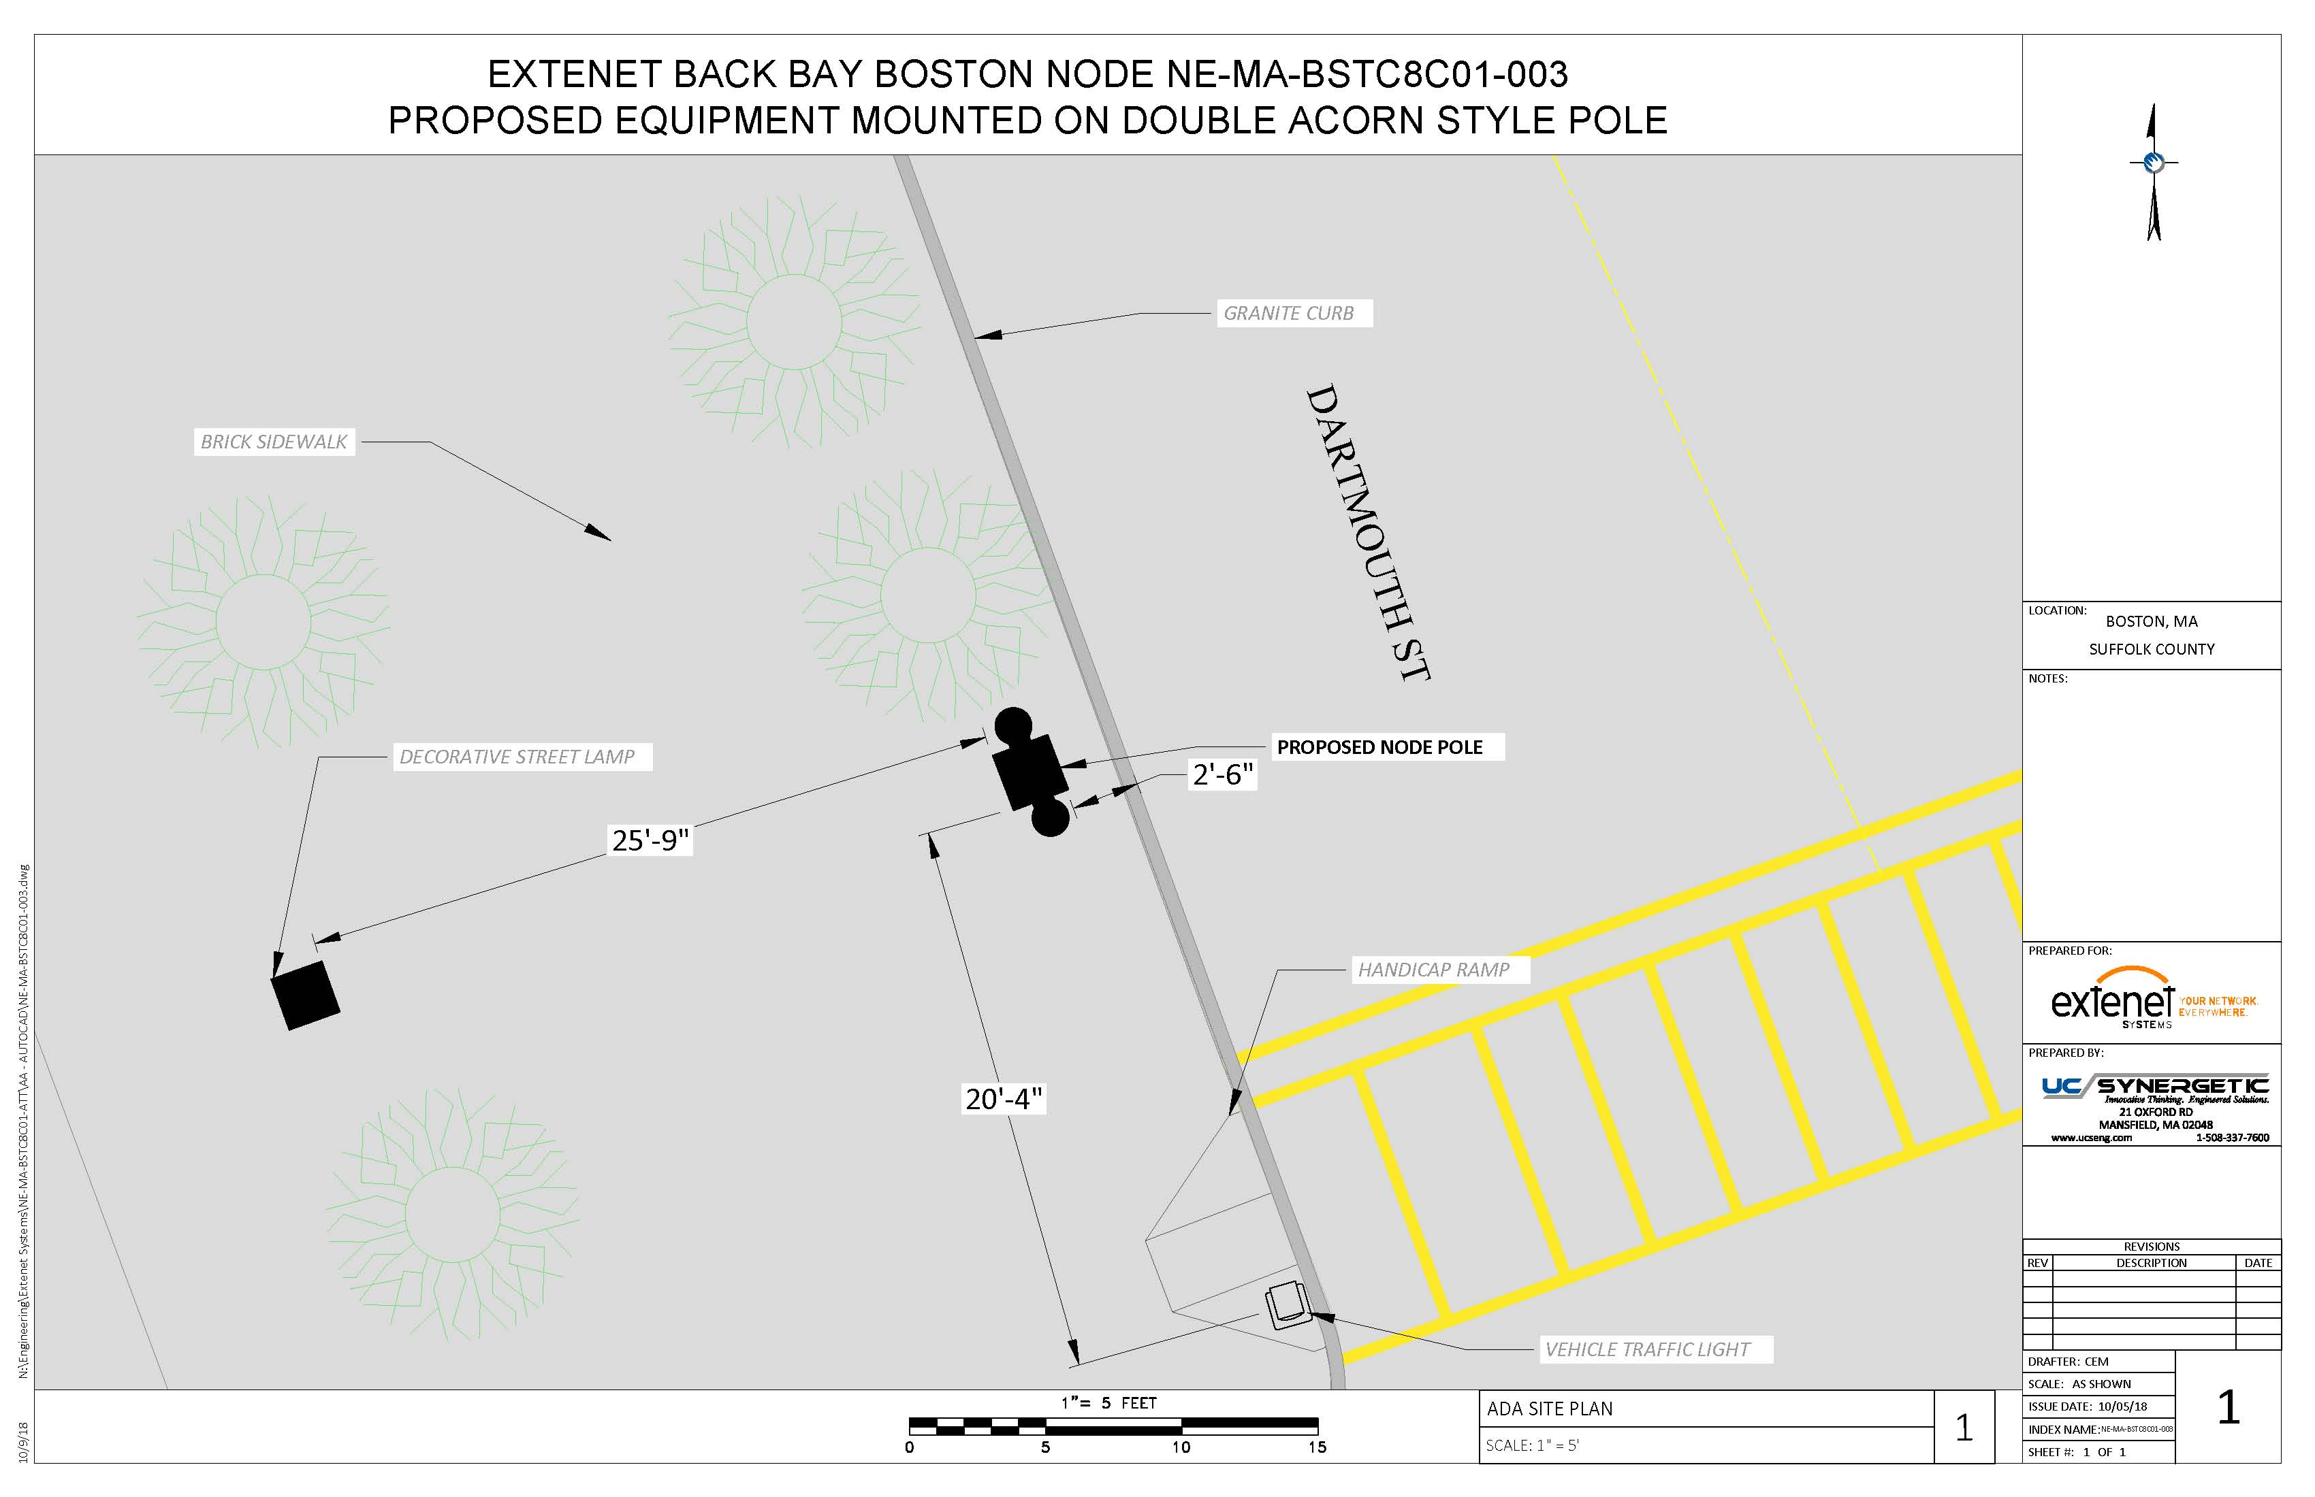

Slide 13
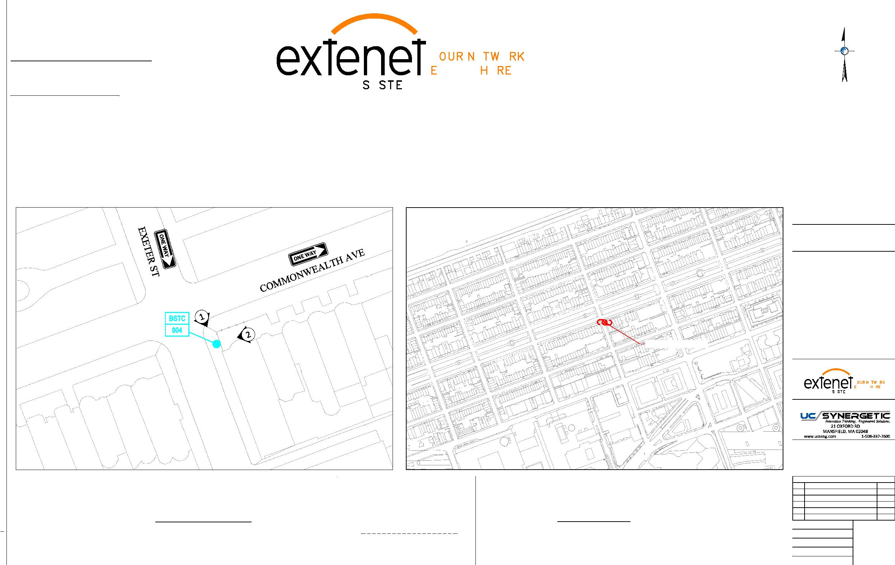
Extenet Systems
3030 Warrenville Rd., Suite 340 Lisle, IL 60532
24/7 Network Operations Center
YEO.
(866) 892-5327
Network Implementation
VERYWE.
YMS
Arthur Pino
Sr. Manager - Network Engineering & Implementation apino@extenetsystems.com Mobile: (978)-804-0652
BOSTON, MA
BACK BAY DISTRIBUTED ANTENNA SYSTEM
PROPOSED 4G/LTE NODE SITES
PROPOSED COMMONWEALTH AVE EXPANSION NODE NE-MA-BSTC8C01-004
COMMONWEALTH AVE AT EXETER ST
LOCATION:
BOSTON, MA SUFFOLK COUNTY
NOTES:
N:\Engineering\Extenet Systems\NE-MA-BSTC8C01-ATT\AA - AUTOCAD\NE-MA-BSTC8C01-004.dwg
PROPOSED NODE POLE
PREPARED FOR:
YEO.
YMS
VERYWE.
PREPARED BY:
REVISIONS
REV
DESCRIPTION
DATE
Location and Design Approved Boston Public Works
Street Lighting Department
1
ADDED ADA SITEPLAN
2/28/19
LOCATION MAP
LOCUS MAP
LATITUDE: 42.351045° LONGITUDE:-71.080171°
42° 21' 3.766" N, 71° 4' 48.612" W
SCALE: 1" = 50'
By:
ELEVATION: 9' AMSL
DRAFTER: CEM
SCALE: 1" = 500'
SCALE: AS SHOWN
1
10/9/18
Date:
ISSUE DATE: 10/05/18
INDEX NAME: NE-MA-BSTC8C01-004
SHEET #: 1 OF 9

Slide 14
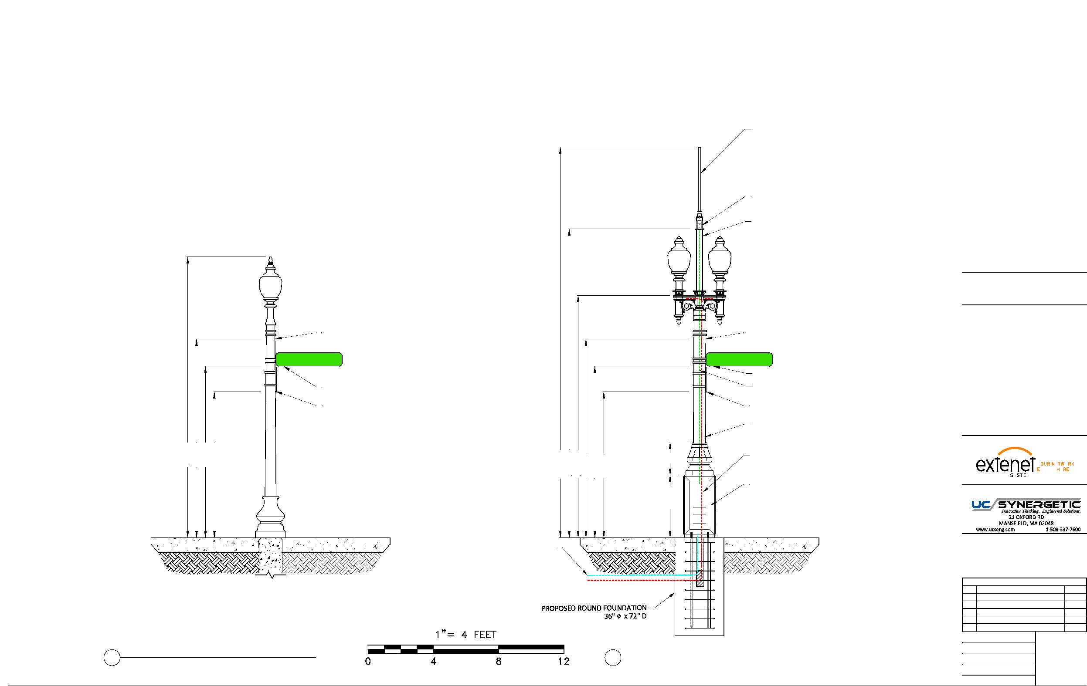
EXTENET BACK BAY BOSTON NODE NE-MA-BSTC8C01-004
PROPOSED EQUIPMENT MOUNTED ON REPLACEMENT STEEL POLE
PROPOSED OMNI ANTENNA
PHAZAR/BRSAWS360Q-698-1710-2-TOM-MD ANTENNA
(SEE DETAIL)
PROPOSED WHIP ANTENNA
CUSTOM ADAPTER (SEE DETAILS)
PROPOSED 3'-9" EXTENSION 4.5" DIAMETER
LOCATION:
BOSTON, MA SUFFOLK COUNTY
NOTES:
EXISTING STREET SIGN 12'-2"
EXISTING STREET SIGN 12'-2"
EXETER ST
EXETER ST
EXISTING STREET SIGN 10'-6"
EXISTING STREET SIGN 10'-6"
COAX FEED
N:\Engineering\Extenet Systems\NE-MA-BSTC8C01-ATT\AA - AUTOCAD\NE-MA-BSTC8C01-004.dwg
EXISTING PARKING SIGN 8'-11"
COMMSCOPE LDF4-50A(1/2")
EXISTING PARKING SIGN 8'-11"
PROPOSED 11' STEEL FLUTED POLE
TAPERED DIAMETER (9" BASE 8.1" TOP)
PREPARED FOR:
17'-2"
12'-2"
10'-6"
8'-11"
23'-11"
18'-11"
14'-10"
12'-2"
10'-6"
8'-11"
3'-10" 2'
SEPARATE POWER TO CONTINUE TO STREETLIGHT
YEO.
YMS
VERYWE.
(2) COMMSCOPE ION-M 7P-85P-17P-19P
PREPARED BY:
OPTICAL REMOTE UNITS
CONCRETE SIDEWALK
CONCRETE SIDEWALK
CONCRETE SIDEWALK
PROPOSED FIBER FEED
PROPOSED POWER FEED
REVISIONS
REV
DESCRIPTION
DATE
1
ADDED ADA SITEPLAN
2/28/19
DRAFTER: CEM
4
2 EXISTING PROFILE - REAR VIEW 2 LOOKING SOUTHWEST TOWARDS EXETER ST
PROPOSED PROFILE - REAR VIEW
LOOKING SOUTHWEST TOWARDS EXETER ST
SCALE: 1" = 5'
ISSUE DATE: 12/05/17
10/9/18
INDEX NAME: NE-MA-BSTC8C01-004
SHEET #: 4 OF 9

Slide 15
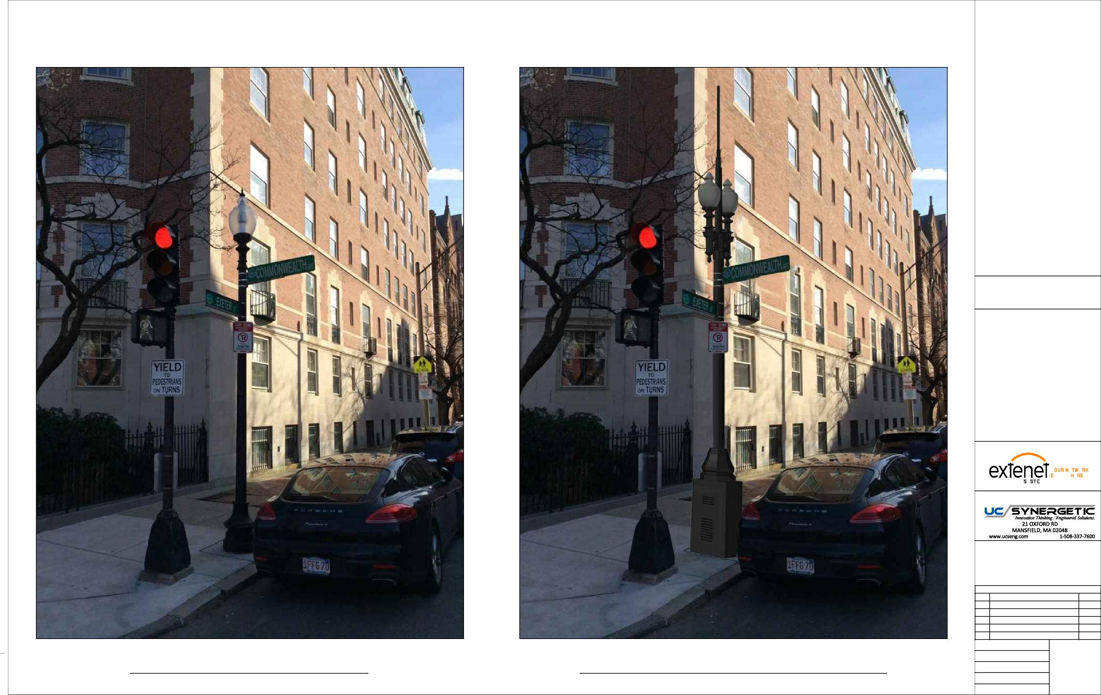
LOCATION:
BOSTON, MA SUFFOLK COUNTY
NOTES:
N:\Engineering\Extenet Systems\NE-MA-BSTC8C01-ATT\AA - AUTOCAD\NE-MA-BSTC8C01-004.dwg
PREPARED FOR:
YEO.
YMS
VERYWE.
PREPARED BY:
REVISIONS
REV
DESCRIPTION
DATE
1
ADDED ADA SITEPLAN
2/28/19
DRAFTER: CEM
EXISTING PHOTOGRAPHIC VIEW PROPOSED PHOTOGRAPHIC SIMULATION
SCALE: NTS
5
10/9/18
ISSUE DATE: 12/05/17
INDEX NAME: NE-MA-BSTC8C01-004
SHEET #: 5 OF 9

Slide 16
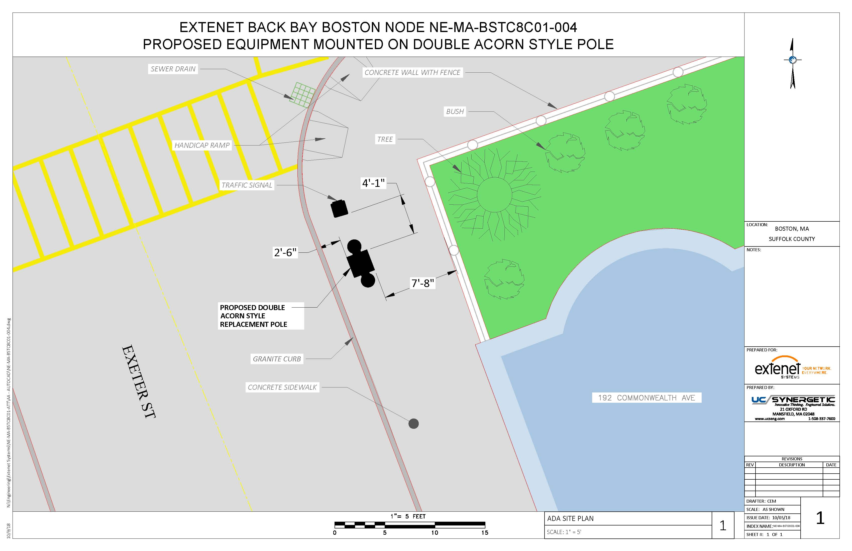

Slide 17
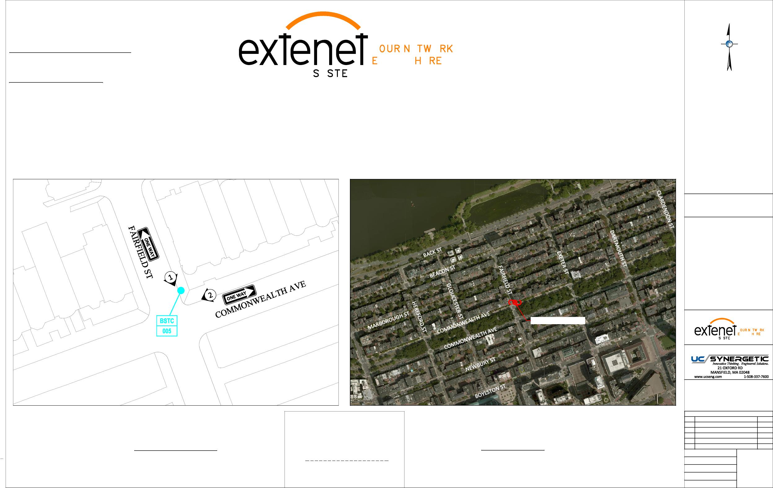
Extenet Systems
3030 Warrenville Rd., Suite 340 Lisle, IL 60532
24/7 Network Operations Center
YEO.
(866) 892-5327
Network Implementation
VERYWE.
YMS
Arthur Pino
Sr. Manager - Network Engineering & Implementation apino@extenetsystems.com Mobile: (978)-804-0652
BOSTON, MA
BACK BAY DISTRIBUTED ANTENNA SYSTEM
PROPOSED 4G/LTE NODE SITES
PROPOSED COMMONWEALTH AVE EXPANSION NODE NE-MA-BSTC8C01-005
COMMONWEALTH AVE AT FAIRFIELD ST
LOCATION:
BOSTON, MA SUFFOLK COUNTY
NOTES:
N:\Engineering\Extenet Systems\NE-MA-BSTC8C01-ATT\AA - AUTOCAD\NE-MA-BSTC8C01-005.DWG
PROPOSED NODE POLE
PREPARED FOR:
YEO.
YMS
VERYWE.
PREPARED BY:
REVISIONS
REV
DESCRIPTION
DATE
Location and Design Approved Boston Public Works
Street Lighting Department
1
ADDED ADA SITEPLAN
3/1/19
LOCATION MAP
LOCUS MAP
LATITUDE: 42.350946° LONGITUDE:-71.082731°
42° 21' 3.47" N, 71° 4' 57.83" W
SCALE: 1" = 50'
By:
ELEVATION: 11' AMSL
DRAFTER: CEM
SCALE: 1" = 500'
SCALE: AS SHOWN
1
10/9/18
Date:
ISSUE DATE: 10/04/18
INDEX NAME: NE-MA-BSTC8C01-005
SHEET #: 1 OF 9

Slide 18
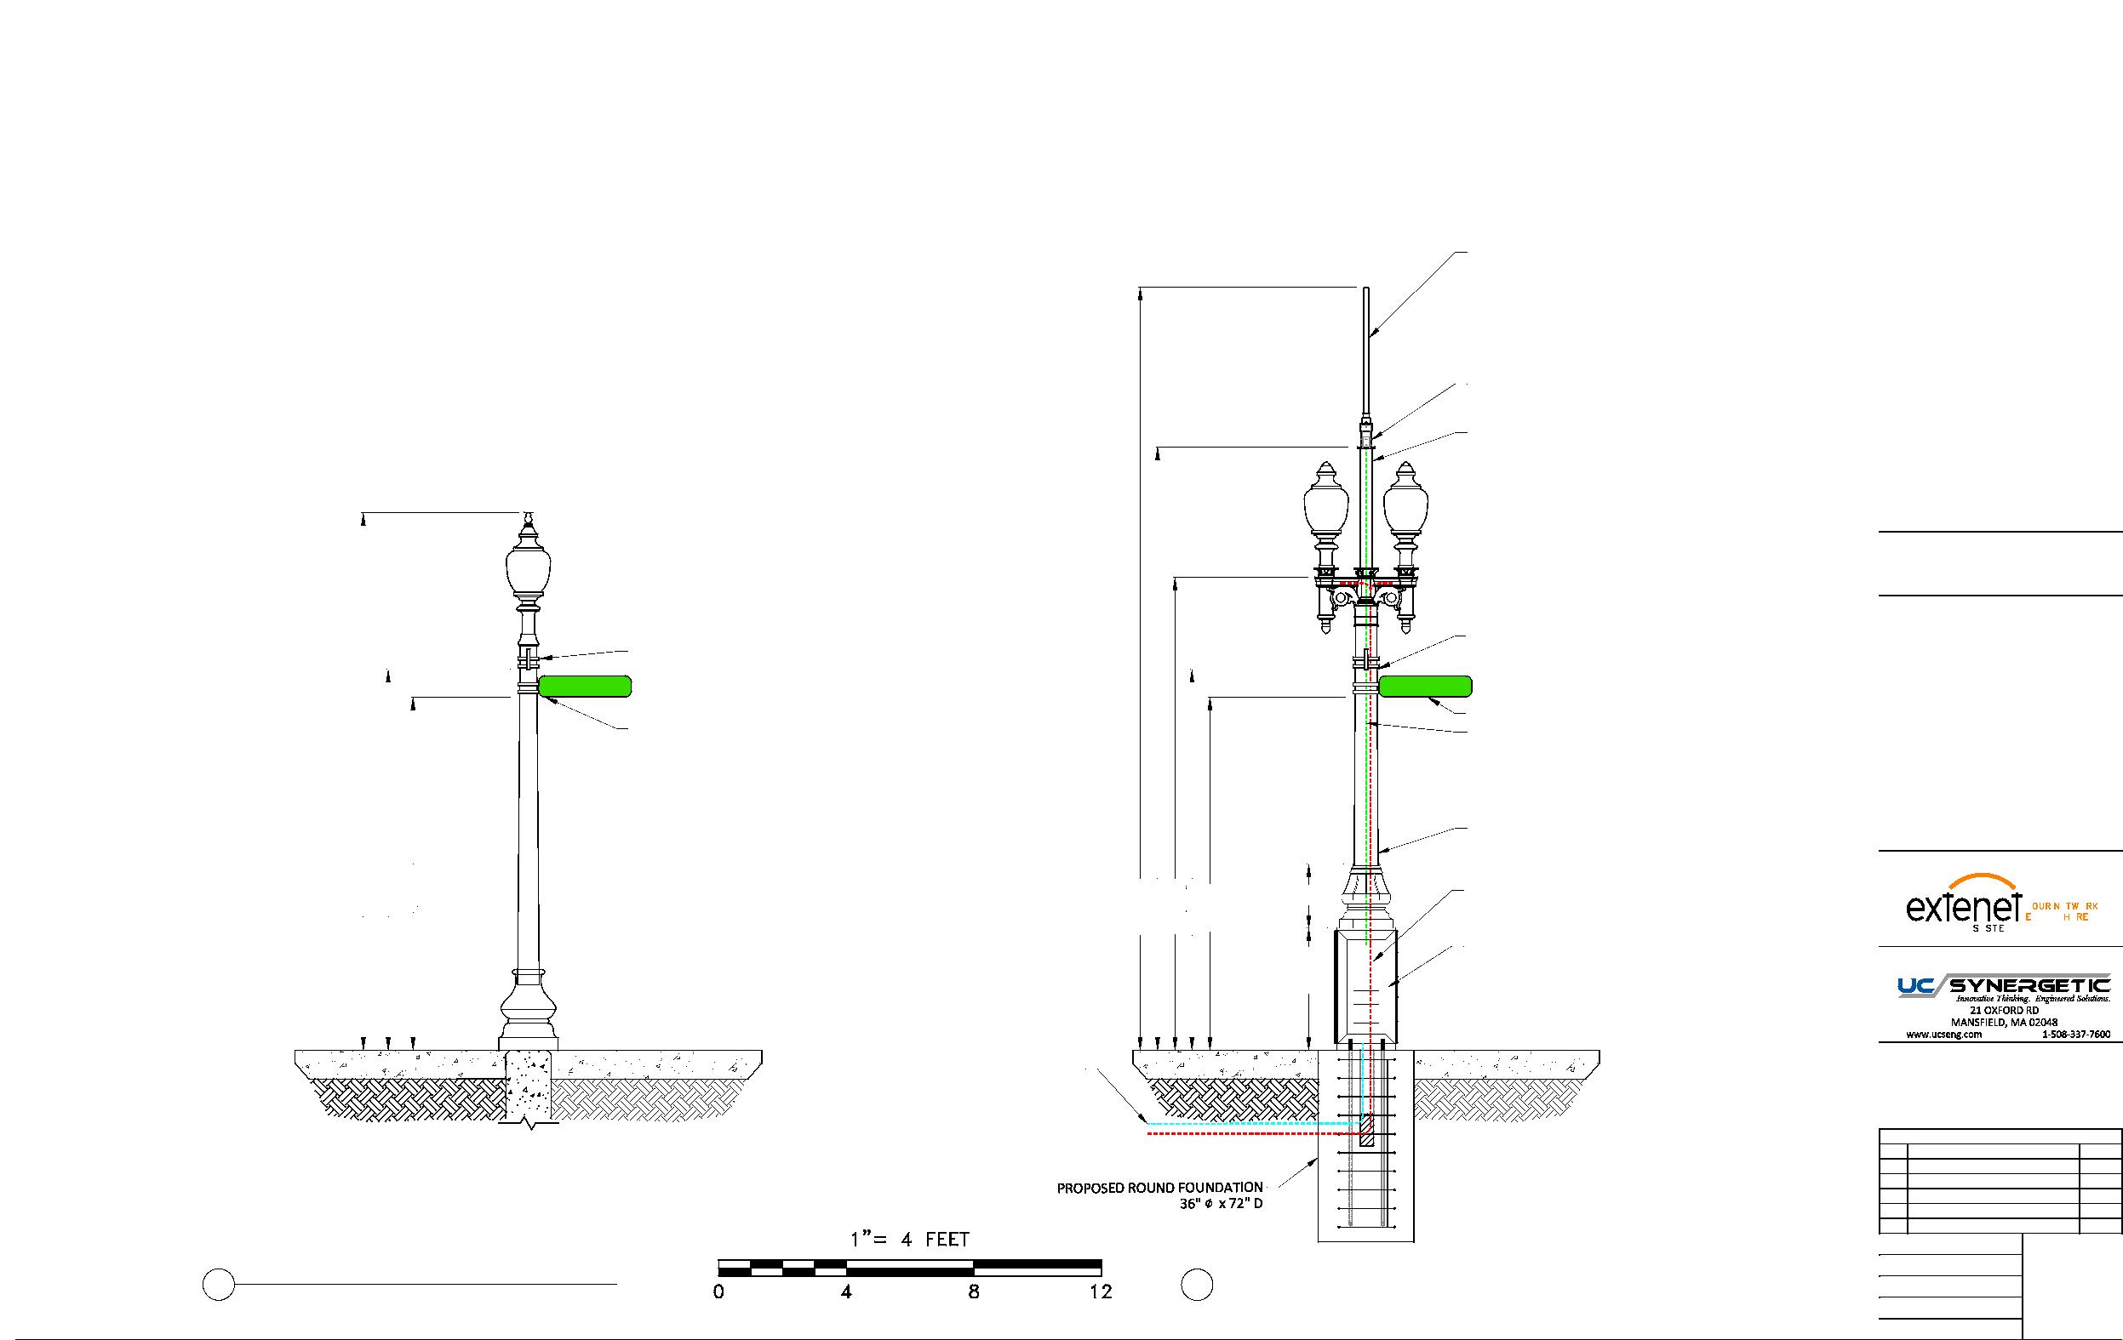
EXTENET BACK BAY BOSTON NODE NE-MA-BSTC8C01-005
PROPOSED EQUIPMENT MOUNTED ON REPLACEMENT STEEL POLE
PROPOSED OMNI ANTENNA
PHAZAR/BRSAWS360Q-698-1710-2-TOM-MD ANTENNA
(SEE DETAIL)
PROPOSED WHIP ANTENNA
CUSTOM ADAPTER (SEE DETAILS)
PROPOSED 3'-9" EXTENSION 4.5" DIAMETER
LOCATION:
BOSTON, MA SUFFOLK COUNTY
NOTES:
EXISTING STREET SIGN 11'-11"
EXISTING STREET SIGN 11'-11"
FAIRFIELD ST
FAIRFIELD ST
EXISTING STREET SIGN 11'-1"
EXISTING STREET SIGN 11'-1"
COAX FEED
COMMSCOPE LDF4-50A(1/2")
N:\Engineering\Extenet Systems\NE-MA-BSTC8C01-ATT\AA - AUTOCAD\NE-MA-BSTC8C01-005.DWG
PROPOSED 11' STEEL FLUTED POLE
16'-10"
11'-11"
TAPERED DIAMETER (9" BASE 8.1" TOP)
PREPARED FOR:
11'-1"
23'-11"
18'-11"
14'-10"
11'-11"
11'-1"
3'-10" 2'
SEPARATE POWER TO CONTINUE TO STREETLIGHT
YEO.
YMS
VERYWE.
(2) COMMSCOPE ION-M 7P-85P-17P-19P
PREPARED BY:
OPTICAL REMOTE UNITS
CONCRETE SIDEWALK
CONCRETE SIDEWALK
PROPOSED FIBER FEED
PROPOSED POWER FEED
REVISIONS
REV
DESCRIPTION
DATE
1
ADDED ADA SITEPLAN
3/1/19
DRAFTER: CEM
4
2 EXISTING PROFILE - REAR VIEW 2 LOOKING SOUTHWEST TOWARDS FAIRFIELD ST
PROPOSED PROFILE - REAR VIEW
LOOKING SOUTHWEST TOWARDS FAIRFIELD ST
SCALE: 1" = 5'
ISSUE DATE: 10/04/18
10/9/18
INDEX NAME: NE-MA-BSTC8C01-005
SHEET #: 4 OF 9

Slide 19
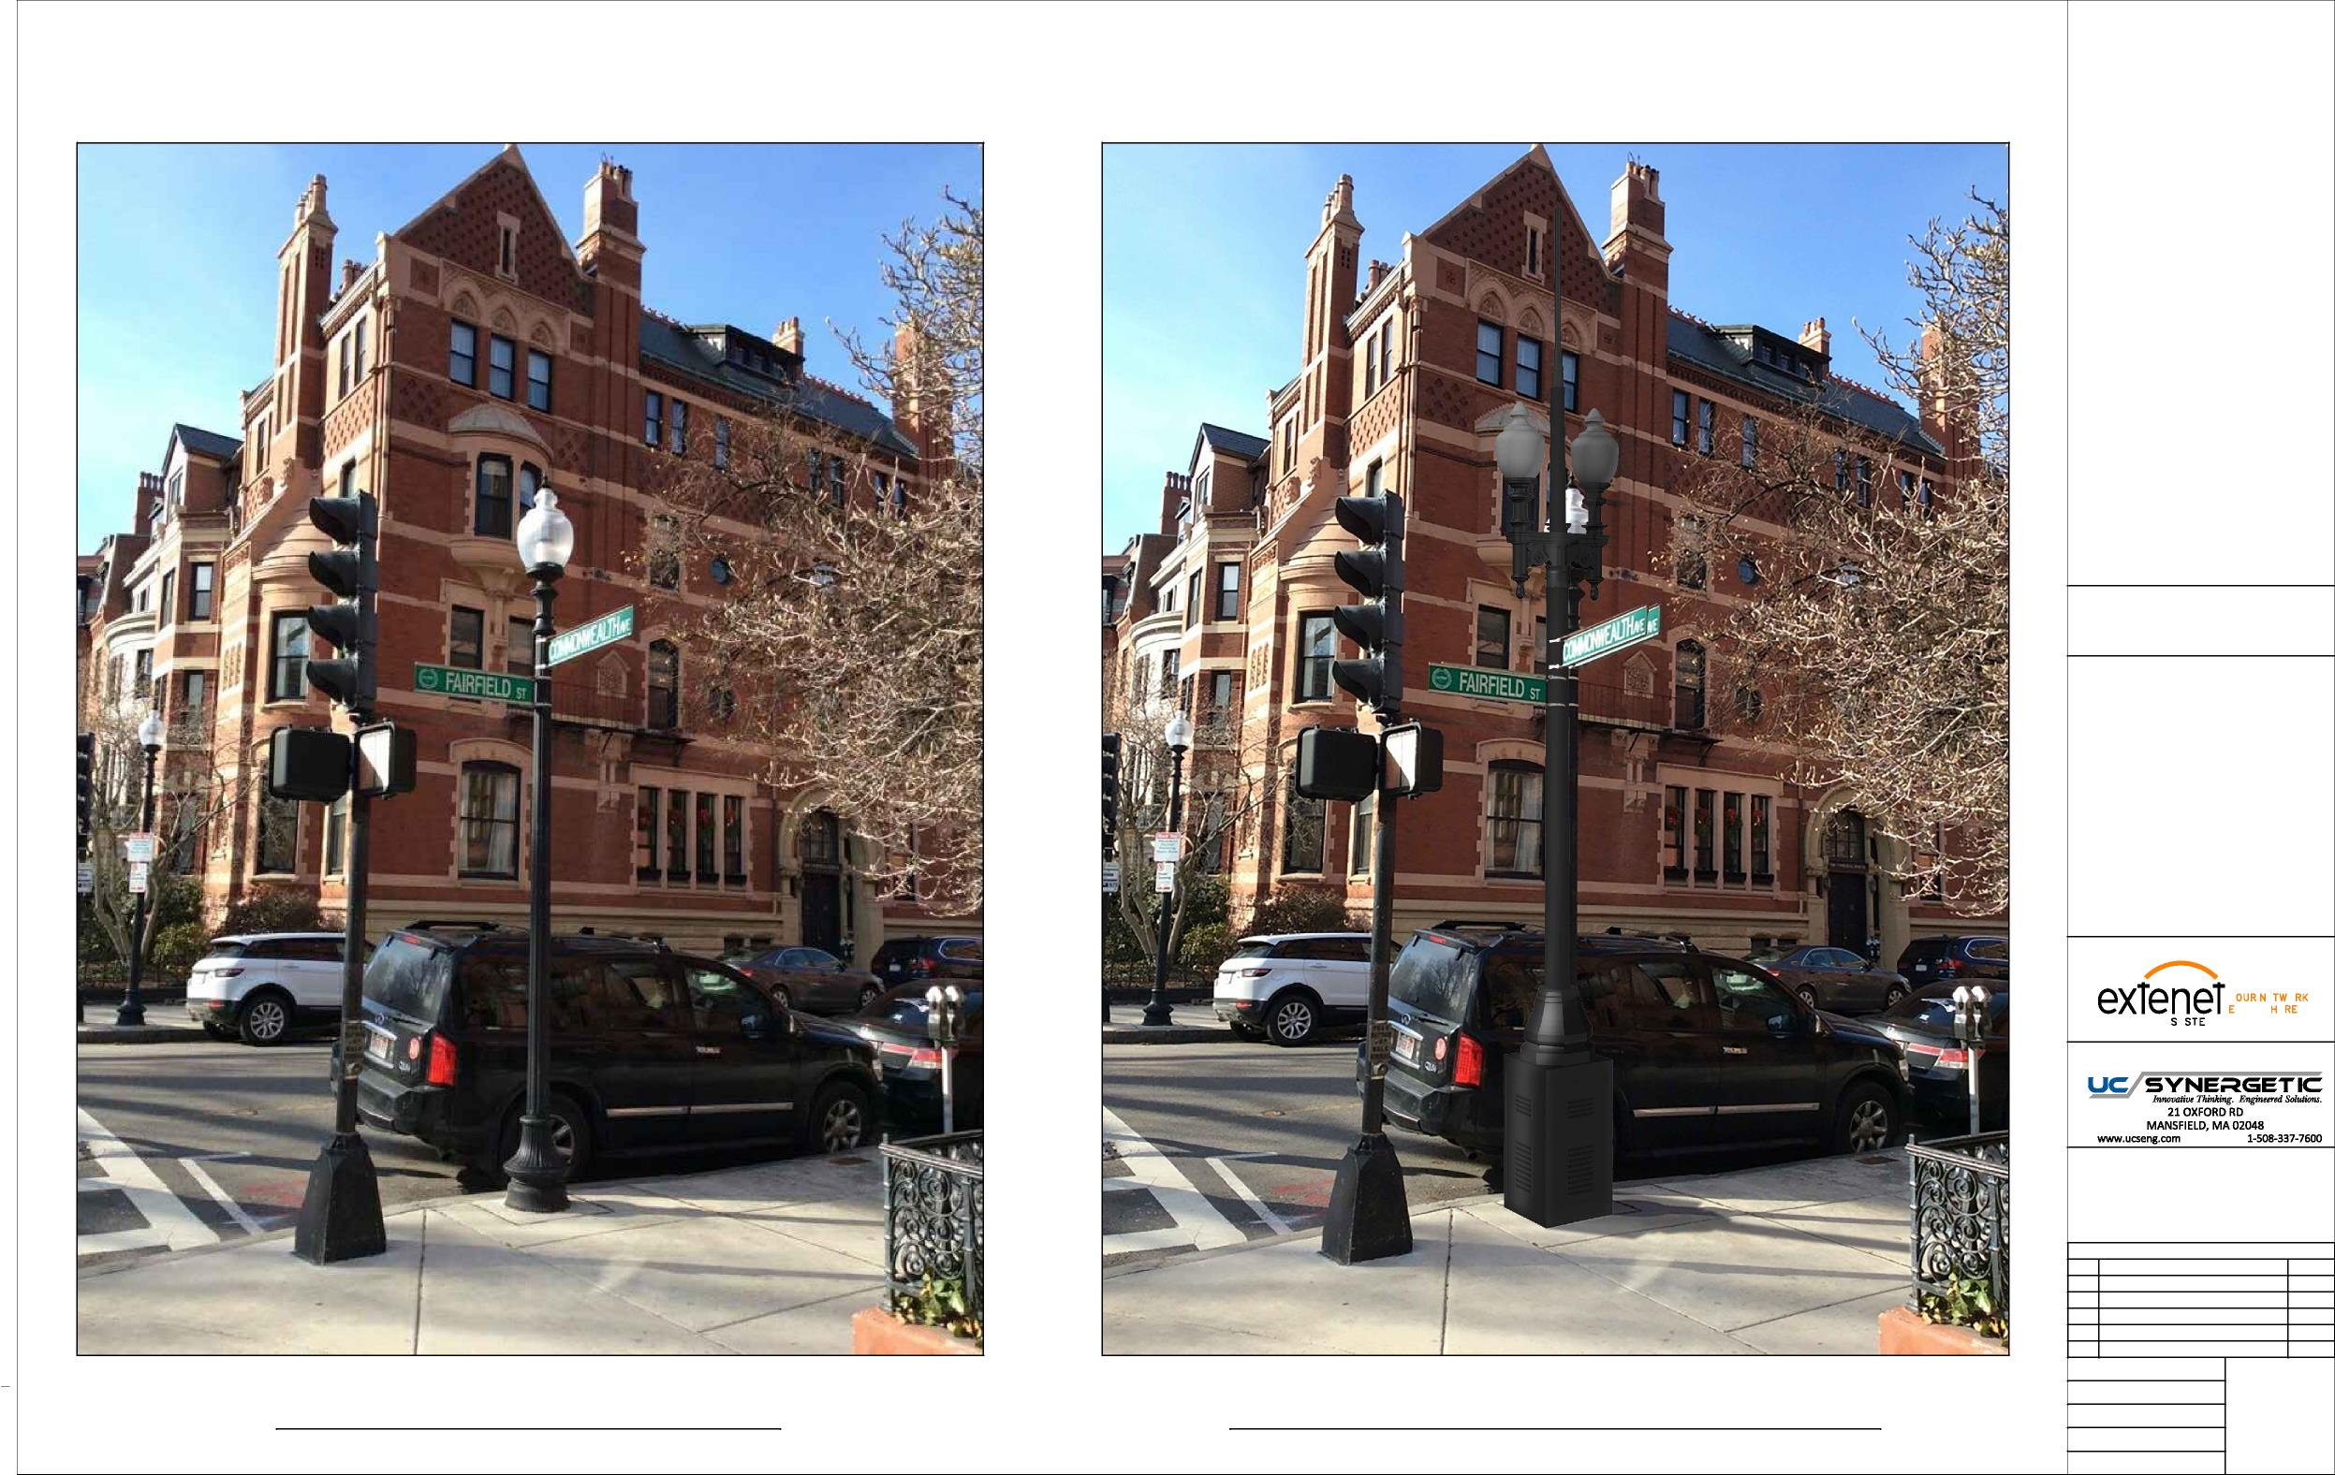
LOCATION:
BOSTON, MA SUFFOLK COUNTY
NOTES:
N:\Engineering\Extenet Systems\NE-MA-BSTC8C01-ATT\AA - AUTOCAD\NE-MA-BSTC8C01-005.DWG
PREPARED FOR:
YEO.
YMS
VERYWE.
PREPARED BY:
REVISIONS
REV
DESCRIPTION
DATE
1
ADDED ADA SITEPLAN
3/1/19
DRAFTER: CEM
EXISTING PHOTOGRAPHIC VIEW PROPOSED PHOTOGRAPHIC SIMULATION
SCALE: NTS
5
10/9/18
ISSUE DATE: 10/04/18
INDEX NAME: NE-MA-BSTC8C01-005
SHEET #: 5 OF 9

Slide 20
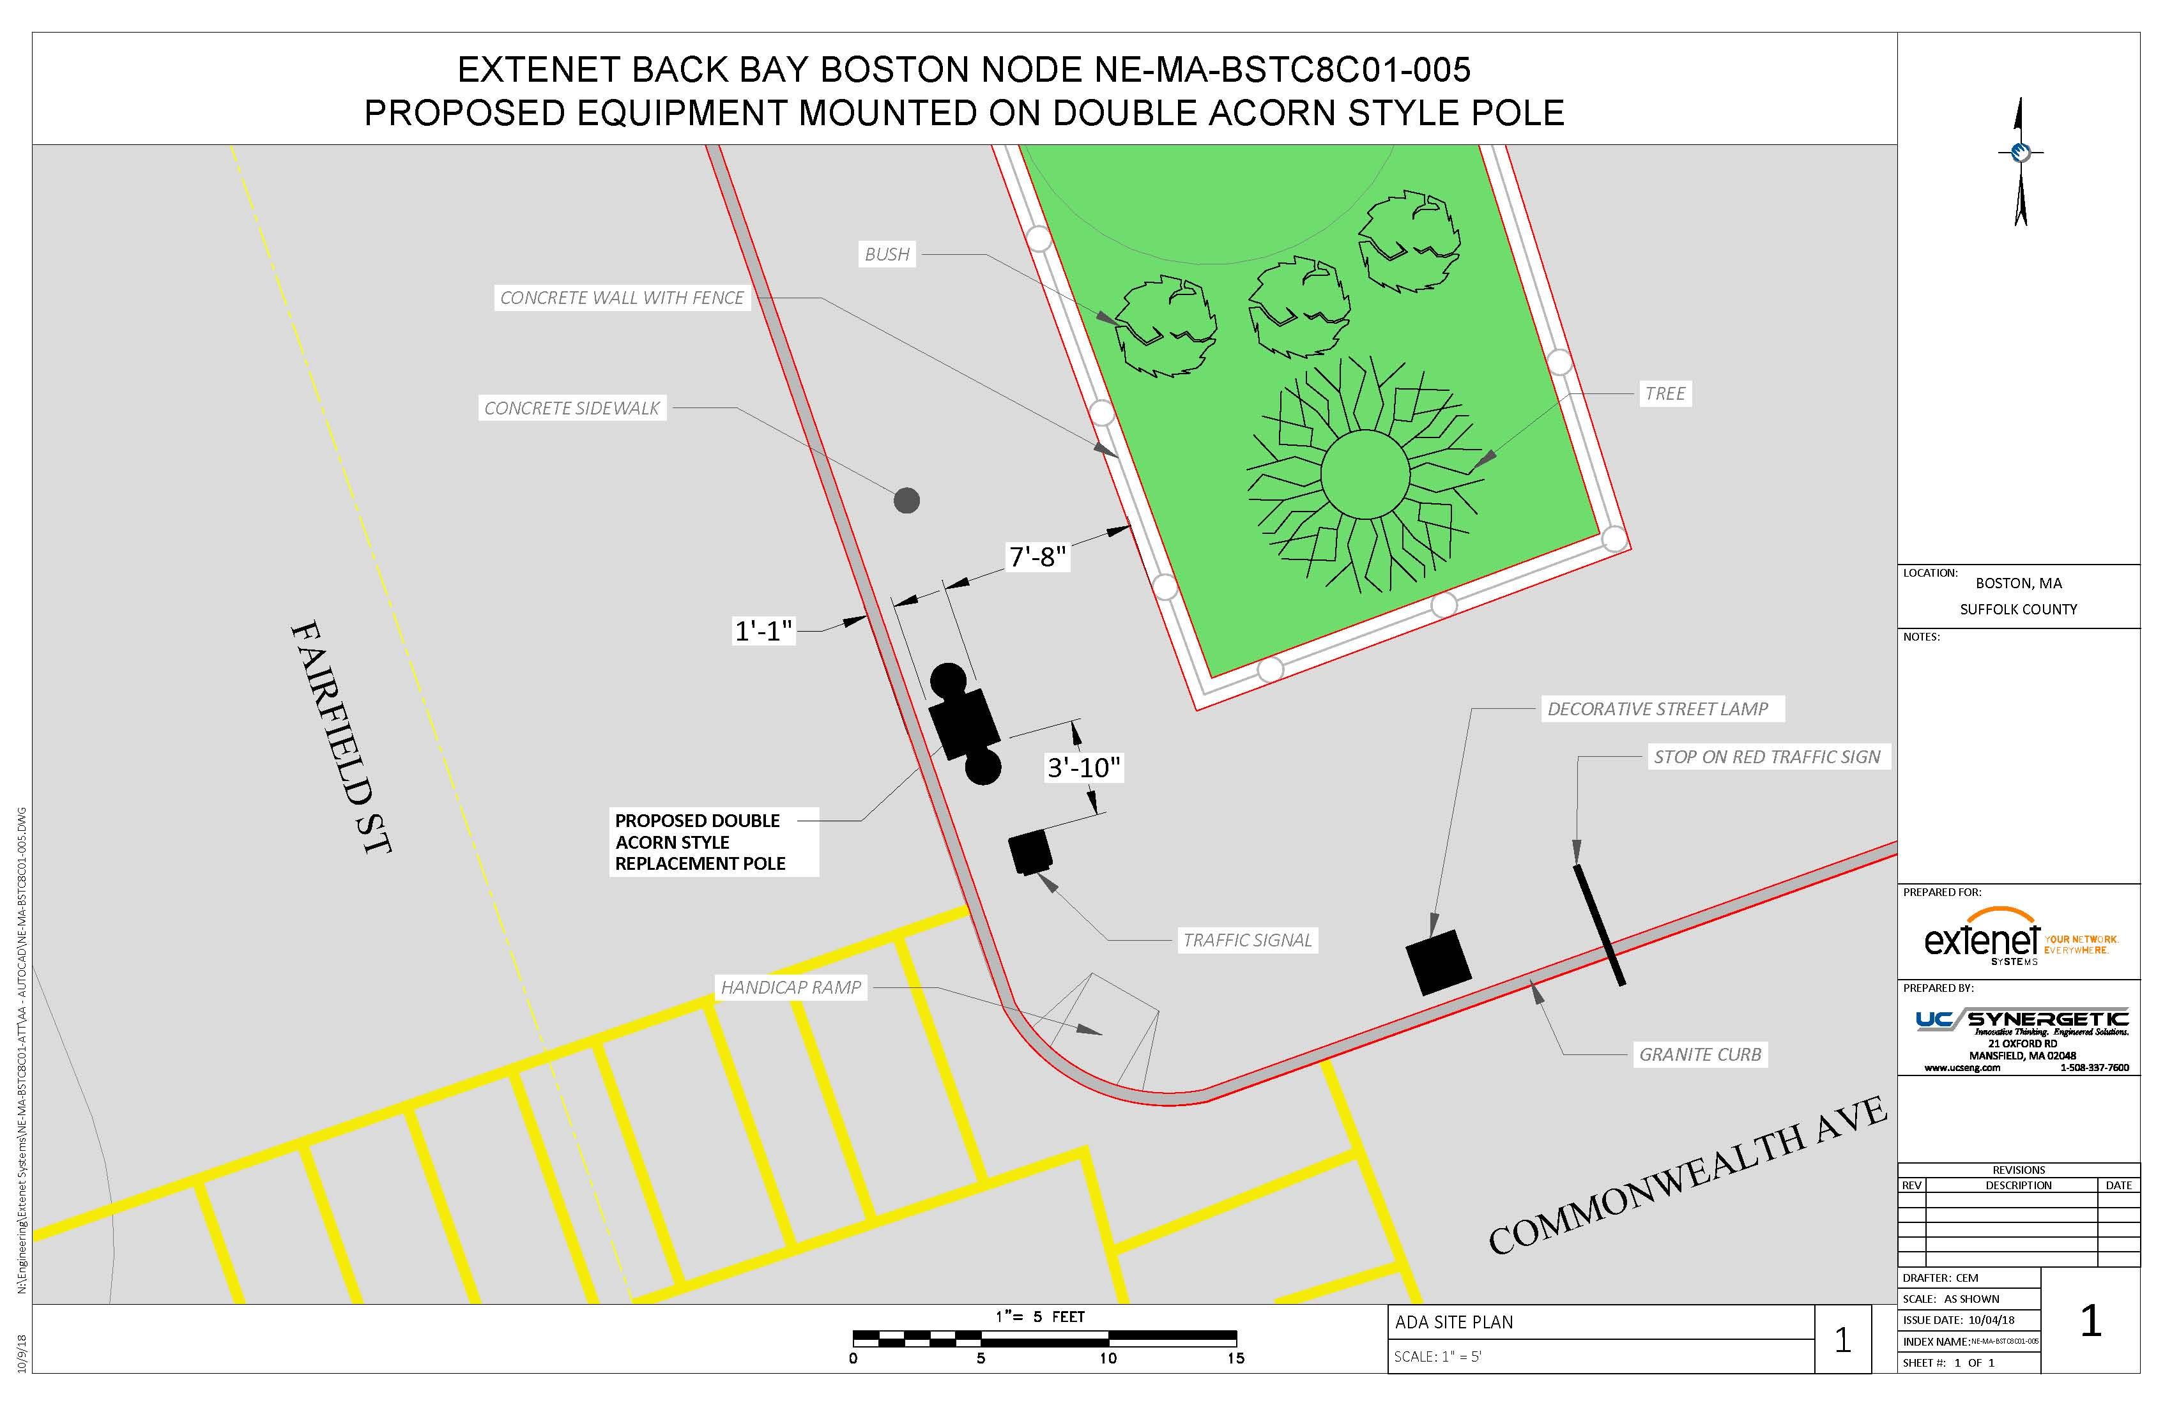

Slide 21
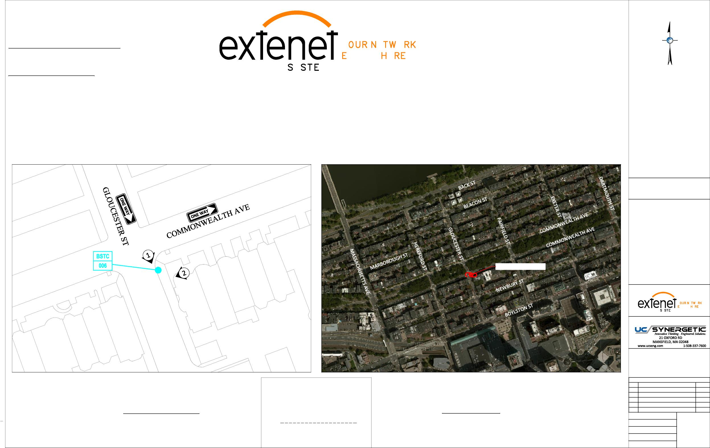
Extenet Systems
3030 Warrenville Rd., Suite 340 Lisle, IL 60532
24/7 Network Operations Center
YEO.
(866) 892-5327
Network Implementation
VERYWE.
YMS
Arthur Pino
Sr. Manager - Network Engineering & Implementation apino@extenetsystems.com Mobile: (978)-804-0652
BOSTON, MA
BACK BAY DISTRIBUTED ANTENNA SYSTEM
PROPOSED 4G/LTE NODE SITES
PROPOSED COMMONWEALTH AVE EXPANSION NODE NE-MA-BSTC8C01-006
COMMONWEALTH AVE AT GLOUCESTER ST
LOCATION:
BOSTON, MA SUFFOLK COUNTY
NOTES:
N:\Engineering\Extenet Systems\NE-MA-BSTC8C01-ATT\AA - AUTOCAD\NE-MA-BSTC8C01-006.dwg
PROPOSED NODE POLE
PREPARED FOR:
YEO.
YMS
VERYWE.
PREPARED BY:
REVISIONS
REV
DESCRIPTION
DATE
Location and Design Approved Boston Public Works
Street Lighting Department
1
ADDED ADA SITEPLAN
3/1/19
LOCATION MAP
LOCUS MAP
LATITUDE: 42.349910° LONGITUDE:-71.084414°
42° 20' 59.676" N, 71° 5' 3.8904" W SCALE: 1" = 50'
By:
ELEVATION: 10' AMSL
DRAFTER: CEM
SCALE: 1" = 500'
SCALE: AS SHOWN
1
10/9/18
Date:
ISSUE DATE: 10/04/18
INDEX NAME: NE-MA-BSTC8C01-006
SHEET #: 1 OF 9

Slide 22
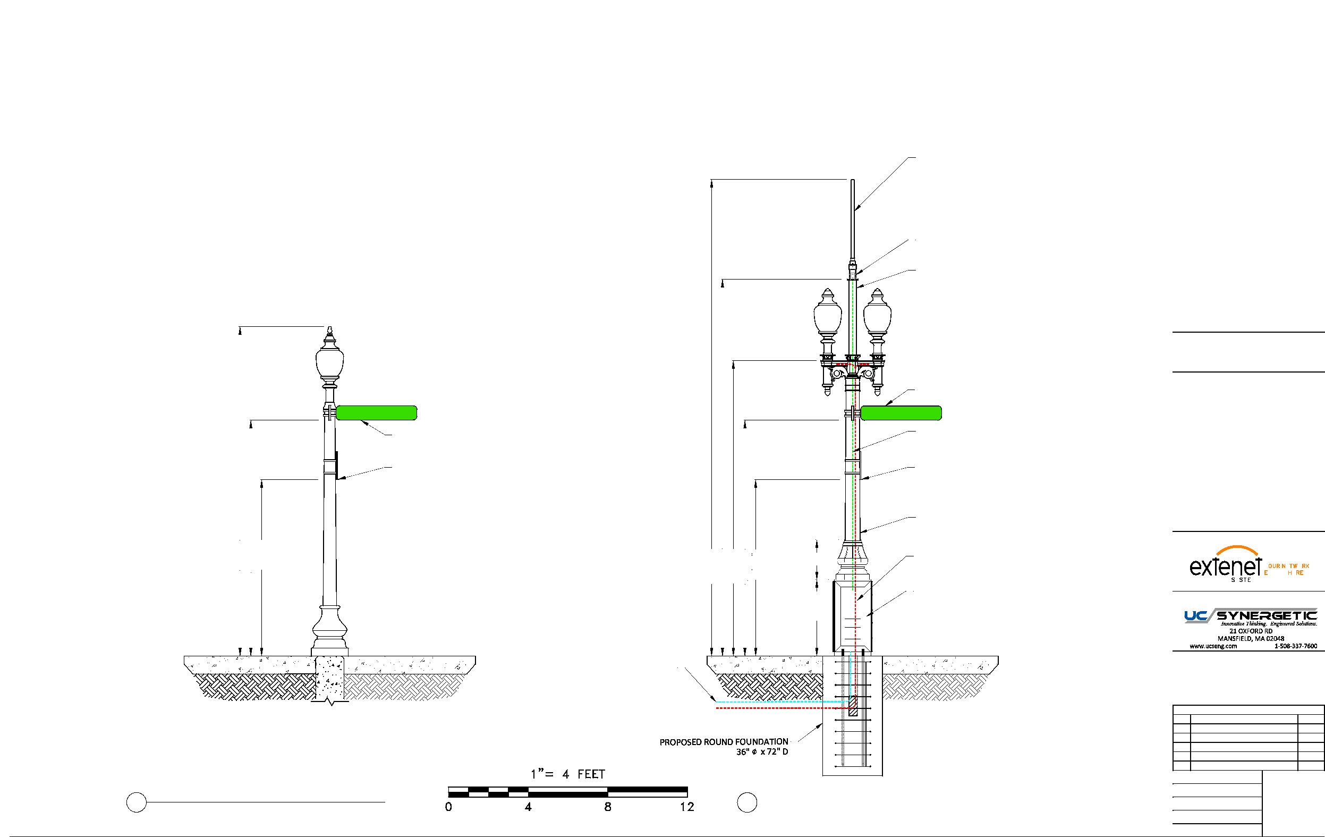
EXTENET BACK BAY BOSTON NODE NE-MA-BSTC8C01-006
PROPOSED EQUIPMENT MOUNTED ON REPLACEMENT STEEL POLE
PROPOSED OMNI ANTENNA
PHAZAR/BRSAWS360Q-698-1710-2-TOM-MD ANTENNA
(SEE DETAIL)
PROPOSED WHIP ANTENNA
CUSTOM ADAPTER (SEE DETAILS)
PROPOSED 3'-9" EXTENSION 4.5" DIAMETER
LOCATION:
BOSTON, MA SUFFOLK COUNTY
EXISTING STREET SIGN 11'-10"
NOTES:
COMMONWEALTH AVE
COMMONWEALTH AVE
EXISTING STREET SIGNS 11'-10"
COAX FEED
COMMSCOPE LDF4-50A(1/2")
EXISTING RESIDENT PARKING SIGN 8'-10"
EXISTING RESIDENT PARKING SIGN 8'-10"
N:\Engineering\Extenet Systems\NE-MA-BSTC8C01-ATT\AA - AUTOCAD\NE-MA-BSTC8C01-006.dwg
PROPOSED 11' STEEL FLUTED POLE
16'-6"
11'-10"
TAPERED DIAMETER (9" BASE 8.1" TOP)
PREPARED FOR:
8'-10"
23'-11"
18'-11"
14'-10"
11'-10"
8'-10"
3'-10" 2'
SEPARATE POWER TO CONTINUE TO STREETLIGHT
YEO.
YMS
VERYWE.
(2) COMMSCOPE ION-M 7P-85P-17P-19P
PREPARED BY:
OPTICAL REMOTE UNITS
CONCRETE SIDEWALK
CONCRETE SIDEWALK
PROPOSED FIBER FEED
PROPOSED POWER FEED
REVISIONS
REV
DESCRIPTION
DATE
1
ADDED ADA SITEPLAN
3/1/19
DRAFTER: CEM
4
2 EXISTING PROFILE - REAR VIEW 2 LOOKING SOUTHWEST TOWARDS GLOUCESTER ST
PROPOSED PROFILE - REAR VIEW
LOOKING SOUTHWEST TOWARDS GLOUCESTER ST
SCALE: 1" = 5'
ISSUE DATE: 10/04/18
10/9/18
INDEX NAME: NE-MA-BSTC8C01-006
SHEET #: 4 OF 9

Slide 23
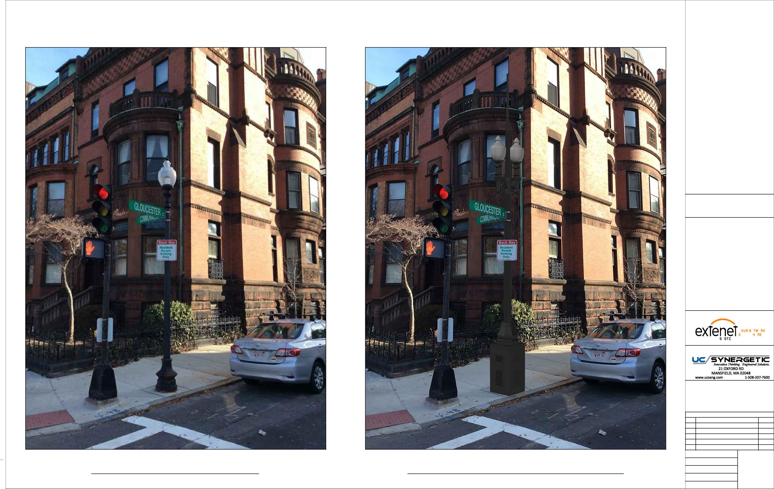
LOCATION:
BOSTON, MA SUFFOLK COUNTY
NOTES:
N:\Engineering\Extenet Systems\NE-MA-BSTC8C01-ATT\AA - AUTOCAD\NE-MA-BSTC8C01-006.dwg
PREPARED FOR:
YEO.
YMS
VERYWE.
PREPARED BY:
REVISIONS
REV
DESCRIPTION
DATE
1
ADDED ADA SITEPLAN
3/1/19
DRAFTER: CEM
EXISTING PHOTOGRAPHIC VIEW PROPOSED PHOTOGRAPHIC SIMULATION
SCALE: NTS
5
10/9/18
ISSUE DATE: 10/04/18
INDEX NAME: NE-MA-BSTC8C01-006
SHEET #: 5 OF 9

Slide 24
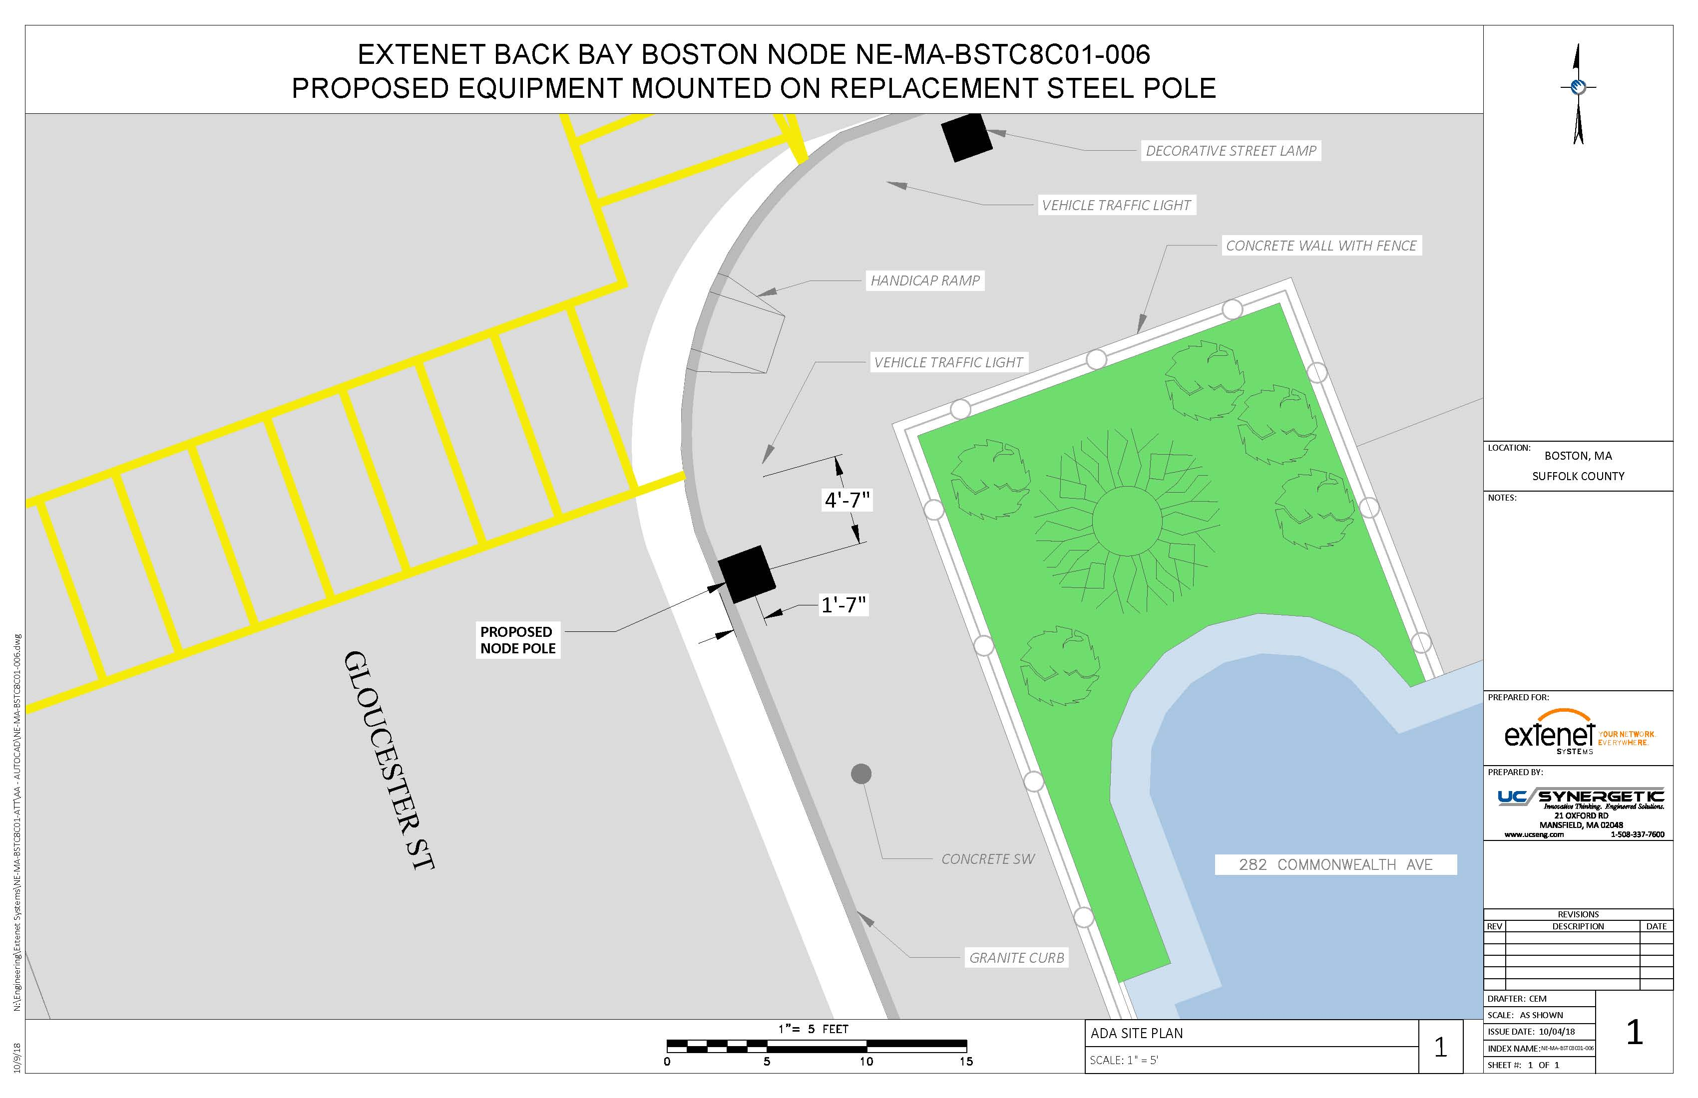

Slide 25
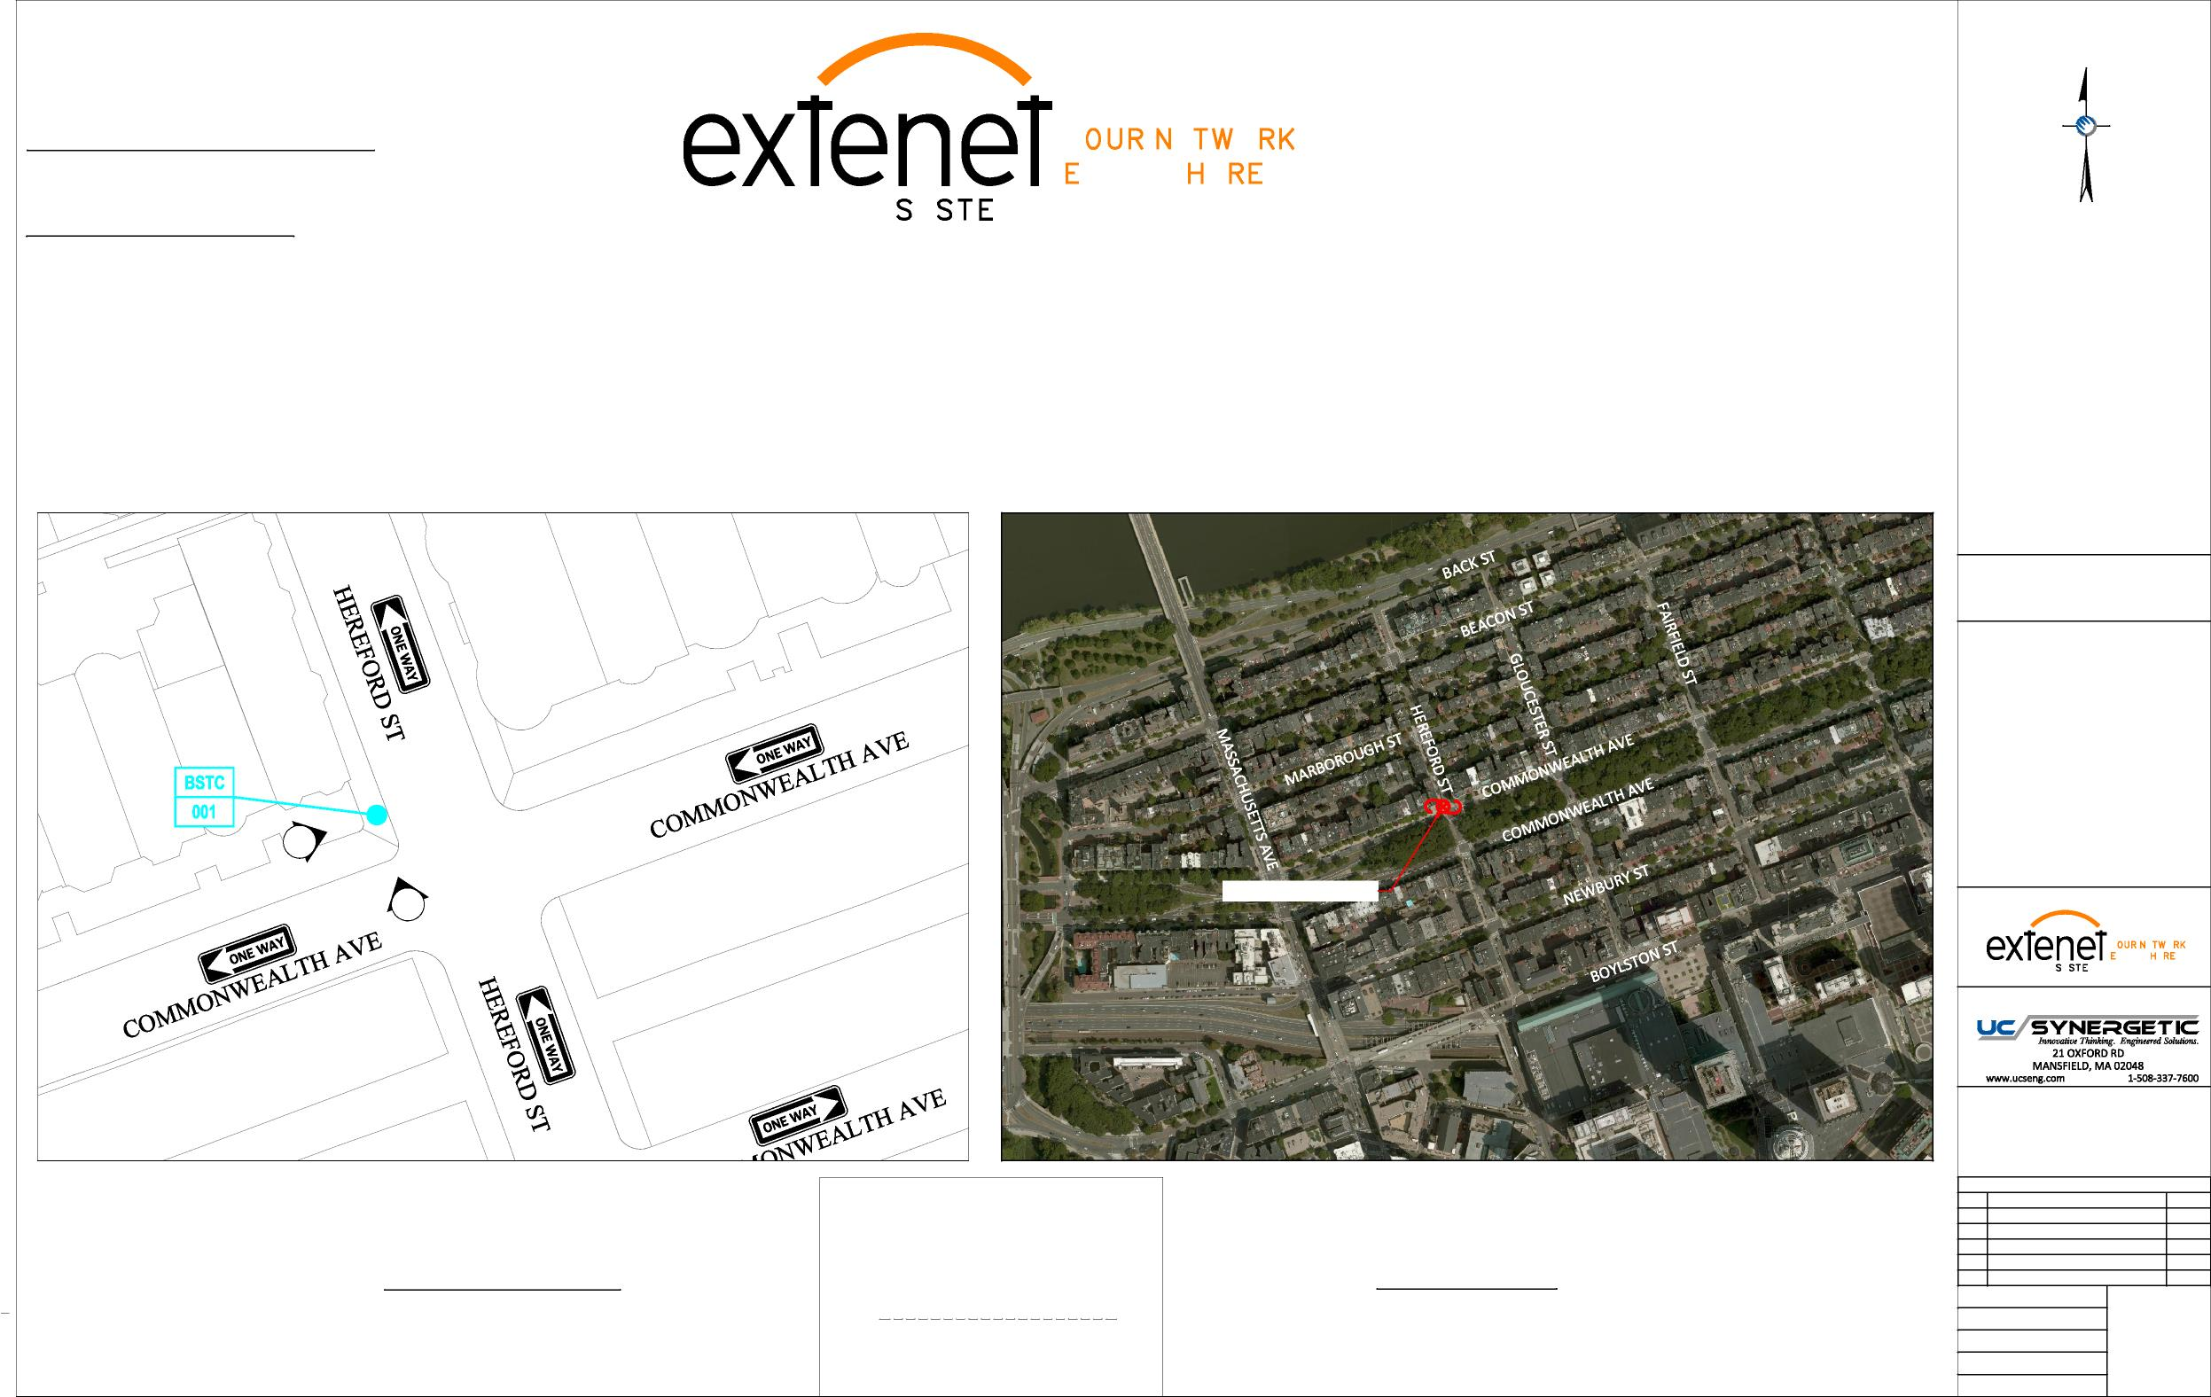
Extenet Systems
3030 Warrenville Rd., Suite 340 Lisle, IL 60532
24/7 Network Operations Center
YEO.
(866) 892-5327
Network Implementation
VERYWE.
YMS
Arthur Pino
Sr. Manager - Network Engineering & Implementation apino@extenetsystems.com Mobile: (978)-804-0652
BOSTON, MA
BACK BAY DISTRIBUTED ANTENNA SYSTEM
PROPOSED 4G/LTE NODE SITES
PROPOSED COMMONWEALTH AVE EXPANSION NODE NE-MA-BSTC8C01-007
COMMONWEALTH AVE AT HEREFORD ST
LOCATION:
BOSTON, MA SUFFOLK COUNTY
NOTES:
N:\Engineering\Extenet Systems\NE-MA-BSTC8C01-ATT\AA - AUTOCAD\NE-MA-BSTC8C01-007.dwg
2
1
PROPOSED NODE POLE
PREPARED FOR:
YEO.
YMS
VERYWE.
PREPARED BY:
REVISIONS
REV
DESCRIPTION
DATE
Location and Design Approved Boston Public Works
Street Lighting Department
1
ADDED ADA SITEPLAN
3/1/19
LOCATION MAP
LOCUS MAP
LATITUDE: 42.349995° LONGITUDE:-71.086334°
42° 20' 59.9" N, 71° 5' 10.80" W
SCALE: 1" = 50'
By:
ELEVATION: 11' AMSL
DRAFTER: MAC
SCALE: 1" = 500'
SCALE: AS SHOWN
1
12/11/17
Date:
ISSUE DATE: 12/05/17
INDEX NAME: NE-MA-BSTC8C01-007
SHEET #: 1 OF 9

Slide 26
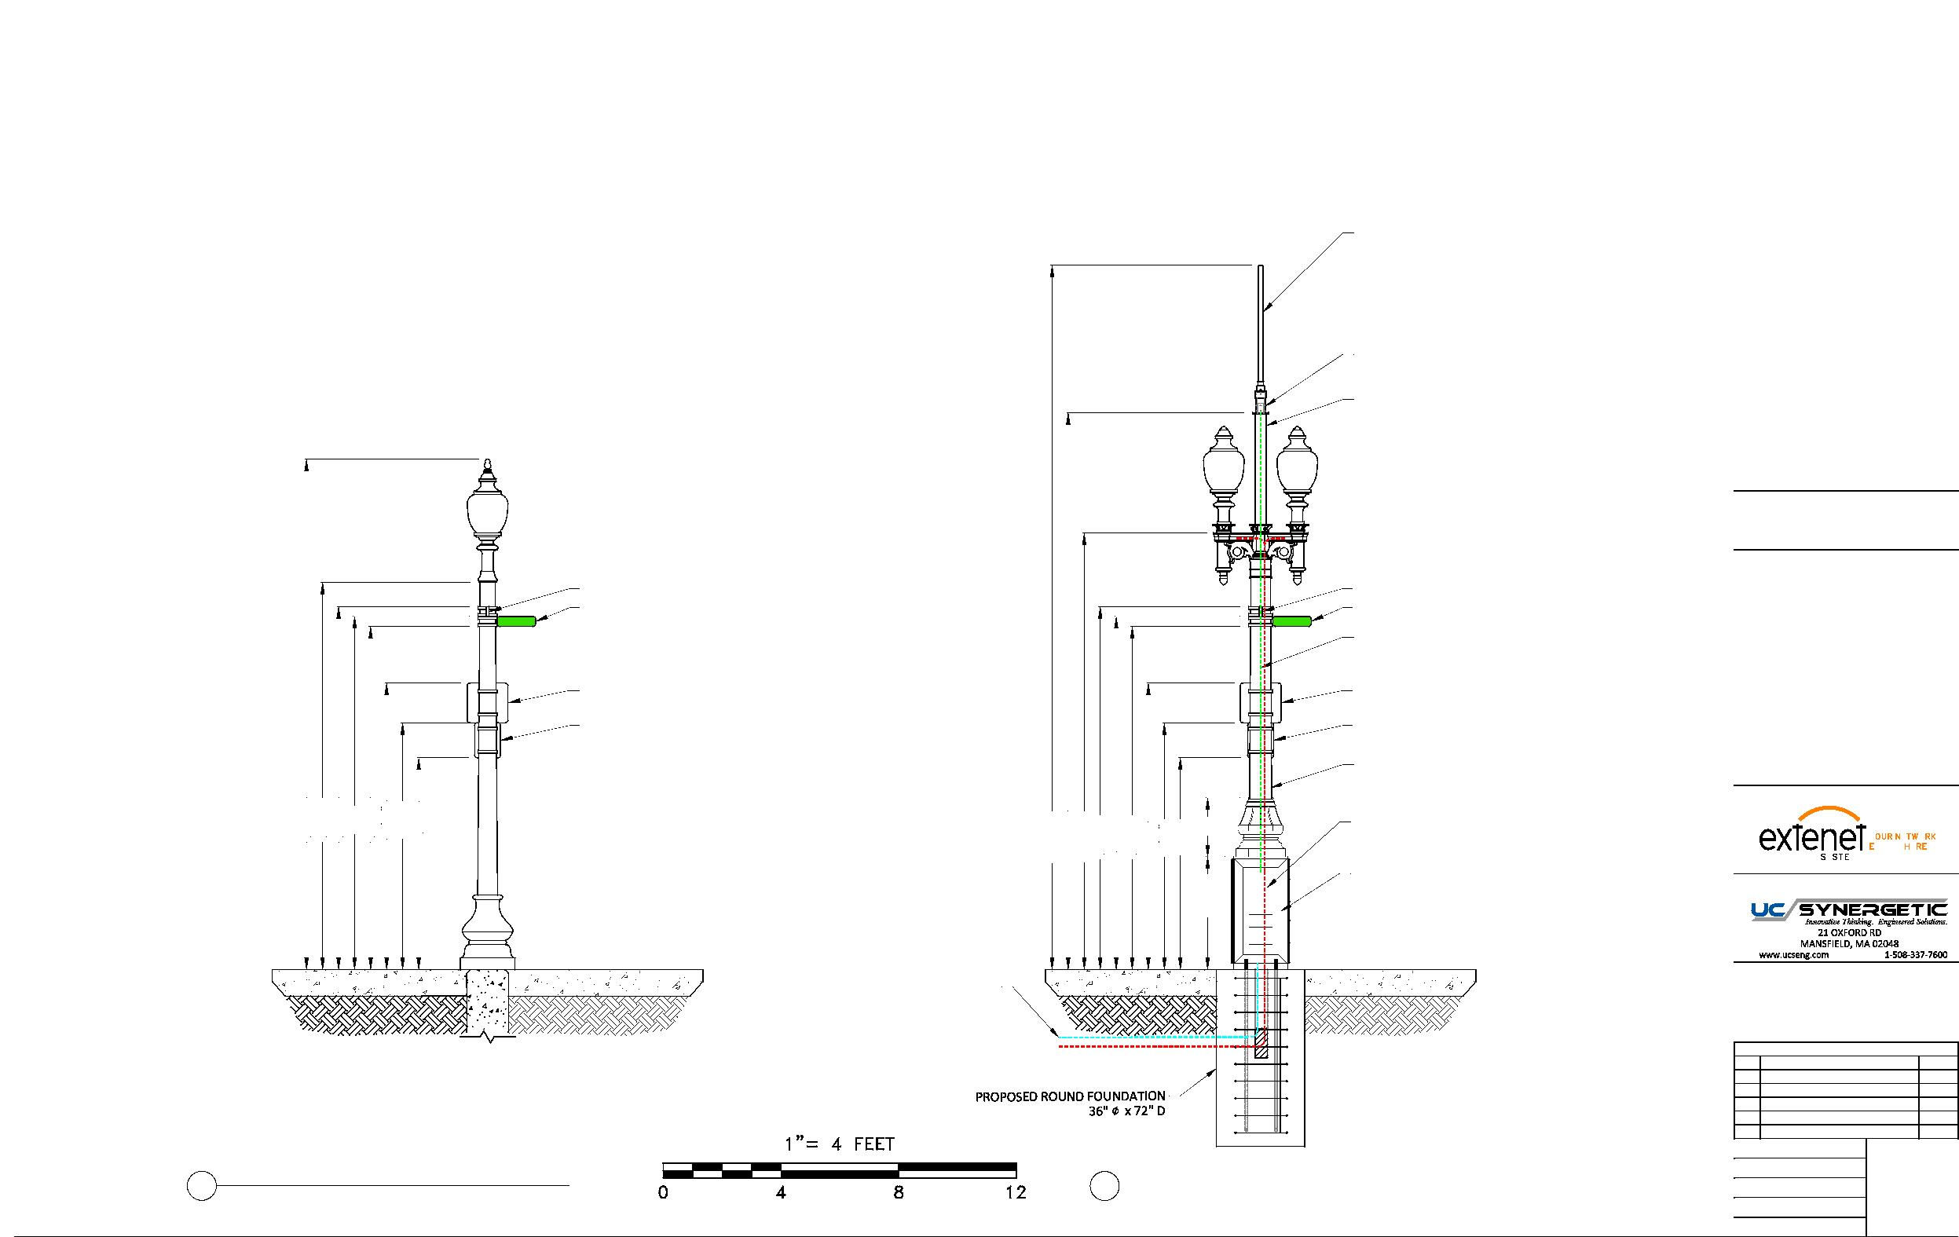
EXTENET BACK BAY BOSTON NODE NE-MA-BSTC8C01-007
PROPOSED EQUIPMENT MOUNTED ON REPLACEMENT STEEL POLE
PROPOSED OMNI ANTENNA
PHAZAR/BRSAWS360Q-698-1710-2-TOM-MD ANTENNA
(SEE DETAIL)
PROPOSED WHIP ANTENNA
CUSTOM ADAPTER (SEE DETAILS)
PROPOSED 3'-9" EXTENSION 4.5" DIAMETER
LOCATION:
BOSTON, MA SUFFOLK COUNTY
NOTES:
EXISTING STREET SIGN
EXISTING STREET SIGN
HEREFORD ST
EXISTING STREET SIGN
HEREFORD ST
EXISTING STREET SIGN
COAX FEED
COMMSCOPE LDF4-50A(1/2")
EXISTING RESIDENT PARKING SIGN
EXISTING RESIDENT PARKING SIGN
N:\Engineering\Extenet Systems\NE-MA-BSTC8C01-ATT\AA - AUTOCAD\NE-MA-BSTC8C01-007.dwg
EXISTING STREET CLEANING SIGN
EXISTING STREET CLEANING SIGN
PROPOSED 11' STEEL FLUTED POLE
TAPERED DIAMETER (9" BASE 8.1" TOP)
PREPARED FOR:
17'-4"
13'-2"
12'-4"
12'
11'-8"
9'-9"
8'-5"
7'-2"
23'-11"
18'-11"
14'-10"
12'-4"
11'-8"
9'-9"
8'-5"
7'-2"
3'-10" 2'
SEPARATE POWER TO CONTINUE TO STREETLIGHT
12'
YEO.
YMS
VERYWE.
(2) COMMSCOPE ION-M 7P-85P-17P-19P
PREPARED BY:
OPTICAL REMOTE UNITS
CONCRETE SIDEWALK
CONCRETE SIDEWALK
PROPOSED FIBER FEED
PROPOSED POWER FEED
REVISIONS
REV
DESCRIPTION
DATE
1
ADDED ADA SITEPLAN
3/1/19
1
DRAFTER: MAC
4
2 EXISTING PROFILE - REAR VIEW 2 LOOKING NORTHEAST FROM HEREFORD ST
PROPOSED PROFILE - REAR VIEW
LOOKING NORTHEAST FROM HEREFORD ST
SCALE: 1" = 5'
12/11/17
ISSUE DATE: 12/05/17
INDEX NAME: NE-MA-BSTC8C01-007
SHEET #: 4 OF 9

Slide 27
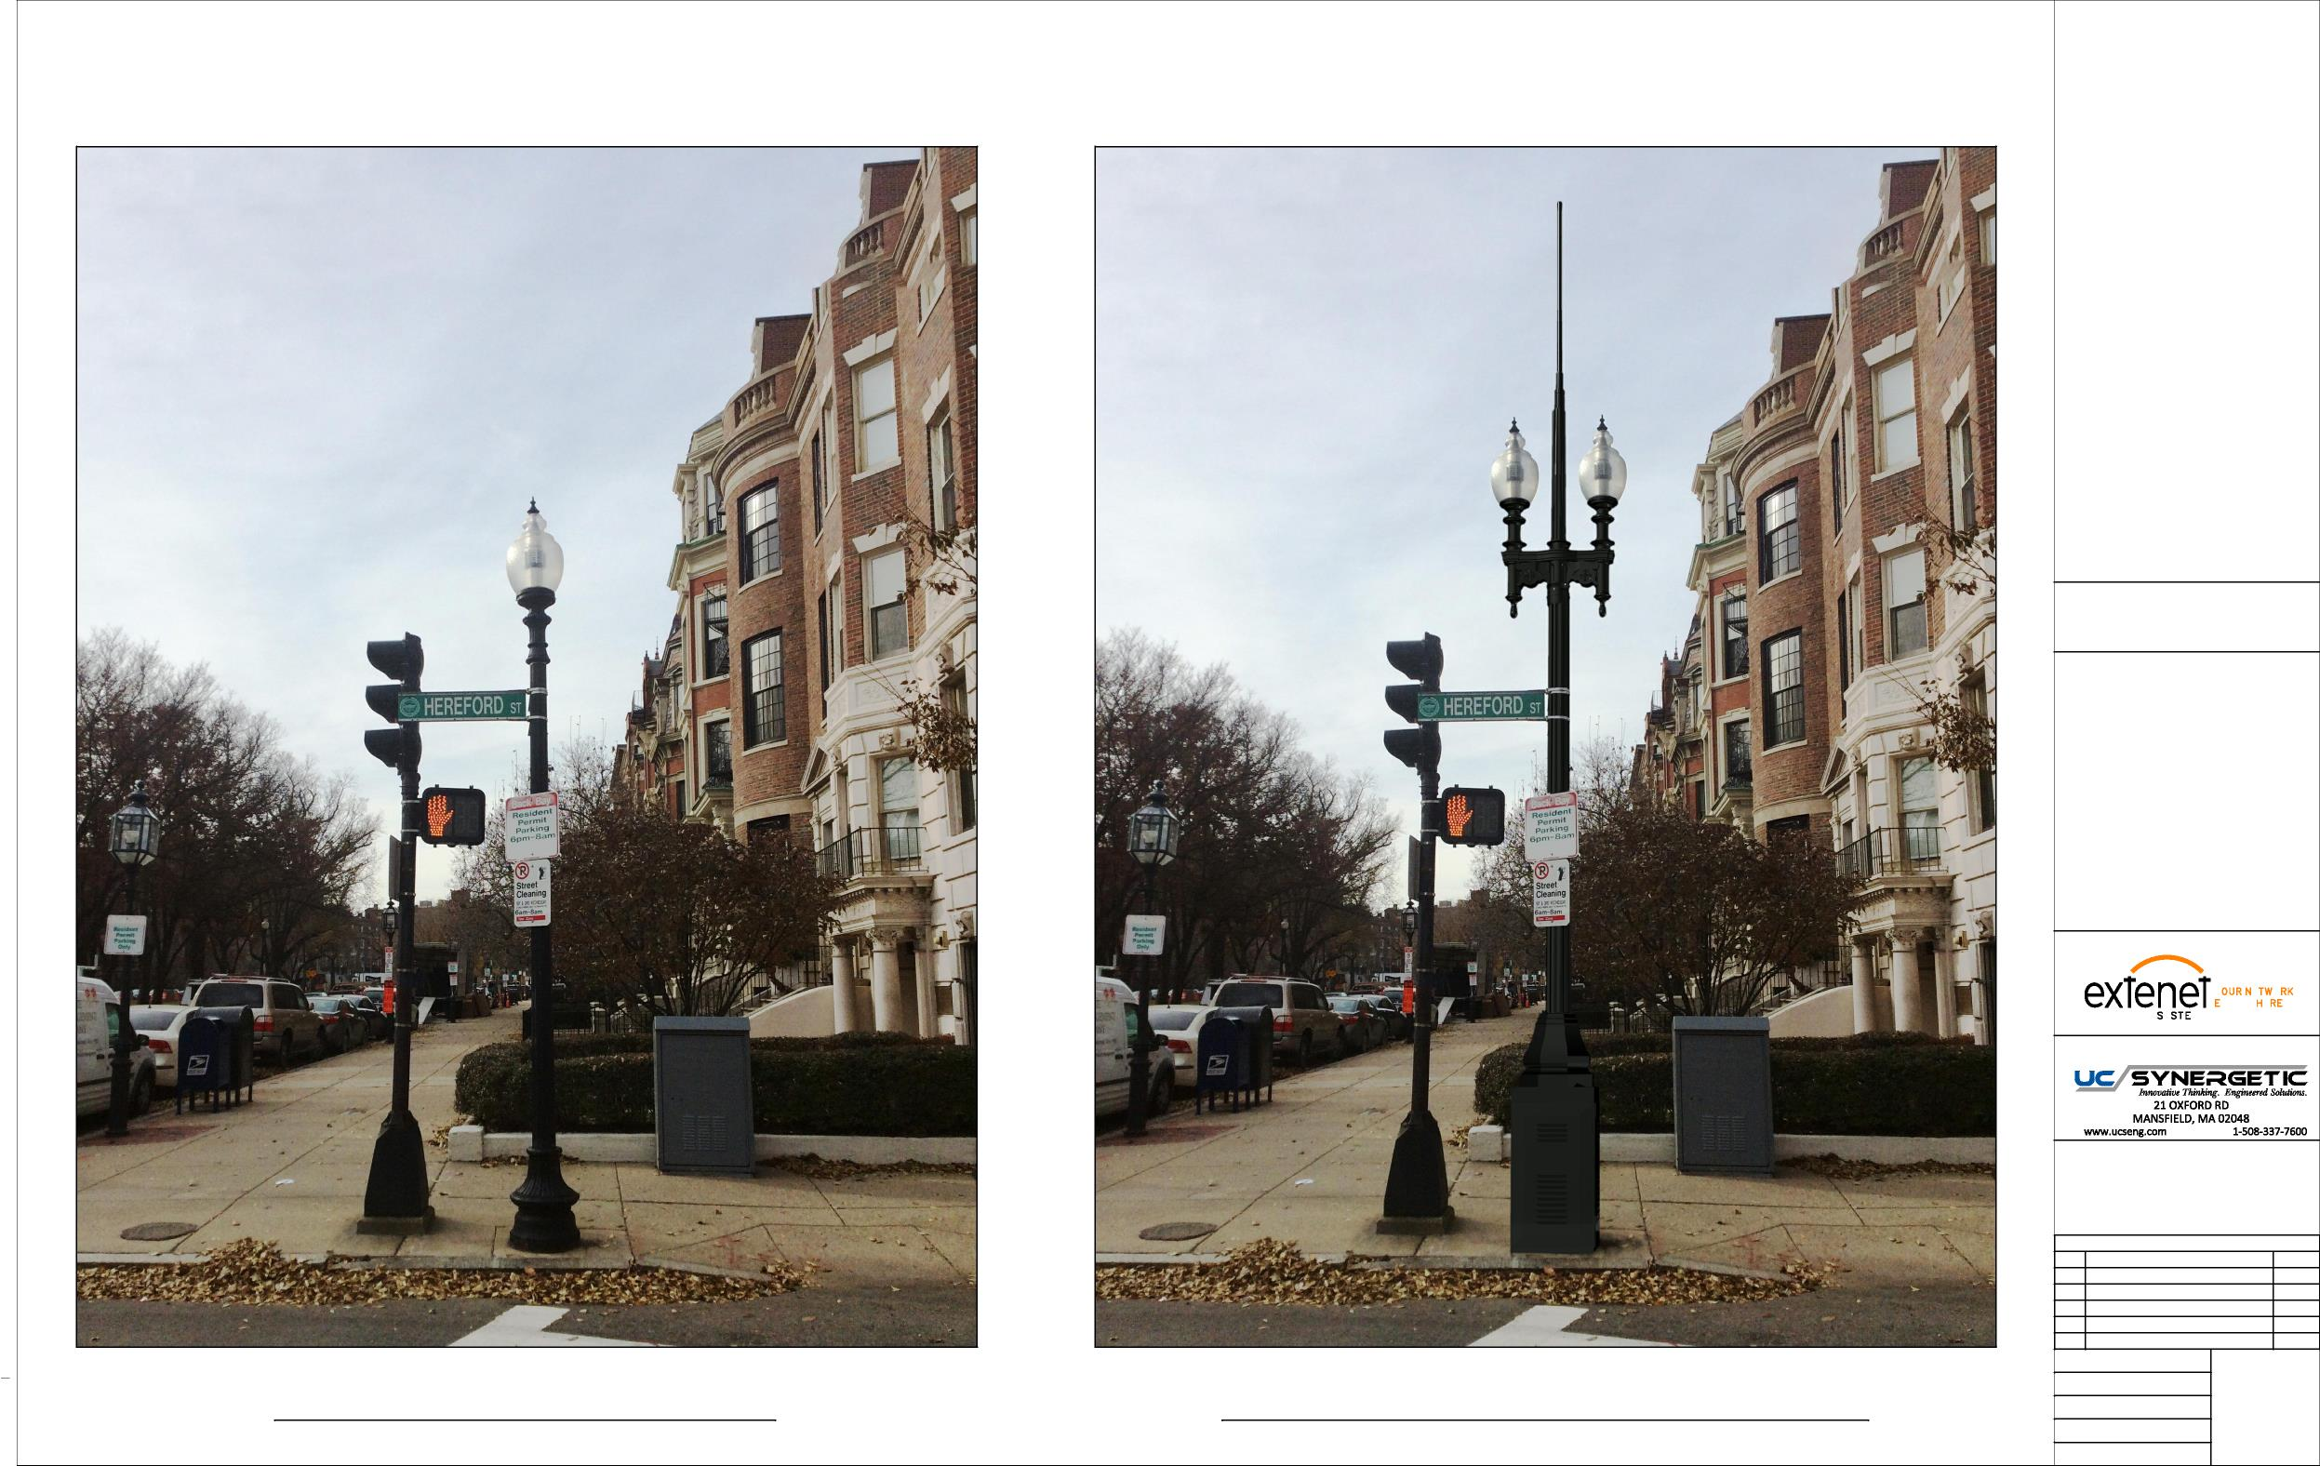
LOCATION:
BOSTON, MA SUFFOLK COUNTY
NOTES:
N:\Engineering\Extenet Systems\NE-MA-BSTC8C01-ATT\AA - AUTOCAD\NE-MA-BSTC8C01-007.dwg
PREPARED FOR:
YEO.
YMS
VERYWE.
PREPARED BY:
REVISIONS
REV
DESCRIPTION
DATE
1
ADDED ADA SITEPLAN
3/1/19
DRAFTER: MAC
EXISTING PHOTOGRAPHIC VIEW PROPOSED PHOTOGRAPHIC SIMULATION
SCALE: NTS
5
12/11/17
ISSUE DATE: 12/05/17
INDEX NAME: NE-MA-BSTC8C01-007
SHEET #: 5 OF 9

Slide 28
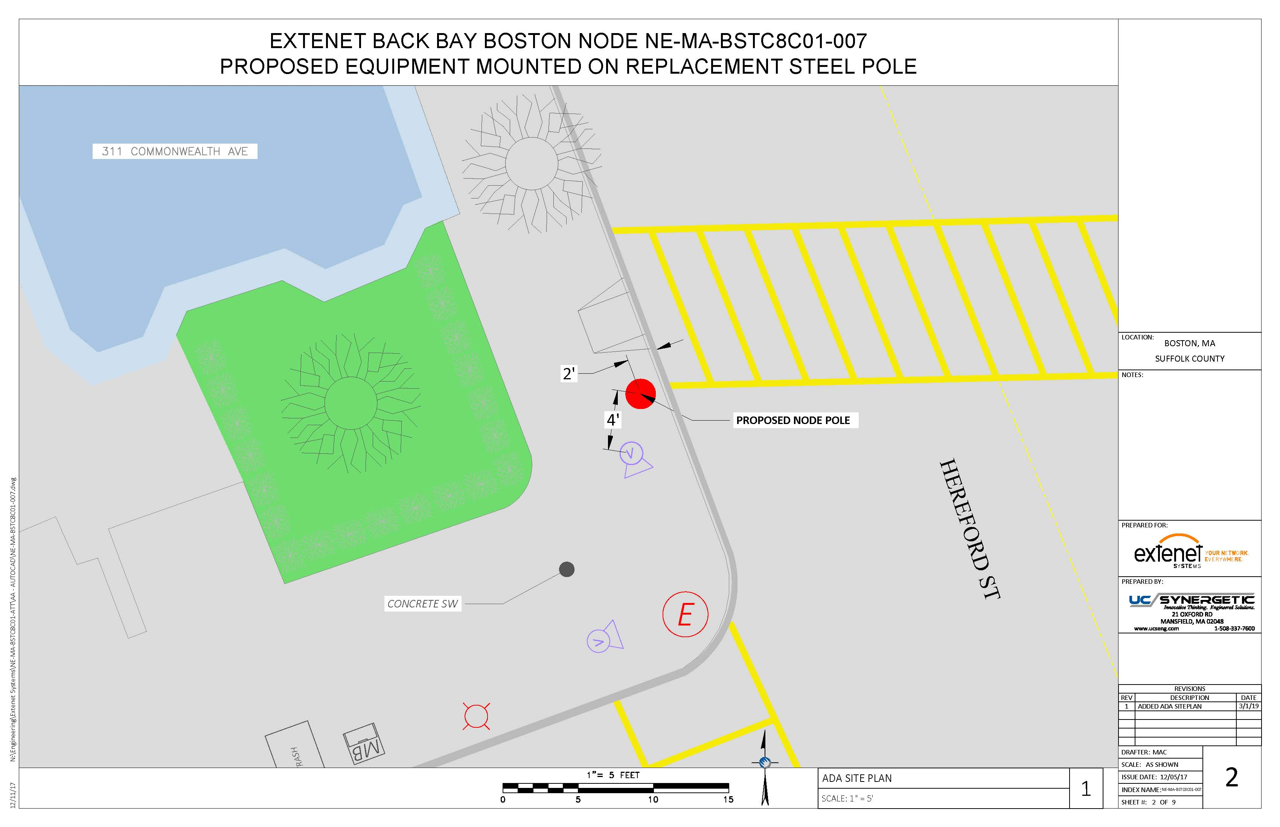

Slide 29
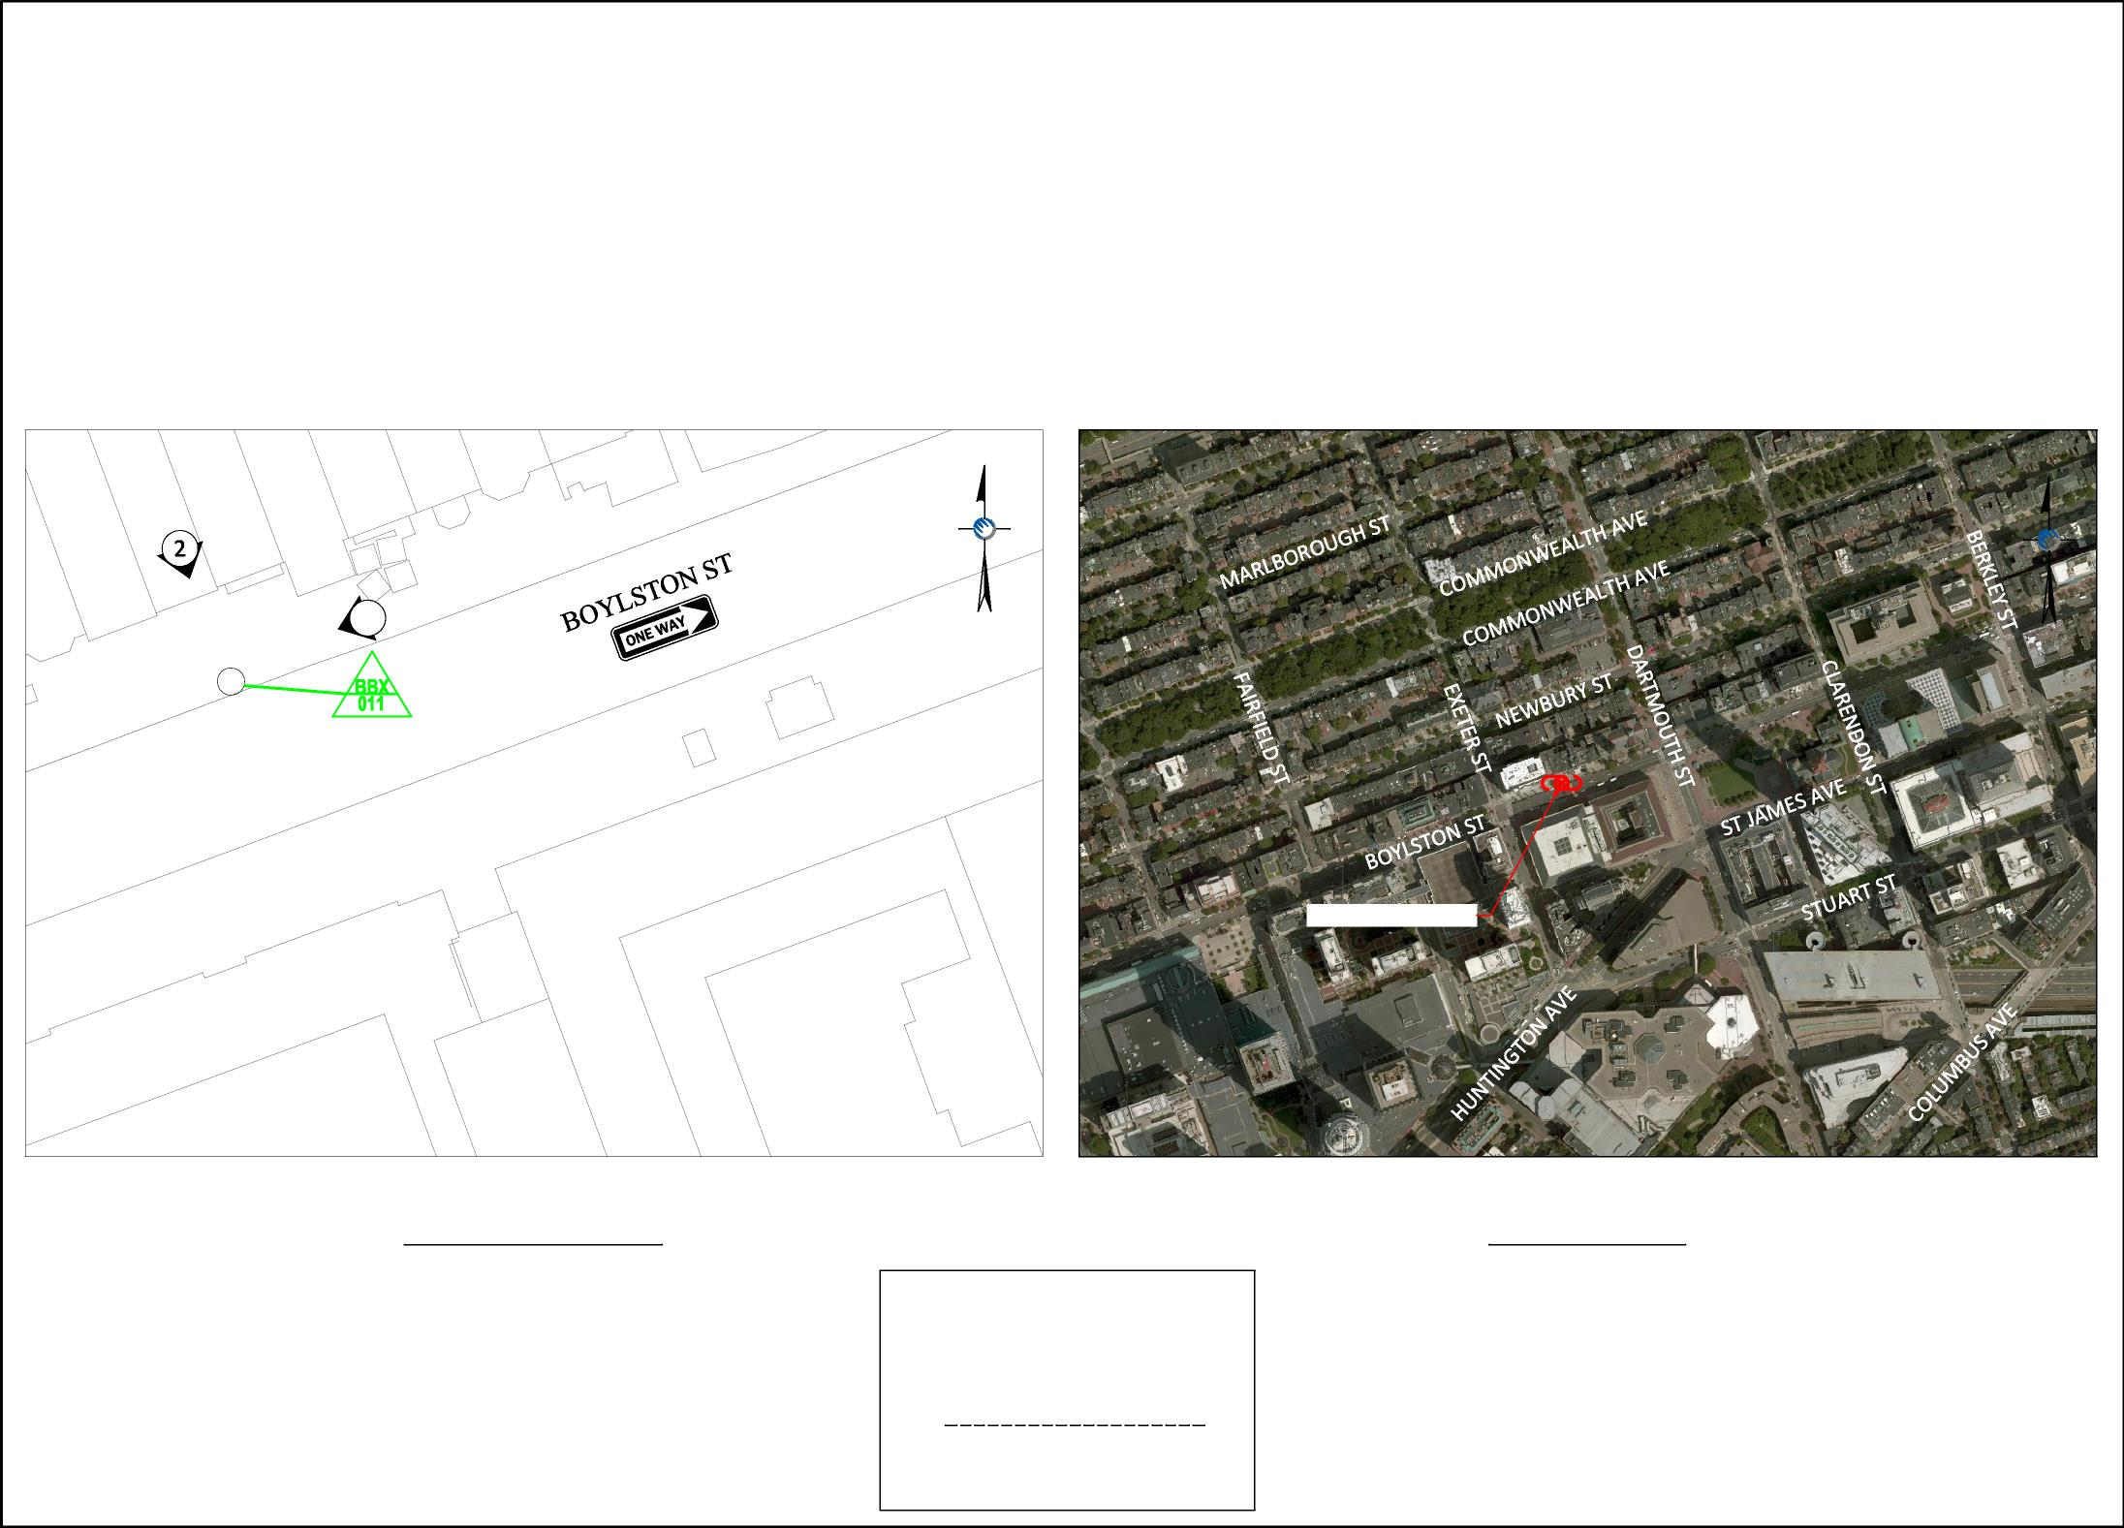

EXTENET SYSTEMS
CITY OF BOSTON
SUFFOLK COUNTY, MA
Location and Design Approved Boston Public Works
Street Lighting Department
N:\Engineering\Extenet Systems\BA - Boston 216 Nodes\BBX - Back Bay\NPPs\AUTOCAD\NODE BBX-011 - 03-06-19.dwg
1
LOCATION:
BOSTON, MA SUFFOLK COUNTY
NOTES:
PROPOSED NODE POLE
PREPARED FOR:
YEO.
YMS
VERYWE.
PREPARED BY:
LOCATION MAP
LOCUS MAP
NODE BBX-011
LATITUDE: 42.349806° LONGITUDE: -71.078723°
PROJECT LOCATION - NODE BBX-011
SCALE: 1" = 50'
SCALE: 1" = 500'
REVISIONS
REV | DESCRIPTION
2 | EQUIPMENT CHANGE
3 | FINAL HARDWARE UPDATE
4 | LOCATION CHANGE
5 | LOCATION CHANGE
6 | ADDED ADA PLAN
DATE
10/10/17
12/12/17
09/12/18
09/25/18
DRAFTER: MI/EP
03/1/19
By:
SCALE: AS SHOWN
1
03/7/2019
Date:
ISSUE DATE: 01/26/16
INDEX NAME: BBX-011
SHEET #: 1 OF 8

Slide 30
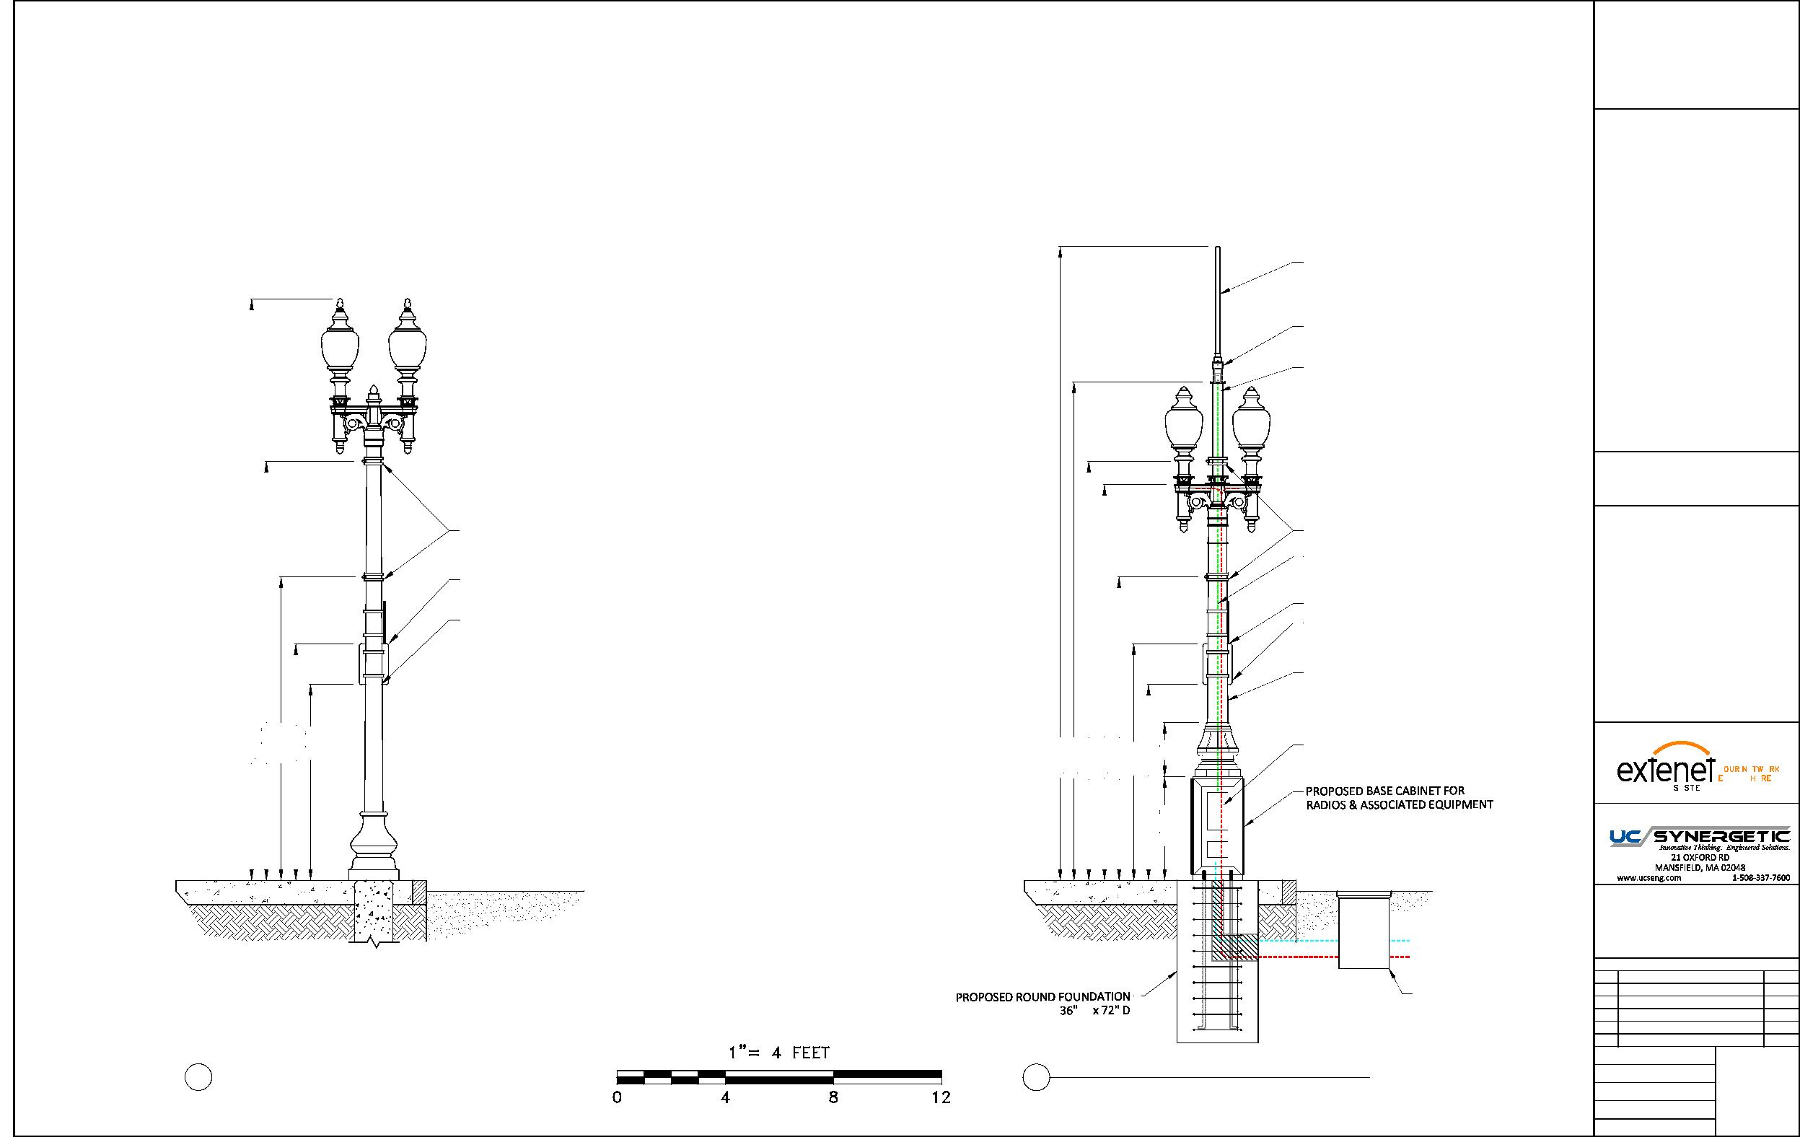
EXTENET DOWNTOWN BOSTON NODE BBX-011
SIDE VIEW
PROPOSED OMNI DAS ANTENNA PHAZAR/O-6002V-C2A2-D4-TOM (SEE DETAIL)
PROPOSED WHIP ANTENNA
CUSTOM BRACKET (SEE DETAILS)
PROPOSED 3'-9" EXTENSION 4.5" DIAMETER
N:\Engineering\Extenet Systems\BA - Boston 216 Nodes\BBX - Back Bay\NPPs\AUTOCAD\NODE BBX-011 - 03-06-19.dwg
LOCATION:
BOSTON, MA SUFFOLK COUNTY
EXISTING BANNER RODS
EXISTING BANNER RODS
NOTES:
COAX FEED
EXISTING PARKING METER SIGN
COMMSCOPE LDF4-50A(1/2")
EXISTING PAY TO PARK SIGN
EXISTING PARKING METER SIGN
EXISTING PAY TO PARK SIGN
PROPOSED 11' STEEL FLUTED POLE
TAPERED DIAMETER (9" BASE 8.1" TOP)
21'-6"
15'-6"
11'-3"
8'-9"
7'-3"
23'-5"
18'-5"
15'-6"
14'-8"
11'-3"
8'-9"
7'-3"
2'
SEPARATE POWER TO CONTINUE TO STREETLIGHT
PREPARED FOR:
YEO.
YMS
VERYWE.
3'-10"
PREPARED BY:
BRICK SIDEWALK
BOYLSTON ST
BRICK SIDEWALK
BOYLSTON ST
ROAD
ROAD
NODE BBX-011
PROPOSED FIBER FEED
PROPOSED POWER FEED
REVISIONS
REV | DESCRIPTION
2 | EQUIPMENT CHANGE
3 | FINAL HARDWARE UPDATE
4 | LOCATION CHANGE
5 | LOCATION CHANGE
6 | ADDED ADA PLAN
DATE
PROPOSED CONCRETE
10/10/17
∅
TRAFFIC RATED HANDHOLE
12/12/17
09/12/18
09/25/18
1 EXISTING PROFILE - SIDE VIEW 1 LOOKING WEST ALONG BOYLSTON ST
PROPOSED PROFILE - SIDE VIEW
LOOKING WEST ALONG BOYLSTON ST
DRAFTER: MI/EP
03/1/19
03/7/2019
SCALE: 1" = 4'
ISSUE DATE: 01/26/16 3
INDEX NAME: BBX-011
SHEET #: 3 OF 8

Slide 31
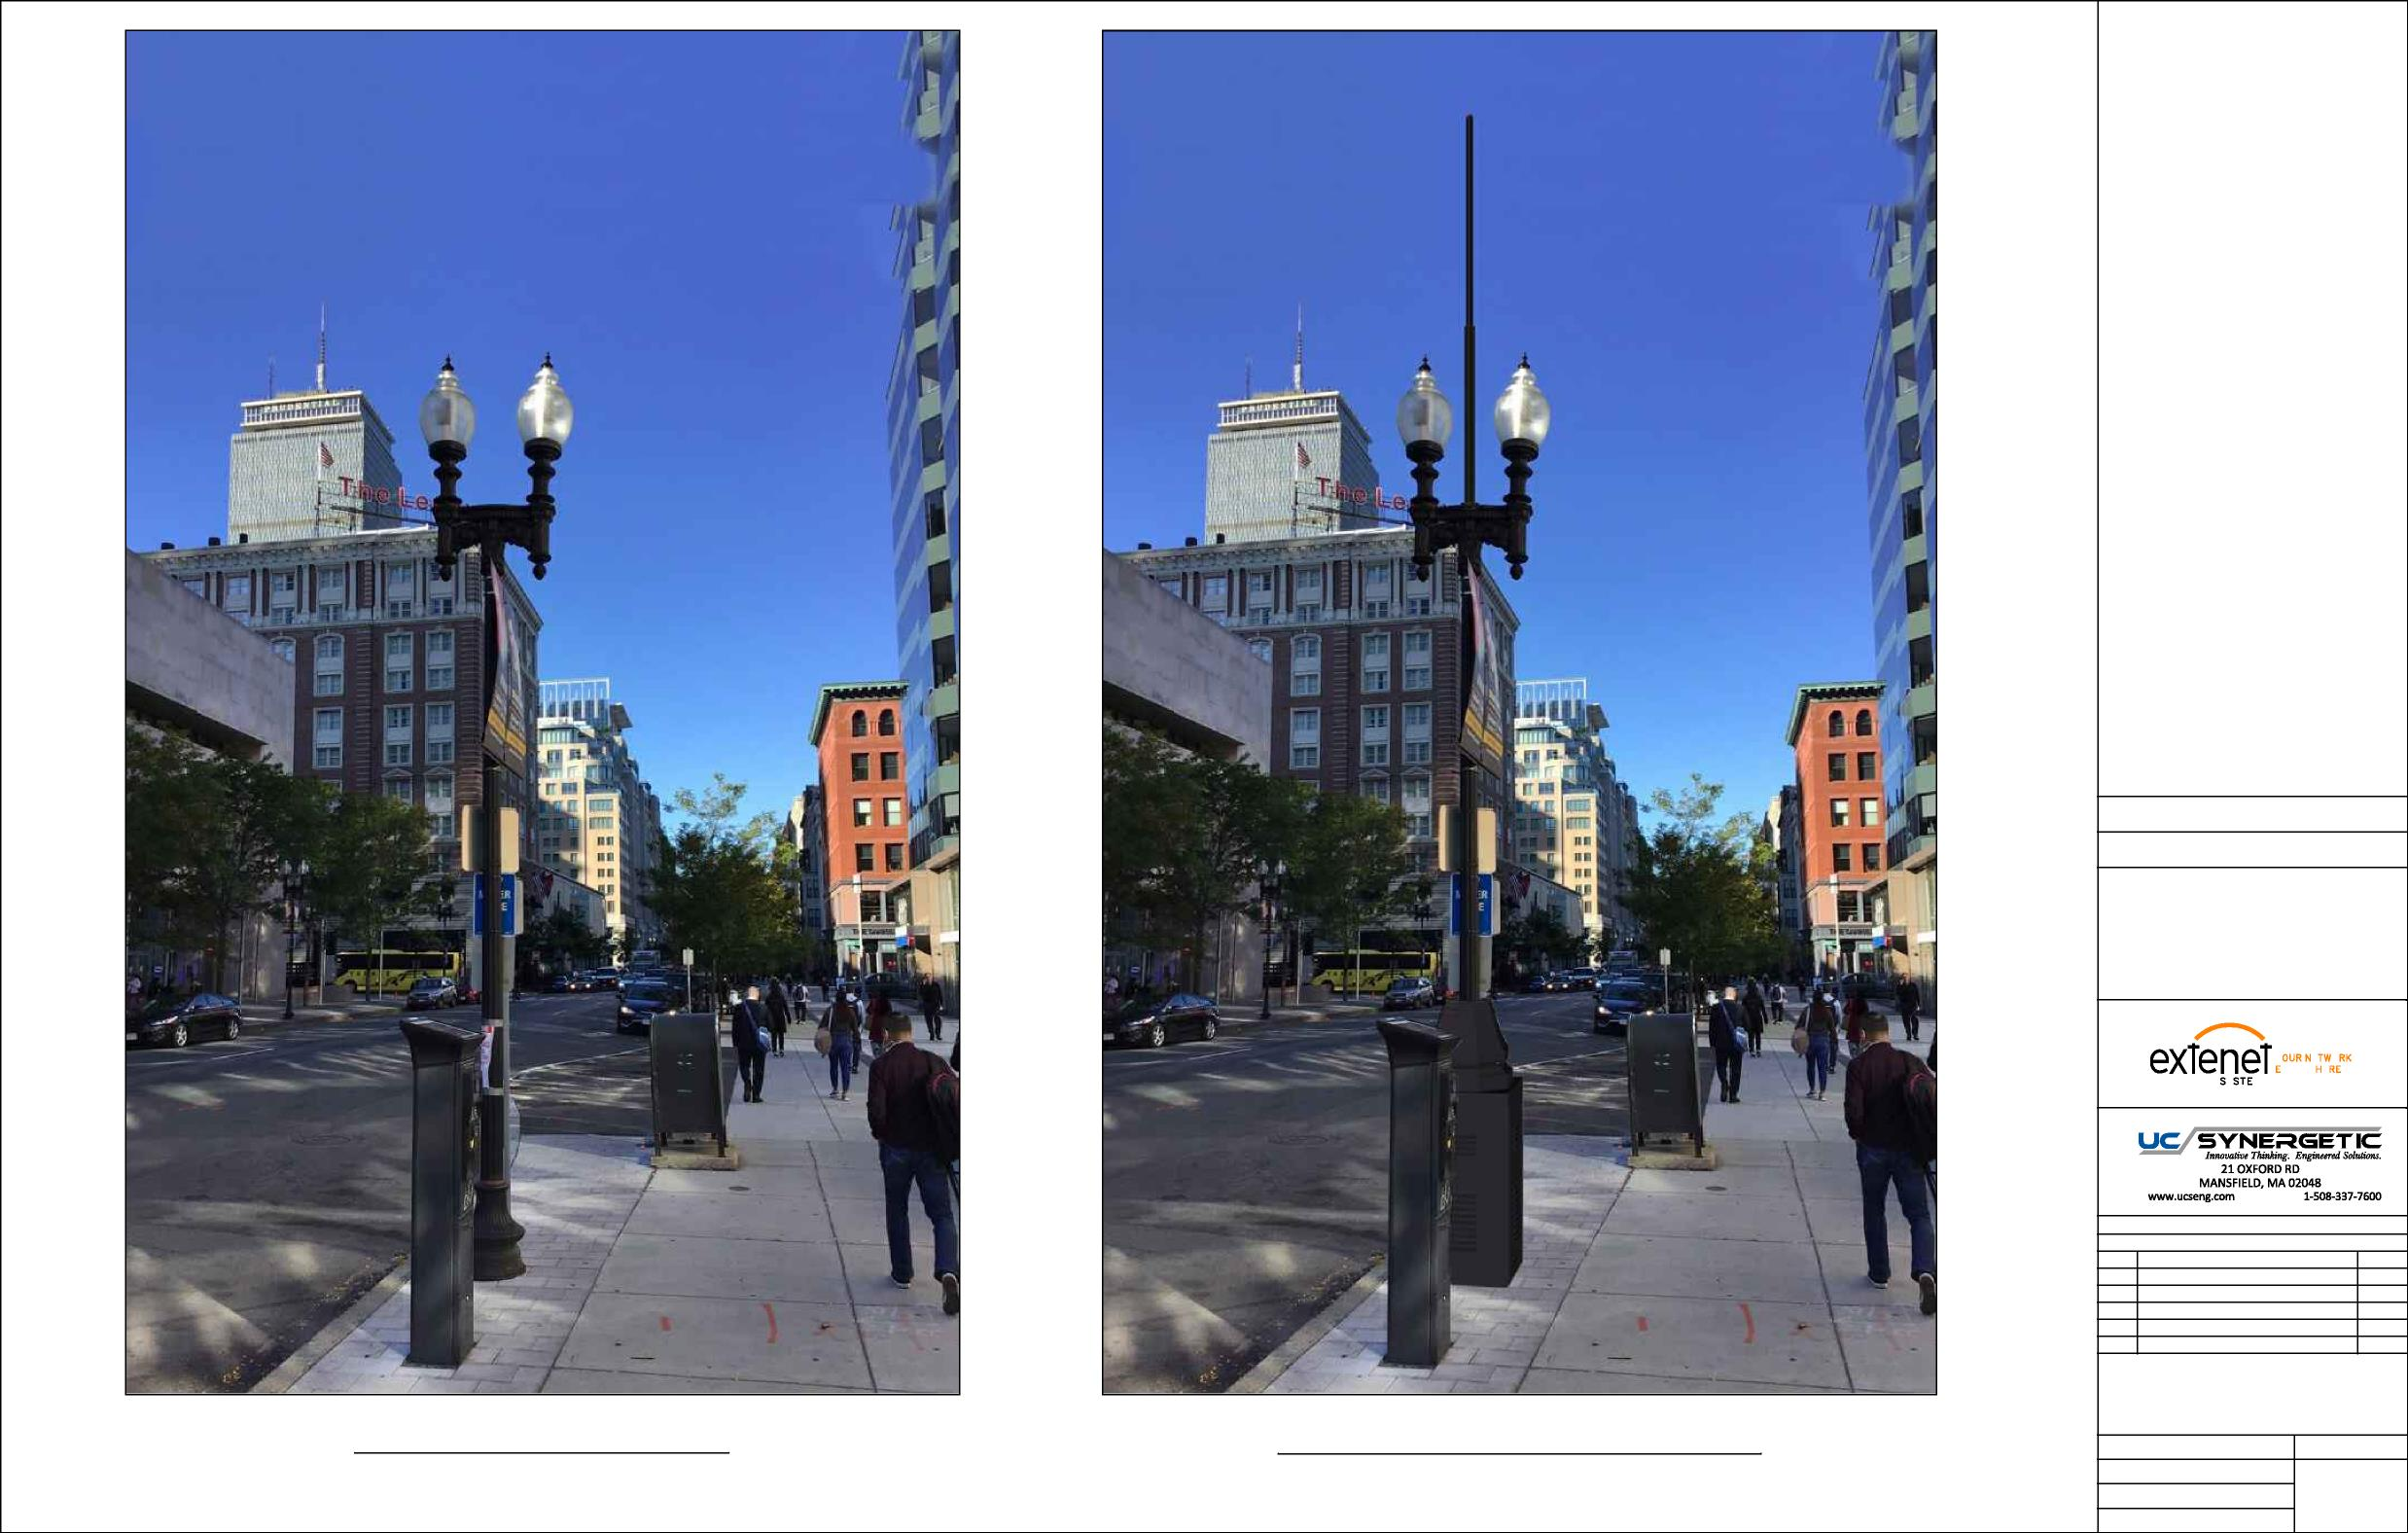
NOTES:
PREPARED FOR:
YEO.
YMS
VERYWE.
PREPARED BY:
REVISIONS
REV DESCRIPTION
DATE
DRAWING TITLE:
PHOTO SIMULATION
EXISTING PHOTOGRAPHIC VIEW
PROPOSED PHOTOGRAPHIC SIMULATION
DRAFTER: NB
DRAWING NO.
SCALE:
NTS
1
ISSUE DATE:
01/16/19
INDEX NAME: NODE BBX-011

Slide 32
