Slide 1
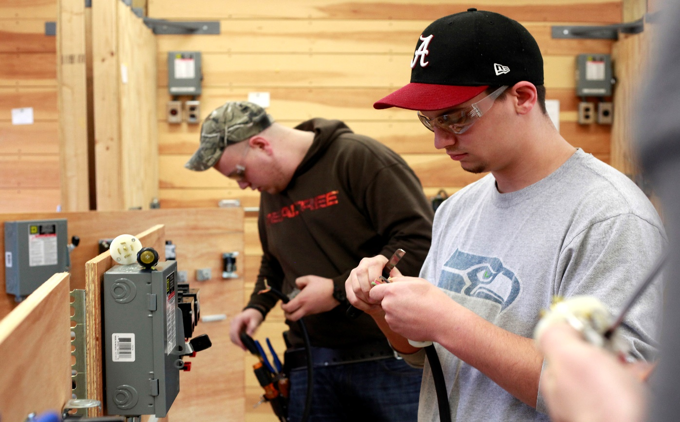
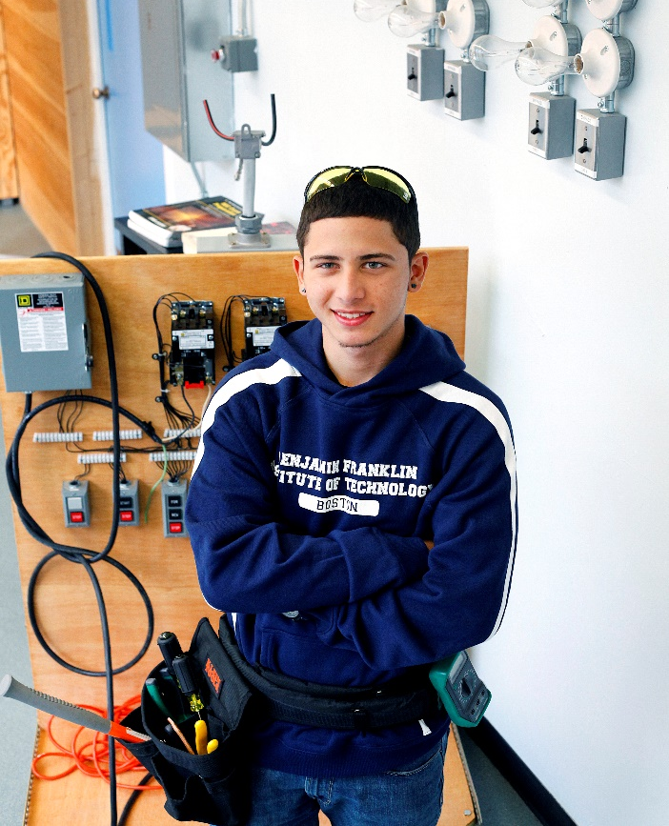
Benjamin Franklin Institute of Technology
SmartFlower Solar Installation

Slide 2
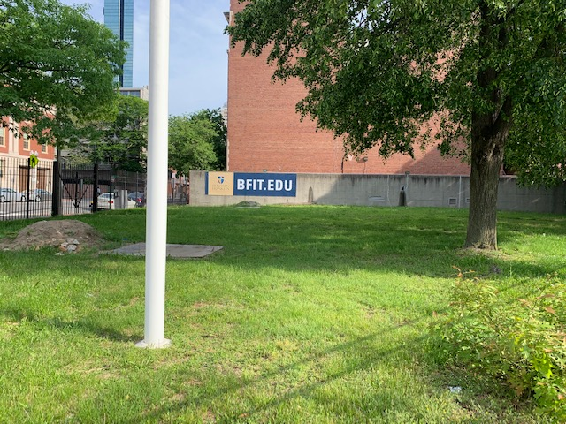
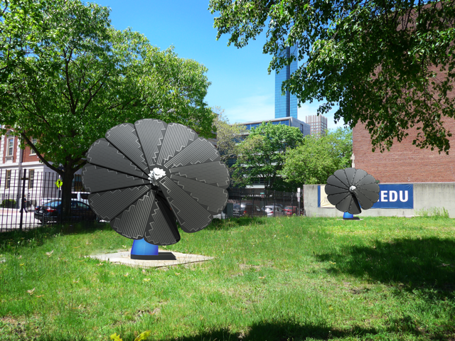
Current Conditions and Proposed Installation

Slide 3
Location on BFIT Property

Slide 4
View from Tremont Street

Slide 5
View from Corner of Berkeley and Tremont Streets

Slide 6
View from Warren Street

