Slide 1
Landmarks Update
5 Necco Street
Signage:
  West face GE Monogram
  Building address
Necco Court Bridge:
  Concrete encasement height increased for structural stability
  West face of bridge detail changes for expansion joint
Delete 4 approved punch out windows
Finished Condition for G1 Parcel (Until Tenant Occupy).

Slide 2
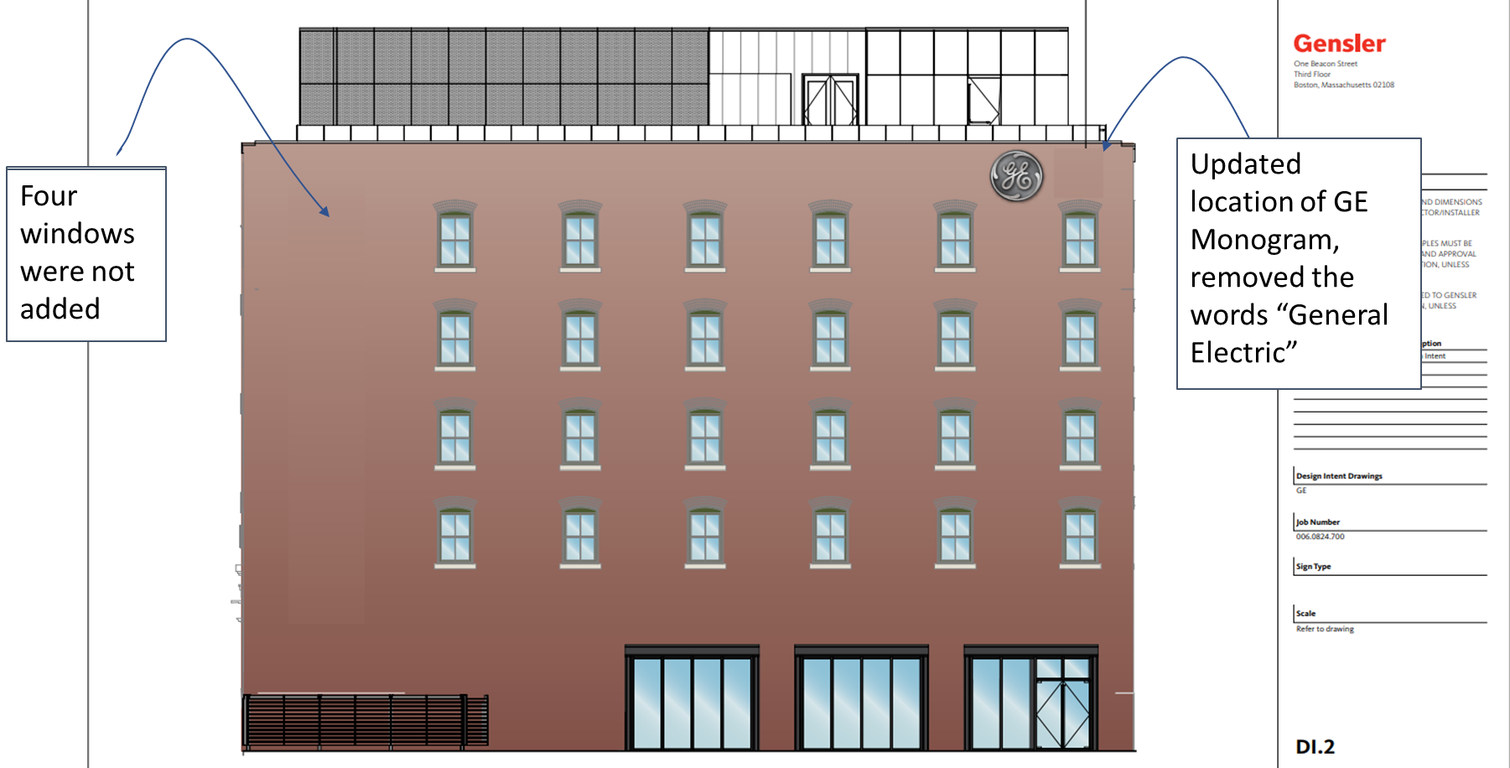
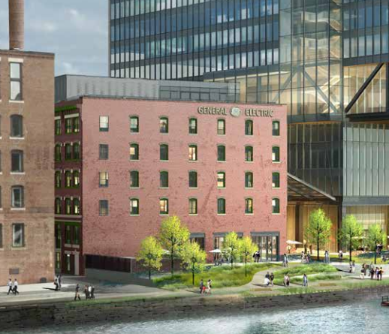
Approved 10-12-17
Design Update 6-18-19

Slide 3
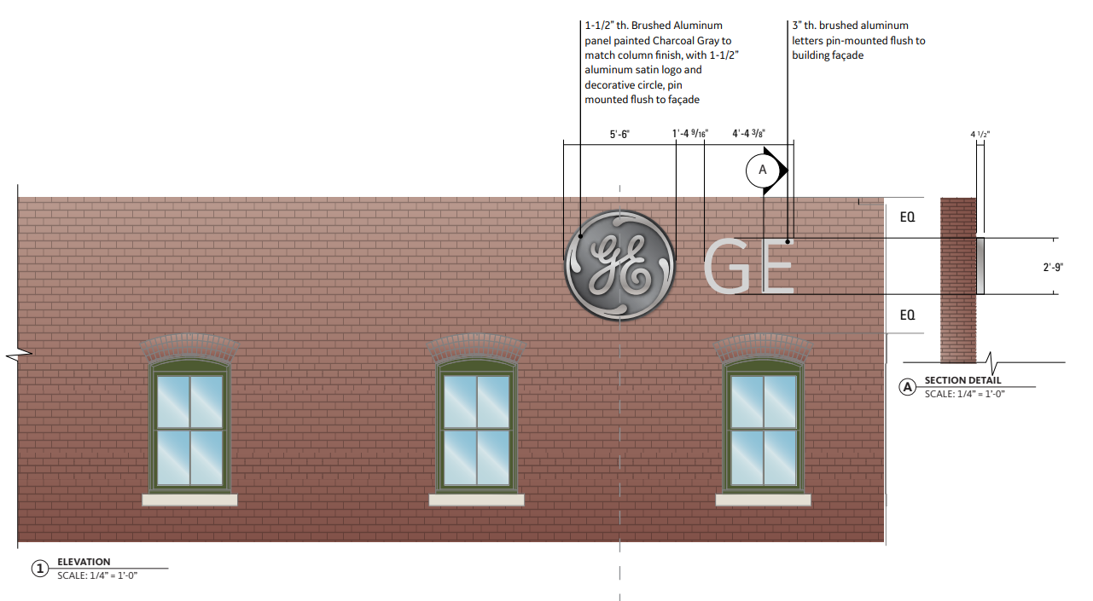

GE Monogram Sign Detail

Slide 4
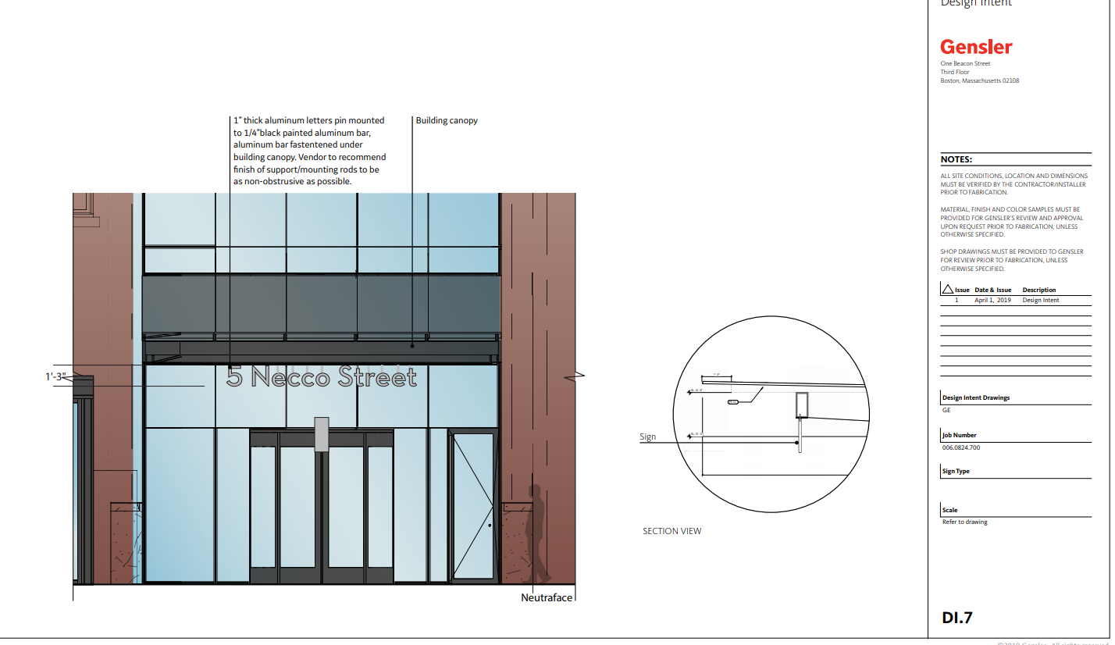
Updated Address of Building

Slide 5
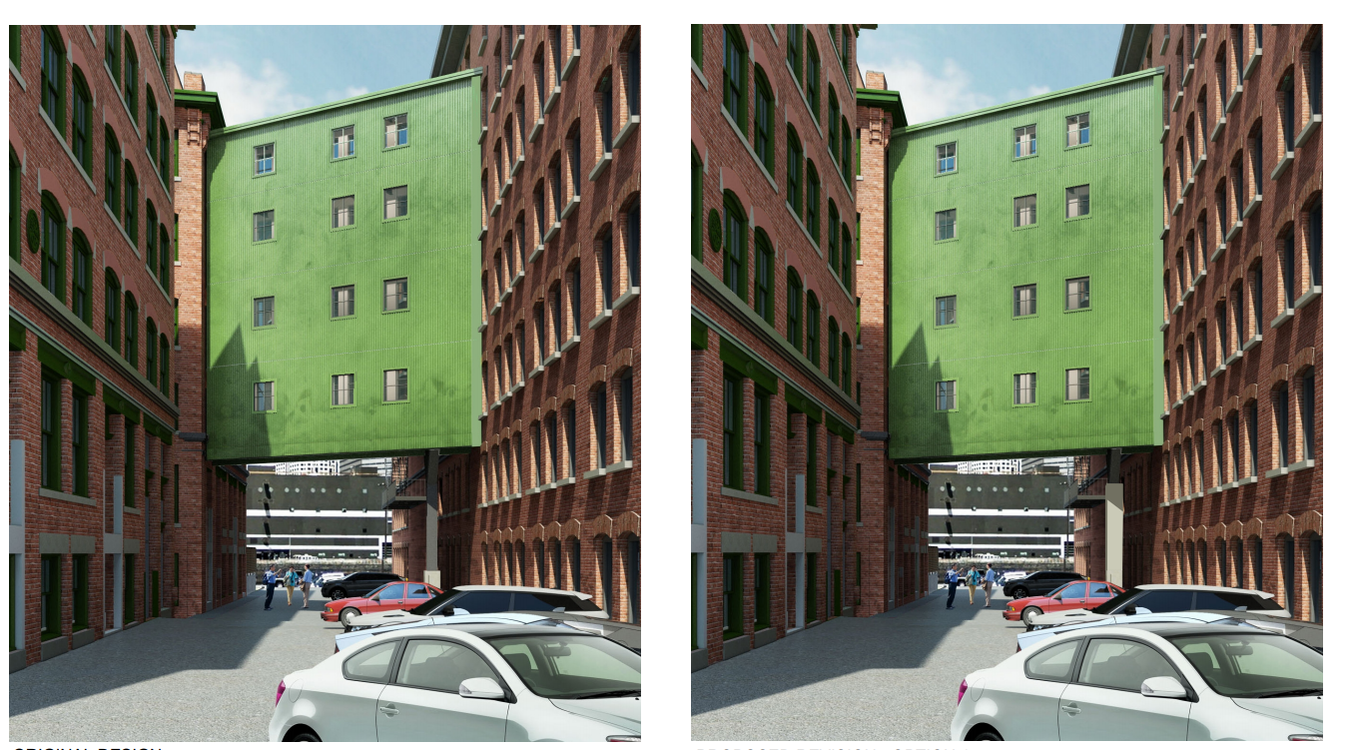
Increased Structural Support

Slide 6
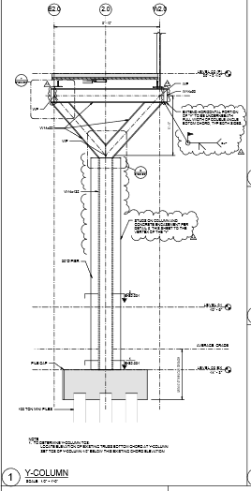
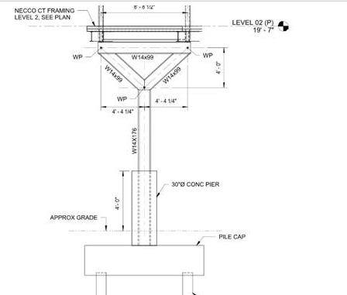
Structural Support for Necco Court Bridge
As Approved
Required for structural support

Slide 7
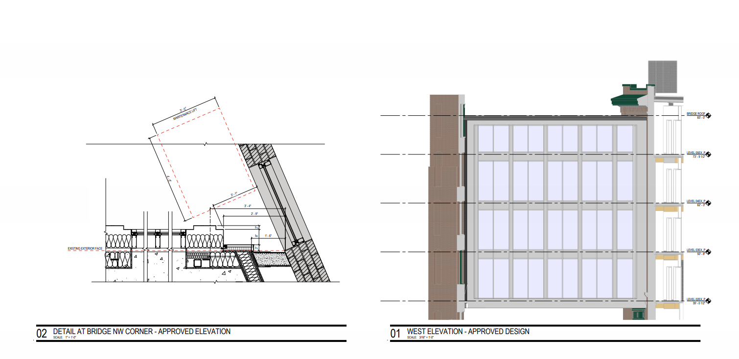

Slide 8
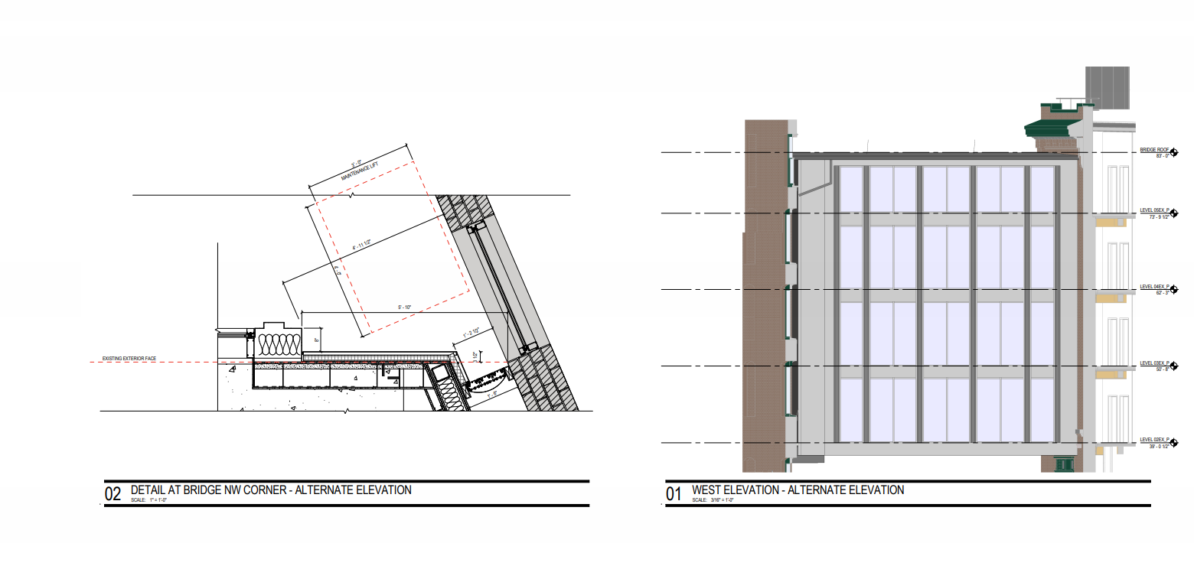

Slide 9
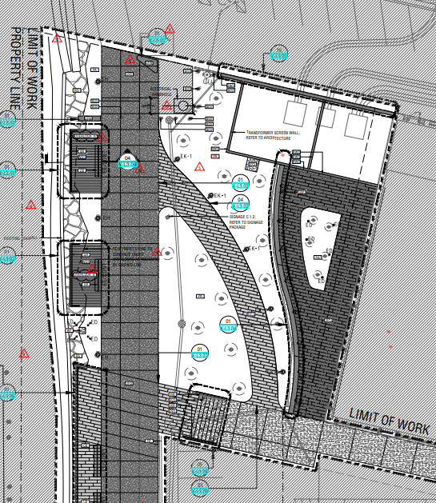
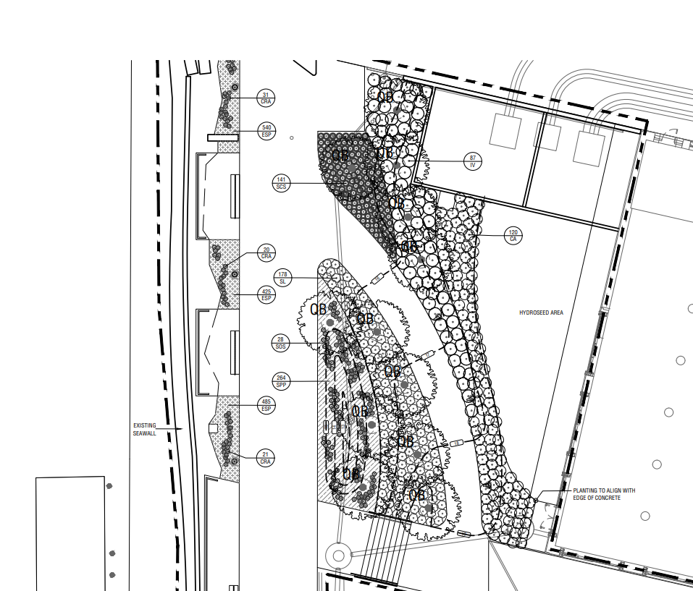
G1 parcel finished condition for GE Project
Replace Bistro Patio with Hydroseed Until Bistro Tenant Identified

