Slide 1
Signs at
5 West Cedar Street
Acorn Street Neighborhood Association
January 16, 2020

Slide 2
Request:
Approval of Two Signs
One replacement of an old wooden sign
One new sign directly below it
Both designed for tastefulness, visibility, and durability
Made of enameled porcelain with an azure blue background and white lettering
Each 24" x 8" in size
Secured to Acorn Street side of 5 West Cedar using four metal screws at the corners of each sign

Slide 3
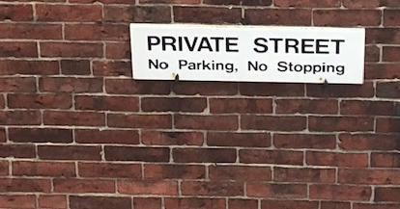
Old Sign at 5 West Cedar

Slide 4
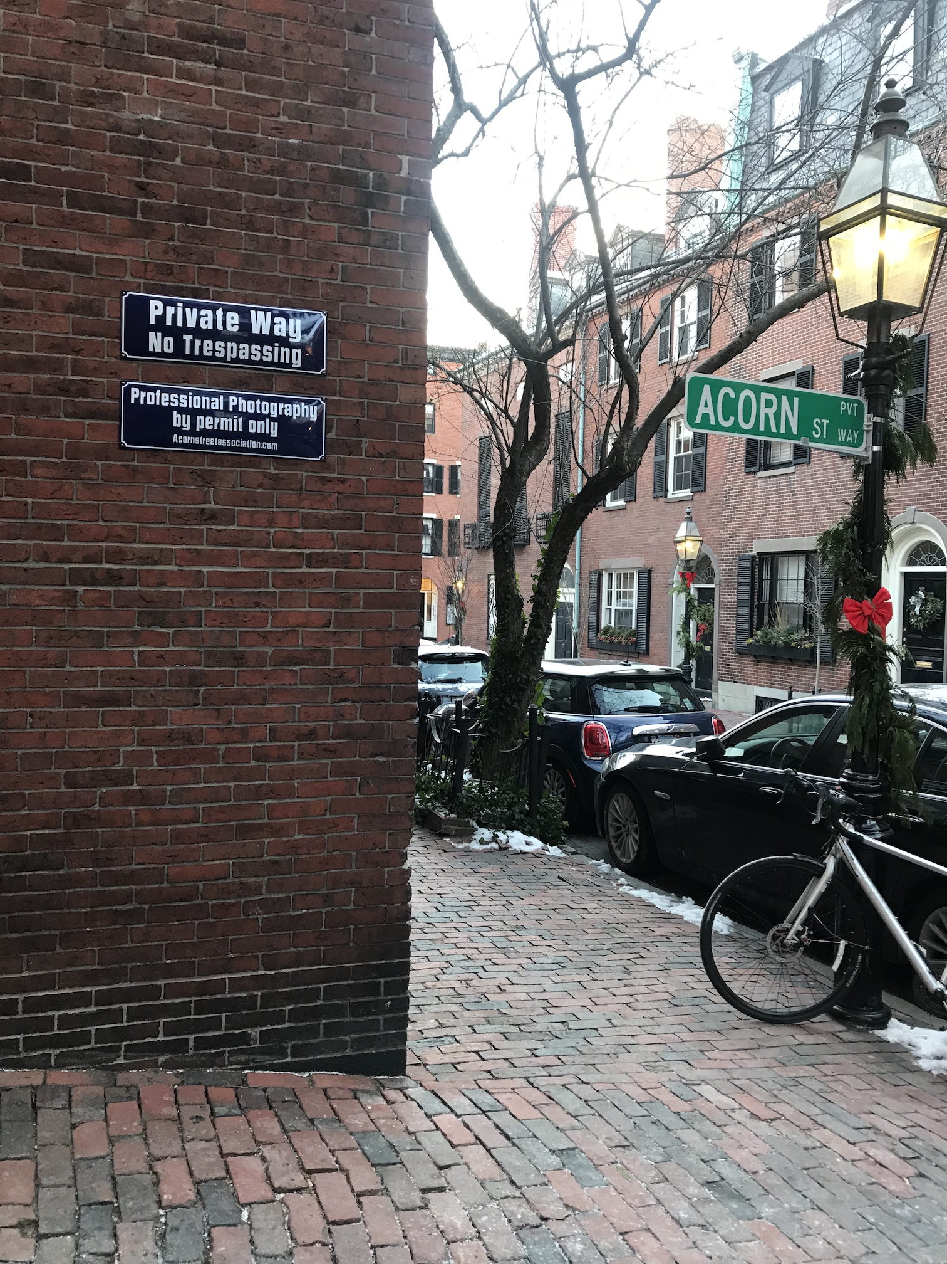
New Signs at 5 West Cedar

Slide 5
Details of New Signs
Text reads
  (1) Private Way / No Trespassing
(2) Professional photography by permit only / AcornStreetAssociation.com

Slide 6
Rationale for Signs: Pedestrian Traffic
Dramatically increasing tourist and traffic on Acorn Street causes congestion and is noisy, messy, and intrusive for residents
Travel guides (actual and virtual) and tourist services, as well as social media, direct tourists to Acorn Street, which has increased the flow dramatically

Slide 7
Rationale for Signs:
Photography
Professional photographers use the street for weddings, engagements, and other notable life events without regard for residential life of neighborhood
Many visitors take selfies and formal photographs on street and on Acorn Street doorsteps, at times creating a carnival-like atmosphere

Slide 8
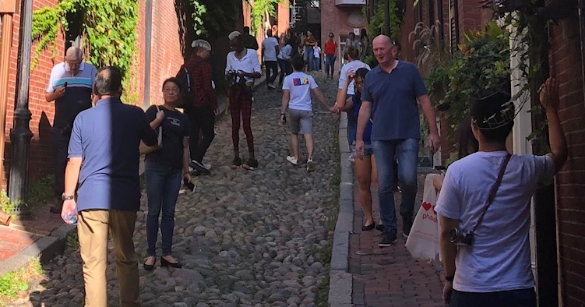
Rationale for Signs

Slide 9
Rationale for Signs:
Private Way
Acorn Street is a “private way” and not a public street
The abutting property owners pay for maintenance of the street, not the City of Boston (snow removal, leaf removal, street repairs)
Acorn Street Neighborhood Association consists of abutting property owners
Association charges fees for movies and professional photographers to defray the cost of maintaining Acorn Street

Slide 10
Appropriateness of Signs
Signs are an attempt to signal that the street is residential and to invite quiet and courtesy
Signs are tasteful and courteous
Other private ways throughout the neighborhood have similar signs, for example
  Byron Street
  Willow Court

