Slide 1
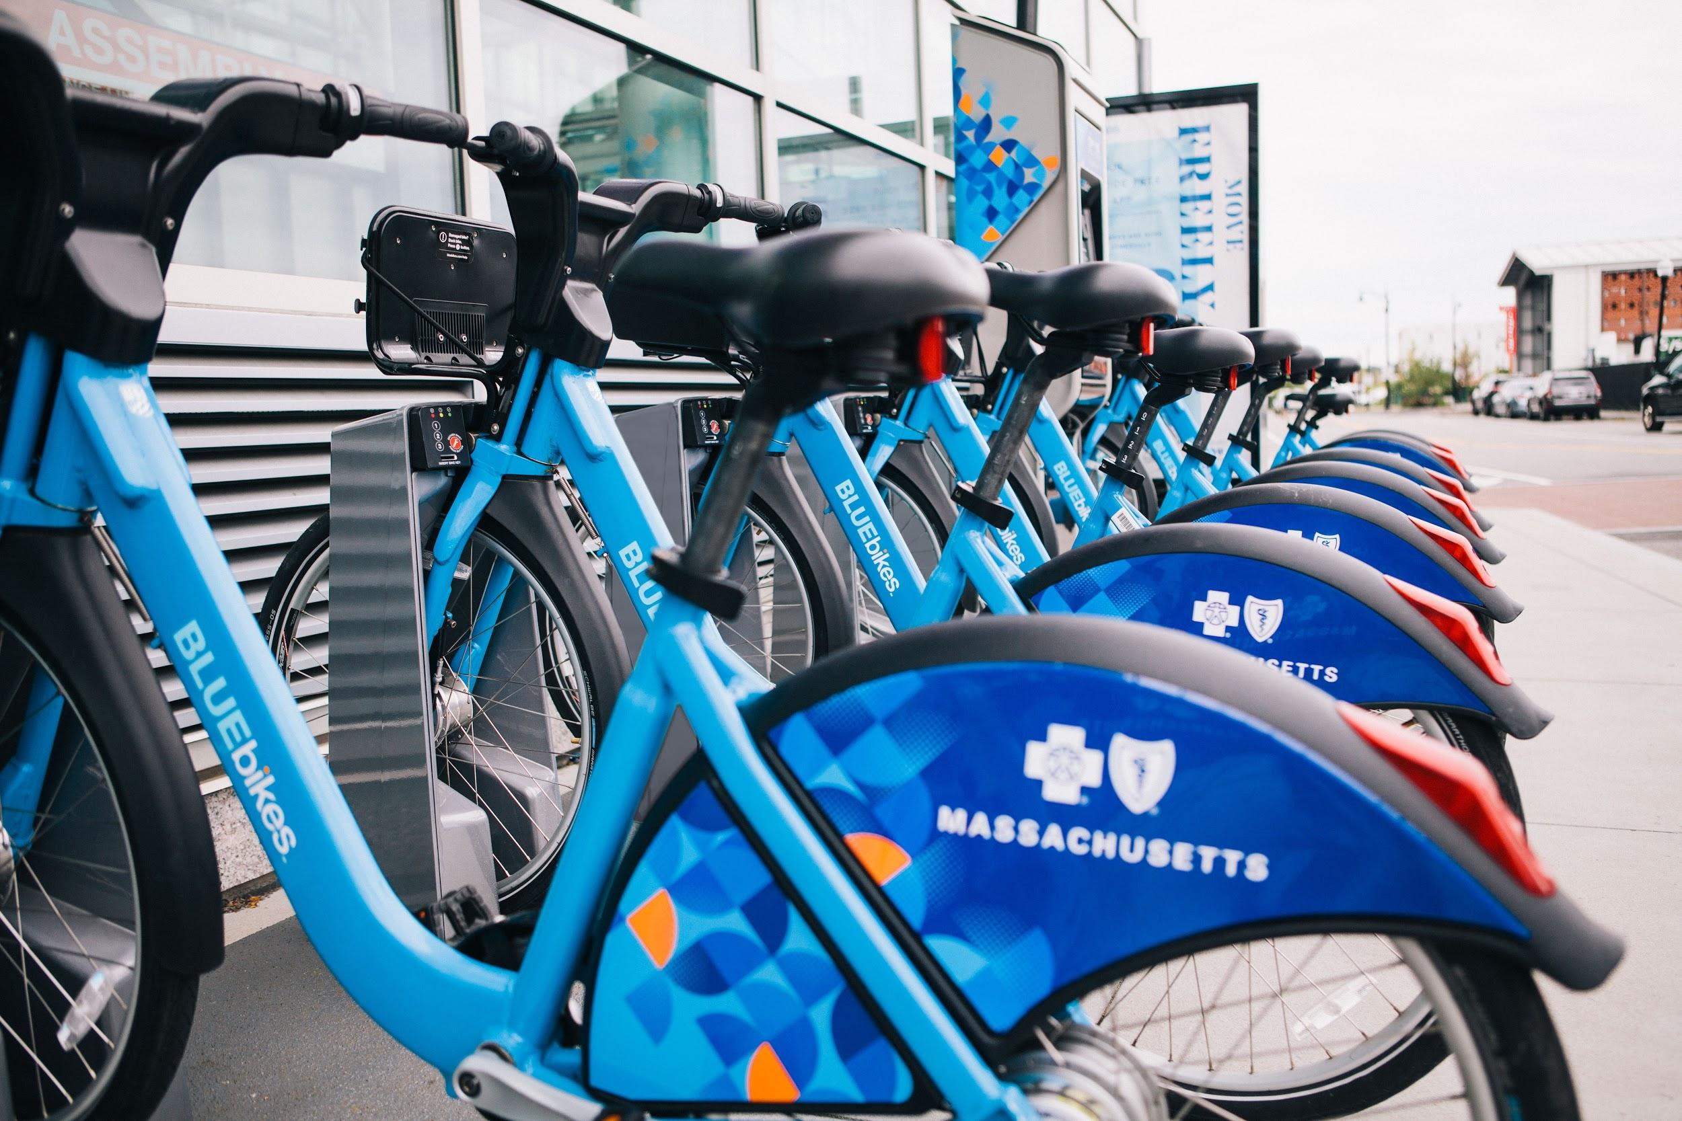
Bluebikes Expansion 2021
We’re adding Bluebikes in Hyde Park!
GMNC Public Services Committee • April 6, 2021

Slide 2
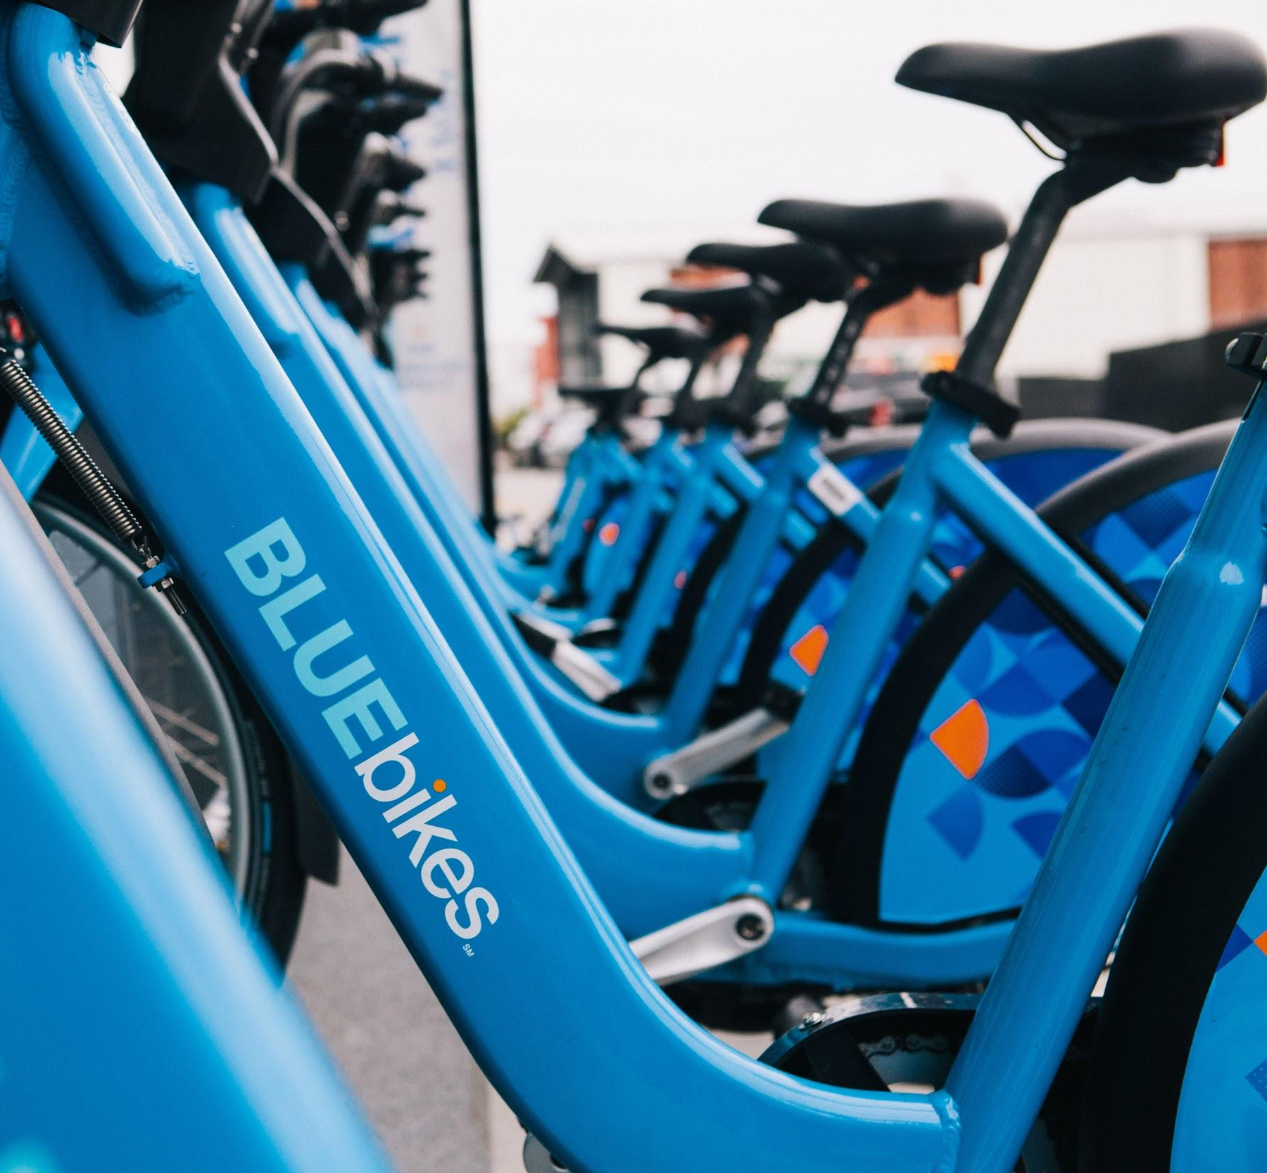
PUBLIC TRANSIT BY BIKE
Bluebikes is a public transit by bike for the Boston region
Bikes and stations owned by Boston, Cambridge, Somerville, Brookline, and Everett
Nearly 13 million trips!
82% of Boston households within a 10 minute walk

Slide 3
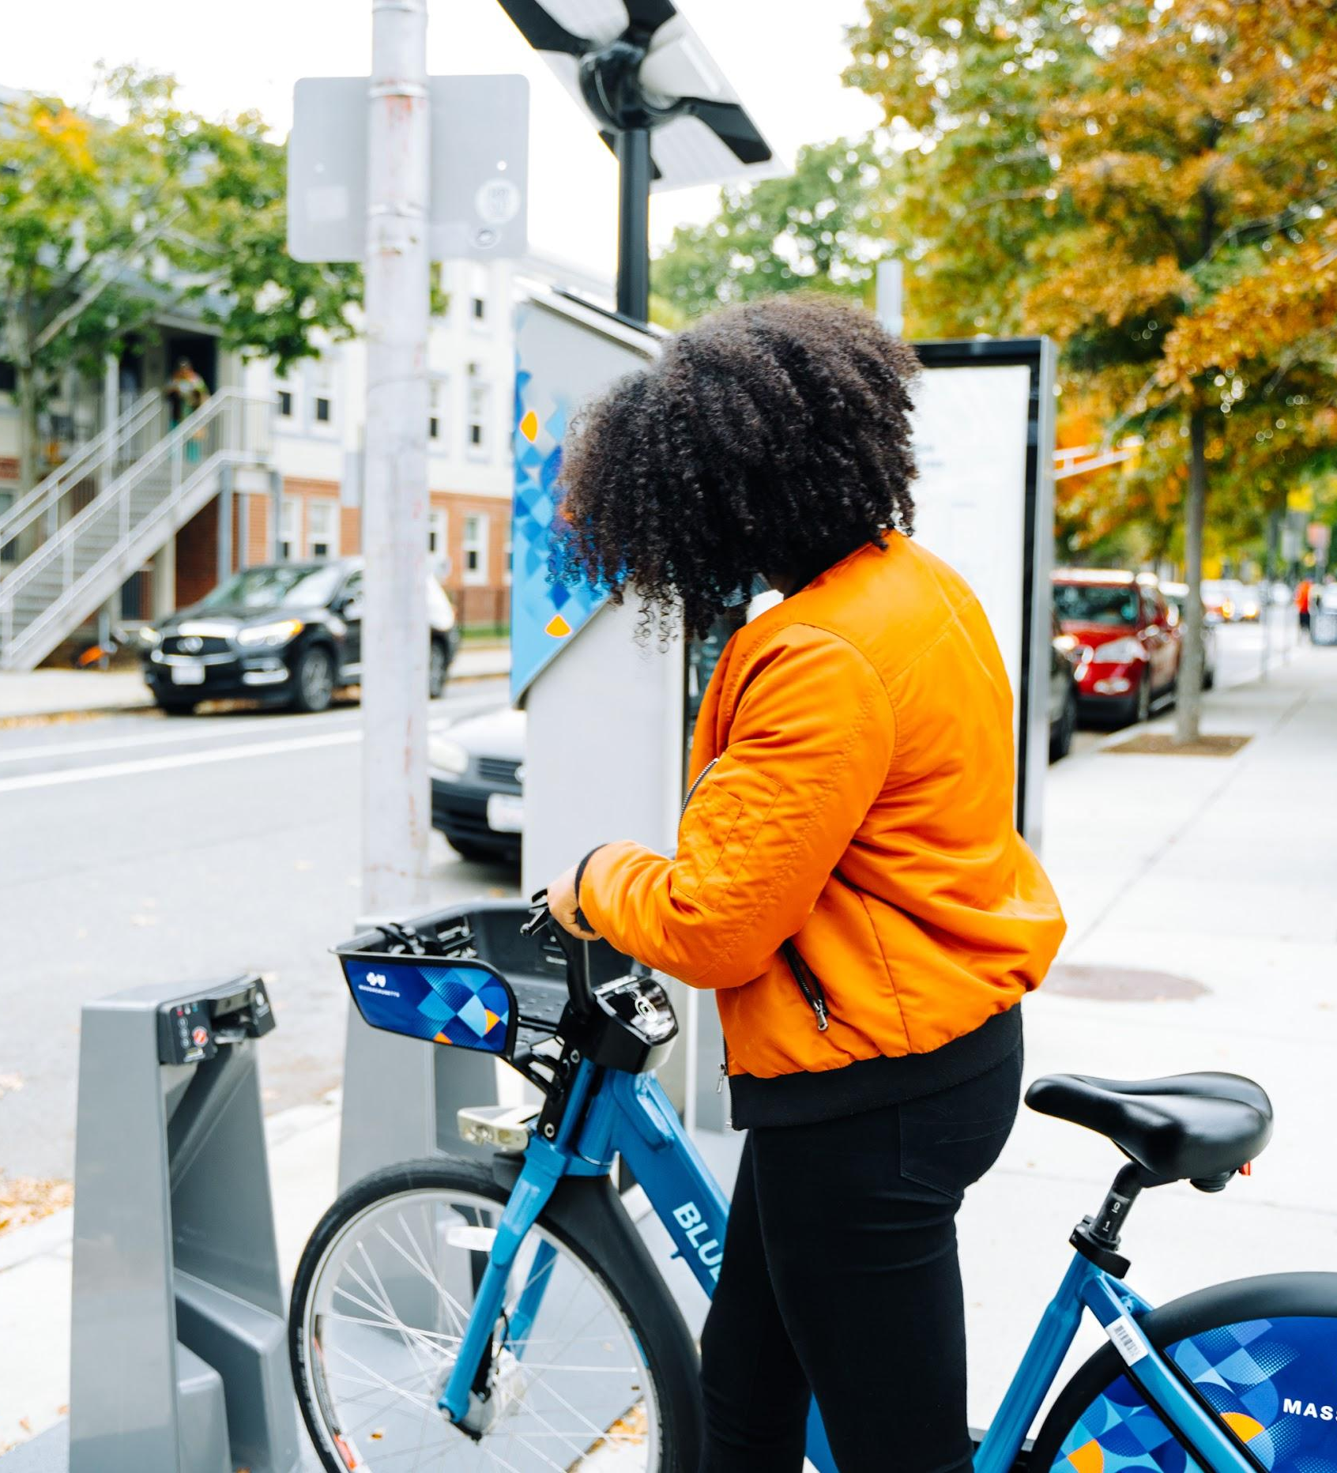
DIFFERENT MEMBERSHIP OPTIONS
REGULAR
Monthly: $25/Month, 45 minute rides
Annual: $132/Year or $11/Month, 45 minute rides
Annual: $109/Year, 45 minute rides
INCOME-ELIGIBLE
Monthly: $5/Month, 60 minute rides
Annual: $50/Year, 60 minute rides
TRY IT OUT!
$2.95 for one 30 minute ride
$10 for 24 hours, 30 minute rides

Slide 4
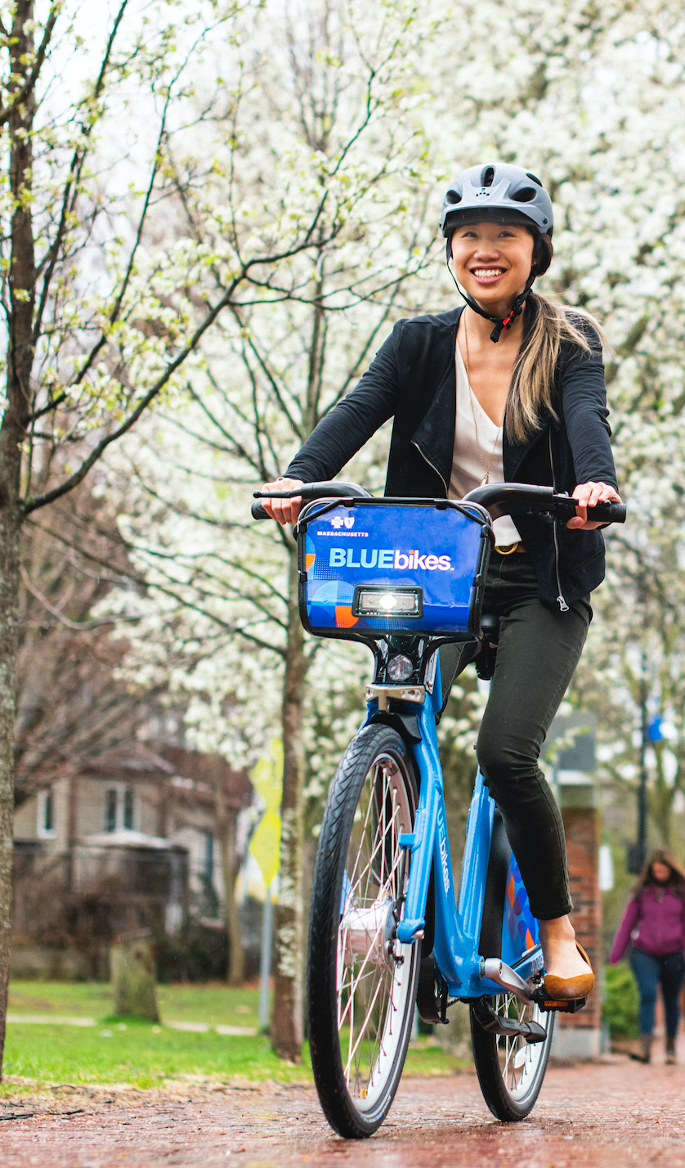
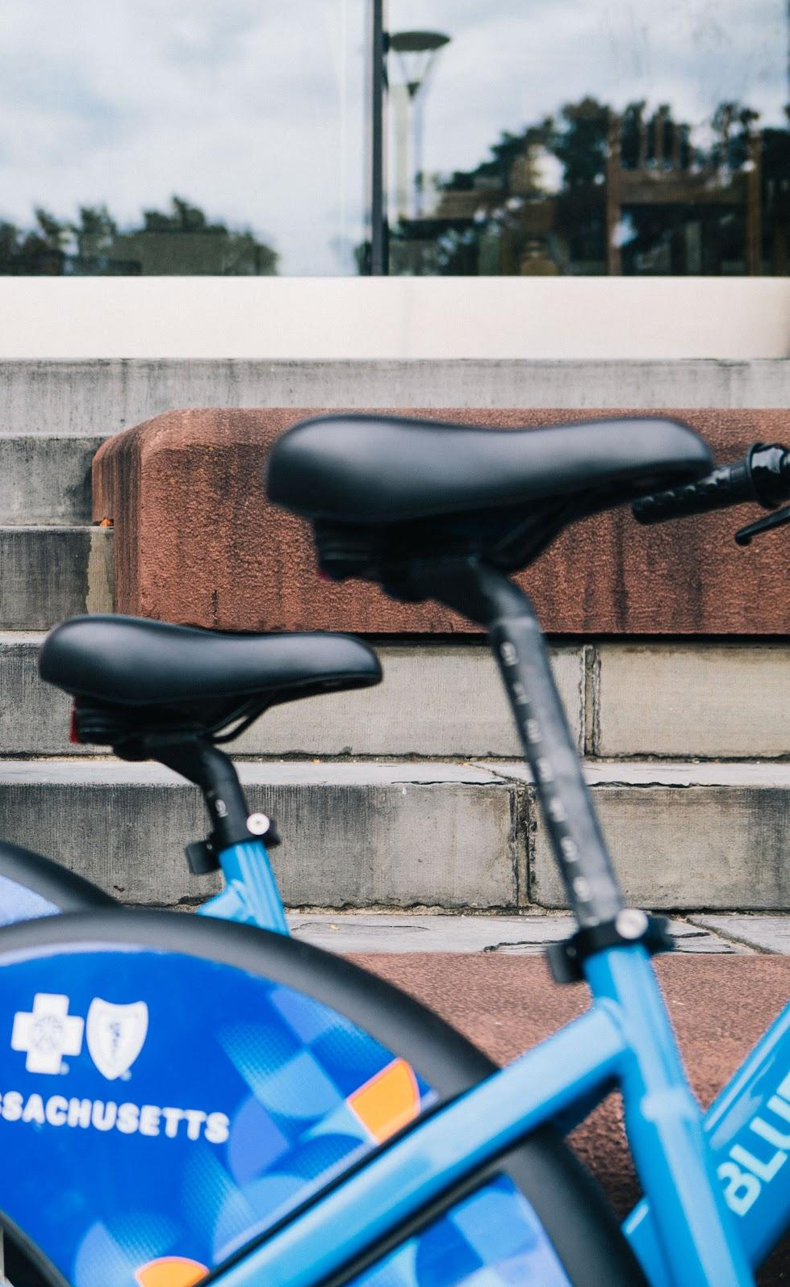
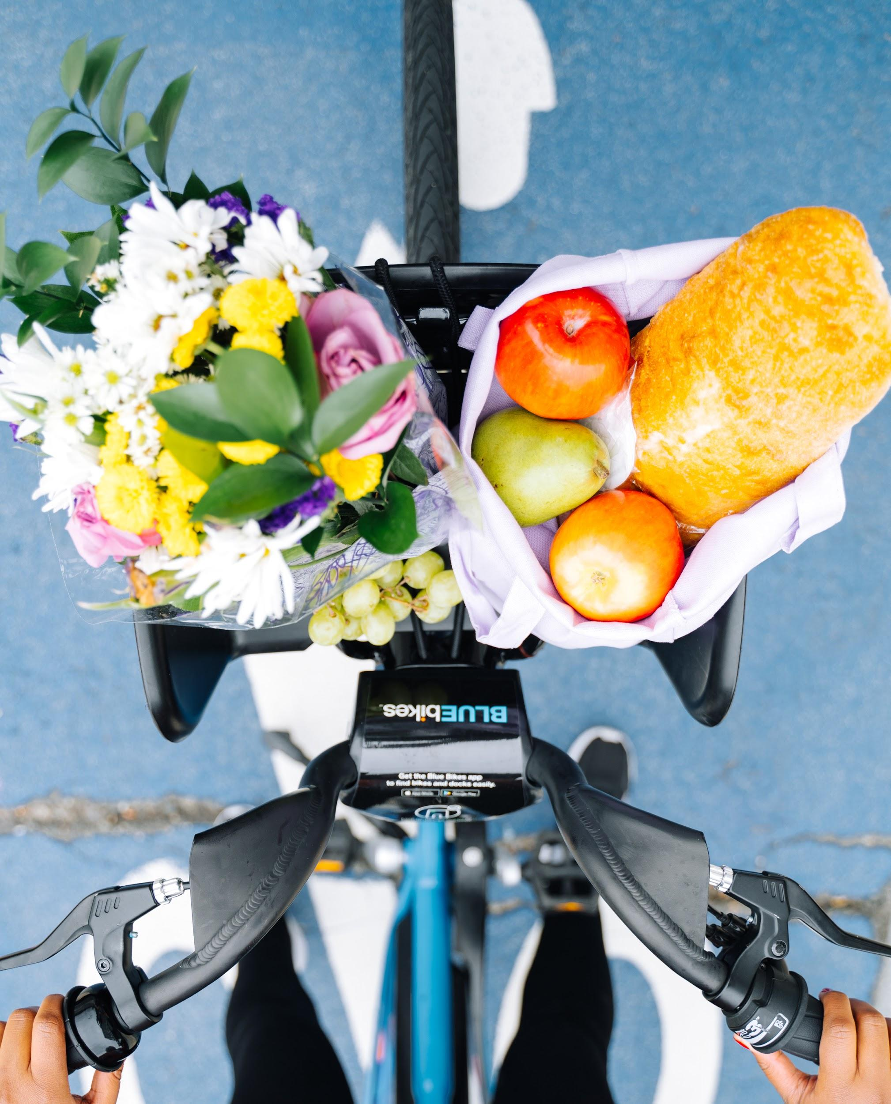
THE BIKE
Adjustable seats
A basket
Lights & bell

Slide 5
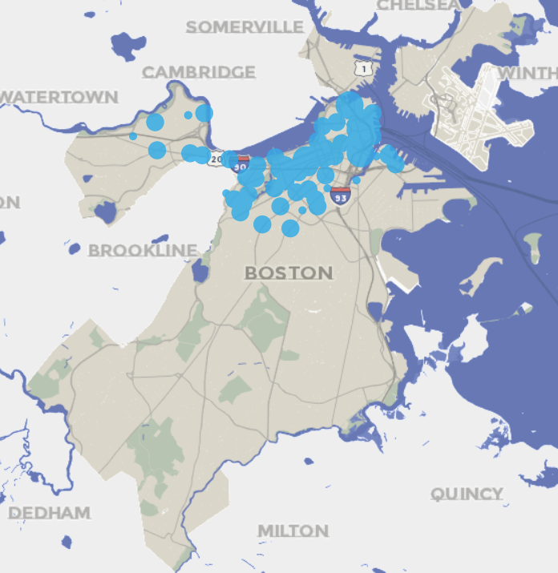
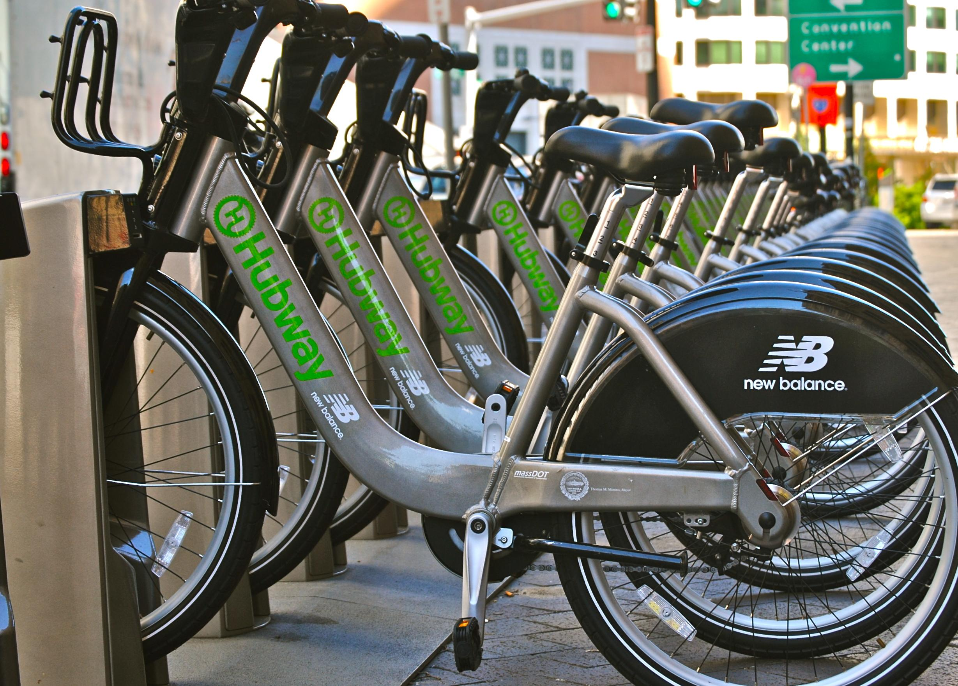
HOW IT STARTED
2011 TRIPS
Stations where trips started
60 stations
610 bikes
12 neighborhoods
141,614 trips

Slide 6
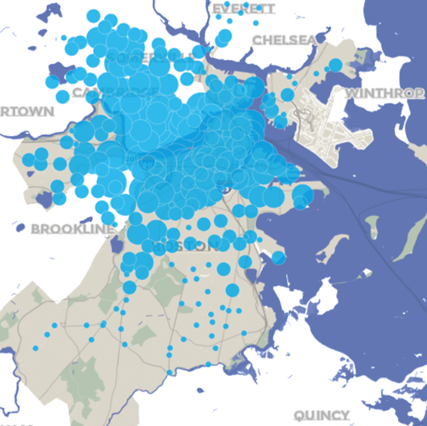
HOW IT’S GOING
2020 TRIPS
Stations where trips started
330 stations
3500 bikes
22 neighborhoods in the City of Boston
10 municipalities
12,920,847 trips to date!

Slide 7
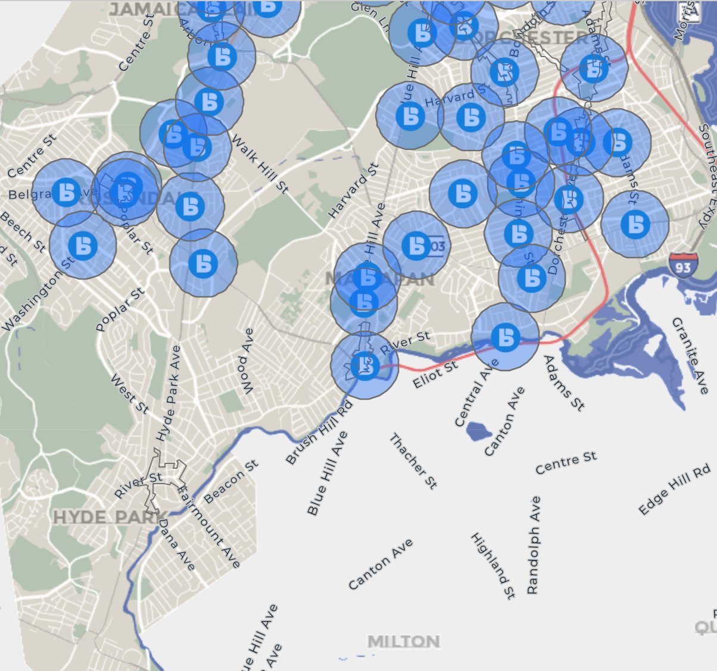
WE’RE NOT DONE YET!

Slide 8
EXPANDING BIKE SHARE IN BOSTON
In neighborhoods, all bike share stations are within a 10 minute walk of each other.
Convenient
More available bikes and docks

Slide 9
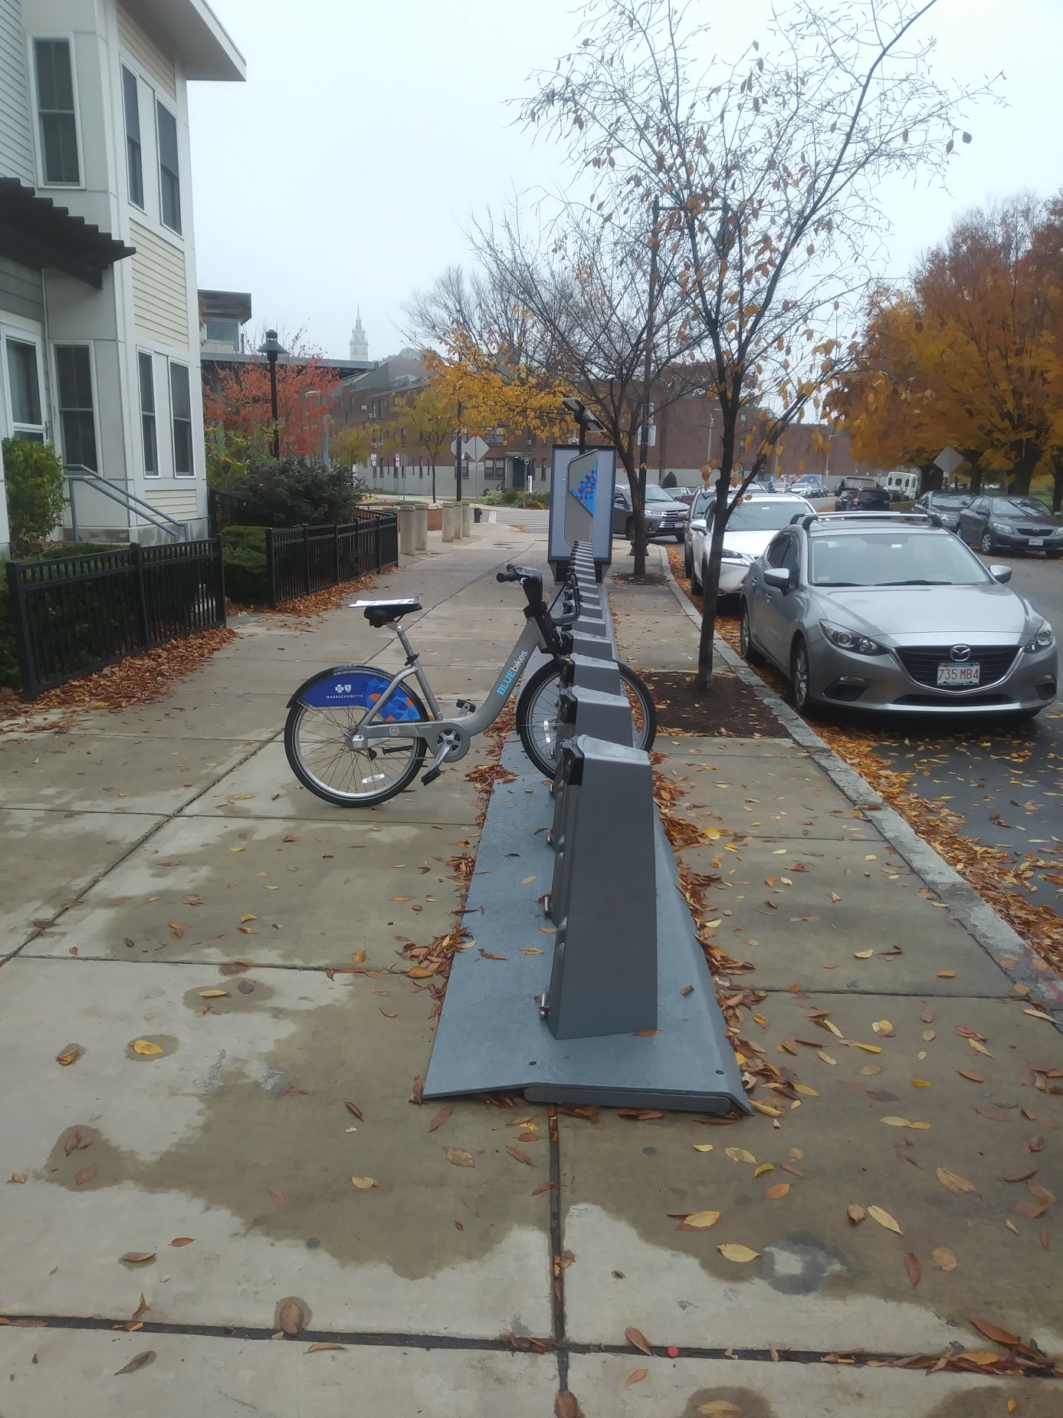
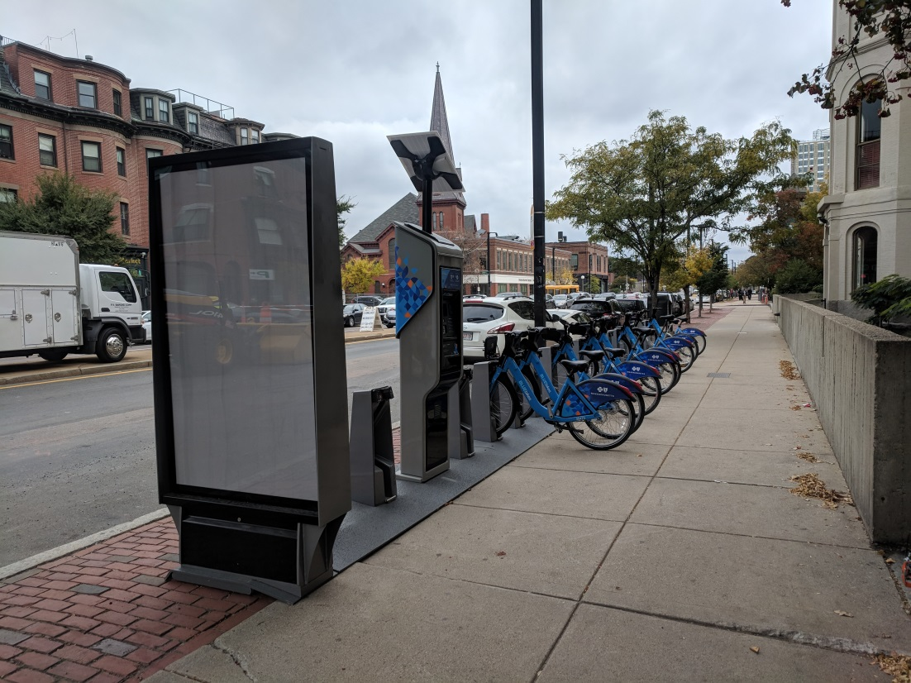
OFF-STREET STATIONS
5’ – 6’
1.5’ – 3’
Notes:
As you think about spaces that might be good for bike share in your community, keep in mind there are a lot of different kinds of places we can put stations. When possible, we prefer off-street sites so the bikes are available for our users year round. City-owned sidewalks are the most common bike share locations.

Slide 10
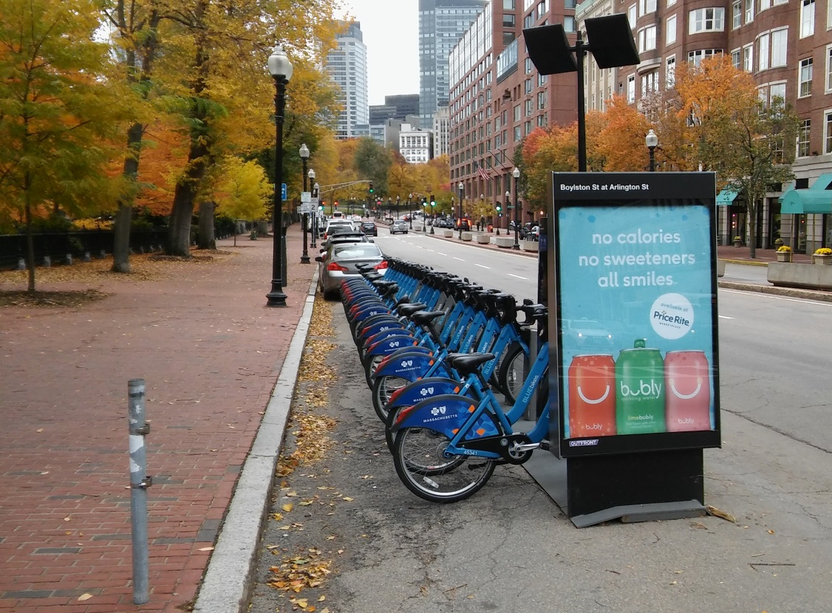
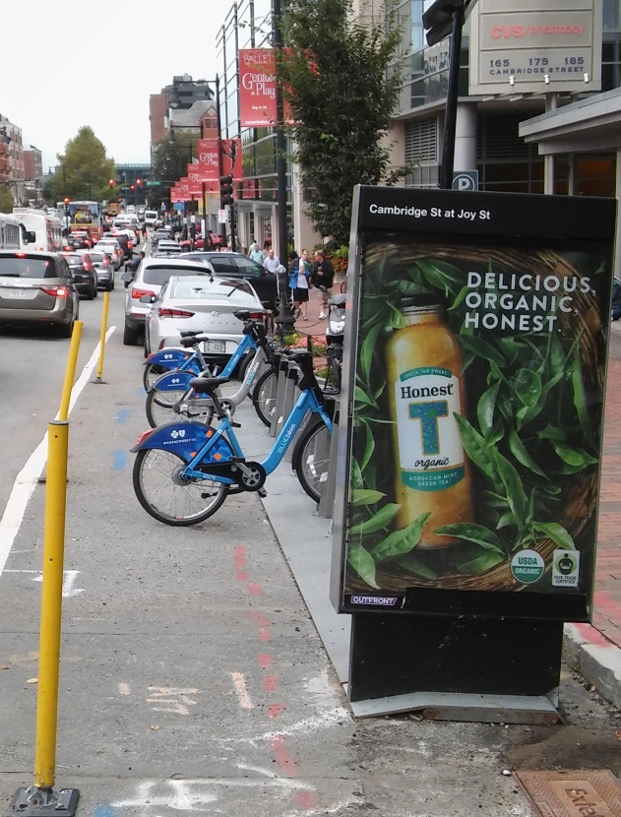
ON-STREET STATIONS
Provide parking for 19 bikes in the same space as about 3 cars
Stored December – April for snow plowing
Notes:
But sometimes sidewalks aren’t wide enough, so then we will use the street. A bike share station provides parking for 19 bikes in the same space that 3 cars would park.

Slide 11
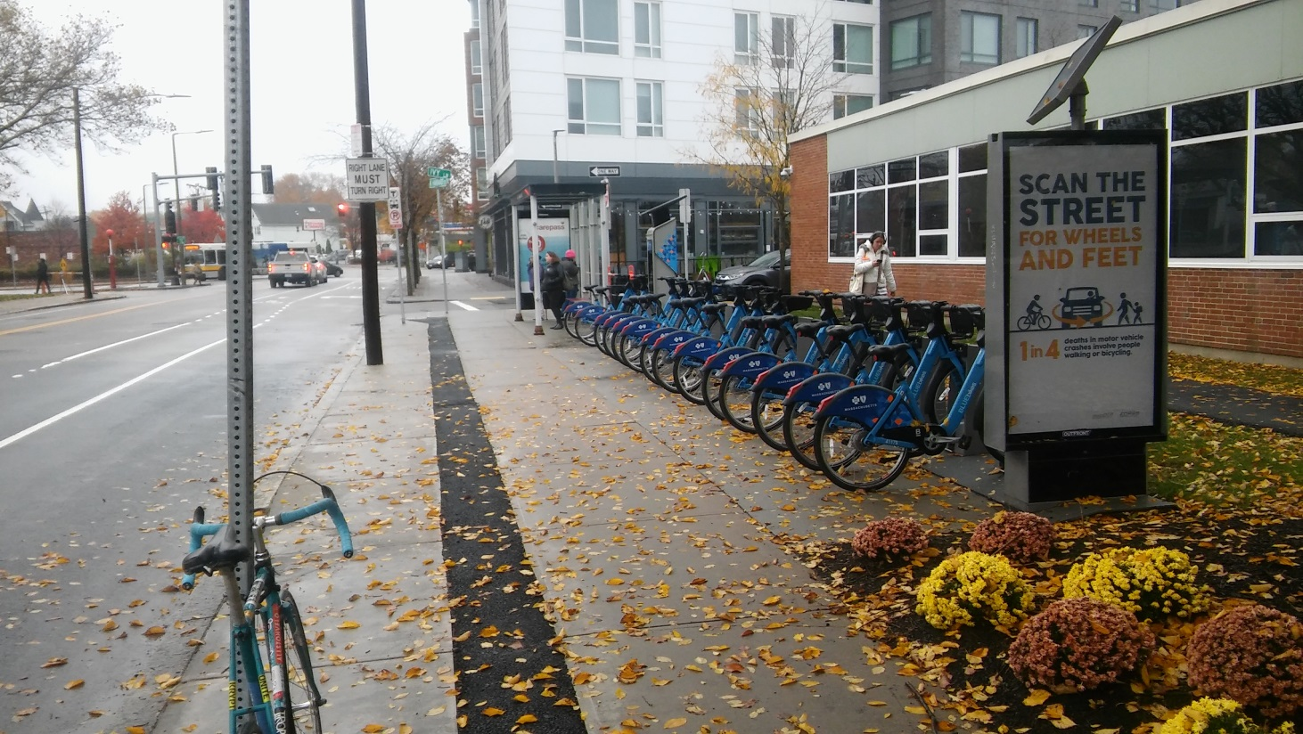
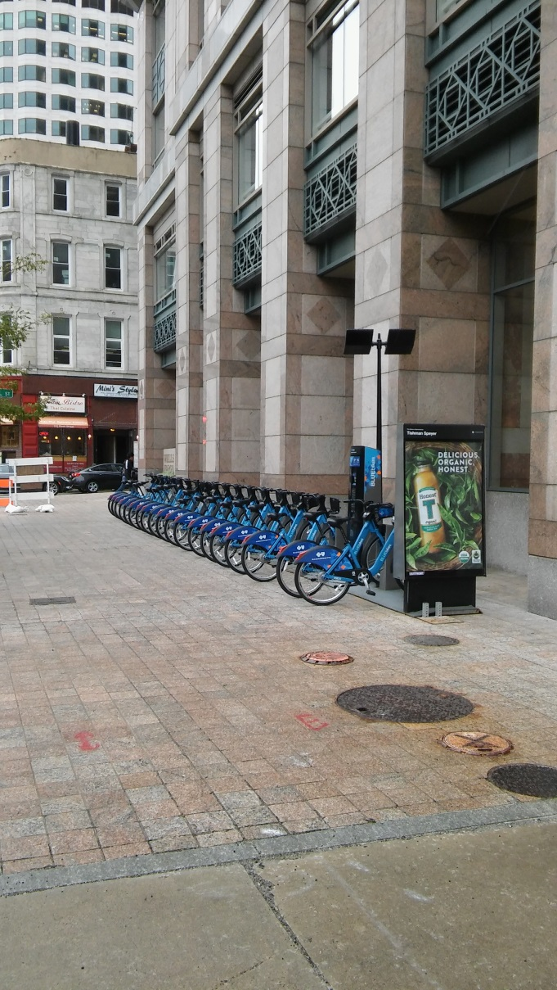
STATIONS ON PRIVATE PROPERTY
PUBLIC
PRIVATE
PRIVATE
PUBLIC
Notes:
Occasionally, we get permission to use private property, but the land owners need to sign legal documents granting access to use the site and ensuring the station is available 24-hours a day.

Slide 12
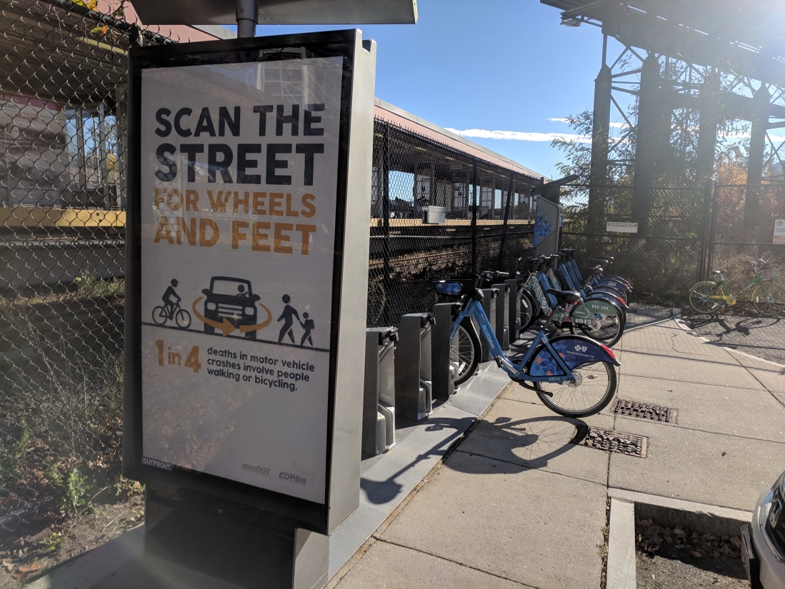
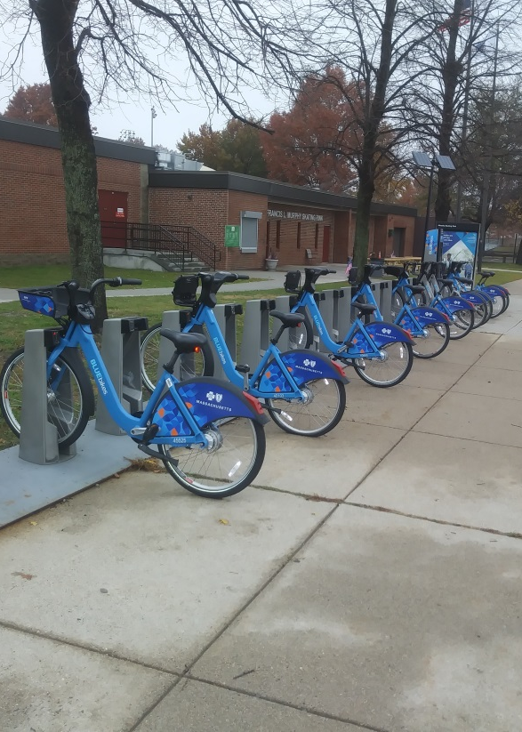
STATIONS ON PROPERTY OWNED BY OTHER AGENCIES
MBTA and DCR will sometimes host our stations
Agencies/departments must agree and sign legal documents
Notes:
We also have stations on other public agencies’ land, like at MBTA stations or on paths owned by DCR. Again, this requires getting the legal authority to use the site and the permitting process can take a long time.

Slide 13
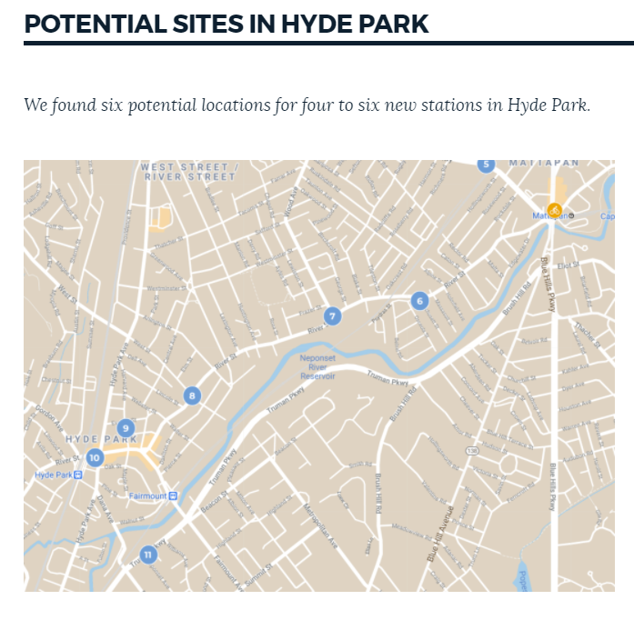
SHARE YOUR THOUGHTS
Surveys of potential sites online.
BOSTON.GOV/
BIKE-SHARE-EXPANSION

