Slide 1
Introducing: Value HMO for City of Boston

Slide 2

Value HMO
Available to City of Boston employees only
Network focused on high quality/high performance/more efficient providers in Massachusetts
Designed to help ensure access to the highest quality care with the greatest value for City of Boston employees and retirees
Massachusetts based:
Ancillary facilities – use full network
Urgent Care and Limited-Service Clinics (Minute Clinic) – no exclusions
PCPs and specialty referrals are required

Slide 3
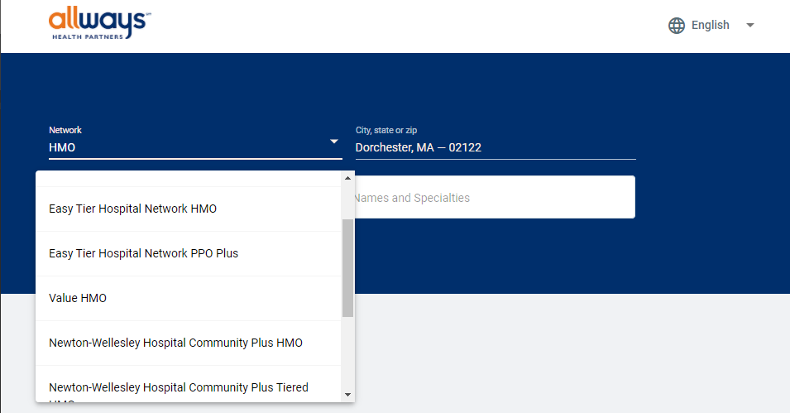
Network Inclusions
Massachusetts General Hospital (including the Mass General Cancer Center, Mass General Hospital for Children)
Mass Eye and Ear
Atrius
Beth Israel Deaconess Medical Center
Boston Medical Center
Brigham and Women’s Hospital
Lahey Clinic
Mass Eye and Ear
Newton-Wellesley Hospital
North Shore Medical Center
South Shore Hospital
Steward Carney Hospital
Spaulding Rehab
* This is not an all-inclusive list and identifies systems only. Always consult the Provider Directory.

Slide 4
Member Experience
Plan benefits for the City of Boston plan are not changing; including behavioral health.
All current contracted behavioral health providers will be in the Value HMO network. Members will continue to use Optum as they do today.
Value HMO plan has lower premium and copayments, as well as no deductible.
Current AllWays Health Partners members do NOT need to take any action to remain a member.
They will be automatically enrolled in the Value HMO
Members who wished to change their carrier needed to take action during Annual Enrollment
All members will receive a new welcome guide and new ID Cards.
Letters have been sent to members whose PCP is no longer in the network.
We have a dedicated Member Service line for City of Boston Members/Prospective members to ensure that questions are answered efficiently and thoroughly.

Slide 5





iHeart Champion, smart clinical innovation For members managing high blood pressure and high cholesterol
EXCLUSIVE
Collaborative approach supported by leading-edge technology and delivered through the member’s preferred communication method
Reduces systolic by 20 mm Hg (upper number) and diastolic by 6 mm Hg (lower number)
Healthy blood pressure is around 110/70
One-in-five people with high cholesterol or hypertension were diagnosed with statin intolerance
40%
Reduces diagnosis of statin intolerance
25%
reduction
85%
by
in LDL cholesterol
of population has high cholesterol or hypertension
engagement rate for provider-driven outreach
20%
95%
Cost for self-funded groups: $450 per year for members who enroll in program (claim is submitted)

Slide 6
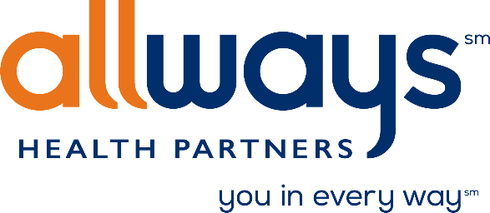
Q&A

