Slide 1
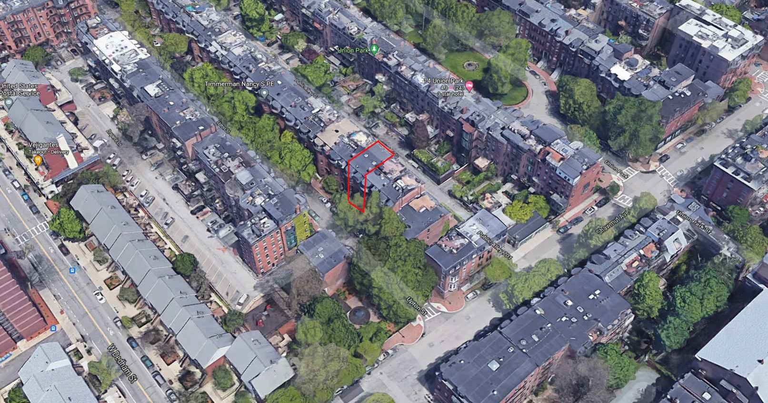


PROPOSED ROOF DECK UNIT 6
13 UPTON STREET BOSTON, MASS
UPTON STREET
C
hoo
NEWLAND PLACE
&Company, Inc.
One Billings Road Quincy, MA 02171
617-786-7727 fax 617-786-7715
SHAWMUT AVE
□
 
BIRDSEYE FROM THE SOUTH
 □

2021040
AS NOTED
04-02-2021
SL

 
 
SITE
REFERENCE
 □


Slide 2
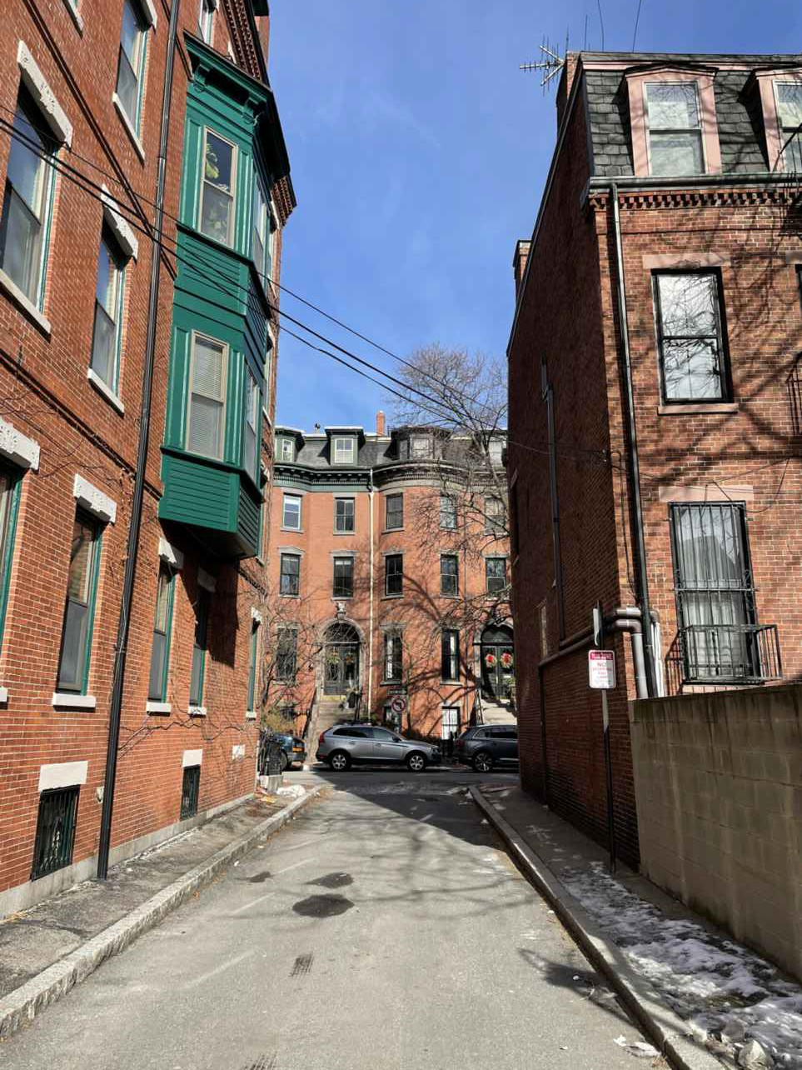
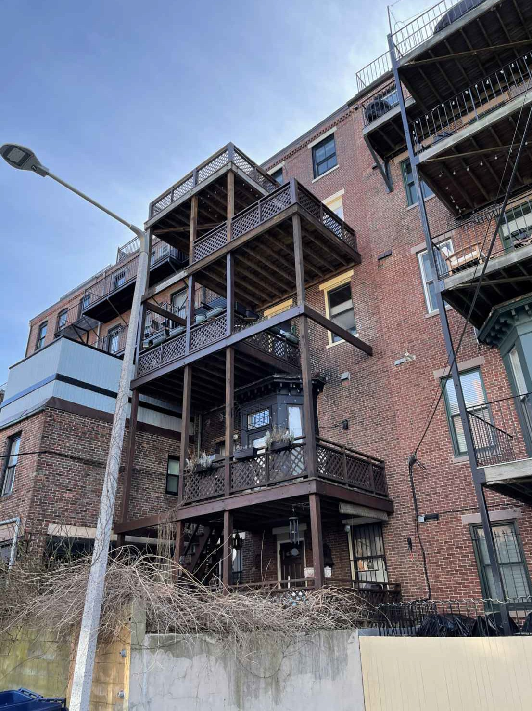
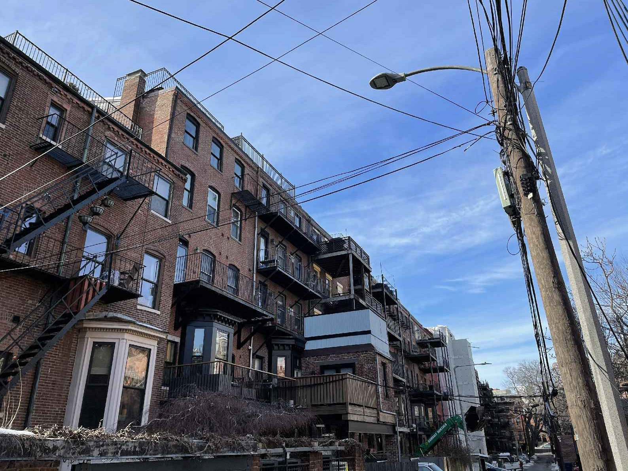
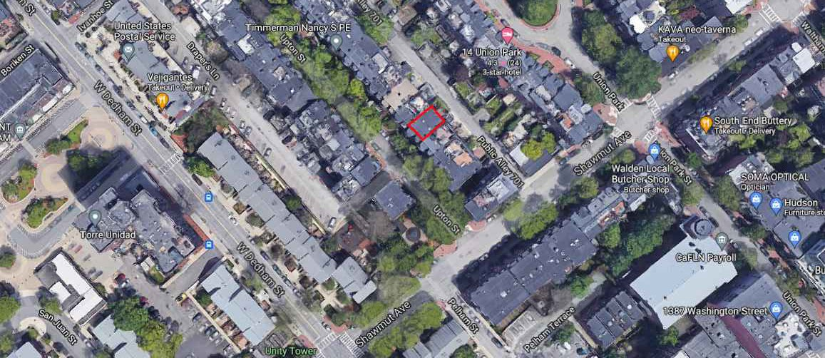

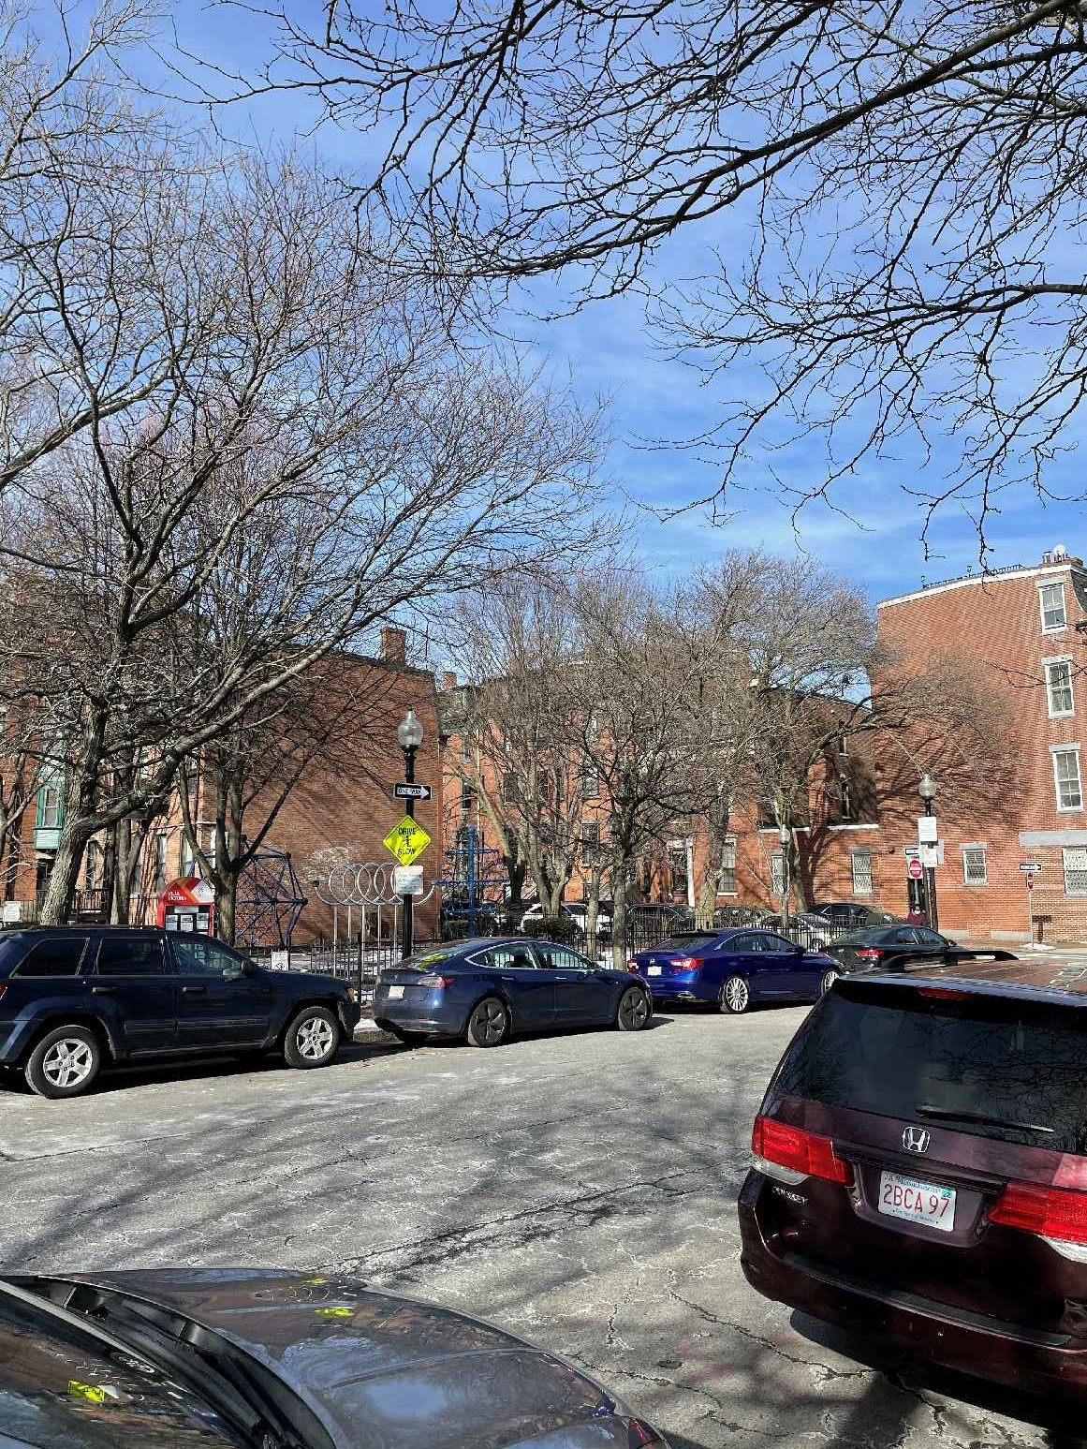
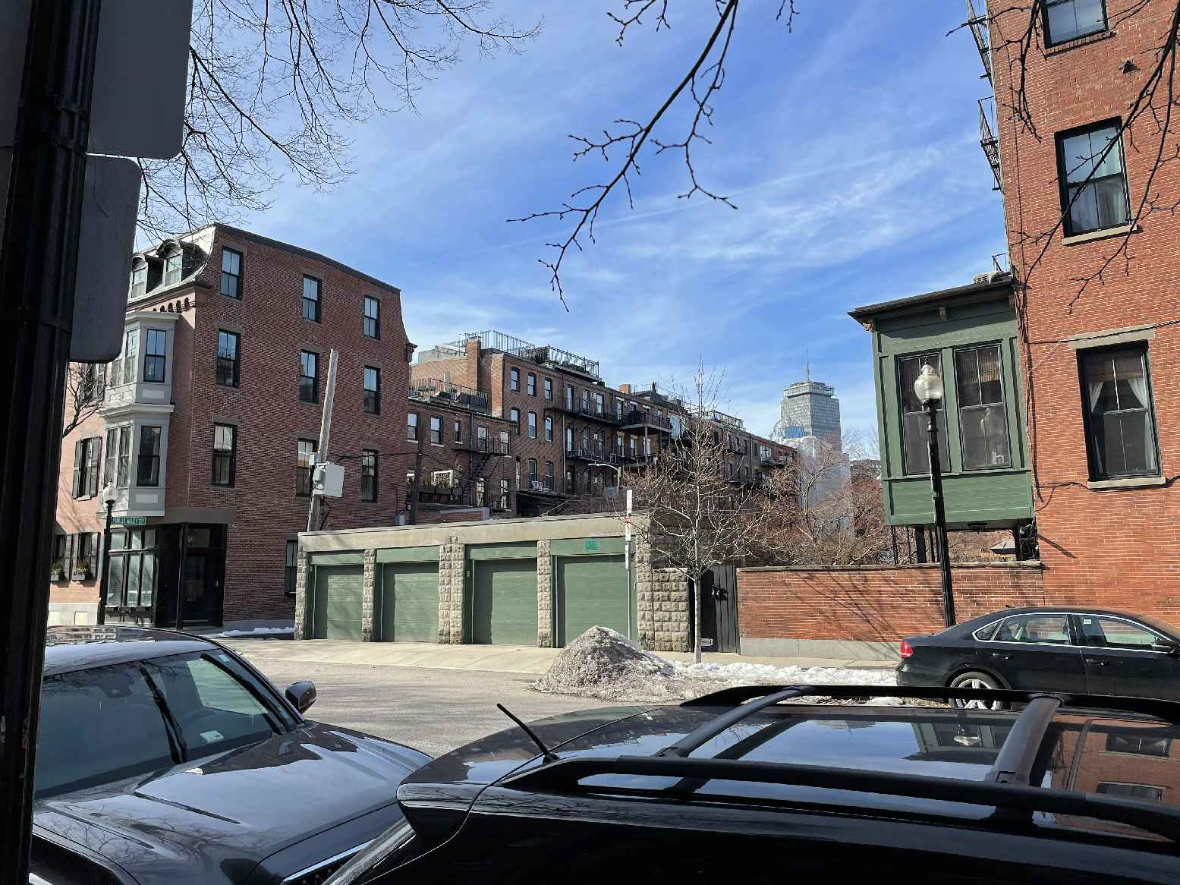
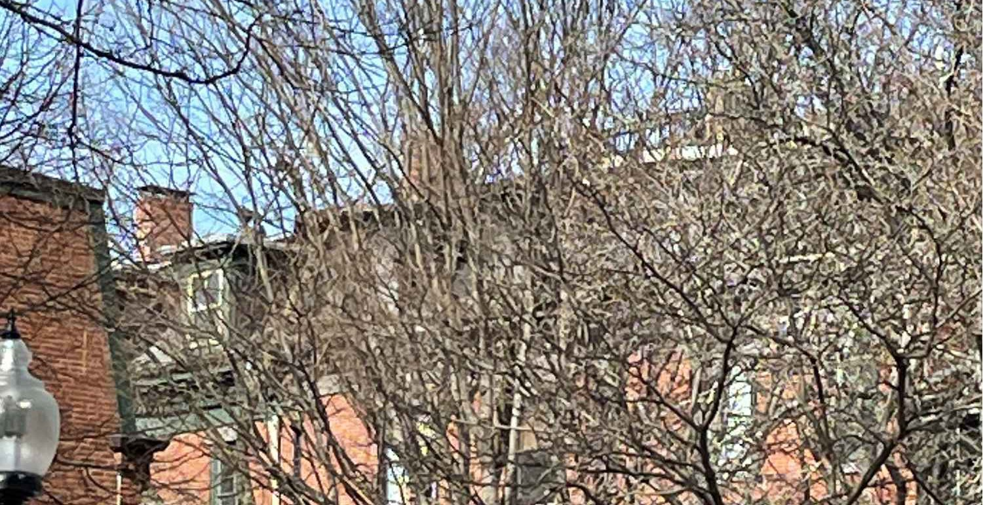
VIEW FROM PA701 FROM THE NORTH
5

15 EX'G DECK
SETBACK OUT OF VIEW
PROPOSED ROOF DECK UNIT 6
13 UPTON STREET BOSTON, MASS
13 PROP DECK
11 EX'G DECK
SETBACK OUT OF VIEW
13 PROP DECK
15 EX'G DECK
5
4
VIEW FROM PA701 FROM THE EAST ₄
Choo
VIEW FROM NEWLAND PLACE
&Company, Inc.
(PRIVATE WAY) 1
3
One Billings Road Quincy, MA 02171
617-786-7727 fax 617-786-7715
1
2
□
 
11 EX'G DECK
 □

2021040
AS NOTED
04-02-2021
SL
13 PROP DECK
15 EX'G DECK

 
 
SITE
REFERENCE
11 EX'G DECK
15 EX'G DECK
 □

VIEW FROM SHAWMUT FROM THE SOUTHWEST 2
VIEW FROM SHAWMUT
FROM THE SOUTHWEST ZOOM 2
VIEW FROM SHAWMUT FROM THE EAST 3

Slide 3
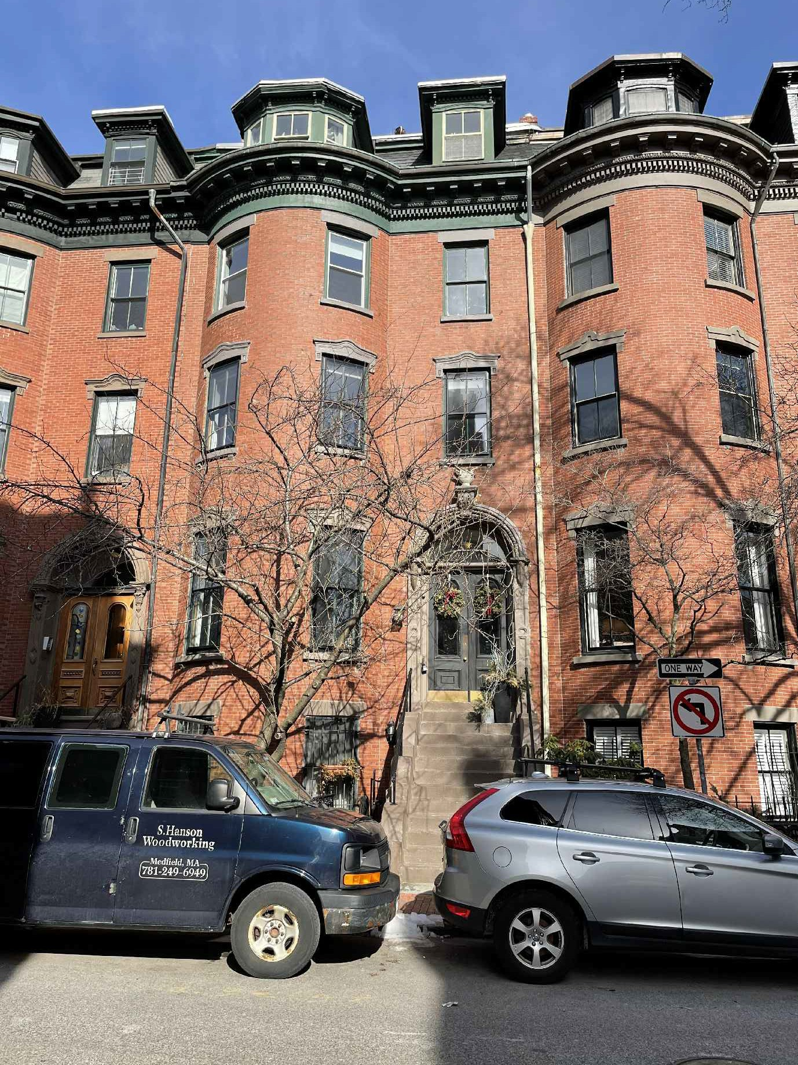
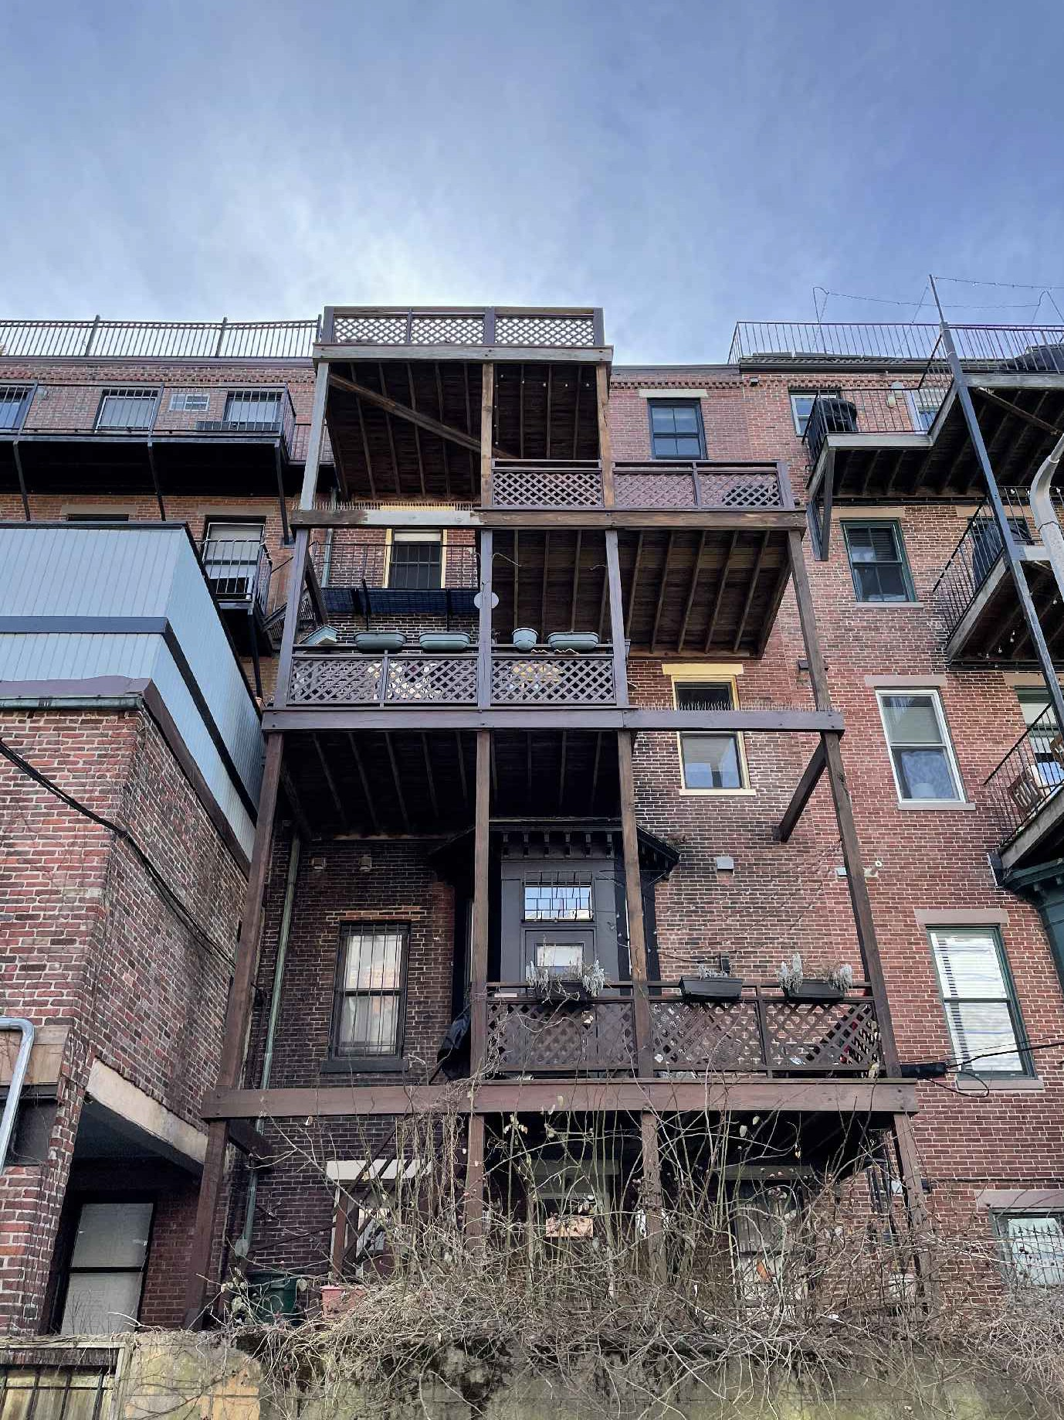
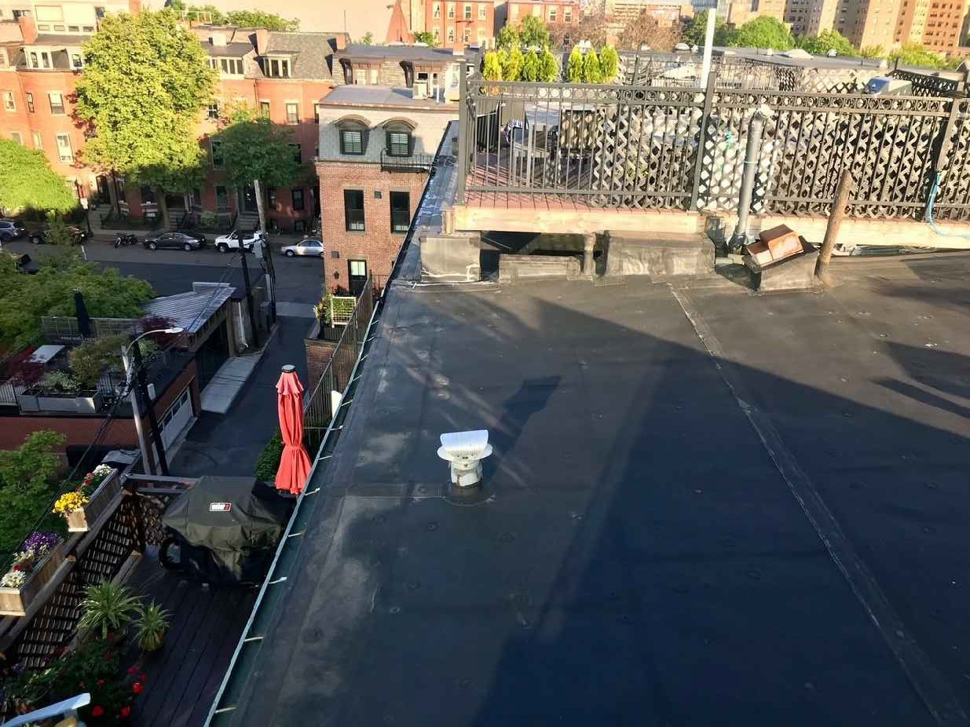
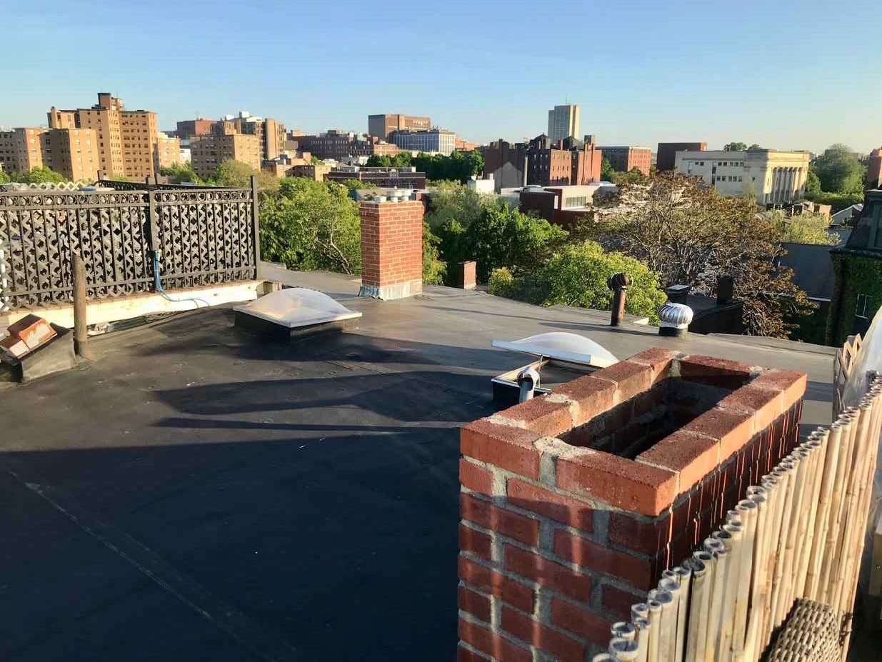
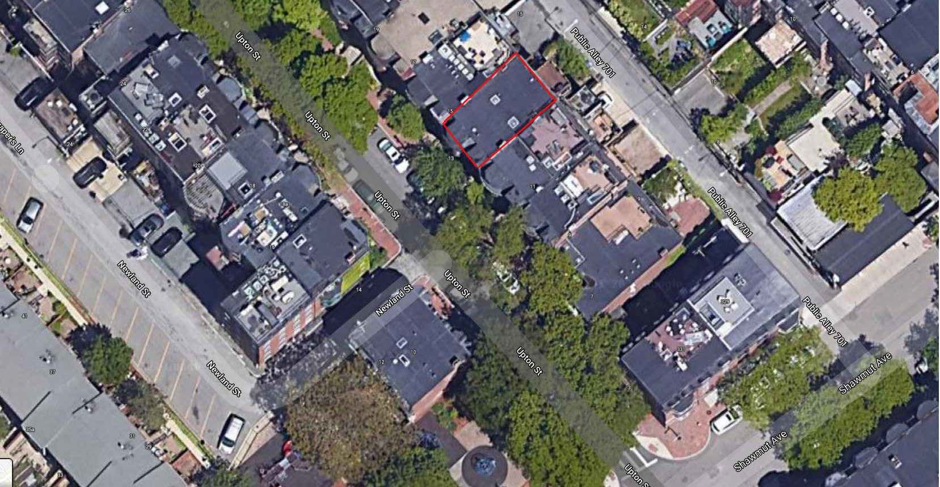
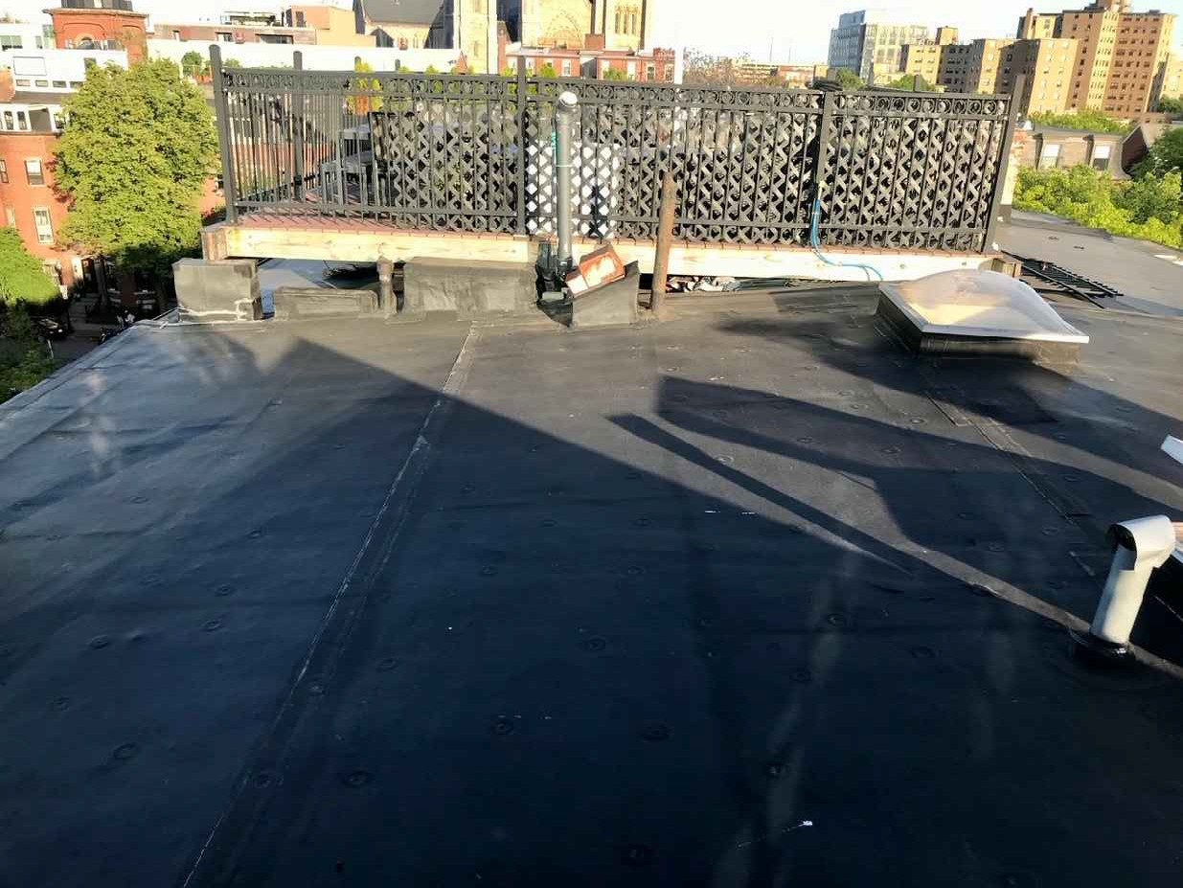

SHAWMUT AVE
PROPOSED ROOF DECK UNIT 6
13 UPTON STREET BOSTON, MASS
EXISTING 13 UPTON REAR OF ROOF
VIEWED FROM 15 DECK (SHAWMUT VISABLE)
C
hoo
&Company, Inc.
One Billings Road Quincy, MA 02171
617-786-7727 fax 617-786-7715
13 UPTON FRONT ELEVATION 13 UPTON REAR ELEVATION
□
 
15 EX'G DECK
11 EX'G DECK
EXISTING 13 UPTON FRONT OF ROOF VIEWED FROM 15 DECK
 □

2021040
AS NOTED
04-02-2021
SL

 
 
SITE
REFERENCE
 □

EXISTING 11 UPTON DECK VIEWED FROM 15 DECK

Slide 4



























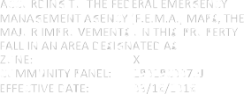
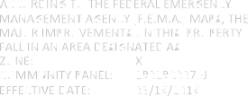

PROPOSED ROOF DECK UNIT 6
13 UPTON STREET BOSTON, MASS
C
hoo
&Company, Inc.
One Billings Road Quincy, MA 02171
617-786-7727 fax 617-786-7715
□
 
 □

2021040
AS NOTED
04-02-2021
SL

 
 
PROPOSED FLOOR PLANS
 □


Slide 5







UPTON STREET
UPTON STREET

PROPOSED ROOF DECK UNIT 6
13 UPTON STREET BOSTON, MASS
7'-9" ±
14'-3" ±
7'-9" ±
14'-3" ±
10'-11" ±
KITCHEN
10'-11" ±
KITCHEN
LIVINGROOM
13'-6" ±
LIVINGROOM
13'-6" ±
PROPOSED SKYLIGHT
UNIT 6
PROP UP
10'-4" ±
CL
BATH
10'-4" ±
CL
BATH
DN
CL
DN
CL
C
hoo
CL CL
CL CL
&Com
pany, Inc.
14'-2" ±
BEDROOM
14'-2" ±
BEDROOM
One Billings Road Quincy, MA 02171
617-786-7727 fax 617-786-7715
BEDROOM
BEDROOM
9'-0" ±
13'-9" ±
9'-0" ±
13'-9" ±
FIRE ESCAPE
FIRE ESCAPE
□
 
DECK
10'-0" ±
DECK
10'-0" ±
14'-0" ±
14'-0" ±
2021040
AS NOTED
04-02-2021
SL
PA 701
PA 701
 □


 

   
  

   
  
 
PROPOSED FLOOR PLANS
 □


Slide 6
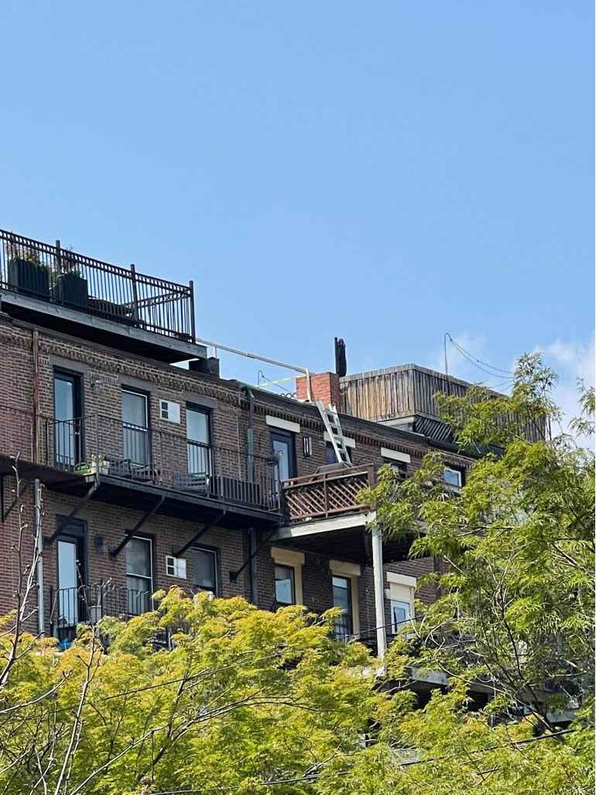




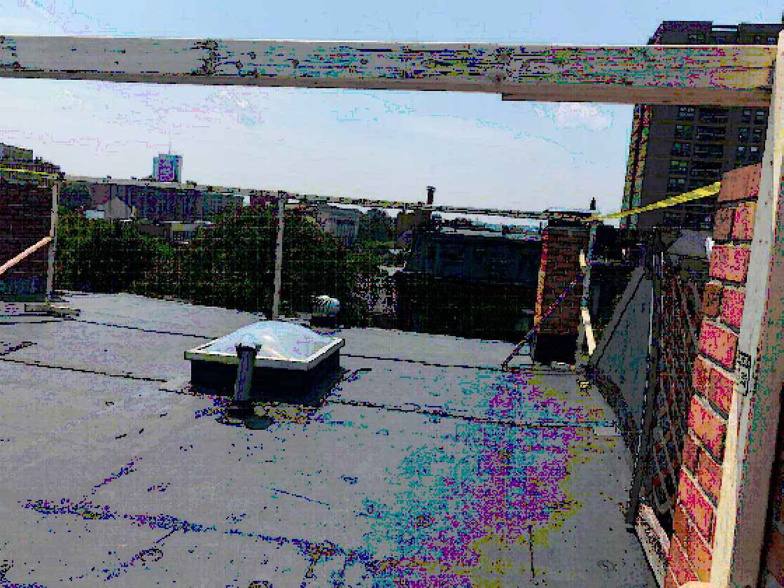
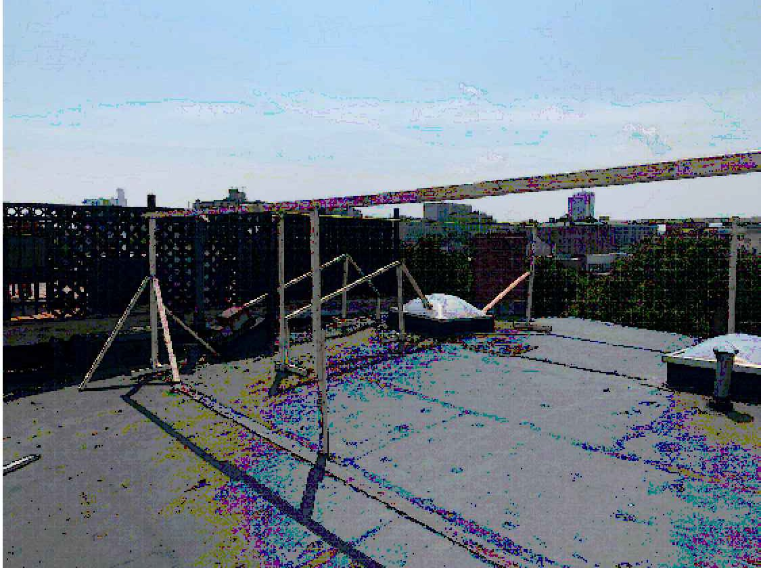
UPTON STREET
UPTON STREET

PROPOSED ROOF DECK UNIT 6
13 UPTON STREET BOSTON, MASS
EX'G CHIMNEY
EX'G CHIMNEY
PROPOSED SKYLIGHT
11'-0" ±
EX'G CHIMNEY
HARDWOOD DECKING
42" BLACK STEEL
RAILING
ROOF SLOPE
DN
19'-10" ±
ADJACENT ROOF HATCH
PROPOSED
WALK ON
ADJACENT ROOF HATCH
SKY
LIGHT
ROOF ACCESS
SKY
LIGHT
HATCH
SKYLIGHT
17'-6" ±
&C
hoo
PROPOSED ROOF DECK
-EXCLUSIVE TO UNIT 6
Company, Inc.
ROOF SLOPE
42" BLACK
23'-4" ±
One Billings Road Quincy, MA 02171
617-786-7727 fax 617-786-7715
ADJACENT ROOF DECK
DN
ADJACENT ROOF DECK
ADJACENT ROOF DECK
STEEL
ADJACENT ROOF DECK
RAILING
EX'G CHIMNEY
8'-6" ±
EX'G CHIMNEY
NEW RUBBER ROOF
□
 
MOCK UP VIEWED FROM SHAWMUT
PA 701
PA 701

  
  

  
  
 □

2021040
AS NOTED
04-02-2021
SL

 
 
PROPOSED FLOOR PLANS
 □

MOCK UP FROM THE FRONT FACING THE ALLEY
MOCK UP FROM THE REAR FACING UPTON

Slide 7







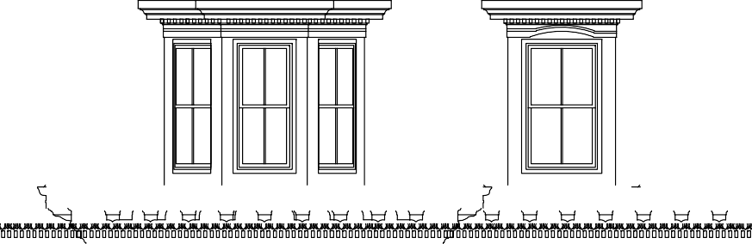









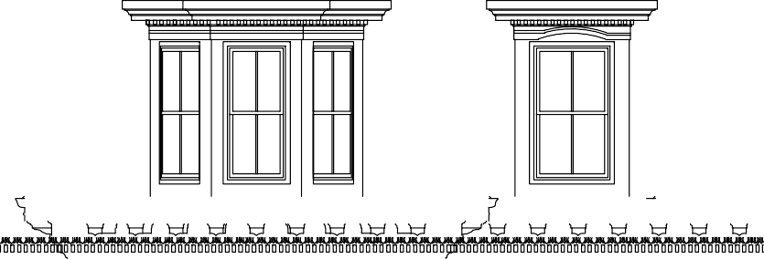
ADJACENT
ROOF DECK RAILING
ADJACENT ROOF DECK RAILING
ADJACENT
ROOF DECK RAILING
ADJACENT ROOF DECK RAILING
ADJACENT
ROOF DECK RAILING
ADJACENT ROOF DECK RAILING
42" BLACK STEEL
RAILING
PROPOSED ROOF DECK
T.O. ROOF
T.O. ROOF
T.O. ROOF
10'-9" ±
10'-9" ±
10'-9" ±
5th FLOOR
5th FLOOR
5th FLOOR
10'-0" ±
10'-0" ±
10'-0" ±
4th FLOOR
4th FLOOR
4th FLOOR
10'-9" ±
10'-9" ±
10'-9" ±
3rd FLOOR
3rd FLOOR
3rd FLOOR
12'-4" ±
12'-4" ±
12'-4" ±
2nd FLOOR
2nd FLOOR
2nd FLOOR
9'-2" ±
9'-2" ±
9'-2" ±
1st FLOOR
1st FLOOR
1st FLOOR
9'-0" ±
9'-0" ±
9'-0" ±
GARDEN
GARDEN
GARDEN

Slide 8
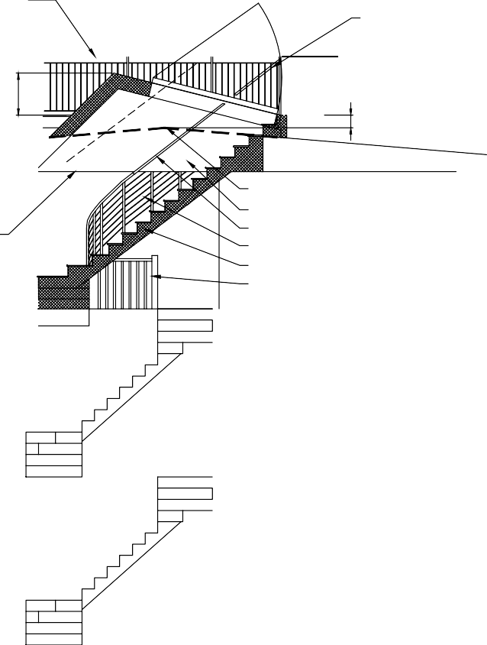
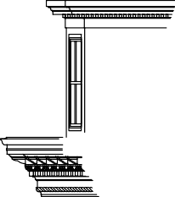


PROPOSED ROOF DECK UNIT 6
13 UPTON STREET BOSTON, MASS
42" BLACK STEEL
RAILING
17'-6" ± PROPOSED ROOF DECK
HANDRAIL
30" MAX
PROPOSED ROOF HATCH
PROPOSED ROOF HATCH FOR ROOF ACCESS W/ PNEUMATIC LIFT SYSTEM
T.O. ROOF
12" MAX ABOVE EX'G
ROOF
12
.9"
4.289° ±
10'-9" ±
EX'G ROOF LINE GYP BOARD WALL HANDRAIL
WIRE GUARD RAIL
PROPOSED STAIR TO ROOF EX'G RAILING
C
hoo
LINE OF EX'G
CEILING
&Com
pany, Inc.
5th FLOOR
One Billings Road Quincy, MA 02171
617-786-7727 fax 617-786-7715
10'-0" ±
4th FLOOR
52'-9" ±
10'-9" ±
□
 
LINE OF SITE
LINE OF SITE
05-25-2021
3rd FLOOR
12'-4" ±
 □

2021040
AS NOTED
04-02-2021
SL
2nd FLOOR

 
9'-2" ±
 
UPTON STREET
PROPOSED
ELEVATIONS
6'-2" ±
26'-0" ±
1st FLOOR
6'-2" ±
9'-0" ±
PA 701
GARDEN
 □


 
  

