Slide 1
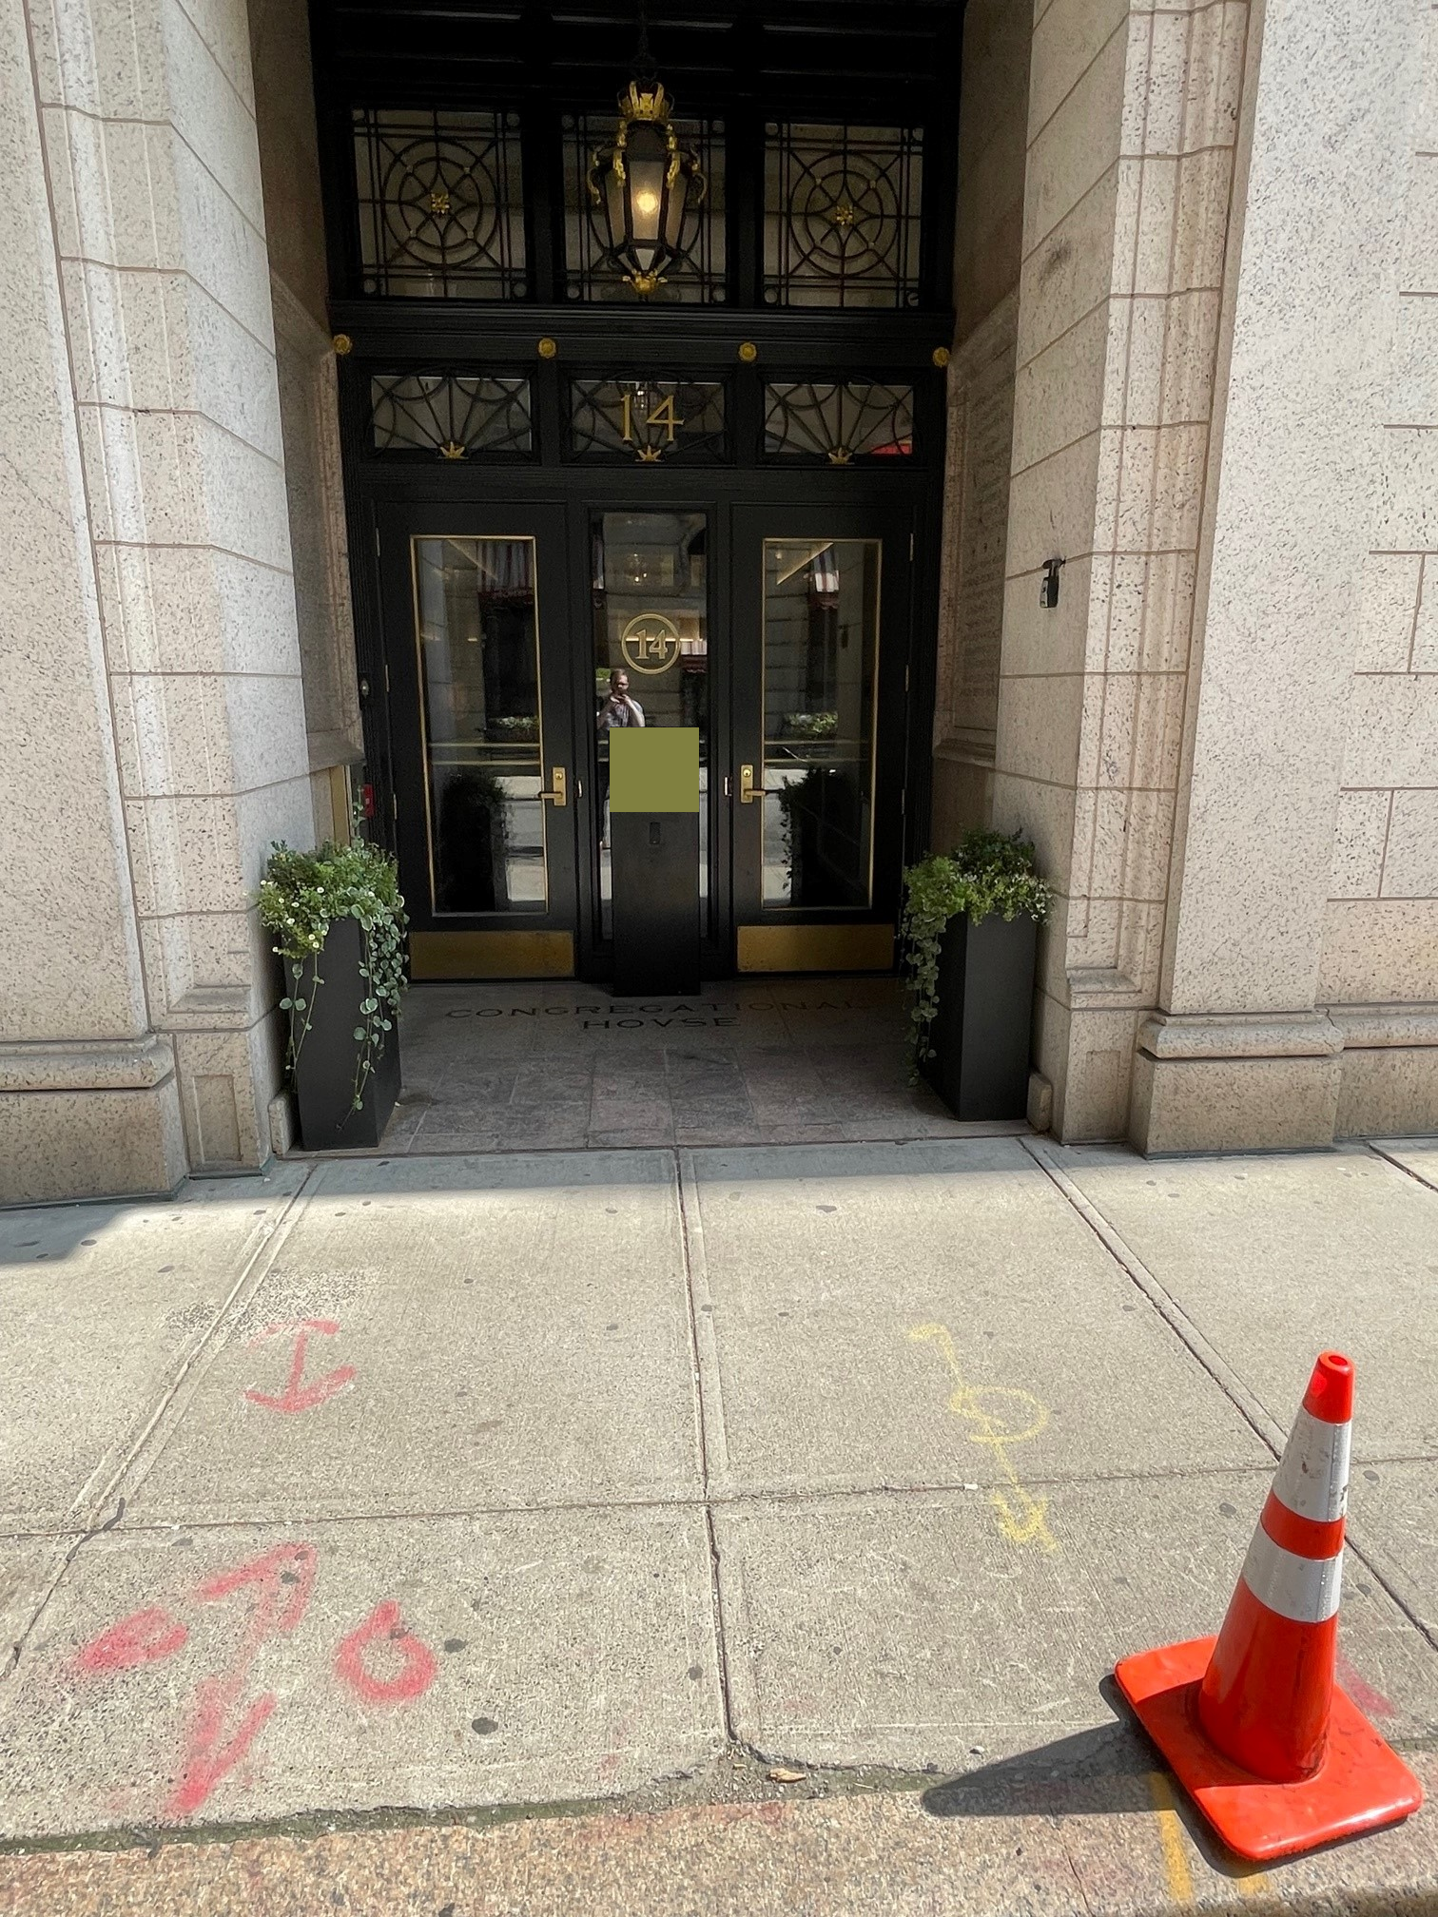
14 Beacon Street
Security Screen and Podium
Application of 14 Beacon Street LLC
Beacon Hill Architectural Commission

Slide 2
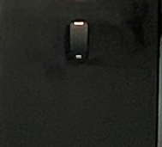

Change to Tenant Card Reader from Prior Submission
Previously there was a light on the top of the card reader
The light has been removed and the card reader is matte black to match the podium

Slide 3
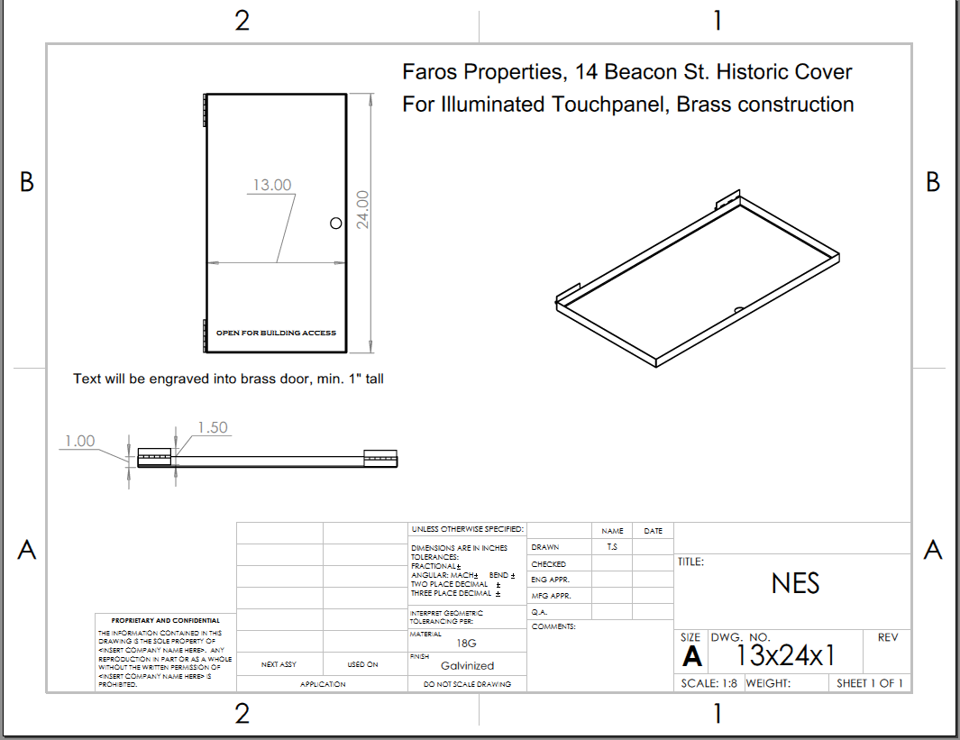
Proposed Brass Cover

Slide 4
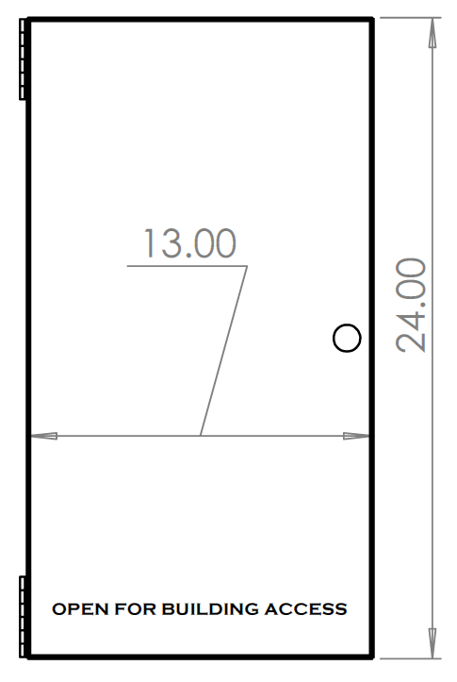
Specifications
Solid brass (alloy 260) door/cover panel with brass hinges mounted inside on the top and bottom. Corners shall be soldered or braised and there shall be a small brass knob mounted half way between the top and bottom of the opening side to allow users to open and close the door covering the electronics.

Slide 5
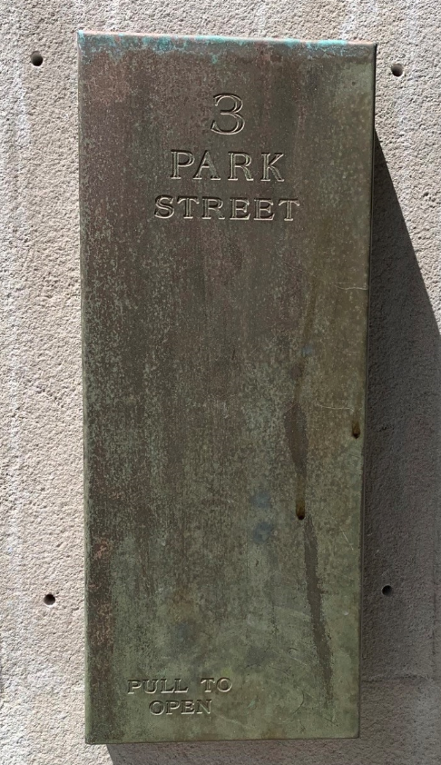
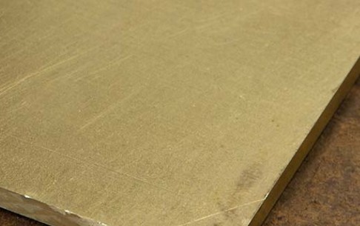
The finish will be “mill finish” -- not polished bright. This will replicate the cover already approved by the Historic Commission for 3 Park St. as shown to the right. The mill finish will wear and age as the one below has.

Slide 6
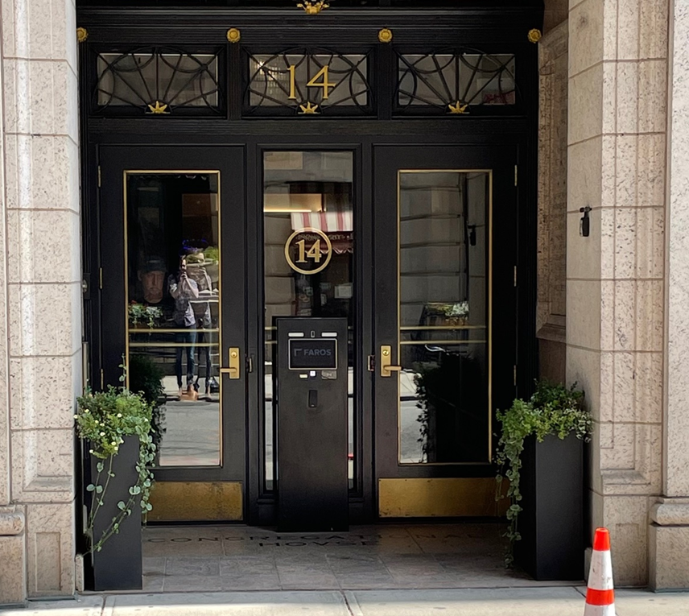
Current Appearance and Location of Podium and Screen

Slide 7
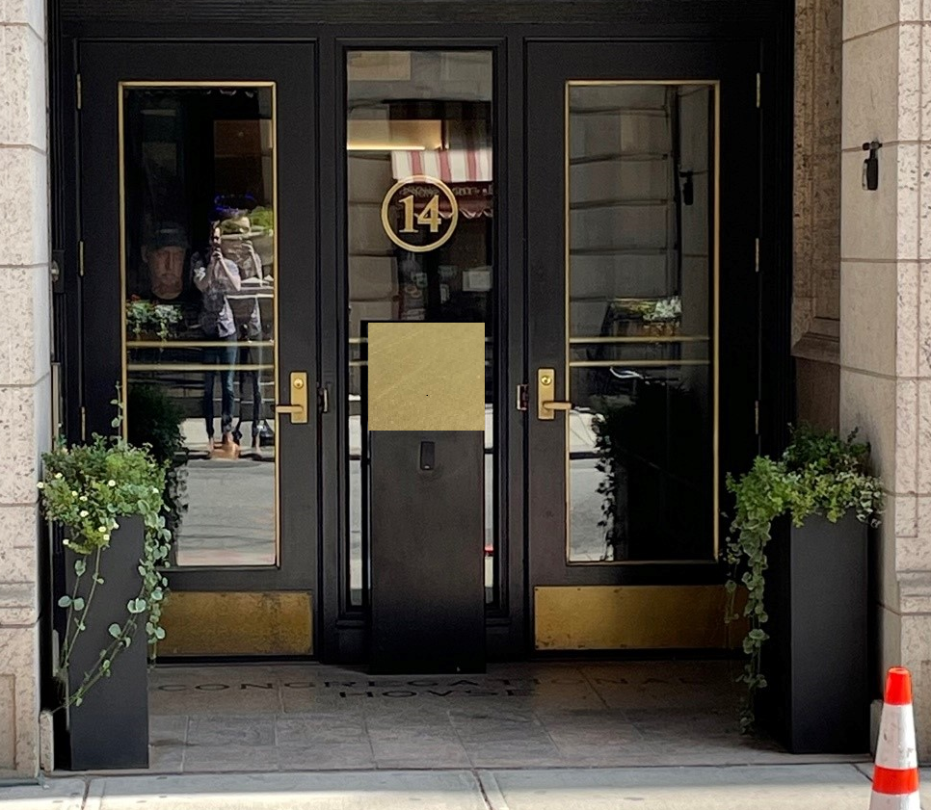
Podium and Screen After Installation of Door

Slide 8
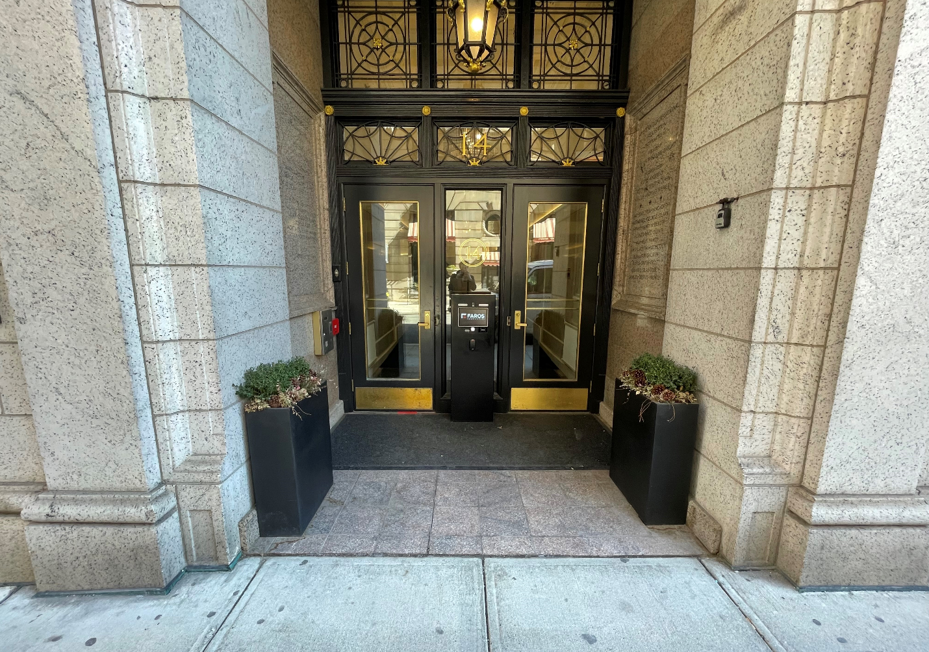
Entryway with Podium and Screen – Prior to Installation of Door

Slide 9
Entryway with Podium after Installation of Door

Slide 10
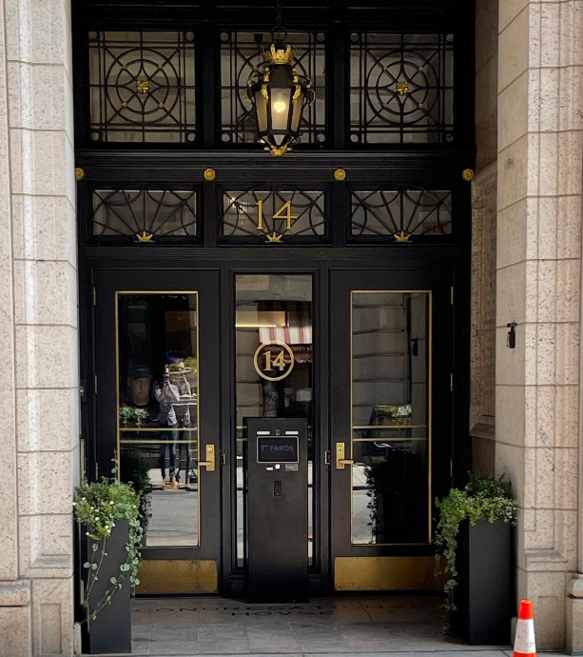

OPEN FOR BUILDING ACCESS

