Slide 1
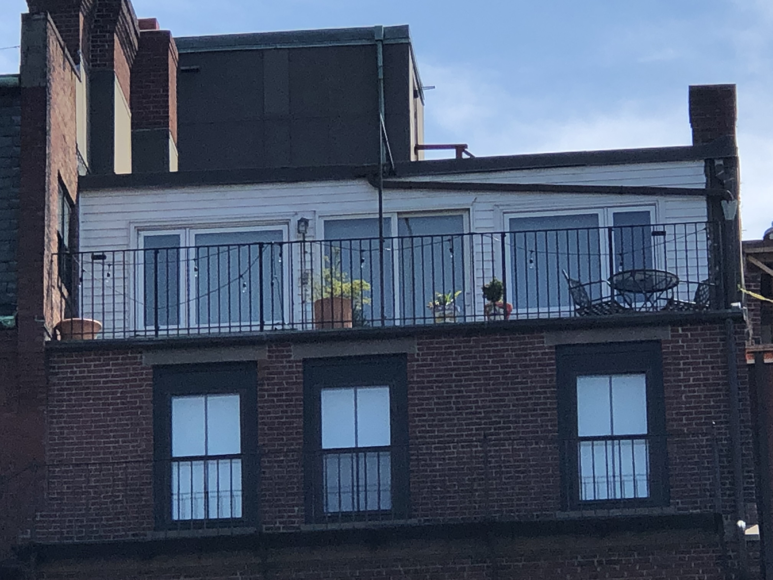
19 Brimmer Street #5 Rear

Slide 2
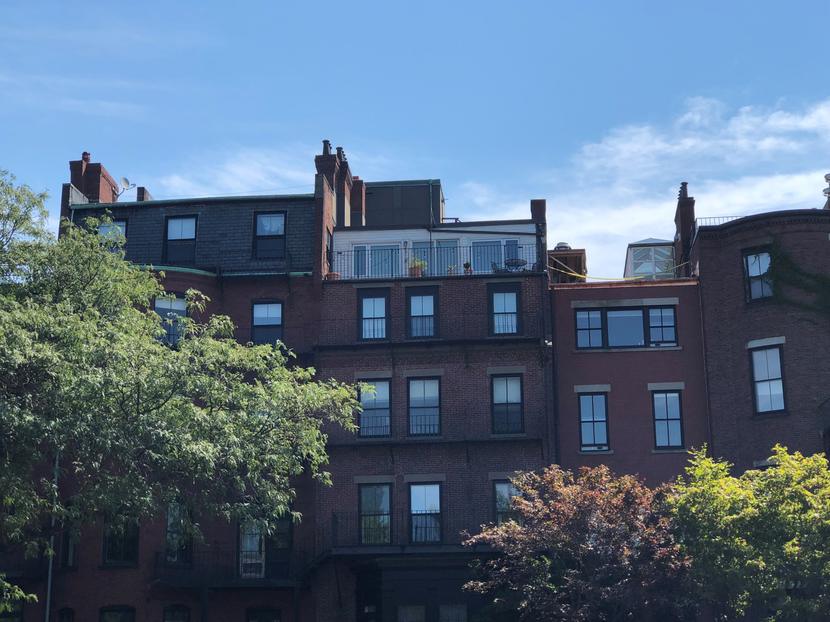
19 Brimmer Street #5 Rear

Slide 3
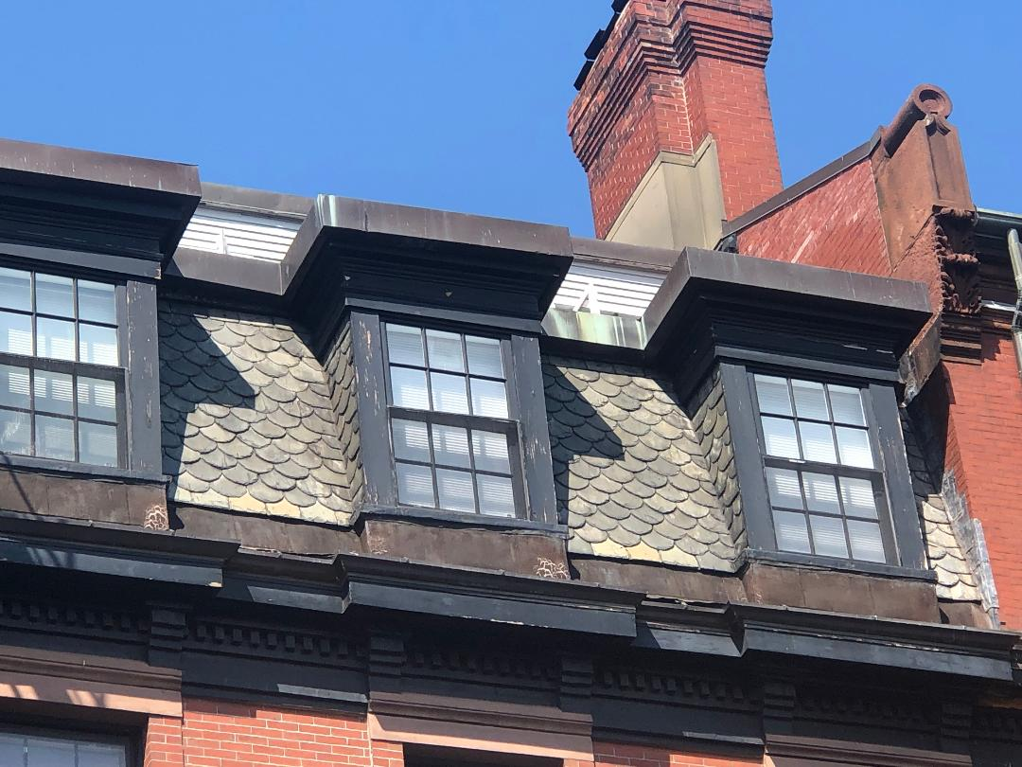
19 Brimmer Street #5 Front

Slide 4
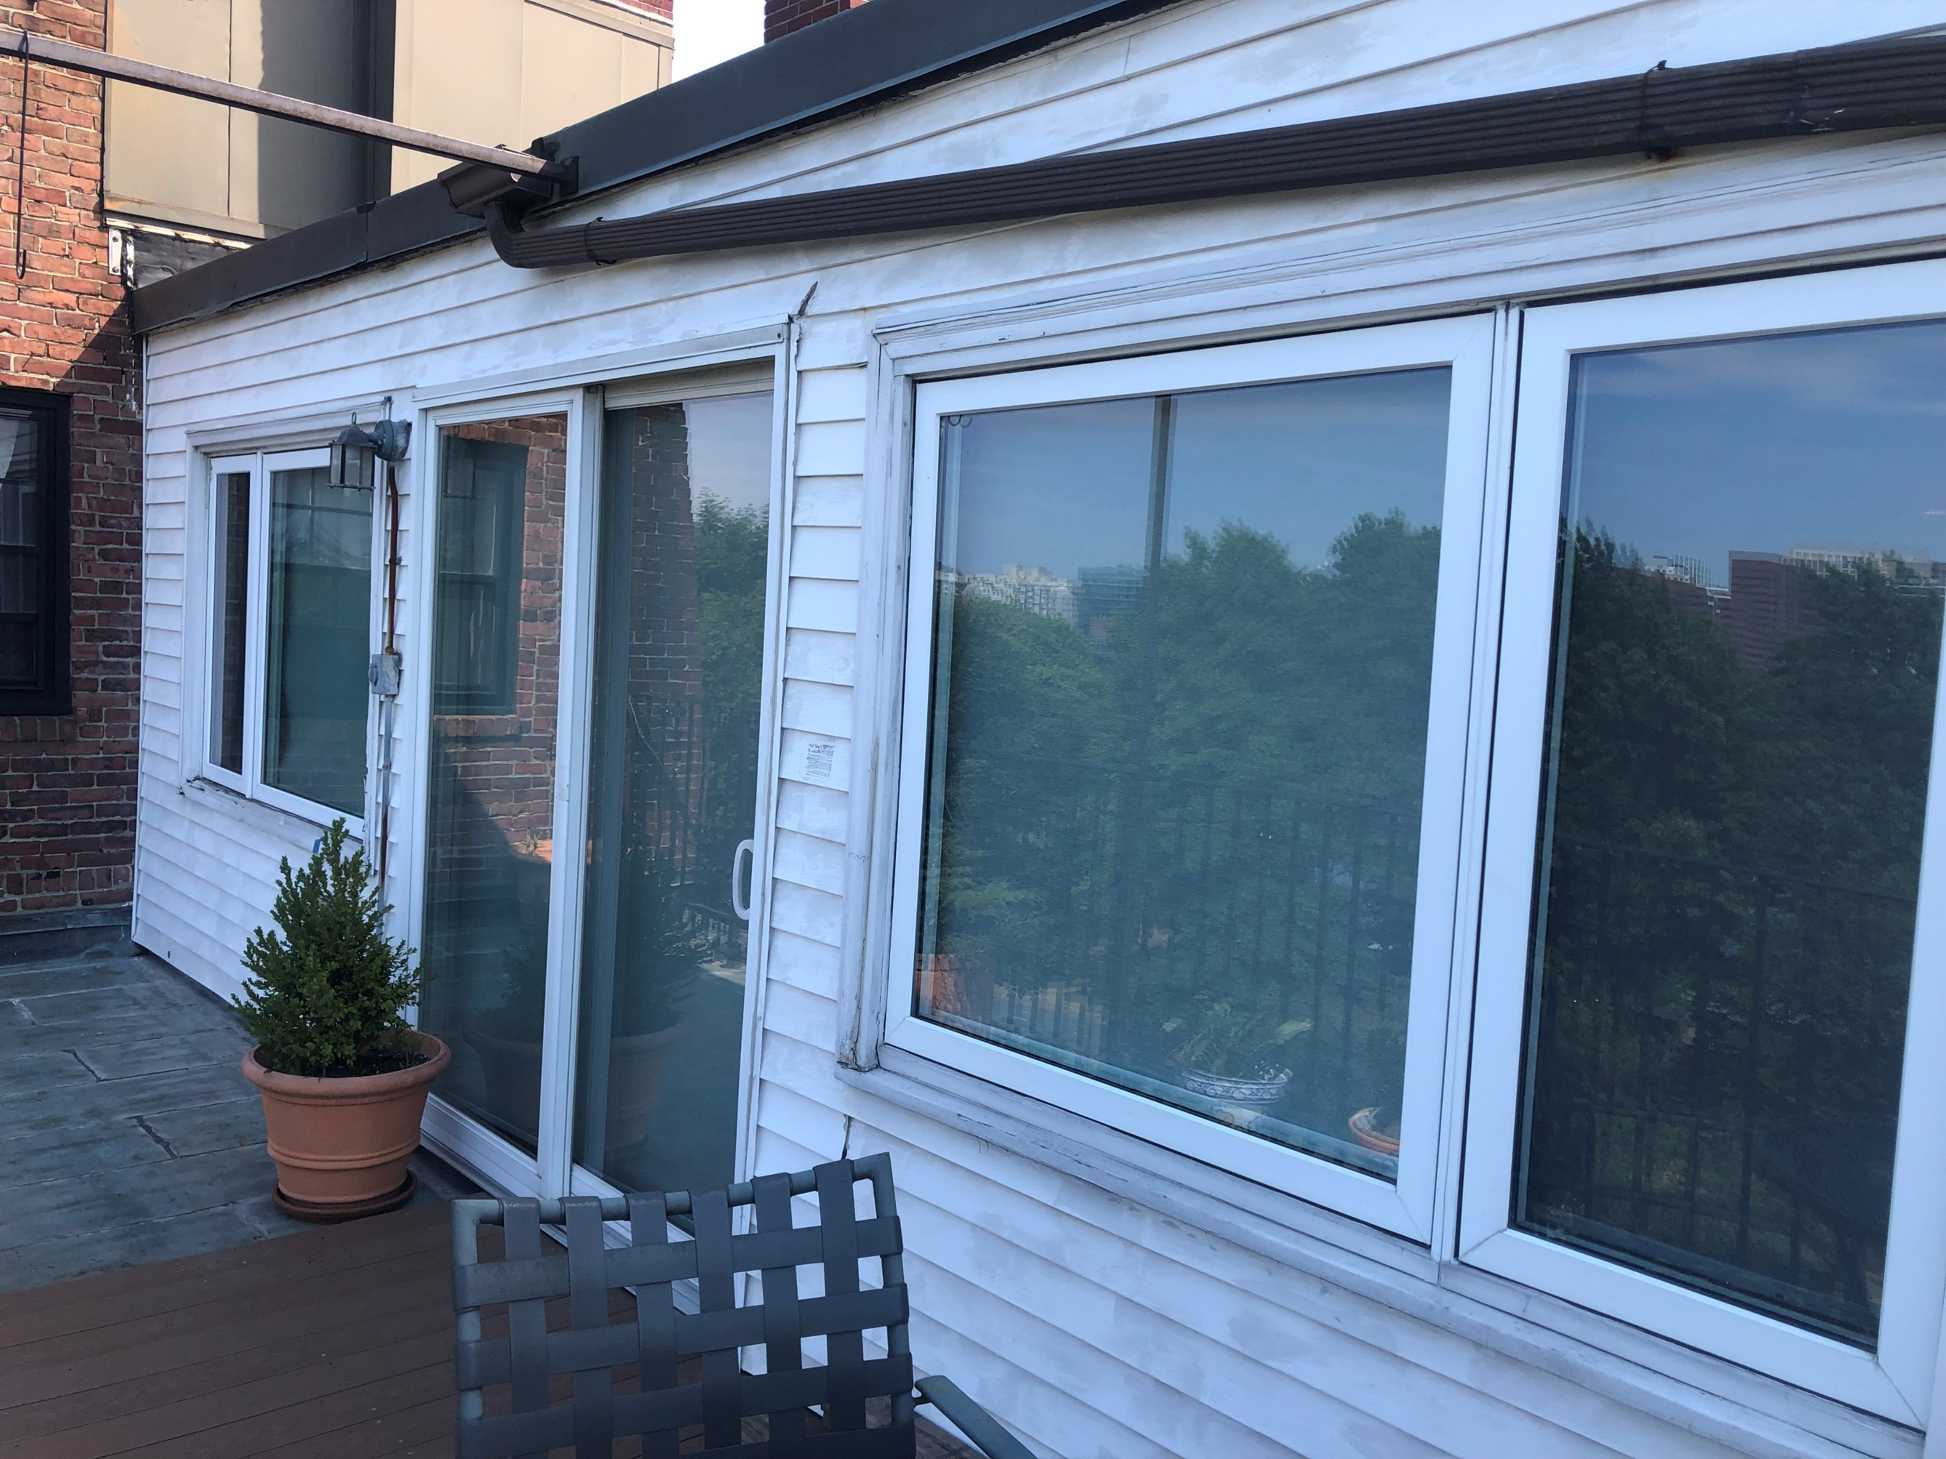
19 Brimmer Street #5 Rear

Slide 5
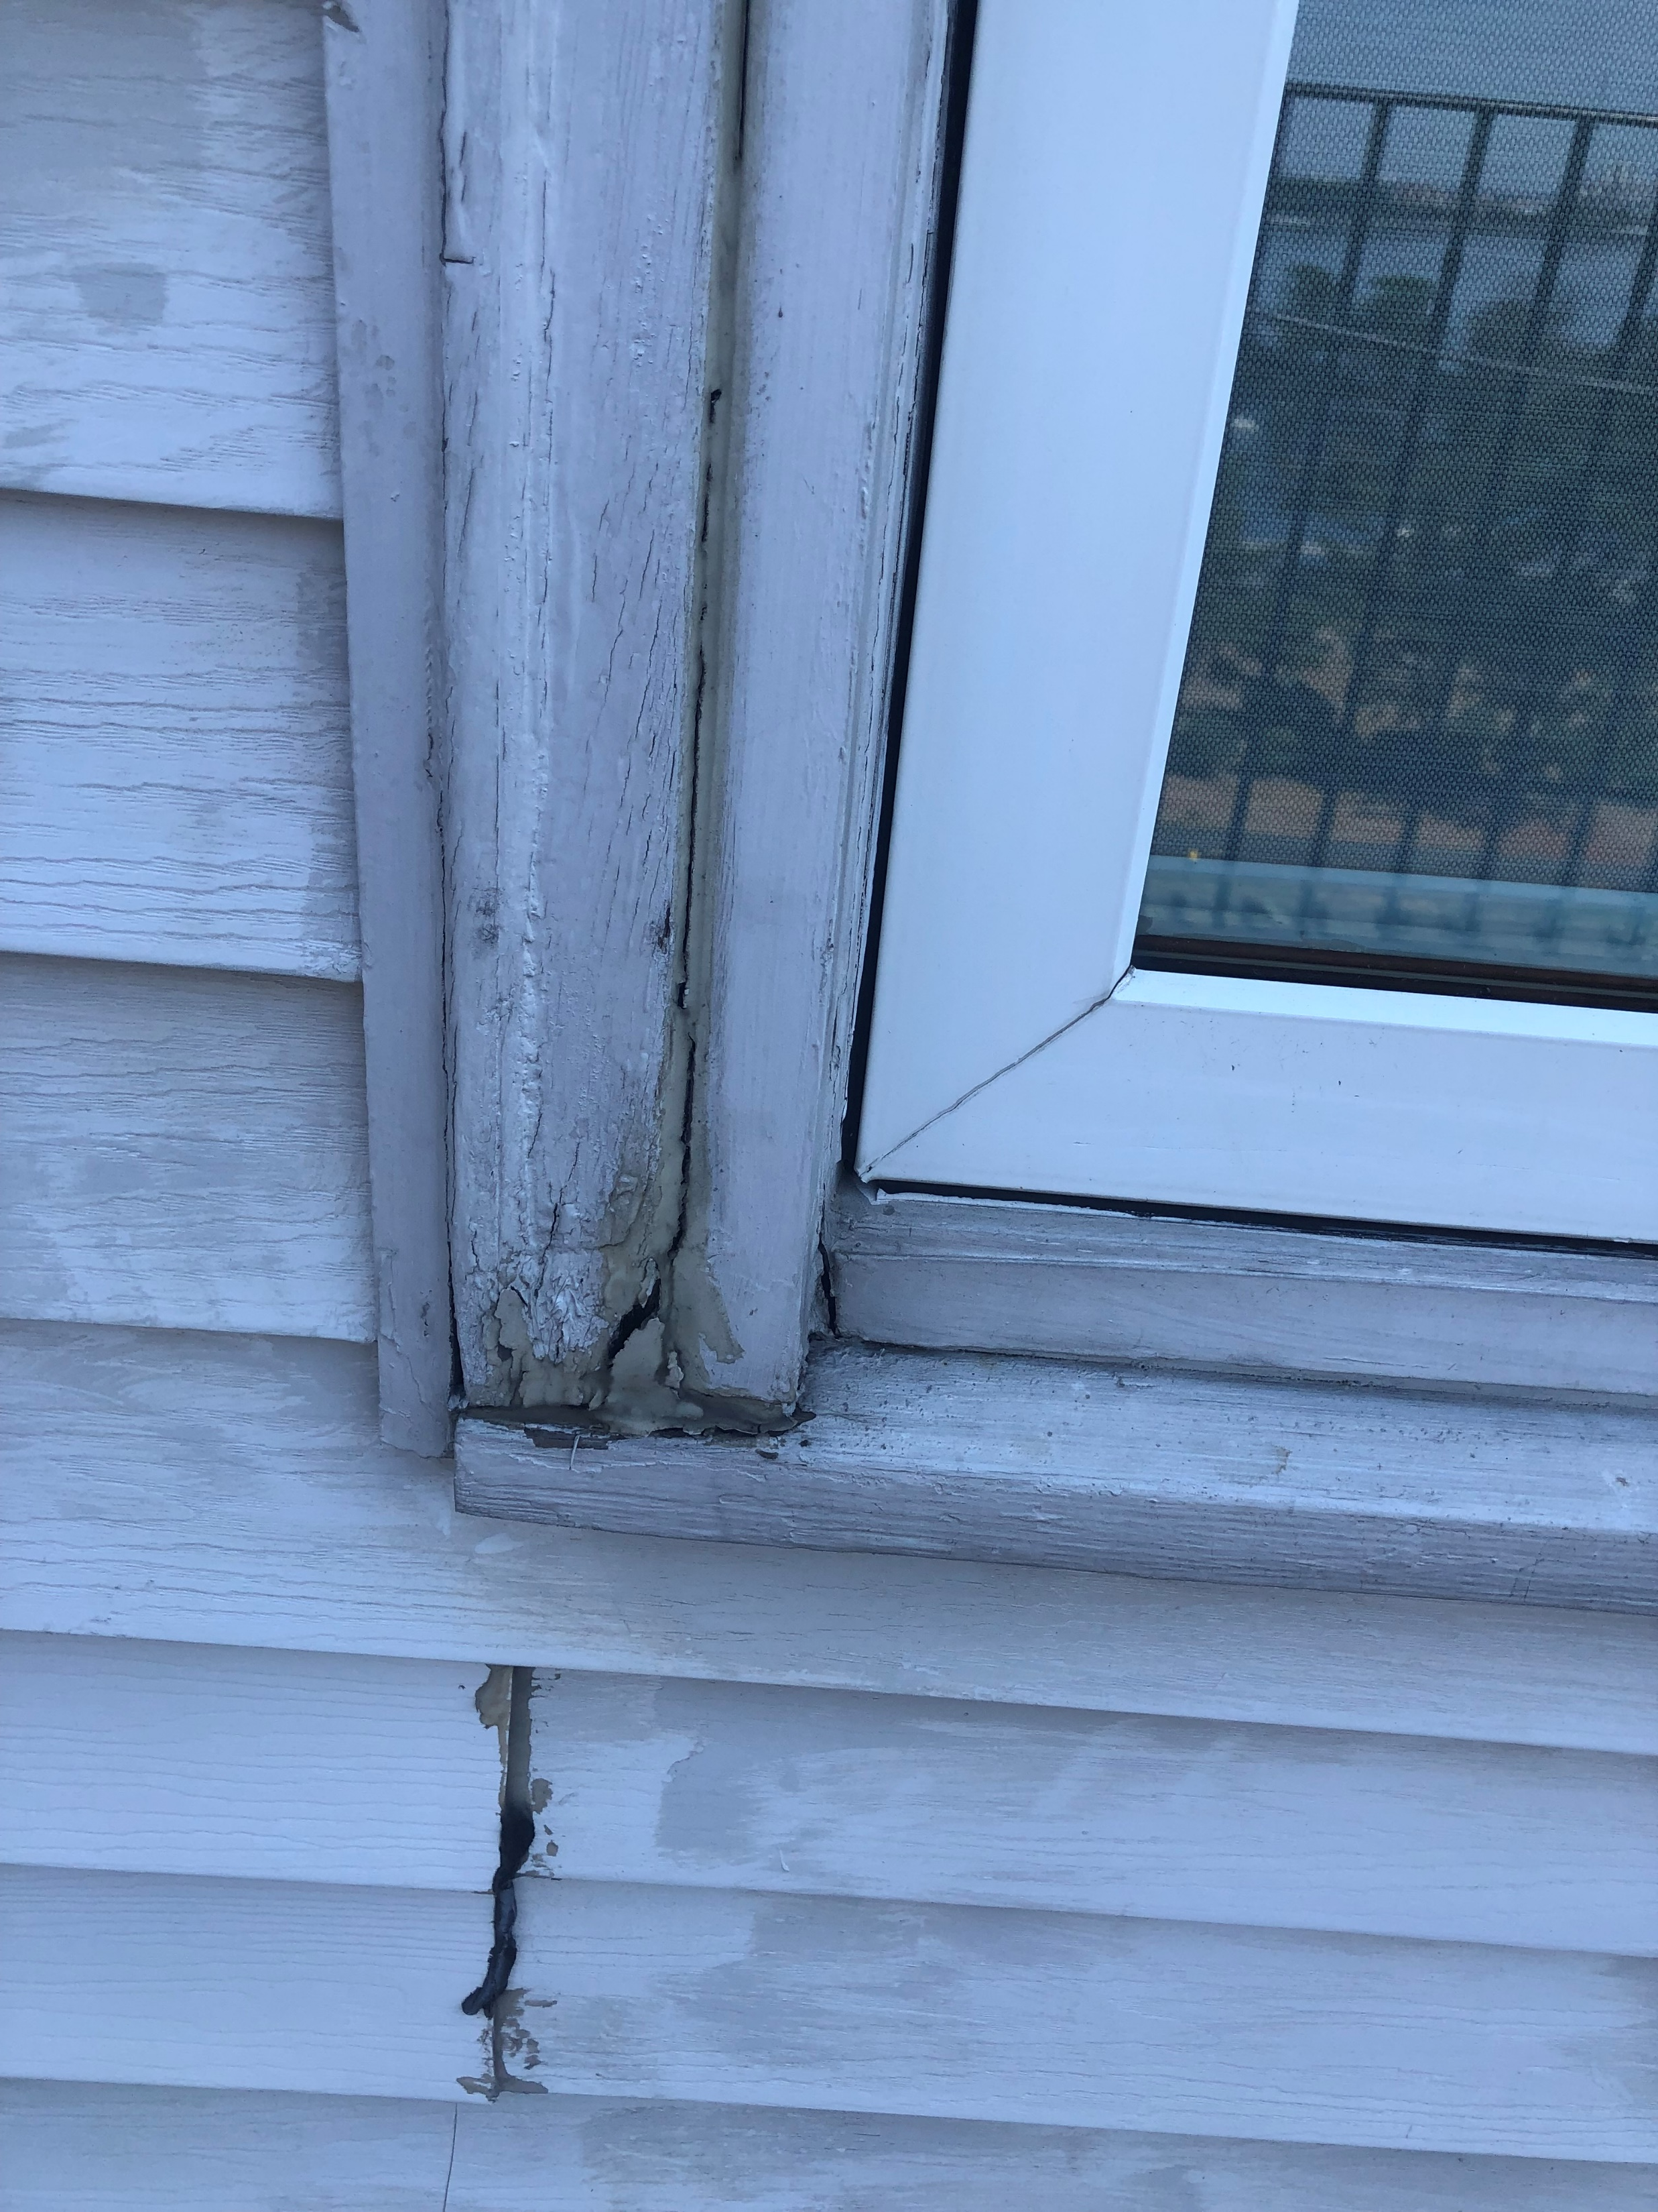
19 Brimmer Street #5 Rear: Right Window

Slide 6
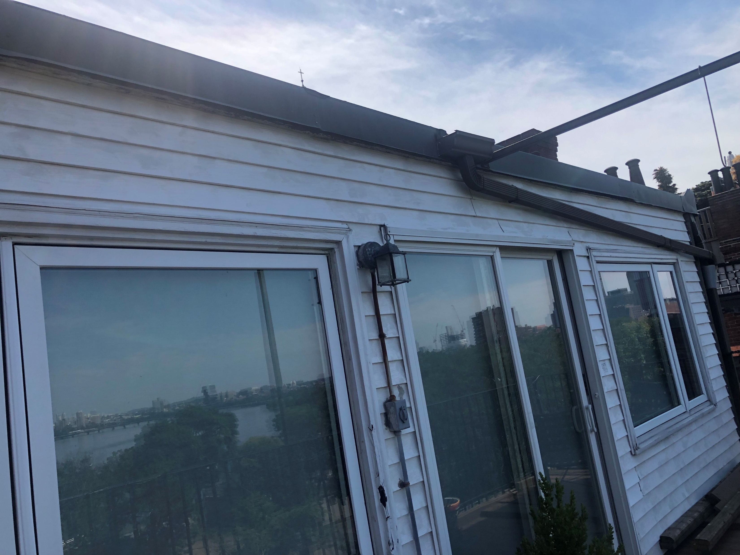
19 Brimmer Street #5 Rear

Slide 7
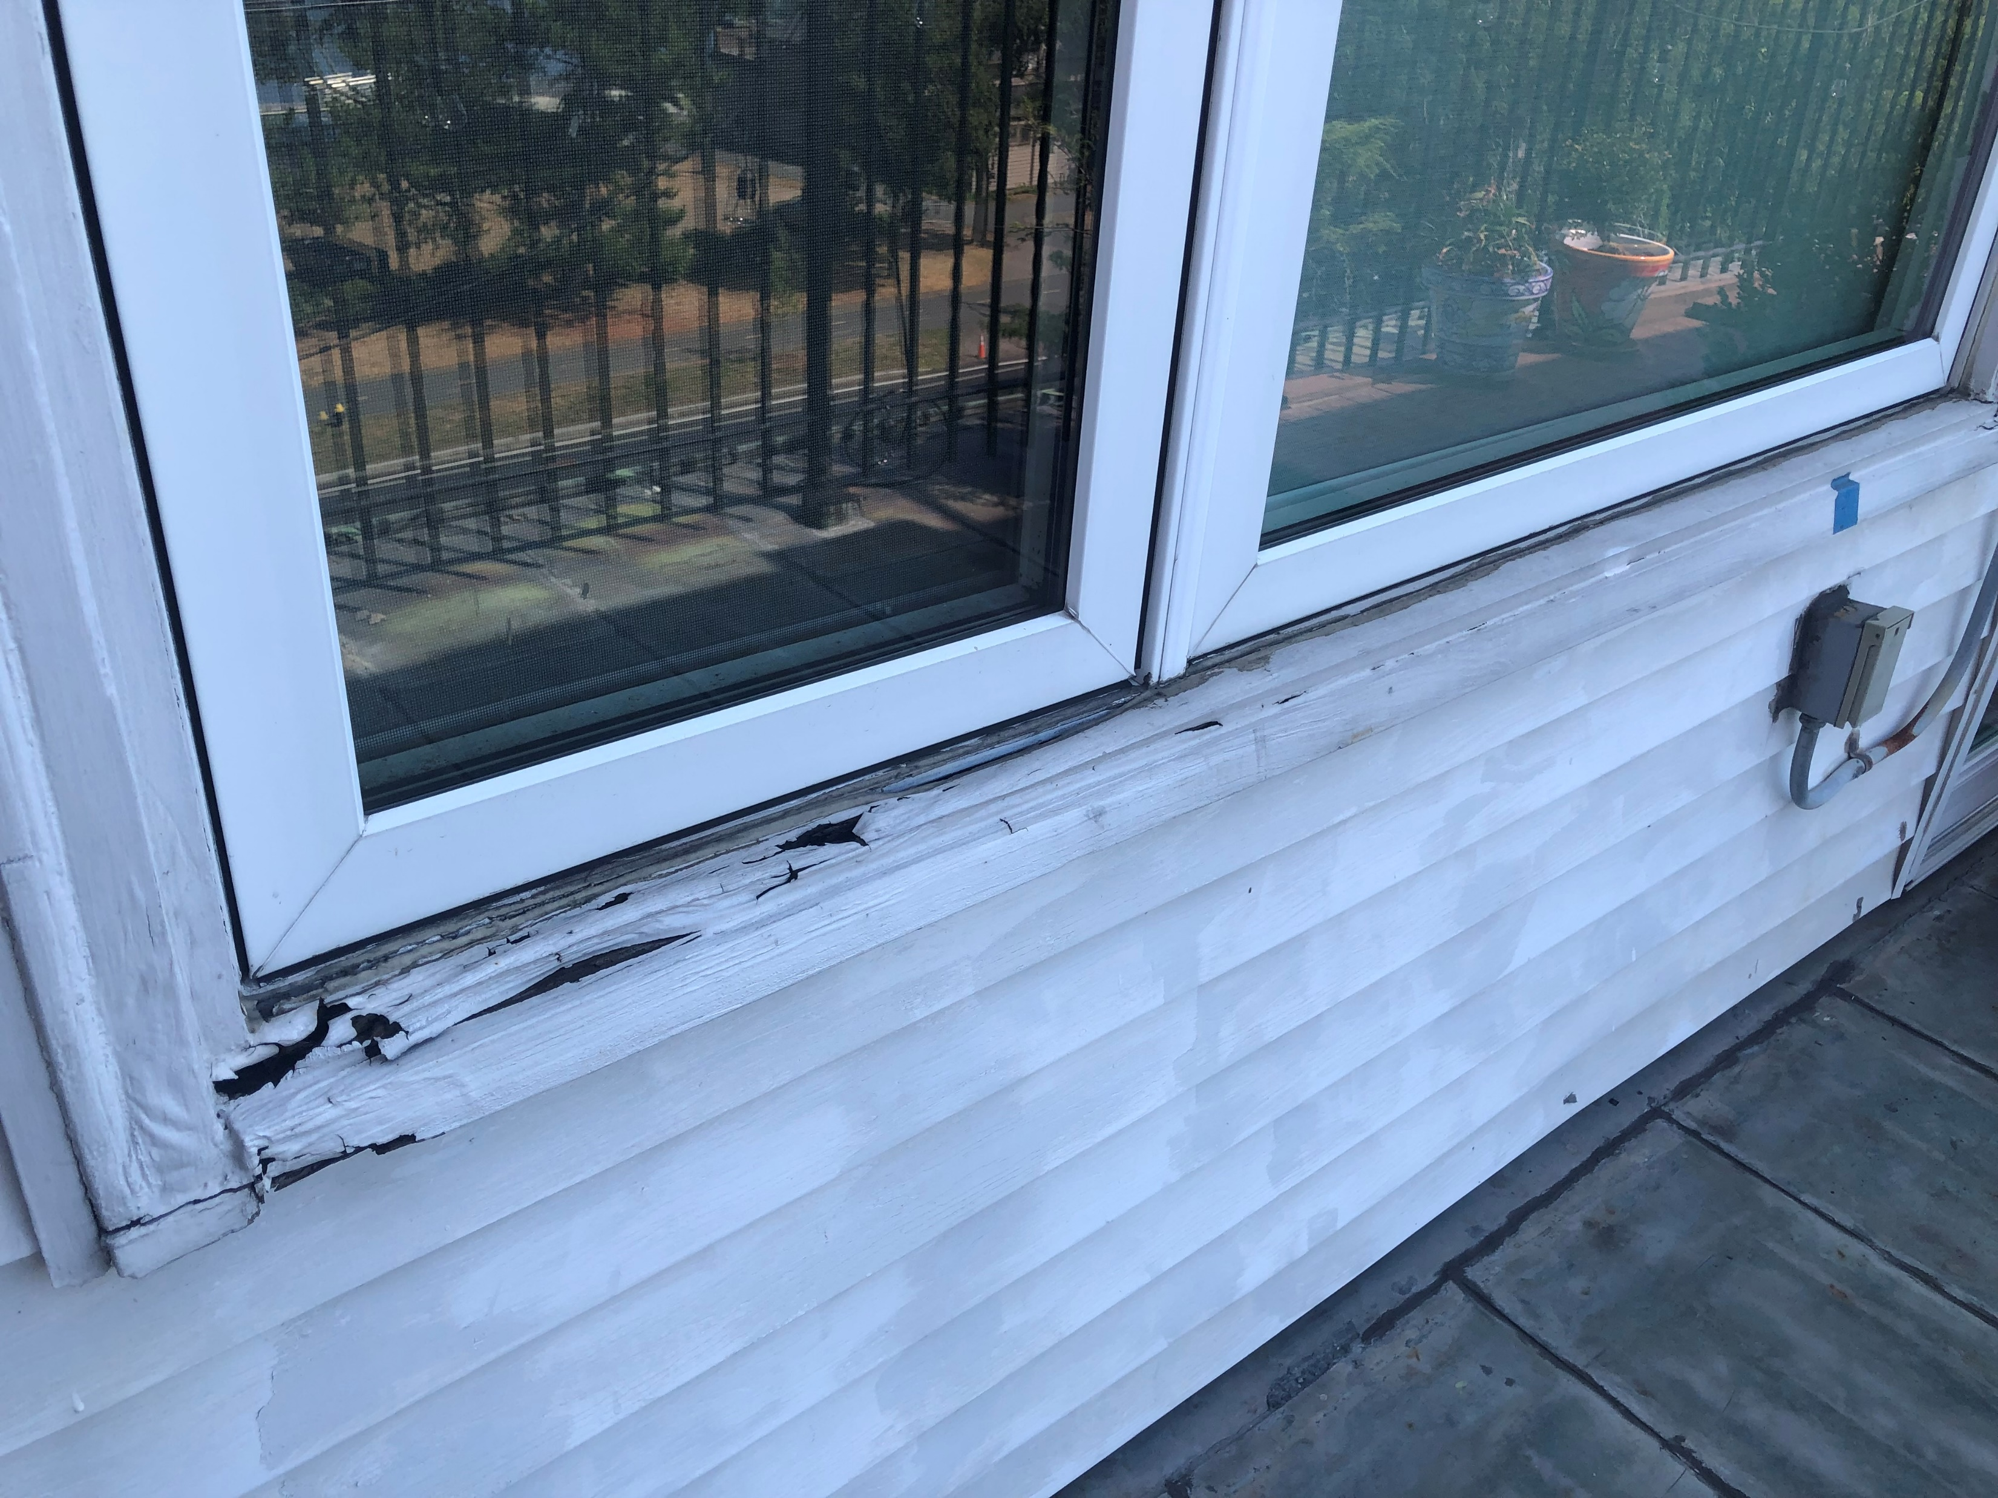
19 Brimmer Street #5 Rear: Left Window

Slide 8
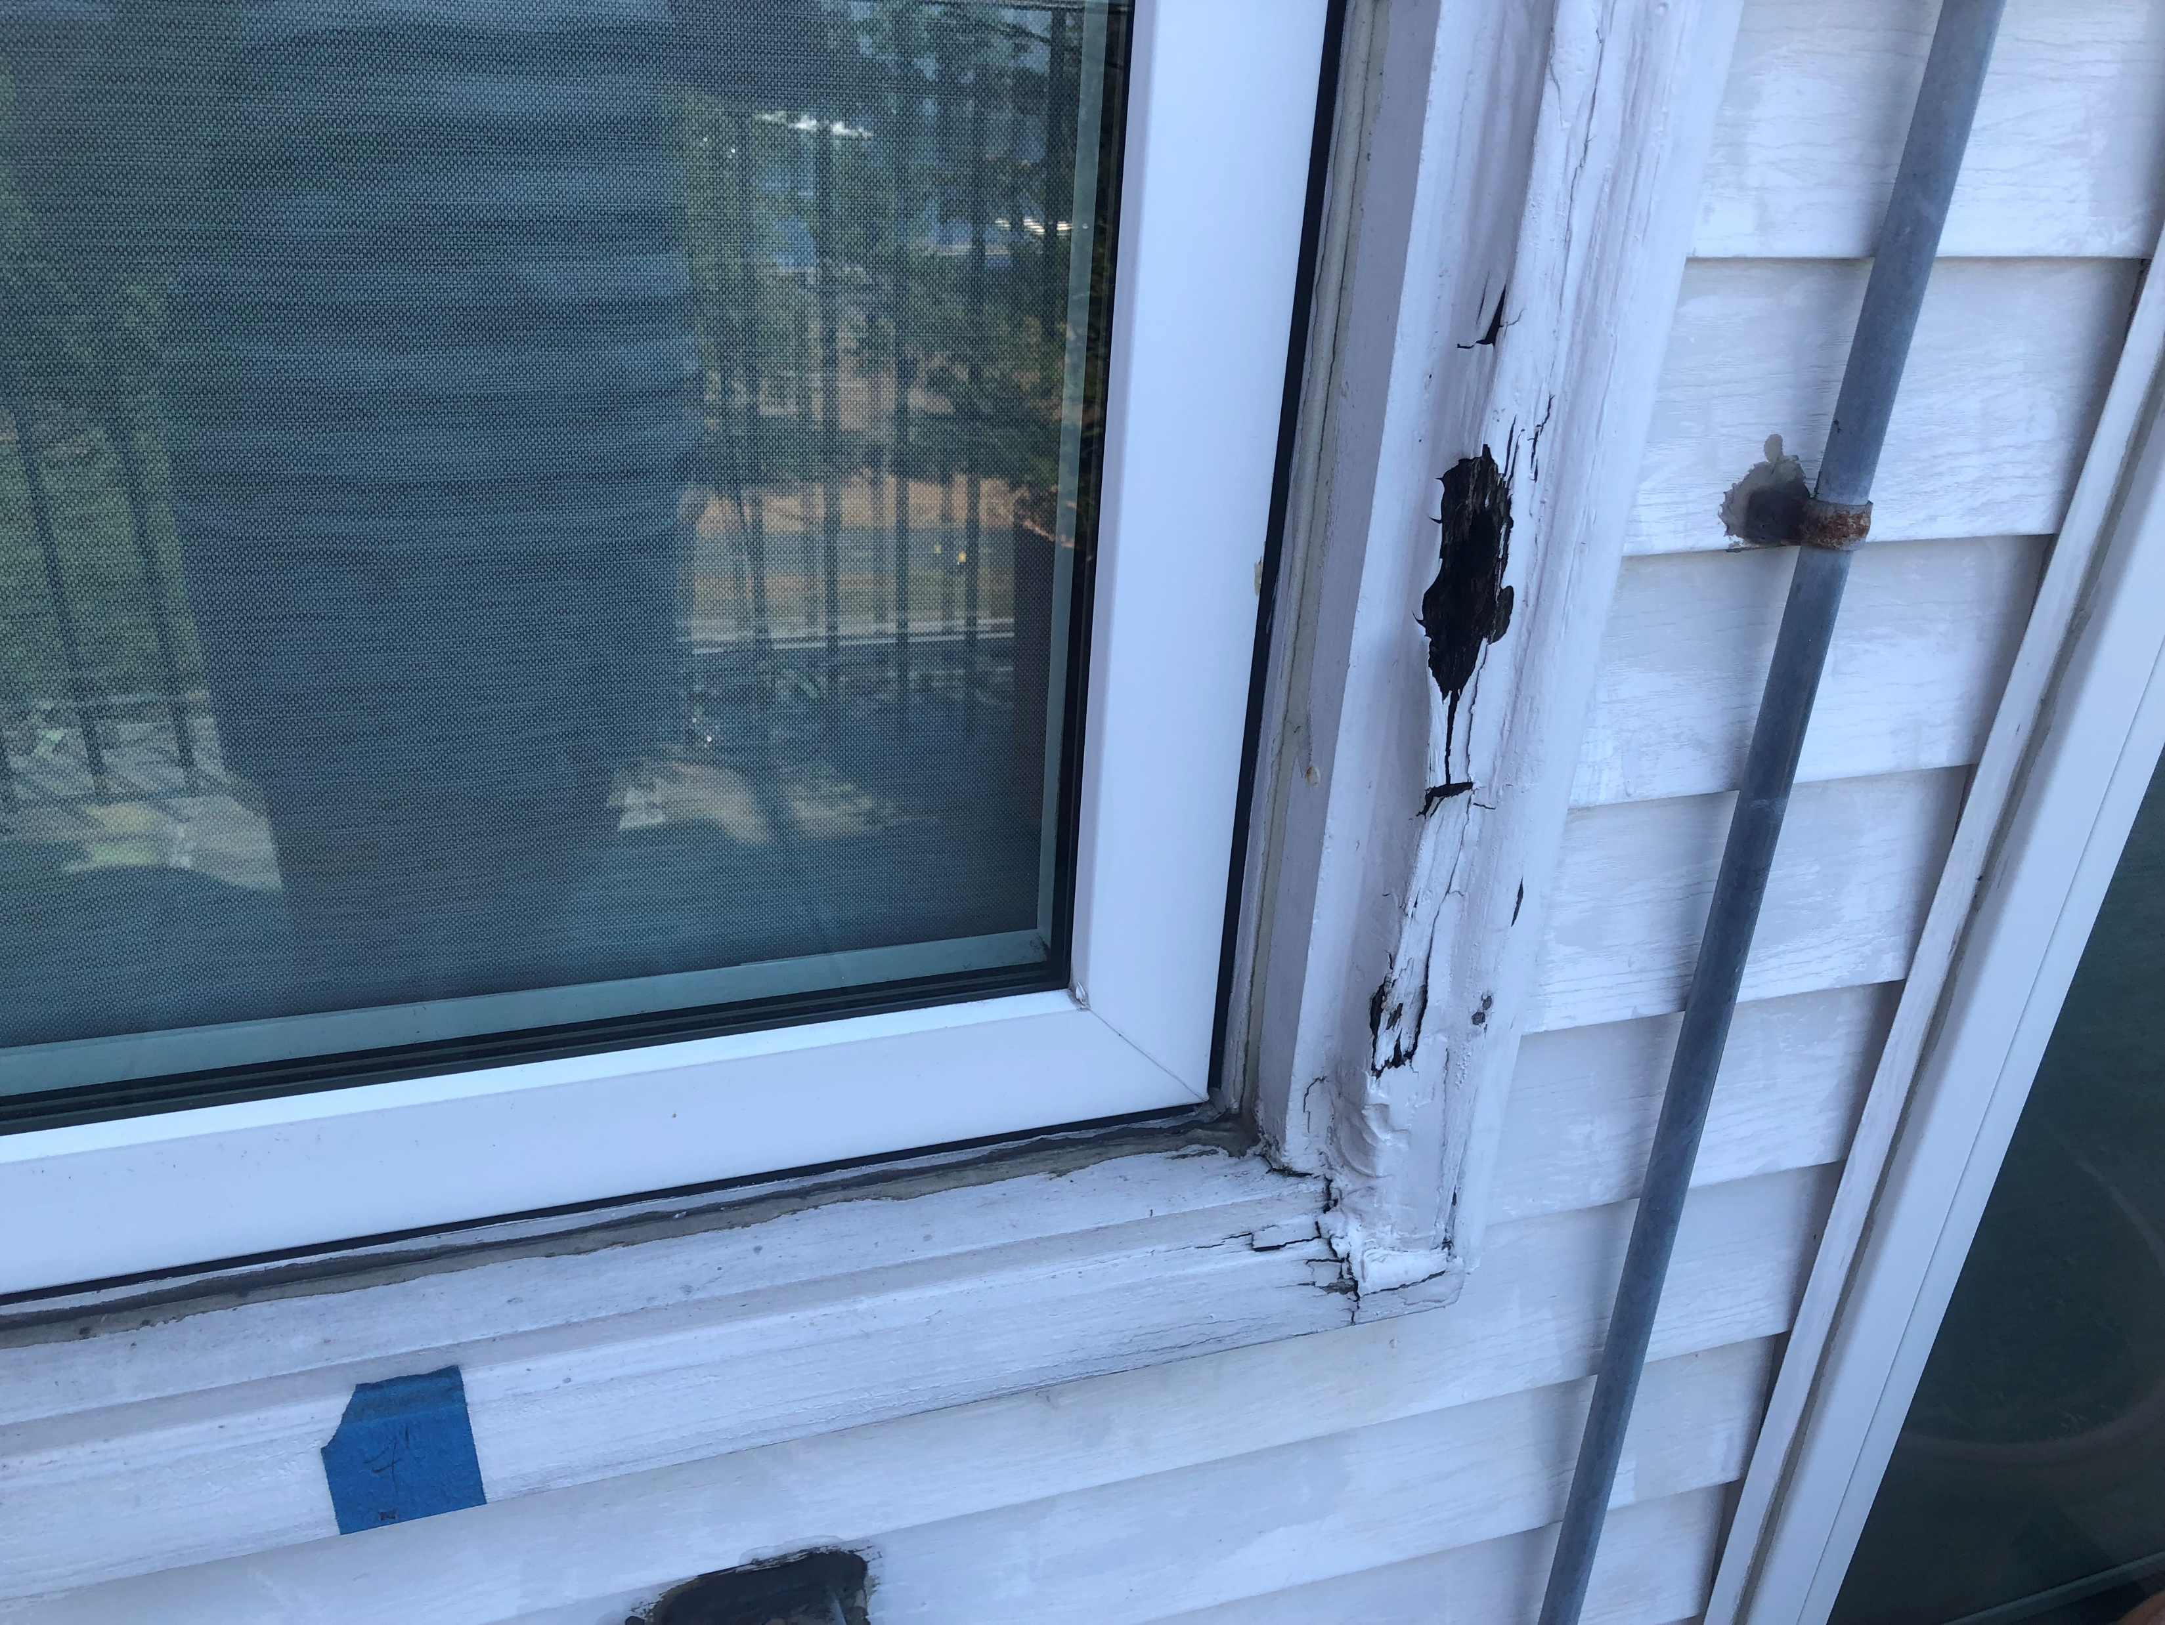
19 Brimmer Street #5 Rear: Left Window

Slide 9
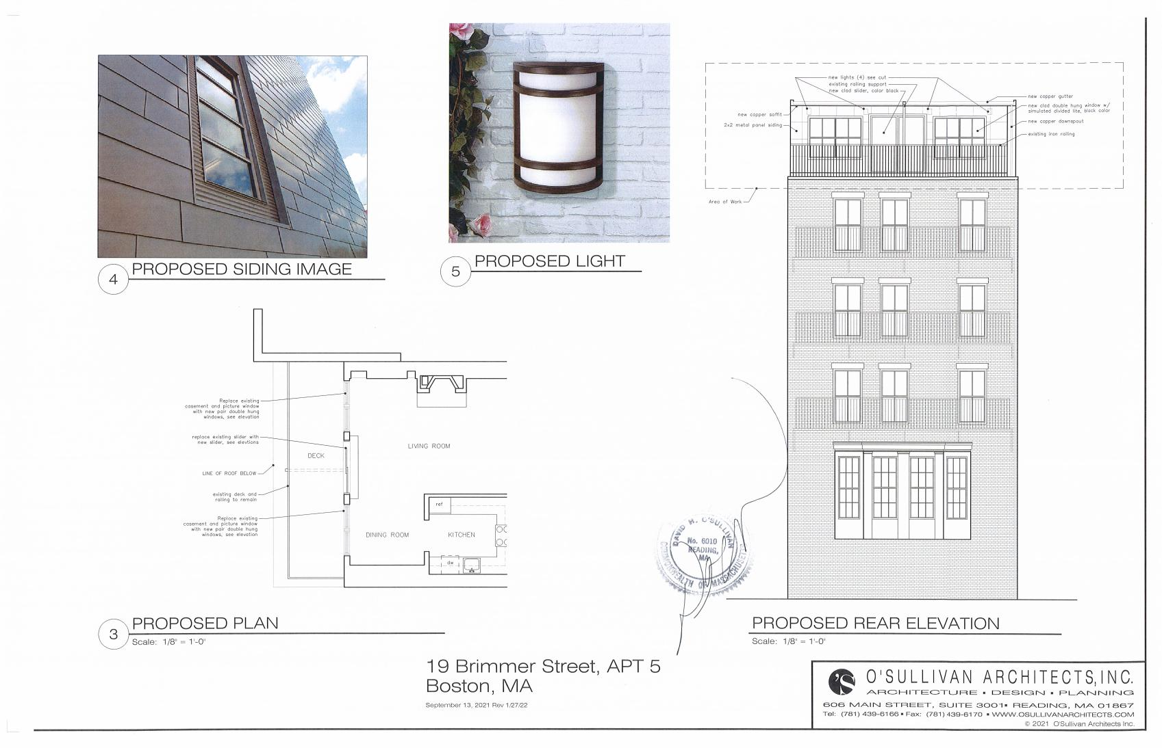
19 Brimmer Street #5 Rear: Proposed Rendering

Slide 10
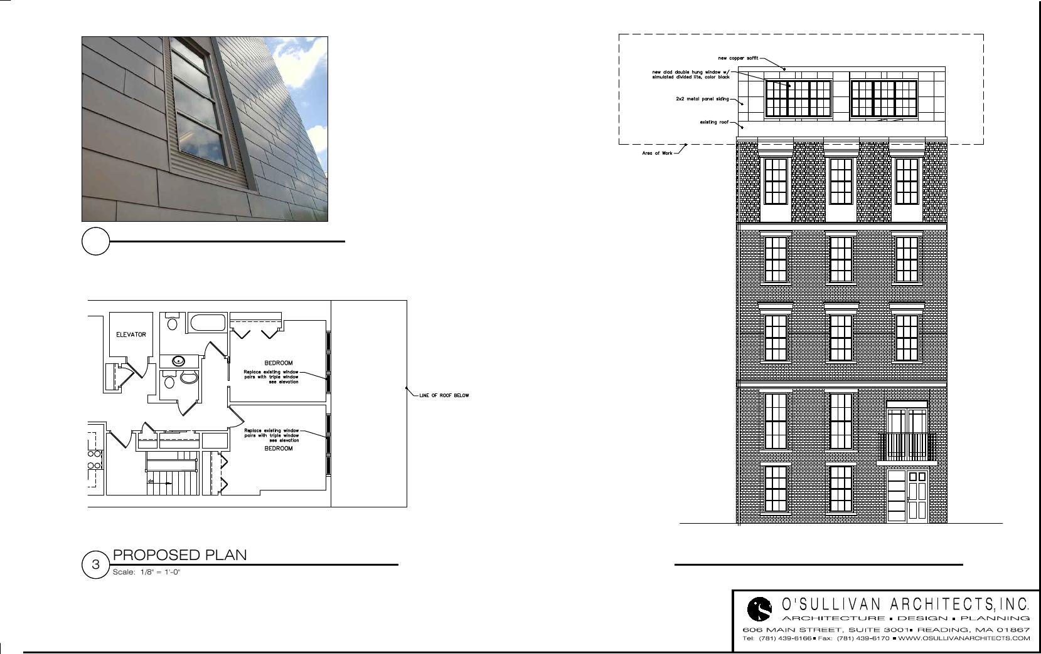
19 Brimmer Street #5 Front: Proposed Rendering

