Slide 1
28-30 Mount Vernon Street
Refurbish Front Entry Way
Proposal

Slide 2
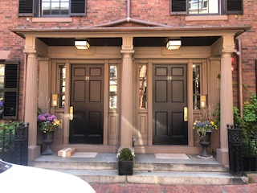
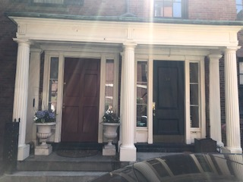
4
4
4
5
5
3
3
3
3
1
2
2
28-30 Mount Vernon Street
32-34 Mount Vernon Street
Opportunity to Improve and Restore historical appearance of the Front Entrance:
Change the paint color from brown to a shade of historical white for the columns and the door framing
Refresh the black paint on the front doors
Strip the painted brick next to the side lights to match 32/34 Mt. Vernon
Add fascia boards to 28/30 Mt. Vernon to match 32/34 Mt Vernon
Replace current modern overhead lights with vintage lanterns (18” hanging lantern) similar to other homes in the neighborhood
Option 1 - 32/34 Mount Vernon
Identical front entrance but in a brighter historical white
Fascia boards create a nice clean look
Brick is exposed next to side light windows

Slide 3
PAINT COLOR PROPOSAL
https://www.benjaminmoore.com/en-us/color-overview/color-palettes/historical-collection
TRIM:
Benjamin Moore "Classics Collection" : Alabaster White # CC -876 (Semi-gloss for trim)
- or -
Benjamin Moore "Colonial Williamsburg Collection" : Capitol White # CW-10 (Semi-gloss for trim)
DOOR:
Benjamin Moore "Historical Collection": Black # HC- 190 (High Gloss for doors)

Slide 4
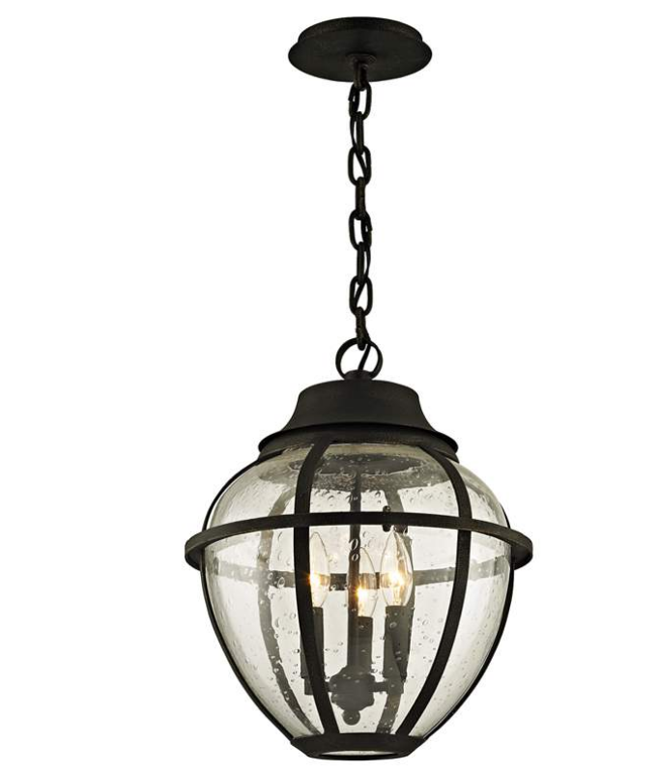
LAMP FIXTURE PROPOSAL https://www.lampsplus.com/products/bunker-hill-16-inch-high-vintage-bronze-outdoor-hanging-light__45d25.html
16" high x 13" wide. Canopy is 5 1/2" wide. Weighs 14.28 lbs.
Includes 6-feet of chain and 8-feet of wire. Sloped ceiling adaptable.
Uses three maximum 60 watt candelabra base bulbs (not included).
Bunker Hill three-light outdoor hanging light by Troy Lighting.
Vintage bronze finish over hand-worked iron construction. Clear seeded glass globe.
Damp location rated only for use on covered porches or patios. Can also be used indoors.

Slide 5
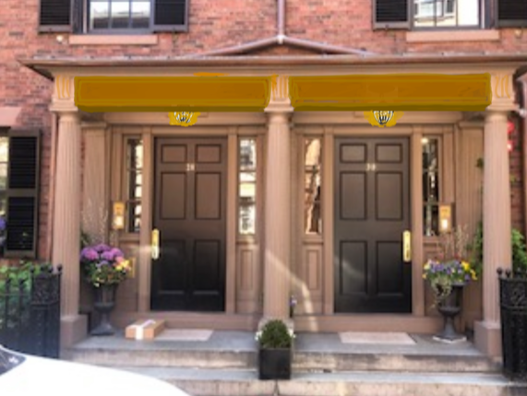
With Fascia Boards and Lanterns
4
5

Slide 6
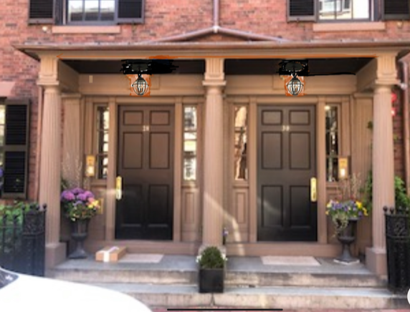
With just Lanterns
5

