Slide 1
The Impacts of COVID-19 on Working Parents, Childcare, and Gender Equity
Alicia Sasser Modestino
Associate Professor, School of Public Policy and Urban Affairs
Research Director, Dukakis Center for Urban and Regional Policy

Slide 2
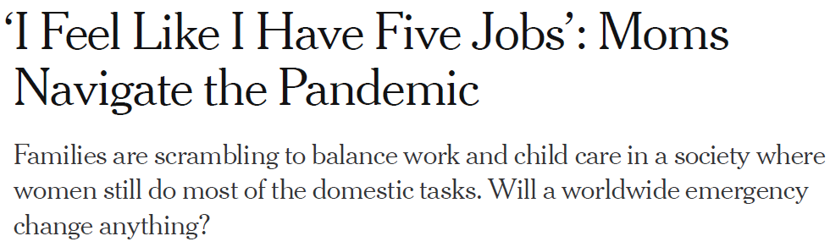
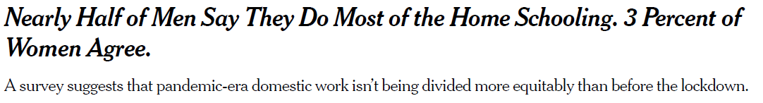
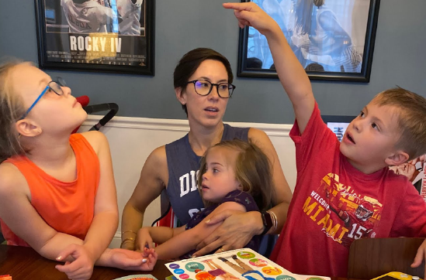

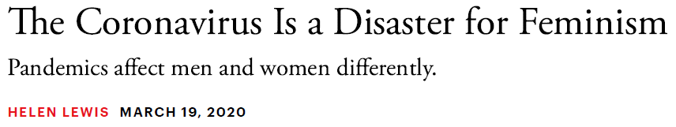

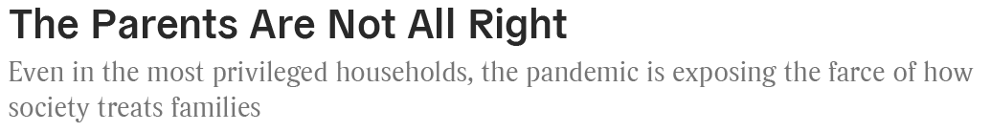



This past spring COVID-19 severely disrupted the nature and availability of childcare as schools and daycares were shuttered, with much of the burden falling on women.
May 6, 2020
March 23, 2020
April 8, 2020
Parents are panicking, giving up their careers, and spending thousands of dollars on piecemeal solutions for the school year
July 22, 2020
Notes:
While hiring of staff and ER nurses is lightly lower than same time last year, postings for CNAs and ICU nurses are up more than 50%
While physical therapists fell off the top 20 list in Q2 2020 versus 2019, Respiratory therapists made the top 20 for the first time.
Similarly speech language pathologists were not in high demand compared to this time last year, but internal medicine physicians were.

Slide 3
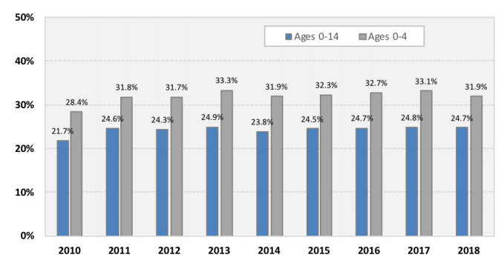
Childcare is an important concern for a large share of the workforce with one third of the workforce (50 million workers) living with a child under age 14 in their household.
Share of U.S. Children in Paid Childcare by Age
Source: U.S. Census Bureau, Current Population Survey – March Annual Social and Economic Supplement.
Notes:
While hiring of staff and ER nurses is lightly lower than same time last year, postings for CNAs and ICU nurses are up more than 50%
While physical therapists fell off the top 20 list in Q2 2020 versus 2019, Respiratory therapists made the top 20 for the first time.
Similarly speech language pathologists were not in high demand compared to this time last year, but internal medicine physicians were.

Slide 4
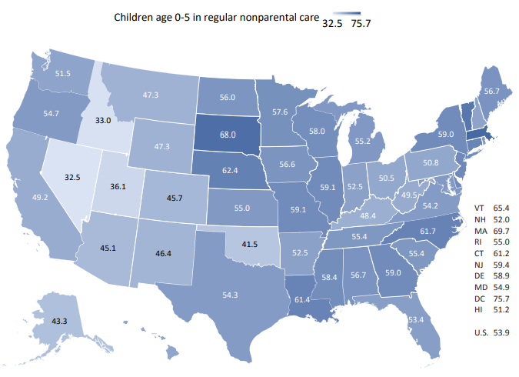
Childcare usage varies considerably across states, ranging from a low of 33% in Nevada to a high of 70% in Massachusetts among children age 5 and under.
Share of Children Ages 0-5 in Non-parental Care for More than 10 Hours per Week
As of April 2020, among working parents who reported needing care, nearly two-thirds (63%) of parents had difficulty finding childcare, including 33% who found it very difficult—nearly double what parents reported just six months earlier.
Source: U.S. Census Bureau, Current Population Survey – March Annual Social and Economic Supplement.
Nationwide Survey: Childcare in the Time of Coronavirus https://bipartisanpolicy.org/blog/nationwide-survey-child-care-inthe-time-of-coronavirus/
Notes:
While hiring of staff and ER nurses is lightly lower than same time last year, postings for CNAs and ICU nurses are up more than 50%
While physical therapists fell off the top 20 list in Q2 2020 versus 2019, Respiratory therapists made the top 20 for the first time.
Similarly speech language pathologists were not in high demand compared to this time last year, but internal medicine physicians were.

Slide 5
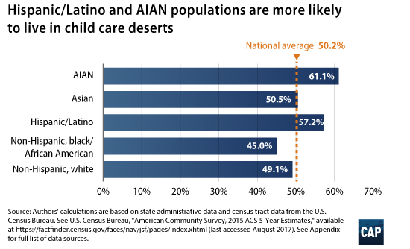
Even before the pandemic, Hispanic and AIAN families were more likely to live in childcare deserts with few childcare options.
Source: https://www.americanprogress.org/issues/early-childhood/reports/2017/08/30/437988/mapping-americas-child-care-deserts/
Notes:
While hiring of staff and ER nurses is lightly lower than same time last year, postings for CNAs and ICU nurses are up more than 50%
While physical therapists fell off the top 20 list in Q2 2020 versus 2019, Respiratory therapists made the top 20 for the first time.
Similarly speech language pathologists were not in high demand compared to this time last year, but internal medicine physicians were.

Slide 6
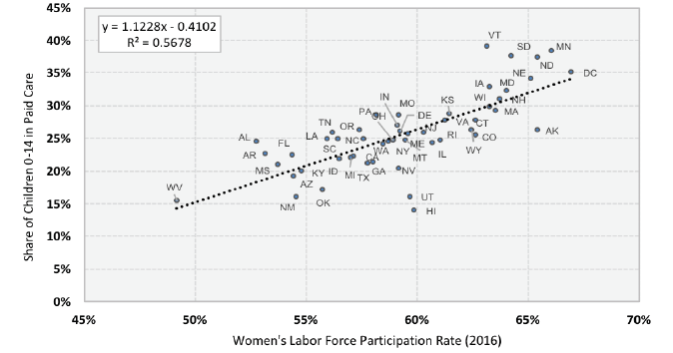
Childcare provides a service that is essential for working parents, thereby expanding the economy’s labor force, particularly among women with young children
Paid Child Care Usage and Women’s Labor Force Participation Rate (2016)
Source: U.S. Census Bureau and Bureau of Labor Statistics as reported in “Childcare in State Economies. 2019 Update.” By the Committee for Economic Development of The Conference Board. https://www.ced.org/assets/reports/childcareimpact/181104%20CCSE%20Report%20Jan30.pdf
Notes:
While hiring of staff and ER nurses is lightly lower than same time last year, postings for CNAs and ICU nurses are up more than 50%
While physical therapists fell off the top 20 list in Q2 2020 versus 2019, Respiratory therapists made the top 20 for the first time.
Similarly speech language pathologists were not in high demand compared to this time last year, but internal medicine physicians were.

Slide 7
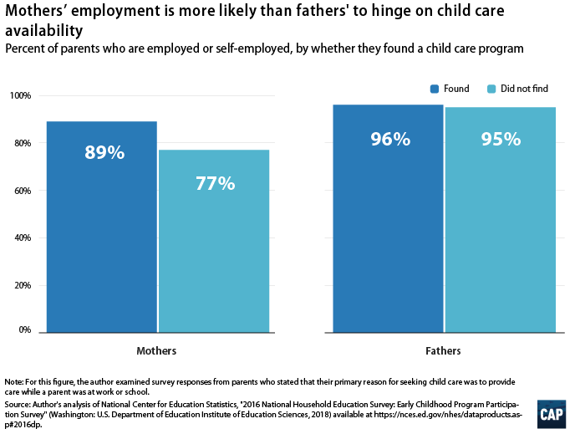
Even before the pandemic, the burden of childcare has typically fallen disproportionately on women when their family cannot find or afford childcare.
Source: https://www.americanprogress.org/issues/early-childhood/reports/2019/03/28/467488/child-care-crisis-keeping-women-workforce/
Notes:
While hiring of staff and ER nurses is lightly lower than same time last year, postings for CNAs and ICU nurses are up more than 50%
While physical therapists fell off the top 20 list in Q2 2020 versus 2019, Respiratory therapists made the top 20 for the first time.
Similarly speech language pathologists were not in high demand compared to this time last year, but internal medicine physicians were.

Slide 8

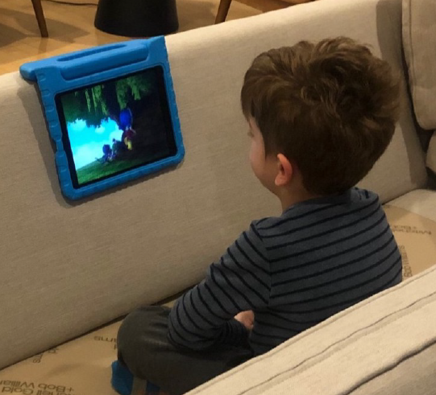
The disruption caused by the pandemic has raised new concerns about the long-term viability of the childcare industry and the subsequent consequences for childcare workers, parents, and children.
Childcare Industry: A national survey of providers in July found that 40% of such programs said they would have to close if they did not receive government support, potentially leading to the loss of as many as 450,000 childcare slots.
Childcare Workers: Between March and April, 351,500 child-care workers lost their jobs with just under one-third of those jobs having been recovered in May and June.
Parents: Among working parents who reported needing care, nearly two-thirds (63%) of parents had difficulty finding childcare, including 33% who found it very difficult—nearly double what parents reported just six months ago.
Children: A recent survey in Massachusetts, found that 84% of parents reported that they were “worried that my child is missing out on important developmental opportunities (socialization and learning)” while daycares have been closed.
Notes:
While hiring of staff and ER nurses is lightly lower than same time last year, postings for CNAs and ICU nurses are up more than 50%
While physical therapists fell off the top 20 list in Q2 2020 versus 2019, Respiratory therapists made the top 20 for the first time.
Similarly speech language pathologists were not in high demand compared to this time last year, but internal medicine physicians were.

Slide 9
We conducted a national panel survey of 2,500 working parents with PureSpectrum between Mother’s Day (May 10) and Father’s Day (June 21) of this year.
We study the disruption caused by the COVID-19 pandemic with regards to how sudden shocks to caregiving affect working parents and what policies and practices can ameliorate these impacts.
1. How did the division of household labor shift between working moms and dads during the pandemic?
2. To what extent did working moms versus dads experience a change in work status (e.g. hours or employment) during the pandemic? How often was the lack of childcare associated with changes in work status for women versus men?
3. How has the pandemic affected the health and well-being of moms and dads (e.g. sleep, stress, PTSD)?
4. To what degree have public policies (e.g., paid leave) and/or employer practices (e.g. remote work) helped alleviate the impacts on caregiving, work status, and well-being for working parents?
5. How has the burden of work and caregiving varied by race, income, and level of education during the pandemic? To what extent to black and brown or low-income parents have access to paid leave and remote work?
Notes:
While hiring of staff and ER nurses is lightly lower than same time last year, postings for CNAs and ICU nurses are up more than 50%
While physical therapists fell off the top 20 list in Q2 2020 versus 2019, Respiratory therapists made the top 20 for the first time.
Similarly speech language pathologists were not in high demand compared to this time last year, but internal medicine physicians were.

Slide 10
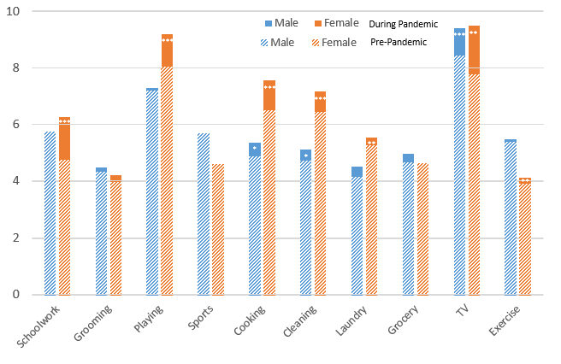
Women significantly increased time spent per week on schoolwork and playing with children as well as cooking and cleaning. Men saw marginal increases in time spent cooking and cleaning.
Hours per Week Spent on Household Tasks
How many hours per week did you typically spend on the following before the COVID-19 pandemic?
How many hours per week did you typically spend on the following during the COVID-19 pandemic?
Hours per week
Source: Author's calculations based on data collected from a national panel through Pure Spectrum between Mother's Day (May 10, 2020) and Father's Day (June 21, 2020).
Note: *indicates statistical significance at the 10% level, ** at the 5% level and *** for the 1% level for the change pre- versus during the pandemic.
Notes:
While hiring of staff and ER nurses is lightly lower than same time last year, postings for CNAs and ICU nurses are up more than 50%
While physical therapists fell off the top 20 list in Q2 2020 versus 2019, Respiratory therapists made the top 20 for the first time.
Similarly speech language pathologists were not in high demand compared to this time last year, but internal medicine physicians were.

Slide 11
The “She-cession” has meant that more women are furloughed or out of work during the pandemic.
Among those with no job loss, women and men were equally likely to have their hours reduced.
Incidence of Jobs and Hours Lost by Gender
**
**
***
***
**
***
Among survey respondents, 45.5% of women versus 34.1% of men were employed in in-person industries.
***
**
***
***
**
Source: Author's calculations based on data collected from a national panel through Pure Spectrum between Mother's Day (May 10, 2020) and Father's Day (June 21, 2020).
Note: *indicates statistical significance at the 10% level, ** at the 5% level and *** for the 1% level for women versus men.
Notes:
While hiring of staff and ER nurses is lightly lower than same time last year, postings for CNAs and ICU nurses are up more than 50%
While physical therapists fell off the top 20 list in Q2 2020 versus 2019, Respiratory therapists made the top 20 for the first time.
Similarly speech language pathologists were not in high demand compared to this time last year, but internal medicine physicians were.

Slide 12
Nearly 20% of working parents report being out of work or reducing hours solely due to childcare. Among those women who became unemployed, 26% said it was due to childcare versus 14% of men.
Incidence of Jobs Lost and Hours Reductions due to Childcare
*
**
*
***
**
**
**
Source: Author's calculations based on data collected from a national panel through Pure Spectrum between Mother's Day (May 10, 2020) and Father's Day (June 21, 2020).
Note: *indicates statistical significance at the 10% level, ** at the 5% level and *** for the 1% level for women versus men.
Notes:
While hiring of staff and ER nurses is lightly lower than same time last year, postings for CNAs and ICU nurses are up more than 50%
While physical therapists fell off the top 20 list in Q2 2020 versus 2019, Respiratory therapists made the top 20 for the first time.
Similarly speech language pathologists were not in high demand compared to this time last year, but internal medicine physicians were.

Slide 13
Working parents lost 11 hours per week on average due to a lack of childcare. This was similar in magnitude to the loss of hours due to staff reductions, loss of business, or lack of remote work available.
Any Reason
Childcare
Staff
Reduced
No Remote
Work
Lost
Business
Among survey respondents, only 50.5% of women versus 72.1% of men were working from home during the pandemic.
***
**
Source: Author's calculations based on data collected from a national panel through Pure Spectrum between Mother's Day (May 10, 2020) and Father's Day (June 21, 2020).
Notes:
While hiring of staff and ER nurses is lightly lower than same time last year, postings for CNAs and ICU nurses are up more than 50%
While physical therapists fell off the top 20 list in Q2 2020 versus 2019, Respiratory therapists made the top 20 for the first time.
Similarly speech language pathologists were not in high demand compared to this time last year, but internal medicine physicians were.

Slide 14
What factors affect how the caregiving responsibilities for your children are divided up between you and your partner/spouse/co-parent during the COVID-19 pandemic? (Check all that apply)
**
***
**
Source: Author's calculations based on data collected by Northeastern University between Mother's Day (May 10, 2020) and Father's Day (June 21, 2020).
Notes:
While hiring of staff and ER nurses is lightly lower than same time last year, postings for CNAs and ICU nurses are up more than 50%
While physical therapists fell off the top 20 list in Q2 2020 versus 2019, Respiratory therapists made the top 20 for the first time.
Similarly speech language pathologists were not in high demand compared to this time last year, but internal medicine physicians were.

Slide 15
Both moms and dads are experiencing high levels of distress, although women sleep less and worry more about their jobs, possibly due to a greater sense of uncertainty about when life will return to “normal.”
**
***
**
***
**
***
**
***
***
Source: Author's calculations based on data collected by Northeastern University between Mother's Day (May 10, 2020) and Father's Day (June 21, 2020).
Note: *indicates statistical significance at the 10% level, ** at the 5% level and *** for the 1% level for women versus men.
Notes:
While hiring of staff and ER nurses is lightly lower than same time last year, postings for CNAs and ICU nurses are up more than 50%
While physical therapists fell off the top 20 list in Q2 2020 versus 2019, Respiratory therapists made the top 20 for the first time.
Similarly speech language pathologists were not in high demand compared to this time last year, but internal medicine physicians were.

Slide 16
Only 30% of all working parents had any form of back-up childcare during May/June with significant disparities between low- and high-income households.
Frequency of Back-Up Childcare by Household Income
***
Do you currently use any backup childcare during the COVID-19 pandemic?
If you answered yes to backup childcare, who is providing care during the COVID-19 pandemic?
**
***
***
***
***
*
**
**
Source: Author's calculations based on data collected from a national panel through Pure Spectrum between Mother's Day (May 10, 2020) and Father's Day (June 21, 2020).
Note: High Income is statistically significantly different from Low Income at the 1% level (***), 5% level (**), or 10% level (*).
Notes:
68% are heterosexual couples, 13% are same-sex couples,
75% live with no other adults,

Slide 17
Although 24% of working parents reported paid family leave was available, only 4% had used it during the pandemic. The most common COVID19 practice was to offer WFH followed by childcare subsidies.
Standard Workplace Policies
COVID19 Workplace Practices
Source: Author's calculations based on data collected from a national panel through Pure Spectrum between Mother's Day (May 10, 2020) and Father's Day (June 21, 2020).
Notes:
Only 8 states plus D.C. had enacted some form of paid family leave program prior to the start of the pandemic, and only 5 states had their programs up and running.

Slide 18
Women were less likely to cite childcare as a reason for becoming unemployed if they had access to paid family leave through their employer, the ability to work from home, or support from coworkers.
Reason for Job Change is Childcare | Policy or Practice that Ameliorated
 | Job Loss |  |  | Hours Reduction
Personal Circumstances | Impact |  |  | Impact
Has Access to Back Up Childcare | -3.0% |  |  | -9.1% | *
Paid Leave
Lives in a State with Paid Family Leave | -7.4% |  |  | -7.2%
Family Leave Available through Employer | -39.4% | ** |  | 7.6%
Work Supports
Work Autonomy | -4.2% |  |  | -5.1%
Managerial Support | -4.2% |  |  | -47.9% | **
Coworker Support | -23.5% | ** |  | -1.1%
Employer COVID19 Practices
Child Care Subsidy | -1.8% |  |  | -11.6% | *
Allowed to Work From Home (WFH) | -31.1% | ** |  | -0.9%
No Penalty for Time Off | 2.5% |  |  | -3.4%
Unlimited Unpaid Time Off | -18.1% |  |  | -6.3%
Paid for Time Spent in Quarantine | -6.7% |  |  | 0.01%
Paid Time Off for Symptomatic Employees or Dependents | -21.8% |  |  | -0.01%
**
***
**
Source: Author's calculations based on data collected from a national panel through Pure Spectrum between Mother's Day (May 10, 2020) and Father's Day (June 21, 2020).
Note: Standard Errors in Parentheses. *indicates statistical significance at the 10% level, ** at the 5% level and *** for the 1% level for women versus men.
Notes:
While hiring of staff and ER nurses is lightly lower than same time last year, postings for CNAs and ICU nurses are up more than 50%
While physical therapists fell off the top 20 list in Q2 2020 versus 2019, Respiratory therapists made the top 20 for the first time.
Similarly speech language pathologists were not in high demand compared to this time last year, but internal medicine physicians were.

Slide 19
Working parents who identify as Black or Hispanic are less likely to work in jobs with paid sick time and medical leave or have COVID19 policies such as back-up childcare subsidies and working from home.
**
***
***
**
***
***
**
***
**
***
**
**
**
***
**
Source: Author's calculations based on data collected by Northeastern University between Mother's Day (May 10, 2020) and Father's Day (June 21, 2020).
Note: *indicates statistical significance at the 10% level, ** at the 5% level and *** for the 1% level for women versus men.
Notes:
While hiring of staff and ER nurses is lightly lower than same time last year, postings for CNAs and ICU nurses are up more than 50%
While physical therapists fell off the top 20 list in Q2 2020 versus 2019, Respiratory therapists made the top 20 for the first time.
Similarly speech language pathologists were not in high demand compared to this time last year, but internal medicine physicians were.

Slide 20
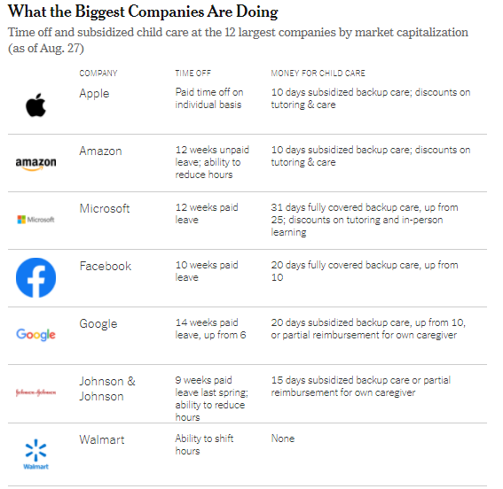

Absent large-scale support from the federal government, some employers are finding additional ways to support working parents that go beyond beyond increasing subsidies.
Source: https://www.nytimes.com/2020/09/17/upshot/pandemic-workers-benefits-disparity.html
Notes:
While hiring of staff and ER nurses is lightly lower than same time last year, postings for CNAs and ICU nurses are up more than 50%
While physical therapists fell off the top 20 list in Q2 2020 versus 2019, Respiratory therapists made the top 20 for the first time.
Similarly speech language pathologists were not in high demand compared to this time last year, but internal medicine physicians were.

Slide 21
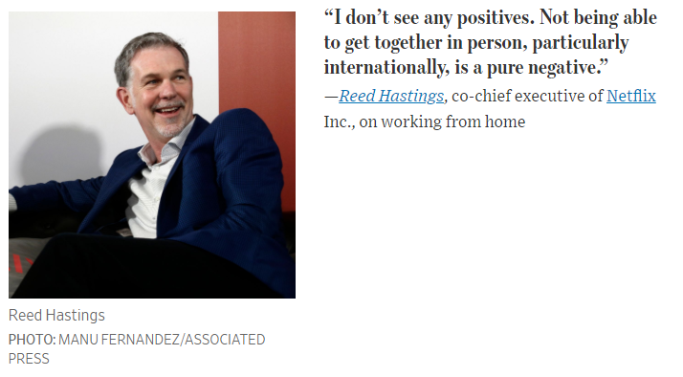
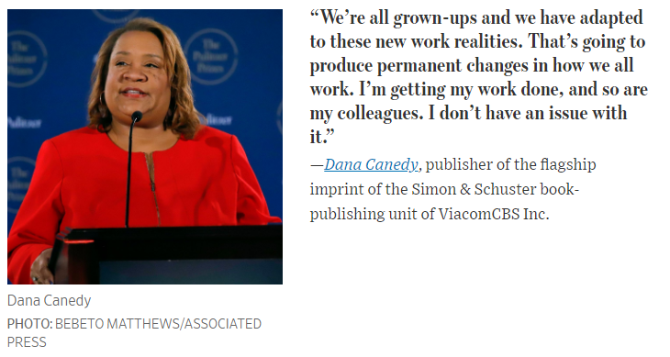
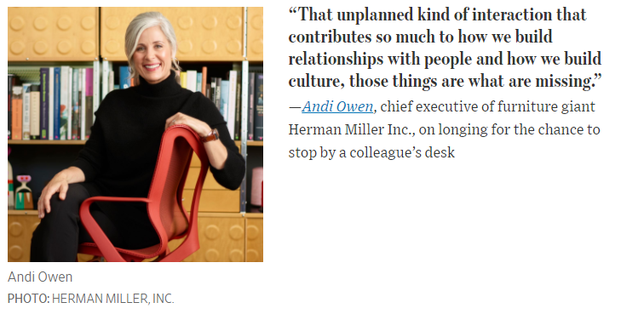
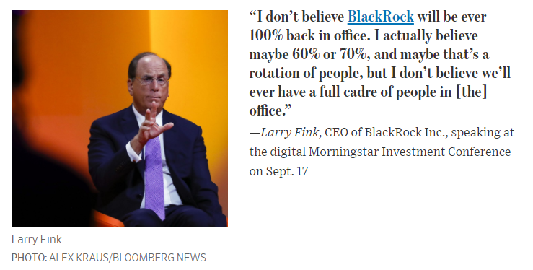
Back to Normal or Back to Better?
Source: https://www.wsj.com/articles/what-ceos-really-think-about-remote-work-11600853405
Notes:
While hiring of staff and ER nurses is lightly lower than same time last year, postings for CNAs and ICU nurses are up more than 50%
While physical therapists fell off the top 20 list in Q2 2020 versus 2019, Respiratory therapists made the top 20 for the first time.
Similarly speech language pathologists were not in high demand compared to this time last year, but internal medicine physicians were.

Slide 22



To date, public policy efforts have essentially put a Band-Aid on a gunshot wound.
Congress expanded unemployment insurance benefits and a temporary paid leave program to cover parents, but people have had difficulty accessing those benefits.
Barriers to the application process for the Paycheck Protection Program (PPP) and the program itself have hampered its effectiveness in addressing the needs of the childcare industry.
Although the CARES Act back in March provided an additional $3.5 billion for the Childcare Development Block Grant (CCDBG) for emergency support, the funding was not enough to keep childcare programs afloat.
Notes:
Congress expanded unemployment insurance benefits and a temporary paid leave program to cover parents, but people have had difficulty accessing those benefits.
Paid leave expired at the end of the year and only applied to employers with more than 50 but less than 500 people.
Only one New England state, Rhode Island, already had a paid leave program in place prior to the pandemic.
Barriers to the application process for the Paycheck Protection Program (PPP) and the program itself have hampered its effectiveness in addressing the needs of the childcare industry.
Only 53% of childcare centers and 25% of family childcare providers applied for a PPP loan and of those, only half of were approved for a loan—roughly equivalent to one-quarter of the childcare market.
Even among those daycare providers who were fortunate to receive a PPP loan, they will be lucky to break-even as they re-open under the new public health guidelines.
Although the CARES Act back in March provided an additional $3.5 billion for the Childcare Development Block Grant (CCDBG) for emergency support, the funding was not enough to keep childcare programs afloat.
In Massachusetts CCDBG funds covered only $2,200 per month to eligible childcare centers in July and August.
In the absence of substantial new funding, it is projected that we will lose 450,000 childcare slots nationwide.

Slide 23

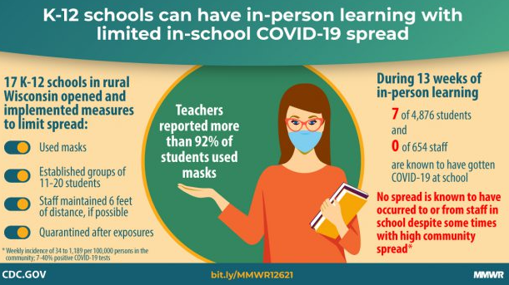

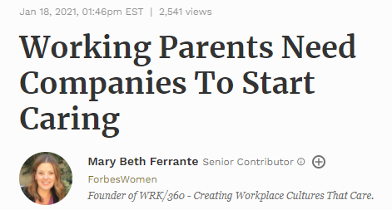
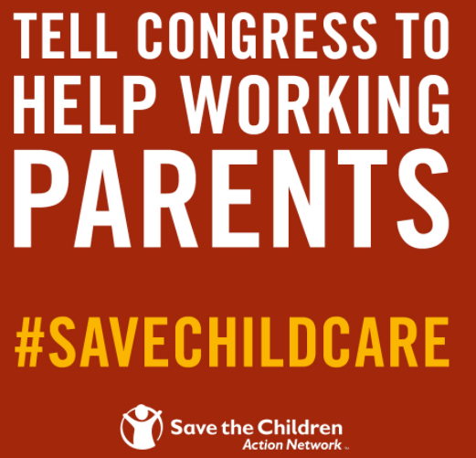
It is imperative that policymakers act quickly to put the childcare industry on life support until the pandemic can be brought under control.
Notes:
The childcare industry is an essential component of the U.S. economic recovery and should receive a large-scale and immediate bail out with some portion of PPP loans targeted towards family daycare providers.
One analysis from the Center for Law and Social Policy (CLASP) estimates that it will cost about $9.6 billion a month, for a total of more than $50 billion. Such an investment would pay for itself in the near-term.
Family daycare providers are sole proprietors, some of whom may be unbanked, and additional oversight is needed to ensure that banks are not overly restrictive in their lending requirements.
Among daycares that have re-opened, we should be learning about transmission of COVID19 among children and which public health measures are the most effective at limiting the spread of the virus in schools.
Policymakers should consider loosening restrictions that are less effective but costly to providers and developmentally inappropriate for children. COVID-19 public health restrictions are intended to mitigate, rather than eliminate, risk.
Schools should be equipped with adequate ventilation, physical space, and PPE to safely re-open in person.
Employers need to be part of the solution and provide working parents with the flexibility, job stability, and supports needed to weather the pandemic.
Expanding childcare subsidies, maintaining or even expanding on-site daycares, and providing access to paid leave—even temporarily—can help employees who need it most and retain top talent for the long-term.
Congress needs to extend the supports put in place by the CARES Act and the FFCRA and ensure that they can be accessed by working parents.
Biden: paid leave extended through Sept, includes small and large employers, fully reimbursed up to $75K

Slide 24


Core Master’s Programs
Public Administration
Public Policy
Urban Planning & Policy
Urban Informatics
Joint Master’s Programs
Environmental Science & Policy
Engineering & Policy
International Affairs
Doctoral Programs
PhD in Public Policy
Sustainability & Resilience
Urban & Regional Policy
Health Care Policy & Management
JD/MS in Law & Public Policy
Graduate Certificates
Nonprofit Sector, Philanthropy & Social Change
Urban Analytics
Data Analytics
Public Policy Analysis
Urban Studies
Undergraduate Majors/Minors
Human Services
Law & Public Policy
Urban Studies
Food Systems Sustainability
Preparing leaders to address complex problems, serve communities, and build a just, sustainable, and resilient world.
Alicia Sasser Modestino
a.modestino@northeastern.edu
Twitter: @SasserModestino

