Slide 1
77 Myrtle Street Paint & Window Repai

Slide 2
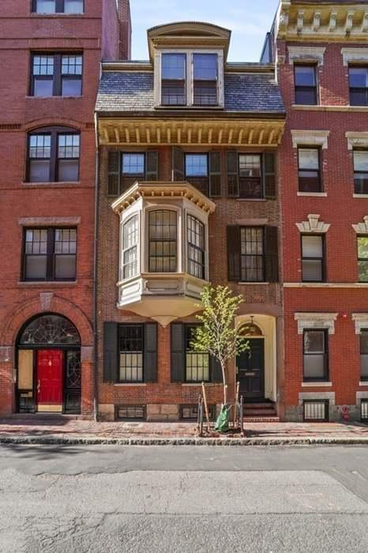
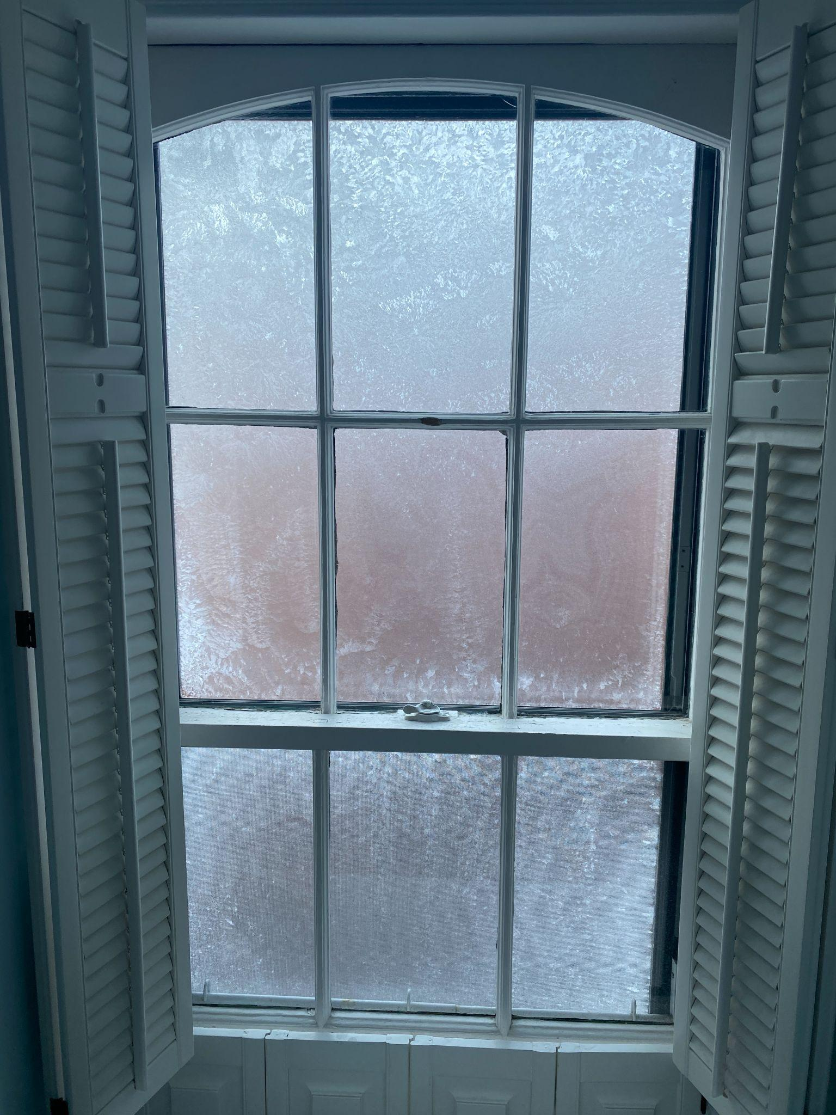
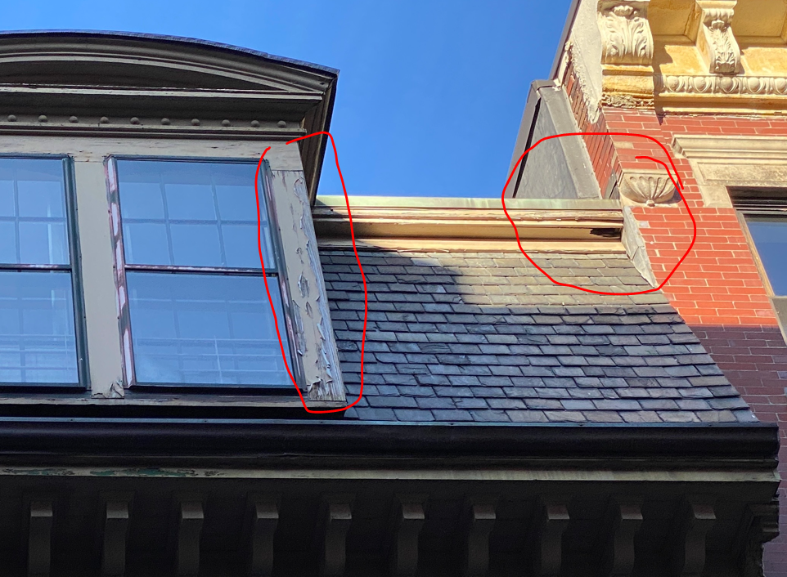
Current Conditions
Windows need repair & storm replacement
Facade needs wood repair & repainting

Slide 3
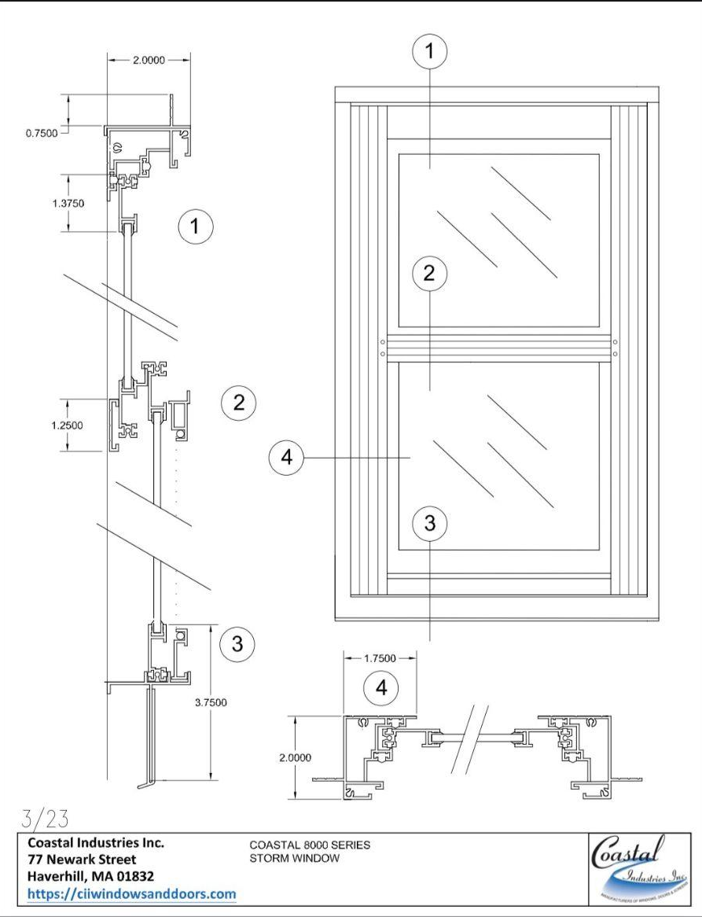
Proposed Work
WINDOW & TRIM REPAIR w/ NEW STORMS
Repair existing windows throughout
Replace existing poor storm windows with Coastal Industries (see shop drawing to left)
Considered comparable to what Harvey Windows used to make available
Color will be black per consultation with Cambridge Historical
REPAINT WOODEN FACADE
Paint wooden elements of facade
Bay Window, dormer & dental - Benjamin Moore (BM) HC-33 ‘Montgomery White’
Window exteriors and storms - Benjamin Moore (BM) HC-190 ‘Black’
Front Door - Sherwin Williams (SW) 6510 Loyal Blue

