Slide 1
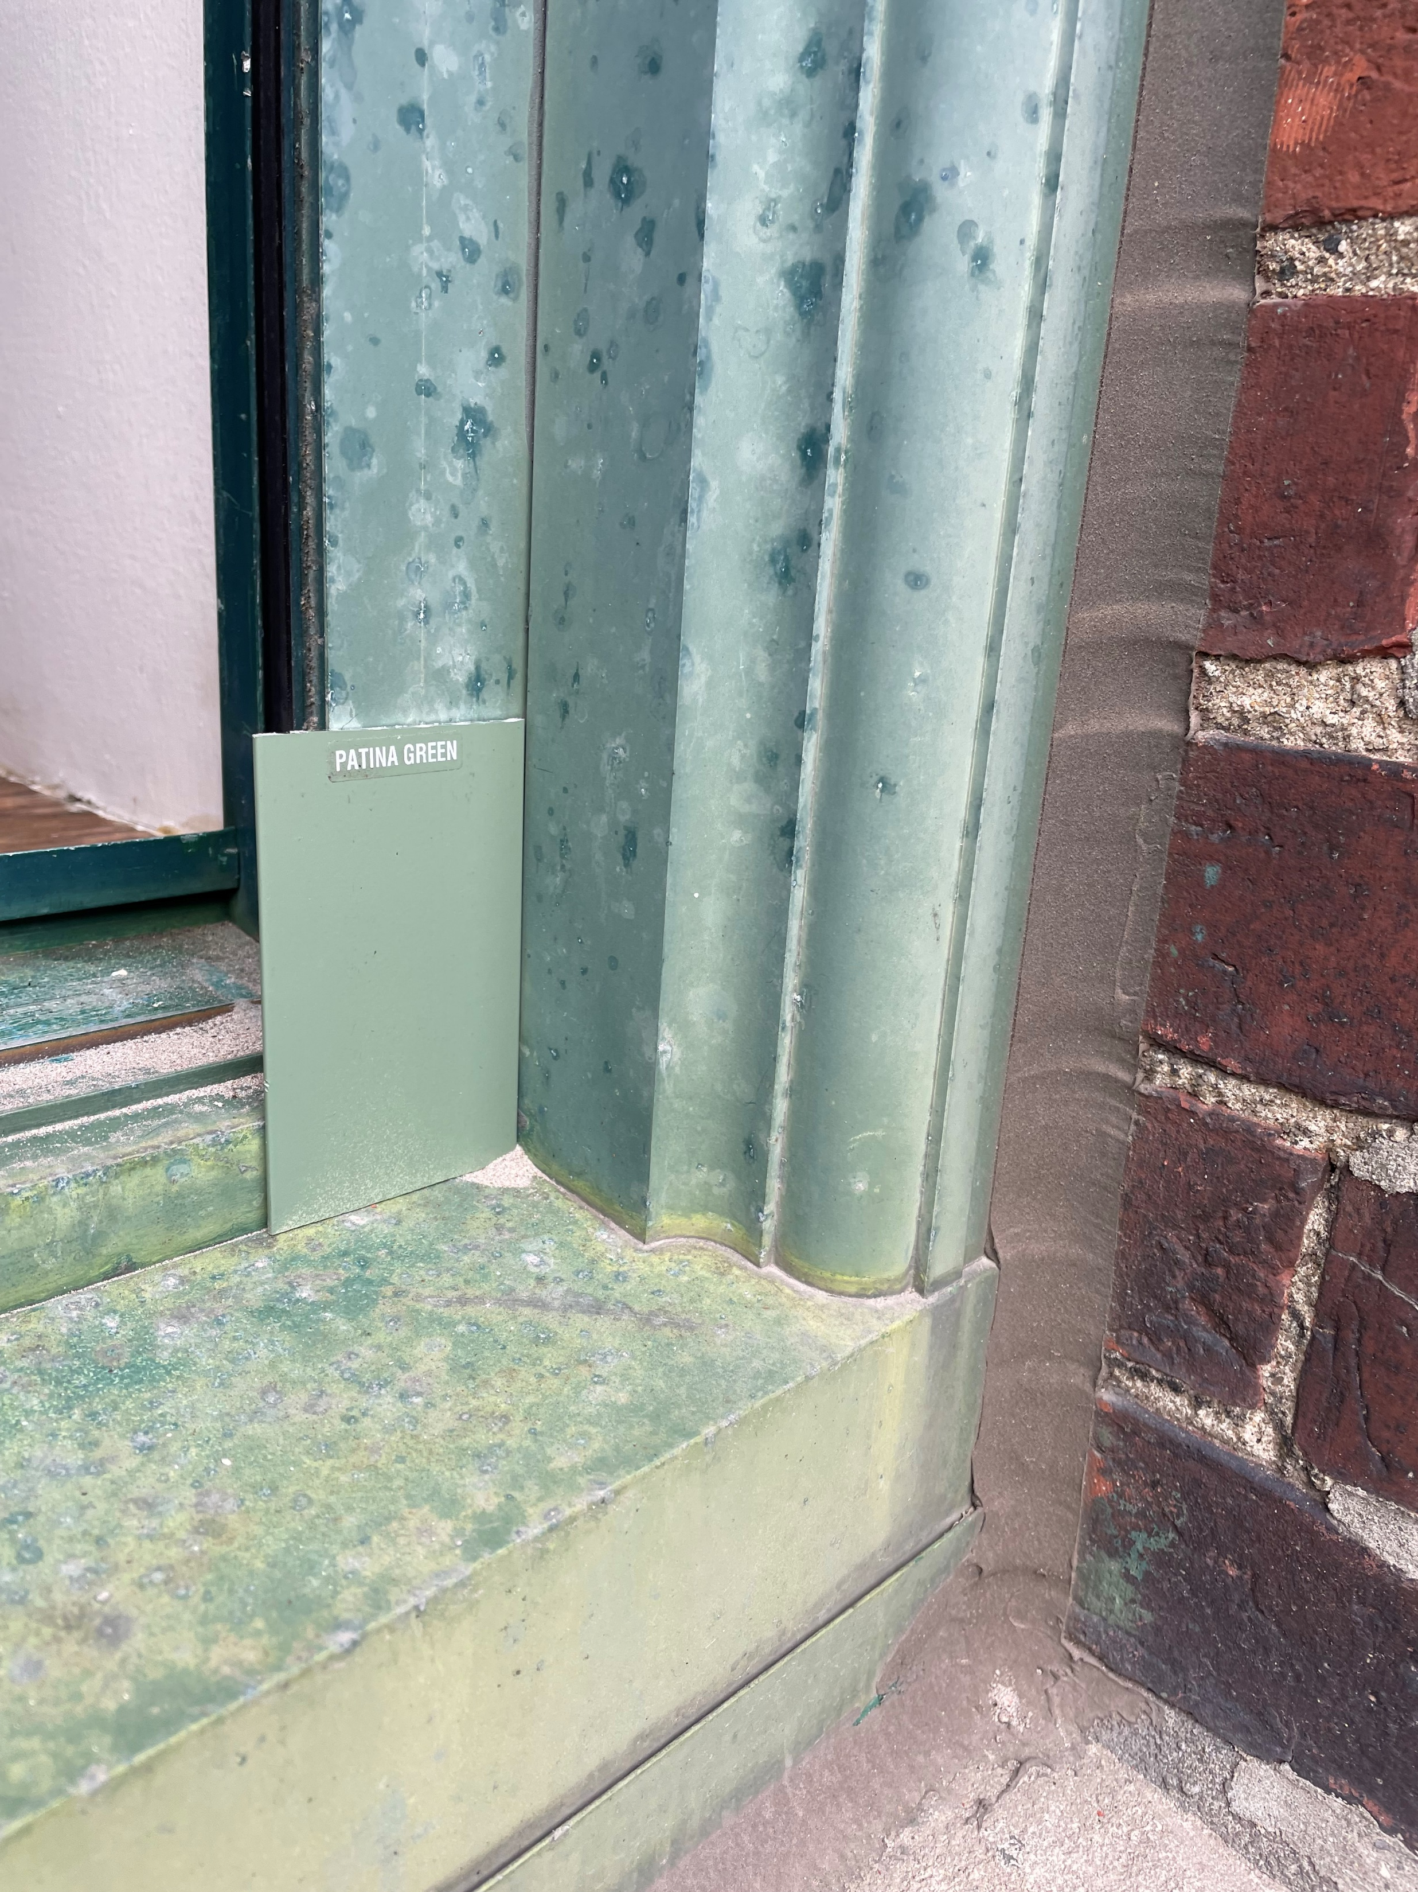
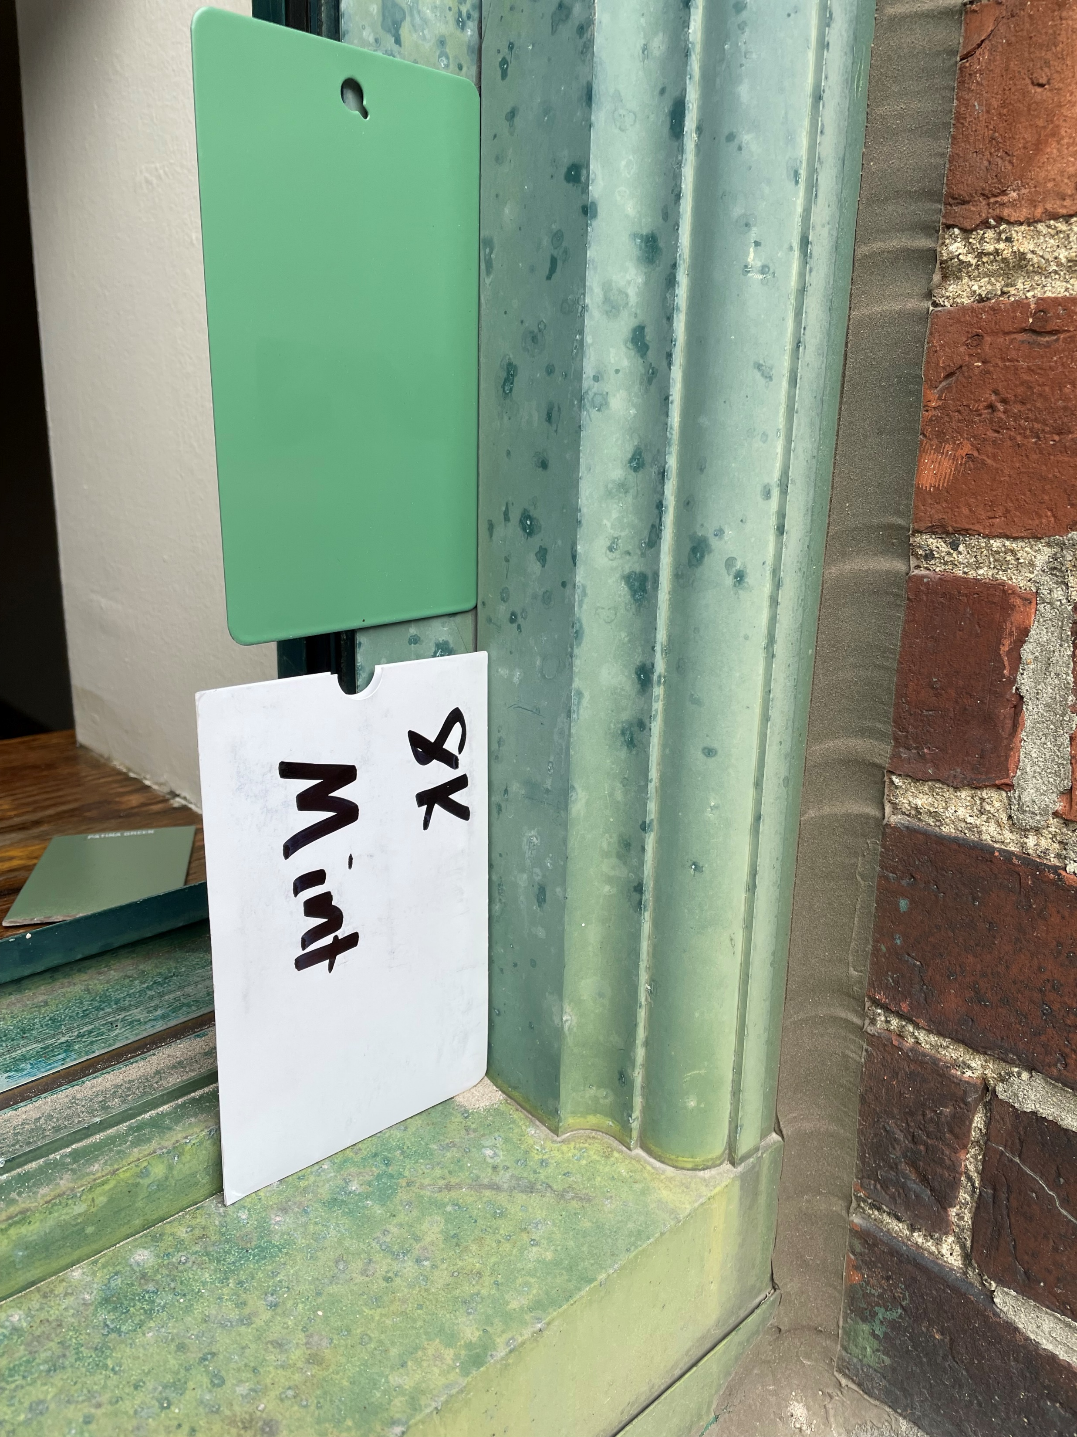
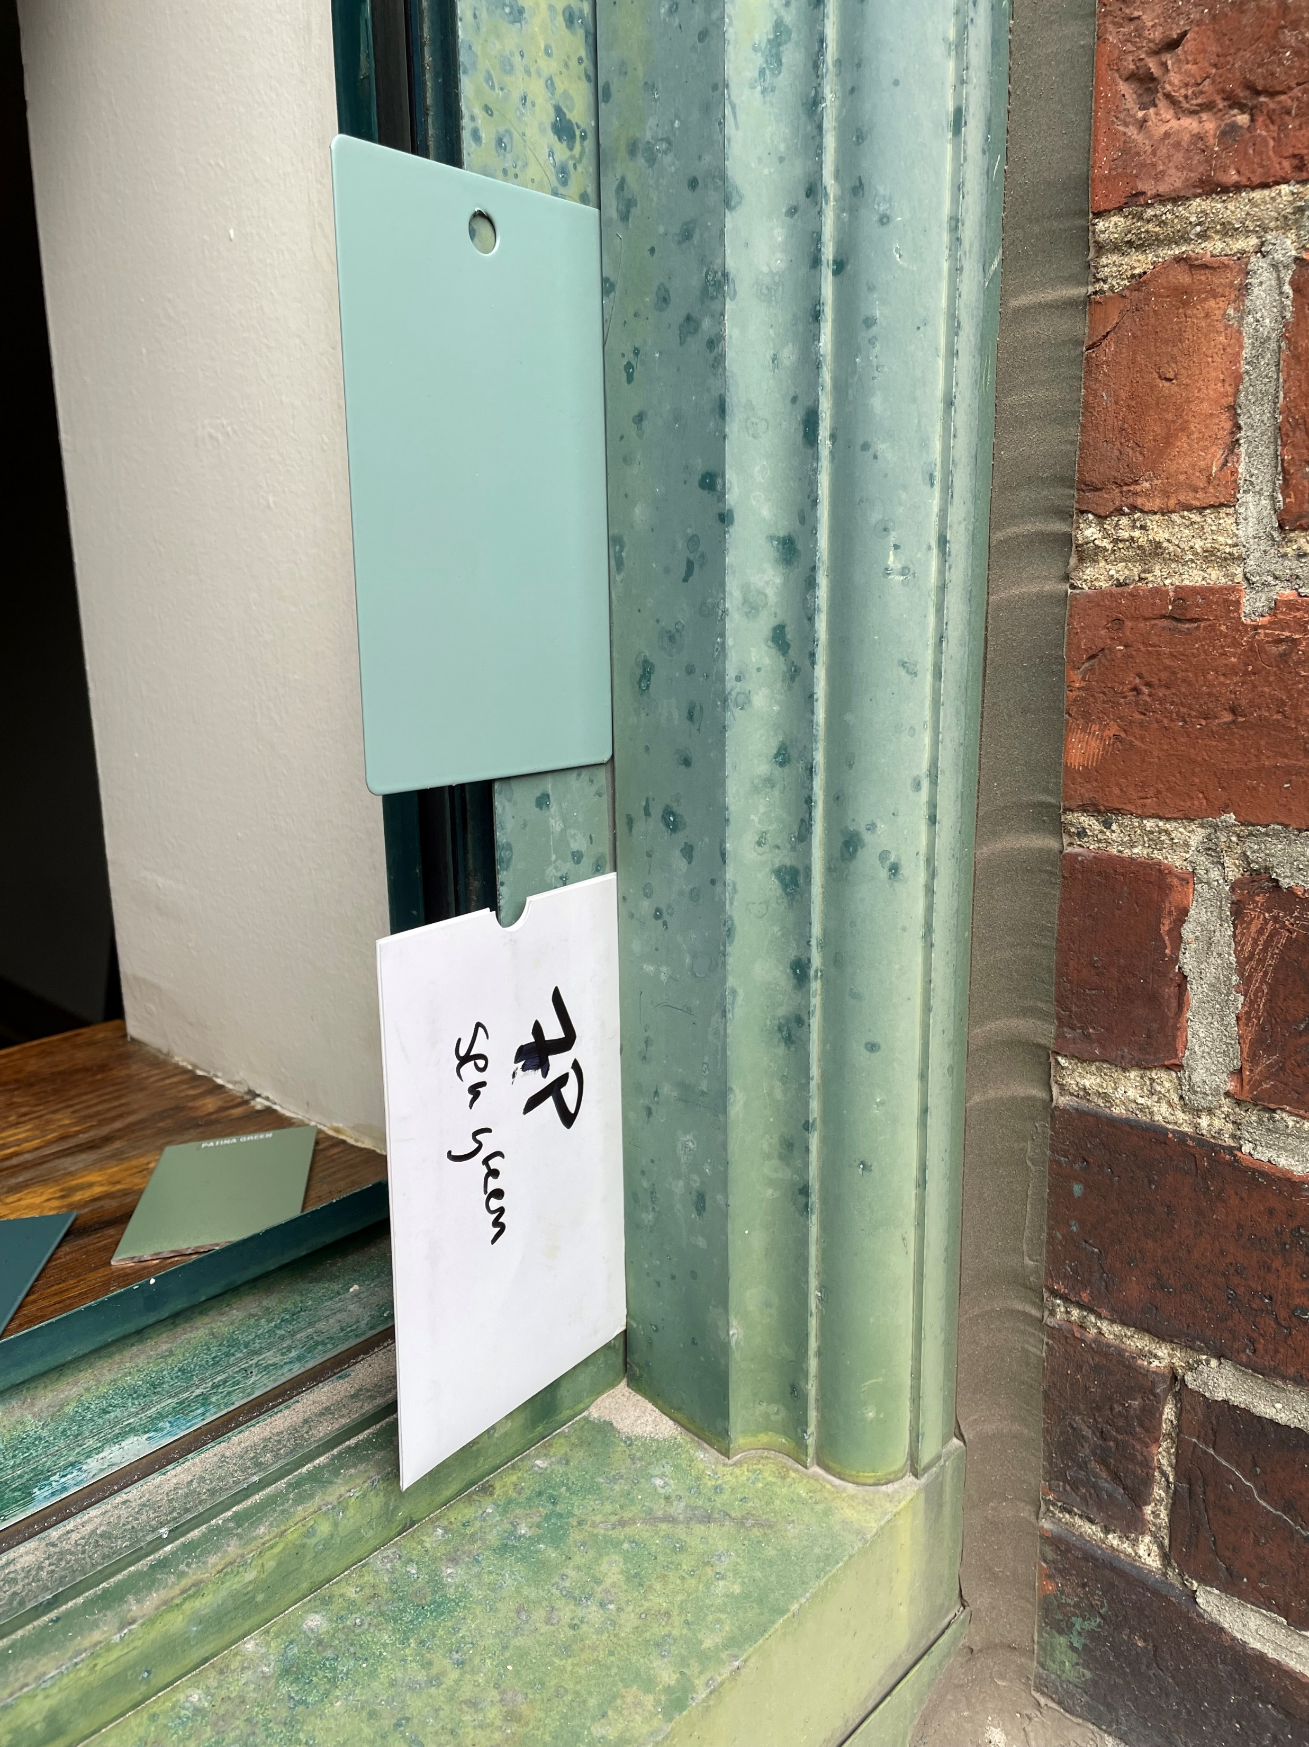
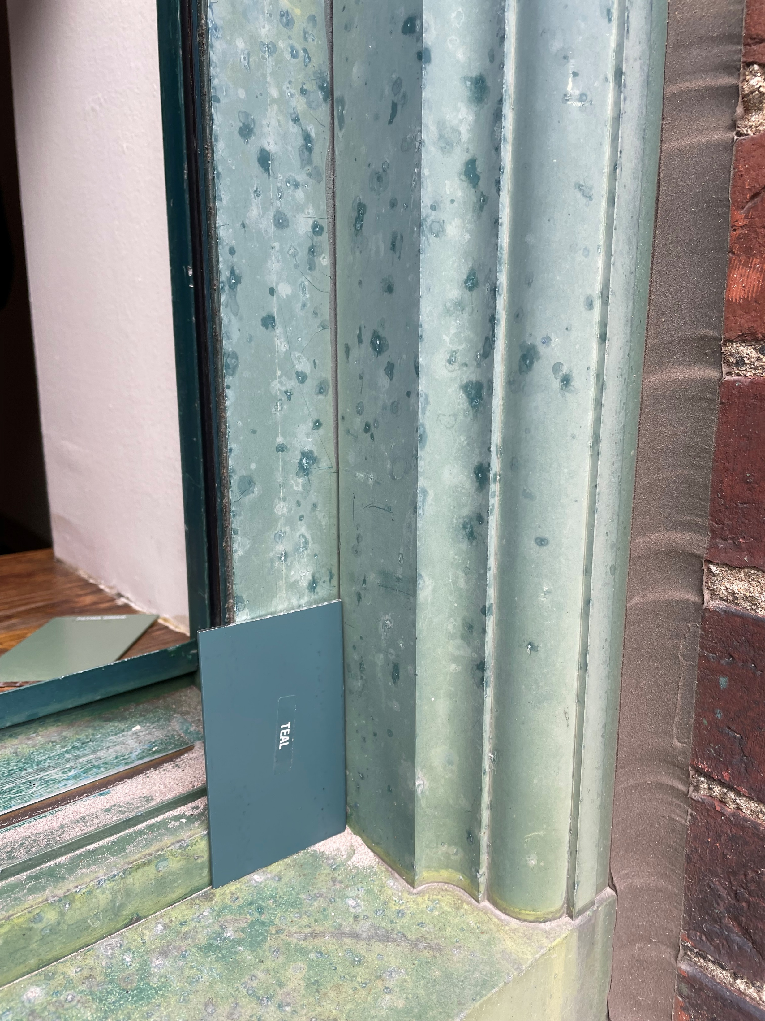
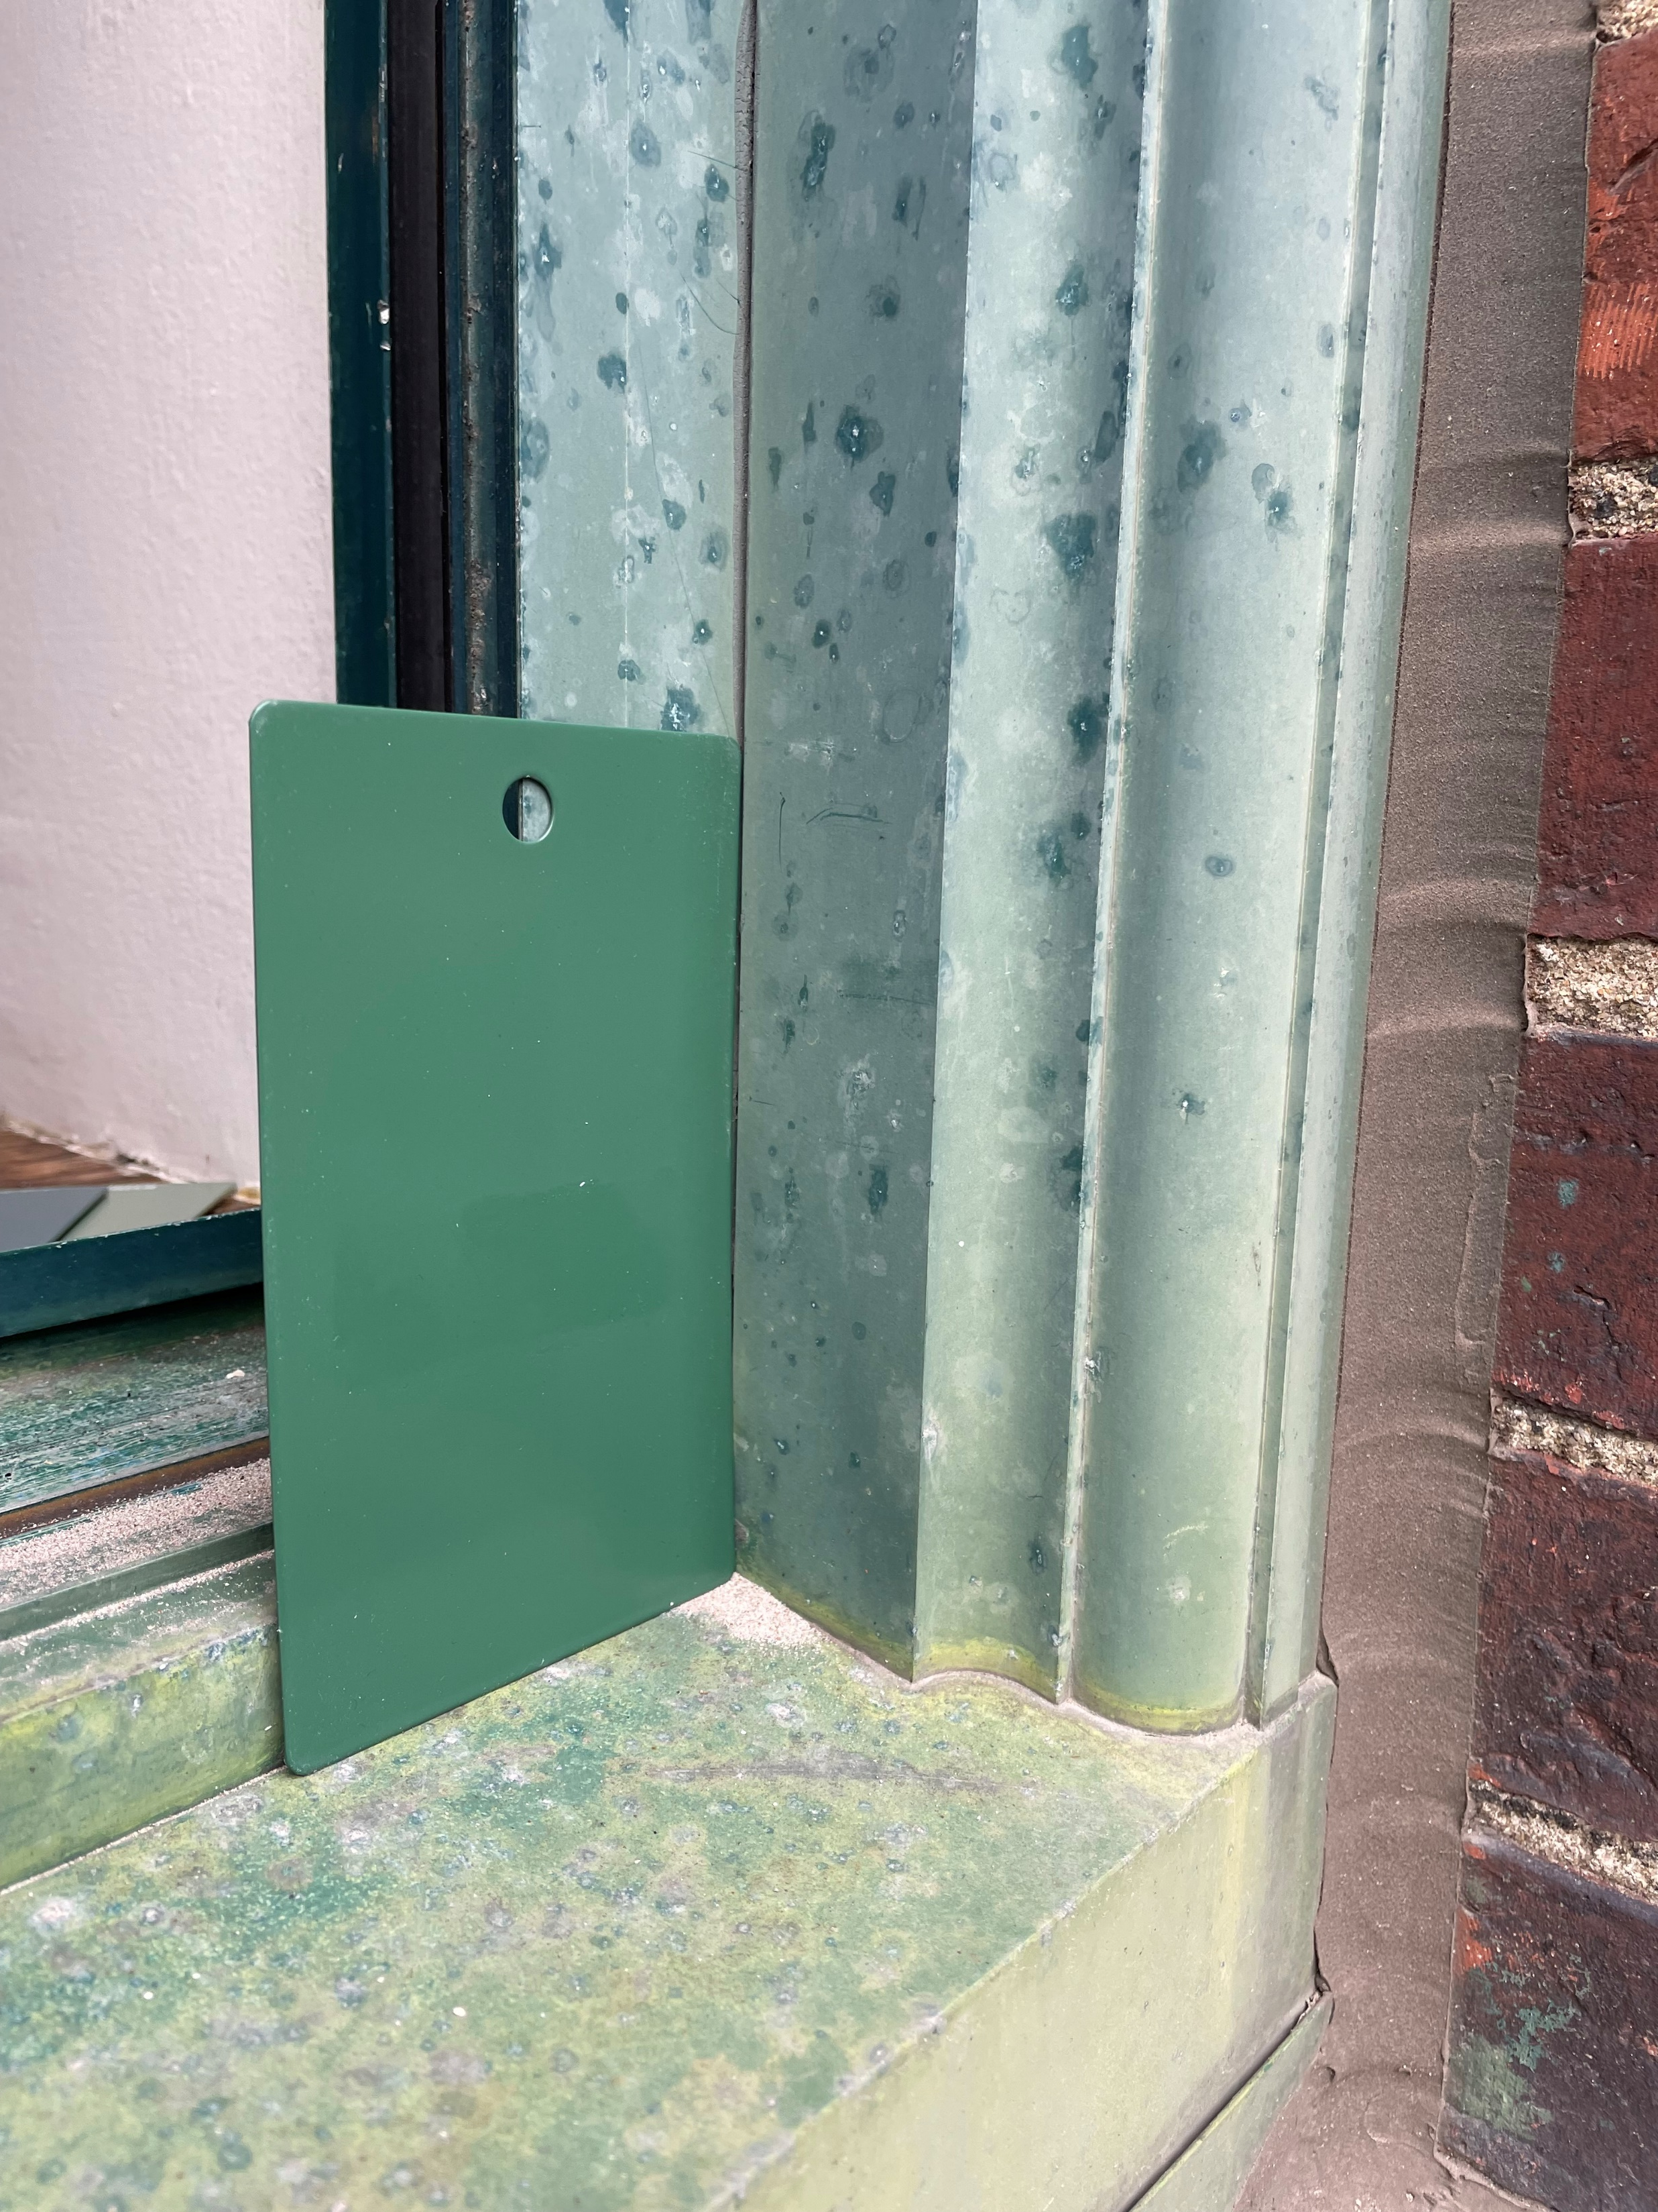
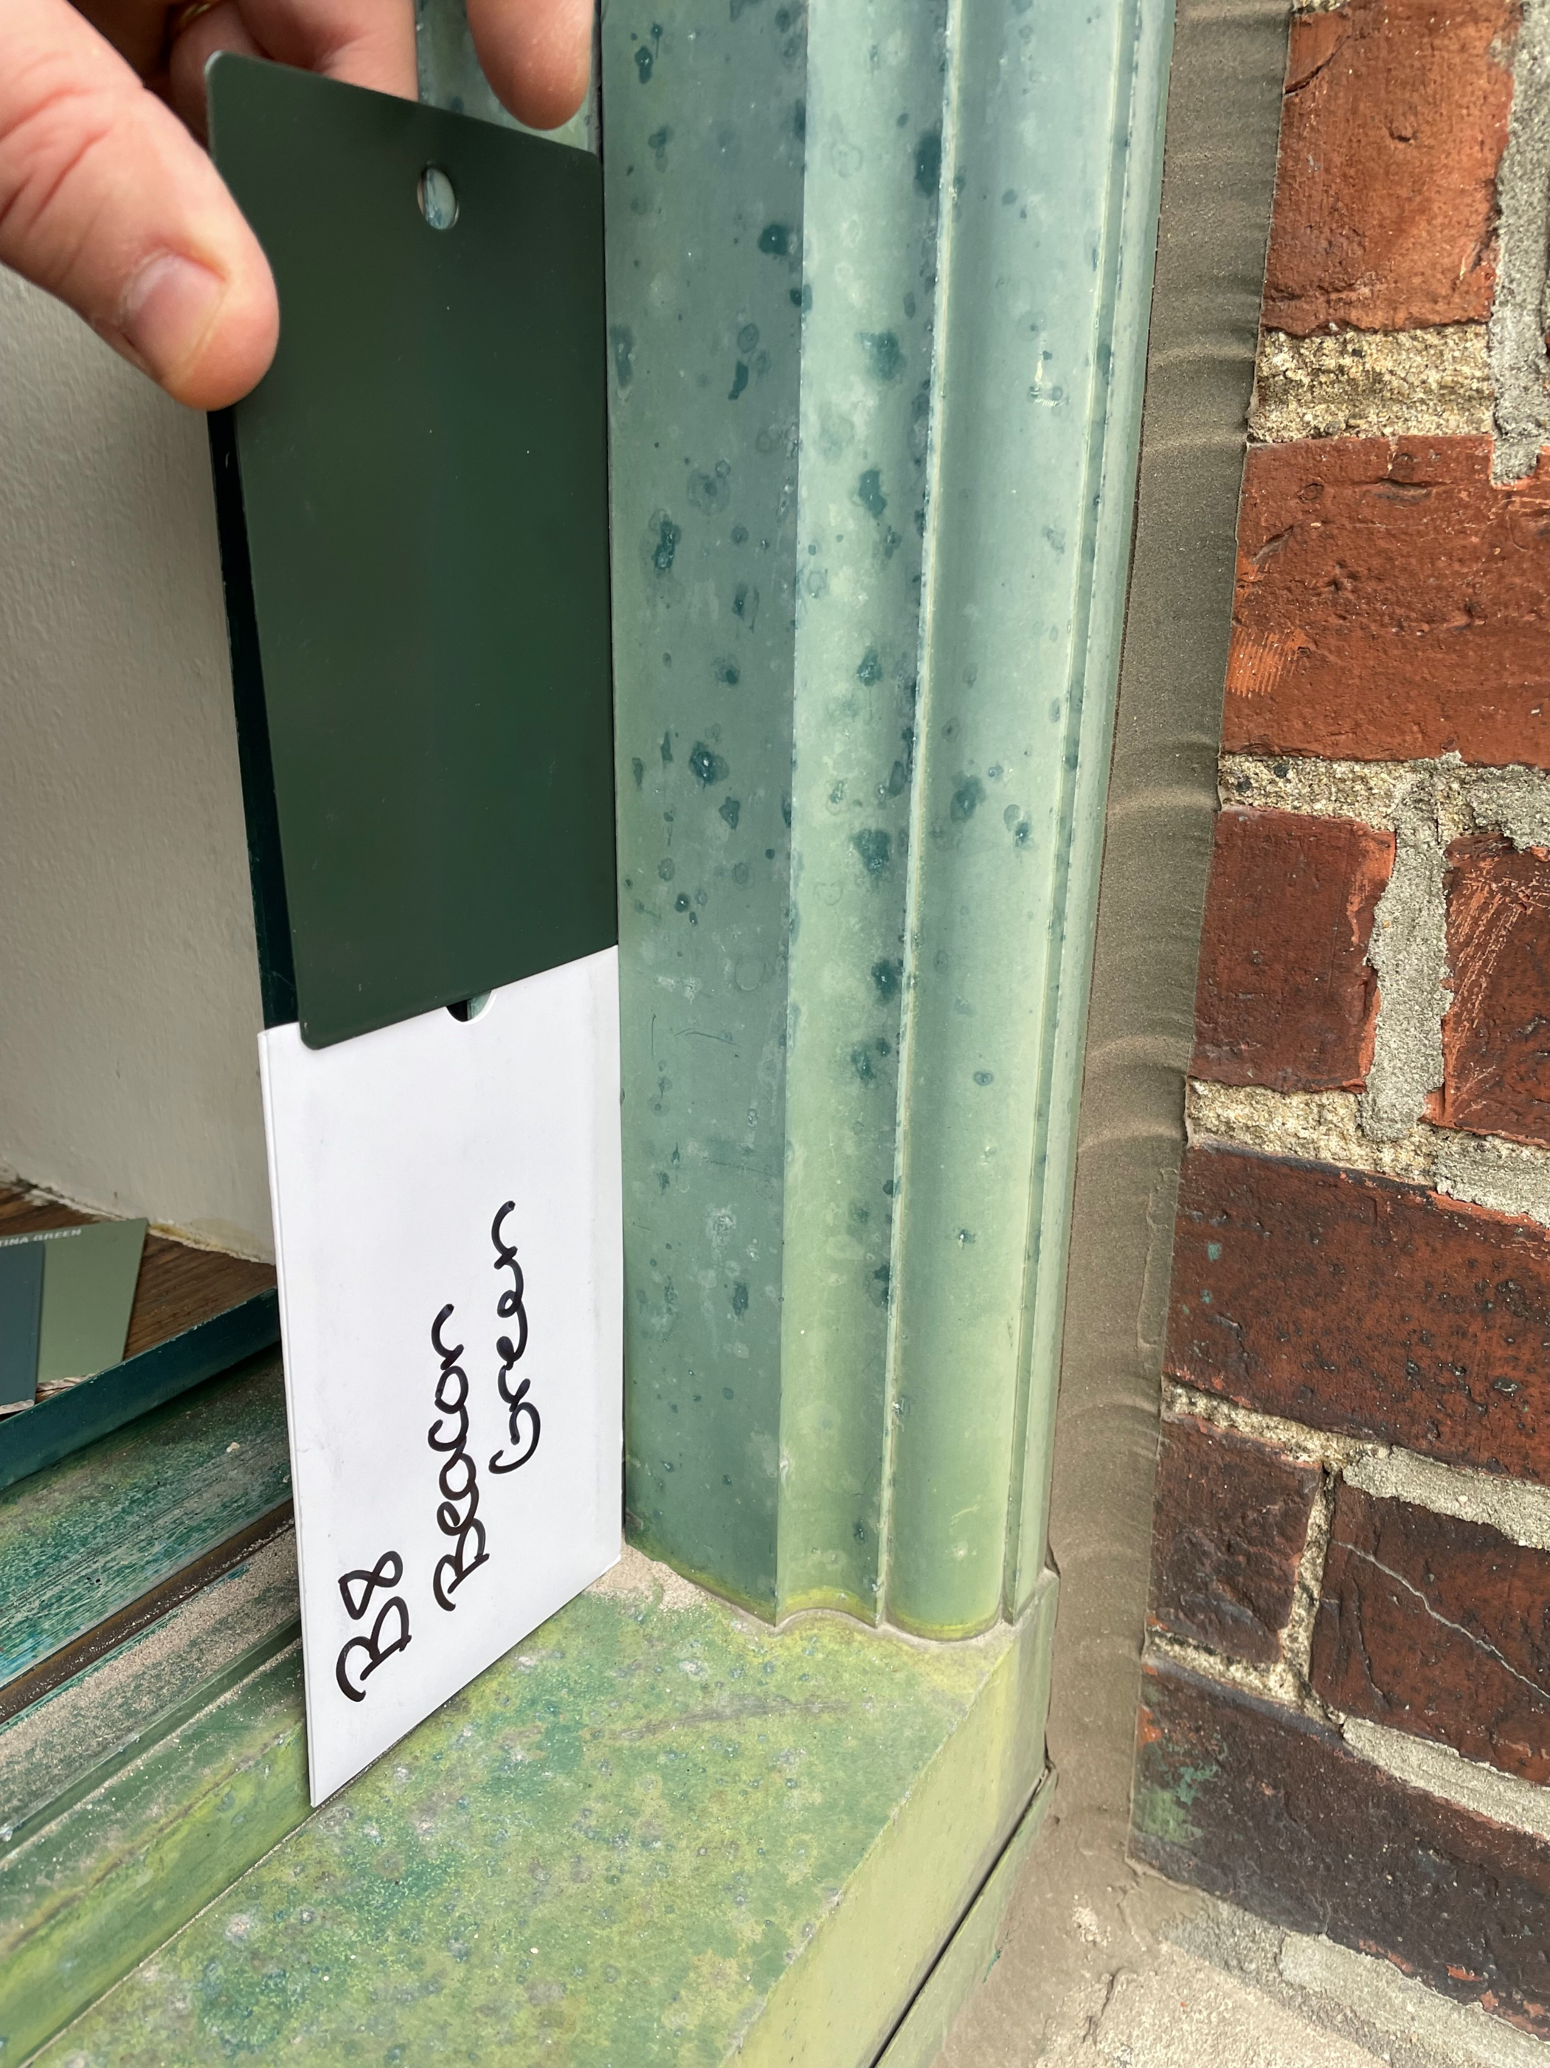
Beacon House Window Replacement - Rear Drive Elevation
Patina Green
Mint
Sea Green
Teal
Fire Green
Available Color Selections:
Beacon House, 19 Myrtle Street
Beacon Green

Slide 2
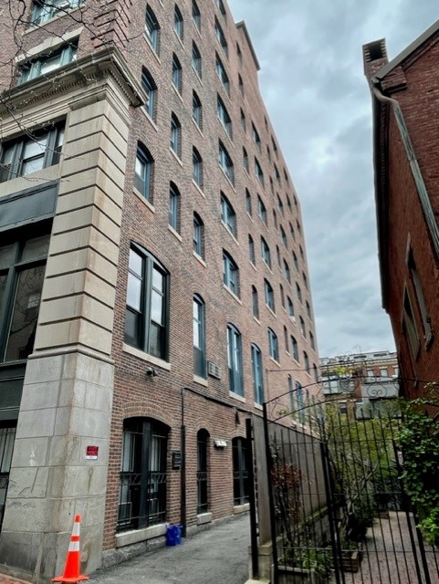
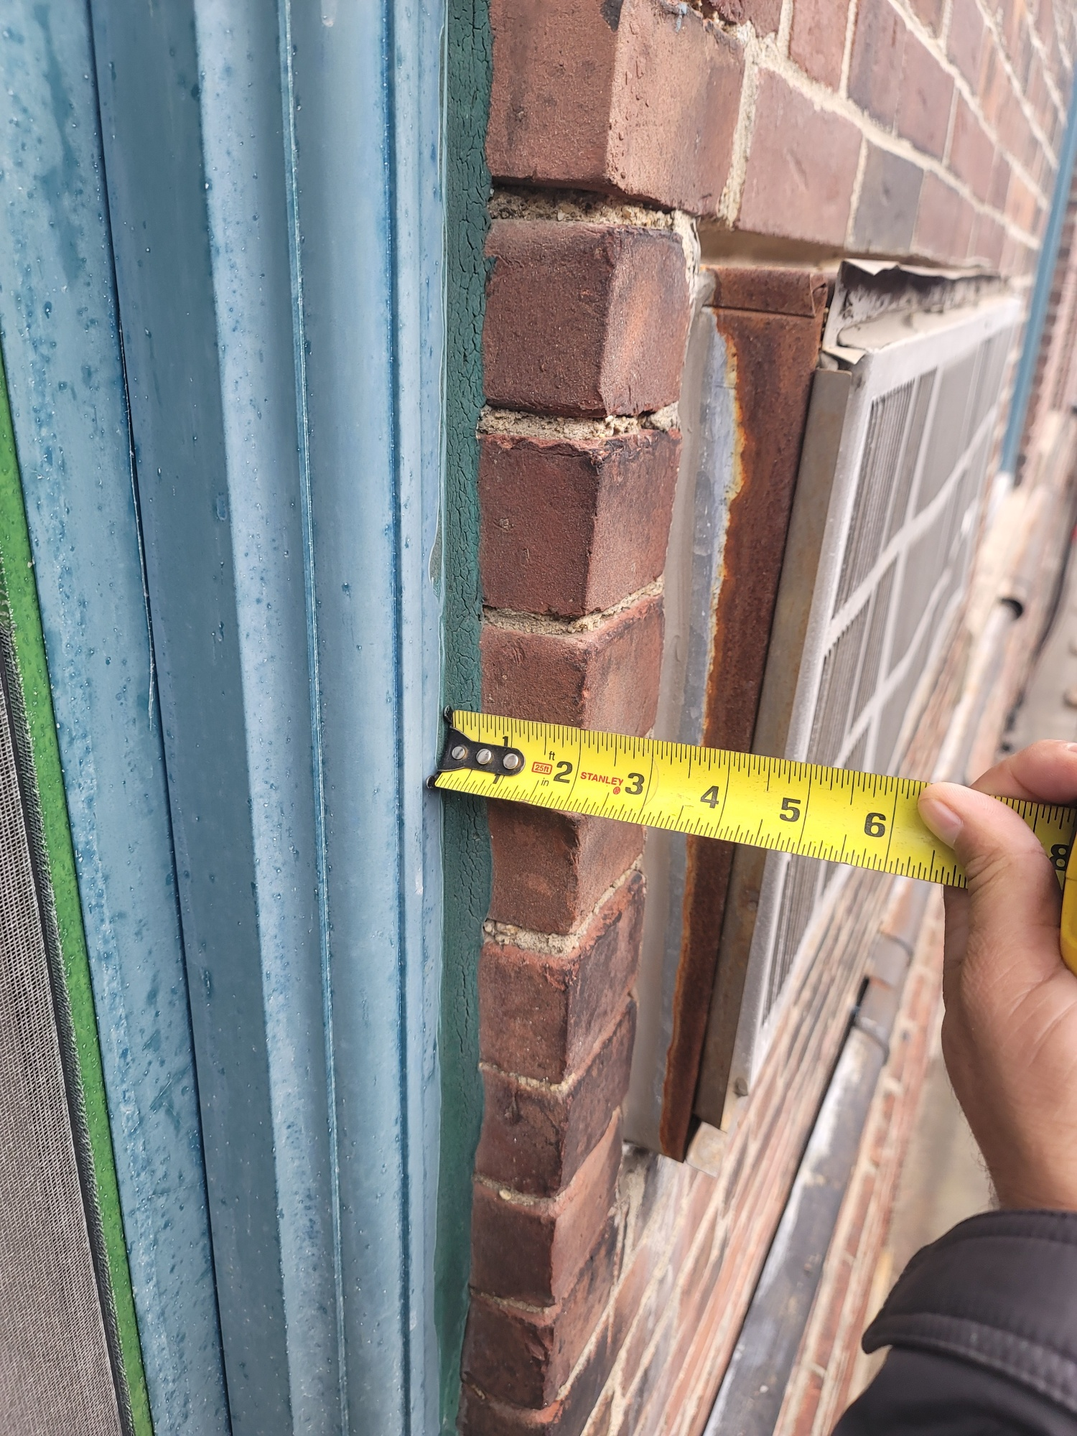
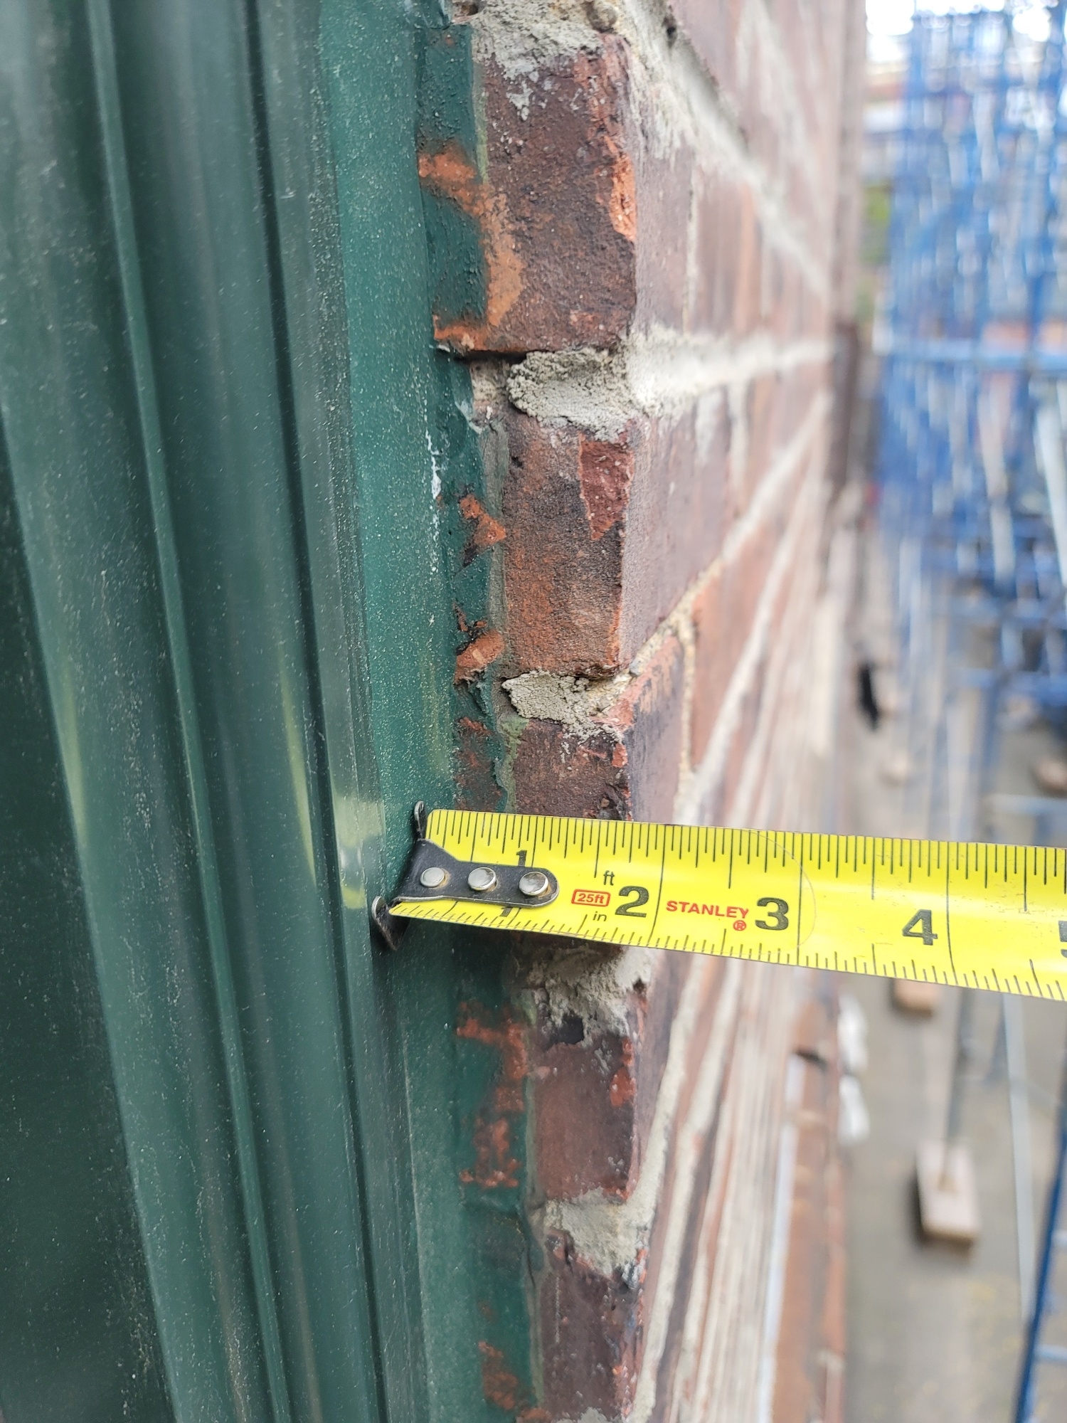



Rear façade for replacement windows. Mock-up shown in yellow box.
Existing brickmold.
The new window and brickmold will be installed in the same location as the existing window and brickmold eliminating the excess residual caulking on the brick. After first window installed set review meeting with Senior Preservation Planner for approval.
Beacon House, 19 Myrtle Street

