Slide 1
45 Beacon St Request for Flagpole Replacement

Slide 2
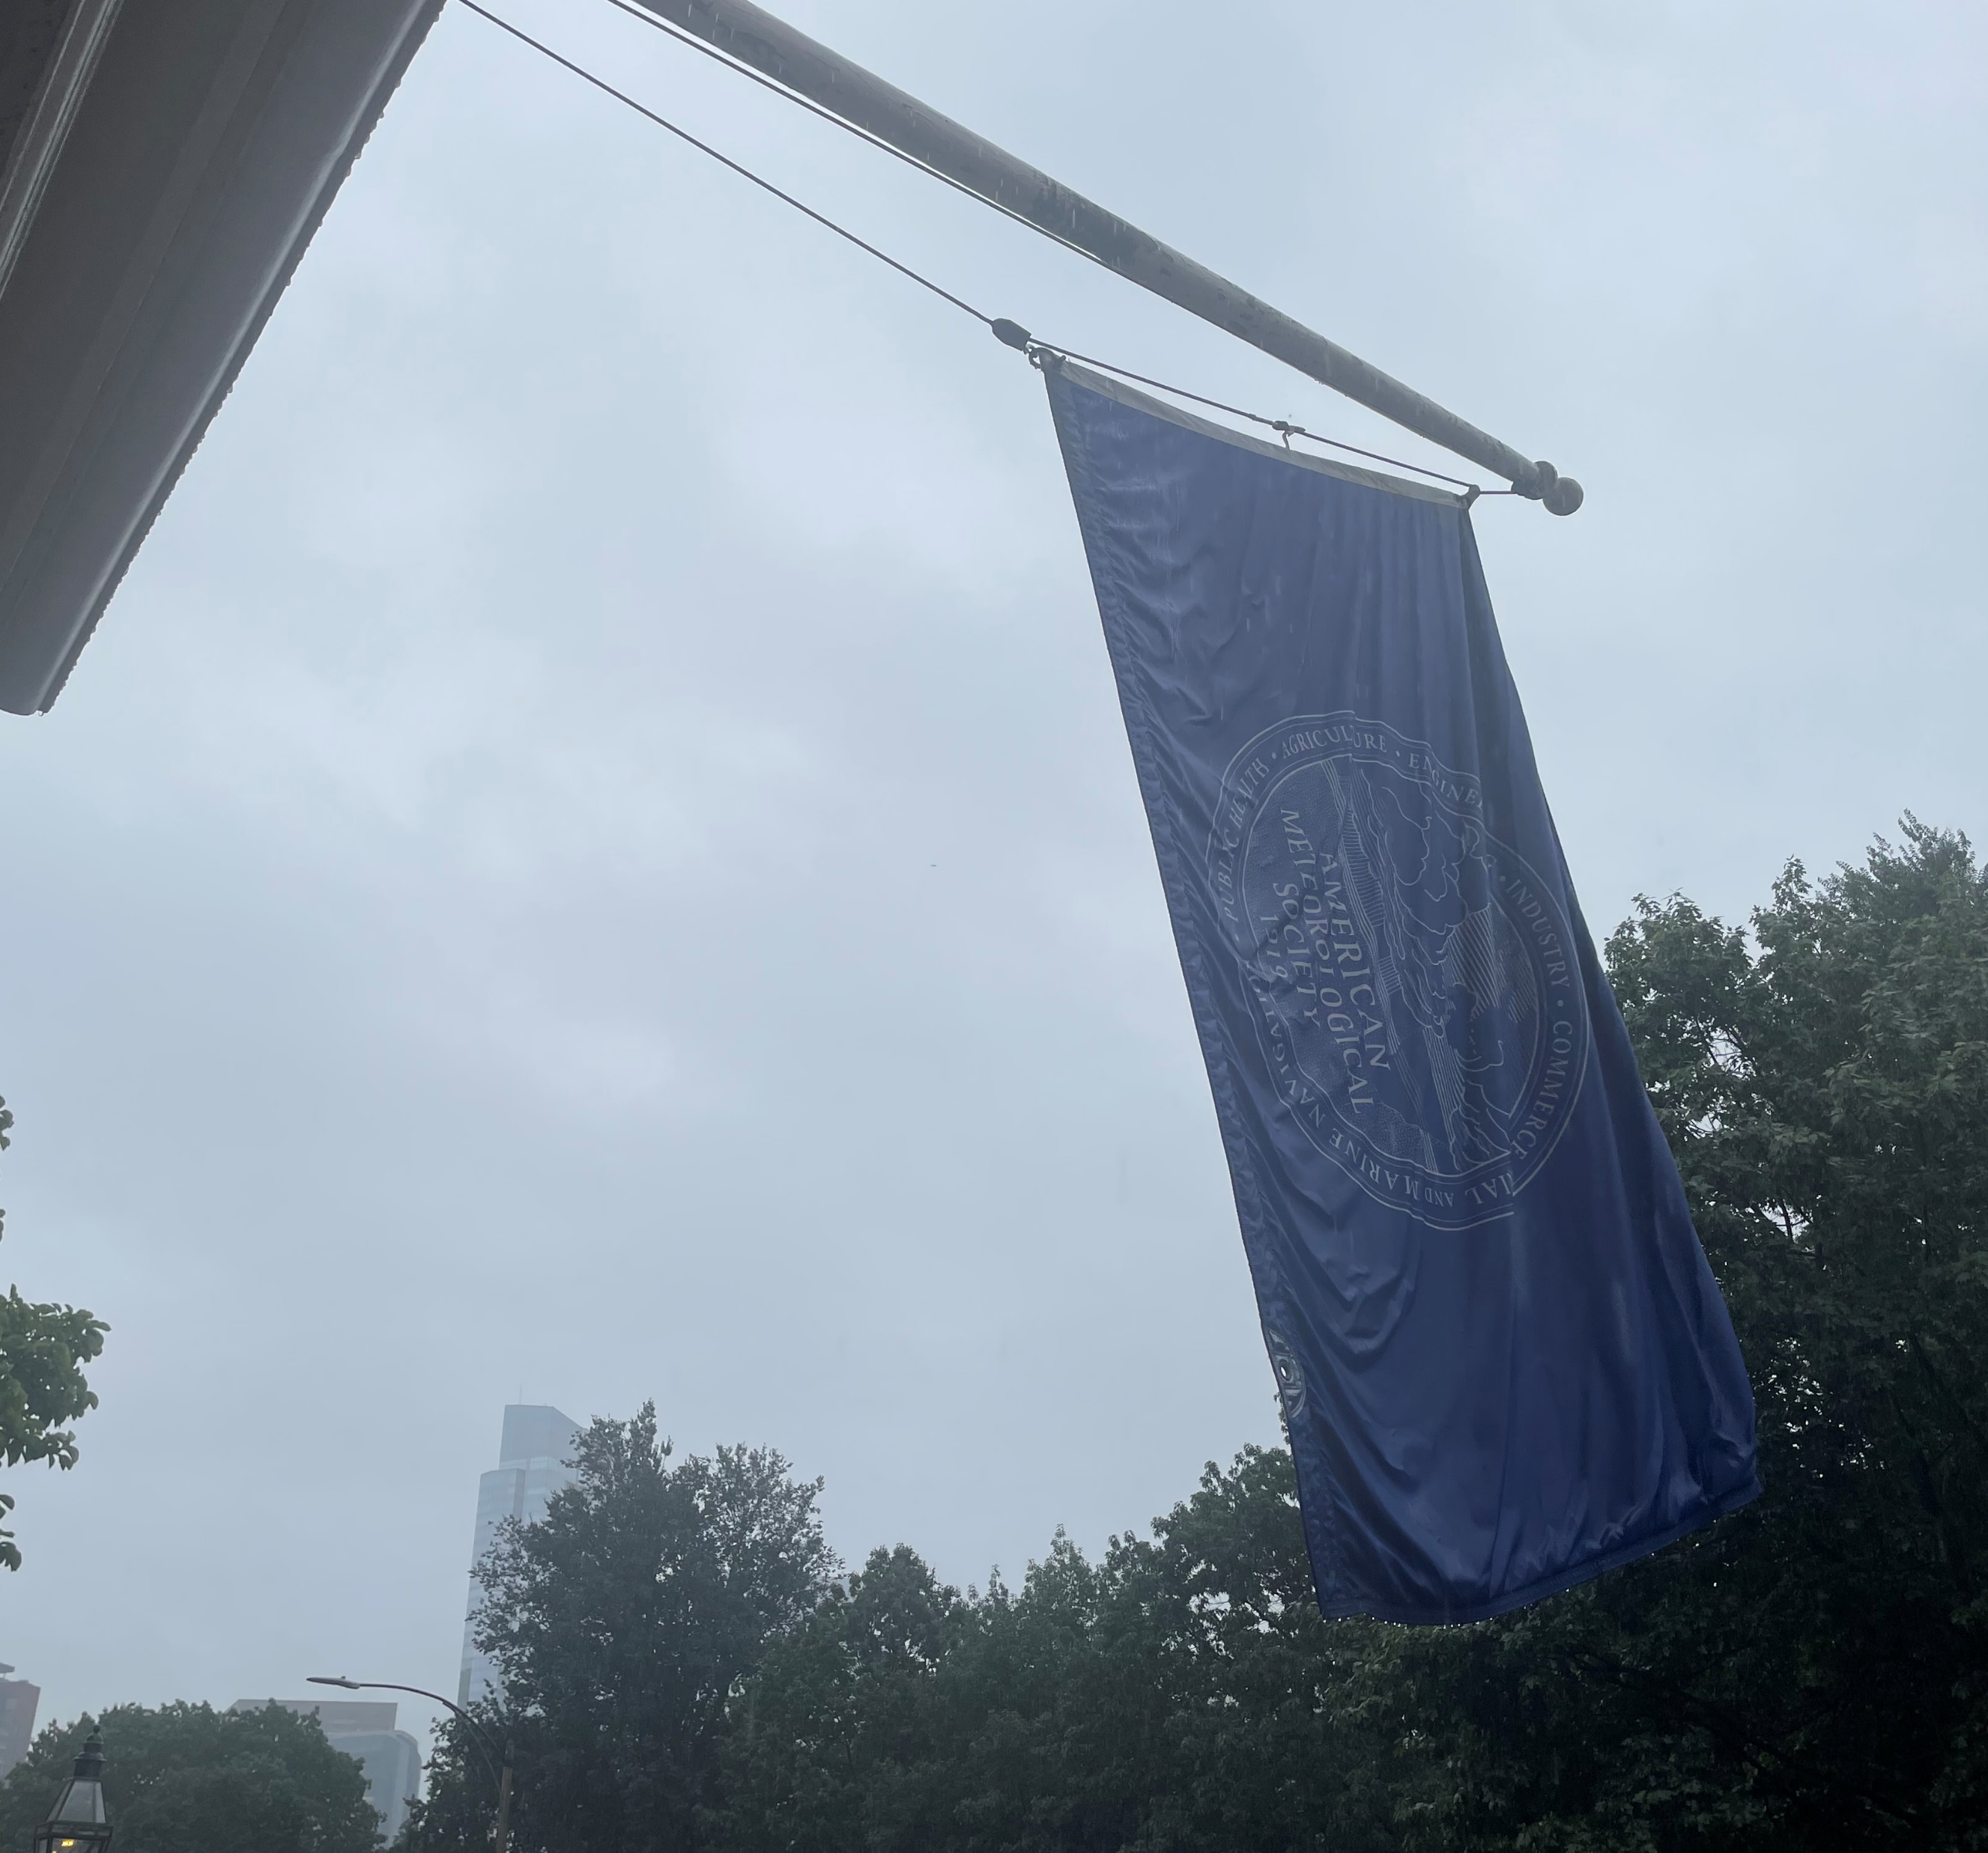
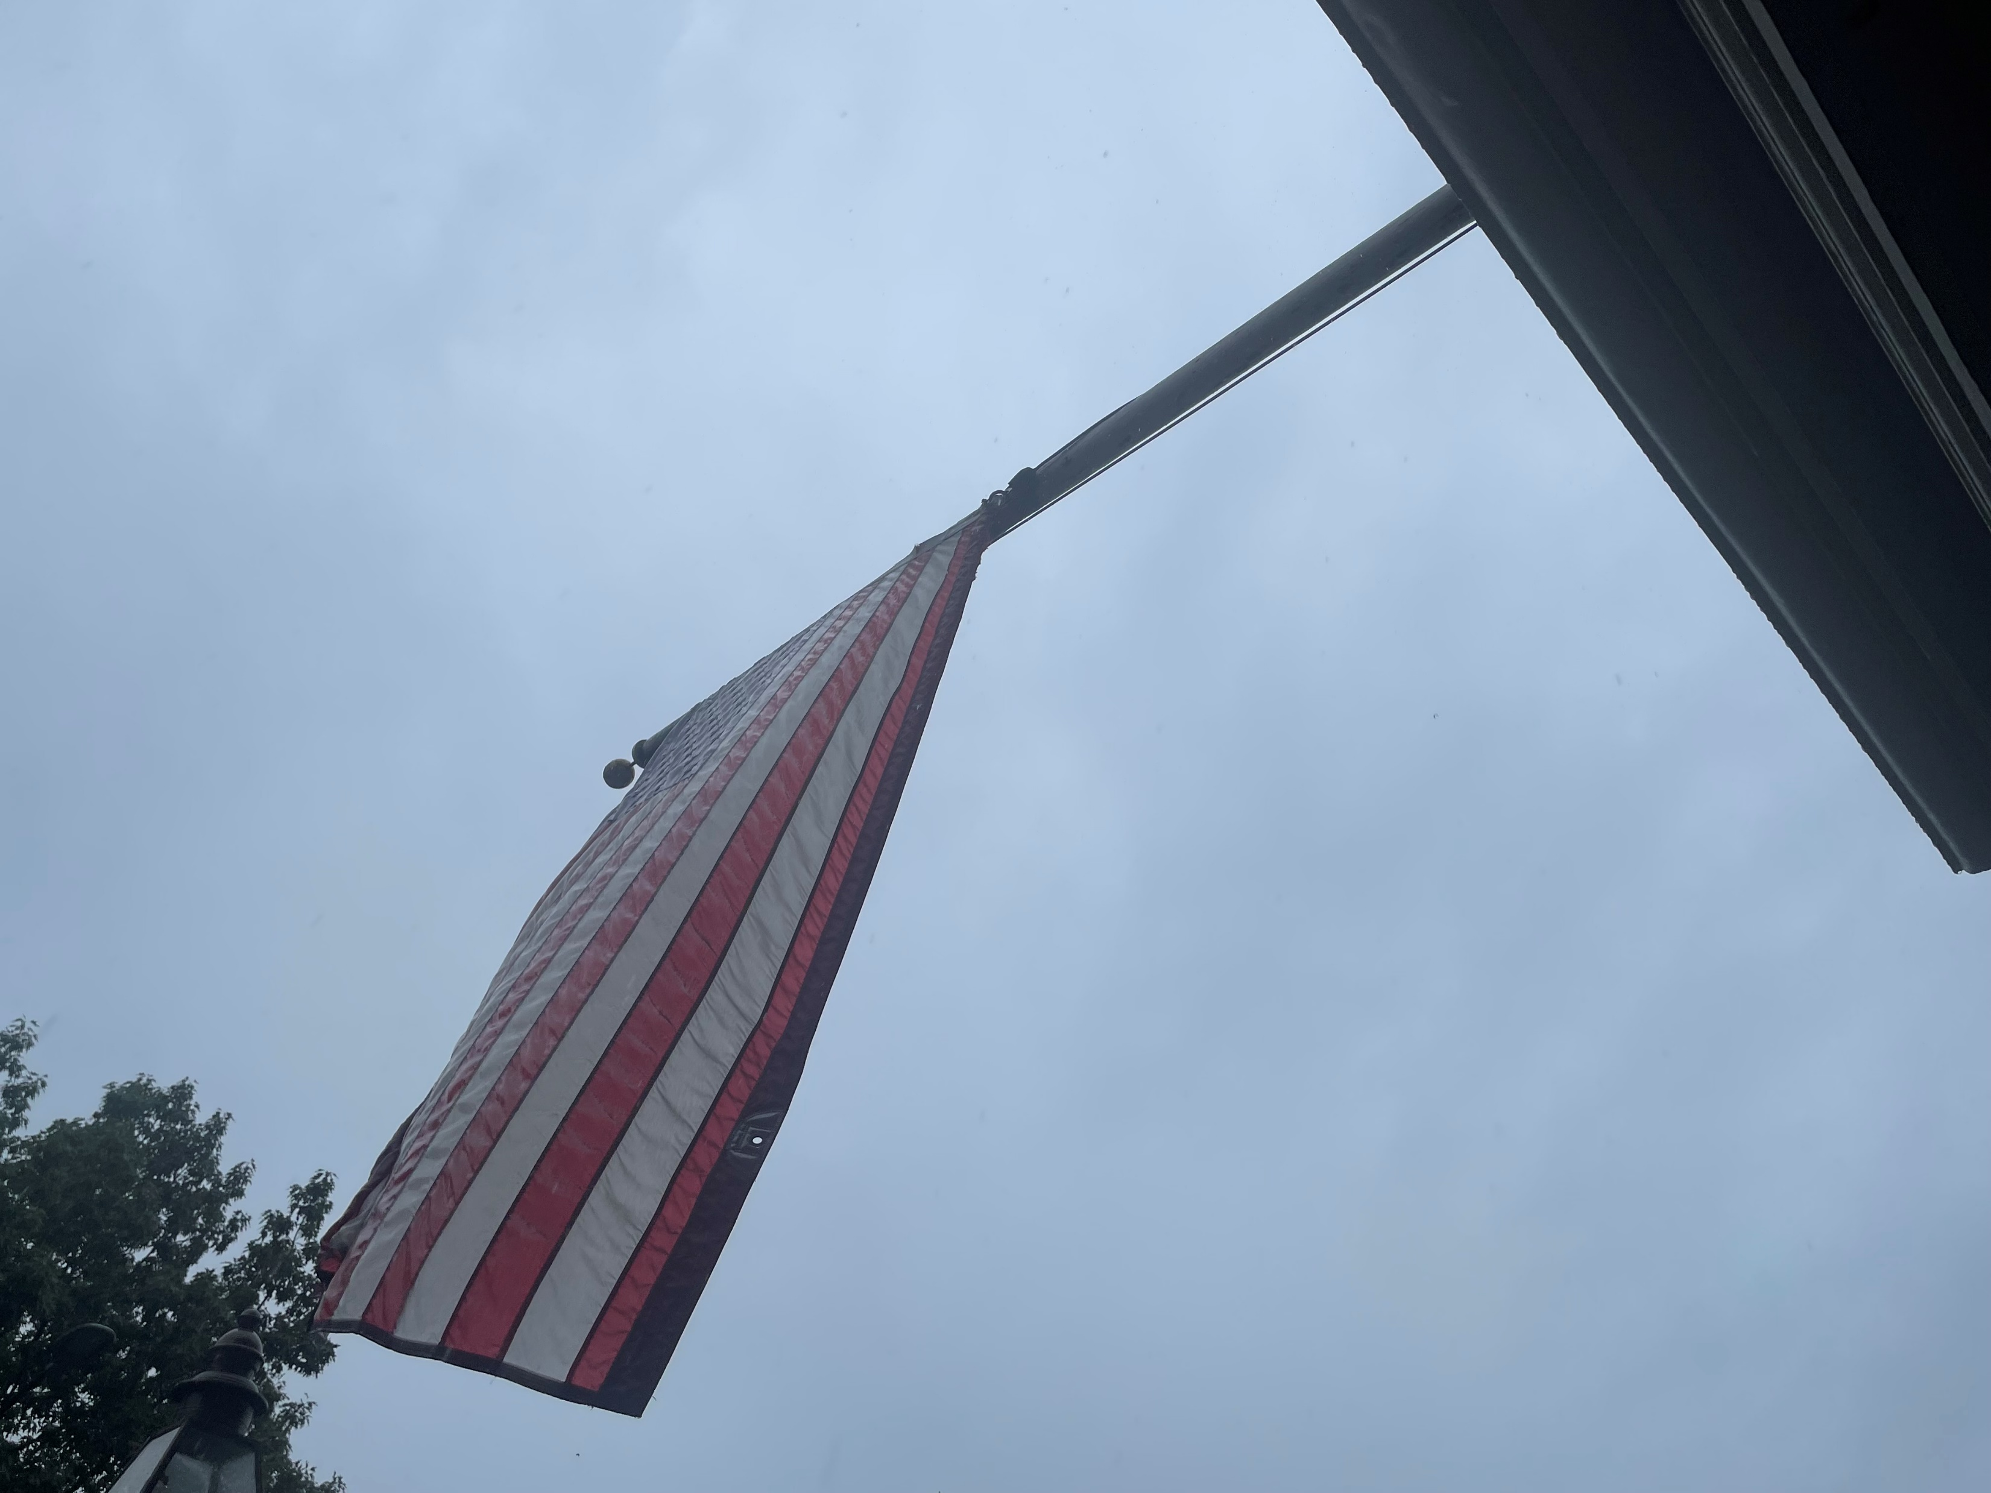
Existing wooden flagpoles are in need of replacement

Slide 3
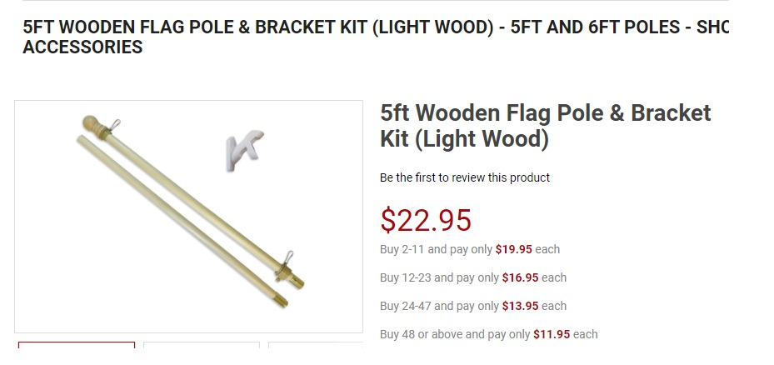
We are seeking replacement with wooden poles

