Slide 1
Alterations to 37 A Charles Street
New Split Signage with Anton's Cleaners (current tenant)
Add hood exhaust on flat roof of 37A (back area)
Replace existing back doors for rear entry/ exit

Slide 2
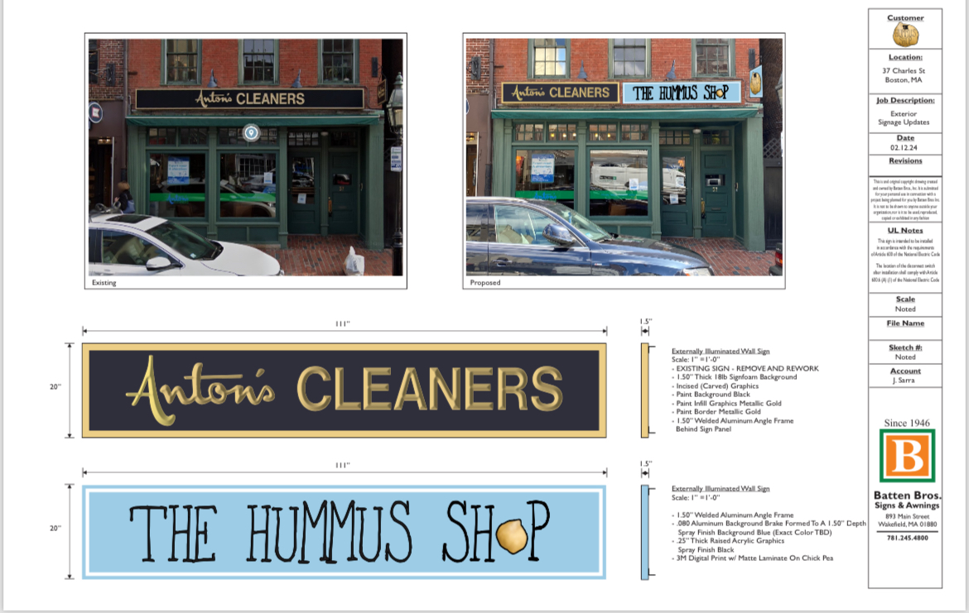
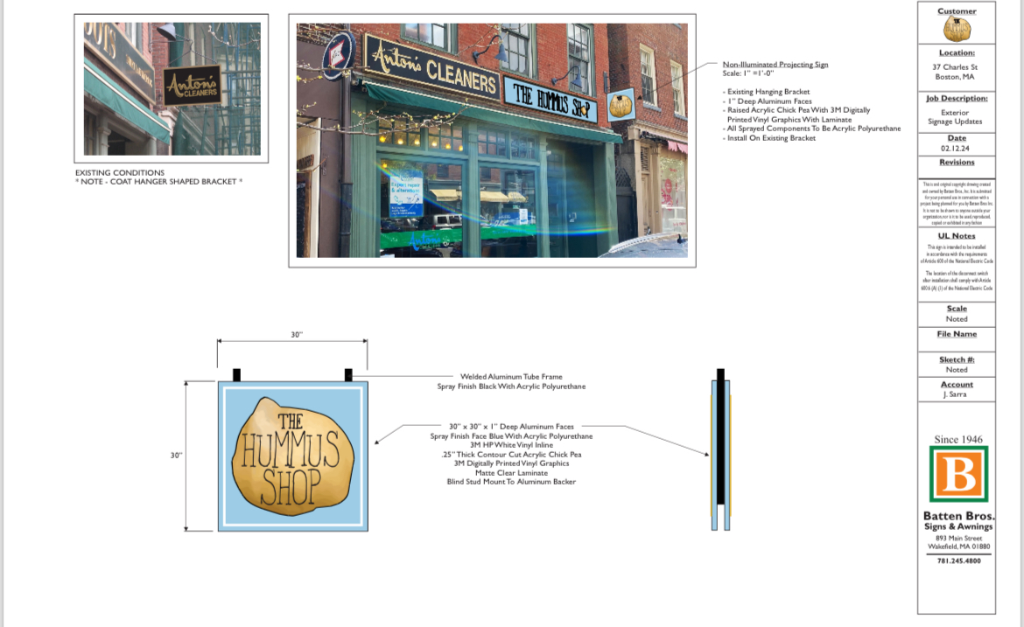
Replace current store front signage

Slide 3
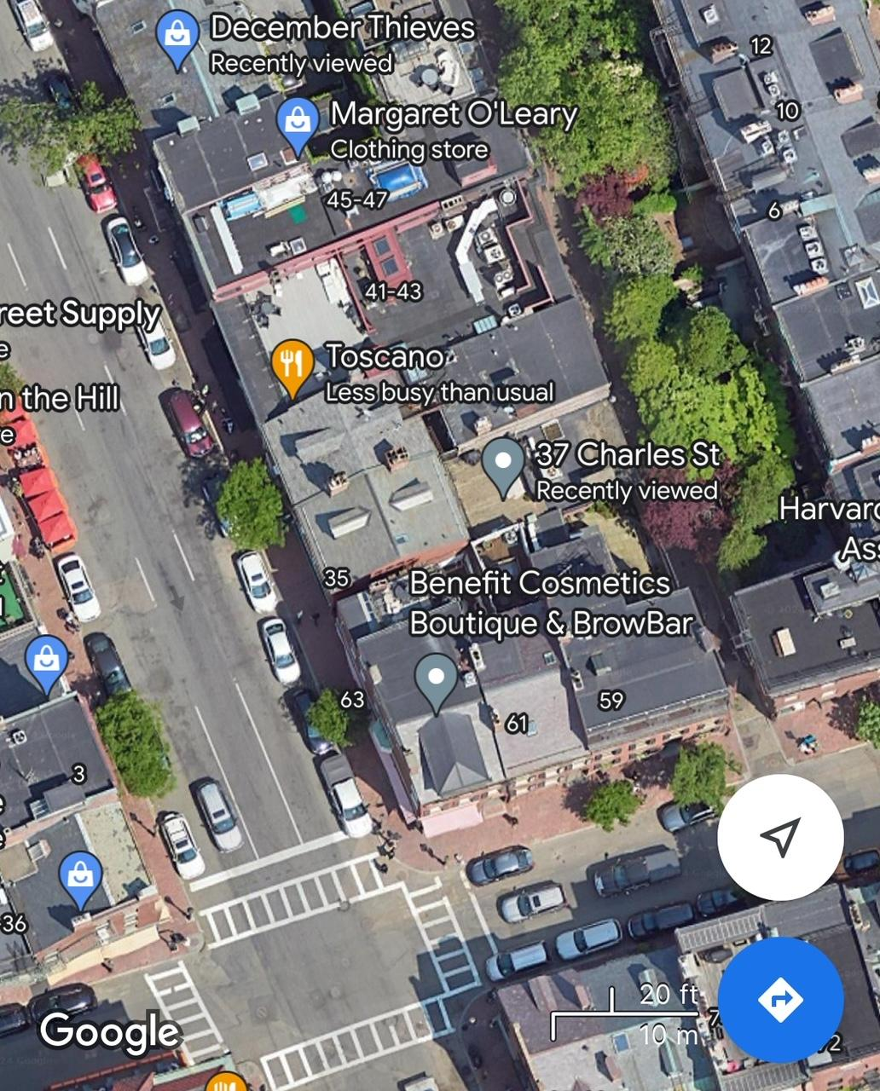
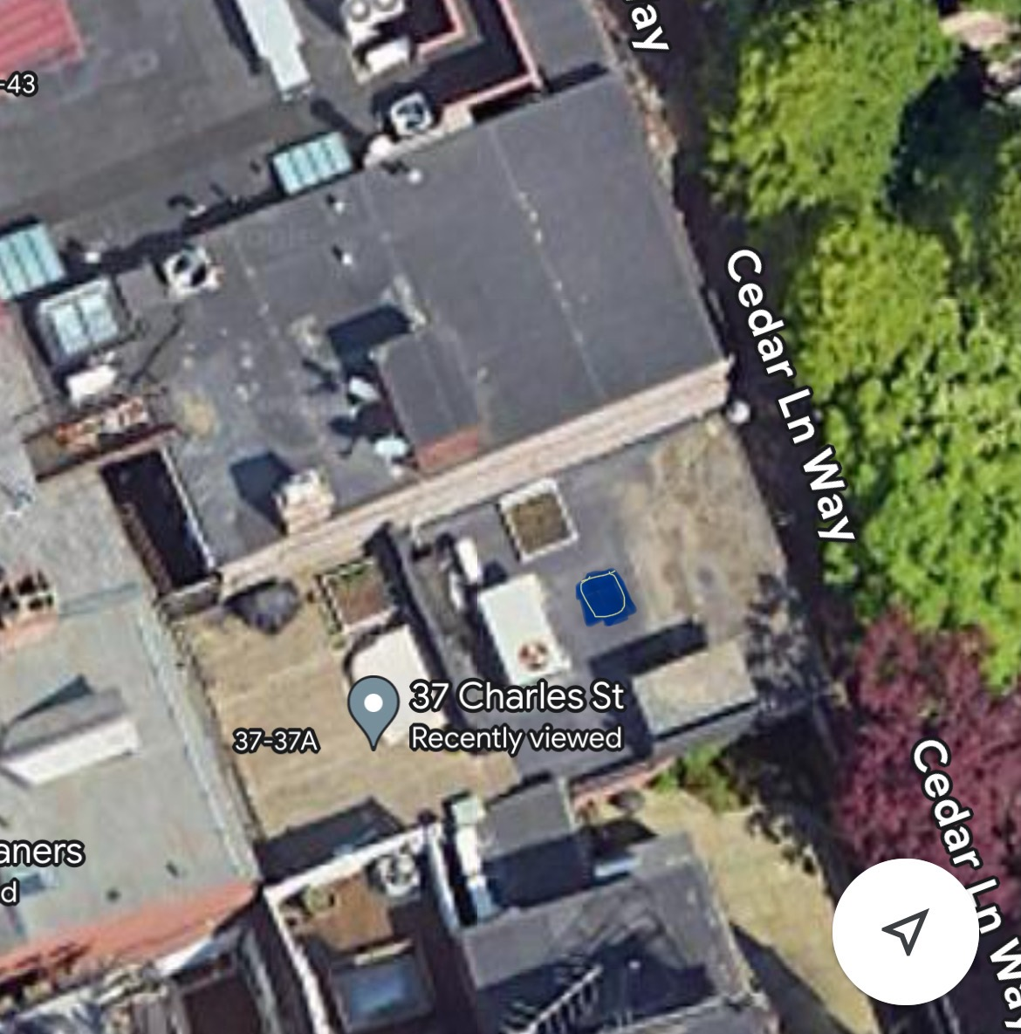
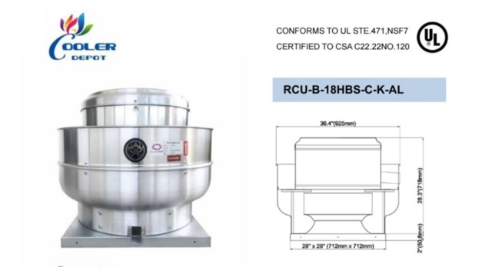
Add hood exhaust to roof on 37A
Blue square indicates 3’ x 2.5’
Hood exhaust added. Not visible from Cedar Way.
37 charles street

Slide 4
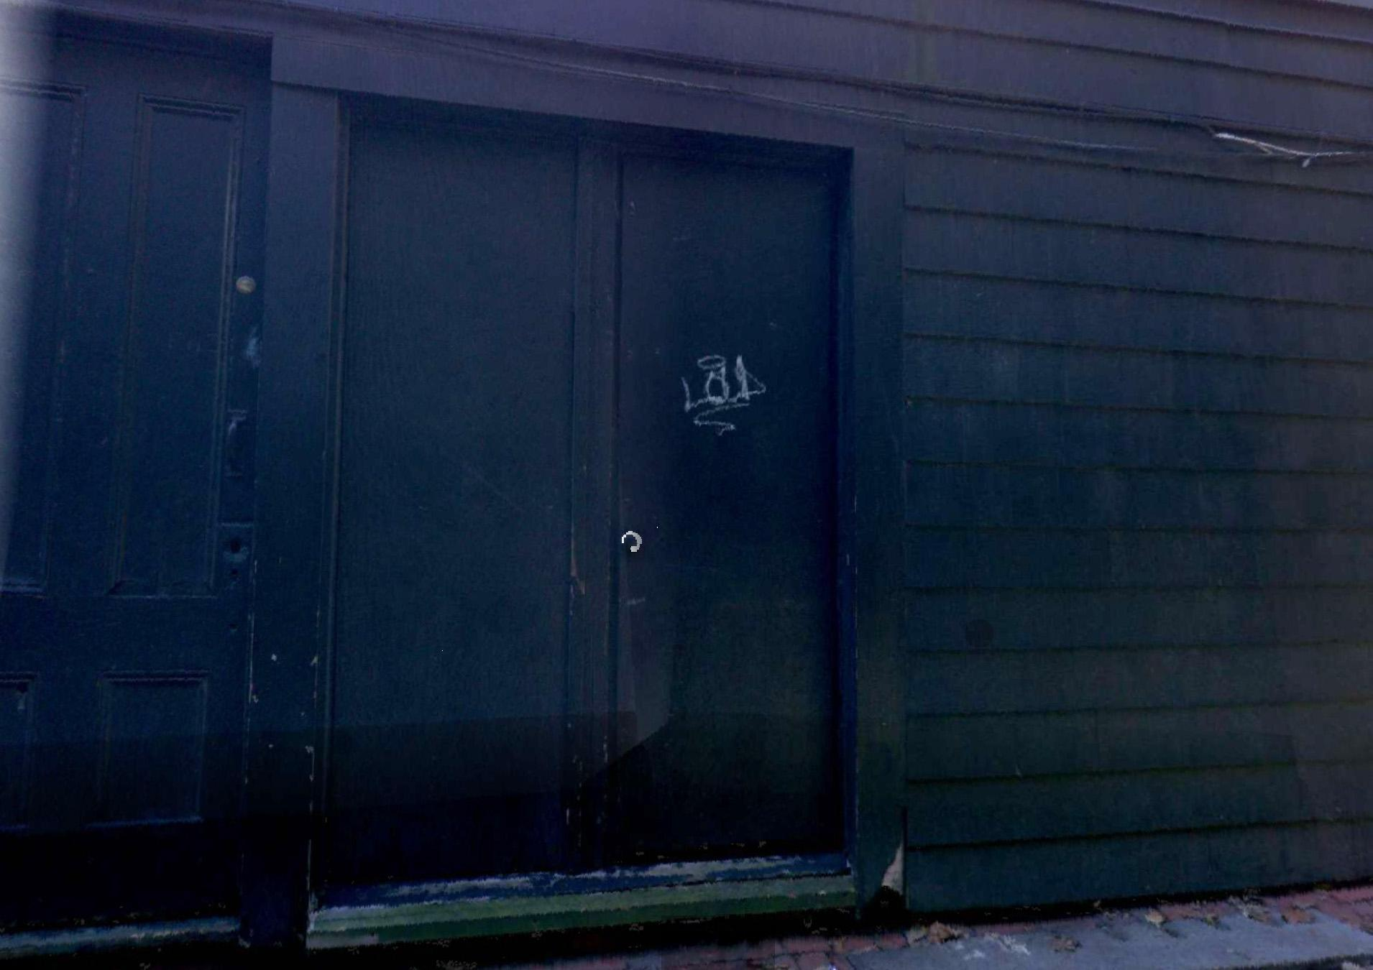
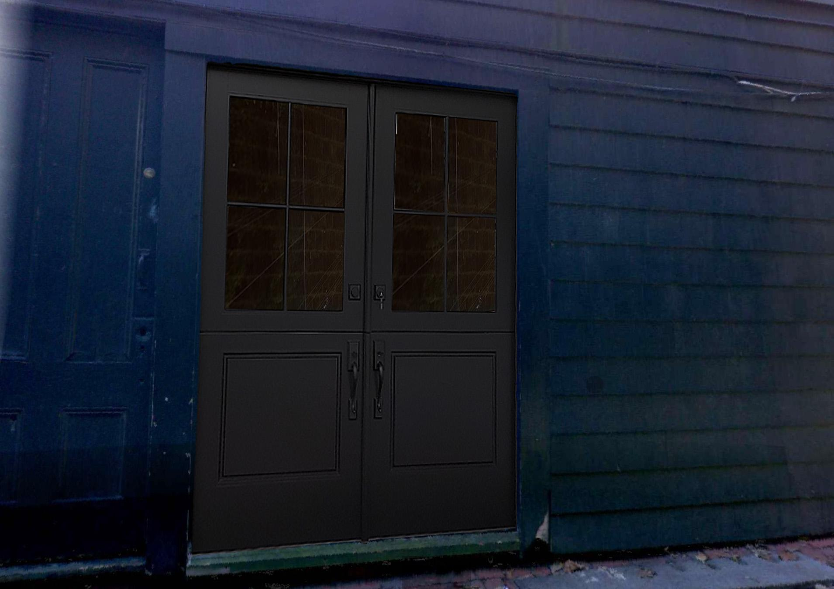
Replace non working back doors with new doors
(same size as current doors)
Current non functioning double back doors
Proposed replacement doors

