Slide 1
Requesting Tree Removal

Slide 2
What we were told by our arborist in our service last year:
Remove the 9.23” diameter linden located on Highland leaving a low stump This tree is in a state of decline.
Trees above 8” dbh require permission form the below mentioned prior to removal.
This will require permission from Highland Park Architectural conservation district -via Boston Landmarks Commission Client will be responsible for obtaining this and providing proof to STC This removal will be billed and done separately from Item 1
$622.50
Link to invoice: https://docs.google.com/document/d/1n-orJ5MfMu5kQxhhY9bmqsSNx3nCkMUNBh9z58yBZi8/edit?usp=sharing

Slide 3
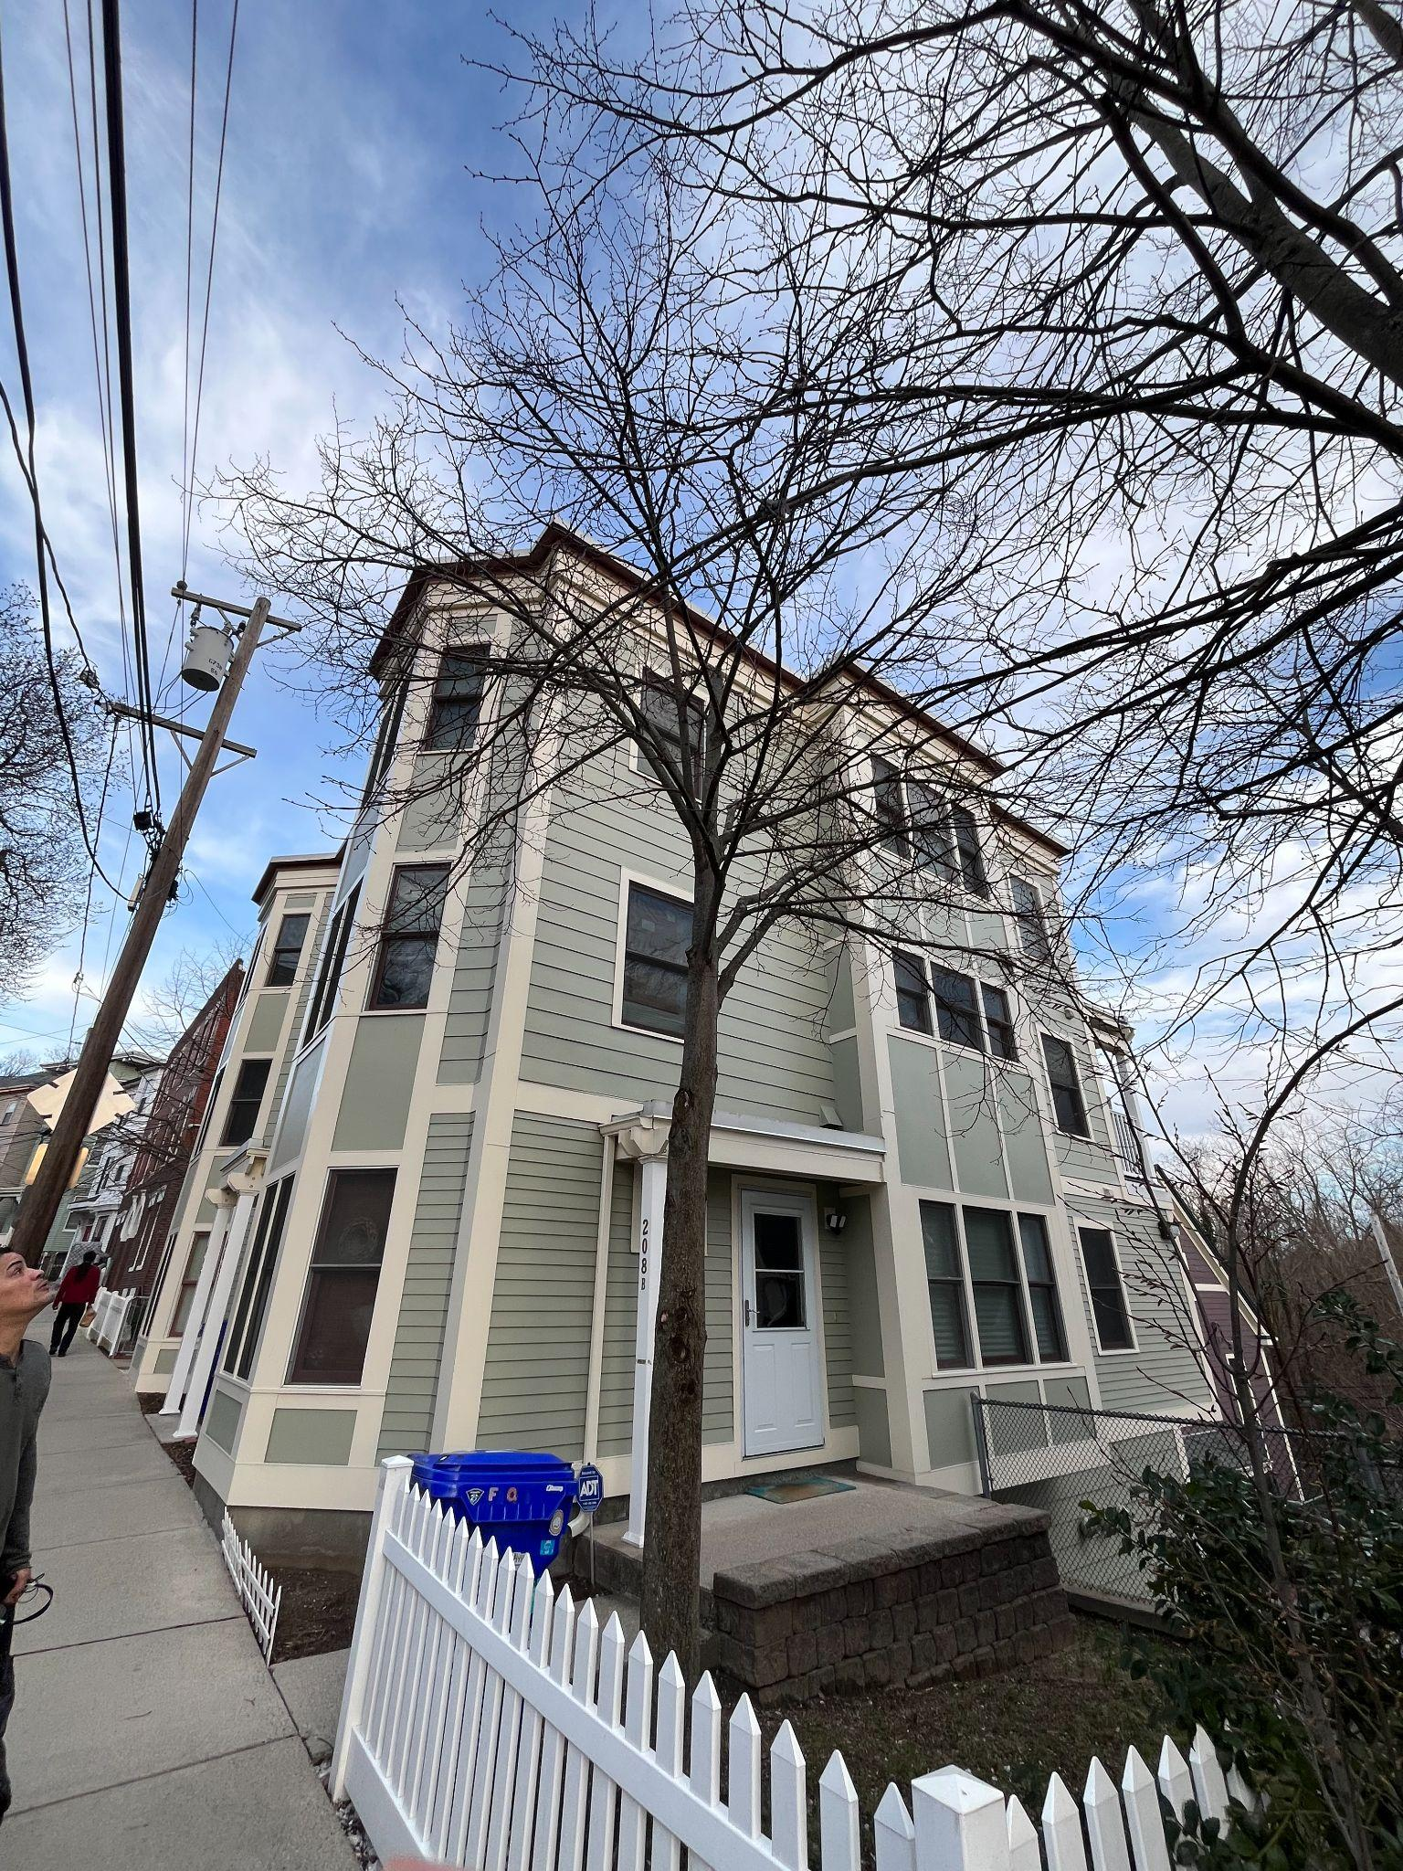
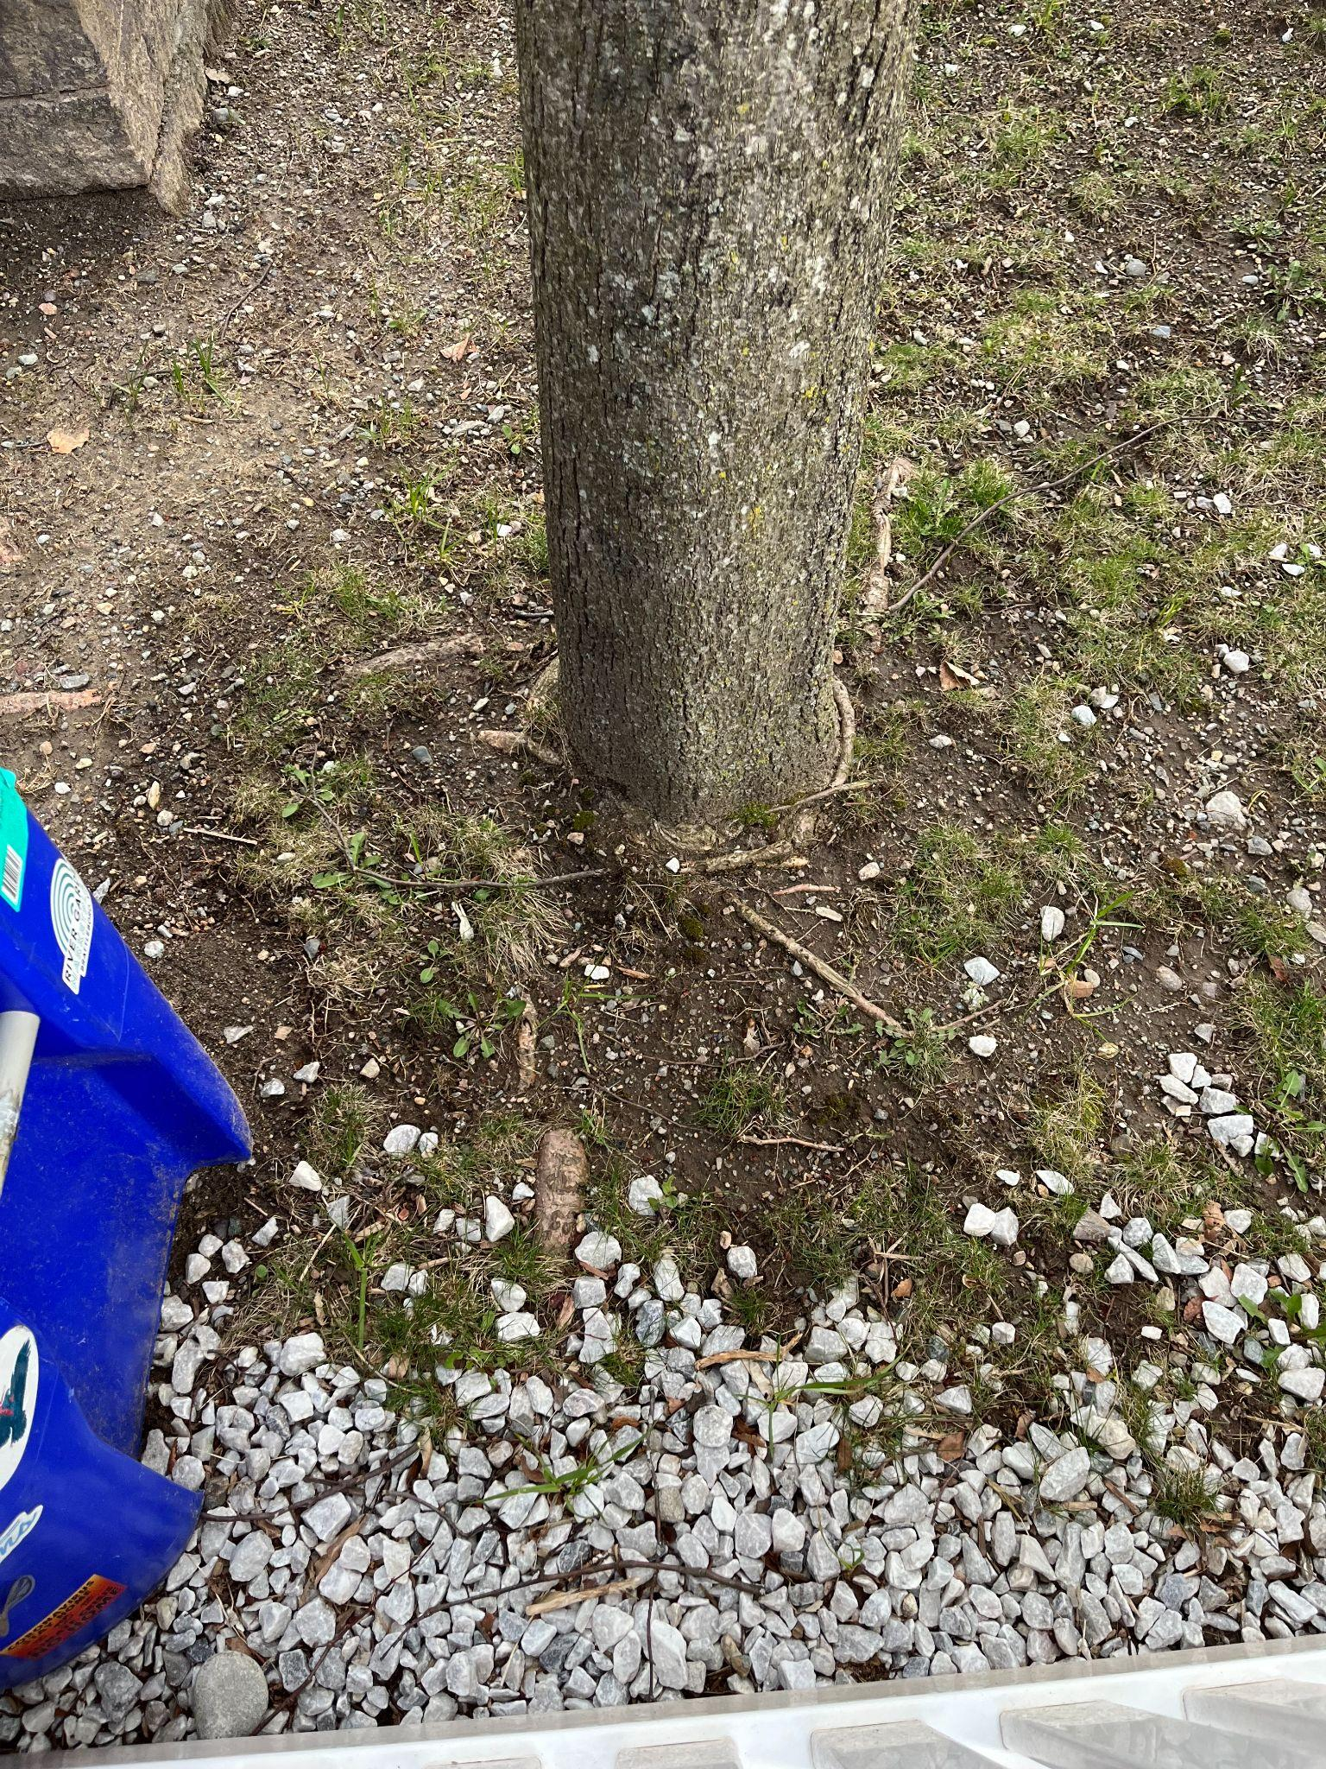

Slide 4
