Slide 1
Handrail at 43 South Russell St Application in response to Answering a violationVIO.24.0875

Slide 2
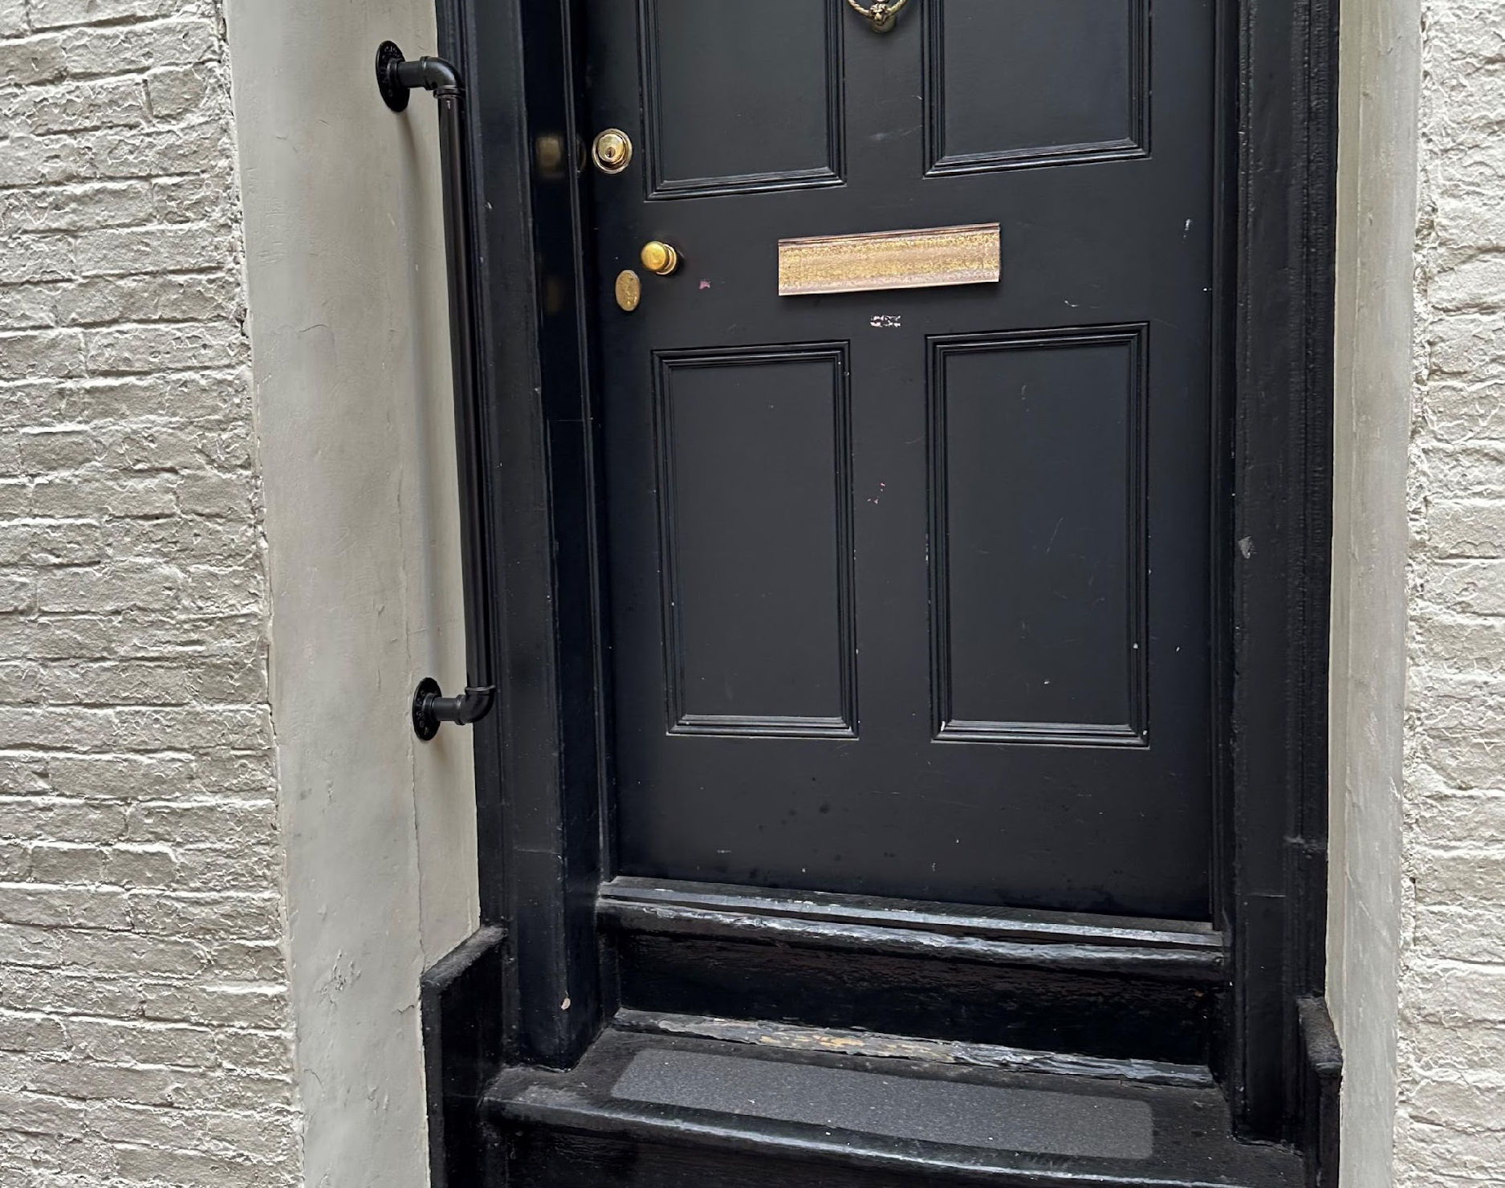
We put in a handrail in for the Retired Archbishop of Kenya who stayed with us for 6 months.
He needed the assistance of a handrail to help him get in and out of the steep steps at the house.
We have other visitors who may also need the assistance of a handrail due to disability or age.

Slide 3
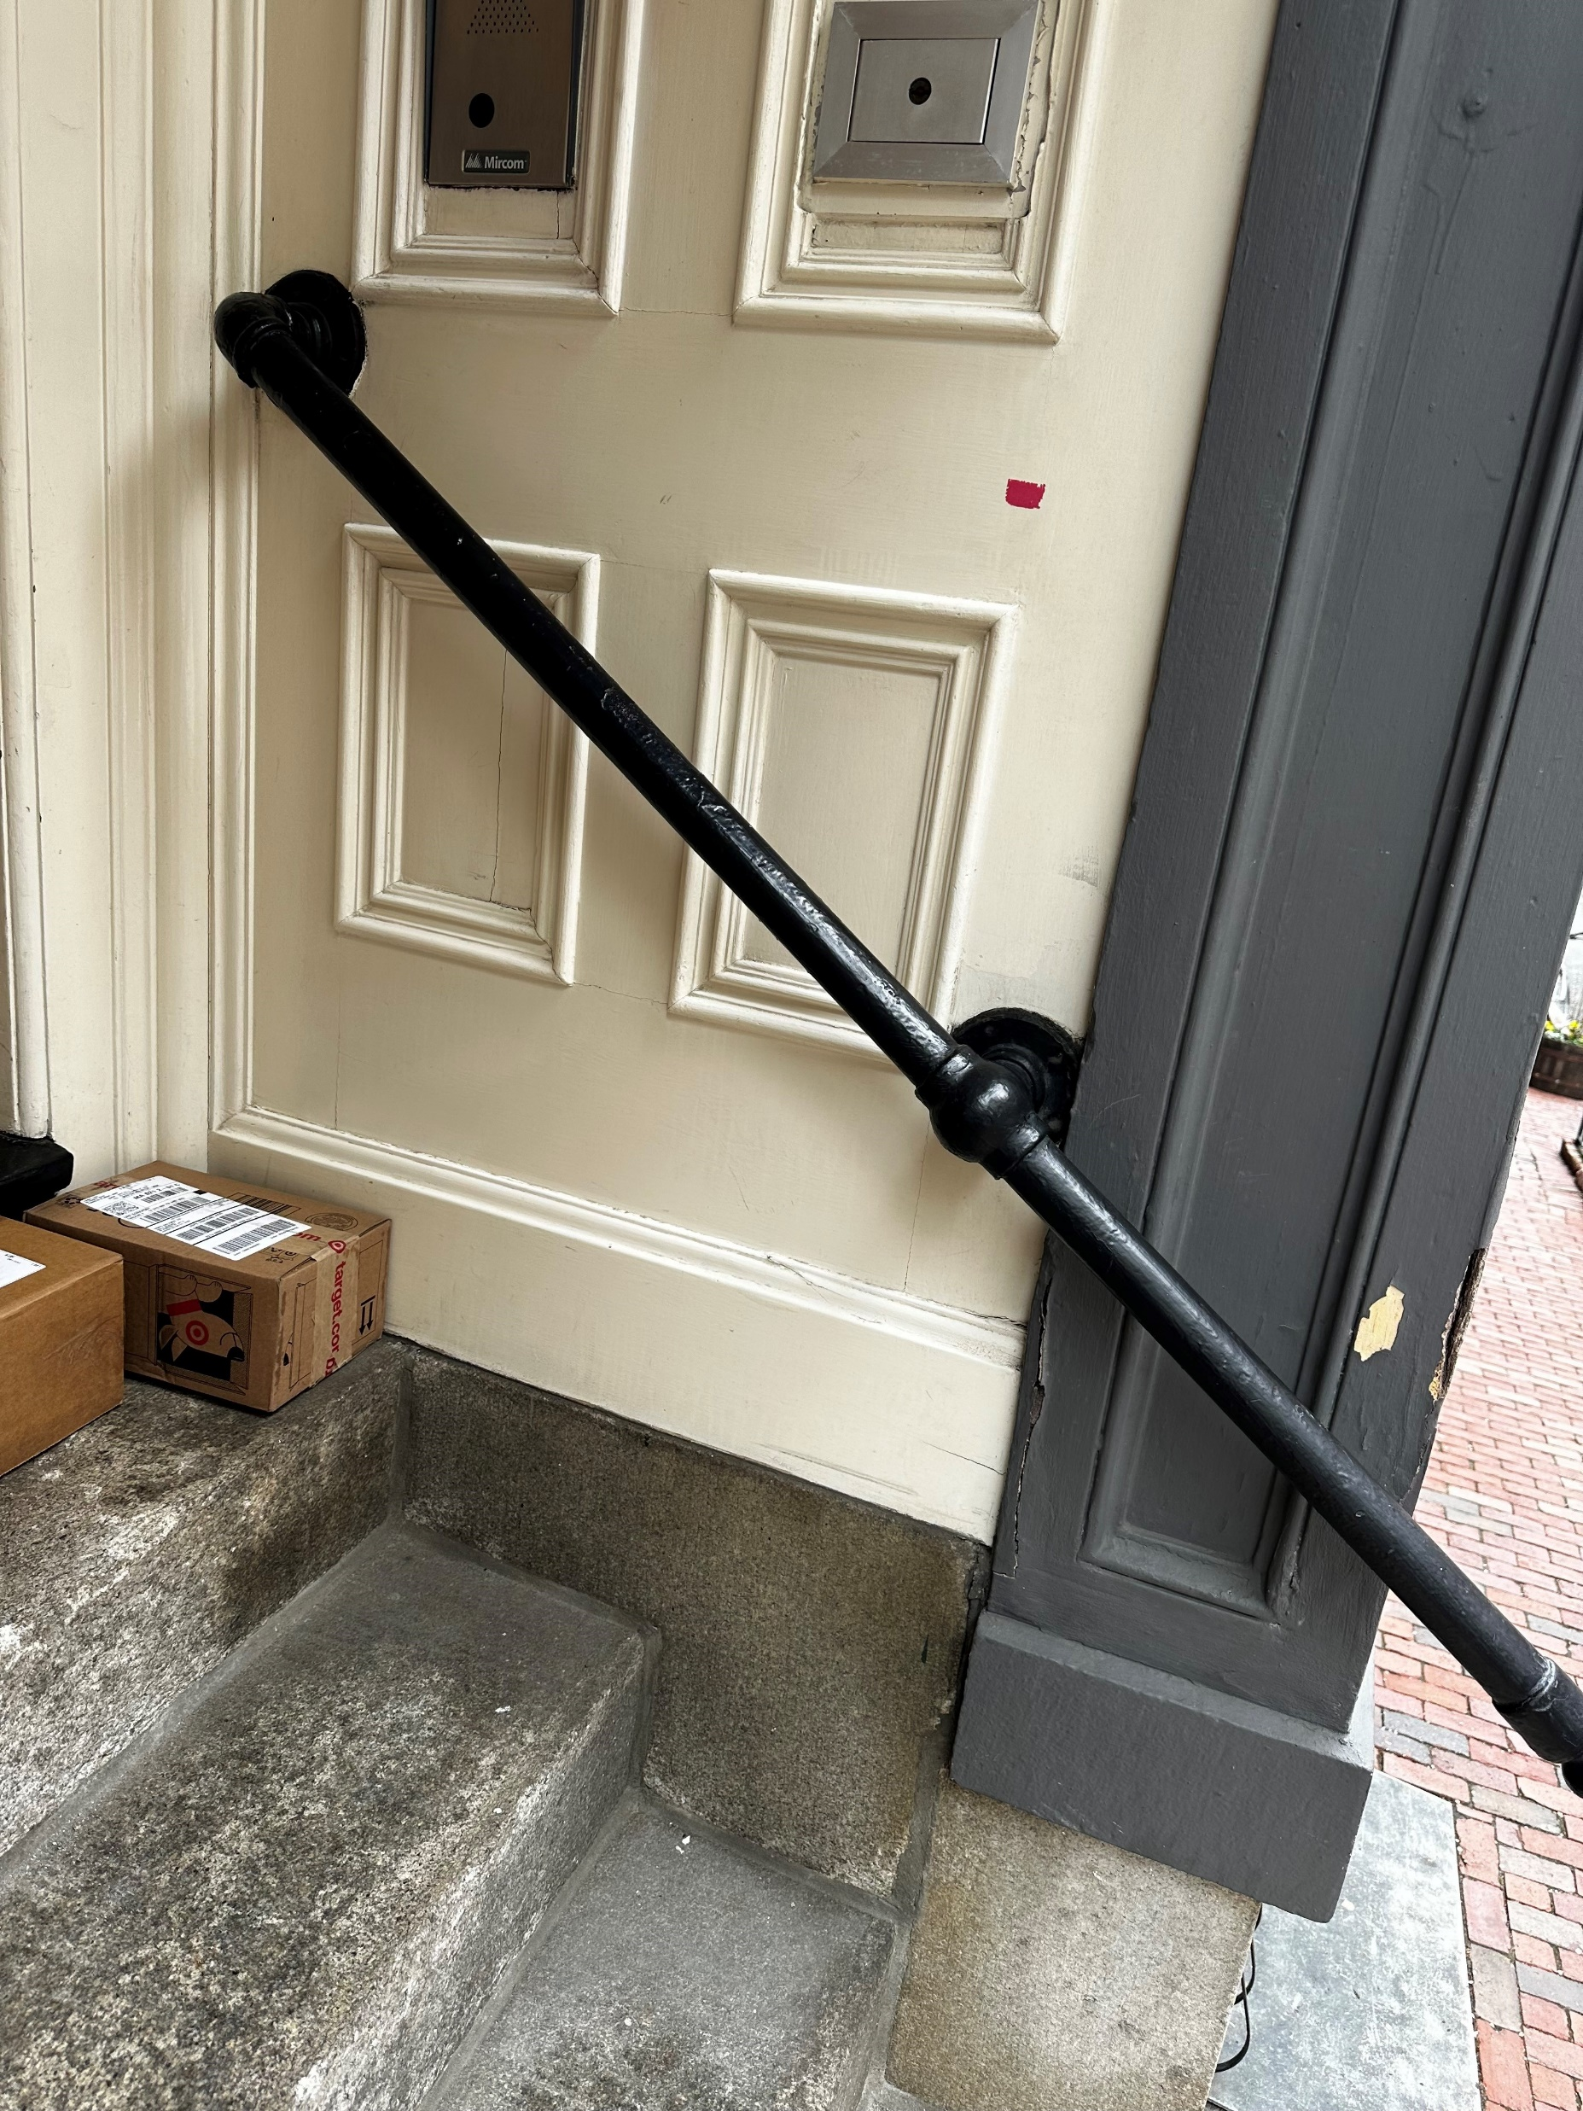
Pictures of Rails in Neighborhood
This rail is the same model as we installed. It differs in size and angle of installation due to the size and position of the stairs.

Slide 4
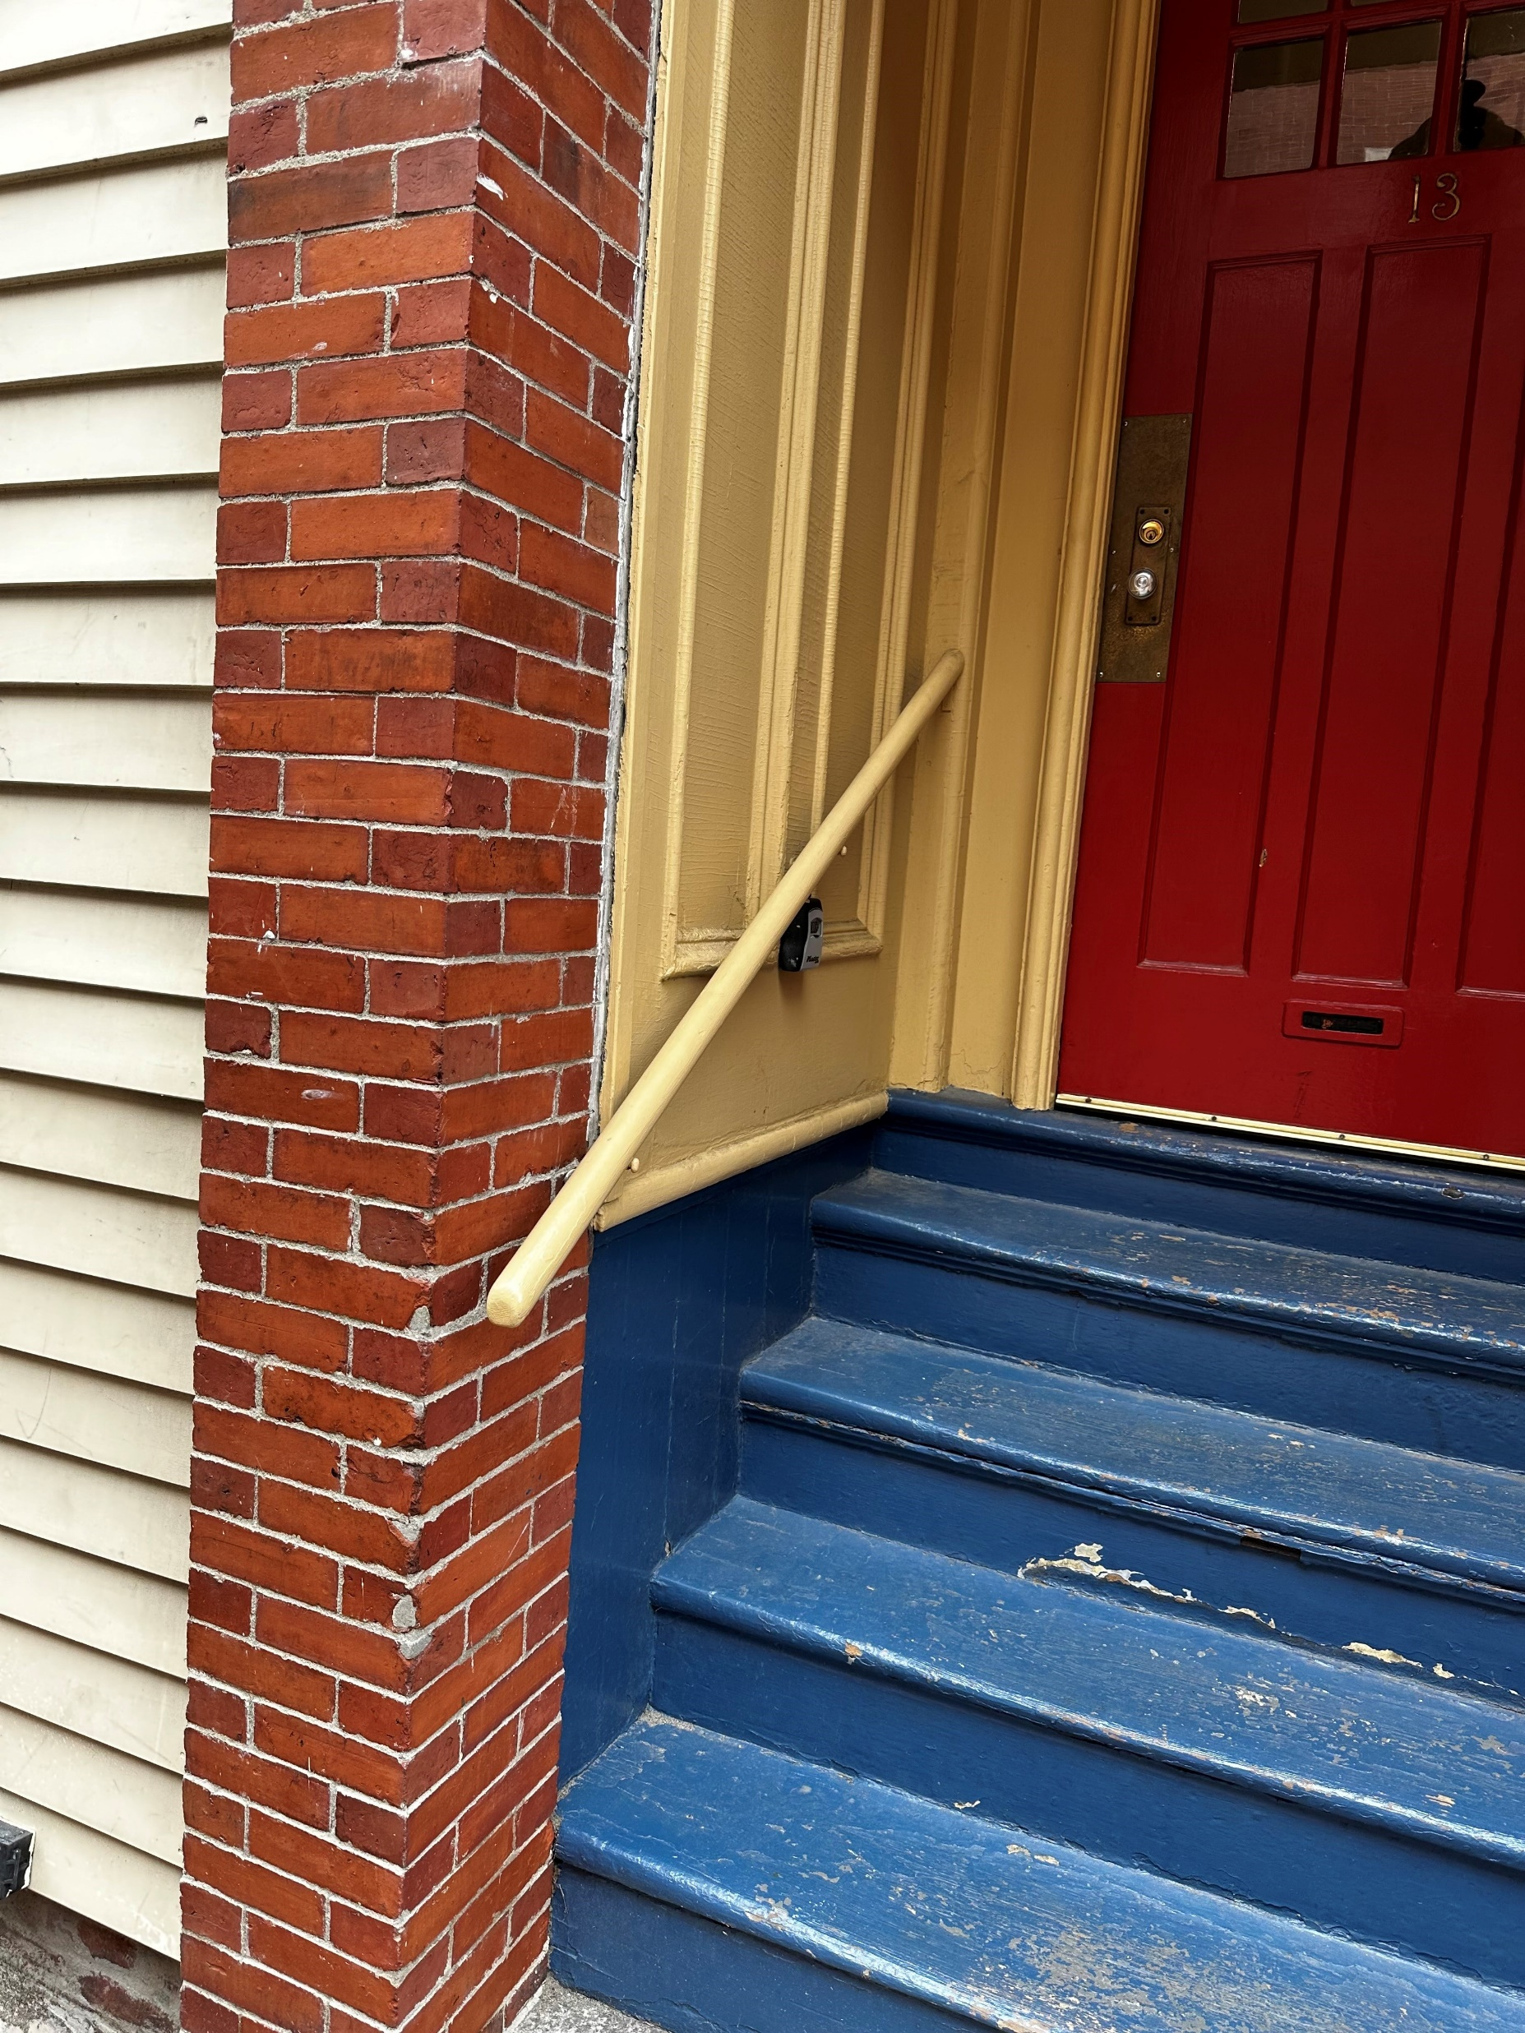
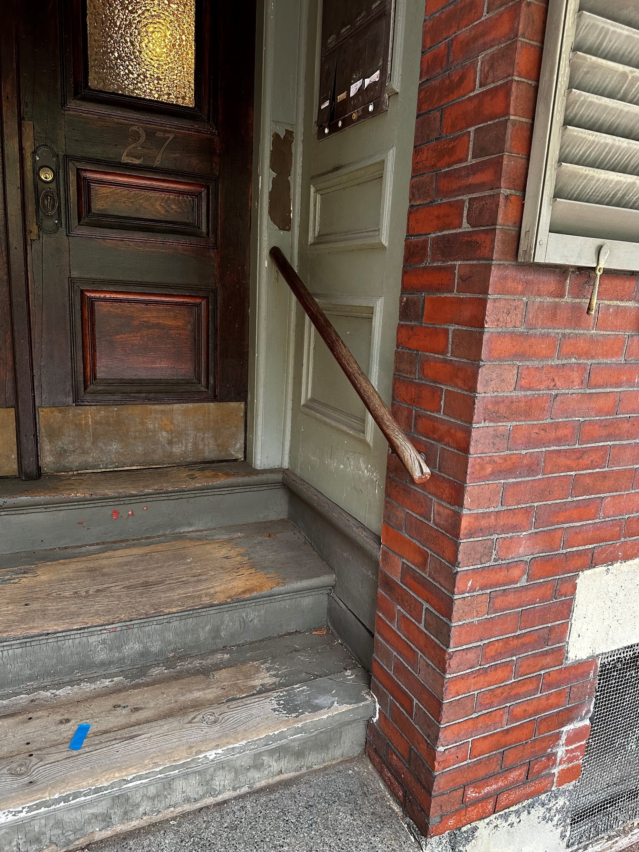
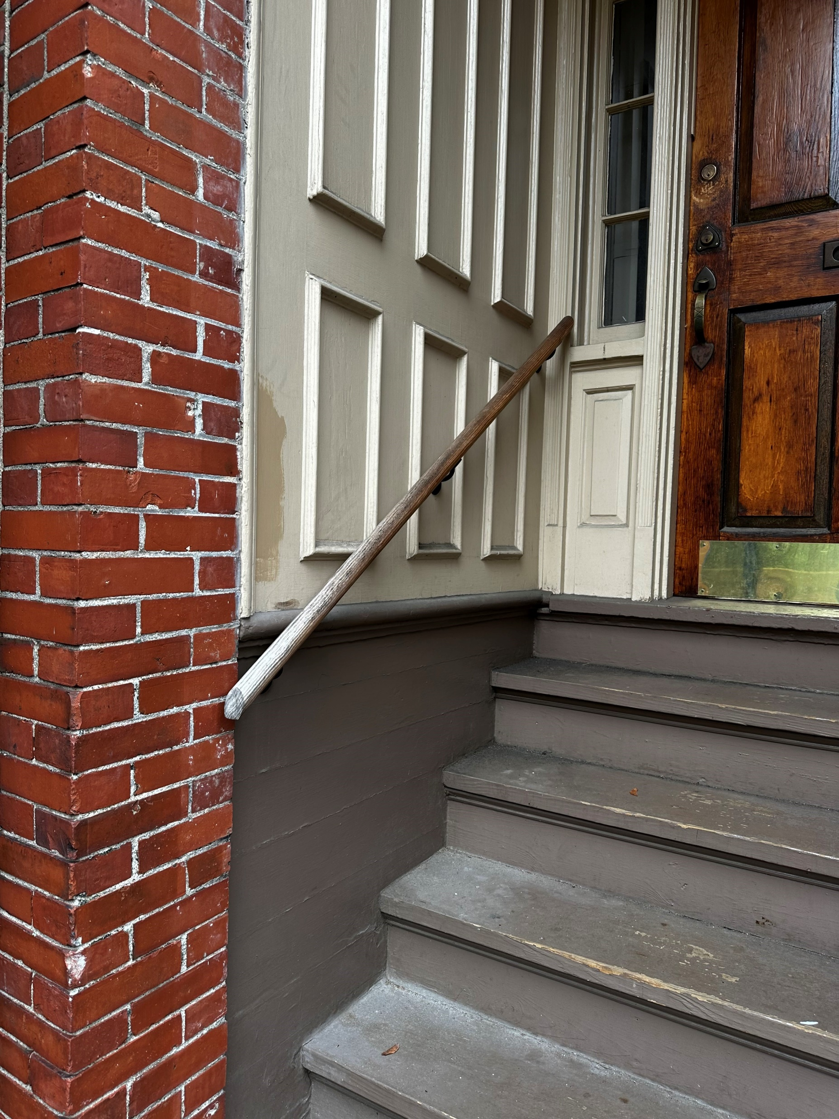
More Examples of Neighborhood Rails

Slide 5
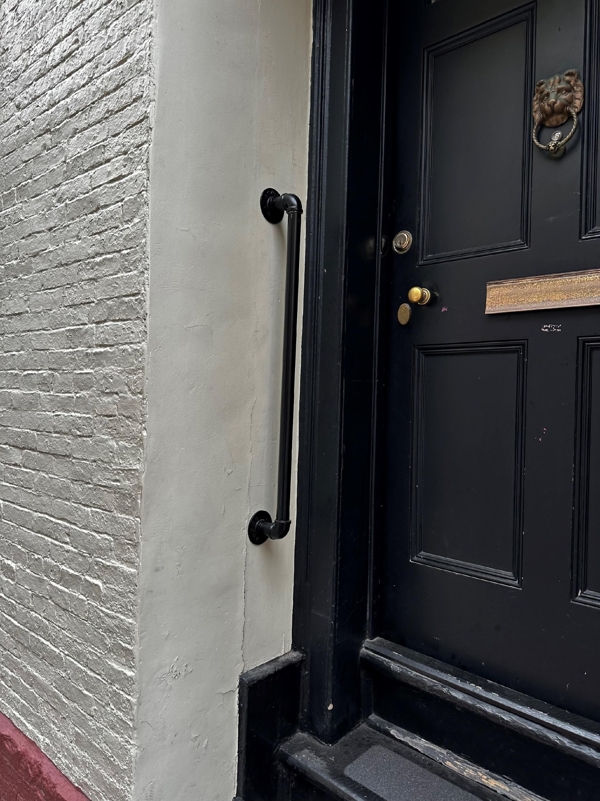
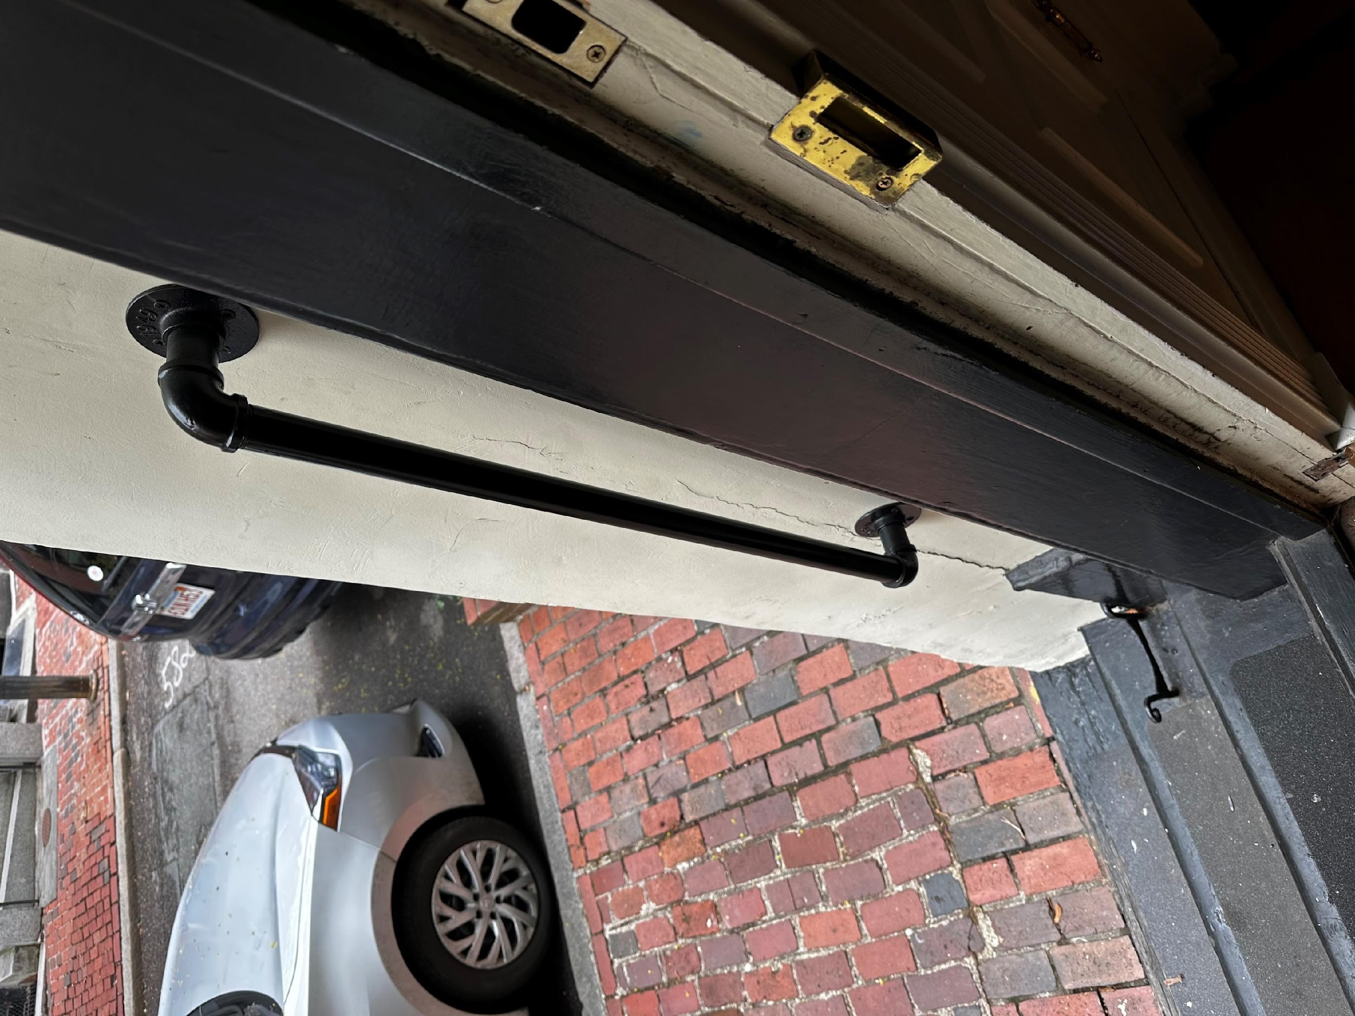
Our rail is the same as others in the neighborhood and pleasing to the eye. It is helpful for those who stay at the house who have a disability due to age or health.

