Slide 1

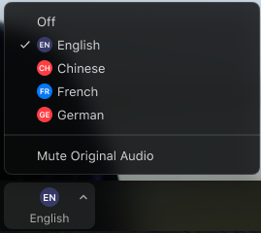


Interpretation Information
English: For interpretation in [_____],
Go to the horizontal control bar at the bottom of your screen. Click on “Interpretation.”
Then click on the language that you would like to hear.
You are now accessing this meeting in [____]
Haitian Creole: Pou entèpretasyon Kreyòl ayisyen,
Ale nan kontwòl ba nan pati anba ekran an epi Klike sou "Interpretation"
Apre sa, klike sou lang ke ou ta renmen tande a.
Kounye a ou gen aksè a reyinyon an Kreyòl ayisyen
Spanish: Para traducción en Español,
1. Vaya a la parte baja de la pantalla, en la barra horizontal, y presione la tecla “Interpretation”.
2. Luego seleccione el idioma que desea escuchar.
3. Después de seleccionar, usted entrará a la reunión en el idioma “Español”.
Cabo Verdean Creole: Gossim bu ta entra na reuniao na kriolu,
Bai na barra de controlo horizontal na parte inferior di computador bu kalka na “Interpretation”.
Depos kalka na idioma qui bu kre ovi.
Agora djabu sta ta entra na reuniaun em creole.
1.
2.
3.

Slide 2
Reparations Task Force
March 18, 2024 Public Meeting

Slide 3
AGENDA
Notice of accommodations and interpreters’ introductions
Embrace Presentation
Q&A
Public Comment
Adjournment

Slide 4
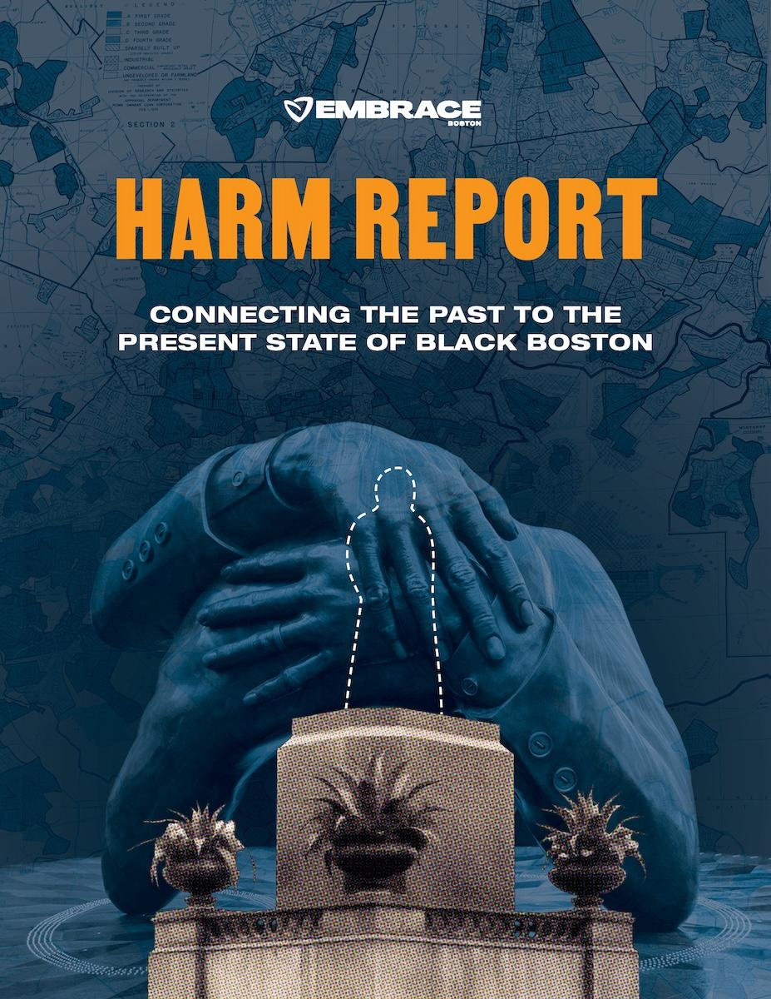

Elizabeth Tiblanc
Vice President, Arts & Culture
Jenny LaFleur
Senior Research Manager
Notes:
Introduce ourselves
Intro Embrace Boston - racial justice organization working to increase racial equity in the city of Boston at the intersection of Arts & Culture and Research & Policy
Grateful to be invited by City of Boston to present the Harm Report
We acknowledge the work of the Reparations Task Force Researchers….contemporary impact
We are not the experts in each given sector represented in the HR, however…
What is the Harm Report

Slide 5
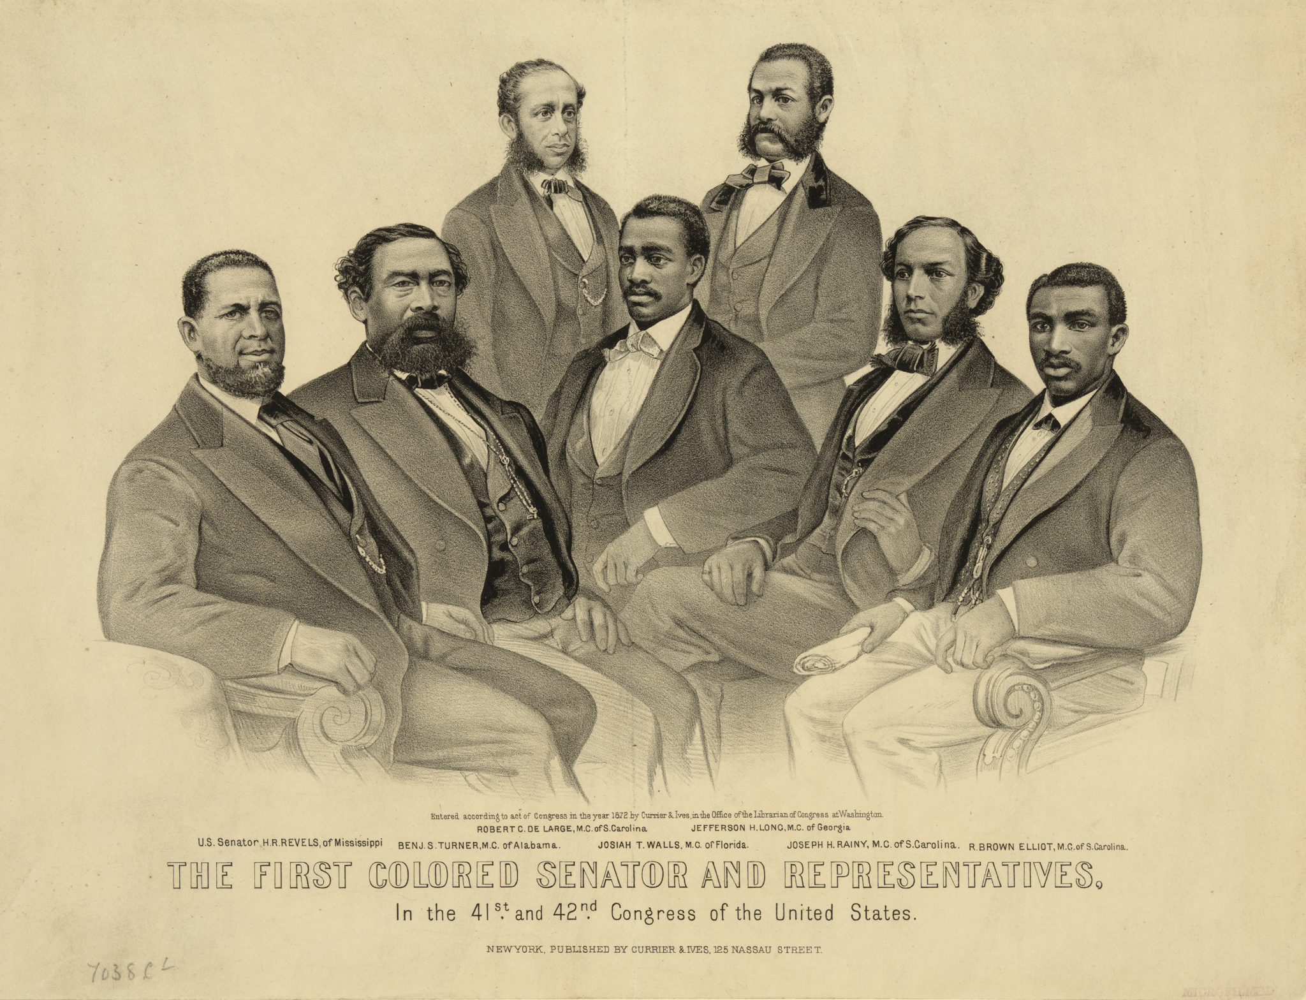
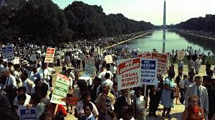
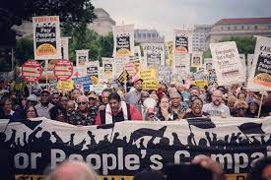
First Reconstruction
Post Civil War
(1865-1877)
Second Reconstruction Civil Rights era (1950s-1960s)
Third Reconstruction
2016-present
Notes:
Our Reparations work emerged during a viral, racial, and economic pandemic in many ways, to serve as a communal learning space to support healing and accountability-holding.

Slide 6
8 Harm Areas
Housing
Transportation
Education
Criminal Legal Systems
Health
Income & Wealth
Culture & Symbols
{Climate}
N’COBRA
NAARC
Amherst Reparations Harm Report

Slide 7
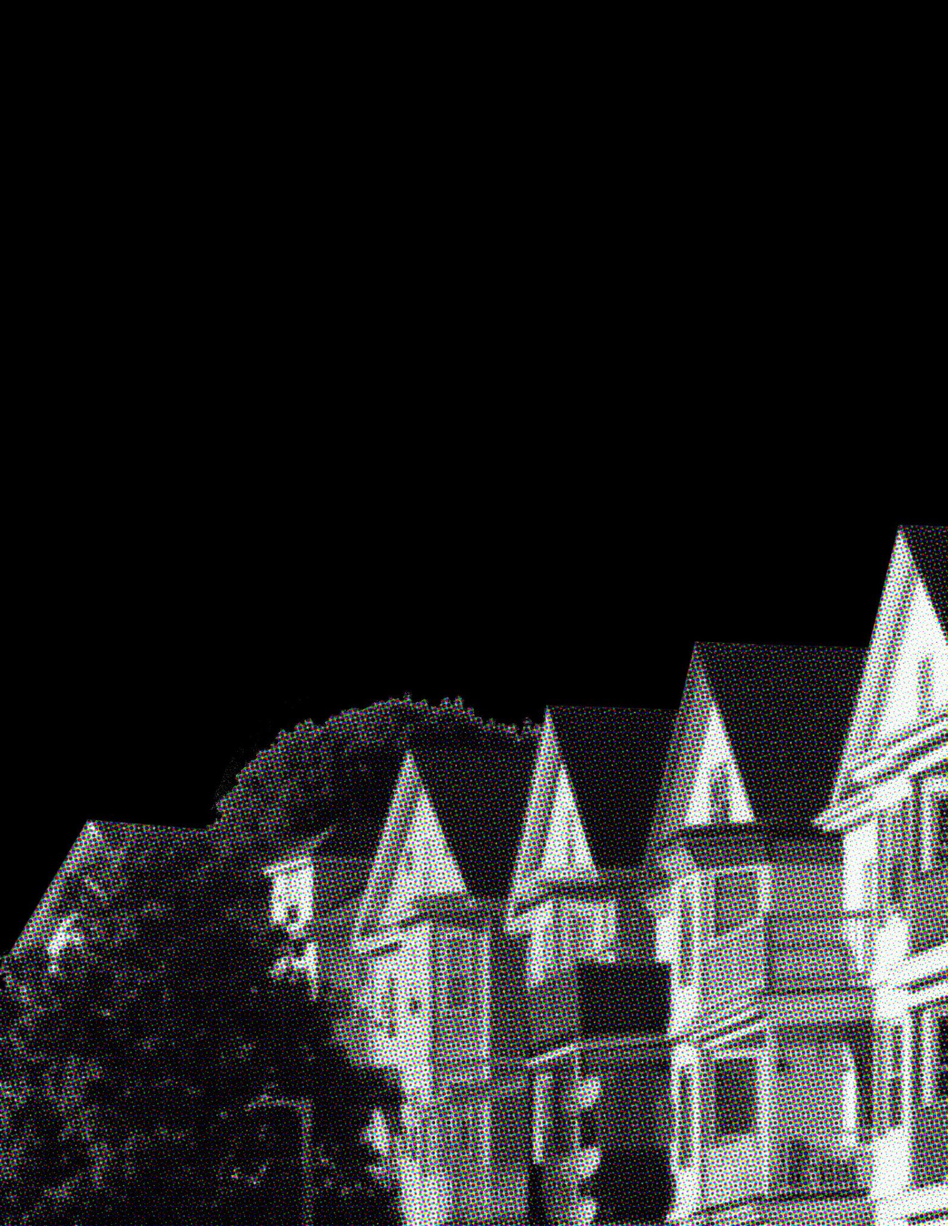
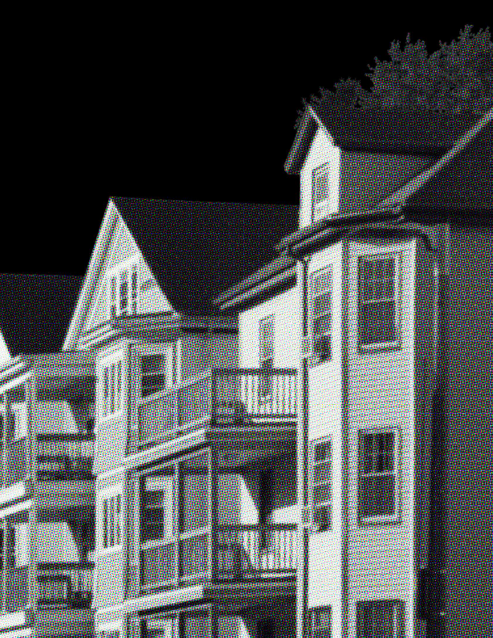
Housing
Following federal policy, Boston’s real estate industry actively supported racial segregation
Today, the share of Boston’s Black residents who are homeowners (34%) is half that of white residents (69%)
“A Realtor should never be instrumental in introducing into a neighborhood a character of property or occupancy, members of any race or nationality, or any individuals whose presence will clearly be detrimental to property values…”
1926 Boston Real Estate Exchange Code of Ethics
Notes:
Modern conceptualizations of land ownership were born out of the settler colonial project exemplified by the Massachusetts Bay Colony
The dispossession of Indigenous peoples and the creation of a system of land ownership was premised on the right to exclude
Land ownership was not just about the control of territory but was a prerequisite of full citizenship - and became a key component of establishing America’s racial hierarchy
Today, while land ownership is not required for access to the full legal rights of citizenship, it is the primary generator of intergenerational wealth
Home ownership became a policy goal of the federal government in the interwar period but its policies governing loan underwriting actively discouraged lenders from granting home loans in areas of Boston where the majority of inhabitants were Black or in areas that were racially and ethnically mixed.
These practices amounted to a public-private partnership to devalue of Black life and Black neighborhoods
Today 34% of Black households in Boston are homeowners, compared to 69% of white households
Attempts to create housing for families who were excluded from certain Massachusetts communities by restrictive covenants and racist homeowners associations, have found only limited success
Only 30% of municipalities in greater Boston are in compliance with Chapter 40B, which requires a certain share of the rental housing stock to be available at “affordable” rates
Further, a recent audit study by Suffolk University found that Black applicants for rental units in the greater Boston area were substantially less likely to be shown apartments than white study participants with the same income and employment profiles.

Slide 8

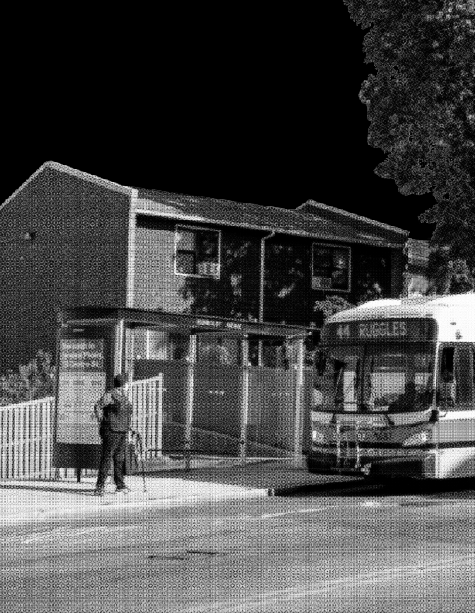
Transportation
The 1956 Federal Highway Act financed the leveling of Black neighborhoods
The Washington Street Elevated Rail’s 1987 shuttering limited transit options for Black Bostonians
Investments in the Commuter rail and the Green Line extension have not been matched in Black-majority neighborhoods
Notes:
Boston’s transportation story, much like its housing story, takes place against the backdrop of federal policies
The Federal Highway Act of 1954 was pitched as a effort to create a national highway system to connect key pieces of the nation’s defense infrastructure during the cold war
The construction of highways was part of a larger federal effort to encourage home ownership and create construction jobs by encouraging the growth of the nation’s suburbs
With the help of racist lending practices, this was tantamount to an investment in infrastructure for white flight from American cities
Highways constructed to connect the financial and political centers of American cities to burgeoning bedroom communities played a central role in the further segregation of metropolitan areas
They also, however, involved the material destruction of urban communities in order to provide the physical space needed for highway construction
Resistance in Boston found some success–plans for the Southwest Corridor of I-95 were called off due to community protest
Yet, all across the city, thousands of people had already been displaced–neighborhoods leveled and erased
Investment in public transportation has similarly privileged predominantly white municipalities in the Boston metropolitan area
The 1987 destruction of the Washington Street Elevated Rail, which served Roxbury occurred even as investments in suburban commuter rail service increased
Mattapan, Roxbury, Dorchester, the South End, as well as Chelsea and Revere have been labeled as “transportation disadvantaged”
Transportation limits access to employment, health care, and education

Slide 9
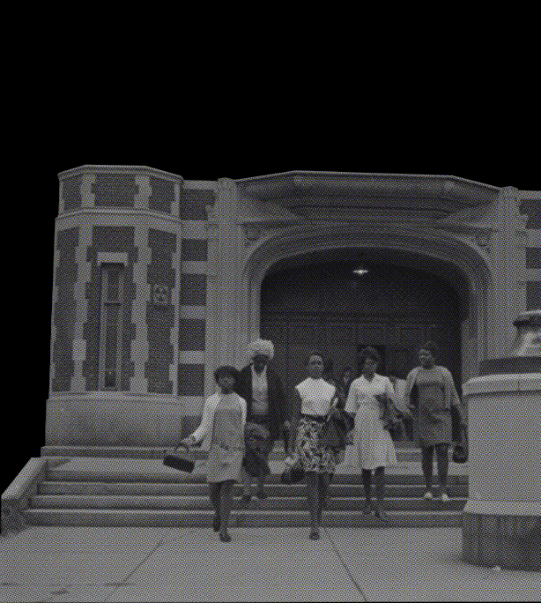
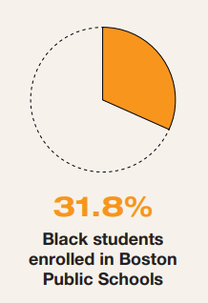
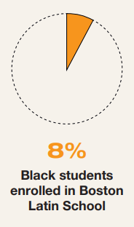

Education
The Massachusetts Supreme Judicial Court legalized racially segregated schooling in 1849
Segregation persists in BPS and throughout school in the Commonwealth
2017
Notes:
Half a century before the US Supreme court would enshrine the concept of “separate but equal” in Plessy v Ferguson, in 1849, the Supreme Judicial Court of Massachusetts upheld the right of the city to deny Black children access to white public schools
Even after the de jure end of segregation in Boston, schools remained separate but unequal
In 1963 Ruth Batson, chair of the NAACP’s Education Committee petitioned the Boston School Community to address the de facto segregation in BPS schools and the chronic underfunding of predominantly Black schools
Resistance on the part of the BPS School Committee and white residents of the city was vehement and brutal–
It shaped the belief among generations of Americans’ that Boston is an inhospitable and dangerous place for people of color
There has never been meaningful integration achieved in BPS schools and the separate and unequal educational experiences of Black BPS students continues
Black BPS students are less likely to enroll in BPS’s advanced work classes, to gain admission to an exam school
They are less likely to be taught by teachers with content expertise in the subject they teach
Black and Brown students in BPS are less likely to have a teacher who shares their racial and ethnic background–a factor shown to be important to students’ academic success
While Black students are more likely to be subjected to exclusionary discipline, they are less likely to graduate or go on to a 4-year college.
Education does not exist in a vacuum. It is part of a larger social context that devalues and criminalizes Black life.

Slide 10
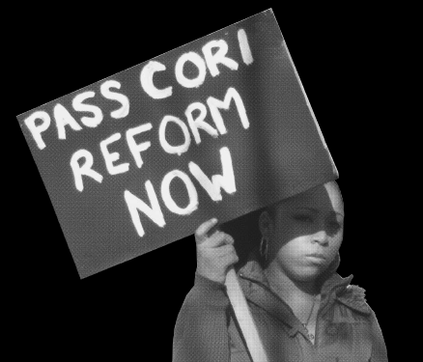
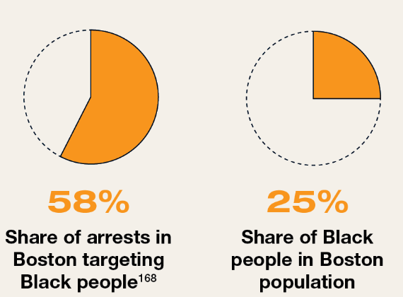
Criminal Legal Systems
As early as 1703 laws criminalized people of African, Indigenous, and mixed descent for being out in public at night
Law enforcement capitulated to the Fugitive Slave Law and returned formerly enslaved persons to their enslavers in the South
2020
Notes:
Even at the beginning of the 18th century, a law was passed prohibiting people of African descent, Indigenous peoples, and anyone of mixed race from going out after 9 pm unless on an errand for a white enslaver
In the 1850s, law enforcement in Boston returned enslaved persons who were discovered to have escaped to Massachusetts back to their owners in slave states, denying them the right to freedom in our state, where slavery had been outlawed more than 50 years before
In 2020, the same year that Mayor Marty Walsh declared racism a public health crisis, the share of arrests of Black people in Boston was more than double their share of the population
In 2020, nearly 60% of the city’s more than 4,000 arrests were of Black people, despite the fact that only 25% of the city’s residents are Black
This was not an outlier, it is a trend that was escalated by the “War on Drugs” in the last half of the 20th century that consistently led to disproportionate arrests of Black individuals
The governor has taken important steps to pardon misdemeanor marijuana convictions in the commonwealth
However, despite being disproportionately targeted by the war on drugs, Black residents of Massachusetts have been grossly underrepresented in licensing by the Cannabis Control Commission
Ironically, the chance to earn income off of the legalization of marijuana has largely been out of reach for Black residents who were unfairly targeted by its criminalization for so many years.
Finally, the CORI system in our state is broken. Black Bostonians, who are disproportionately targeted by by the criminal justice system are automatically disadvantaged when they seek housing, employment, and other economic opportunities

Slide 11


Health
Neighborhoods subject to divestment via redlining in the 1930s are now designated as highly vulnerable areas by the CDC
Today, the life expectancy of residents of Back Bay is nearly 25 years longer than that of residents in Roxbury
Notes:
It is widely understood that health is not simply a product of biological factors
Instead, we know that people’s wellbeing and their longevity are predicted by many factors that are social in nature
Health, in many ways, reflects someone’ power in their society–one’s economic, social, cultural, and environmental capitals are all critical to the maintenance of one’s well being
Neighborhood segregation established by federal lending and housing policies has meant that Black Bostonians are more likely to live in areas with:
high levels of air pollution
crowded dwellings
little tree canopy cover
Higher temperatures, often referred to as urban heat islands
As such, we see that the life expectancy in Boston varies enormously by both race and neighborhood–The Boston Public health commission found that the life expectancy for the largely white residents of Back Bay is nearly a quarter of a century longer than that of the primarily Black residents of Roxbury
These enormous disparities are not simple reflections of what is happening in Boston today, they have grown over time as the compounding toll of structural and interpersonal racism that has been endemic to our city since the 17th century

Slide 12

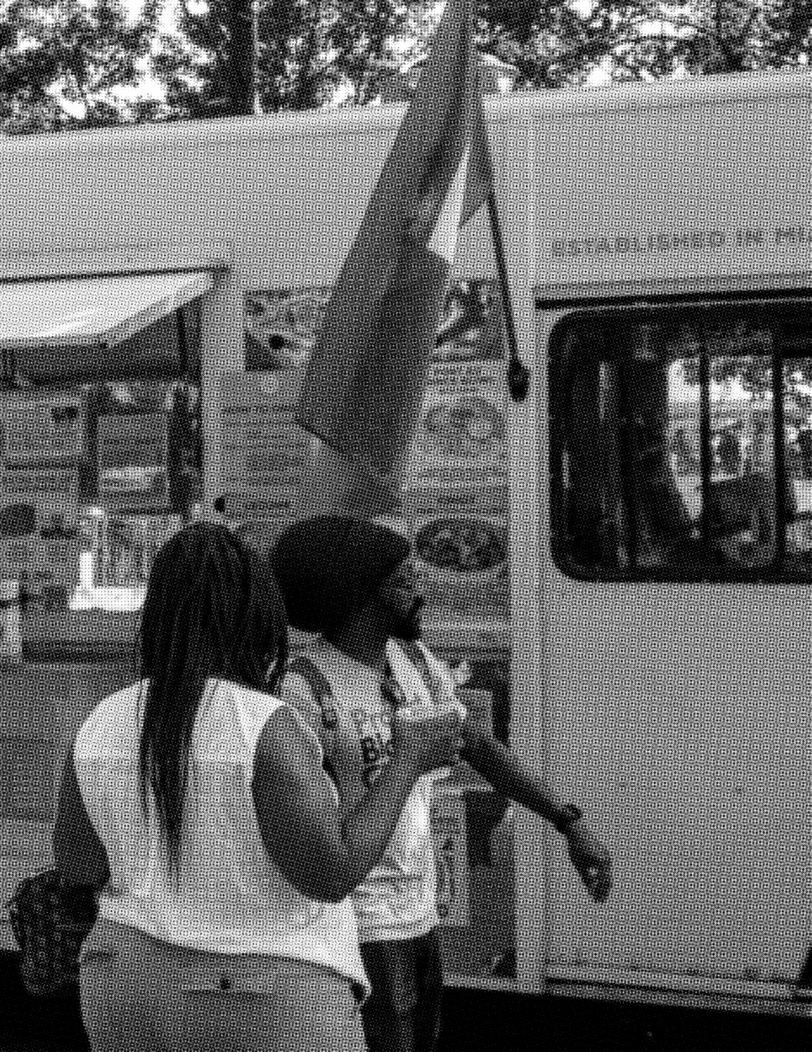
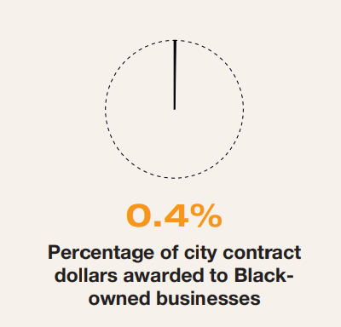
Income & Wealth
The plunder of Black wealth begins in the Commonwealth with the legalization of slavery in 1641
Exclusion from homeownership through redlining and restrictive covenants blocked the most effective pathway for building wealth
The city’s present quarter-million dollar racial wealth gap reflects the compounded impact of anti-Blackness in our city
2014-2019
Notes:
In a society organized around capitalism, perhaps the easiest way to highlight the impact of centuries of dehumanization–beyond premature death–is the enormous wealth gap between white and Black households in our city
The plunder of Black wealth began, of course, with the legalization of slavery in 1641
The second class status of free Black residents continued well beyond abolition
Free black residents were denied the right to vote and largely did not send children to public schools, yet they were taxed
In the centuries following the abolition of slavery, Black residents of the commonwealth remained excluded from economic opportunity through the denial of equal access to
educational opportunities,
land ownership, and
fair treatment by the criminal legal system
Pre-pandemic numbers showed that Black Bostonians had the highest unemployment rate of any racial or ethnic group in the city, at 13.5%
In 2016, the Federal Reserve Bank of Boston published their widely cited analysis that found the median net worth of non-immigrant Black households to be more than a quarter of a million dollars less than white households
Opportunities to build wealth are limited when, for example, less than half of a percent of city contract dollars went to Black-owned businesses between 2014 and 2019.

Slide 13
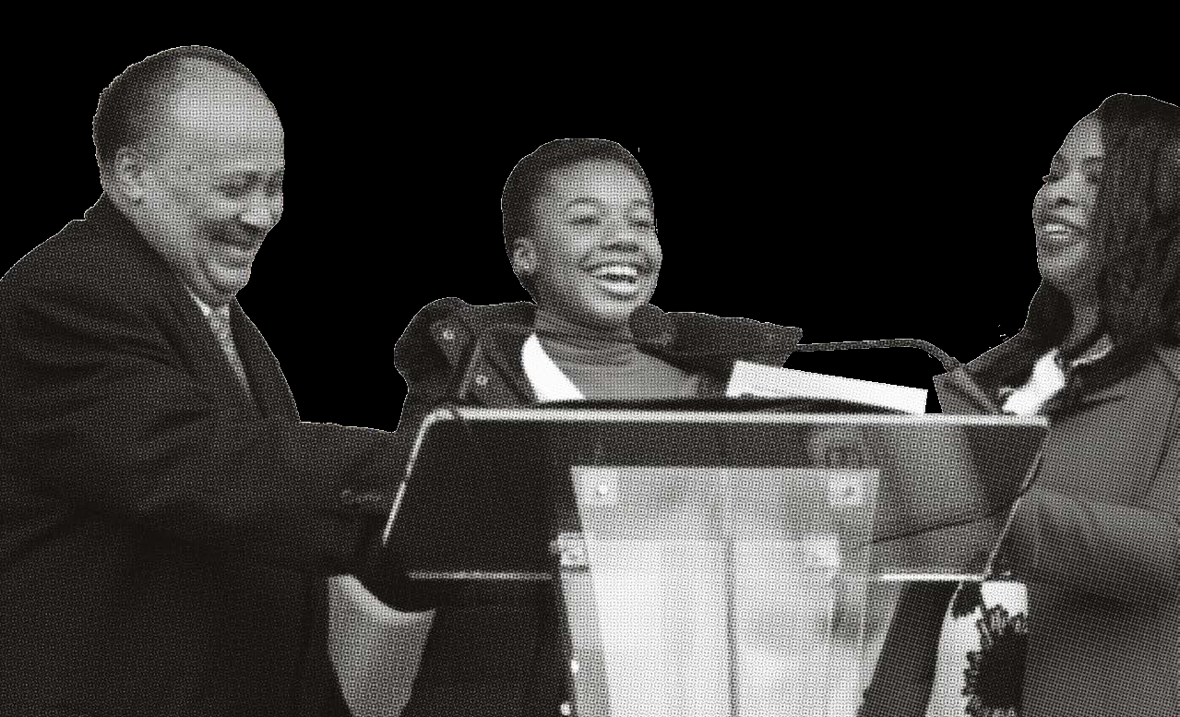

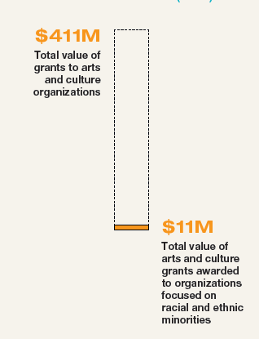
Culture & Symbols
Of nearly 80 statues and monuments in Boston, only 8 reflect Black history and voices
Leading cultural organizations’ collections continue to reify European artistic traditions, while those of the Global South and the African diaspora occupy marginal spaces
2016
Notes:
City’s landscape of public spaces–from streets to squares to buildings and statues–has, since the 17th century, reflected the racial hierarchies that shaped Boston’s cultural life.
All of the data we’ve quoted to this point can be viscerally felt by simply walking the streets of our city
Boston boasts of nearly 80 statues and monuments, each one bringing local heroes and national legends to life.
Of that number, a mere eight are dedicated to Black history and Black voices and more than one of those has been critiqued, removed, or amended because of its paternalistic and racist tenor
Our major arts and cultural institutions continue to reproduce white supremacy–the collections and their display celebrate European arts and culture
Inclusion of contributions from the Global South–especially Africa and its diaspora–are included only in peripherally or in traveling and temporary exhibitions.
A recent analysis of arts funding by the Helicon collaborative found that over the 5-year study period, in Boston less than 3% of arts and culture grants went to organizations dedicated to the work of racial and ethnic minorities
Efforts to undo the erasure of the Black creative presence in Boston are underway–but it remains unclear how the most recent racial reckoning will be able to make permanent rather than momentary change in our city.

Slide 14

THE CALL FOR REPARATIONS IS ABOUT
MORE THAN FINANCIAL COMPENSATION.
IT IS ABOUT ACKNOWLEDGING THE
ONGOING HARMS OF SYSTEMIC RACISM,
ADDRESSING THE ROOT CAUSES OF
THESE INJUSTICES, AND PROMOTING
HEALING AND RESTORATION FOR
INDIVIDUALS AND COMMUNITIES WHO
HAVE SUFFERED FOR FAR TOO LONG.

Slide 15







@embracebos
@theembracemonument
embracebos
embracebos
embracebos
embracebos
www.embraceboston.org
Scan to access a digital copy of the Harm Report

Slide 16
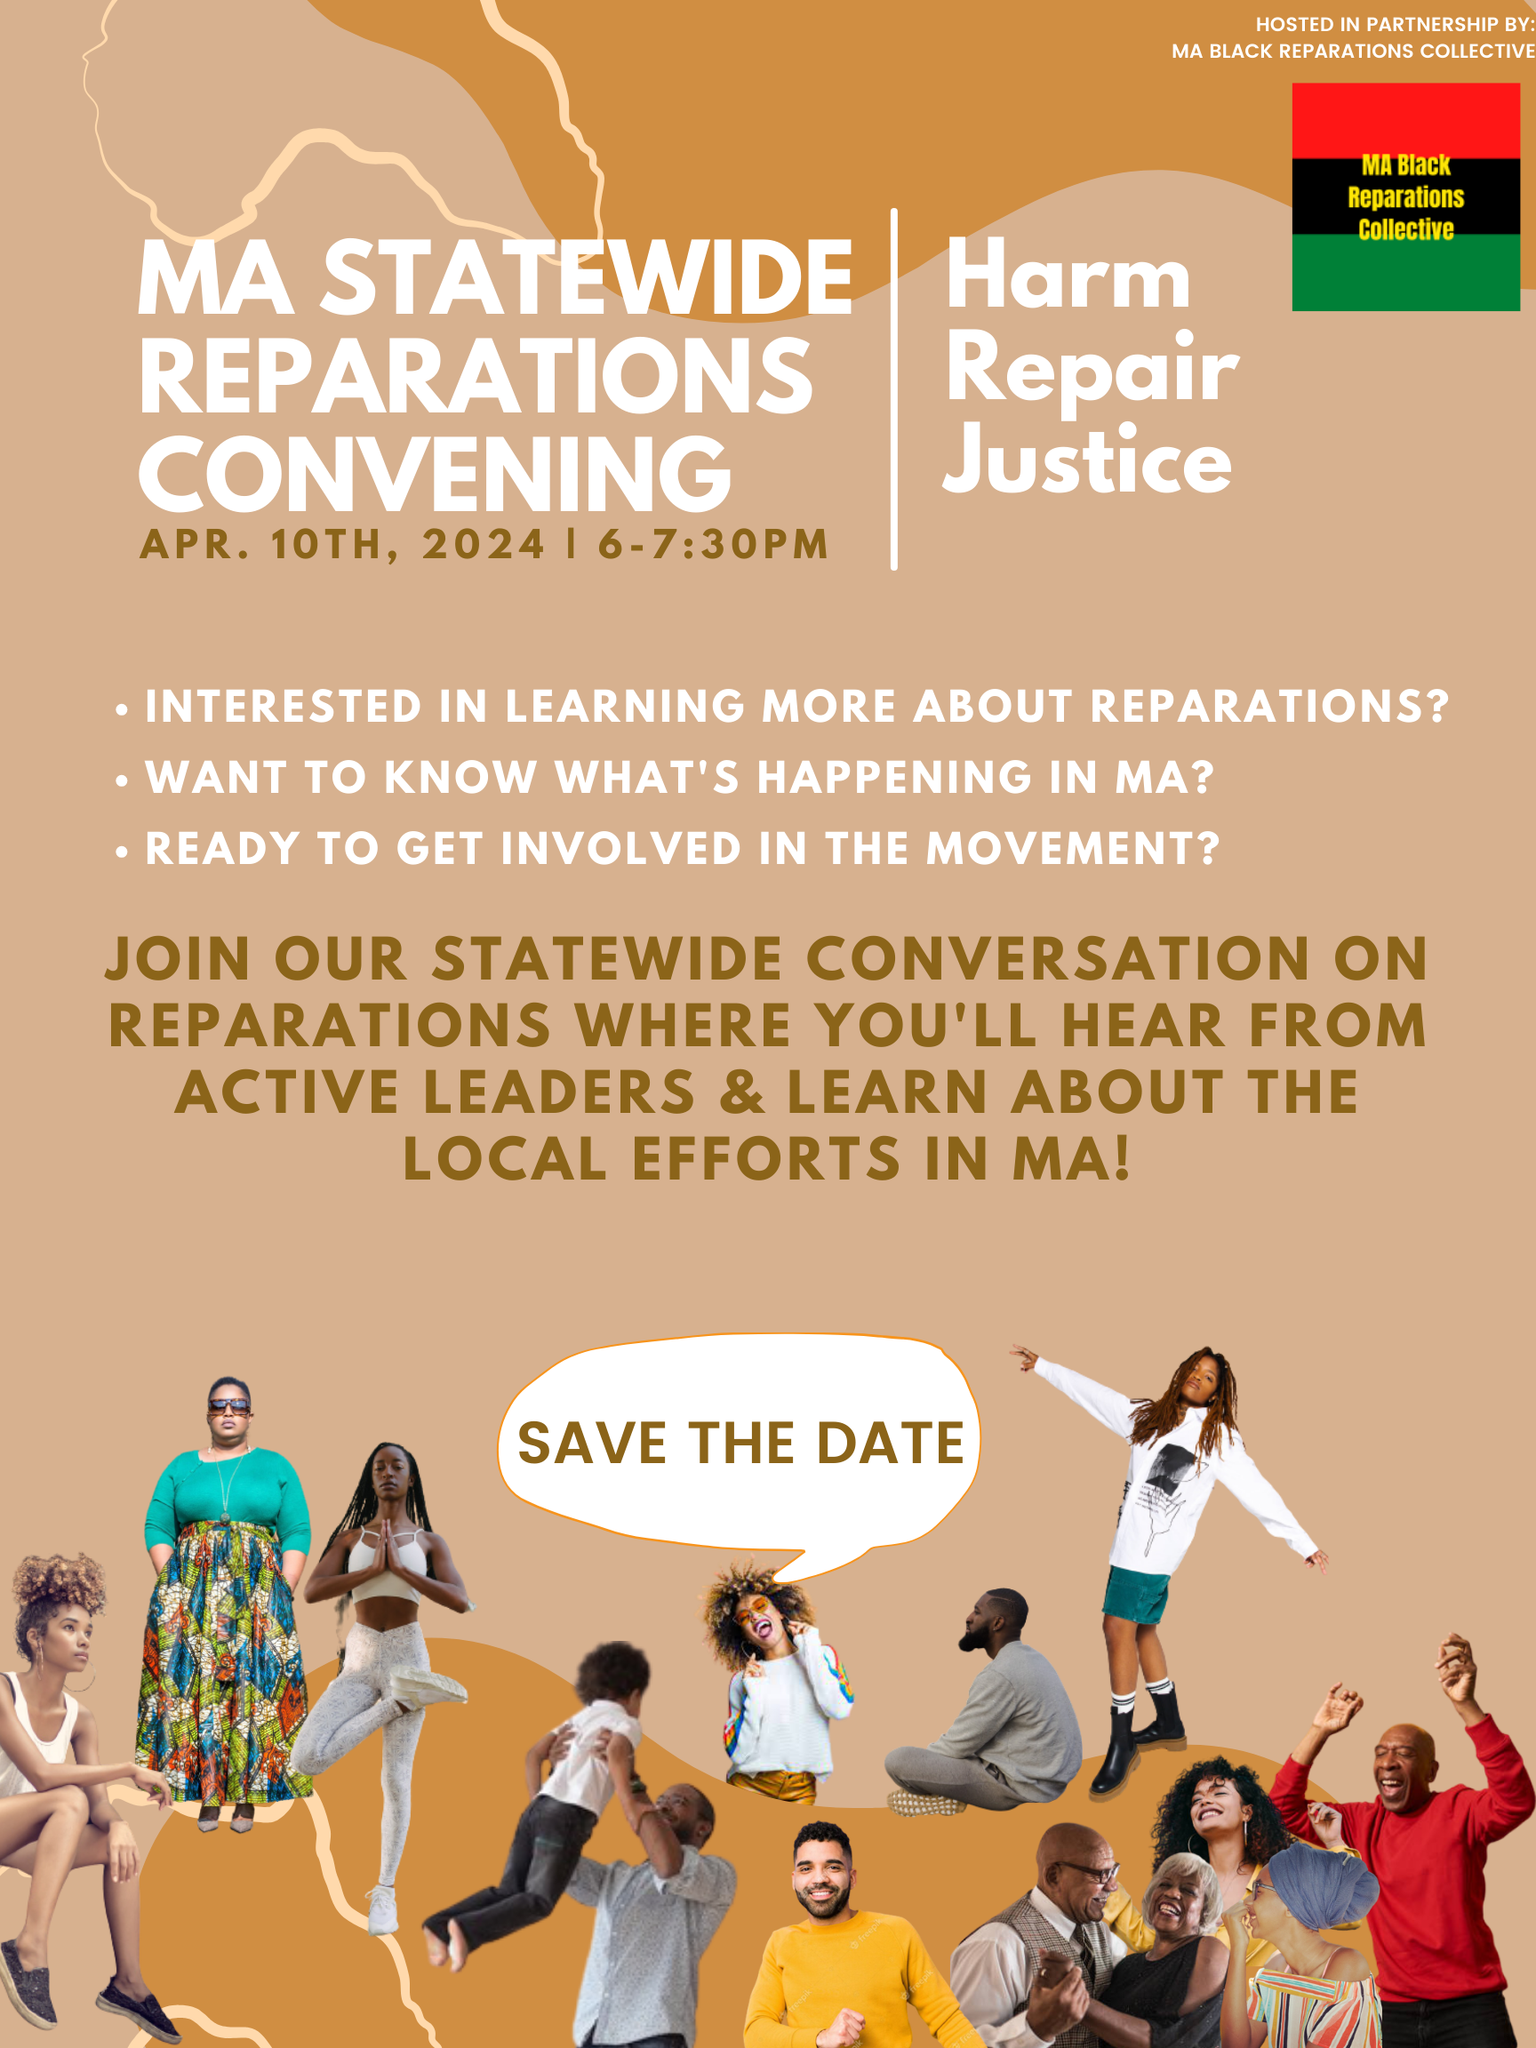

Slide 17
Q&A
We will now open the floor and the Zoom chat for questions and comments about the presentation.
Please keep your comment limited to 2 minutes or less. We will time comments.

Slide 18
General public comment
We will now open the floor and the Zoom chat for questions and comments.
Please keep your comment limited to 2 minutes or less. We will time comments.

