Slide 1
AT&T Modifications to Existing Wireless Facility
44 Farnsworth Street Presentation to the Fort Point Channel Landmark District Commission APP # 19.575 FPC December 13, 2018 @ 6:00 p.m. Boston City Hall – Piemonte Room
Michael R. Dolan, Esq.

Slide 2
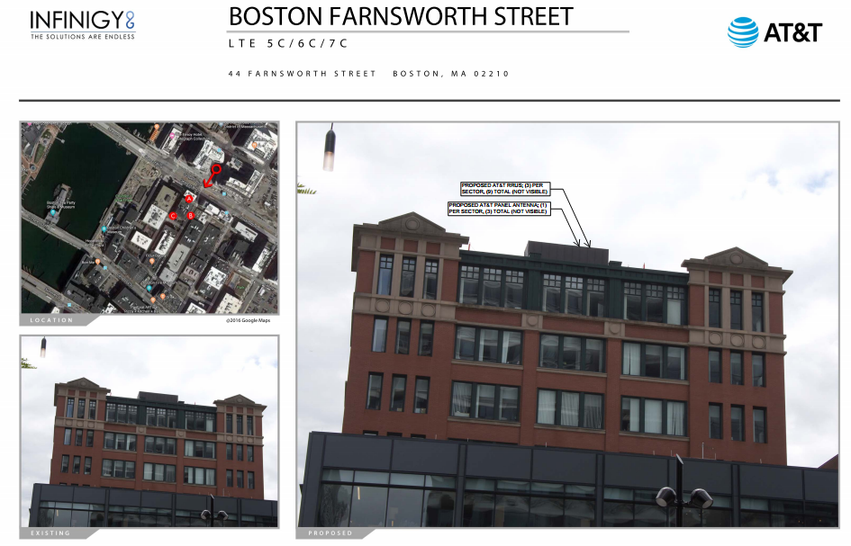

Slide 3
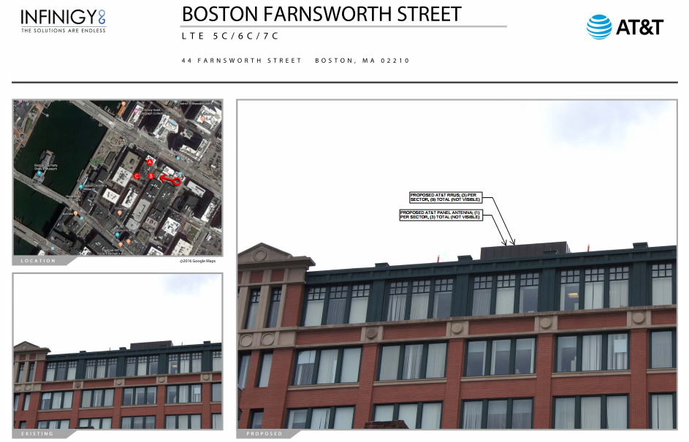

Slide 4
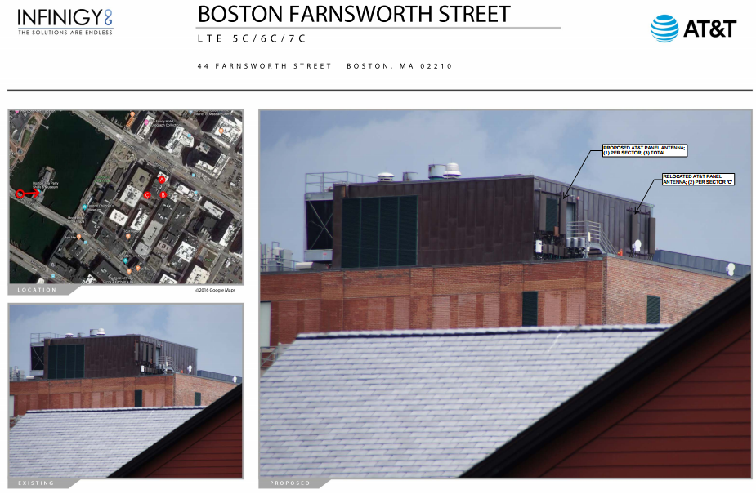

Slide 5
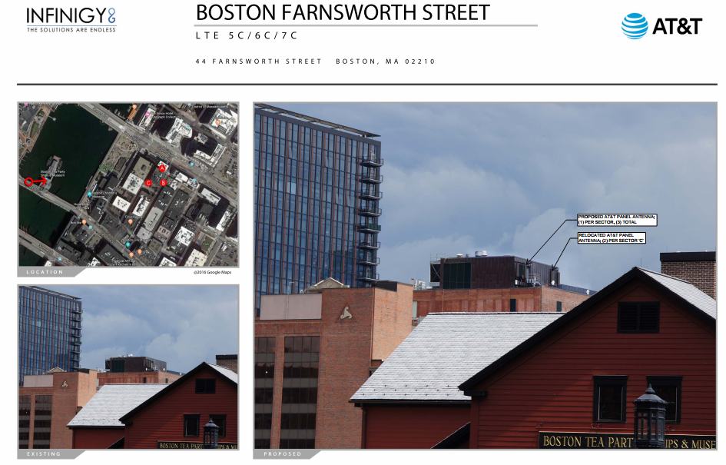

Slide 6
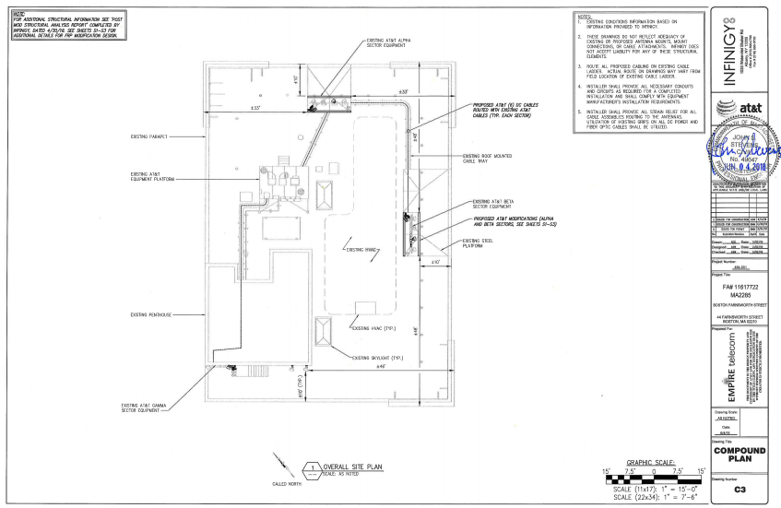

Slide 7
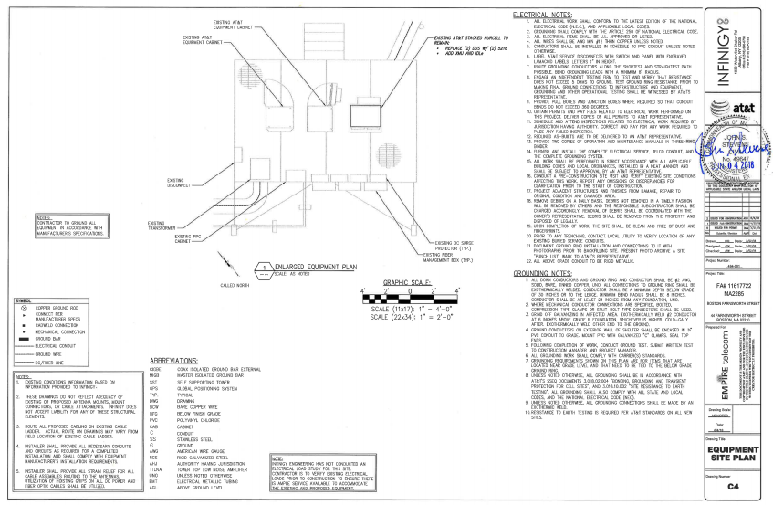

Slide 8
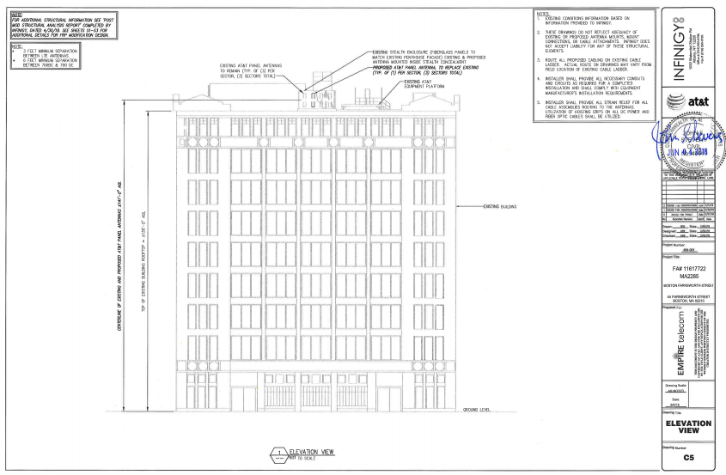

Slide 9
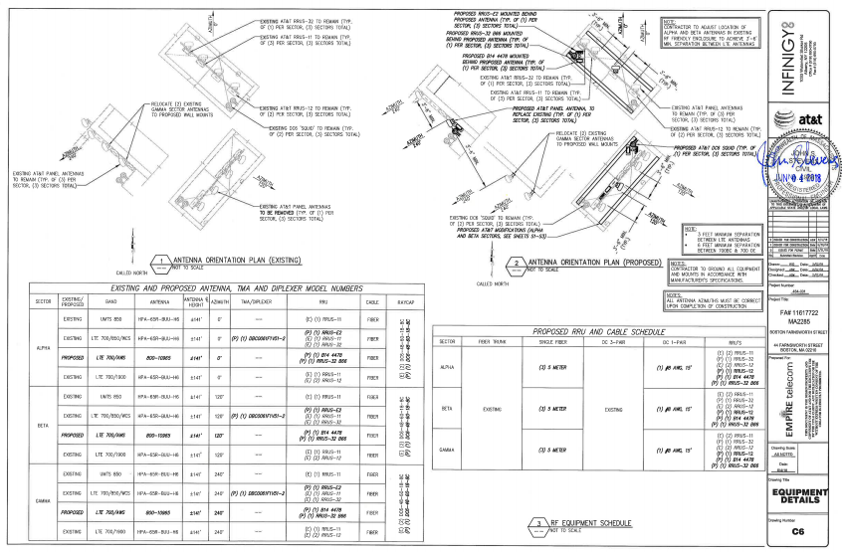

Slide 10
